Slide 1

CLIENT PRESENTATION | FMCG PROMOTIONAL ANALYTICS
Nova Mart
Diwali 2023 & Sankranti 2024
Campaign Analysis
Promotional performance across Nova Mart stores and Nova-branded products
Prepared by Trijesh Kondapuram
Data Science Intern | AtliQ Technologies Pvt. Ltd.
Business insights to support the next promotional campaign

Slide 2
EXECUTIVE SUMMARY
What the campaign data tells us
Nova Mart supplied data from Diwali 2023 and Sankranti 2024; the seven charts here focus on the supplied Sankranti questions.
300
70.5%
+0.27
~121%
Bengaluru stores
Grocery & Staples
Price–quantity correlation
Madurai ISU metric
Largest store footprint
177,724 promoted units
Weak positive association
Highest supplied value
CAMPAIGN SCOPE & TOP TAKEAWAYS
• Source data covers Diwali 2023 and Sankranti 2024; supplied charts focus on Sankranti questions.
• Bengaluru has the largest store footprint, followed by Chennai and Hyderabad.
• Grocery & Staples dominates promoted unit volume; Home Appliances is next.
• Hyderabad: Cashback leads incremental revenue, while BOGOF leads incremental units.
• Bengaluru: Combo1 shows the strongest revenue increase; Personal Care declines.
Prepared for Nova Mart • AtliQ Technologies
02

Slide 3
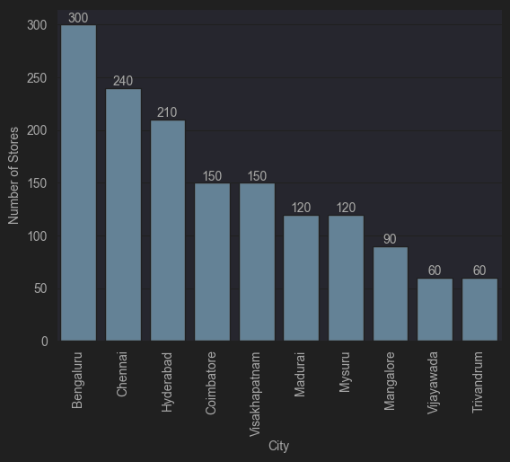
01 • STORE FOOTPRINT
Bengaluru has the largest store footprint
Store counts across the ten cities in the supplied chart.
KEY INSIGHTS
• Bengaluru leads with 300 stores.
• Chennai has 240 and Hyderabad has 210.
• Coimbatore and Visakhapatnam are tied at 150 stores.
• Vijayawada and Trivandrum have the smallest footprints at 60 each.
• Bengaluru has 25% more stores than Chennai and about 43% more than Hyderabad.
03

Slide 4
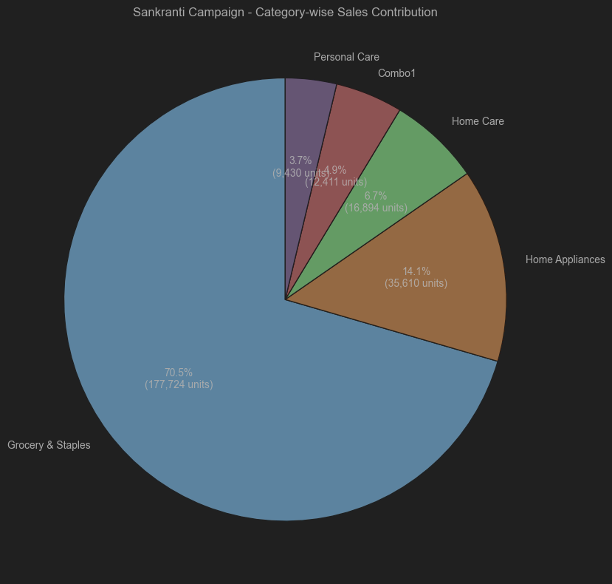
02 • SANKRANTI CATEGORY MIX
Grocery & Staples dominates promoted unit sales
Share of total quantity sold after promotion.
KEY INSIGHTS
• Grocery & Staples contributes 70.5% (177,724 units).
• Home Appliances contributes 14.1% (35,610 units).
• Home Care contributes 6.7%; Combo1 4.9%; Personal Care 3.7%.
• The top two categories contribute about 84.6% of promoted units.
• Prioritize stock availability in core categories and test focused offers in smaller categories.
04

Slide 5
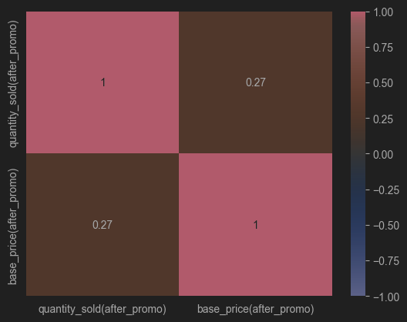
03 • PRICE RESPONSE
Price has a weak positive relationship with sales quantity
Correlation between base price and quantity sold after promotion.
KEY INSIGHTS
• The chart shows a correlation of +0.27.
• This is a weak positive association; it does not show that higher prices cause higher sales.
• Demand, discount depth, product type, city and promotion mechanics may also influence volume.
• Compare similar products and promotion types before drawing pricing conclusions.
05

Slide 6
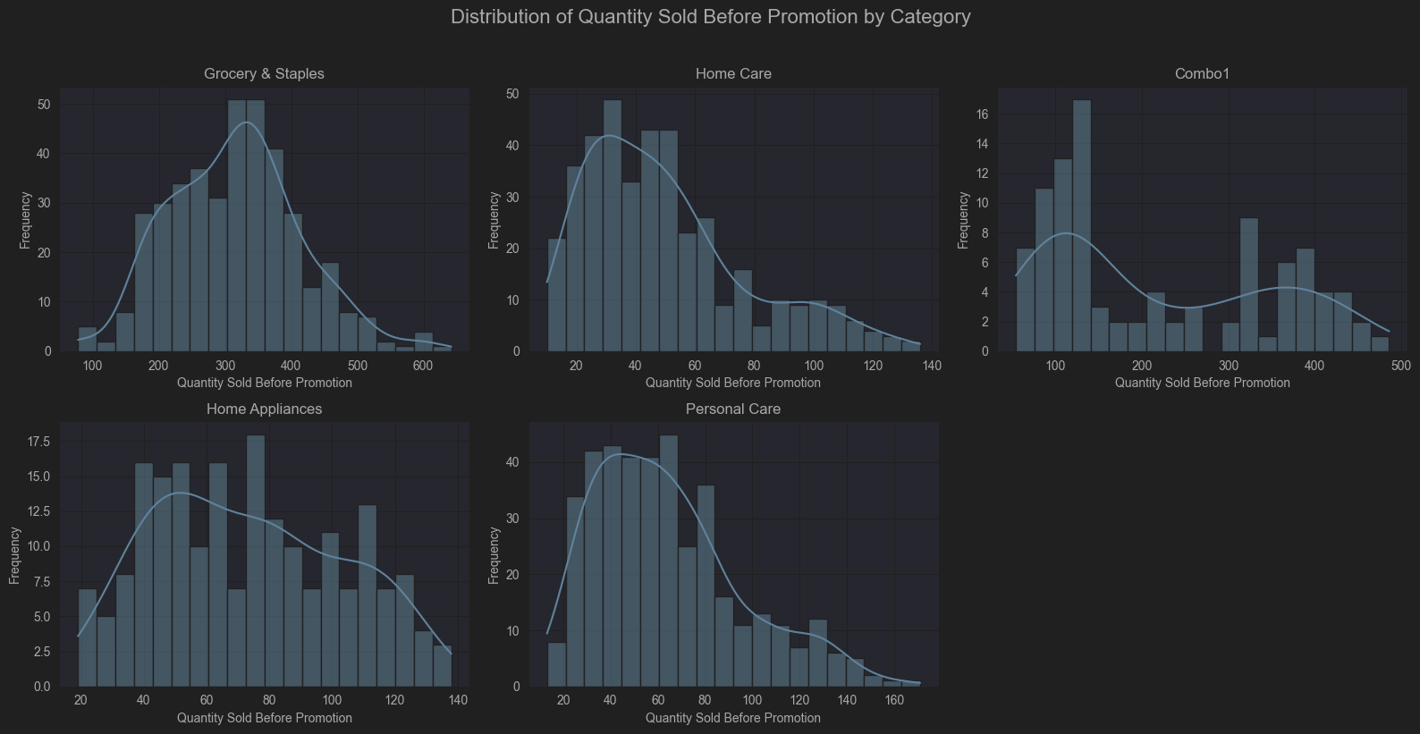
04 • PRE-PROMOTION DEMAND
Baseline demand varies by product category
Distribution of quantity sold before promotion by category.
KEY INSIGHTS
• Grocery & Staples has the highest quantities and a broad distribution.
• Home Care and Personal Care cluster at lower quantities and have right-skewed tails.
• Home Appliances spans a wider range of baseline demand.
• Combo1 appears to have multiple demand clusters.
• Use category-specific baselines and targets instead of one threshold for all products.
06

Slide 7
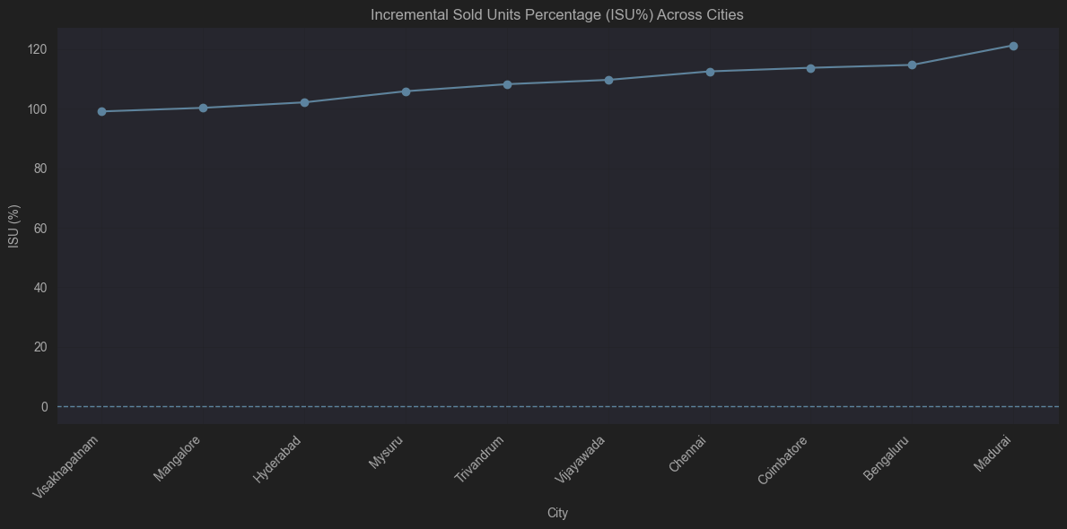
05 • CITY-LEVEL RESPONSE
Madurai has the highest displayed ISU metric
City comparison based on the supplied ISU% visualization.
KEY INSIGHTS
• Madurai is highest at approximately 121% in the supplied chart.
• Visakhapatnam is lowest at approximately 99%.
• Other cities range roughly from 100% to 115%.
• Validate the ISU% formula and whether the plot represents uplift or an index.
• Study high-performing city conditions and test localized offers in lower-performing markets.
07

Slide 8
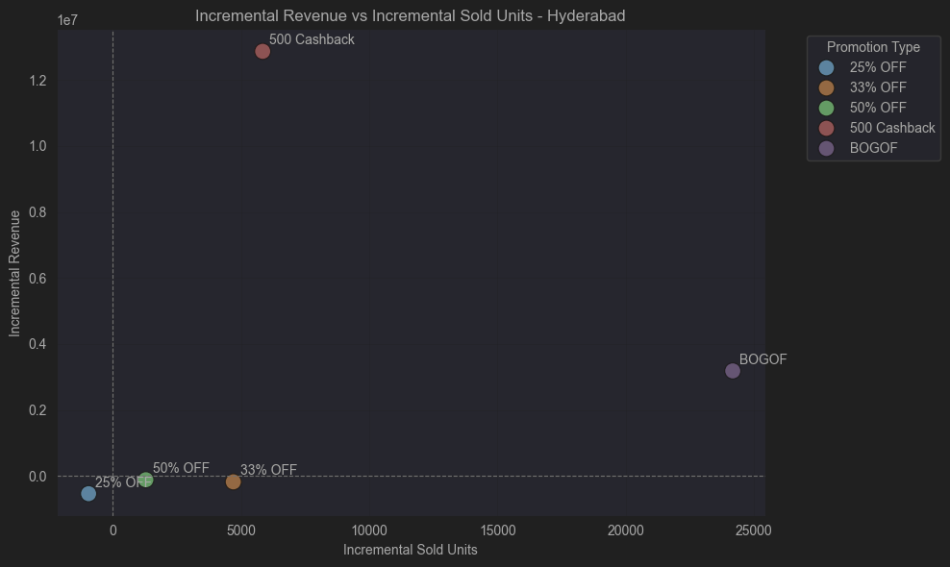
06 • PROMOTION EFFECTIVENESS
Hyderabad: Cashback leads revenue; BOGOF leads units
Incremental revenue versus incremental sold units by promotion type.
KEY INSIGHTS
• 500 Cashback shows the highest incremental revenue, about 12.9 million.
• BOGOF produces the highest incremental sold units, about 24,000.
• 25% OFF, 33% OFF and 50% OFF sit near or below zero incremental revenue in the chart.
• Choose offers based on the objective: revenue versus unit growth.
• Include margin and campaign cost before selecting an overall winner.
08

Slide 9
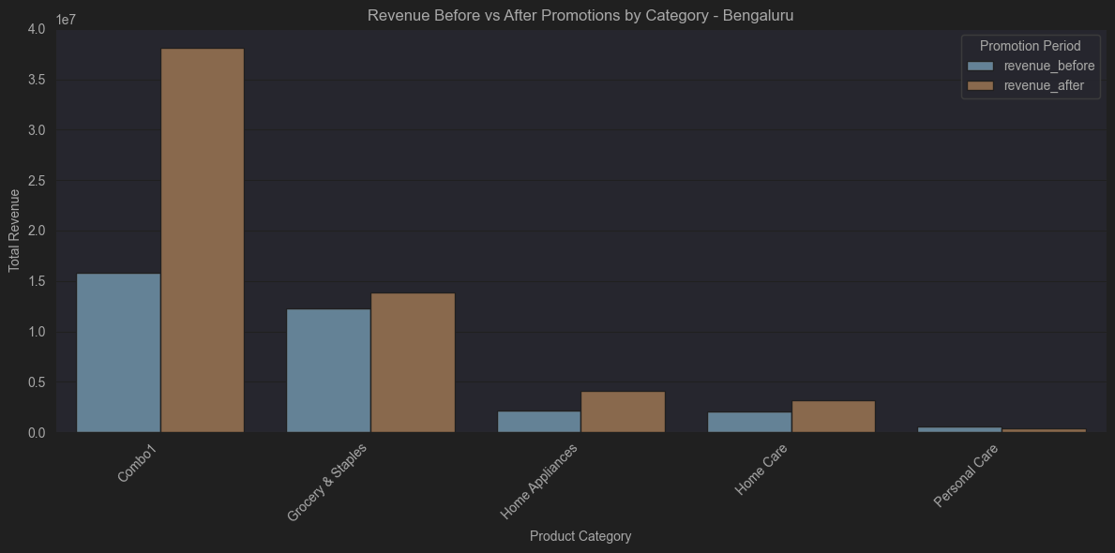
07 • BENGALURU REVENUE
Combo1 drives the largest Bengaluru revenue increase
Revenue before and after promotion by category in Bengaluru.
KEY INSIGHTS
• Combo1 rises from about 15.7M to 38.0M—the largest increase.
• Grocery & Staples grows from roughly 12.2M to 13.8M.
• Home Appliances and Home Care also rise from smaller bases.
• Personal Care declines from roughly 0.5M to 0.3M.
• Revenue improves overall, but profitability and promotion costs should also be assessed.
09

Slide 10
RECOMMENDATIONS
Actions for Nova Mart’s next campaign
Use these findings to shape measurable tests and operational priorities.
01
Protect core availability
Plan replenishment for Grocery & Staples ahead of the festival; it represents about seven in ten promoted units.
02
Review Combo1 economics
Investigate Bengaluru’s Combo1 uplift and verify margin, cannibalization and stock-out risk before scaling.
03
Match offer to objective
Test Cashback for revenue and BOGOF for unit growth; compare incremental profit, not just sales.
04
Localize city execution
Explore what is working in Madurai and test targeted changes in Visakhapatnam.
05
Measure campaign quality
Track margin, incremental profit, basket size, redemption, repeat purchase and stock availability.
10

Slide 11
CLOSING SUMMARY
Focus investment where volume and revenue are strongest—then validate profitability.
VALIDATE BEFORE SCALING
• Confirm the ISU% calculation and units.
• Reconcile chart values with the source dataset.
• Add margin and campaign costs to compare true profitability.
Thank you
AtliQ Technologies
Prepared for Nova Mart • Trijesh Kondapuram • Data Science Intern

