Slide 1
Guide to the paper
“Best Estimates for Reserves”
http://www.casact.org/dare/index.cfm?fuseaction=view&abstrID=5144

Slide 2

Overview
Introduction
Guide to the Extended Link Ratio Family (ELRF) modelling framework
  Mathematical framework
  Diagnostic tools for evaluating a method’s fit
Guide to the Probabilistic Trend Family (PTF) modelling framework
  Mathematical framework
  How models are built
  Diagnostics for assessing a model’s fit: does the model work?

Slide 3
Introduction
What does it mean to say a model gives a good fit? e.g. lognormal fit to claim size distribution
The fitted distribution is regard as the probabilistic mechanisms for creating the data as a sample. In other words, you can regard x₁ to x_{n} as a sample from the fitted model.
- Real Sample:
x₁,…,x_{n}
- Fitted Distribution
fitted lognormal – gives a good fit
- Random Sample from fitted distribution:
y₁,…,y_{n}
y’s look like x’s: —
If we simulate y₁ to y_{n} from the fitted distribution (to the x’s) then the y values ‘look like’ the x’s.

Slide 4

Introduction
PTF model fitted to the real data describes the trend structure in the three directions and the quality of the process variability around the trend structure.
Real
Data
S1
S2
The fitted model fits a distribution to every cell. The triangle is regarded as a sample path from the fitted model. If we simulate other triangles (S) from the fitted model they are indistinguishable from the real triangle. They have similar trends, trend changes in same periods, same amount of random variation about trends.

Slide 5
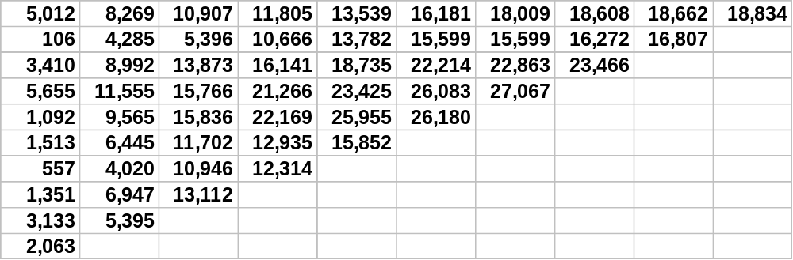
Extended Link Ratio Family (ELRF) Modelling Framework
Link ratio techniques can be formulated as regressions: start with the cumulative loss development array
8,269 / 5,012 = 1.65
8,992 / 3,410 = 2.64
- These data are analysed by Mack (1993)
Incurred Losses, Historical Loss Development Study, 1991 Ed. (RAA)

Slide 6
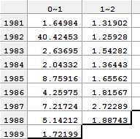
ELRF modelling framework
We can graph one development period versus the previous development period:
Cum.(1) vs Cum.(0)
12,000
11,000
10,000
9,000
Excerpt of link ratio table for Mack method (volume weighted average).
8,000
7,000
6,000
8,269
5,000
Link Ratio =1.65
4,000
3,000
2,000
1,000
5,012
0
0
2,000
4,000

Slide 7
ELRF modelling framework
What is the SLOPE of this line?
Slope = rise/run (the ratio)
= 8,269/5,012
= 1.65
Cum.(1) vs Cum.(0)
12,000
11,000
10,000
9,000
2.64
8,000
1.65
7,000
6,000
5,000
4,000
8,269
3,000
2,000
1,000
5,012
0
0
2,000
4,000
Any link ratio is the slope of a line (equivalently a trend) through the origin.

Slide 8
ELRF modelling framework
Select link ratios to be typical (“average”) link ratios
e.g. arithmetic average, Mack method (chain ladder or volume weighted average),
average of last three years, ...
Cum.(1) vs Cum.(0)
12,000
10,000
8,000
A weighted average ratio is the same as a weighted average trend through the origin.
6,000
4,000
2,000
0
0
2,000
4,000

Slide 9
ELRF modelling framework
Arithmetic Average ratio ^{1/}_{n} ∑(y/x)
Cum.(1) vs Cum.(0)
12,000
Mack method ratio =
∑ ^{y}/ x · x/ ∑x =∑y/ ∑x
(Volume weighted average, Chain ladder)
10,000
8,000
6,000
4,000
Regression Line through origin
BUT a weighted average trend line through the origin is a regression line through the origin!
Weighted average link ratio techniques are forms of regressions through the origin.
2,000
0
0
2,000
4,000

Slide 10
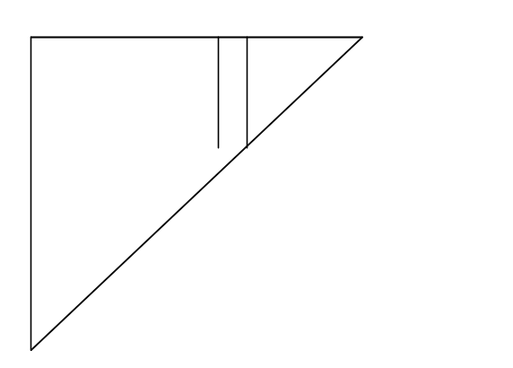
ELRF modelling framework
If link ratios are regressions, we can describe link ratio techniques using formal statistical language.
j-1
j
x{
}y
Regression equation:
y = bx + ε,
where E(ε ) = 0
and Var(ε ) = σ²x^{δ}
Equivalently
E( y | x ) = bx and Var( y | x ) = σ² x^{δ}
δ = 0 corresponds to volume squared weighted average
δ = 1 is the Mack method - equivalent to volume weighted average (Chain Ladder - Mack 1993)
δ = 2 is the arithmetic average

Slide 11
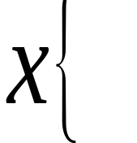
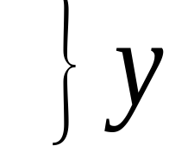
ELRF modelling framework
x is cumulative at dev. j-1 and y is cumulative at dev. j
Link Ratios are a comparison of columns
We can graph the link ratios of Y to X
j-1
j
y
X = Cum. @ j-1
Y = Cum. @ j
y/x
y
y/x
y
x
x
x

Slide 12
ELRF modelling framework
To determine an average link ratio (slope) b we use weighted least squares. Method aims to estimate b by minimising
Σ w(y-bx)²,
where weight w = ¹/ x^{δ} ∝ ¹/ Var(ε )
For δ = 1 we obtain
Σ x y ·¹/ x
Σ ^{y}/ x · x
Σ y
^
Mack (1993)
b = = =
Σ x² ·¹/ x
Σ x
Σ x
which is the Chain Ladder Ratio (or Volume Weighted Average, or Volume Weighted Ratio); commonly referred to as the ‘Mack method’ in its regression form. There are no differences between the techniques, they are all equivalent. The Mack method is just a regression formulation of the chain ladder link ratios.

Slide 13
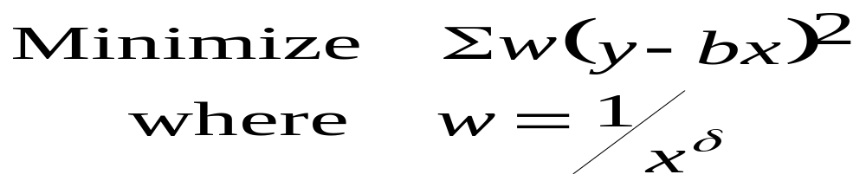
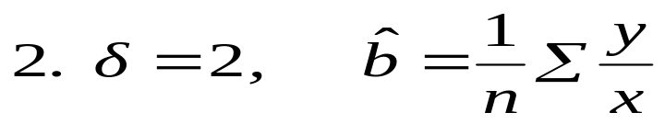
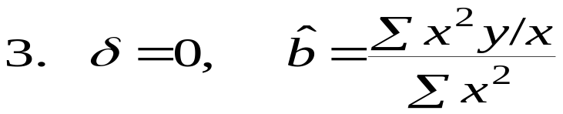
ELRF modelling framework
For other values of δ (0 and 2) we obtain:
Arithmetic Average
Weighted average (weighted by volume squared)
What if, for the graph of y versus x, the best line does not go through the origin?
Solution proposed by Murphy (1994) was to add an intercept to the regression equation.

Slide 14
Assessing link ratio techniques
Assessing link ratios in the ELRF modelling framework
What are the major assumptions made by the models based on link ratio techniques?
E( y | x ) = bx; and x∝ Var(x)
  i.e. to obtain the mean cumulative at development period j, take the cumulative at the previous period and multiply by the link ratio, and as x increases, the variance of x increases.
No trend in the calendar period (diagonal) direction
  Link ratio techniques do not measure calendar trends. Changing calendar trends can be seen in the residuals but they cannot be measured.
Normality
  If error structure is not normal, then the estimates of the ratios are no longer efficient.

Slide 15
Assessing link ratio techniques
Assessing link ratios in the ELRF modelling framework
Fitted values
- value given by the model (the value on the line)
called the fitted (or predicted) value, y
^
Fitted line (fitted average ratio)
y
y_{i}
^
y_{i}
x
x_{i}

Slide 16
Assessing link ratio techniques
Assessing link ratios in the ELRF modelling framework
Residual = Observed value - Fitted value
That is, Residuals are best interpreted as:
Trend(s) in the data minus Trend(s) estimated by the method
Fitted line (fitted average ratio)
y
y_{i}
residual
^
y_{i}
y_{i}
x
x_{i}

Slide 17
Assessing link ratio techniques
Assessing link ratios in the ELRF modelling framework
Residual Analysis Residual = Data – Fit
Raw residuals have different standard deviations
- need to adjust to make them comparable
Many model checks use standardized residuals
Standardized residual =
Residual
Std. dev.(residual)
______________

Slide 18
Assessing link ratio techniques
Assessing link ratios in the ELRF modelling framework
What can we do with the residuals?
e.g.:
Plot vs dev. yr
Plot vs cal. yr
Plot vs acci. yr
Plot vs fitted value
6
1990
x
1996
What features of the data does this model not capture?
Residual plots should appear random about 0, without pattern. The first requirement is necessary for a model to be good, but it is not sufficient.

Slide 19
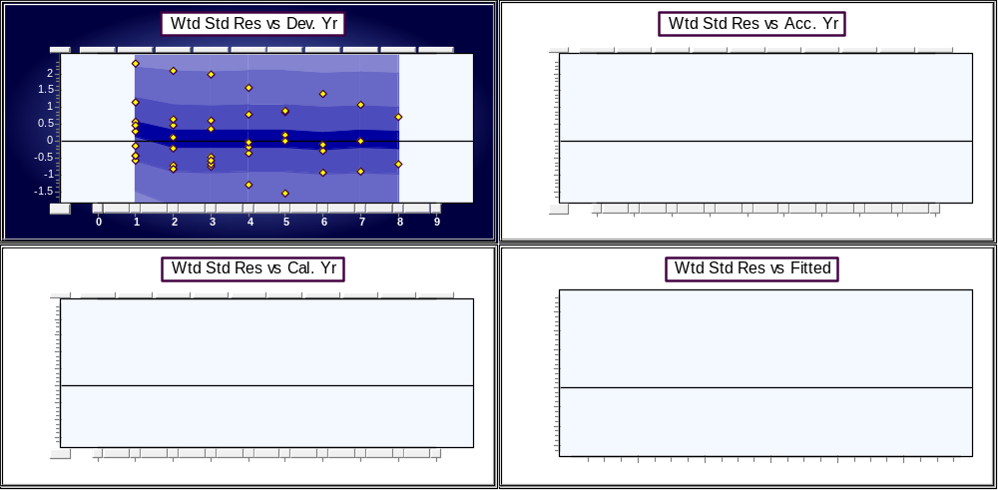
Complete residuals Historical Loss Development Study
The Mack method is applied to the data as analysed by Mack (1993) and the weighted standardised residuals are plotted against the three directions and against the fitted values. The downward trend in the residuals versus the fitted values indicates the need for an intercept.

Slide 20
Assessing link ratio techniques
Assessing link ratios in the ELRF modelling framework
Is E( y | x ) = bx satisfied by the Historical Loss Development Study data?
Std. Residuals
vs. Fitted Values
Underfit small values
2
1
0
Overfit large values
-1
0
5000
10000
15000
20000
25000
30000
The method seems to overfit the big values and underfit the small values. Does this mean we need an intercept?

Slide 21
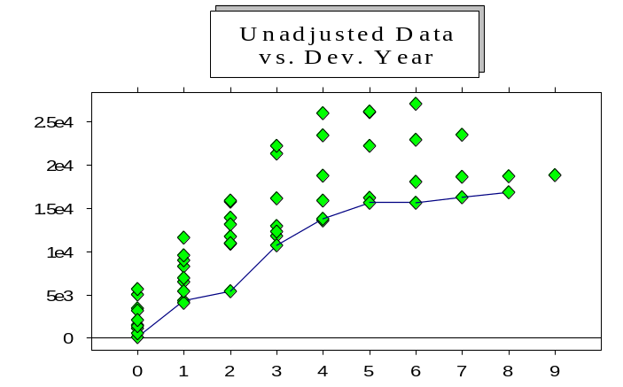
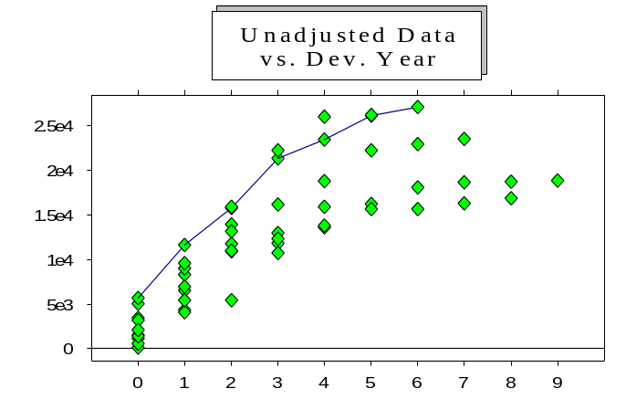
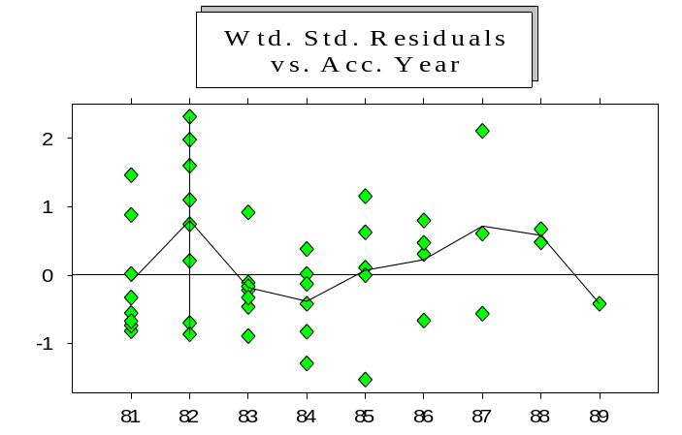
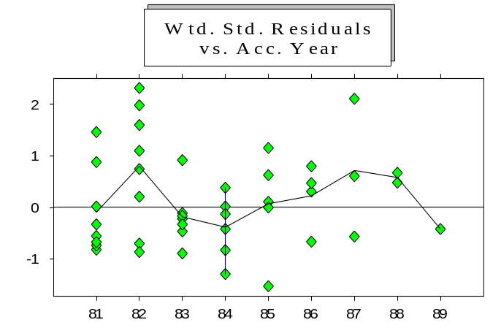
Assessing link ratio techniques
Assessing link ratios in the ELRF modelling framework
1982: low incurred development
1984: high incurred development
1982 is underfitted
1984 is overfitted
Why is E(y|x) = bx not satisfied by the data?

Slide 22
ELRF modelling framework
Example where best line to fit the points does not go through the origin.
The residuals indicated an intercept and you can now see it in the graph of the data Cum(1) vs Cum(0); this is also true for other consecutive periods.
Cum.(1) vs Cum.(0)
Incr.(1) vs Cum.(0)
12,000
8,000
10,000
7,000
8,000
6,000
6,000
5,000
4,000
4,000
2,000
3,000
0
2,000
4,000
0
2,000
4,000
Corr. = -0.117, P-value = 0.764

Slide 23

ELRF modelling framework
Intercept (Murphy (1994))
Equivalently
Incremental Cumulative
at j at j -1
Is b -1 significant ? Venter (1998)
The second formulation of the equation as discussed by Venter, is more useful. We know the current cumulative – we are forecasting the incremental conditional on the current cumulative.

Slide 24







ELRF modelling framework
Cumulative
Incremental
y-x
j-1 j
j-1 j
}p
x
x
x
y = a + bx + ε
x
x
x
x
If b = 1 then the incrementals at development year j are not correlated with the cumulatives at development year j – 1. => The link ratio does not have any predictive power.
Use link ratios for projection
Abandon link ratios - No predictive power

Slide 25
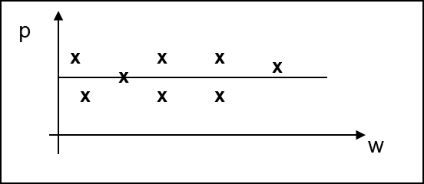
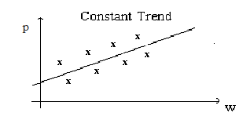
ELRF modelling framework
Cumulative
Incremental
j-1 j
j-1 j
90
}p
91
92
w
Condition 1:
If condition 1 is satisfied, then we assert that
b -1 = 0;
incrementals are not correlated.
Condition 2:

Slide 26
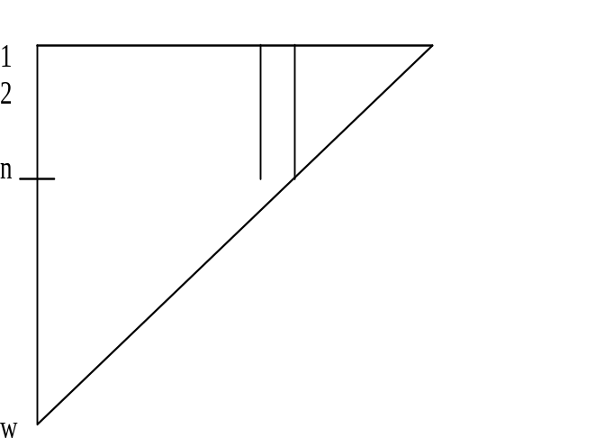
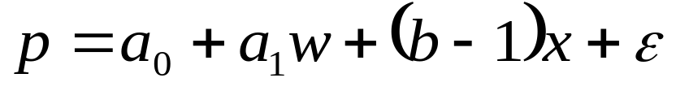



ELRF modelling framework
Now introduce trend parameter for incrementals. Most often, the trend has more predictive power than the link ratio and you don’t need the link ratio. That is, the link ratio – 1 = 0.
This forms the extended link ratio family. The extended link ratio family includes all models of the following form including where one (or more) of entries are zero.

Slide 27
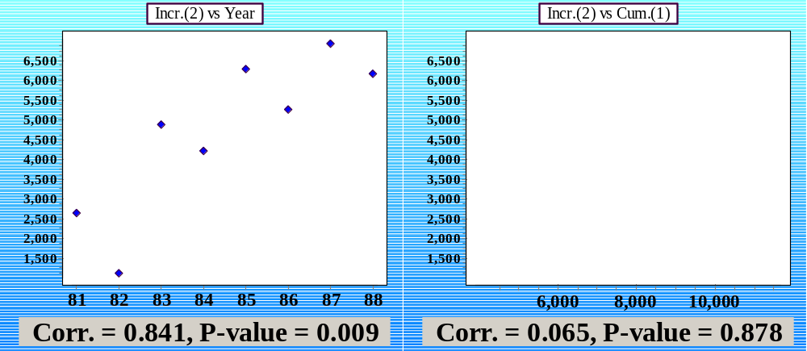
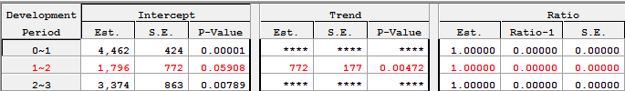
ELRF modelling framework
For the data analyzed by Mack, there is a trend in development year two. That is, condition 2 is satisfied, but in the incremental versus cumulative shows no correlation – in other words b-1 is zero.

Slide 28
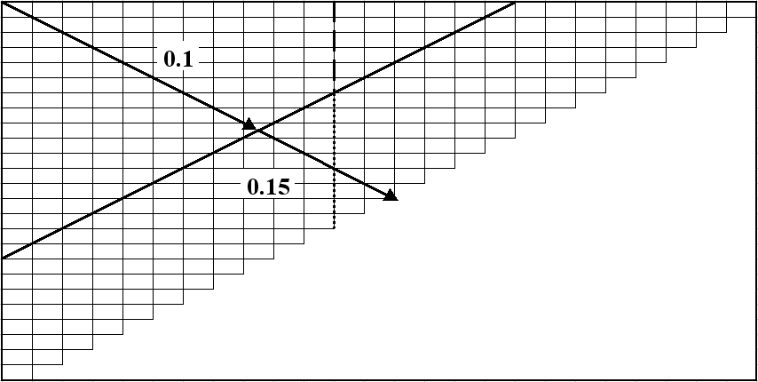
ELRF modelling framework
Condition 3: if there is a change in calendar period trend as shown below, then the trend going down the development period is not constant.
Incremental
Review 3 mutually exclusive conditions:
Condition 1: Zero trend
Condition 2: Constant trend, positive or negative
Condition 3: Non-constant trend
Under conditions 2 & 3 link ratios sometimes capture some of the trends; but you have no idea how much! Residuals give some relativities.

Slide 29
ELRF modelling framework
As a result of conditions 2 & 3 where the Mack method captures some of the calendar trend but without quantifying it, we have no idea of whether the method gives results that are reasonable, too low, or too high. We can hazard a guess by the direction of the residuals, but we still cannot answer the question: by how much?
An example of both these cases (too low, too high) are given as the final examples in this set of supplementary notes. The triangle ABC gives results from Mack that are too low. For the triangle LR High, as its name suggests, the Mack method produce answers that are far too high – about double what models designed in PTF produce.
The major difference between the modelling frameworks, link ratio based and probabilistic based, is that the probabilistic method fits a distribution to every cell in the triangle, quantifies calendar trends, and measures the volatility in the data and about the trends. Link ratio methods are information free and do not tell you any information about the triangle. The probabilistic framework provides a natural mechanism of dealing with both these fundamental features of the data. Control over future assumptions in the PTF modelling framework is fully in the hands of the actuary.

Slide 30
Assessing link ratios in the ELRF modelling framework
How does this formal regression methodology in the ELRF framework help us to assess whether link ratio techniques ‘work’?
We know that when we apply a link ratio technique, we are actually fitting a regression model through the origin.
Any regression model is based on a set of assumptions.
If the assumptions of a model are not supported by the data then any subsequent calculations made using the model (eg forecasts) are meaningless – they are based on the model, not the data.
Regression methodology allows us to test the assumptions made by a model.

Slide 31
Assessing link ratio techniques
Assessing link ratios in the ELRF modelling framework
Summary of Assumption 1: E( y | x ) = bx
Very often not satisfied by the data
  residuals suggest intercept is needed
Include intercept term:
  Case 1: ratios abandoned in favour of intercepts
  Case 2: projection using link ratios
A relationship between y and x is often better modelled using a trend parameter
  Case 3: ratios abandoned in favour of trend terms
‘Optimal’ model in the ELRF is not likely to include ratios!

Slide 32
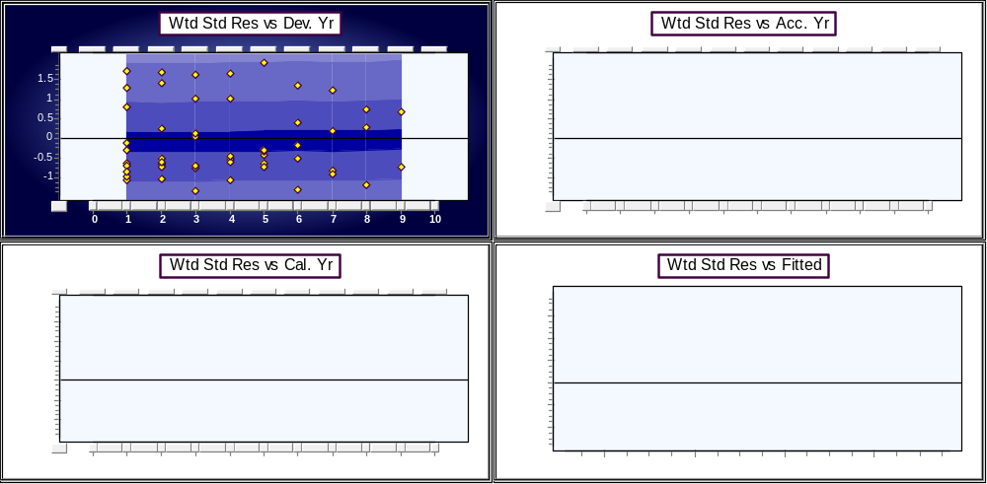
Complete residuals ABC
The Mack method is applied to the data ABC and plotted against the three directions and residuals versus fitted value. The fact that the method can’t capture the calendar year trends suggests a modelling framework that has calendar year trends, accident year trends, and development year trends.

Slide 33
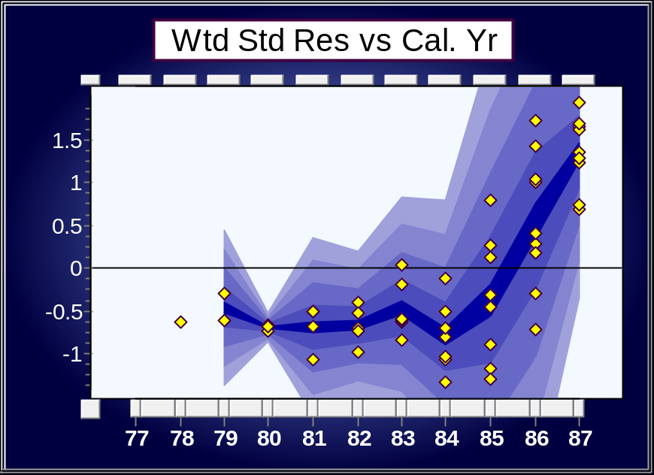
Assessing link ratio techniques
Assessing link ratios in the ELRF modelling framework
Assumption 2: Are there trends in the calendar period direction?
Any time there are calendar year shifts, the Mack method (Chain ladder ratios) will not capture it.
Real data commonly have changing calendar period trends
Indicated here by Chain Ladder Ratio (Mack method) model residuals
Assumption 2 (no calendar trends) is not supported by this data

Slide 34
Assessing link ratio techniques
Assessing link ratios in the ELRF modelling framework
Cumulatives “smear” over the breaks
With randomness and cumulation means no hope of seeing the trend changes
Lack control over future calendar year trend assumptions
Even the ‘best’ model in the ELRF modelling framework can’t capture such trend changes
A modelling framework which includes calendar trend changes by definition should be used.

Slide 35
Summary of the ELRF modelling framework
Average link ratios are regression estimators through the origin.
Regression methods allow us to test the assumptions of a model.
Often find that major assumptions of link ratios models are not satisfied by the data
  lack predictive power
  cannot capture calendar trend changes
  non-normality.
Need to work from a different paradigm.

Slide 36
Where to from here?
very important to check if the model is appropriate!
Link ratios techniques
  do not relate the numbers in the triangle in any meaningful way – they do not tell a story about the data
  do not give control over future assumptions
changing trends (e.g. against calendar years) suggests modelling trend changes
non-normality and nonlinear trends suggests transformation - particularly log transform
Thus we introduce the Probabilistic Trend Family (PTF) modelling framework.

Slide 37
The study of trends
Trends occur in three directions:
0
1
Development year
d
Past
Future
1996
1997
Calendar year
2009
t = w+d
w
Accident year

Slide 38
Trend example: development period
e.g. trends in the development year direction
x
x
x
x
x
x
x
x
If we graph the data for an accident year against development year, we can see changing trends.
x
x
x
x
x
0 1 2 3 4 5 6 7 8 9 10 11 12
x
x
x
x
x
x
x
x
x
x
x
x
x

Slide 39
Trend example: development
Trend example: development period
x
x
x
x
x
Could put a line through the points, using a ruler.
Or could do something formally, using regression.
x
x
x
x
x
x
x
x
0 1 2 3 4 5 6 7 8 9 10 11 12
x
x
x
x
x
x
x
x
x
x
x
x
x

Slide 40
Trend example: development
Trend example: development period
x
x
x
x
x
x
x
x
x
x
x
x
x
0 1 2 3 4 5 6 7 8 9 10 11 12
The model is not just the trends in the mean, but the distribution about the mean
(Data = Trends + Random Fluctuations)

Slide 41
Introduction to the Probabilistic Trend Family (PTF) modelling framework
The probabilistic trend family (PTF) modelling framework is used to identify (build) the most appropriate model for the data. Such a model, consists of two components:
Model the mean in each cell by:
Trends in the three directions
  Development period
  Accident period
  Calendar period
Measure the quality of the volatility around the trend structure.
Equivalent to fitting a distribution to every cell on the log scale. The means of the distributions are related through the trend structure.

Slide 42
Introduction to PTF
Real data show the same features as the model
8
7
Log scale
6
5
4
3
0
1
2
3
4
5
6
7
8
3000
Original scale
- spread related to mean
2500
2000
1500
1000
500
0
0
1
2
3
4
5
6
7
8

Slide 43
Introduction to PTF
Let’s step back a little and consider the type of problem we are trying to solve:
Essentially we are wanting to project the future incrementals(*) in the red section of the triangle (which may be extended to the right, below, or both) for each cell in order to calculate the total remaining to be paid.
The total has a distribution of possible outcomes with all the features of a distribution: mean, standard deviation, and other properties. In order for the distribution of the total to be meaningful, the calculation of the total must be directly related to the individual cells, and the projection of the individual cells must be relatable to every other cell in the triangle.
These concepts are illustrated with a series of examples.
First, an example is given where the data are constant, then where the data come from the same distribution in all cells. After this, we consider the simpler problem of projecting a single cell in one direction. Then we examine projecting multiple cells both down and across. The initial examples do not have calendar trends.
(*) This applies to any incremental triangle, including paid, incurred, and any type of count triangle.
2
Incremental
Data
1
Future incrementals

Slide 44
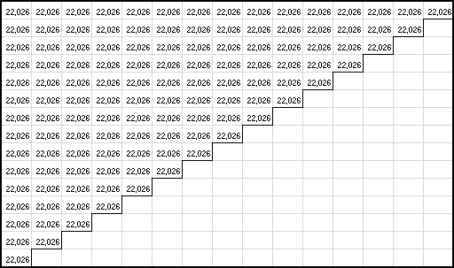
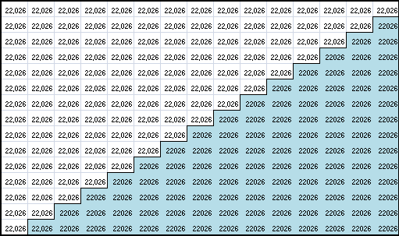
Example 1: constant data
Consider the following ‘data’.
The data are constant, and the best prediction is simply to project this constant for every cell. The constant is the ‘best estimate’ given the information to date.
If the data are variable, then the projection should project distributions with a mean and standard deviation; not a single value.

Slide 45
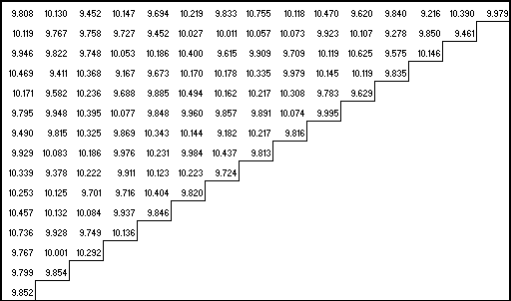
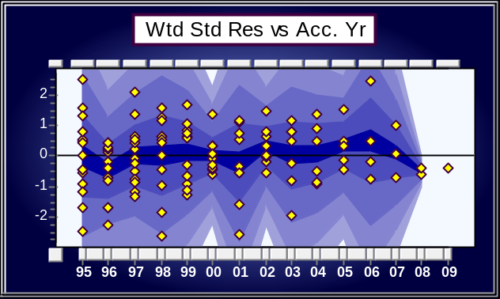
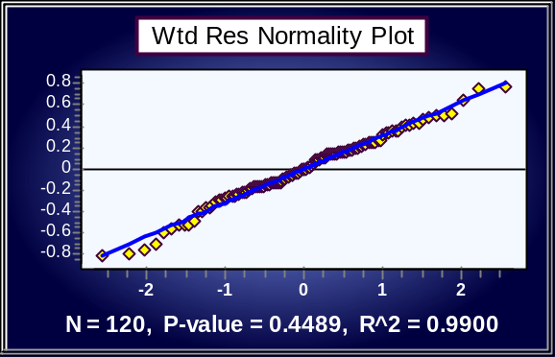
Example 2: known data (one mean, low variance)
Consider the following ‘data’ on a log scale.
The data are not constant, but all the cells come from the same distribution and this distribution is known (thus the title) – a normal distribution on a log scale with a mean of 10 and a variance of 0.1. (All the data were independently simulated from this distribution).
Assuming the true distribution is not known, the best projection is to estimate the distribution from the data, and then project that distribution to all remaining cells.
The mean and variance of the data, on a log scale, are: 9.978 and 0.097 respectively (to three decimal places). The standard deviation is: 0.311 again to three decimal places.
If the data are plotted versus accident period (left) there are no patterns in the data and the dots are scattered randomly around the zero mark. This is the same as a plot of the data after removing the average and standardising. The points plotted are the differences between the data and the fitted model (in this case the model is simply the mean). The differences (residuals) are then standardised. Residuals are simply the trend(s) in the data less the trend(s) in a model.
We can also test the normality of the residuals as shown in the result on the right. The p-value is greater than a 5% significance level so the assumption of normality is unable to be rejected.

Slide 46
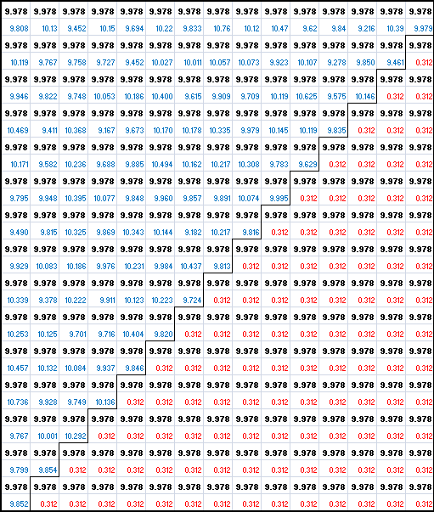

Example 2: known data (one mean, low variance)
The complete projection (log scale) is therefore the values on the lower right of the completed ‘square’. For emphasis, each cell in the triangle has the projected mean (bold type). In the original data cells, the blue values are the original data.
In the projected cells, the red numbers are the standard deviation for the projections for each cell (the measured variance is 0.097).
For every cell in the triangle a normal distribution has been fitted – both a mean and a standard deviation.
The distribution for the total is simply the distribution of the sum of the normal distributions in each projected cell. Since each individual cell comes from an independent normal distribution the sum is also normally distributed with a mean of the sum of the individual means and a variance of the sum of the individual variances.
The total (log scale) is therefore normally distributed with a mean of:
  1,047.69
And a standard deviation of:
  3.20

Slide 47
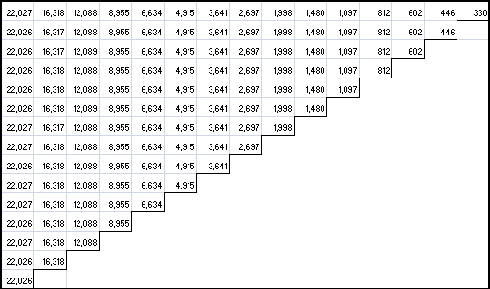
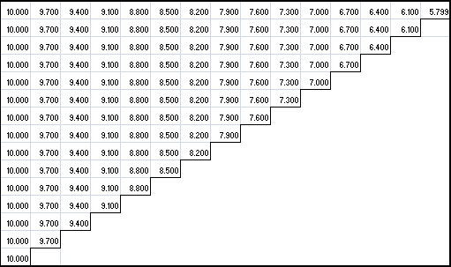
Example 3: ‘known’ data with development trend
For emphasis, data with zero variance is used to illustrate the trend. The data are transformed to a log scale (below right) so the percentage trends can be seen.
Since there is no variation in the data, projection, as with first example, is incredibly simple. Either projection is done down each column, or from left to right, the projected values remain the same. If we go from left to right (log scale), then we decrease the previous value by 0.3 down the column, we just project the last known value.

Slide 48
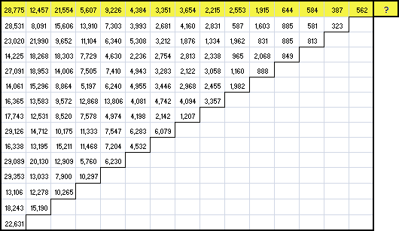
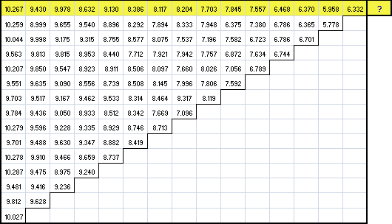
Example 4: ‘known’ data with development trend
The same trend structure (-30% decay) was used, starting with a mean of 10 (log scale), but where noise was added to the data. Log scale is on the lower right. Can you still see the development trend?
Let’s examine the process of building a complete model relating all the cells in the triangle with distributions starting with the projection of a single cell. Assume for now we only have the data highlighted in yellow and we wish to project the ?.
How would you do it?

Slide 49
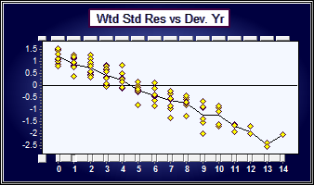
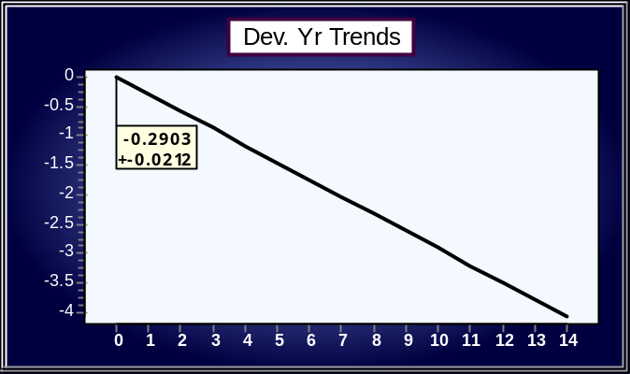
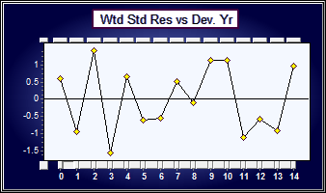
Example 4: ‘known’ data with development trend
Well, first you would plot the data (right) and observe an obvious downward trend in the points (ignore the scale). You could guess at this trend by eye and place a line on the graph. This slope of the line should correspond roughly to the average decay. Regression is a technique for mathematically estimating the slope of the line from the data to minimise the distance between the data and the line. Residuals are just the differences between the fitted line and the data – usually standardised to a common scale.
The regression line using least squares is fitted below. For the second accident period, the slope of this line is estimated to be -29.03% with a standard error of the slope of: 2.12%. What does this tell us? This means on average as we move to the right along the data, we expect the payments to reduce by about 29% on average (not the 30% we used since we’re estimating the parameter). We then transform back to the dollar scale with the final projection being as in the rightmost column. The red value is the standard deviation – this time of log-normal distribution as the data is normally distributed on a log scale, log-normal when transformed back to the dollar scale.
The residuals are shown to the below right after fitting the regression line.

Slide 50
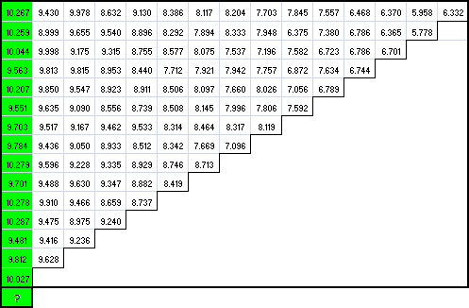
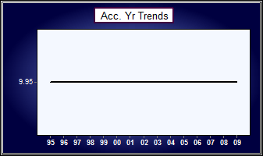
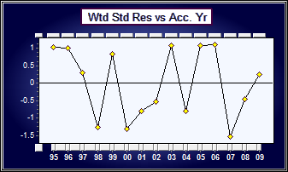
Example 4: ‘known’ data with development trend
We can use the same process of projecting down the column (assuming we only have the green highlighted values) as used for projecting across the row. In this case, however, we can use the average as we ‘know’ no changes have occurred in the accident level. This can be confirmed by the residuals (right) which confirm no change in level. The above has procedure has applications to pricing and writing future underwriting periods since we are extending to future accident periods.
The mean of the column on a log scale is: 9.95 (above right).
On a dollar scale, this mean of the log-normal corresponds to 21,942; and the standard deviation of the log normal to: 6,860.

Slide 51
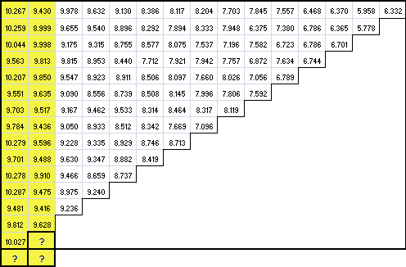
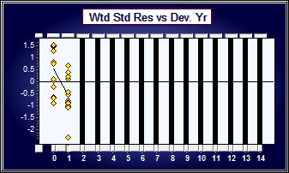

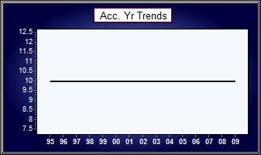

Example 4: ‘known’ data with development trend
This approach is readily extended to multiple projections with trends, eg: projecting the following three cells.
Since there are only two development periods, the development parameter trend is fairly uncertain (the standard error of the parameter is quite high).
From the residuals above, without the trend fitted, development 0 is clearly higher (on average) than development 1.
Using this model, we have related all the cells in the triangle available to the model (highlighted yellow). The cell in the first accident period, first development period (10.267) is related, by the model, to every other highlighted cell. Using this model we can project the ‘?’s by extending the model as before.
Projections on the dollar scale are shown on the far left. Again, bold black is the mean of the fitted lognormal distribution, red is the standard deviation, blue is the observed data.

Slide 52
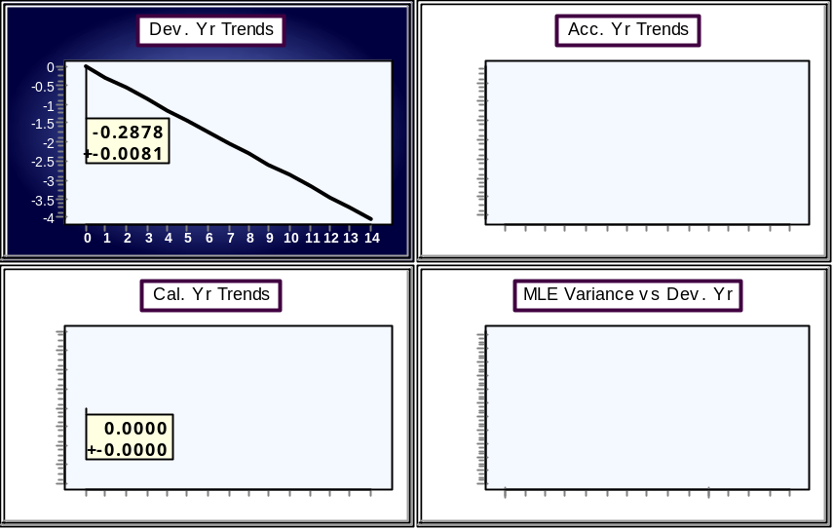
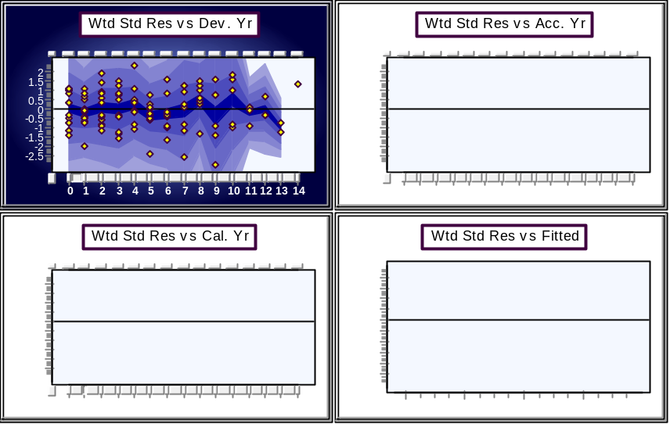
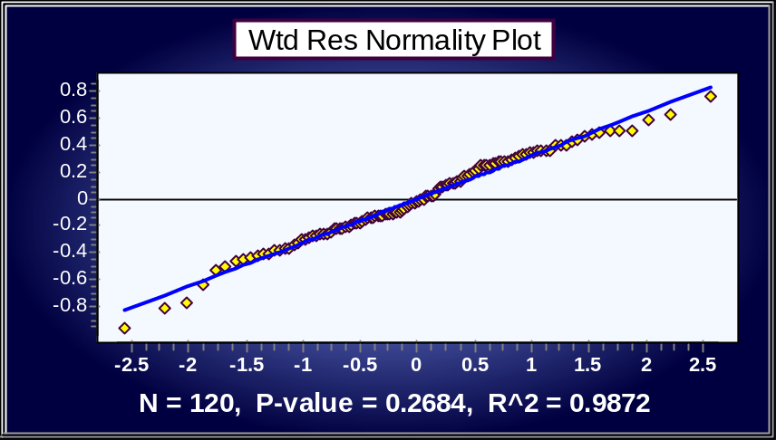
Example 4: ‘known’ data with development trend
As per the previous slides, the regression analysis can be extended by using all the data in the triangle. This leads to the following model and residual displays.
The residuals are scattered randomly over the three directions (although accident year 2002 looks low). The assumption of normality is unable to be rejected.
The trend structure described, -28.78%+_0.81% development trend and the mean accident level of 9.9267+_0.0481 with a process variance of 0.1032 is statistically the same as the structure used to create the data.
The probabilistic modelling framework has enabled the construction of a model which describes the salient features of the data while relating every cell in the triangle.

Slide 53
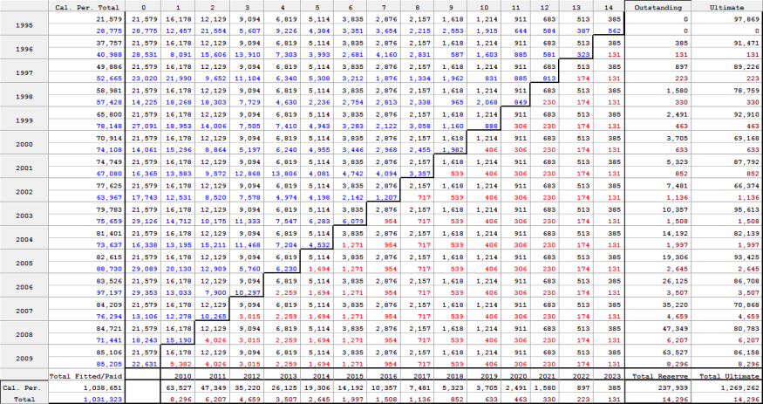
Example 4: ‘known’ data with development trend
The completed table with a log-normal distribution fitted to each cell in the triangle, with the projected distributions and their sums displayed in the lower right section of the triangle. As before, blue numbers are observed, black are fitted means, and red numbers are the standard deviation of the log-normal distribution. The burgundy numbers of the aggregate totals are also standard deviations, but the distribution of the sums are not necessarily log-normally distributed since they are the sum of log-normals.

Slide 54
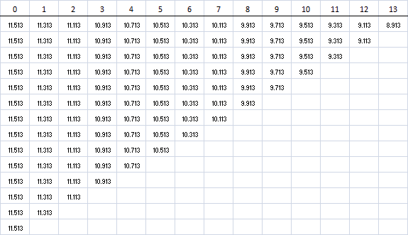

Example 5: M3IR5
Thus far, the examples have included neither changing trends nor calendar trends. The effect of calendar trends on the accident and development levels are now illustrated. We start, as usual, with the following specified model – no process variability – with data shown on a log scale.
- 0.2d
d
alpha = 11.513
PAID LOSS = EXP(alpha - 0.2d)

Slide 55
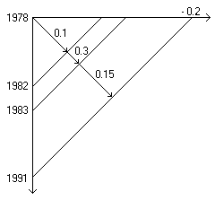
Example 5: M3IR5: axioms of trends
Add three new calendar year trends on a log scale to the data. Any calendar year trend projects in the other two directions to produce resultant trends.
0.15
0.3
0.1

Slide 56
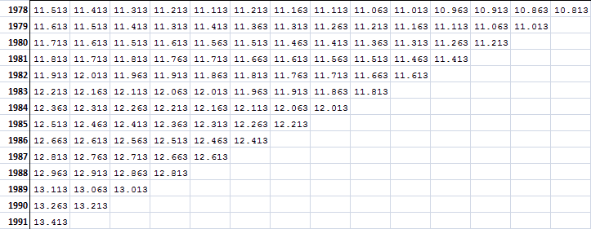
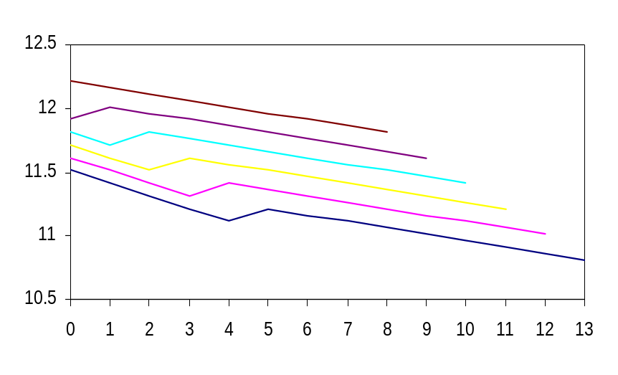
Example 5: M3IR5
Log of data (alpha - 0.2d) + calendar trends
Arrows apply to first row and column respectively and show the direction of the net trends.
Resultant Development year trends for accident year ‘78 to ‘83
Accident year 1983
Note kick up is in different development periods for each accident year. Both accident and development trends are affected by the change in calendar year trends.
Accident year 1978
Accident year 1979

Slide 57
Example 5: M3IR5
Consider accident year 1978. Along development years 0-4 the resultant trend is -0.2+0.1 (=-0.1). From development year 4-5 the resultant trend is: -0.2+0.3 (=0.1), and from development year 5 to 13 the resultant trend is: -0.2+0.15 (=-0.5).
Accident year 1979 is 0.1 higher than 1978 but the kick up of the 0.1 is one development period earlier.
For development year 4, as you step down the accident years, the first trend is 0.3, and the subsequent trends are each 0.15. For development year 7, the difference is 0.05 between successive accident years.
For development year 2, it is 0.1 for two accident years going down, then 0.3, then 0.15 thereafter.
Resultant Development year trends for accident year ‘78 to ‘83

Slide 58
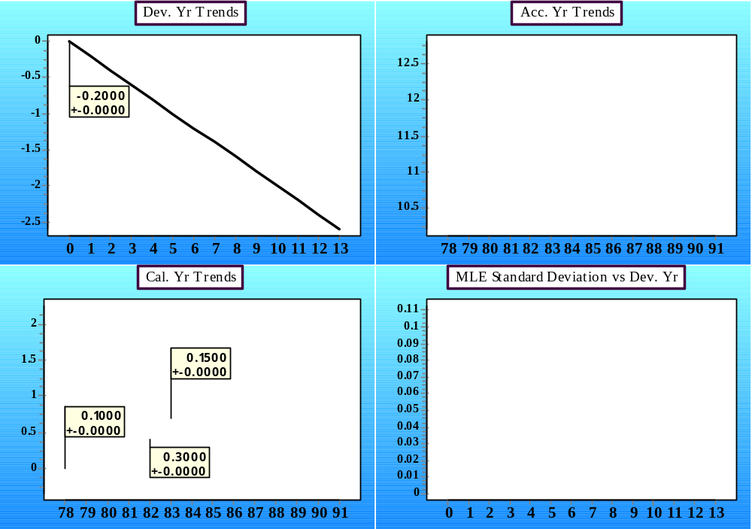
Example 5: M3IR5
The model display below shows the trend structure in each direction and the process variability in the lower right.

Slide 59

Example 5: M3IR5
Now add some process variation: in this case random numbers from a normal distribution with mean 0 and standard deviation 0.1.
Trends + randomness
Changing trends hard to pick without removing main development and payment year trend.

Slide 60

Example 5: M3IR5
Fitting the average calendar year trend to three calendar year trends; after fitting the average development year trend and a zero trend along the accident years.
Calendar Period Trends
13.75
log data
13.25
12.75
12.25
11.75
11.25
78 79 80 81 82 83 84 85 86 87 88 89 90 91
Calendar Periods
15.63% is the average trend
10% trend 78-82, 30% trend 82-83, and 15% trend 83+
The residuals represent trend in data minus trend estimated by the method. From 78-82 the difference is 10%-15.63%, for 82-83, the differences is the 30%-15.63% and from 83 to 91, the difference is 15% - 15.63%.

Slide 61
Summary of trend concepts
Trends in calendar year direction project onto the other two directions and vice versa
You cannot determine calendar period trend changes without including parameters in that direction
Changing trends can be hard to pick up in the presence of noise, unless main trends are removed first (regression as a form of adjustment)
• Modelling a changing trend as a single trend will result in pattern in the residual plots

Slide 62
Summary of trend concepts
If the modelling framework “works”, it should be hard to differentiate between real data and data simulated from an identified model for that data
  trends are the ‘same’ and change in the same periods
  amount of randomness is the same
If you create (simulate) data, you should be able to identify the (known) changing trends in the data; mean forecasts should usually be within about 2 standard errors of the true mean

Slide 63

Example 6: ABC
Smooth data, that is, data with very little process variability, can conceal calendar year trend changes.
Very smooth data (ABC)

Slide 64

Example 6: ABC
Residuals below are after removing all accident and development year trends. This is a diagnostic model to determine whether there are any left over calendar trends after accounting for accident and development trend changes. This model is not be used for forecasting.
Residuals versus calendar year show clear structure. A good model, reflective of the data, will both adjust for and quantify these trends.

Slide 65



Example ABC: PTF modelling framework
Identifying a PTF model for this data allows the full description of the changing trends including the volatility around them. Furthermore, we have control over exactly what trends are assumed going forward.
It is only in the PTF modelling framework that we can quantify, and adjust for, the change in calendar trend.
The initial calendar trend is measured at 6.52% +_ 0.35%. This trend changes in 1984-1985 to: 10.83% +_ 1.23%, and again in 1986-1987 to 16.91% +_ 0.74%.
The reserve forecast, assuming the most recent calendar trend continues is:
In the PTF modelling framework we have control over the calendar year trends. If we know why the 16.91% +_ 0.74% trend occurred, we can make decisions about whether this trend will continue into the future or whether it would revert to one of the older trends.

Slide 66

Example ABC: ELRF modelling framework
When you apply the Mack method to this data, we can see it does not capture the calendar year trends (nor the accident year trends).
The residuals versus calendar year show a distinct change in trend from 1984 onwards. (Note this change in trend is not necessarily constant; the superimposed arrows are illustrative only).

Slide 67


Example: LR High
In this example, the Mack method produces estimates which are far too high. The data triangle is shown below (and then again on a log scale).

Slide 68


Example: LR High
There are obvious patterns in the residuals, remembering that residuals represent the trend(s) in the data minus the trend(s) in the method. In this example, the trend(s) in the method are much higher than the trends in the data. As a result, the forecast from the Mack method is far too high. We do not have control over capturing of calendar trends in the Mack method and, as a result, we must move to a framework which quantifies calendar trend in order to formulate a more correct estimate. The mean estimate of the total outstanding using the Mack method is 896M, with a standard deviation of the distribution of 104M. The arithmetic average gives around 1.1 Billion.

Slide 69


Example: LR High
What if we adjust for the calendar year trends for the last 6 calendar years?
The residuals versus calendar year look more around zero. This means that the trend estimated by the method is pretty close to the trend in the data. Accordingly the answer is much lower.
However, although the method now seems to capture the most calendar trend, we don’t know what it is, nor can we control the assumption of the future calendar trend. It is all hidden in the method’s black box.

Slide 70

Example LR High
Optimal parameter estimates: best combination of intercepts, trends, and ratios
In this example, when an intercept and/or trend is used in the model, the ratio is not used (the ratio is set to 1.

Slide 71
Combining answers
Combining answers from several techniques
It is a misguided exercise to combine information from several models without assessing their appropriateness (fidelity to data, assumptions, validation)
  why mix good with bad?
Answers should not be selected merely on the basis of their similarity to each other — not borrowing strength
Projections from the best models unlikely to come from the centre of the range of answers.

Slide 72
Combining answers
Misguided to try to fit a continuous probability distribution to the results from a collection of methods.
Different methods do not simply yield random values from some underlying process centered on the correct answer - many methods will share similar biases. e.g. may miss the same features.
More methods do not mean more information about the process.
The range of answers from a variety of methods does not reflect the uncertainty in the process generating the losses.

Slide 73
Summary
1) Ratio techniques and extensions
  Ratios are regressions
  Regressions have assumptions
    Know what you assume when using ratios
  Assumptions need to be checked
    When do ratios work?
  Assumptions often don't hold
    What does this suggest?

Slide 74
Summary
2) Probabilistic Trend Family modelling framework
  Model the incrementals on a logarithmic scale and use the relationship between the multivariate normal and the multivariate log-normal to transform to a dollar scale. (Include parameter uncertainty)
  Identify a parsimonious set of parameters that capture the trends in the three directions recognising that any calendar period trend projects in the other two directions.
  The identified model fits a probability distribution to every cell (mean + variance) and relates them through the trend structure.
  Test that all assumptions are met – they usually are.
  The methodology applies to any incremental array: paid losses, incremental incurred losses, case reserve estimates, claim counts.

