Slide 1

Trilinos Progress, Challenges and Future Plans
Michael A. Heroux
Sandia National Laboratories
Sandia is a multiprogram laboratory operated by Sandia Corporation, a Lockheed Martin Company,
for the United States Department of Energy under contract DE-AC04-94AL85000.
Notes:
Questions from audience
Can you use another matrix-vector multiply?
Are multivectors supported?
Are Petsc and Hypre available via Thyra?
How does Trilinos differ from Petsc?

Slide 2
Trilinos Contributors
Chris Baker
Ross Bartlett
Pavel Bochev
Paul Boggs
Erik Boman
Cedric Chevalier
Todd Coffey
David Day
Karen Devine
Clark Dohrmann
David Gay
Esteban Guillen
Mike Heroux
Ulrich Hetmaniuk
Robert Hoekstra
Russell Hooper
Vicki Howle
Jonathan Hu
Tammy Kolda
Sarah Knepper
Joe Kotulski
Rich Lehoucq
Kevin Long
Roger Pawlowski
Eric Phipps
Lee Ann Riesen
Marzio Sala
Andrew Salinger
Chris Siefert
Bill Spotz
Heidi Thornquist
Ray Tuminaro
Jim Willenbring
Alan Williams
Past Contributors
Jason Cross
Michael Gee
Bob Heaphy
Kris Kampshoff
Joe Outzen
Mike Phenow
Paul Sexton
Bob Shuttleworth
Ken Stanley
New Member
Brent Perschbacher

Slide 3
Background/Motivation

Slide 4
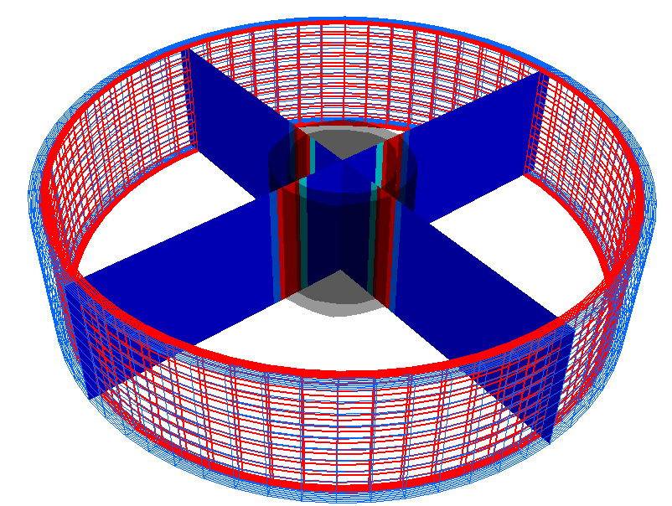
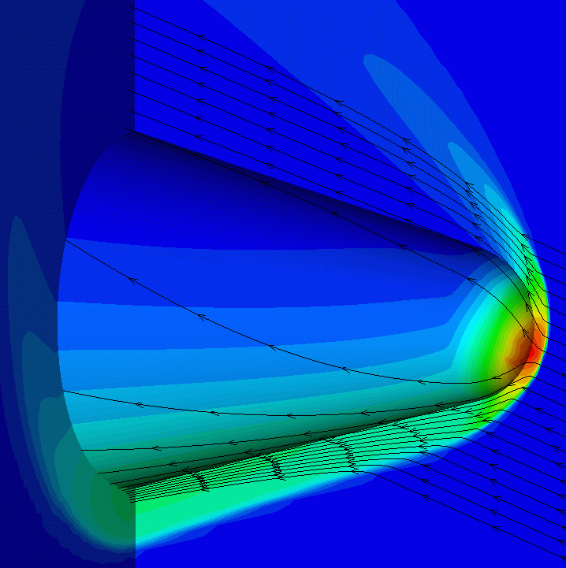
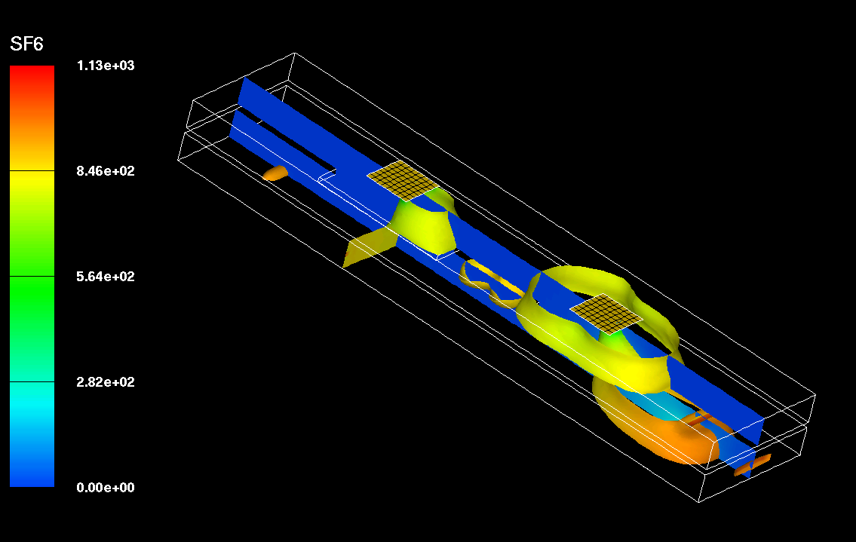
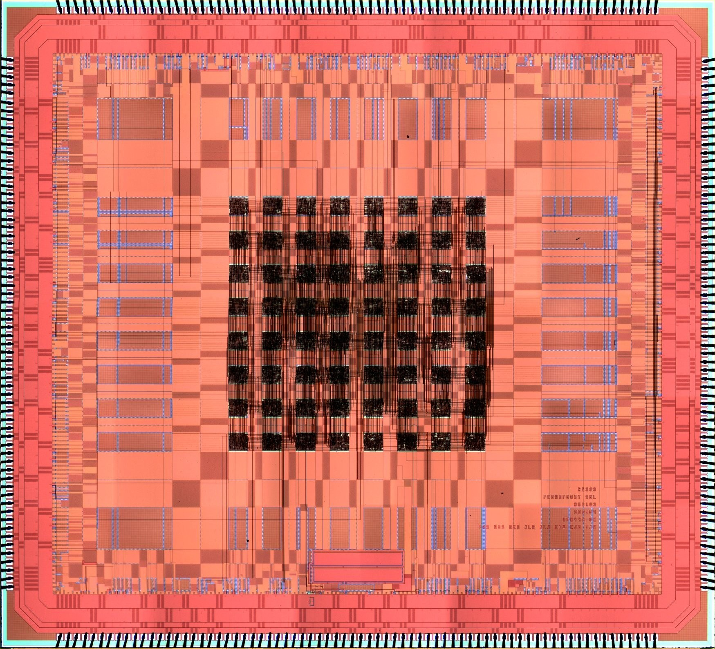
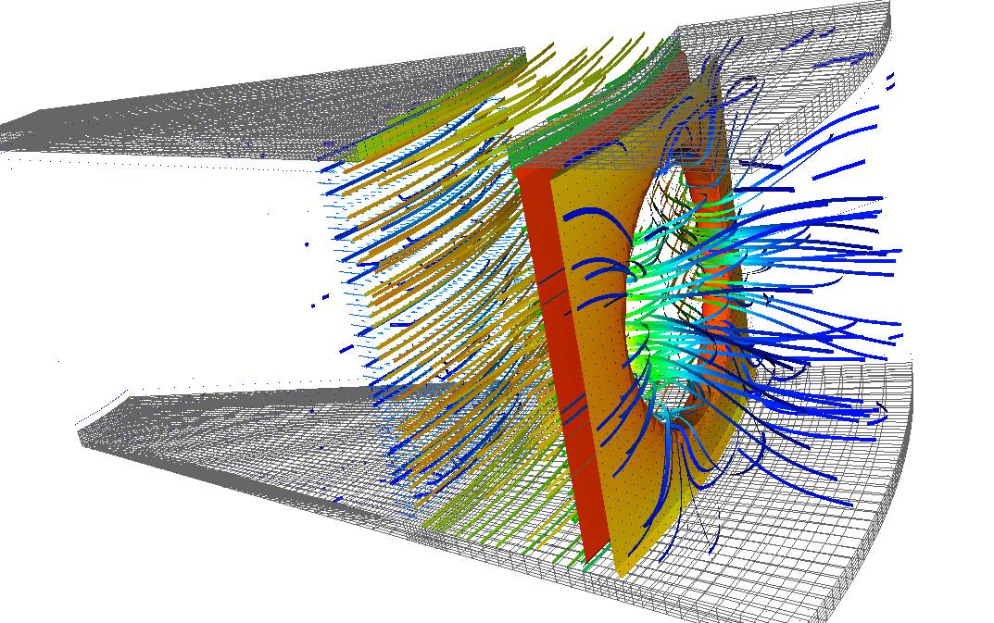
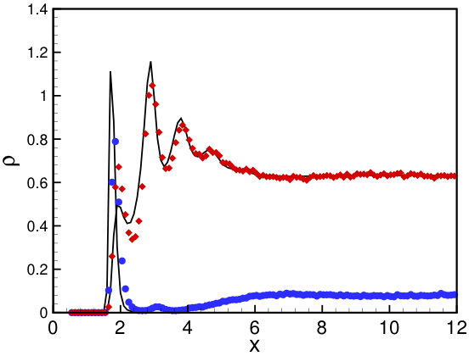
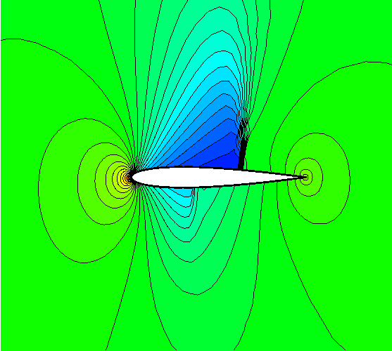
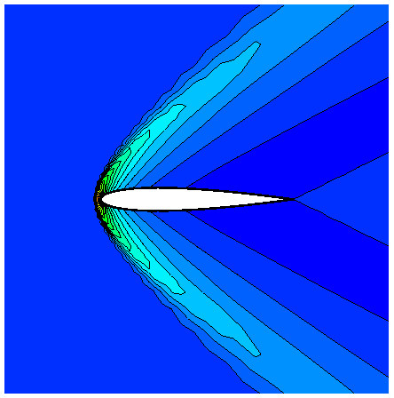
Target Problems: PDES and more…
Circuits
PDES
Inhomogeneous
Fluids
And More…

Slide 5

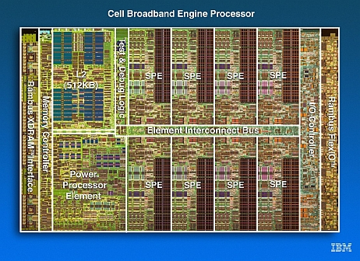

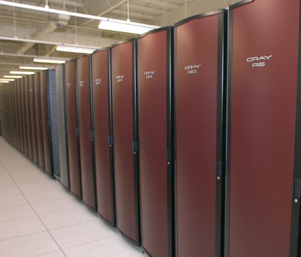
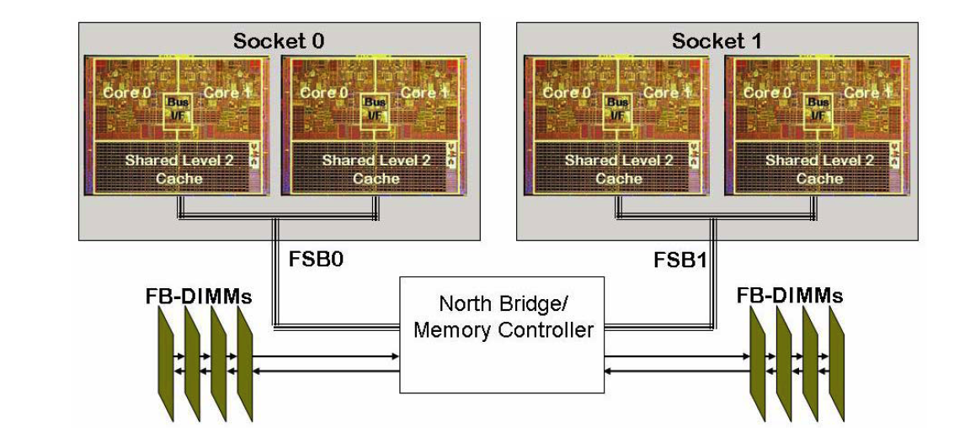
Target Platforms: Any and All
(Now and in the Future)
Desktop: Development and more…
Capability machines:
  Redstorm (XT3), Clusters
  Roadrunner (Cell-based).
  Multicore nodes.
Parallel software environments:
  MPI of course.
  UPC, CAF, threads, vectors,…
  Combinations of the above.
User “skins”:
  C++/C, Python
  Fortran.
  Web, CCA.

Slide 6
Evolving Trilinos Solution
Trilinos¹ is an evolving framework to address these challenges:
  Fundamental atomic unit is a package.
  Includes core set of vector, graph and matrix classes (Epetra/Tpetra packages).
  Provides a common abstract solver API (Thyra package).
  Provides a ready-made package infrastructure (new_package package):
    Source code management (cvs, bonsai).
    Build tools (autotools, soon Cmake).
    Automated regression testing.
    Communication tools (mailman mail lists).
  Specifies requirements and suggested practices for package SQA.
In general allows us to categorize efforts:
  Efforts best done at the Trilinos level (useful to most or all packages).
  Efforts best done at a package level (peculiar or important to a package).
  Allows package developers to focus only on things that are unique to
  their package.
1. Trilinos loose translation: “A string of pearls”

Slide 7

Evolving Trilinos Solution
physics
Beyond a “solvers” framework
Natural expansion of capabilities to satisfy application and research needs
L(u)=f
Math. model
discretizations
methods
Numerical math
Convert to models that can be solved on digital computers
Time domain
Space domain
Automatic diff.
Domain dec.
Mortar methods
L_{h}(u_{h})=f_{h}
Numerical model
solvers
core
Algorithms
Find faster and more efficient ways to solve numerical models
Linear
Nonlinear
Eigenvalues
Optimization
Petra
Utilities
Interfaces
Load Balancing
u_{h}=L_{h}⁻¹•f_{h}
Algorithms
Discretization methods, AD, Mortar methods, …
computation

Slide 8
Trilinos Strategic Goals
Scalable Computations: As problem size and processor counts increase, the cost of the computation will remain nearly fixed.
Hardened Computations: Never fail unless problem essentially intractable, in which case we diagnose and inform the user why the problem fails and provide a reliable measure of error.
Full Vertical Coverage: Provide leading edge enabling technologies through the entire technical application software stack: from problem construction, solution, analysis to optimization.
Grand Universal Interoperability: All Trilinos packages will be interoperable, so that any combination of packages that
makes sense algorithmically will be possible within Trilinos and with compatible external software.
Universal Accessibility: All Trilinos capabilities will be available to users of major computing environments: C++, Fortran, Python and the Web, and from the desktop to the latest scalable systems.
Universal Capabilities RAS: Trilinos will be:
  Integrated into every major application at Sandia (Availability).
  The leading edge hardened, efficient, scalable solution for each of these applications (Reliability).
  Easy to maintain and upgrade within the application environment (Serviceability).
Algorithmic
Goals
Software
Goals

Slide 9
Trilinos Statistics, 11/2007
Stats: Trilinos Download Page 11/5/2007.

Slide 10
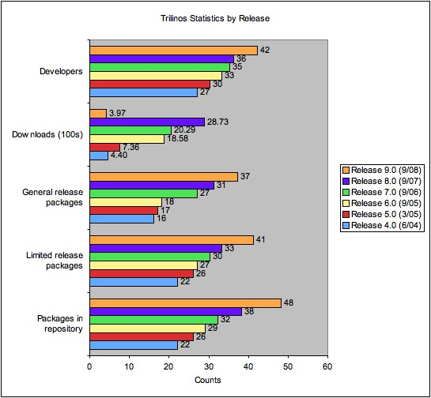
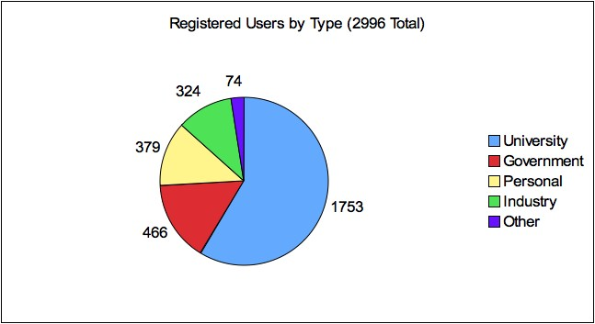
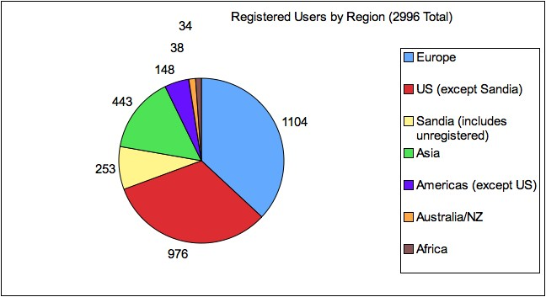
Trilinos Statistics
Stats: Trilinos Download Page 10/20/2008.

Slide 11

External Visibility
Awards: R&D 100, HPC SW Challenge (04).
www.cfd-online.com:
Industry Collaborations: Boeing, Goodyear, ExxonMobil, others.
Linux distros: Debian, Mandriva, Ubuntu, Fedora.
SciDAC TOPS-2 partner, IAA Algorithms (with ORNL).
Over 8000 downloads since March 2005.
Occasional unsolicited external endorsements such as the following two-person exchange on mathforum.org:
  > The consensus seems to be that OO has little, if anything, to offer
  > (except bloat) to numerical computing.
  I would completely disagree. A good example of using OO in numerics is
  Trilinos: http://software.sandia.gov/trilinos/
Trilinos
  A project led by Sandia to develop an object-oriented software framework for scientific computations.
  This is an active project which includes several state-of-the-art solvers and lots of other nice things a
  software engineer writing CFD codes would find useful. Everything is freely available for download once
  you have registered. Very good!

Slide 12
Trilinos Presentation Forums
ACTS “Hands-on” Tutorial:
  Aug 18-20, 2009 (approximate).
  At Lawrence Berkeley Lab, Berkeley, CA, USA.
Next Trilinos User Group Meeting:
  Proposal: Nov 3-5, 2009.
  At Sandia National Laboratories, Albuquerque, NM, USA.
HPCSW Week Symposium ?
  Tutorial last year.
  Not sure if happening again this year.
Supercomputing 2009 ?
  Tutorial on Library-based Application Development.

Slide 13
Characterizing the Trilinos “Project”
Not a “project” but an infrastructure to support inter-related projects: A project of projects.
Package participation is voluntary:
  Framework must be attractive (and continue to be).
  Requirements are few, opportunities are many.
  Package team decides what and when.
  Opt-out is always an option.
Package autonomy is carefully guarded:
  Even if redundant development occurs.
  Decision-making pushed to lowest (best) level.
Participation is attractive:
  Increasing infrastructure capabilities.
  Access to many other packages.

Slide 14
Changing Scope of Trilinos
Capabilities:
  Past: Solver capabilities and supporting components.
  Now: Any library for science/engineering (Zoltan, Intrepid, …).
Customers:
  Past: Sandia and other NNSA customers.
  Now: Expanding to Office of Science applications, DoD, DHS, CRADAs and WFO.
Platforms:
  Past: All platforms using command-line installer (Autotools). Linux/Unix bias.
  Now: Expanding to GUI & binary installer (Cmake). Native Winodws/Mac process.
The Changing Scope of the Trilinos Project, Michael A. Heroux, Technical Report, Sandia National Laboratories, SAND2007-7775, December 2007.

Slide 15
Capability Leaders:
New Layer of Proactive Leadership
Areas:
  Framework, Tools & Interfaces (J. Willenbring).
  Software Engineering Technologies and Integration (R. Bartlett).
  Discretizations (P. Bochev).
  Geometry, Meshing & Load Balancing (K. Devine).
  Scalable Linear Algebra (M. Heroux).
  Linear & Eigen Solvers (J. Hu).
  Nonlinear, Transient & Optimization Solvers (A. Salinger).
Each leader provides strategic direction across all Trilinos packages within area.

Slide 16
Courting Science Apps
Attended Many Office of Science meetings in FY07/08.
Clear messages:
  Fortran is the language.
  PETSc is used in many apps.
Therefore Trilinos Needs:
  A legitimate Fortran API: ForTrilinos (Ctrilinos pre-req).
    Using some (but not all) of Fortran 2003 features:
      C interoperability.
      OO Fortran.
    Exposes user-oriented interfaces (small fraction of total).
  PETSc interoperablity.
    App should be able to leverage investment in PETSc data structures and solvers.
    Use of Trilinos capabilities (preconditioners, transient, optimization, UQ) should build on top.

Slide 17
Two Budding Collaborations
Homme: Atmospheric dynamical core.
  Kate Evans ORNL.
  Implicit methods for shallow water equations.
  D. Rouson, A. Salinger, M. Taylor, R. Bartlett.
POP: Parallel Ocean Program
  Wilbert Weijer LANL.
  Implicit methods, tangent linear/adjoint methods.

Slide 18
Trilinos Package Concepts
Package: The Atomic Unit

Slide 19
Trilinos Packages
Trilinos is a collection of Packages.
Each package is:
  Focused on important, state-of-the-art algorithms in its problem regime.
  Developed by a small team of domain experts.
  Self-contained: No explicit dependencies on any other software packages (with some special exceptions).
  Configurable/buildable/documented on its own.
Sample packages: NOX, AztecOO, ML, IFPACK, Meros.
Special package collections:
  Petra (Epetra, Tpetra, Jpetra): Concrete Data Objects
  Thyra: Abstract Conceptual Interfaces
  Teuchos: Common Tools.
  New_package: Jumpstart prototype.

Slide 20
Trilinos Package Summary http://trilinos.sandia.gov
 | Objective | Package(s)
Discretizations | Meshing & Spatial Discretizations | phdMesh, Intrepid, Pamgen, Sundance
 | Time Integration | Rythmos
Methods | Automatic Differentiation | Sacado
 | Mortar Methods | Moertel
Core | Linear algebra objects | Epetra, Jpetra, Tpetra
 | Abstract interfaces | Thyra, Stratimikos, RTOp
 | Load Balancing | Zoltan, Isorropia
 | “Skins” | PyTrilinos, WebTrilinos, Star-P, ForTrilinos, CTrilinos
 | C++ utilities, I/O, thread API | Teuchos, EpetraExt, Kokkos, Triutils, TPI
Solvers | Iterative (Krylov) linear solvers | AztecOO, Belos, Komplex
 | Direct sparse linear solvers | Amesos
 | Direct dense linear solvers | Epetra, Teuchos, Pliris
 | Iterative eigenvalue solvers | Anasazi
 | ILU-type preconditioners | AztecOO, IFPACK
 | Multilevel preconditioners | ML, CLAPS
 | Block preconditioners | Meros
 | Nonlinear system solvers | NOX, LOCA
 | Optimization (SAND) | MOOCHO, Aristos
 | Stochastic PDEs | Stokhos

Slide 21
Why Packages?

Slide 22
Package Interoperability

Slide 23
Interoperability vs. Dependence
(“Can Use”) (“Depends On”)
Although most Trilinos packages have no explicit dependence, each package must interact with some other packages:
  NOX needs operator, vector and solver objects.
  AztecOO needs preconditioner, matrix, operator and vector objects.
  Interoperability is enabled at configure time. For example, NOX:
    --enable-nox-lapack compile NOX lapack interface libraries
    --enable-nox-epetra compile NOX epetra interface libraries
    --enable-nox-petsc compile NOX petsc interface libraries
Trilinos configure script is vehicle for:
  Establishing interoperability of Trilinos components…
  Without compromising individual package autonomy.
Trilinos offers seven basic interoperability mechanisms.
../configure –enable-python

Slide 24
Trilinos Interoperability Mechanisms
(Acquired as Package Matures)
Package builds under Trilinos configure scripts. | ⇒ | Package can be built as part of a suite of packages; cross-package interfaces enable/disable automatically
Package accepts user data as Epetra or Thyra objects | ⇒ | Applications using Epetra/Thyra can use package
Package accepts parameters from Teuchos ParameterLists | ⇒ | Applications using Teuchos ParameterLists can drive package
Package can be used via Thyra abstract solver classes | ⇒ | Applications or other packages using Thyra can use package
Package can use Epetra for private data. | ⇒ | Package can then use other packages that understand Epetra
Package accesses solver services via Thyra interfaces | ⇒ | Package can then use other packages that implement Thyra interfaces
Package available via PyTrilinos, ForTrilinos, WebTrilinos | ⇒ | Package can be used with other Trilinos packages via Python, Fortran, Website.

Slide 25
Interoperability Example: ML
ML: Multi-level Preconditioner Package.
Primary Developers: Ray Tuminaro, Jonathan Hu, Marzio Sala.
No explicit, essential dependence on other Trilinos packages.
  Uses abstract interfaces to matrix/operator objects.
  Has independent configure/build process (but can be invoked at Trilinos level).
Interoperable with other Trilinos packages and other libraries:
  Accepts user data as Epetra matrices/vectors.
  Can use
    Epetra for internal matrices/vectors.
    IFPACK, Amesos, AztecOO, etc. objects as smoothers, coarse solvers.
  Can be used via
    Thyra abstract interfaces.
    PyTrilinos.
  Can be built via Trilinos configure/build process.
  Can be driven via Teuchos ParameterLists.
  Available as preconditioner to all other Trilinos packages.
  Available to PETSc users without dependence on any other Trilinos packages.

Slide 26
Package Maturation Process
Asynchronicity

Slide 27
Day 1 of Package Life
CVS: Each package is self-contained in Trilinos/package/ directory.
Bugzilla: Each package has its own Bugzilla product.
Bonsai: Each package is browsable via Bonsai interface.
Mailman: Each Trilinos package, including Trilinos itself, has four mail lists:
  package-checkins@software.sandia.gov
    CVS commit emails. “Finger on the pulse” list.
  package-developers@software.sandia.gov
    Mailing list for developers.
  package-users@software.sandia.gov
    Issues for package users.
  package-announce@software.sandia.gov
    Releases and other announcements specific to the package.
New_package (optional): Customizable boilerplate for
  Autoconf/Automake/Doxygen/Python/Thyra/Epetra/TestHarness/Website

Slide 28
Sample Package Maturation Process
Step | Example
Package added to CVS: Import existing code or start with new_package. | ML CVS repository migrated into Trilinos (July 2002).
Mail lists, Bugzilla Product, Bonsai database created. | ml-announce, ml-users, ml-developers, ml-checkins, ml-regression @software.sandia.gov created, linked to CVS (July 2002).
Package builds with configure/make, Trilinos-compatible | ML adopts Autoconf, Automake starting from new_package (June 2003).
Epetra objects recognized by package. | ML accepts user data as Epetra matrices and vectors (October 2002).
Package accessible via Thyra interfaces. | ML adaptors written for TSFCore_LinOp (Thyra) interface (May 2003).
Package uses Epetra for internal data. | ML able to generate Epetra matrices. Allows use of AztecOO, Amesos, Ifpack, etc. as smoothers and coarse grid solvers (Feb-June 2004).
Package parameters settable via Teuchos ParameterList | ML gets manager class, driven via ParameterLists (June 2004).
Package usable from Python (PyTrilinos) | ML Python wrappers written using new_package template (April 2005).
Startup Steps
Maturation Steps

Slide 29
Latest Maturation: Cmake-enabled
Cmake: Alternative to Autotools.
  GUI.
  Supports Windows/MS, Mac, Unices.
  Supports binary packaging.
Target system-wide deployment: Trilinos 10.0.

Slide 30
What Trilinos is not
Trilinos is not a single monolithic piece of software. Each package:
  Can be built independent of Trilinos.
  Has its own self-contained CVS structure.
  Has its own Bugzilla product and mail lists.
  Development team is free to make its own decisions about algorithms, coding style, release contents, testing process, etc.
Trilinos top layer is not a large amount of source code:
  Less than 1% SLOC outside of packages.
Trilinos is not “indivisible”:
  You don’t need all of Trilinos to get things done.
  Any collection of packages can be combined and distributed.
  Current public release contains only 30 of the 40+ Trilinos packages.

Slide 31
Insight from History
A Philosophy for Future Directions
In the early 1800’s U.S. had many new territories.
Question: How to incorporate into U.S.?
  Colonies? No.
  Expand boundaries of existing states? No.
  Create process for self-governing regions. Yes.
  Theme: Local control drawing on national resources.
Trilinos package architecture has some similarities:
  Asynchronous maturation.
  Packages decide degree of interoperations, use of Trilinos facilities.
Strength of each: Scalable growth with local control.

Slide 32
Major Framework Themes: FY05/06
Trilinos Package Architecture:
  Continue refinement of new_package.
  Explicitly define Trilinos compatibility.
  Resolve the abstract interface issue.
Software Quality:
  Expand use and ease-of-use of test harness.
  Identify metrics and automate capture and display.
  Establish a life-cycle model (hybrid agile/unified process?).
  Customize the ASC SQP to our environment.
Packages:
  Foster new package development.
  Manage the growth. Issue: complexity of package coupling.
  Harden our mature packages.
Transition to post-delivery maintenance:
  Organizational issue: Tough to solve.

Slide 33
Major Themes for FY06/07
Framework
Take Steps toward dynamic package addition.
  In light of more outward focus:
  (SciDAC, Boeing, ???)
  Trilinos-compatibility definition or something similar.
Define SW Lifecycle(s) and begin formalized efforts.
  Need something for external audits.
  Agile vs. UP vs. hybrid.

Slide 34
FY07/08 Themes: Framework
Trilinos Level II Milestone.
  Demonstrate Use of Full Vertical capabilities in Charon.
Joint licensing and copyright of development with other organizations.
  Other DOE Labs, international orgs, private companies.
Package Autonomy (reacting to rapid growth):
  18 to 27 to ??
  Guarding against incidental coupling.
  Revisiting the location of “skins”.
Stratimikos: Uniform access to many packages.
Access from Fortran.
  DOE Science Users, DOD Users.
  Stratimikos focus.
Split of User vs Developer tools.
  http://trilinos.sandia.gov
  http://software.sandia.gov

Slide 35
Themes for FY08/09
Redefinition of Trilinos scope beyond solvers.
Next steps in packaging and distribution.
Continued outreach to other communities
Rethinking source management.
Formalizing App-Trilinos relationship.
Post-delivery maintenance improvements.
Trilinos Advisory Group.
Matrixing with software services group.

Slide 36
Themes for FY09/10
Ubiquitous availability:
  Desktop to Supercomputers.
  Use across DOE complex.
New directions for “Extreme Scale” computing.
Transition to Cmake and related tools.
Scalable Linear Algebra Themes:
  Multicore/GPUs: Pre-requisite for extreme scale.
  Multi-precision algorithms.
Many More (next talks).

Slide 37
Trilinos Availability/Information
Trilinos and related packages are available via LGPL.
Current release is 9.0.
Unlimited availability.
Planning 9.1 release March 2009.
More information:
  http://trilinos.sandia.gov
  http://software.sandia.gov
  Additional documentation at my website:
  http://www.cs.sandia.gov/~mheroux.

