Slide 1
Partitioning and
Load-Balancing in Trilinos
Erik Boman
Cedric Chevalier, Karen Devine, Lee Ann Riesen
Sandia National Laboratories, NM, USA
Trilinos User’s Group, Oct 21, 2008.

Slide 2
Partitioning and Load Balancing
Load Balancing
  Assign data/work to processors to distribute data/work evenly and minimize communication
Static vs. dynamic
  Static: Partition once (pre-processing)
  Dynamic: May need to repartition and redistribute data (at run-time)

Slide 3
Partitioning Methods
Block distribution
  Give n/p consecutive data elements (e.g. rows) to each proc.
  Good load balance, but possibly high communication
  Default distribution for Epetra maps!
Graph partitioning
  Vertices (weighted) = computation
  Edge (weighted) = data dependence
  Minimize cut edges
Hypergraph partitioning
  Generalizes graph partitioning
  Accurate model of communication volume
  Works for nonsymmetric and rectangular matrices
Proc 1
Proc 3
Proc 2

Slide 4
Zoltan
Toolkit: Focus on partitioning and load-balancing
  Collection of many partitioning algorithms
  Also provides graph coloring, matrix ordering (Cedric)
  Mature (predates Trilinos); used in production codes
New package in Trilinos 9.0
  May also be obtained and built separately
  No dependence on Trilinos packages

Slide 5
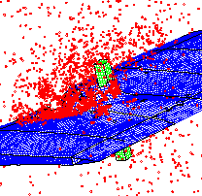
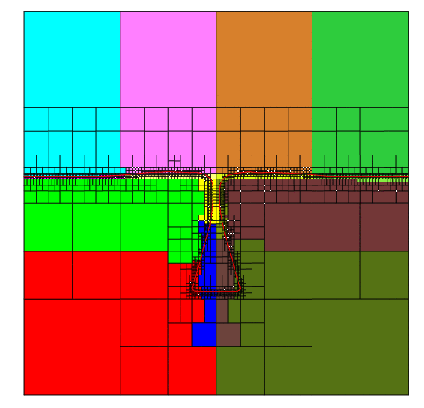
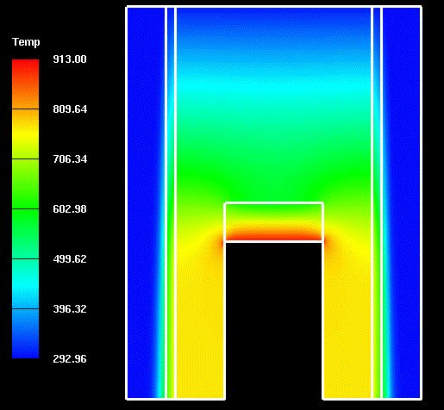
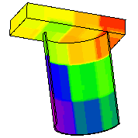
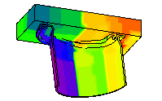

Zoltan Supports
Many Applications
SIERRA, ALEGRA, CHISELS, Presto, Chemcell, Xyce, Aleph, …
1
1
1
1
=
Rg02
C02
2
C2
Rg2
2
R
2
C
2
L2
1
2
R2
1
C
2
R
1
Vs
INDUCTOR
R
SOURCE_VOLTAGE
1
2
1
Cm012
Rl
1
Cm12
A
x
b
1
Rs
2
C
2
R
2
C
Linear solvers &
preconditioners
2
R
2
L1
1
2
R1
1
1
1
INDUCTOR
R
1
1
Rg1
Rg01
C01
C1
2
R
2
C
2
C
2
R
Parallel electronics networks
Particle methods
Multiphysics simulations
Adaptive mesh refinement
Crash simulations

Slide 6
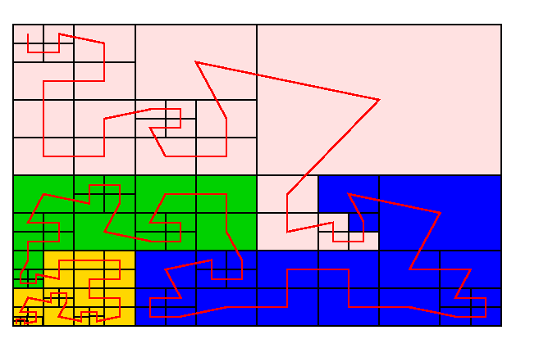
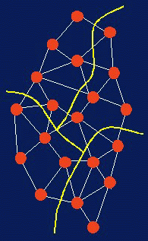
Zoltan Toolkit: Suite of
Partitioning Algorithms
Recursive Coordinate Bisection
Recursive Inertial Bisection
Space Filling Curves
Refinement-tree Partitioning
Octree Partitioning
Graph Partitioning
(ParMETIS , PHG )
Hypergraph Partitioning

Slide 7
Zoltan and Isorropia
Isorropia is the primary user interface to Zoltan for Trilinos/Epetra users
Trilinos
application
Isorropia
Zoltan

Slide 8
Isorropia
Isorropia is a Trilinos package that provides a matrix-based interface to Zoltan
  Requires: Zoltan, Epetra, Teuchos
  Relies on Zoltan for most algorithms
  Focuses on sparse matrix partitioning
  Accepts Epetra matrices as input
  Supports block, graph, hypergraph partitioning
  Generates good Epetra maps
    Load-balanced to reduce communication

Slide 9
Feature Overlap
Isorropia only supports a subset of Zoltan
  Expanding to most features
Isorropia will soon go beyond Zoltan
  2d matrix partitioning
Zoltan
Isorropia

Slide 10
Isorropia API
Three primary user-interface classes:
  Partitioner:
    Constructed with distributed graph/matrix as input, calls Zoltan to compute ‘new’ partitioning (map).
  Redistributor:
    Constructed with Partitioner instance. Can then be used to redistribute objects (matrices, vectors, matrix-graphs) from the old partitioning to the new partitioning.
  CostDescriber:
    Interface which allows users to specify weights or costs associated with the vertices or edges of the object to be repartitioned.
    Allows user-specified vertex weights, graph edge weights,
    and hypergraph edge weights.

Slide 11
Isorropia Example
// RCP is a smart pointer type in Teuchos.
RCP<const Epetra_CrsMatrix> matrix = ...
RCP<const Epetra_Vector> vec = ...
Teuchos::ParameterList paramlist; //Optionally set Zoltan parameters
// Create partitioner from matrix
Isorropia::Epetra::Partitioner partitioner(matrix, paramlist);
//partitioner->compute_partitioning();
// Create redistributor from partitioner
Isorropia::Redistributor rd(rcp(&partitioner));
// Create a balanced matrix from redistributor
RCP<Epetra_CrsMatrix> balanced_matrix = rd.redistribute(*matrix);
RCP<Epetra_Vector> balanced_vec = rd.redistribute(*vec);

Slide 12
Load-balancing in Trilinos
An application has two options:
Call Zoltan directly
  Most flexible approach
  App must write Zoltan callback functions
  No support for Epetra data types
Use Isorropia
  Highly recommended (easy!) for Epetra users
  Currently limited to sparse matrices (graphs)
  Geometric partitioning via Multivectors under development (not in 9.0)

Slide 13
Comparison Chart
Zoltan
Isorropia
Build system | Automake and manual | Automake
Language | C (also C++ and F90 interfaces) | C++
Interface | Callback functions (user must provide) | Epetra data types
Package dependencies | None | Zoltan, Epetra, Teuchos
Features | Partitioning, Coloring, Ordering, Dist. data directory, Unstr. Comm. Lib. | Partitioning, Coloring, Ordering, Data redistribution

Slide 14
How to configure/build
Simply enable the package you want:
  ../configure –enable-zoltan
  ../configure –enable-isorropia
  Note: Isorropia will enable Zoltan (required dep.)
Both Zoltan and Isorropia can use select 3rd party partitioning libraries (optional)
  ParMetis
  PT-Scotch (new!)
  Patoh
Specify TPL as configure option
  ../configure –enable-zoltan –with-parmetis

Slide 15
Work in Progress (10.0)
Geometric partitioning in Isorropia
  Support load-balancing for mesh and particles
  Interface: MultiVector
2D matrix partitioning
  Reduce communication by non-row-based partition
  Resulting matrix can still be stored as CrsMatrix
Create 1-1 maps from overlapping maps
  Application: FEM code where assembly map is overlapping but we need 1-1 solver map
Symmetrize matrix for graph partitioning

Slide 16
The End

Slide 17
Isorropia
Tool to create better maps
  Produce maps for better load balance and optimized communication
  4 different maps for 2D objects (graphs, matrices):
    RowMap, ColumnMap, RangeMap, DomainMap
  Currently Isorropia performs row partitioning
    Novel 2D partitioning in progress

Slide 18
Isorropia Example
// RCP is a smart pointer type in Teuchos.
RCP<const Epetra_CrsMatrix> matrix = ...
RCP<const Epetra_Vector> vec = ...
Teuchos::ParameterList paramlist; //Optionally set Zoltan parameters
// Create partitioner from matrix
RCP<Isorropia::Partitioner> partitioner =
Isorropia::Epetra::create_partitioner(matrix, paramlist);
//partitioner->compute_partitioning();
// Create redistributor from partitioner
Isorropia::Redistributor rd(partitioner);
// Create a balanced matrix from redistributor
RCP<Epetra_CrsMatrix> balanced_matrix = rd.redistribute(*matrix);
RCP<Epetra_Vector> balanced_vec = rd.redistribute(*vec);

