Slide 1

Extreme Scale Trilinos:
How We are Ready, And Not
Michael A. Heroux
Sandia National Laboratories
Sandia is a multiprogram laboratory operated by Sandia Corporation, a Lockheed Martin Company,
for the United States Department of Energy under contract DE-AC04-94AL85000.

Slide 2
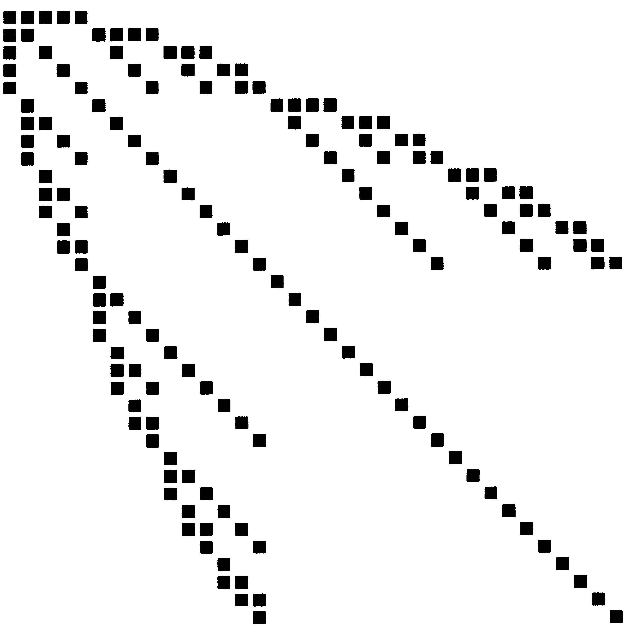
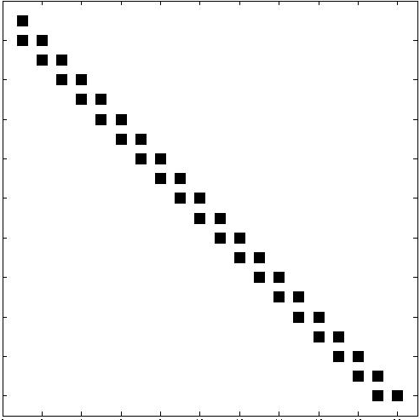
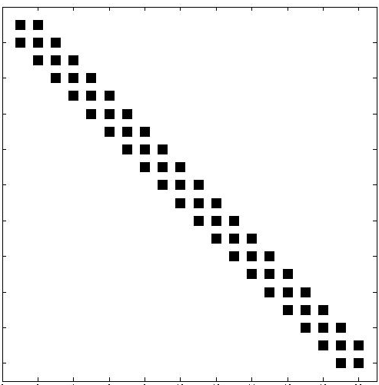
Advanced Modeling and Simulation Capabilities:
Stability, Uncertainty and Optimization
Promise: 10-1000 times increase in parallelism (or more).
Pre-requisite: High-fidelity “forward” solve:
  Computing families of solutions to similar problems.
  Differences in results must be meaningful.
SPDEs:
t₀
Transient
Optimization:
Lower Block
Bi-diagonal
t₀
Block
Tri-diagonal
t_{n}
t_{n}
- Size of a single forward problem

Slide 3
Advanced Capabilities:
Readiness and Importance
Modeling Area | Sufficient Fidelity? | Other concerns | Advanced capabilities priority
Seismic S. Collis, C. Ober | Yes. | None as big. | Top.
Shock & Multiphysics (Alegra) A. Robinson, C. Ober | Yes, but some concerns. | Constitutive models, material responses maturity. | Secondary now. Non-intrusive most attractive.
Multiphysics (Charon) J. Shadid | Reacting flow w/ simple transport, device w/ drift diffusion, … | Higher fidelity, more accurate multiphysics. | Emerging, not top.
Solid mechanics K. Pierson | Yes, but… | Better contact. Better timestepping. Failure modeling. | Not high for now.

Slide 4
Advanced Capabilities:
Other issues
Non-intrusive algorithms (e.g., Dakota):
  Task level parallel:
    A true peta/exa scale problem?
    Needs a cluster of 1000 tera/peta scale nodes.
Embedded/intrusive algorithms (e.g., Trilinos):
  Cost of code refactoring:
    Non-linear application becomes “subroutine”.
    Disruptive, pervasive design changes.
Forward problem fidelity:
  Not uniformly available.
  Smoothness issues.
  Material responses.

Slide 5
Advanced Capabilities:
Derived Requirements
Large-scale problem presents collections of related subproblems with forward problem sizes.
Linear Solvers:
  Krylov methods for multiple RHS, related systems.
Preconditioners:
  Preconditioners for related systems.
Data structures/communication:
  Substantial graph data reuse.

Slide 6
Programming Model Issues for Algorithms on Scalable Multicore Systems

Slide 7
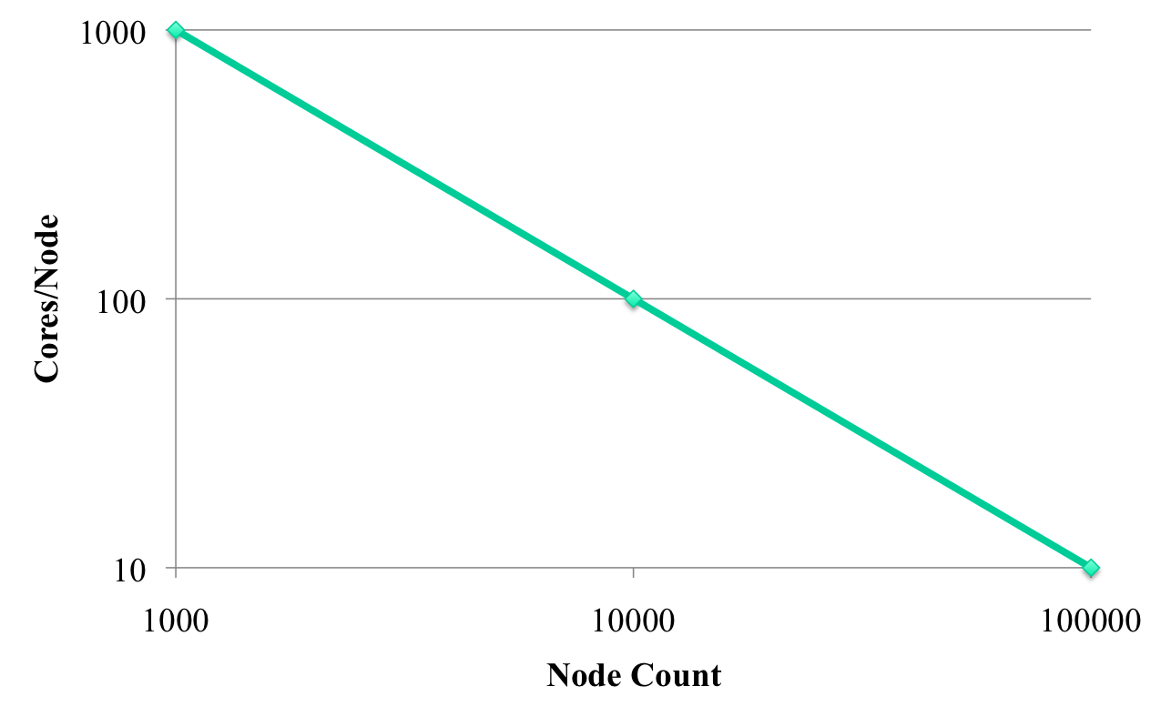
Core Configurations: Factoring 1M Cores
MPI+?? (vectorization/streaming?)
MPI+light-weight threads
Traditional MPI-only+traditional threading

Slide 8
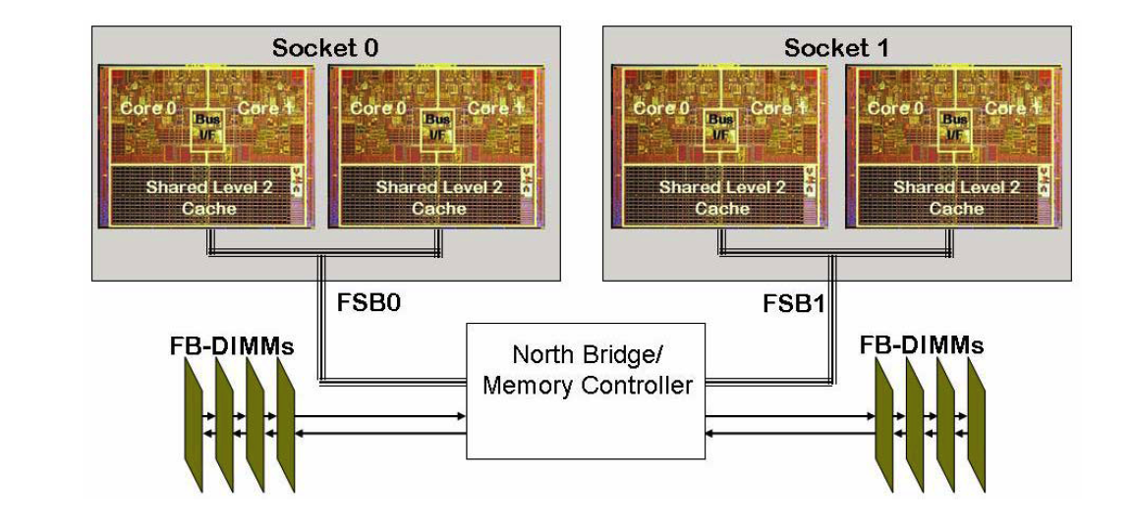
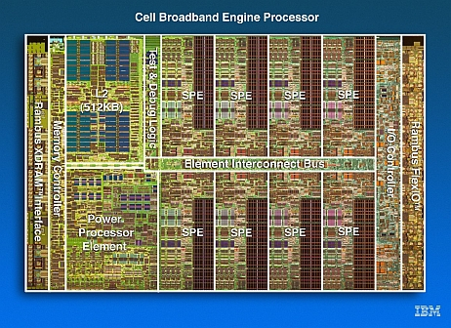
Node Classification
Homogeneous multicore:
  SMP on a chip.
  NUMA nodes.
  Varying memory architectures.
Heterogeneous multicore:
  Serial/Controller processor(s).
  Team of identical, simpler compute
  processors.
  Varying memory architectures.

Slide 9
Why Homogeneous vs. Heterogeneous?
Homogeneous:
  Out-of-the-box: Can attempt single-level MPI-only.
  m nodes, n cores per node: p = m*n
  mpirun -np p …
Heterogeneous:
  Must think of compute cores as “co-processors”.
  mpirun -np m …
  Something else on the node.
Future:
  Boundary may get fuzzy.
  Heterogenous techniques can work well on homogeneous nodes.

Slide 10
About MPI
MPI will be the primary inter-node programming model.
Very few people program in MPI: Abstractions.
Right ingredients:
  Portable, ubiquitous.
  Forced alignment of work/data ownership and transfer.
Matches architectures:
  Interconnects of best commercial node parts.
New languages:
  Big fan of Co-Array Fortran (Have been for 15 years: F--).
  Chapel looks good.
  But tough uphill climb.
Real question: How do we program the node?

Slide 11
Programming Models for Scalable Homogeneous Multicore
(beyond single-level MPI-only)

Slide 12
Threading under MPI
Default approach: Successful in many applications.
Concerns:
  Opaqueness of work/data pair assignment.
    Lack of granularity control.
  Collisions: Multiple thread models.
    Performance issue, not correctness.
Bright spot: Intel Thread Building Blocks (TBB).
  Iterator (C++ language feature) model.
  Opaque or transparent: User choice.
App
LibA
(OpenMP)
LibB
(TBB)

Slide 13
MPI Under MPI
Scalable multicores:
  Two different MPI architectures.
  Machines within a machine.
Exploited in single-level MPI:
  Short-circuited messages.
  Reduce network B/W.
  Missing some potential.
Nested algorithms.
Already possible.
Real attraction: No new node programming model.
Can even implement shared memory algorithms (with some enhancements to MPI).
“Ping-pong” test | Latency (microsec) | Bandwidth (MB/sec)
Intra-node machine | 0.71 | 1082
Inter-node machine | 47.5 | 114

Slide 14
MPI-Only + MPI/Threading: Ax=b
App
Rank 0
App
Rank 1
App
Rank 2
App
Rank 3
App passes matrix and vector values to library data
classes
Lib
Rank 0
Lib
Rank 1
Lib
Rank 2
Lib
Rank 3
All ranks store A, x, b data in memory visible to rank 0
Mem
Rank 0
Mem
Rank 1
Mem
Rank 2
Mem
Rank 3
Multicore: “PNAS” Layout
Library solves Ax=b using shared memory algorithms
on the node.
Lib
Rank 0
Thread 0 Thread 1 Thread 2 Thread 3

Slide 15
Heterogeneous Multicore Issues

Slide 16
Excited about multimedia processors
Inclusion of native double precision.
Large consumer market.
Qualitative performance improvement over standard microprocessors…
If your computation matches the architecture.
Many of our computations do match well.
But a long road ahead…

Slide 17
APIs for Heterogeneous Nodes
(A Mess)
Processor | API
NVIDIA | CUDA
AMD/ATI | Brook+
STI Cell | ALF
Intel Larrabee | Ct
Most/All? | Sequoia
Most | RapidMind (Proprietary)
Apple/All | OpenCL
Commonality: Fine-grain functional programming.
Our Response: A Library Node Abstraction Layer

Slide 18
Epetra Communication Classes
Epetra_Comm is a pure virtual class:
  Has no executable code: Interfaces only.
  Encapsulates behavior and attributes of the parallel machine.
  Defines interfaces for basic services such as:
    Collective communications.
    Gather/scatter capabilities.
  Allows multiple parallel machine implementations.
Implementation details of parallel machine confined to Comm classes.
In particular, rest of Epetra (and rest of Trilinos) has no dependence on any particular API, e.g. MPI.

Slide 19
Comm Methods
CreateDistributor() const=0 [pure virtual]
CreateDirectory(const Epetra_BlockMap & map) const=0 [pure virtual]
Barrier() const=0 [pure virtual]
Broadcast(double *MyVals, int Count, int Root) const=0 [pure virtual]
Broadcast(int *MyVals, int Count, int Root) const=0 [pure virtual]
GatherAll(double *MyVals, double *AllVals, int Count) const=0 [pure virtual]
GatherAll(int *MyVals, int *AllVals, int Count) const=0 [pure virtual]
MaxAll(double *PartialMaxs, double *GlobalMaxs, int Count) const=0 [pure virtual]
MaxAll(int *PartialMaxs, int *GlobalMaxs, int Count) const=0 [pure virtual]
MinAll(double *PartialMins, double *GlobalMins, int Count) const=0 [pure virtual]
MinAll(int *PartialMins, int *GlobalMins, int Count) const=0 [pure virtual]
MyPID() const=0 [pure virtual]
NumProc() const=0 [pure virtual]
Print(ostream &os) const=0 [pure virtual]
ScanSum(double *MyVals, double *ScanSums, int Count) const=0 [pure virtual]
ScanSum(int *MyVals, int *ScanSums, int Count) const=0 [pure virtual]
SumAll(double *PartialSums, double *GlobalSums, int Count) const=0 [pure virtual]
SumAll(int *PartialSums, int *GlobalSums, int Count) const=0 [pure virtual]
~Epetra_Comm() [inline, virtual]

Slide 20
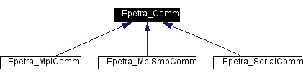
Comm Implementations
Three implementations of Epetra_Comm:
  Epetra_SerialComm:
    Allows easy simultaneous support of serial and parallel version of user code.
  Epetra_MpiComm:
    OO wrapping of C MPI interface.
  Epetra_MpiSmpComm:
    Allows definition/use of shared memory multiprocessor nodes.

Slide 21
Abstract Node Class
Kokkos::Node
Kokkos::SerialNode
Kokkos::TbbNode
…
Kokkos::CudaNode
Trilinos/Kokkos: Trilinos compute node package.
Abstraction definition in progress: Will look a lot like TBB.
Composition needed:
  Node with quadcore and GPU.
  Kokkos::TbbNode uses Kokkos::SerialNode.
Trilinos/Tpetra:
  Tpetra::Comm constructor takes Kokkos::Node object.

Slide 22
Going Forward:
Changing the Atomic Unit
Now:
Single-level MPI-only OK for many apps.
Future:
Hiding network heterogeneity beneath single MPI level too hard.
Philosophical approach:
Node becomes the new atomic unit.
Key Requirement:
Portable standard node API.
Hard work:
Changes are ubiquitous (unlike MPI).

Slide 23
Library Efforts for Multicore

Slide 24
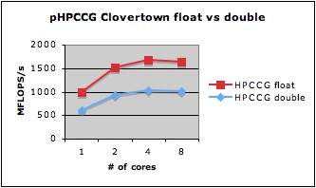
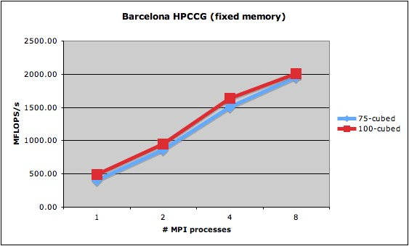
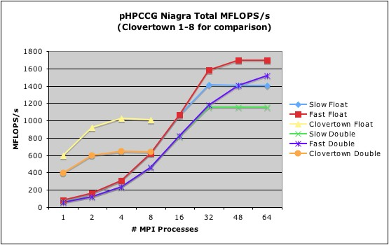
A Few HPCCG Multicore Results
Float useful:
  Mixed precision algorithms.
Memory system performance even more important:
  Saturation means loss of core use.
Memory placement a concern:
  Shared memory allows remote placement.
NiagaraT2 threads hide latency:
  Easiest node to program.
Notes:
The dashed red line is the Barcelona performance for a large subdomain, prior to memory placement fix. The problem was that memory for a core on socket 0 was placed on socket 1 because I/O buffers were competing. This is an example of the problems we have with current runtime environments.
- Niagara results show that simple oversubscribing of cores with multiple threads (there are 8 HW threads per core) can allow us to continue getting excellent speed ups. This is a easy way to hide latency for unstructured computations.

Slide 25
Library Preparations for New Node Architectures (Decision Made Years Ago)
We knew node architectures would change…
Abstract Parallel Machine Interface: Comm Class.
Abstract Linear Algebra Objects:
  Operator class: Action of operator only, no knowledge of how.
  RowMatrix class: Serve up a row of coefficients on demand.
  Pure abstract layer: No unnecessary constraints at all.
Model Evaluator:
  Highly flexible API for linear/non-linear solver services.
Templated scalar and integer types:
  Compile-time resolution float, double, quad,… int, long long,…
  Mixed precision algorithms.

Slide 26
Library Effort in Response to
Node Architecture Trends
Block Krylov Methods (Belos & Anasazi):
  Natural for UQ, QMU, Sensitivity Analysis…
  Superior Node and Network complexity.
Specialized sparse matrix data structures:
  Sparse diagonal, sparse-dense, composite, leverage OSKI.
Templated Kernel Libraries (Tpetra & Tifpack):
  Choice of float vs double made when object created.
  High-performance multiprecision algorithms.
Shared memory node-only algorithms:
  Triangular solves, multi-level preconditioner smoothers.
Kokkos Node class
  Intel TBB support, compatible with OpenMP, Pthreads, …
  Clients of Kokkos::TbbNode can access static, ready-to-work thread pool.
  Code above the basic kernel level is unaware of threads.
MPI-only+MPI/PNAS
  Application runs MPI-only (8 flat MPI processes on dual quad-core)
  Solver runs:
    MPI-only when interfacing with app using partitioned nodal address space (PNAS).
    2 MPI processes, 4 threads each when solving problem.

Slide 27
C++ Templates
Standard method prototype for apply matrix-vector multiply:
template<typename OT, typename ST>
CisMatrix::apply(Vector<OT, ST> const& x, Vector<OT, ST>& y)
Mixed precision method prototype (DP vectors, SP matrix):
template<typename OT, typename ST>
CisMatrix::apply(Vector<OT, ScalarTraits<ST>::dp()> const& x,
Vector<OT, ScalarTraits<ST>::dp()> & y)
Sample usage:
Tpetra::Vector<int, double> x, y;
Tpetra::CisMatrix<int, float> A;
A.apply(x, y); // Single precision matrix applied to double precision vectors

Slide 28
C++ Templates
Compile time polymorphism.
True generic programming.
No runtime performance hit.
Huge compile-time performance hit:
  But this is OK: Good use of multicore :)
  Can be reduced for common data types.
Example was for float/double but works for:
  complex<float>/complex<double>.
  Arbitrary precision.

Slide 29
Fault Tolerant Algorithms
Extreme scale systems:
  Node failure likely, frequent.
  Checkpoint/restart not sufficient.
Fault Tolerant Algorithms:
  Embed detection features:
    Mathematical identities.
    Invariants.
  How can our algorithms recover? (Assuming fault recovery from node loss)
    Multilevel preconditioners?
    Iterative methods?
    Non-linear methods?
    Transient and up the stack…

Slide 30
Addressing Communication Overhead
Communication-avoiding algorithms:
  Reorganized Krylov solvers:
    Express vector ops to reduce number of collective ops.
    More operations, single synchronization.
Communication-computation overlap:
  Multiple communication ports.
  Overlap of communication and computation will actually help.

Slide 31
Algorithms at Scale
Multiscale preconditioners:
  Small coarse grid problem.
  Real problem: On a large dedicated machine.
  Solution:
    Minimize coarse grid solve time.
    Find something else to do while waiting?
Transient stability:
  Tyranny of CFL-like conditions.
  Multiphysics problems: Consider reformulations.

Slide 32
Summary
Advanced Capabilities:
  Demand tremendous computing capabilities.
  Require continued advances in fidelity of forward solves.
  Place new requirements on lower level (e.g., linear solver) capabilities.
Multimedia processors:
  seem to have right mix for next qualitative performance improvement.
  Very difficult to program.
Possible scenario for some apps/libs:
  Heterogeneous API superior on homogeneous nodes.
  Go directly from single-level MPI-only to MPI+heterogenous node?
A common, standard API for multicore: Most critical need.
Libraries: Already on path to address many issues presented here.

Slide 33
Extra Slides

Slide 34
Homogeneous Multicore Issues

Slide 35
Single Core Performance:
Still improving for some codes
Year | Processor | Clock (GHz) | Cores per socket | MFLOPS/sec
2003 | AMD Athlon | 1.9 | 1 | 178
2004 | AMD Opteron | 1.6 | 1 | 282
2005 | Intel Pentium M | 2.1 | 1 | 310
2006 | AMD Opteron | 2.2 | 2 | 359
2007 | Intel Woodcrest | 1.9 | 4 | 401
2007 | AMD Opteron | 2.1 | 4 | 476
2007 | Intel Core Duo | 2.3 | 2 | 508
HPCCG microapp.
Clock speeds stable:
~ 2GHz.
FP-friendly computations stalled.
Memory-intensive computations still improving.

Slide 36
MPI-Only
(Intel Clovertown)
The incumbent: Always present.
Sometimes sufficient.

Slide 37
Programming Model Translation
(courtesy H.C. Edwards)
Been here before:
  12-15 years ago: SMP nodes.
  MPI vs. MPI/OpenMP/Pthreads.
Lesson learned:
  Nothing magic about programming model.
  For SMP model to matter: Algorithms must exploit shared memory.

Slide 38
Epetra Benchmark Tests
Focused on core Epetra kernels:
  Sparse MV, MM.
  Dot products, norms, daxpy’s.
spMM:
  Better performance.
  Better core utilization.

Slide 39
Epetra Kernels on Niagara2
 | Speedup 60 vs 1
SpMV | 36.0
SpMM2 | 31.0
SpMM4 | 22.3
Norm2 | 28.7
Dot | 14.9
Update | 26.1

Slide 40
Tramonto Clovertown Results
Super-linear speedup
(Setup phase)
Sub-linear speedup
(Solve phase)
Setup (The application code itself): Excellent MPI-only.
Solve (libraries): Much poorer. Inherent in algorithms.

Slide 41
Tramonto Niagara2 Results
Super-linear/linear speedup
(Setup phase)
Linear/sublinear speedup
(Solve phase)

Slide 42
Observations (So Far) for MPI Applications
MPI-only is a legitimate approach and the default.
Multicore will change how we program the node, eventually.
  Opinions on time frame vary greatly.
  Uncomfortable defending MPI but: Bold predictions of MPI-only demise so far have proved false.
Simple programming model translation is ineffective.
Runtime environment is fragile: process/memory placement.
Memory-system-intensive code problematic: Ineffective core use.
Multithreading helps us: performance and simpler code.
Data placement: Huge performance impact, abstraction a challenge.

Slide 43
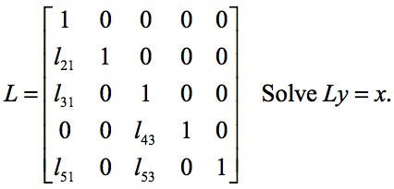
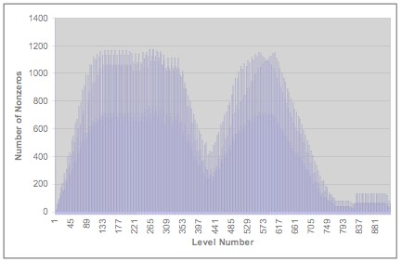
Shared Memory Algorithms

