Slide 1

SAND2008-7504P
Embedded Nonlinear Analysis Tools Capability Area
We are: top level algorithms (outermost loops)
  solution of nonlinear equations
  time integration
  bifurcation tracking / stability analysis
  parameter continuation
  optimization (PDE-constrained)
  uncertainty quantification
Governing Philosophy: “Analysis beyond Simulation,”
Goal: to automate many computational analysis and design tasks using good algorithms and good math, replacing trial-and-error or repeated simulation.
  parameter studies
  sensitivity analysis
  calibration
  optimization
  error control in transient integration
  locating instabilities
  performing UQ
Trilinos Strategic Goals that we align with:
  Full Vertical Coverage
  Hardened Solvers
  Scalability

Slide 2
Trilinos Packages in the Embedded Nonlinear Analysis Capability Area
Package Name Quick Description Point of Contact
  NOX Nonlinear Solver with Globalized Newton’s methods Roger Pawlowski
  LOCA Parameter Continuation, Bifurcation Tracking, 4D Eric Phipps
  Rythmos Time integration algorithms Todd Coffey
  Moocho Embedded (PDE-constrained) Optimization, rSQP Roscoe Bartlett
  Aristos Full-space embedded optimization (not yet released) Dennis Ridzal
  Sacado Automatic Differentiation using Expression Templates Eric Phipps
  Stokhos Stochastic-Galerkin Uncertainty Quantification Tools Eric Phipps
  TriKota Interface to Dakota for a Trilinos app (not yet released) Andy Salinger
Related Efforts Outside of Trilinos
Dakota Dakota is a mature and widely-used software toolkit at Sandia that delivers many related analysis capabilities using non-intrusive...
DemoApps ...a code project building a prototype PDE code primarily from Trilinos packages...
We are consolidating on a single expandable interface: the ModelEvaluator
    Application code must be stateless to let Analysis code do the driving!

Slide 3
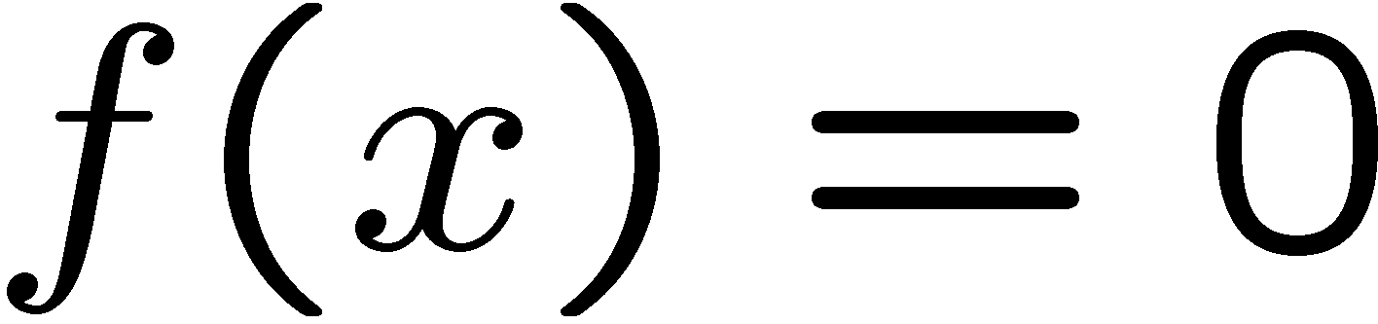

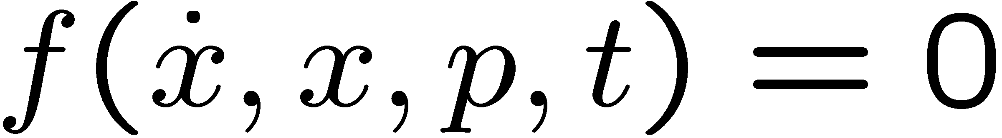
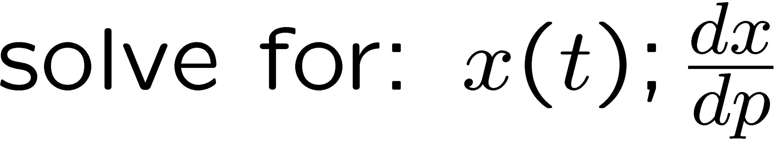
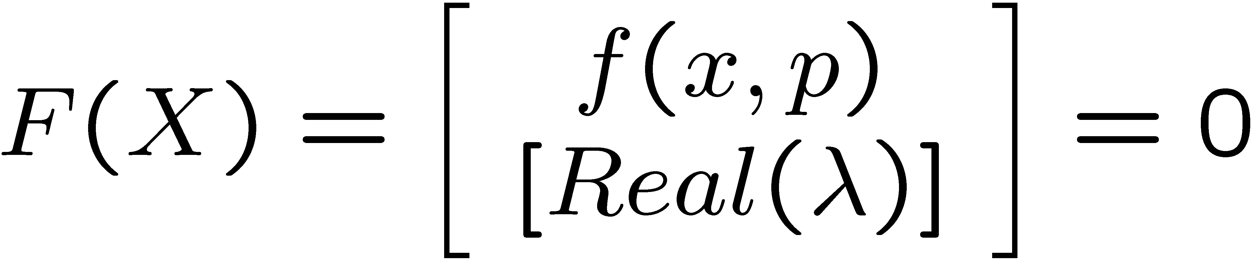
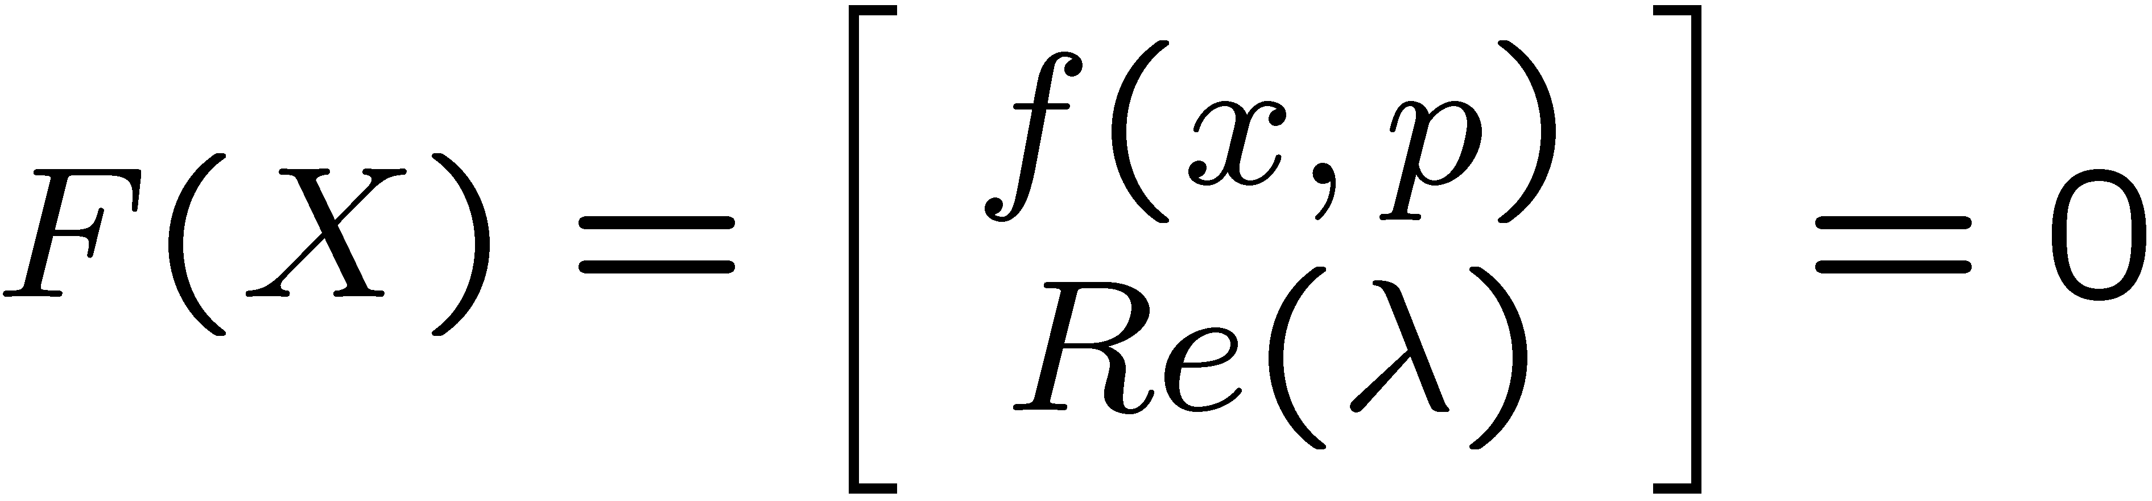
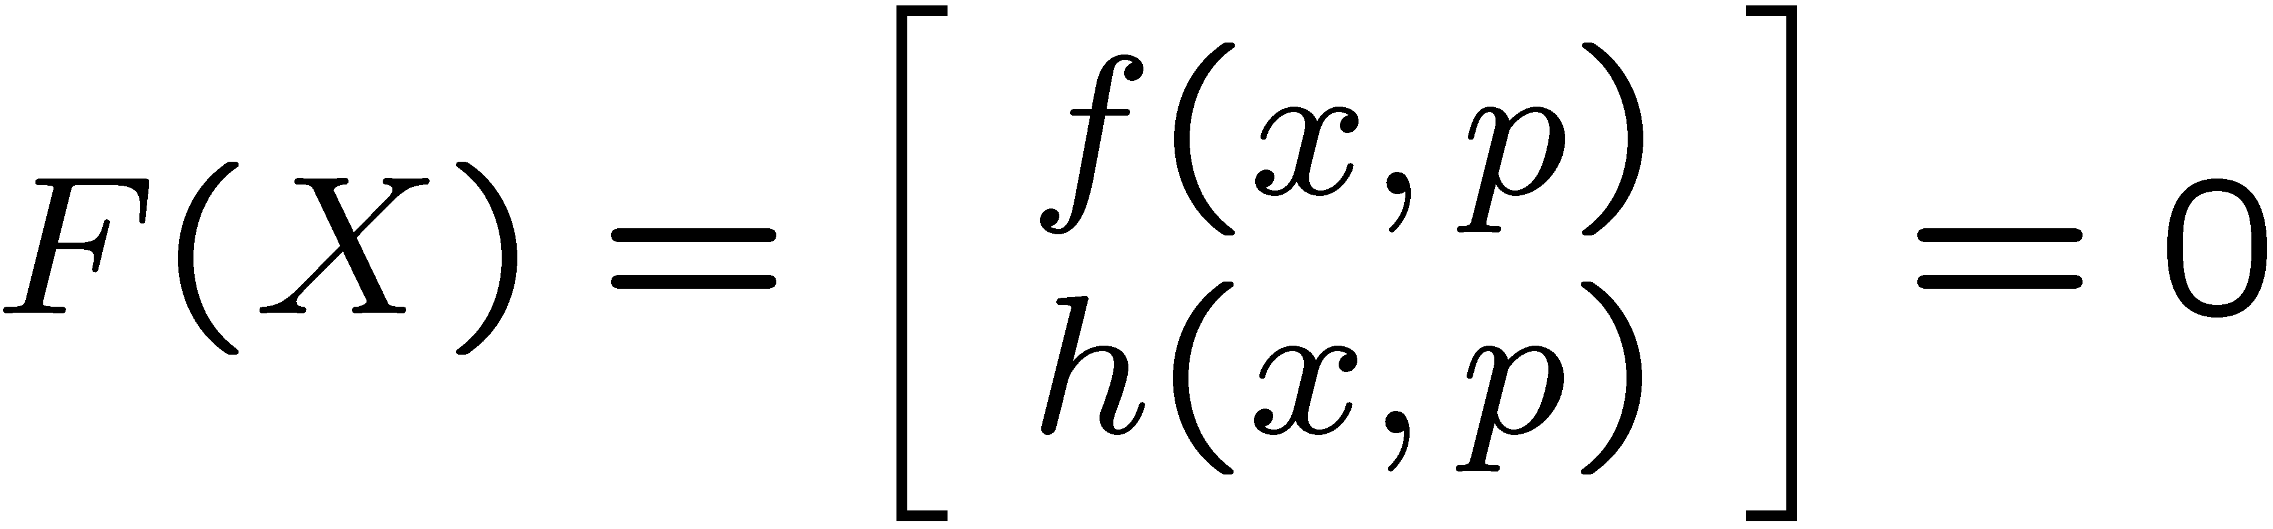
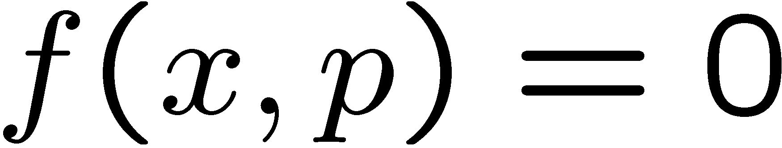
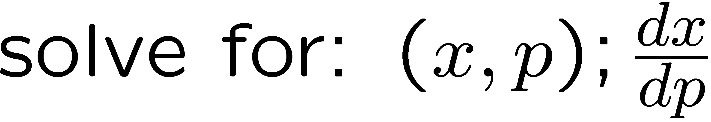
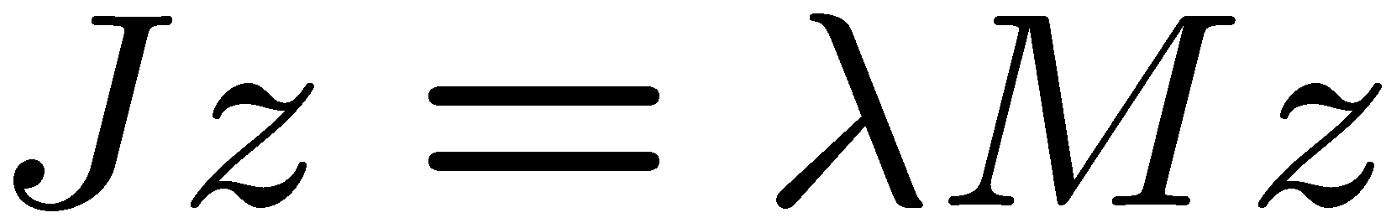

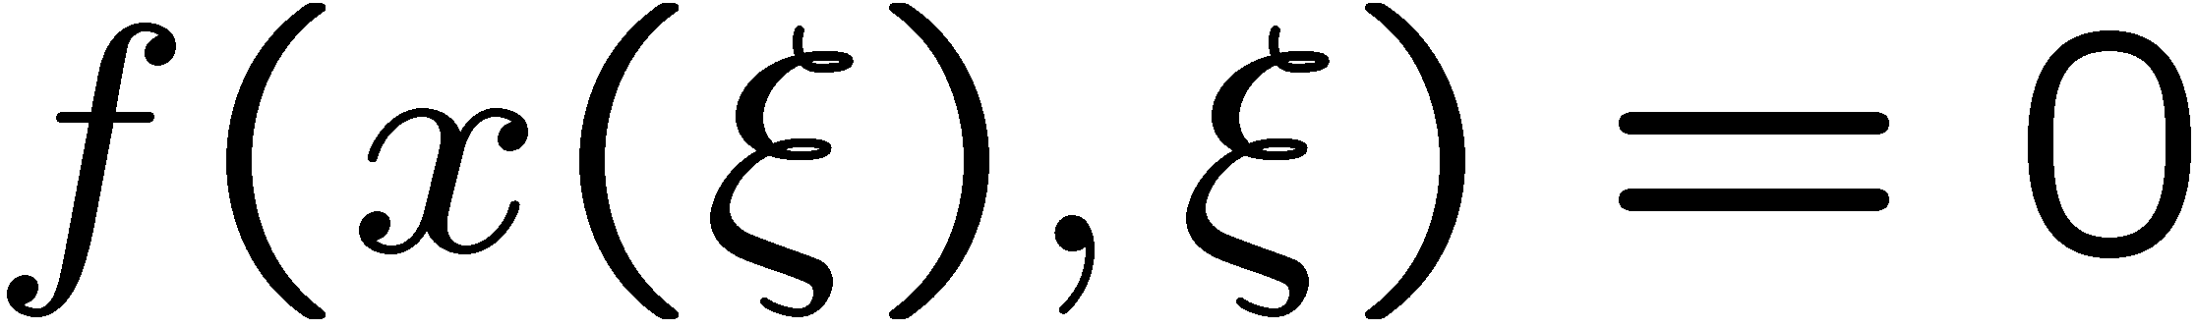

Brief Mathematical Description of
Embedded Nonlinear Analysis Capabilities:
Nonlinear Solver (NOX):
Time Integration (Rythmos):
Bifurcation Tracking / Constraint Enforcement (LOCA):
Parameter Continuation (LOCA):
Stability Analysis (LOCA→Anasazi):
PDE-Constrained Optimization (Moocho/Aristos):
Embedded UQ (Stokhos):

Slide 4


Pop Quiz: What is the favorite Trilinos package among the developers in the Embedded Nonlinear Analysis Capability Area*?
1. Sacado (Automatic Differentiation → Analytic Derivatives)
2. Epetra (Distributed memory vector and matrix formats)
3. Teuchos::RCP (Reference Counted Pointers for memory management)
*Based on a statistical sample of 14% of the developers.

Slide 5
Active Areas of Research and Development
  Expand Rythmos Capabilities (today 2:45pm)
    Error estimation and control
    Adjoint integration with checkpointing
  Embedded UQ capability (today 3:45pm)
    hybrid sampling / embedded
    linear solves of stochastic systems
  System Modeling Capability
    System-level Interfaces
    Network builders
    System Solvers (Born with AD/UQ)
  Single ENAT_Solver factory for NOX, LOCA, Rythmos, Moocho
  Improved Software Quality, e.g. exception handing
  Demonstrations of Transformational Embedded Nonlinear Analysis Capabilities (today: 4:10pm)
Roscoe Bartlett, Todd Coffey, Roger Pawlowski, Eric Phipps, Andy Salinger, Dennis Ridzal, Bart van Bloemen Waanders

