Slide 1
SAND2008-7503P
Agile Components for the Rapid Development of Production Applications
Andy Salinger, CSRI,
Sandia National Laboratories
Strategic Goals:
To align the many efforts at Sandia involved in developing software for the modeling and simulation of physical systems (mostly PDEs):
  To enable the Rapid development of new Production codes
  To embed the codes with Transformational design, analysis, and decision-support capabilities
  To benefit from Synergy & reduce Redundancy
Consensus Vision: Our goals will best be met by delivering:
  A full range of independent yet interoperable software components
    Capabilities
    Interfaces
  Software quality tools and procedures
  Prototype applications that demonstrate use cases, vertical integration, and verification, and provide pull

Slide 2
Analysis Tools
(black-box)
Agile Components
Composite Physics
Particle Code Tools
Optimization
MultiPhysics Coupling
Data Structures
Parameter Studies
Solution Control
Neighbor Search / Sort
UQ (non-invasive)
System Models
Utilities
V&V, Calibration
System UQ
PostProcessing
Input File Parser
OUU, Reliability
Visualization
Parameter List
Computational Steering
Mesh Tools
Embedded Verification
I/O Management
Mesh I/O
Feature Extraction
Memory Management
Analysis Tools
(embedded)
Inline Meshing
Data Reduction
Communicators
Partitioning
Model Reduction
Runtime Compiler
Nonlinear Solver
Load Balancing
MultiCore
Parallelization Tools
Time Integration
Adaptivity
Mesh Database
Continuation
Remeshing
Mesh Database
Sensitivity Analysis
Grid Transfers
Geometry Database
Stability Analysis
Mesh Quality
Solution Database
Software Quality
Constrained Solves
Version Control
Optimization
Local Fill
Regression Testing
UQ Solver
Build System
Discretizations
Discretization Library
Physics Fill
Backups
Linear Algebra
Element Level Fill
Mailing Lists
Data Structures
Field Manager
Material Models
Unit Testing
Iterative Solvers
Derivative Tools
Bug Tracking
Direct Solvers
Objective Function
UQ / PCE
Propagation
Constraints
Performance Testing
Eigen Solver
Code Coverage
Preconditioners
Sensitivities
Error Estimates
MMS Source Terms
Porting
Matrix Partitioning
Derivatives
Web Pages
Architecture-
Dependent Kernels
Adjoints
Release Process

Slide 3
Some Collected Interfaces
Analysis Tools
(black-box)
Composite Physics
Utilities
PostProcessing
TriKota
ResponseOnly M.E.
ITAPS Interfaces
XML
Mesh Tools
Analysis Tools
(embedded)
Mesh I/O
Interface
Input File
Mesh File
Mesh Database
Stratimikos
ModelEvaluator
Phalanx “Fill” Manager
Discretizations
Linear Algebra
Physics Fill
Software Quality
cmake
SVN
mailman
Derivative Tools
FEI
Epetra
template
<Scalar>

Slide 4
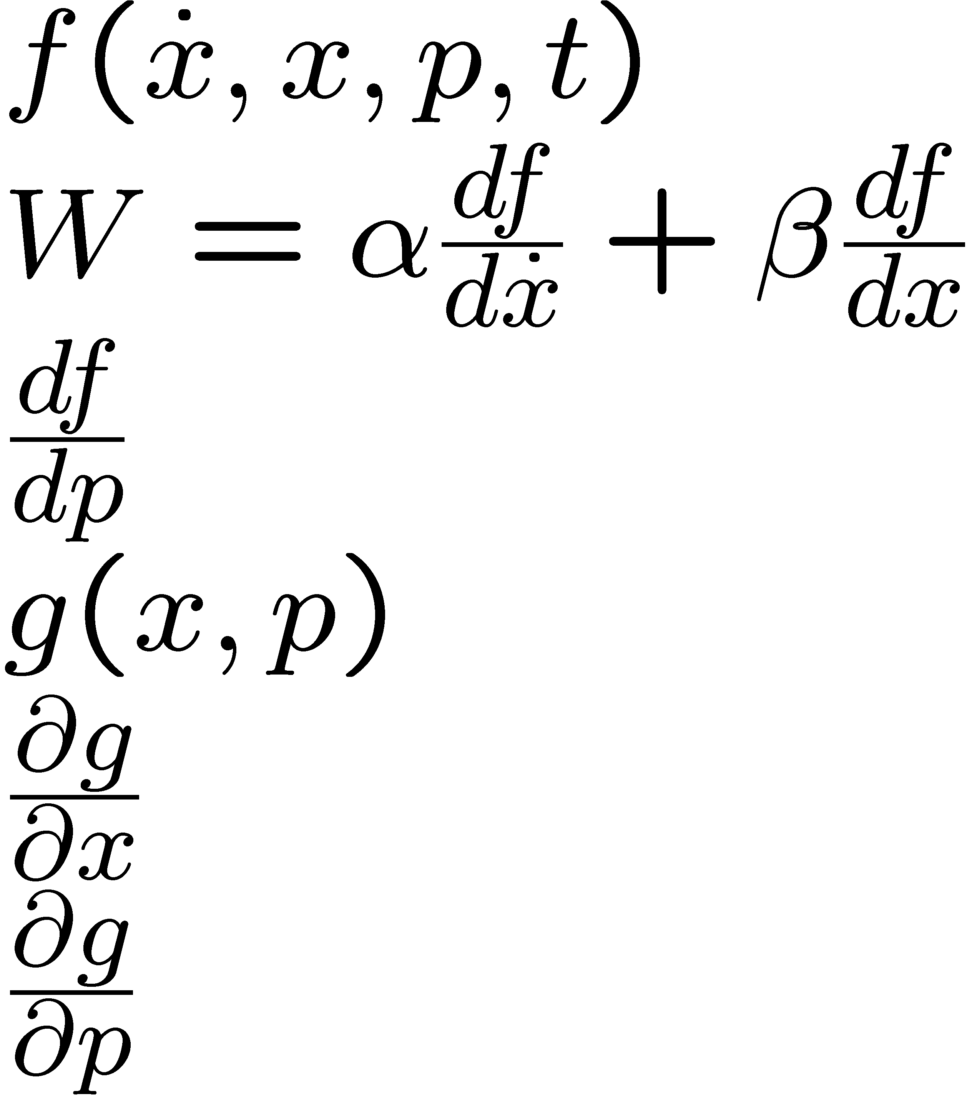
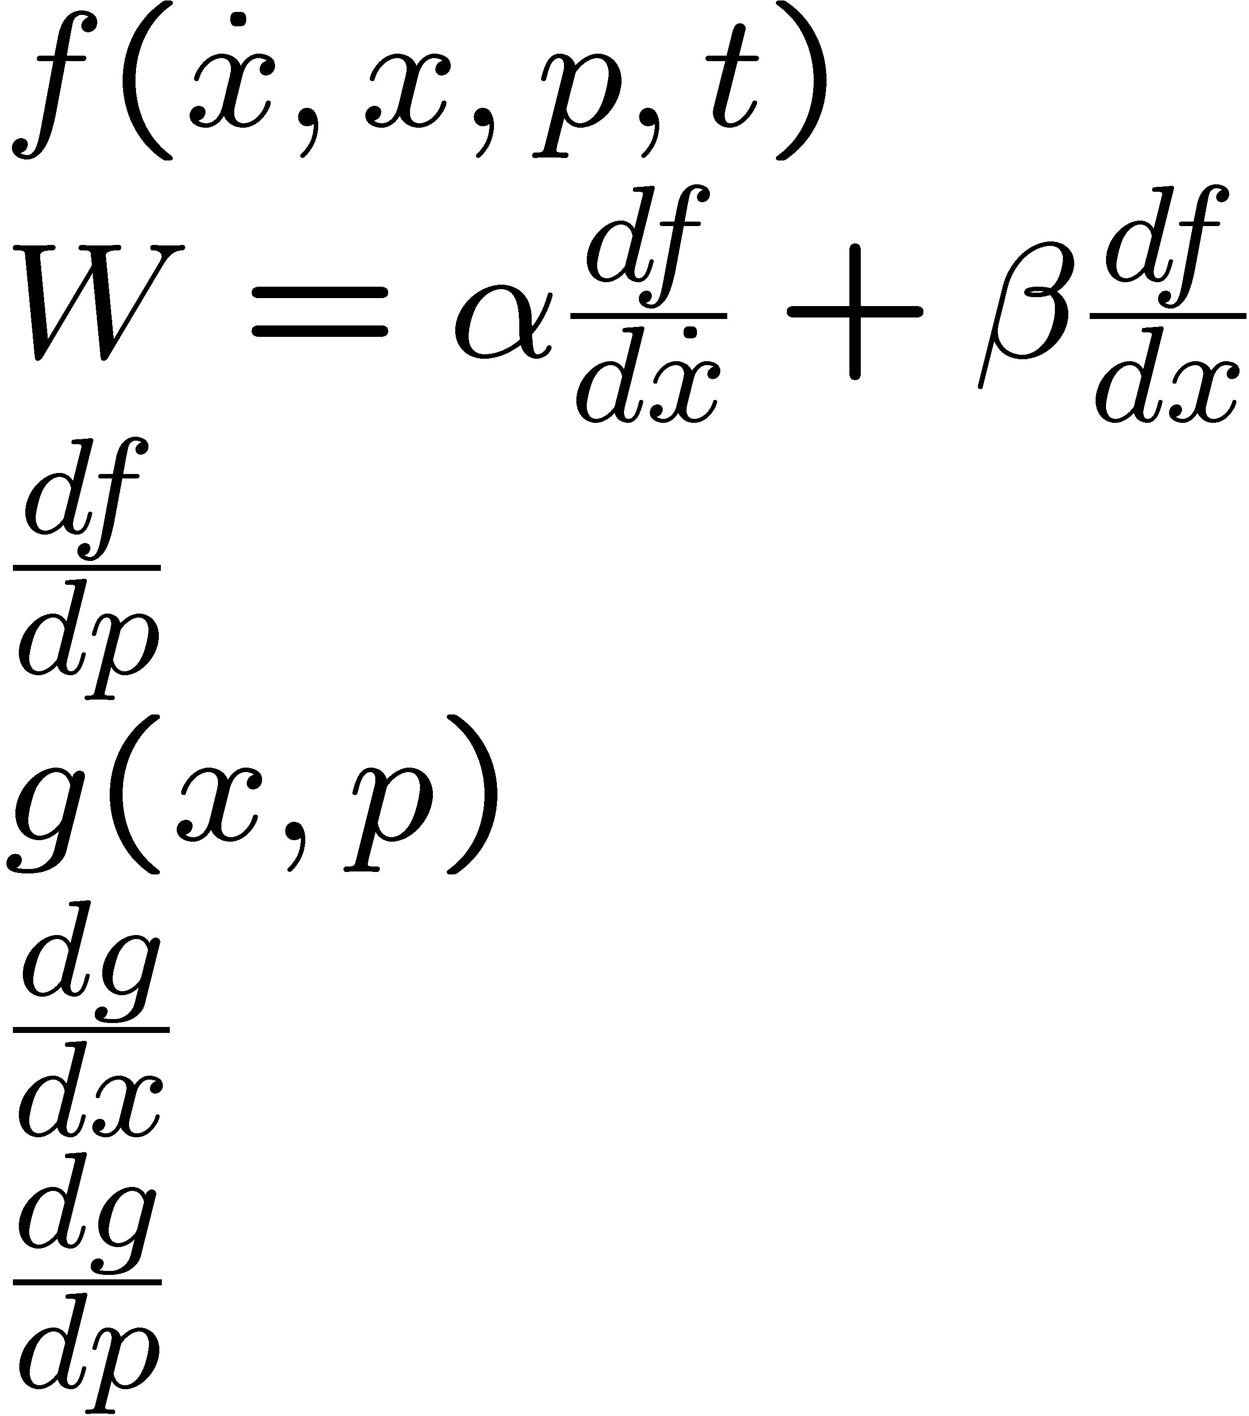

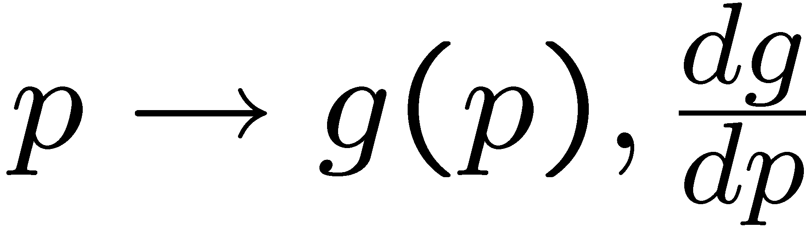
Response Only Model Evaluator: an “Application” or “Problem” Abstraction
A Model Evaluator registers what Input and Output it can handle.
I can make use of: I can compute:
Response Only Model Evaluator:

Slide 5
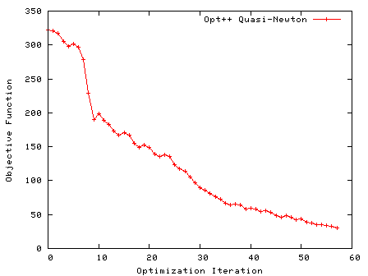
“TriKota” is an adapter between Dakota’s “DirectApplicInterface”
and Trilinos’ “ResponseOnlyModelEvaluator”
Analysis Tools
(black-box)
= Dakota
DirectApplicInterface
TriKota
ResponseOnly M.E.
Main_Dakota.cpp
Analysis Tools
(embedded)
TriKota::Driver dakota;
RCP<EpetraExt::ModelEvaluator>
App = rcp(new MyResponseOnlyME(dakota.getAnalysisComm()) );
RCP<TriKota::DirectApplicInterface>
trikota_interface = rcp(new TriKota::DirectApplicInterface
(dakota.getProblemDescDB(), App), false);
dakota.run(trikota_interface);
TriKota contains sophisticated coding such as...
for (int i=0; i<numVars; i++) (*modelEval_p)[i]=xC[i];
Joint work with Bartlett, Adams, Eldred, Gay

Slide 6
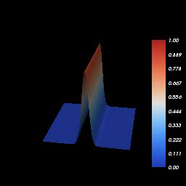
VTK visualization software hooked up to
generic ITAPS Mesh Database Interface
Post Processing
Visualization
Joint work with Nathan Fabian (1426)
with help from Vitus Leung & Karen Devine
vtkITAPS
ITAPS Interfaces
Mesh Database
A frame is dumped every time step from a RythmosObserver object.

Slide 7
DemoApp Timeline
Uncertainty Inversion
OUU
Adaptivity
Improved Environment
Shape Optimization
ROM
In-core Geometry
Hybrid-Discretization
3/08: Started with Working 1D FEM Code (Sacado::FEApp) [Phipps] and a
Trilinos-like Application Environment (Tramonto) [Willenbring, Phenow, Heroux]
System Solver
Encore
Performance Testing
Mesquite
MultiPoint Opt
4D
MultiPhysics
Code Coverage
Multi-Physics App
Dakota UQ
MultiCore
Error Estimates
Unit Tests
PLANNED
2nd Mesh Database
GUI Input File Editor
Adjoint in Time
LOCA
DG, FV
Zoltan
3D PDEs
Order Verification
Transient Sensitivities
2D Elastics
Mesh I/O
FEI/DOF
MMS Tests
Moocho
Stokhos UQ
DONE
Inline Meshing
Solution Verification
2D Acoustics
in situ Visualization
MeshField Interface
Nightly IntegrationTesting
Dakota OPT
Rythmos
1D Acoustics
Intrepid
Mesh DataB.
Sensitivity Analysis
SVN
Input File Parser
2D Heat Eq
Phalanx Field Manager
STARTED WITH
ModelEvaluator
NOX
trivial 2D Mesh/Element
Test Harness
1D Transient
Sacado AD
Linear Solvers
1D Mesh/Element
Build System
1D Heat Eq
Solvers/Analysis
Mesh/Element
Software/
Verification
Physics
Notes:
The DemoApps effort strives to build an application out of interoperable packages/components. The code is designed to facilitate and model the use of our most sophisticated embedded analysis algorithms. The code also hopes to assemble a full-featured production software/verification environment that can be cut-and-pasted for a new application.
The vision is for the code to be used as a testbed for new capabilities and for prototyping interfaces. Two recent highlights along these lines are “TriKota” interface for library-mode-Dakota, and the in situ Visualization capabilty, where “jpeg” files are rendered in parallel in core. As in the TriKota example, the philosophy is to migrate reusable code back to Trilinos.
Not only do we expect components and interfaces that were matured in DemoApps to be used in Sierra and Ramses codes, but we hope that these ASC code bases will contribute components. The indications are good that this is happening with the mesh database component of SierraToolkit effort.
The blue test boxes in the picture were completed this year. The purple boxes are all within striking distance in the next year, but only a subset will be accomplished. The boxes with the red outline have a conection to this CSRF pot of money. The XOM CRADA is helping drive work in optimization, explicit integrators, wave physics, and discretizations.
* I could REALLY use some manpower help in the Mesh/Element area.
* I would love to have someone take on the vision software environment piece (build system, testing dashboard, ...).

