Slide 1





Building Trilinos Using CMake
Trilinos User Group Meeting
Thursday, November 8th, 2007
Timothy M. Shead (1424)
Danny Dunlavy (1415)
SAND 2007-7297 P
Sandia is a multiprogram laboratory operated by Sandia Corporation, a Lockheed Martin Company,
for the United States Department of Energy’s National Nuclear Security Administration
under contract DE-AC04-94AL85000. This document is SAND Number: 2007-7297 P

Slide 2
What is this thing you call CMake?
Open-source cross-platform build / test / distribution system.
  Win32
  Mac OSX
  Unix / Linux
Used Extensively Within Sandia
  VTK/Titan
  ParaView
  ThreatView

Slide 3
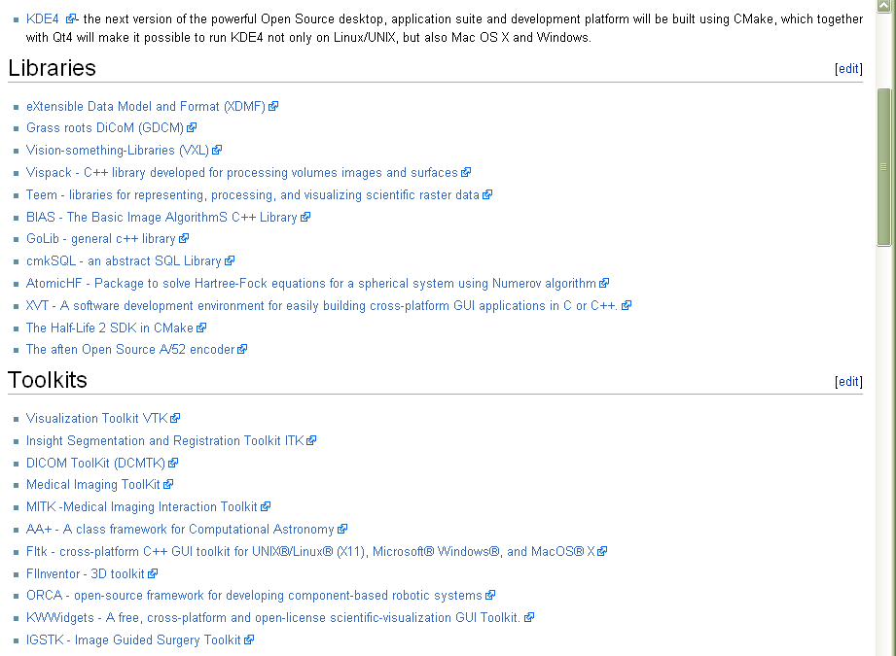
CMake Outside Sandia
Source: http://www.cmake.org/Wiki/CMake_Projects

Slide 4
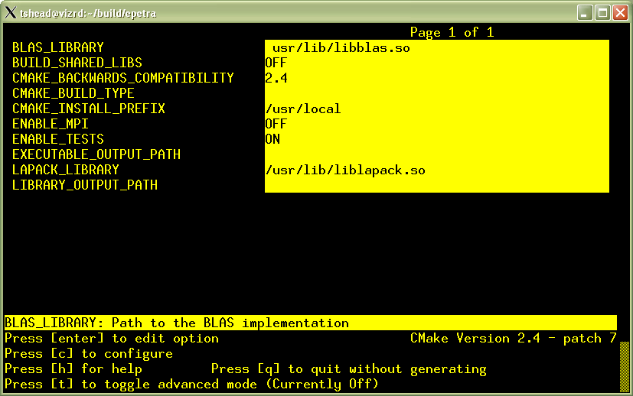
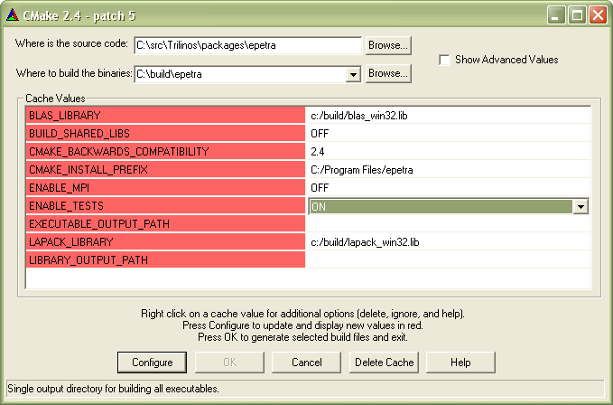
Multiple Front-Ends
Command-line
Curses
Graphical (Win32)

Slide 5
Multiple Back-Ends
Borland Makefiles
KDevelop 3
MinGW Makefiles
MSYS Makefiles
NMake Makefiles
Unix Makefiles
Visual Studio 6
Visual Studio 7
Visual Studio 7 .NET 2003
Visual Studio 8 2005
Visual Studio 8 2005 Win64
Watcom WMake
XCode

Slide 6
Regression Testing with CTest
Tests integrated with the build system
Tests can be enabled/disabled based on configuration
Tests can be submitted to a Dashboard Server
  Nightly Builds
  Continuous Builds
  Experimental Builds
Ex: VTK Dashboard
Ex: Epetra Dashboard

Slide 7
Installation
Install target
Compatible with downstream distribution
  Builtin prefix support
  Builtin DESTDIR support

Slide 8
Binary Packaging with CPack
Self-extracting Tar/gzip packages (Unix)
Tar/gzip packages (Unix)
Tar/bzip2 packages (Unix)
ZIP compressed packages (Unix / Win32)
NSIS graphical installers (Win32)
PackageMaker installers (Mac OSX)
X11 Bundles (Mac OSX)
Debian Packages (CMake 2.6.0)
RPM Packages (CMake 2.6.0)

Slide 9
Downloads
Binary
  Win32
  MacOS Universal
  Linux i386
  SunOS Sparc
  IRIX64 64
  IRIX64 n32
  HPUX 9000/785
  AIX PowerPC
Source
  Minimum dependencies: C++ compiler
  Optional dependencies: Curses, Qt (CMake 2.6)

Slide 10
Fabulous Demo Here!

