Slide 1
Leveraging Trilinos for
Data Mining & Data Analysis
Danny Dunlavy (1415)
Tim Shead (1424)
Pat Crossno (1424)
SAND 2007-7233C

Slide 2
Outline
Motivation
Current requirements
Titan / ThreatViewTM
LSALIB
Epetra / Anasazi / RBGen
Future Requirements
Conclusions

Slide 3


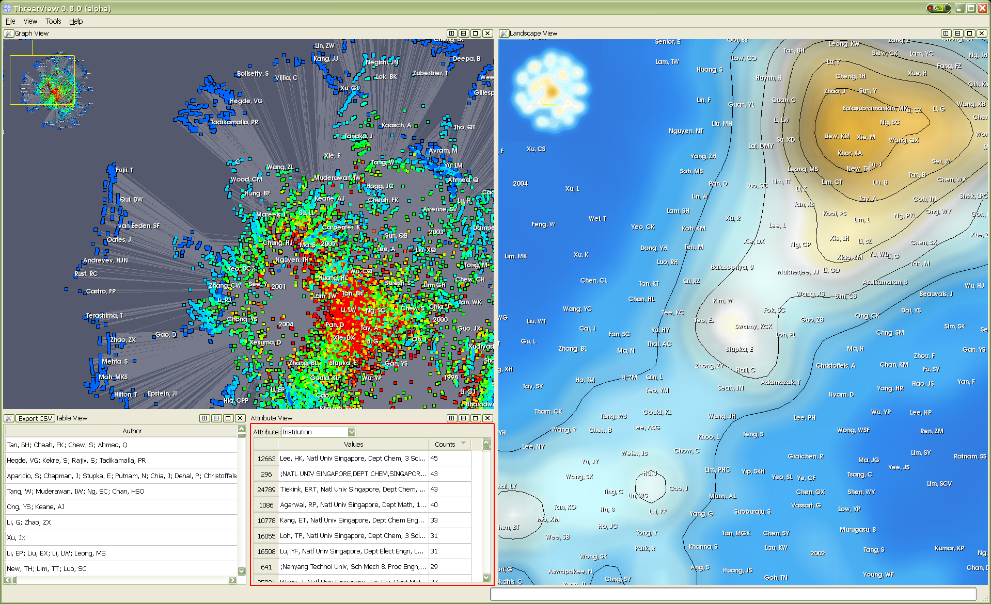
Motivation
Database
Unstructured text
Data analyst
Few and
overworked
Terabytes
Processing and analysis
Visualization
Scalable: New & Ongoing
Scalable: Titan

Slide 4
LDRD Project
Scalable Solutions for Processing and Searching Very Large Document Collections
  Address big data problem for text analysis/visualization
  Develop parallel informatics visualization capability
Leverage Existing Sandia Expertise
  Visualization: ThreatViewTM, VTK, ParaView
  Text: LSALIB, QCS
  HPC: Parallel VTK, Trilinos
Challenges
  Single serial component creates bottleneck
  Understanding of scalability for text applications is key
  Data intensive
  Both local and global understanding of data relationships important

Slide 5
Current Requirements
Cross-platform builds
  Windows, MacOS, Unix
  Serial/parallel architectures
  CMake configuration
Distributed data structures/algorithms
  Sparse data: no physics, no geometry
  Parallel matrix decompositions (SVD to start)
  Work with existing parallel execution pipeline
Access to third party development

Slide 6
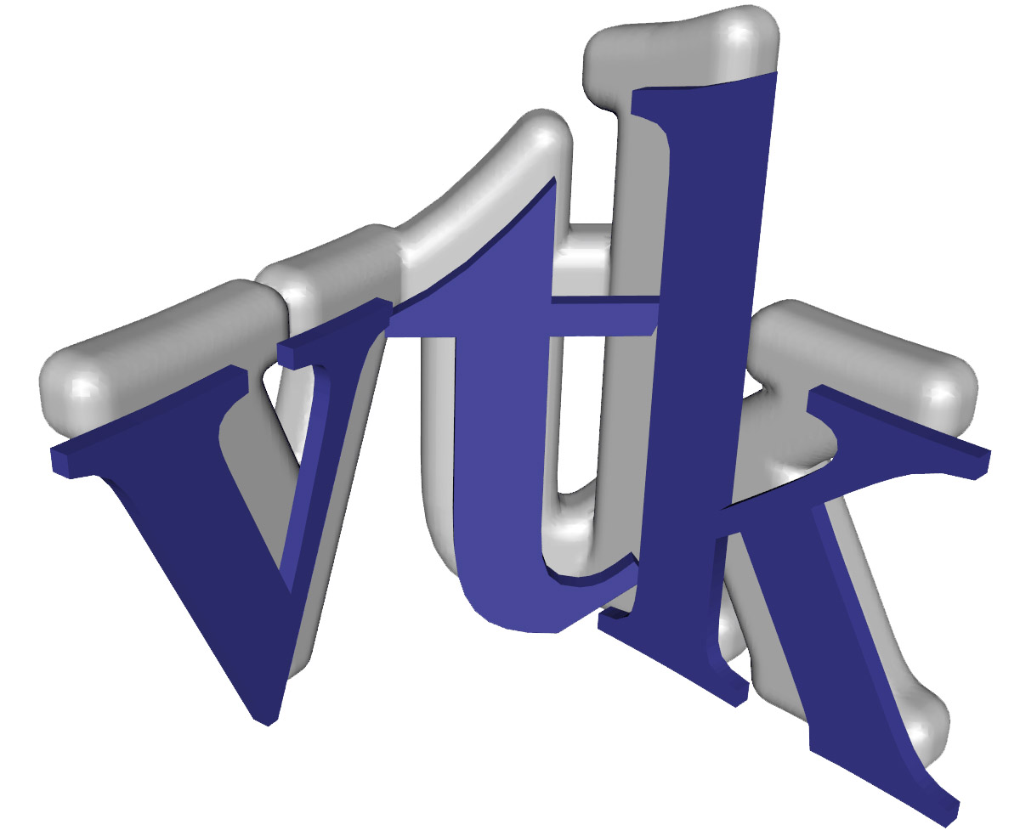

Titan
B. Wylie (PI), 1424
Goal is to extend scientific and distributed visualization capabilities to include informatics visualization
C++ Code Base
Example Components
  Data Structures: table, graph, tree
  Boost Graph Library adapters
  Database hooks: MySQL, Postgres, SQLite, ODBC, Oracle
  Parallel components/algorithms
    Graph data structures, database queries, graph algorithms (MTGL),
    landscape generation, selection and picking
Scientific Visualization
Distributed Visualization

Slide 7
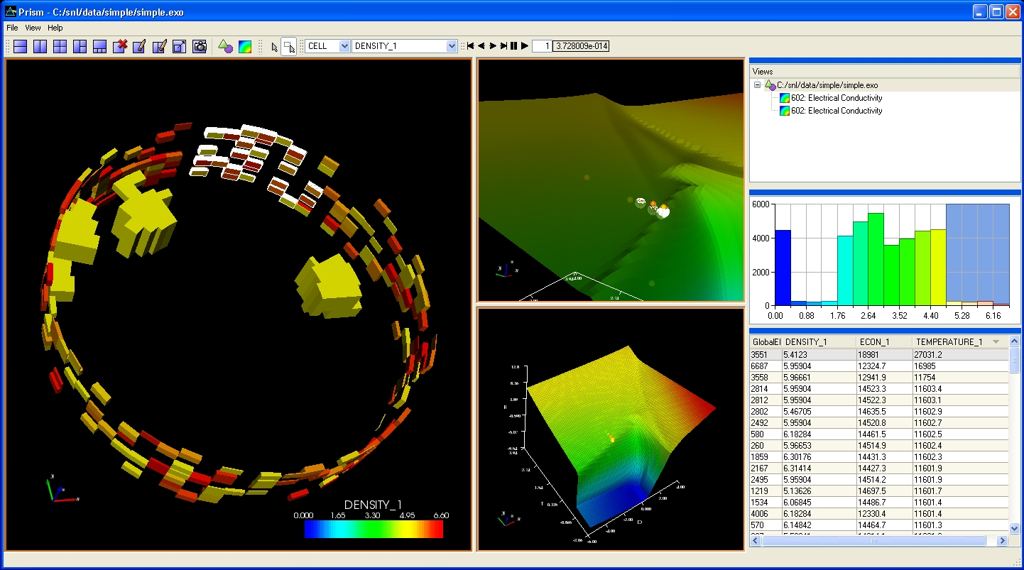
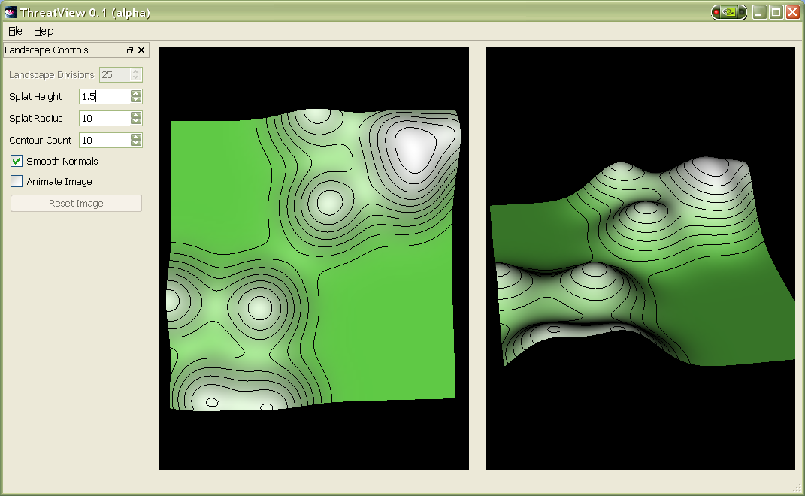
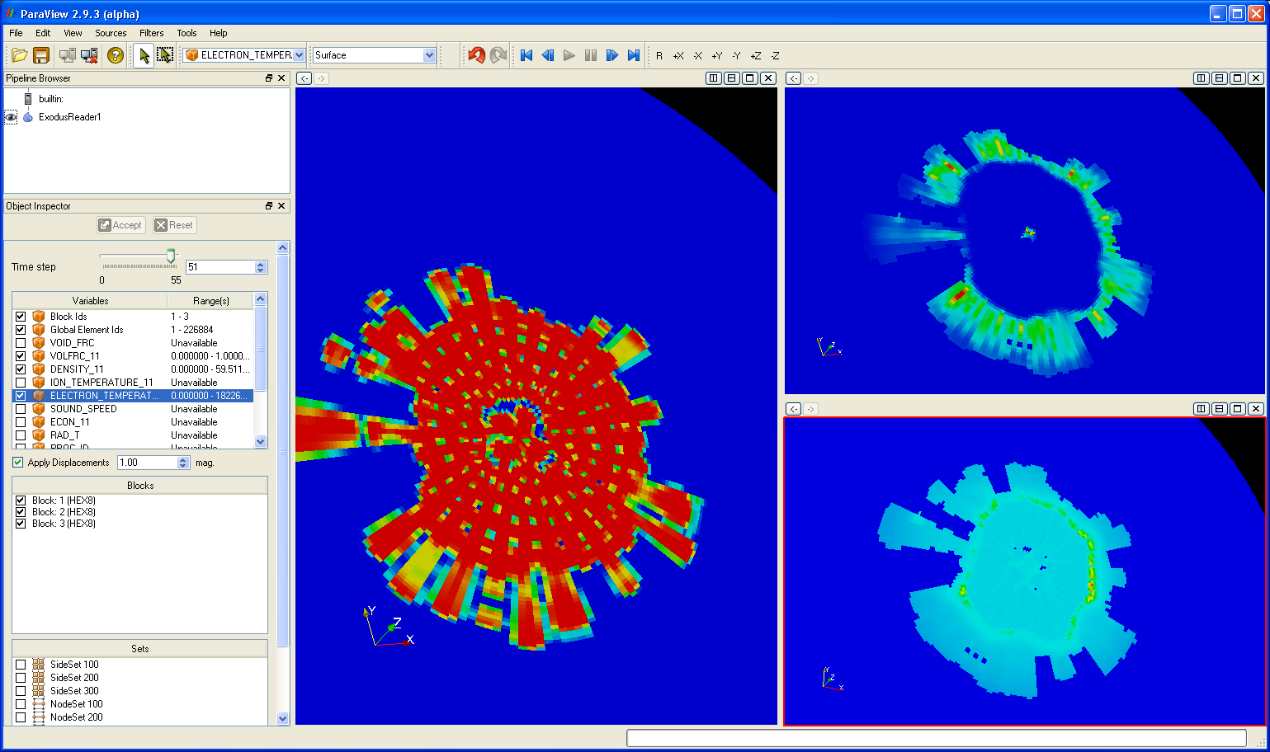
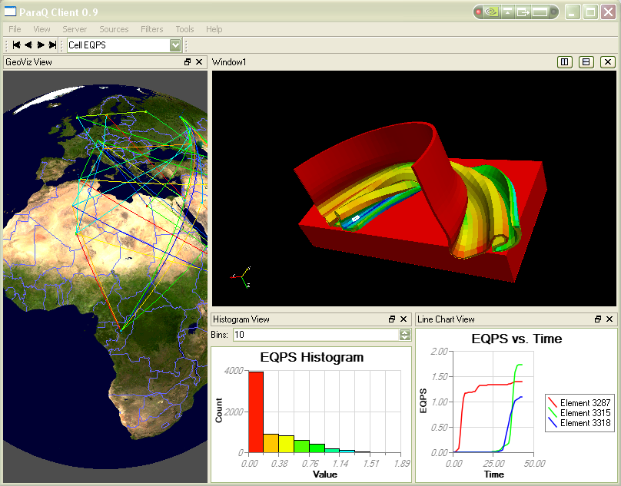
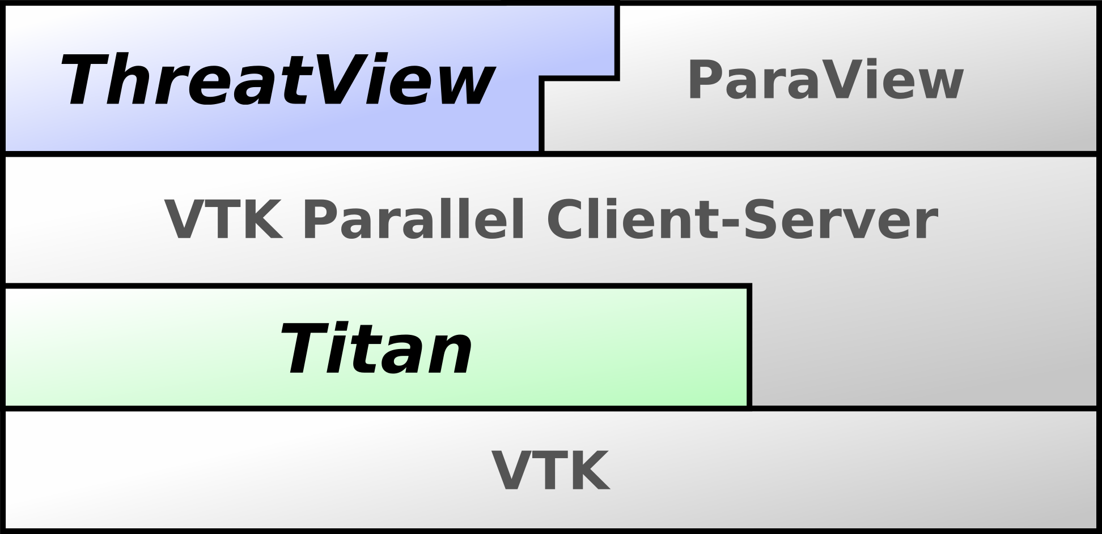
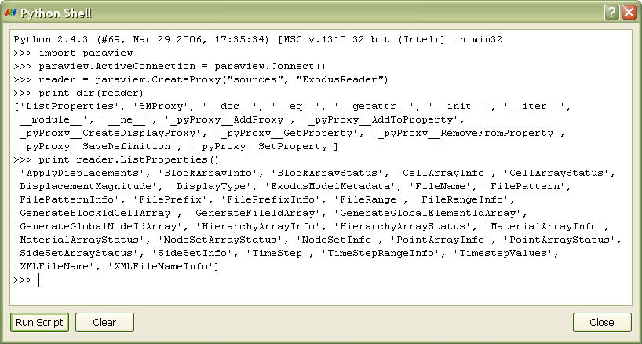
Titan
Prism 3.0
ThreatView 0.1
ParaView 3.0
GeoTest 0.1
Python Script

Slide 8

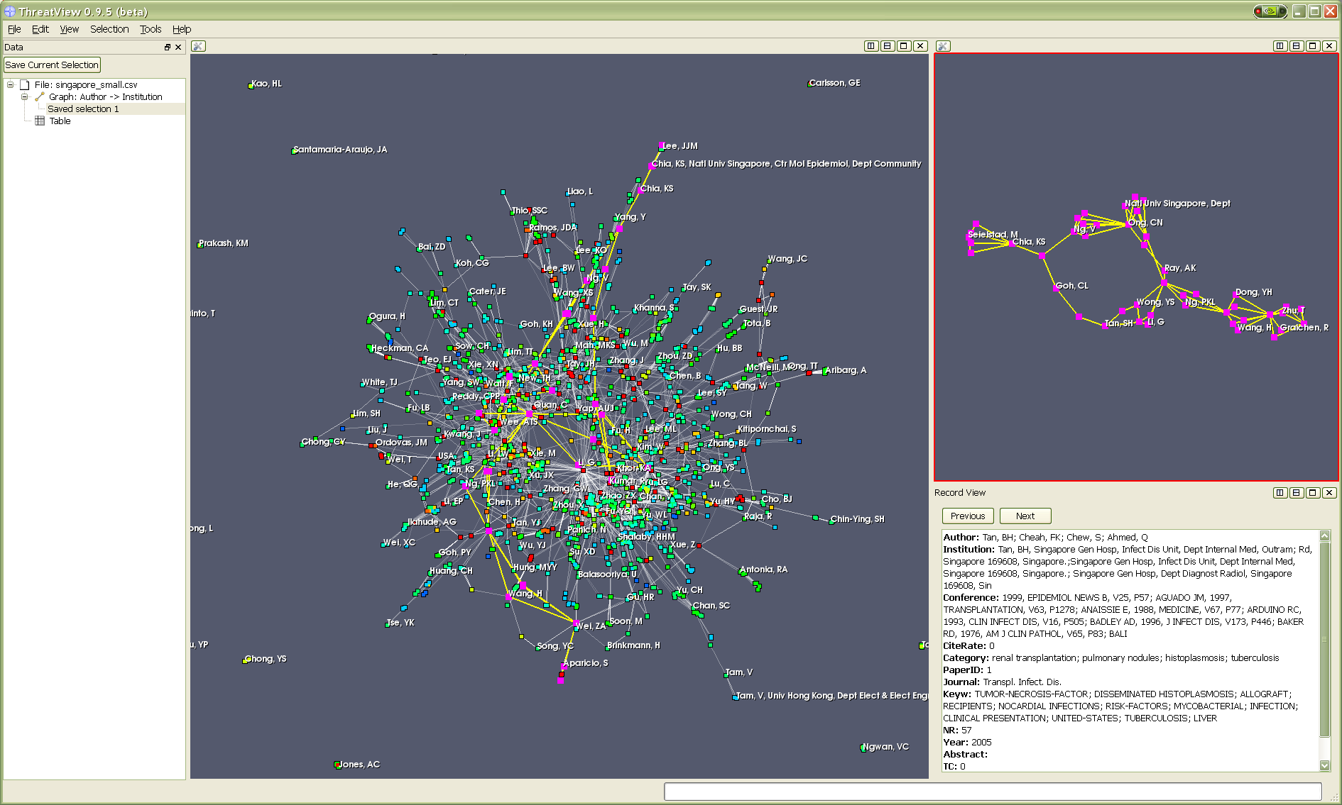
ThreatViewTM
T. Shead, B. Wylie,
E. Stanton
Data Sources
  Delimited text files
    CSV, XML, ISI, RIS
  SQL Databases
    MySQL, PostgreSQL, SQLite, Oracle
  Object-oriented databases
    AHOTE
Data Views
  Traditional "ball-and-stick" graph view
  Clustered landscape view
  Table view
  Record view
  Attribute view
  Statistics view
Interface
  Wizards for data ingestion
  Drag-and-drop direct data manipulation
  Coordinated selection among views

Slide 9
Capabilities
ThreatViewTM =
Parallel data visualization

Slide 10
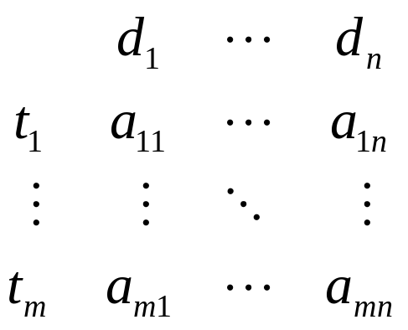
LSALIB
D. Dunlavy, T. Kolda
Latent Semantic Analysis (LSA) [Dumais et al., 1988]
  Theory and method for extracting and representing contextual usage of words by statistical computations applied to a large corpus of text
Vector Space Model of Data
  Terms: {t₁, …, t_{m}} ∈ R^{m}
  Documents: {d₁, …, d_{n}} ∈ R^{n}
  Term × Document Matrix: A
  a_{ij} : measure of importance of
  term i in document j
Implementation
  Low rank approximation of term-document matrix via truncated singular value decomposition (SVD)
⇒

Slide 11
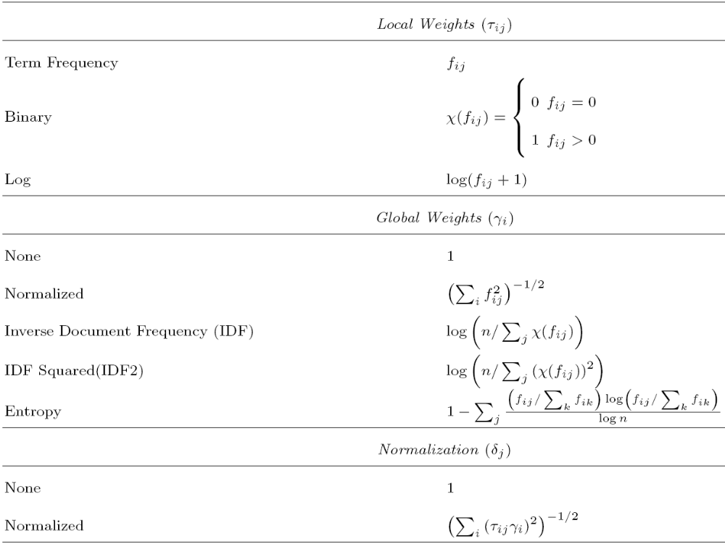
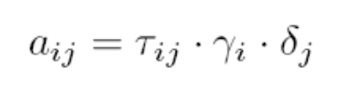
LSALIB: Matrix Weighting
individual
documents
(columns)
over all
documents
(rows)
individual
documents

Slide 12

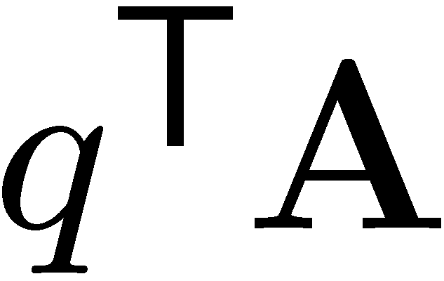
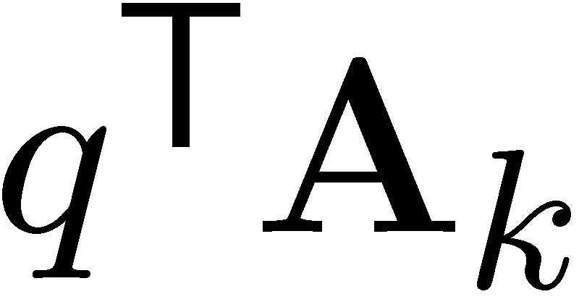


LSALIB: Matrix Operations
SVD:
Truncated:
Query scores (query as new “doc”):
LSA Ranking:
Document similarities:
Term Similarities:
(want sparse output)
(want sparse output)

Slide 13
LSALIB: Example
d₁ : Hurricane. A hurricane is a catastrophe.
d₂ : An example of a catastrophe is a hurricane.
d₃ : An earthquake is bad.
d₄ : Earthquake. An earthquake is a catastrophe.
d₁ : Hurricane. A hurricane is a catastrophe.
d₂ : An example of a catastrophe is a hurricane.
d₃ : An earthquake is bad.
d₄ : Earthquake. An earthquake is a catastrophe.
Remove
stopwords
normalization only
rank-2 approximation
A
A₂
q
A
d₁
d₂
d₃
d₄
d₁
d₂
d₃
d₄
d₁
d₂
d₃
d₄
hurricane
1
hurricane
2
1
0
0
hurricane
.78
.78
-.11
.11
hurricane
.89
.71
0
0
earthquake
0
earthquake
0
0
1
2
earthquake
-.03
.02
.96
.92
earthquake
0
0
1
.89
catastrophe
0
catastrophe
1
1
0
1
catastrophe
.59
.60
.15
.30
catastrophe
.45
.71
0
.45
q^{T}A
.89
.71
0
0
q^{T}A₂
.78
.78
–
.11
captures link to doc 4

Slide 14
LSALIB
Implements latent semantic analysis
  Conceptual searching
    rank(k) ↑ : more exact matches
    rank(k) ↓ : more conceptual matches
    Can compute larger rank and use smaller rank
Computations with thresholds
  Matrix creation
  SVD wrapper
  Similarities
    Minimum similarity score
    Minimum number of similarities

Slide 15
Capabilities
ThreatViewTM =
Parallel data visualization
ThreatViewTM + LSALIB =
Parallel (text) data visualization with
serial conceptual retrieval/similarities

Slide 16
Epetra
Distributed matrix data structure
Flexible data mapping
Local development process
Autotool configuration
Fortran sources & system libs (Windows)
CMake + Intel Fortran + header tweaks =
native Windows Epetra builds!
(see Tim Shead’s talk at TUG tomorrow 8:30 am)

Slide 17
Epetra
Matrix Creation
(parsing, indexing,
weighting)
Parallel
SVD
(Anasazi)
Parallel
Similarities
(LSALIB+)
Graph Creation
(LSALIB+)
Data
Distribution
P0
P0
P0
P0
P0
Data
(Documents)
P1
P1
P1
P1
P1
P2
P2
P2
P2
P2
Pk
Pk
Pk
Pk
Pk
Epetra
Sparse
Term-Doc
Matrix
Epetra
Sparse Similarity Matrix
Epetra
SVD
Multivectors
k processors
vtkGraph

Slide 18
Epetra
⇒
Data issues / questions
  Row (term) partitioning
    What is the cost of partitioning/balancing?
      Only after the matrix creation phase?
  Column (doc) partitioning
    Different term-document matrices on each proc
      Have to merge terms sets
    More efficient all-to-all operations (similarities)?
Computation issues / questions
  Overall cost (matrix, weighting, SVD, sims)?
  Adding more data (documents)?

Slide 19

Anasazi/RBGen
Parallel (truncated) SVD
  Eigenvalue decomposition of
Multiple methods
  Block Krylov-Schur, Block Davidson, LOBPCG
    Different storage, computational requirements
RBGen
  General reduced-order models
    Other methods for dimensionality reduction (text)
      SDD, CUR, CMD
  Incremental SVD methods
    Solution for updating (i.e., adding documents)?

Slide 20
Capabilities
ThreatViewTM =
Parallel data visualization
ThreatViewTM + LSALIB =
Parallel (text) data visualization with
serial conceptual retrieval/similarities
ThreatViewTM + LSALIB + Epetra/Anasazi/RBGen =
Parallel (text) data visualization with
parallel conceptual retrieval/similarities

Slide 21
Future Requirements
Matrix Decompositions
  Semidiscrete decomposition (SDD)
    Entries are -1, 0, +1 (less storage): TPetra?
  CUR
    Columns chosen from distribution
    Preserves sparsity
    How does this impact data management and efficient computation?
  Flexibility to use other decompositions
    RBGen

Slide 22
Future Requirements
Statistics
  Data analysis
    Distributions, tests, regressions, statistical quantities
  Retrieval
    Probabilistic: unigram, pLSA, LDA
    Relevance feedback (text and visualizations)
      Matrix weighting vs. post-processing
  Machine learning
    Prediction of user needs
    Algorithm choice
    Applications
      Categorization, clustering, summarization

Slide 23
Future Requirements
Data partitioning and balancing
  Dynamic balancing
    Epetra parallel data redistribution?
    Zoltan?
  Data management
    Hash tables for term management?
    Hybrid partitioning (across rows/terms and columns/documents) useful?
  Data locality needs
    Classification groups by class label (metadata)
    Clustering groups by attributes (data)

Slide 24
Conclusions
Trilinos is useful for informatics applications
  Epetra, Anasazi/RBGen (so far)
Trilinos can build natively on Windows
  CMake
Informatics needs may help drive new general capabilities in Trilinos
Trilinos developers are available and helpful
  Mike Heroux, Jim Willenbring, Heidi Thornquist, Chris Baker

Slide 25
Thank You
Leveraging Trilinos for
Data Mining & Analysis
Questions
Danny Dunlavy
dmdunla@sandia.gov
http://www.cs.sandia.gov/~dmdunla

