Slide 1

Trilinos: From a User’s Perspective
Russell Hooper
Nov. 7, 2007
SAND 2007-7285P
Sandia is a multiprogram laboratory operated by Sandia Corporation, a Lockheed Martin Company, for the United States Department of Energy under Contract DE-AC04-94AL85000

Slide 2
Aleph Overview
Program Driver
In order to meet greatly reduced product development goals (cost and schedule), a predictive capability for aiding design and assessing performance is needed.
Technical Drivers
Proper operation is strongly coupled to materials, geometry, and applied power:
What are the dominant variables?
What is the design margin?
Is a given design optimized?
Is the design unstable?
No codes currently exist which can handle the extreme range in plasma density and the coupling to materials needed for predictive performance.
Best estimate is that 1-3 petaflops will be needed for an aggressive computation incorporating all important physics (2D calculations with partial physics used 10⁷ CPU-hours in 2004!). The tool will be able to answer many fundamental design and performance questions.

Slide 3
The Team
The modeling project is multidisciplinary :
1100 – Paul Miller, Ed Barnat
1400 – Paul Crozier, David Day, Russell Hooper, Steve Plimpton
1500 – Matt Hopkins, Rick Buss, Alan Williams, Polly Hopkins
2700 – Juan Elizondo, Ben Cole
Aleph Team
Matt Hopkins, 1514 | Project Lead
Paul Crozier, 1435 | Particle physics/dynamics
David Day, 1414 | PIC, Linear Solver Performance
Russell Hooper, 1414 | Field Solve, Infrastructure, PIC
Polly Hopkins, 1514 | Analyst, User
Steve Plimpton, 1412 | Load Balancing, Restarts
Alan Williams, 1543 | Field Solve, Load Balancing, Infrastructure

Slide 4


Aleph - Etymology
First letter of Hebrew alphabet,
Represents cardinality of infinite sets,
Integers
Reals
Arc modeling code
  quantz.sandia.gov/arcmodel/wiki
Notes:
The pieces constructed and used in this work provide most if not all of what are needed for optimization, continuation and time integration of the coupled system problems.

Slide 5
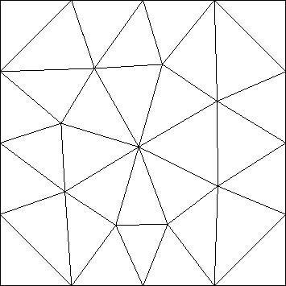



Aleph Physics
Field solve (continuum) :
Particle moves :
Notes:
The pieces constructed and used in this work provide most if not all of what are needed for optimization, continuation and time integration of the coupled system problems.

Slide 7
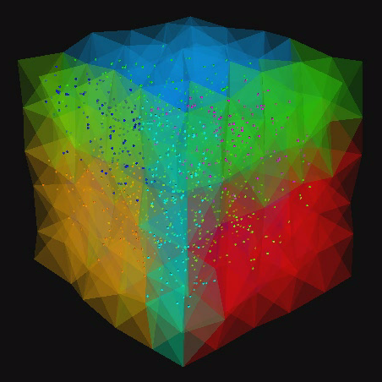
Particles moving through a 3D unstructured tetrahedral mesh in parallel with load balancing. Translucent color indicates processor number. (Real simulations will have many, many, more particles.)

Slide 8
Aleph Dependencies
Justifiable Complexity !!
Exodus
Zoltan
Aleph
IO_Standalone
Trilinos
AztecOO
Epetra
Teuchos
Triutils
Notes:
The pieces constructed and used in this work provide most if not all of what are needed for optimization, continuation and time integration of the coupled system problems.

Slide 9
Current Trilinos Usage - Overview
Construction of Solver LHS - Epetra_FECrsMatrix
Construction of Solver RHS - Epetra_FEVector
Linear Solve - AztecOO (ML, Belos)
Particle spatial averaging - Epetra_FEVector
Particle temporal averaging - Epetra_FEVector
Load balancing - Zoltan, Epetra_FEVector
Notes:
The pieces constructed and used in this work provide most if not all of what are needed for optimization, continuation and time integration of the coupled system problems.

Slide 10
Dynamic Balancing Using Zoltan

Slide 11
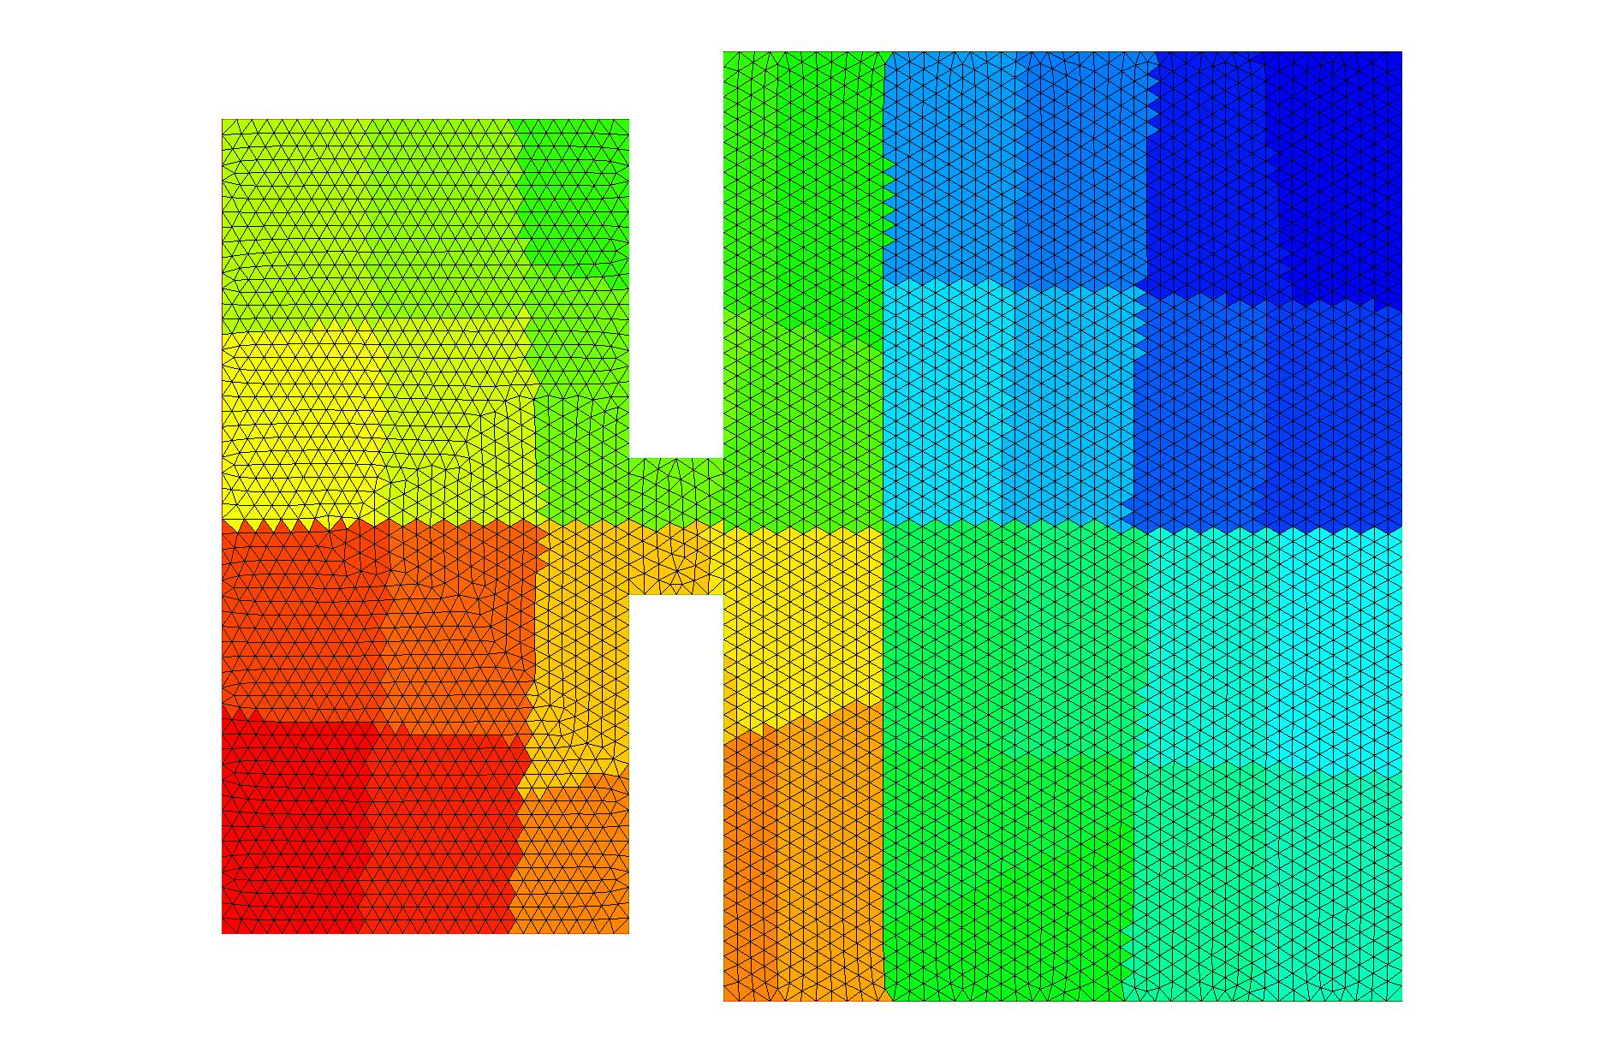
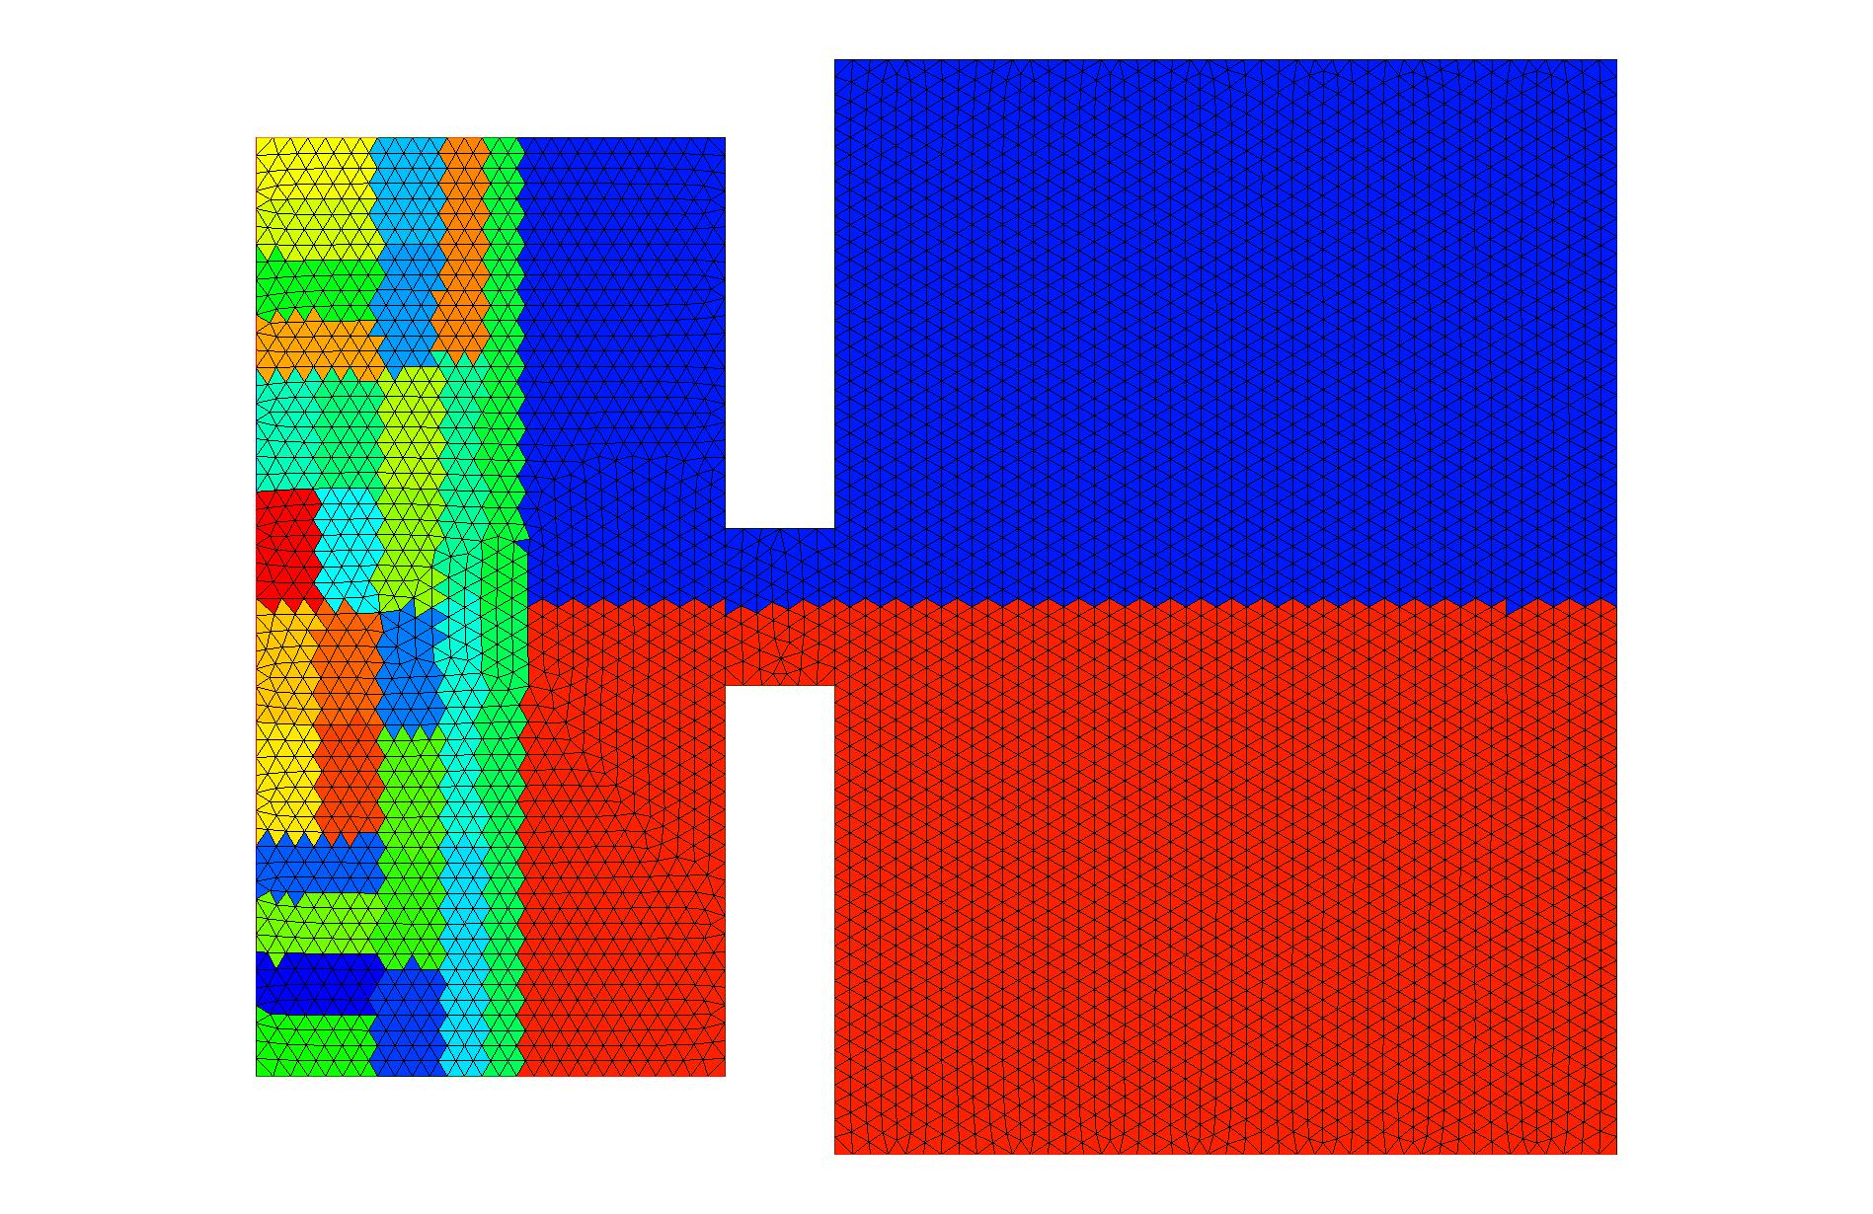

Current Trilinos Usage - Field Solve
Epetra_Import
Epetra_Import

Slide 12

Current Trilinos Usage - Spatial Particle Averaging (pre-PIC)
Epetra_FEVector NodResult1;
NodResult1.SumIntoGlobalValues();
NodResult1.GlobalAssemble(Add);

Slide 13
Current Trilinos Usage - Temporal Particle Averaging
NodResult1.SumIntoGlobal();
NodResult2.SumIntoGlobal();
ElemResult1.SumIntoGlobal();
Exodus
Time Steps
NodResult1.GlobalAssemble(Add);
SharedNodResult1.Import(NodResult1);

Slide 14
Current Trilinos Usage - Temporal Particle Averaging with Dynamic Balancing
NodResult1.SumIntoGlobal();
NodResult1.GlobalAssemble(Add);
Epetra_Import importer(New,Old);
NodResult1.Import(NodResult1,importer);
Exodus
Time Steps
t_{Balance}

Slide 15

Future Trilinos Usage - Performance
Tuned Poisson Solves - ML, Belos, Epetra(Ext ?)_CrsSingletonFilter
Smoothed Gradient Projections :
Improved initial guess - Epetra_Parks_Day?
FEM variants for EMS, EMD - ML, new package(s)

Slide 16
Future Trilinos Usage - Performance
Tuned Poisson Solves - ML, Belos, Epetra(Ext ?)_CrsSingletonFilter
Smoothed Gradient Projections :
Improved initial guess - Epetra_Parks_Day?
FEM variants for EMS, EMD - ML, new package(s)

Slide 17
Feedback
Working tests/examples are invaluable !!
Documentation, esp. in “Mature packages” (I can’t throw stones!)
Apps + Trilinos model, esp. wrt Meta packages

Slide 18
Post-TUG Aleph Dependencies
Exodus
Zoltan
Aleph
Trilinos
IO_Standalone
AztecOO
Epetra
Teuchos
Triutils
Isorropia
EpetraExt
ML
Belos
Notes:
The pieces constructed and used in this work provide most if not all of what are needed for optimization, continuation and time integration of the coupled system problems.

