Slide 1

Trilinos Progress, Challenges and Future Plans
Michael A. Heroux
Sandia National Laboratories
Sandia is a multiprogram laboratory operated by Sandia Corporation, a Lockheed Martin Company,
for the United States Department of Energy under contract DE-AC04-94AL85000.
Notes:
Questions from audience
Can you use another matrix-vector multiply?
Are multivectors supported?
Are Petsc and Hypre available via Thyra?
How does Trilinos differ from Petsc?

Slide 2
Trilinos Contributors (past 3 years)
Chris Baker
Developer of Anasazi, RBGen
Ross Bartlett
Lead Developer of MOOCHO, Stratimikos, RTOp,
Thyra
Developer of Rythmos
Pavel Bochev
Lead Developer Intrepid
Paul Boggs
Developer of Thyra
Erik Boman
Lead Developer Isorropia
Developer Zoltan
Todd Coffey
Lead Developer of Rythmos
Karen Devine
Lead Developer Zoltan
Clark Dohrmann
Lead Developer of CLAPS
Carter Edwards
Lead Developer phdMesh
Michael Gee
Developer of ML, Moertel, NOX
Bob Heaphy
Lead developer of Trilinos SQA
Developer Zoltan
Mike Heroux
Trilinos Project Leader
Lead Developer of Epetra, AztecOO,
Kokkos, IFPACK, Tpetra
Developer of Amesos, Belos, EpetraExt
Ulrich Hetmaniuk
Developer of Anasazi
Robert Hoekstra
Lead Developer of EpetraExt
Developer of Epetra
Russell Hooper
Developer of NOX
Vicki Howle
Lead Developer of Meros
Jonathan Hu
Developer of ML
Joe Kotulski
Lead Developer of Pliris
Rich Lehoucq
Developer of Anasazi and Belos
Kevin Long
Developer of Thyra
Roger Pawlowski
Lead Developer of NOX
Michael Phenow
Trilinos Webmaster
Developer WebTrilinos
Eric Phipps
Lead developer Sacado
Developer of LOCA, NOX
Dennis Ridzal
Lead Developer of Aristos, Intrepid
Marzio Sala
Lead Developer of Didasko, Galeri, IFPACK, WebTrilinos
Developer of ML, Amesos
Andrew Salinger
Lead Developer of LOCA, Capo
Paul Sexton
Developer of Epetra and Tpetra
Bob Shuttleworth
Developer of Meros.
Chris Siefert
Developer of ML
Bill Spotz
Lead Developer of PyTrilinos
Developer of Epetra, New_Package
Ken Stanley
Lead Developer of Amesos and New_Package
Heidi Thornquist
Lead Developer of Anasazi, Belos, RBGen and Teuchos
Ray Tuminaro
Lead Developer of ML and Meros
Jim Willenbring
Developer of Epetra and New_Package.
Trilinos library manager
Alan Williams
Lead Developer Isorropia, FEI
Developer of Epetra, EpetraExt, AztecOO, Tpetra

Slide 3
Background/Motivation

Slide 4
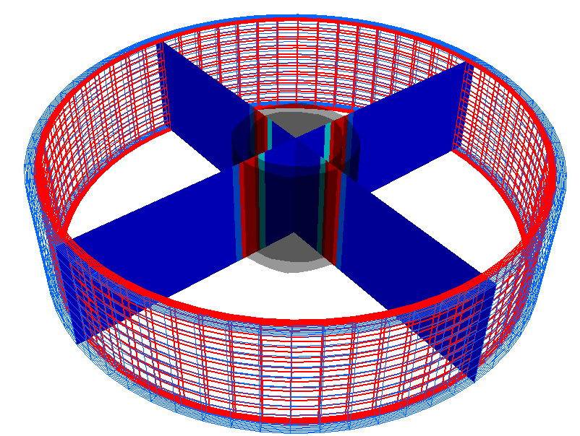
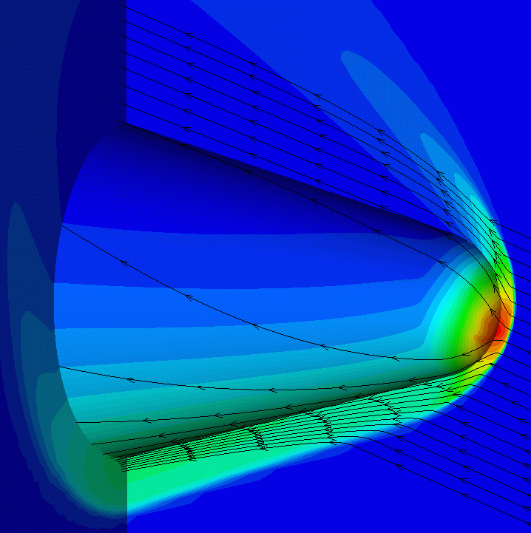
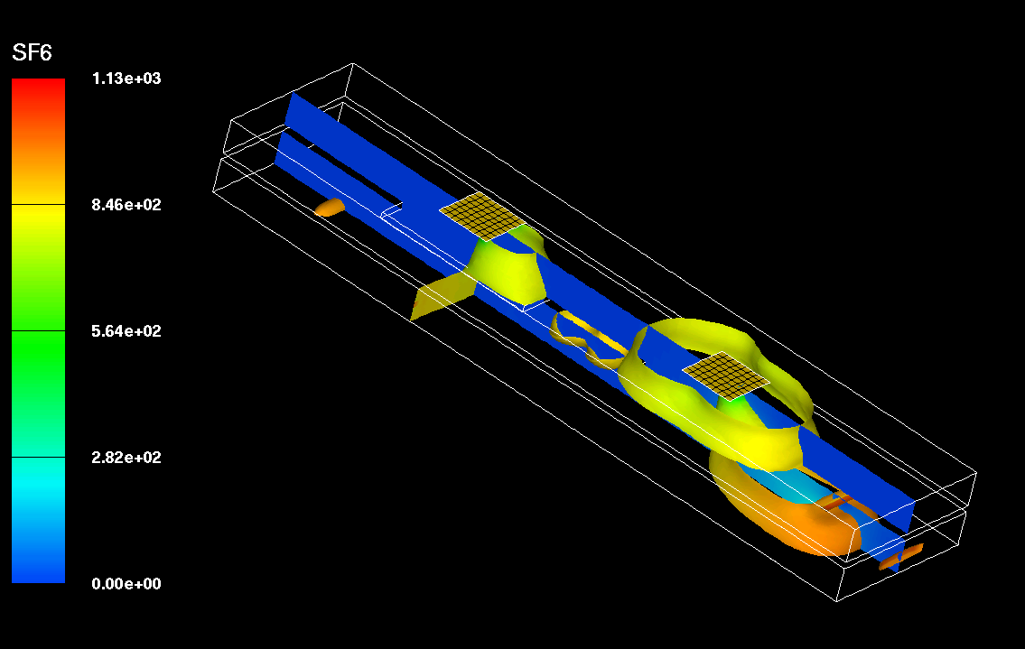
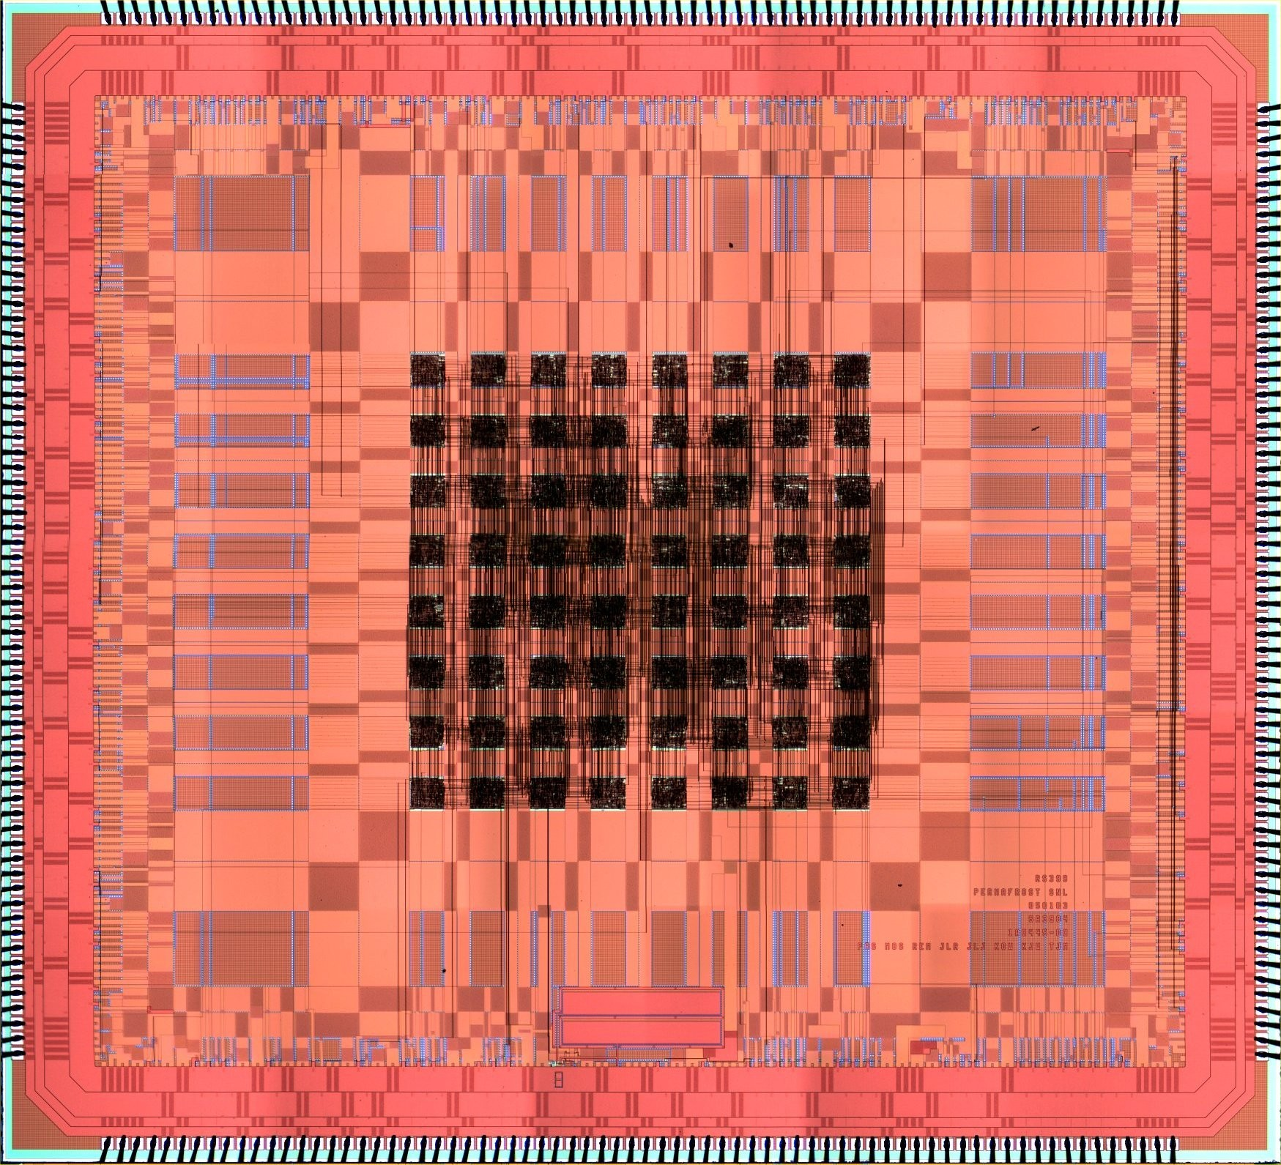
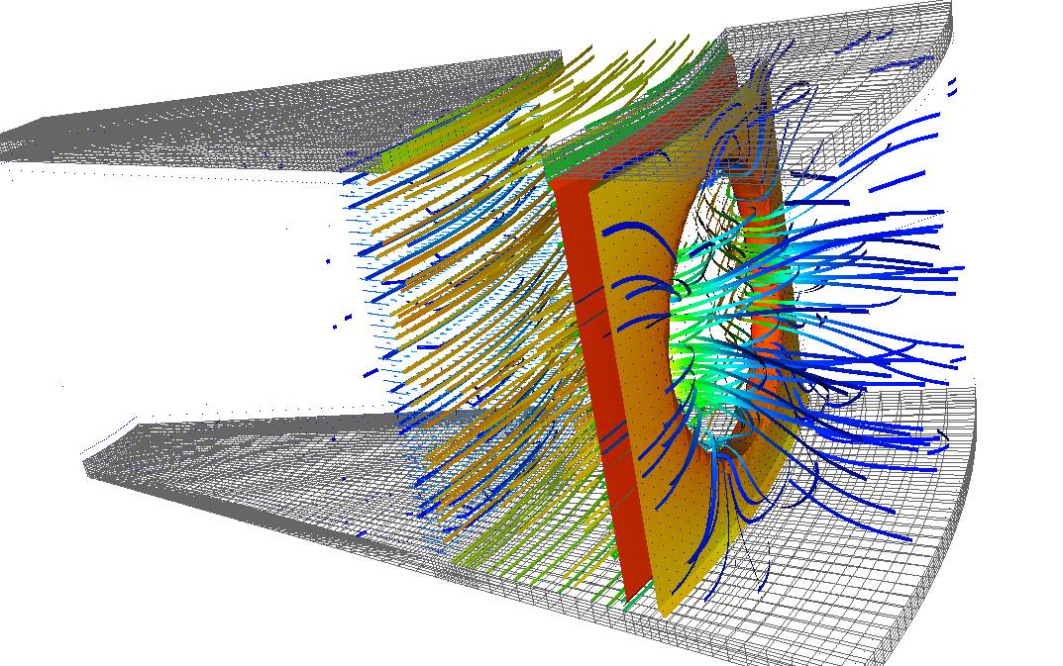
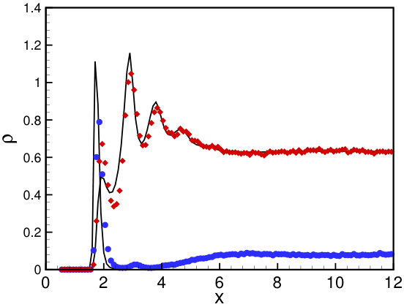
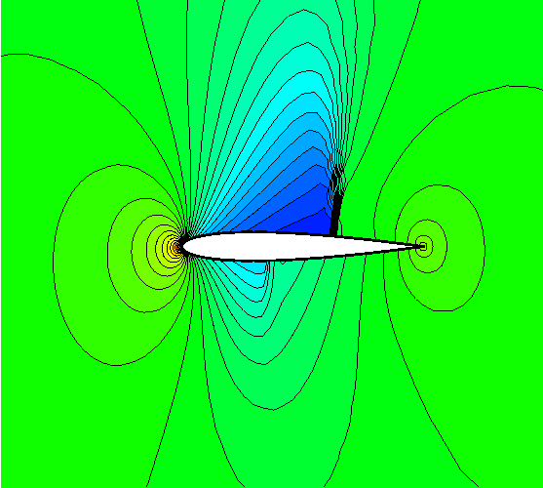
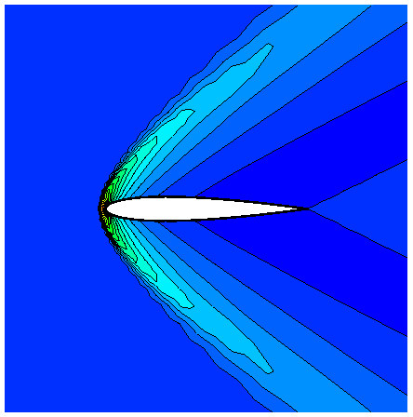
Target Problems: PDES and more…
Circuits
PDES
Inhomogeneous
Fluids
And More…

Slide 5

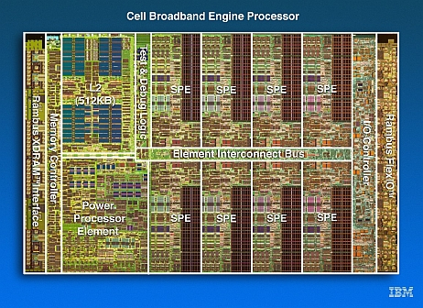

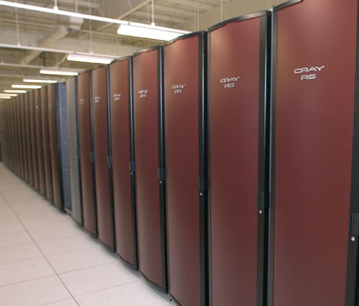
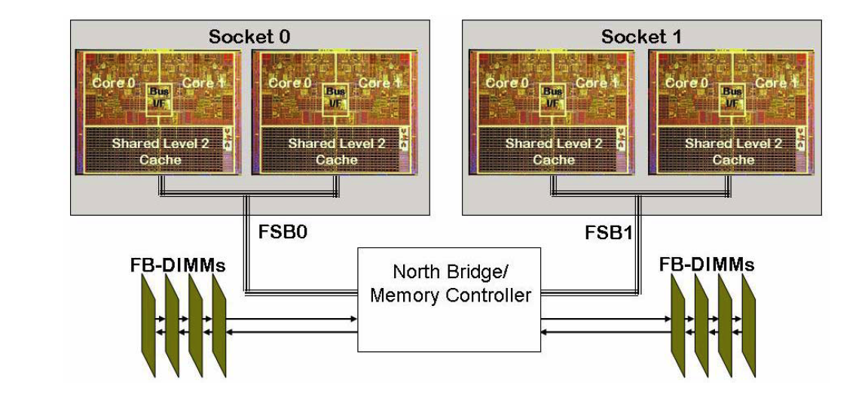
Target Platforms: Any and All
(Now and in the Future)
Desktop: Development and more…
Capability machines:
  Redstorm (XT3), Clusters
  Roadrunner (Cell-based).
  Multicore nodes.
Parallel software environments:
  MPI of course.
  UPC, CAF, threads, vectors,…
  Combinations of the above.
User “skins”:
  C++/C, Python
  Fortran.
  Web, CCA.

Slide 6
Motivation For Trilinos
Sandia does LOTS of solver work.
When I started at Sandia in May 1998:
  Aztec was a mature package. Used in many codes.
  FETI, PETSc, DSCPack, Spooles, ARPACK, DASPK, and many other codes were (and are) in use.
  New projects were underway or planned in multi-level preconditioners, eigensolvers, non-linear solvers, etc…
The challenges:
  Little or no coordination was in place to:
    Efficiently reuse existing solver technology.
    Leverage new development across various projects.
    Support solver software processes.
    Provide consistent solver APIs for applications.
  ASCI (now ASC) was forming software quality assurance/engineering (SQA/SQE) requirements:
    Daunting requirements for any single solver effort to address alone.

Slide 7
Evolving Trilinos Solution
Trilinos¹ is an evolving framework to address these challenges:
  Fundamental atomic unit is a package.
  Includes core set of vector, graph and matrix classes (Epetra/Tpetra packages).
  Provides a common abstract solver API (Thyra package).
  Provides a ready-made package infrastructure (new_package package):
    Source code management (cvs, bonsai).
    Build tools (autotools).
    Automated regression testing (queue directories within repository).
    Communication tools (mailman mail lists).
  Specifies requirements and suggested practices for package SQA.
In general allows us to categorize efforts:
  Efforts best done at the Trilinos level (useful to most or all packages).
  Efforts best done at a package level (peculiar or important to a package).
  Allows package developers to focus only on things that are unique to
  their package.
1. Trilinos loose translation: “A string of pearls”

Slide 8

Evolving Trilinos Solution
physics
Beyond a “solvers” framework
Natural expansion of capabilities to satisfy application and research needs
L(u)=f
Math. model
discretizations
methods
Numerical math
Convert to models that can be solved on digital computers
Time domain
Space domain
Automatic diff.
Domain dec.
Mortar methods
L_{h}(u_{h})=f_{h}
Numerical model
solvers
core
Algorithms
Find faster and more efficient ways to solve numerical models
Linear
Nonlinear
Eigenvalues
Optimization
Petra
Utilities
Interfaces
Load Balancing
u_{h}=L_{h}⁻¹•f_{h}
Algorithms
Discretization methods, AD, Mortar methods, …
computation

Slide 9
Trilinos Strategic Goals
Scalable Computations: As problem size and processor counts increase, the cost of the computation will remain nearly fixed.
Hardened Computations: Never fail unless problem essentially intractable, in which case we diagnose and inform the user why the problem fails and provide a reliable measure of error.
Full Vertical Coverage: Provide leading edge enabling technologies through the entire technical application software stack: from problem construction, solution, analysis to optimization.
Grand Universal Interoperability: All Trilinos packages will be interoperable, so that any combination of packages that
makes sense algorithmically will be possible within Trilinos and with compatible external software.
Universal Accessibility: All Trilinos capabilities will be available to users of major computing environments: C++, Fortran, Python and the Web, and from the desktop to the latest scalable systems.
Universal Capabilities RAS: Trilinos will be:
  Integrated into every major application at Sandia (Availability).
  The leading edge hardened, efficient, scalable solution for each of these applications (Reliability).
  Easy to maintain and upgrade within the application environment (Serviceability).
Algorithmic
Goals
Software
Goals

Slide 10
Trilinos Statistics 11/2006
Stats: Trilinos Download Page 11/01/2006.

Slide 11
Trilinos Statistics, 11/2007
Stats: Trilinos Download Page 11/5/2007.

Slide 12

External Visibility
Awards: R&D 100, HPC SW Challenge (04).
www.cfd-online.com:
Industry Collaborations: Boeing, Goodyear, ExxonMobil.
Linux distros: Debian, Mandriva.
SciDAC TOPS-2 partner.
Over 5100 downloads since March 2005.
Occasional unsolicited external endorsements such as the following two-person exchange on mathforum.org:
  > The consensus seems to be that OO has little, if anything, to offer
  > (except bloat) to numerical computing.
  I would completely disagree. A good example of using OO in numerics is
  Trilinos: http://software.sandia.gov/trilinos/
Trilinos
  A project led by Sandia to develop an object-oriented software framework for scientific computations.
  This is an active project which includes several state-of-the-art solvers and lots of other nice things a
  software engineer writing CFD codes would find useful. Everything is freely available for download once
  you have registered. Very good!

Slide 13
Trilinos Presentation Forums
ACTS “Hands-on” Tutorial:
  Aug 19-21, 2008 (approximate).
  At Lawrence Berkeley Lab, Berkeley, CA, USA.
Next Trilinos User Group Meeting:
  Proposal: Oct 21-23, 2008.
  Old LACSI Symposium week.
  At Sandia National Laboratories, Albuquerque, NM, USA.
SciDAC Conference (tentative).
  July13-17, 2008.
  Seattle.

Slide 14
Characterizing the Trilinos “Project”
Not a “project” but an infrastructure to support inter-related projects: A project of projects.
Package participation is voluntary:
  Framework must be attractive (and continue to be).
  Requirements are few, opportunities are many.
  Package team decides what and when.
  Opt-out is always an option.
Package autonomy is carefully guarded:
  Even if redundant development occurs.
  Decision-making pushed to lowest (best) level.
Participation is attractive:
  Increasing infrastructure capabilities.
  Access to many other packages.

Slide 15
Trilinos Package Concepts
Package: The Atomic Unit

Slide 16
Trilinos Packages
Trilinos is a collection of Packages.
Each package is:
  Focused on important, state-of-the-art algorithms in its problem regime.
  Developed by a small team of domain experts.
  Self-contained: No explicit dependencies on any other software packages (with some special exceptions).
  Configurable/buildable/documented on its own.
Sample packages: NOX, AztecOO, ML, IFPACK, Meros.
Special package collections:
  Petra (Epetra, Tpetra, Jpetra): Concrete Data Objects
  Thyra: Abstract Conceptual Interfaces
  Teuchos: Common Tools.
  New_package: Jumpstart prototype.

Slide 17
Trilinos Package Summary
 | Objective | Package(s)
Discretizations | Meshing & Spatial Discretizations | phdMesh, Intrepid
 | Time Integration | Rythmos
Methods | Automatic Differentiation | Sacado
 | Mortar Methods | Moertel
Core | Linear algebra objects | Epetra, Jpetra, Tpetra
 | Abstract interfaces | Thyra, Stratimikos, RTOp
 | Load Balancing | Zoltan, Isorropia
 | “Skins” | PyTrilinos, WebTrilinos, Star-P, ForTrilinos
 | C++ utilities, (some) I/O | Teuchos, EpetraExt, Kokkos, Triutils
Solvers | Iterative (Krylov) linear solvers | AztecOO, Belos, Komplex
 | Direct sparse linear solvers | Amesos
 | Direct dense linear solvers | Epetra, Teuchos, Pliris
 | Iterative eigenvalue solvers | Anasazi
 | ILU-type preconditioners | AztecOO, IFPACK
 | Multilevel preconditioners | ML, CLAPS
 | Block preconditioners | Meros
 | Nonlinear system solvers | NOX, LOCA
 | Optimization (SAND) | MOOCHO, Aristos

Slide 18
Why Packages?

Slide 19
Package Interoperability

Slide 20
Interoperability vs. Dependence
(“Can Use”) (“Depends On”)
Although most Trilinos packages have no explicit dependence, each package must interact with some other packages:
  NOX needs operator, vector and solver objects.
  AztecOO needs preconditioner, matrix, operator and vector objects.
  Interoperability is enabled at configure time. For example, NOX:
    --enable-nox-lapack compile NOX lapack interface libraries
    --enable-nox-epetra compile NOX epetra interface libraries
    --enable-nox-petsc compile NOX petsc interface libraries
Trilinos configure script is vehicle for:
  Establishing interoperability of Trilinos components…
  Without compromising individual package autonomy.
Trilinos offers seven basic interoperability mechanisms.
../configure –enable-python

Slide 21
Trilinos Interoperability Mechanisms
(Acquired as Package Matures)
Package builds under Trilinos configure scripts. | ⇒ | Package can be built as part of a suite of packages; cross-package interfaces enable/disable automatically
Package accepts user data as Epetra or Thyra objects | ⇒ | Applications using Epetra/Thyra can use package
Package accepts parameters from Teuchos ParameterLists | ⇒ | Applications using Teuchos ParameterLists can drive package
Package can be used via Thyra abstract solver classes | ⇒ | Applications or other packages using Thyra can use package
Package can use Epetra for private data. | ⇒ | Package can then use other packages that understand Epetra
Package accesses solver services via Thyra interfaces | ⇒ | Package can then use other packages that implement Thyra interfaces
Package available via PyTrilinos, ForTrilinos, WebTrilinos | ⇒ | Package can be used with other Trilinos packages via Python, Fortran, Website.

Slide 22
Interoperability Example: ML
ML: Multi-level Preconditioner Package.
Primary Developers: Ray Tuminaro, Jonathan Hu, Marzio Sala.
No explicit, essential dependence on other Trilinos packages.
  Uses abstract interfaces to matrix/operator objects.
  Has independent configure/build process (but can be invoked at Trilinos level).
Interoperable with other Trilinos packages and other libraries:
  Accepts user data as Epetra matrices/vectors.
  Can use
    Epetra for internal matrices/vectors.
    IFPACK, Amesos, AztecOO, etc. objects as smoothers, coarse solvers.
  Can be used via
    Thyra abstract interfaces.
    PyTrilinos.
  Can be built via Trilinos configure/build process.
  Can be driven via Teuchos ParameterLists.
  Available as preconditioner to all other Trilinos packages.
  Available to PETSc users without dependence on any other Trilinos packages.

Slide 23
Package Maturation Process
Asynchronicity

Slide 24
Day 1 of Package Life
CVS: Each package is self-contained in Trilinos/package/ directory.
Bugzilla: Each package has its own Bugzilla product.
Bonsai: Each package is browsable via Bonsai interface.
Mailman: Each Trilinos package, including Trilinos itself, has four mail lists:
  package-checkins@software.sandia.gov
    CVS commit emails. “Finger on the pulse” list.
  package-developers@software.sandia.gov
    Mailing list for developers.
  package-users@software.sandia.gov
    Issues for package users.
  package-announce@software.sandia.gov
    Releases and other announcements specific to the package.
New_package (optional): Customizable boilerplate for
  Autoconf/Automake/Doxygen/Python/Thyra/Epetra/TestHarness/Website

Slide 25
Sample Package Maturation Process
Step | Example
Package added to CVS: Import existing code or start with new_package. | ML CVS repository migrated into Trilinos (July 2002).
Mail lists, Bugzilla Product, Bonsai database created. | ml-announce, ml-users, ml-developers, ml-checkins, ml-regression @software.sandia.gov created, linked to CVS (July 2002).
Package builds with configure/make, Trilinos-compatible | ML adopts Autoconf, Automake starting from new_package (June 2003).
Epetra objects recognized by package. | ML accepts user data as Epetra matrices and vectors (October 2002).
Package accessible via Thyra interfaces. | ML adaptors written for TSFCore_LinOp (Thyra) interface (May 2003).
Package uses Epetra for internal data. | ML able to generate Epetra matrices. Allows use of AztecOO, Amesos, Ifpack, etc. as smoothers and coarse grid solvers (Feb-June 2004).
Package parameters settable via Teuchos ParameterList | ML gets manager class, driven via ParameterLists (June 2004).
Package usable from Python (PyTrilinos) | ML Python wrappers written using new_package template (April 2005).
Startup Steps
Maturation Steps

Slide 26
Latest Maturation: Cmake-enabled
Cmake: Alternative to Autotools.
  GUI.
  Supports Windows/MS, Mac, Unices.
  Supports binary packaging.
Focus: Epetra first, isolated to single package.
Danny Dunlavy, Tim Shead have more…

Slide 27
What Trilinos is not
Trilinos is not a single monolithic piece of software. Each package:
  Can be built independent of Trilinos.
  Has its own self-contained CVS structure.
  Has its own Bugzilla product and mail lists.
  Development team is free to make its own decisions about algorithms, coding style, release contents, testing process, etc.
Trilinos top layer is not a large amount of source code:
  Trilinos repository contains 1,044,266 source lines of code (SLOC).
  Sum of the packages SLOC counts : 1,034,545.
  Trilinos top layer SLOC count: 9,721 (0.9%) (was 1.4% in 6.0).
Trilinos is not “indivisible”:
  You don’t need all of Trilinos to get things done.
  Any collection of packages can be combined and distributed.
  Current public release contains only 30 of the 40+ Trilinos packages.

Slide 28
Insight from History
A Philosophy for Future Directions
In the early 1800’s U.S. had many new territories.
Question: How to incorporate into U.S.?
  Colonies? No.
  Expand boundaries of existing states? No.
  Create process for self-governing regions. Yes.
  Theme: Local control drawing on national resources.
Trilinos package architecture has some similarities:
  Asynchronous maturation.
  Packages decide degree of interoperations, use of Trilinos facilities.
Strength of each: Scalable growth with local control.

Slide 29
Software Lifecycles

Slide 30
(Typical) Project Lifecycle
Consider this lifecycle
End
of
Life
Project
Conception
Research &
Development
Production
Support &
Maintenance

Slide 31
Scientific Research and Life Cycle Models
Life Cycle Models are generally developed from the point of view of business software.
Little consideration is given to algorithmic development.
Traditional business execution environment is traditional mainframe or desktop, not parallel computers.
Traditional development “techniques” are assumed.

Slide 32
Research Software needs a different model
Research should be “informal”:
  Allow external collaborators, students, post-docs, etc.
  Allow changes of direction without seeking permission
  Should use modern software development paradigms
    i.e. Lean/Agile methods
  Must be verified more than validated
Production code must:
  Have formality appropriate to risks,
  Be Complete (documentation, testing, …),
  Be “user proofed”,
  Be platform independent (as necessary),
  Be validated not just verified.

Slide 33
“Promotional” Model
Promotional
Event
Phase k
Phase k+1
Lower formality
Fewer Artifacts
Lean/Agile
Higher formality
Sufficient Artifacts
Bullet proof
Maintainable

Slide 34
Trilinos Software Lifecycle Model
The Trilinos Software Lifecycle Model, James M. Willenbring and Michael A. Heroux and Robert T. Heaphy, Proceeding of the 29th International Conference on Software Engineering, May 2007

Slide 35
Trilinos Lifecycle Phases
Three phases:
  Research.
  Production Growth.
  Production Maintenance.
Each phase contains its own lifecycle model.
Promotional events:
  Required for transition from one phase to next.
  Signify change in behaviors and attitude.
Phase assigned individually to each package.

Slide 36
Lifecycle Phase 1: Research
Conducting research is the primary goal.
Producing software is potentially incidental to research.
Any software that is produced is typically a “proof of concept” or prototype.
Software that is in this phase may only be released to selected internal customers to support their research or development and should not be treated as production quality code.

Slide 37
Phase 1 Required Practices
The research proposal is the project plan.
Software is placed under configuration control as needed to prevent loss due to disaster.
Peer reviewed published papers are primary verification and validation.
The focus of testing is a proof of correctness, not software.
Periodic status reports should be produced, presentation is sufficient.
A lab notebook, project notebook, or equivalent is the primary artifact.

Slide 38
Multicore Efforts

Slide 39
Multi-core Studies with D. Doerfler, H.C. Edwards
Intel Clovertown
8-cores
Opportunities
Challenges

Slide 40
Summary So Far
MPI-only is sometimes enough:
  LAMMPS
  Tramonto (at least parts), and threads might not help solvers.
Introducing threads into MPI:
  Not useful if using same algorithms.
  Same conclusion as 12 years ago.
Increase in bandwidth requirements:
  Decreases effective core use.
  Independent of programming model.
Use of threading can be effective if it enables:
  Change of algorithm.
  Better load balancing:
    Dynamic self scheduling.
    Finer granularity.
Been There, Done That: Lessons Learned from SMP Computing (Presentation)
Some Thoughts on Multicore (Paper)

Slide 41
Major Framework Themes: FY05/06
Trilinos Package Architecture:
  Continue refinement of new_package.
  Explicitly define Trilinos compatibility.
  Resolve the abstract interface issue.
Software Quality:
  Expand use and ease-of-use of test harness.
  Identify metrics and automate capture and display.
  Establish a life-cycle model (hybrid agile/unified process?).
  Customize the ASC SQP to our environment.
Packages:
  Foster new package development.
  Manage the growth. Issue: complexity of package coupling.
  Harden our mature packages.
Transition to post-delivery maintenance:
  Organizational issue: Tough to solve.

Slide 42
Major Themes for FY06/07
Framework
Take Steps toward dynamic package addition.
  In light of more outward focus:
  (SciDAC, Boeing, ???)
  Trilinos-compatibility definition or something similar.
Define SW Lifecycle(s) and begin formalized efforts.
  Need something for external audits.
  Agile vs. UP vs. hybrid.

Slide 43
FY07/08 Themes: Framework
Trilinos Level II Milestone.
  Demonstrate Use of Full Vertical capabilities in Charon.
Joint licensing and copyright of development with other organizations.
  Other DOE Labs, international orgs, private companies.
Package Autonomy (reacting to rapid growth):
  18 to 27 to ??
  Guarding against incidental coupling.
  Revisiting the location of “skins”.
Stratimikos: Uniform access to many packages.
Access from Fortran.
  DOE Science Users, DOD Users.
  Stratimikos focus.
Split of User vs Developer tools.
  http://trilinos.sandia.gov
  http://software.sandia.gov

Slide 44
Themes for FY08/09
Redefinition of Trilinos scope beyond solvers.
Next steps in packaging and distribution.
Continued outreach to other communities
Rethinking source management.
Formalizing App-Trilinos relationship.
Post-delivery maintenance improvements.
Trilinos Advisory Group.
More (will emerge during this meeting).

Slide 45
Scope of Trilinos
Addition of Sacado, Zoltan, FEI, Intrepid, phdMesh: Not solvers.
Framework support natural.
Rephrasing of project goals, descriptions underway.
Grouping of packages into meta-packages: At least conceptually.

Slide 46
A Tale of Two Trilinoses
(with apologies to Dickens)
Trilinos is both:
  Software Engineering Environment
  Delivery mechanism for compatible tools.
Expansion of scope clearly reasonable regarding item 1.
Item 2 requires rethinking of packaging, release processes.

Slide 47
Packaging and Distribution
Mac and Windows are ever more popular development environments.
Goal: Provide click-install capabilities for Mac OS, MS Visual Studio, Linux COE.

Slide 48
Outreach
Trilinos packages part of SciDAC:
  ITAPS, CSCAPES, TOPS-2.
  Opportunity to serve broader DOE community.
Trilinos popular in universities:
  Single largest sector of users.
Trilinos part of several industrial efforts.
  Improves capabilities.
  Amortizes costs over broader funding sources.
Elevates certain activities:
  Fortran accessibility.
  Packaging & distribution.

Slide 49
Source Management
Think of repository as a database.
Logical collections gathered dynamically.
Consider use of multiple source management tools:
  Local vs. global management.
  Fully distributed.
Certainly svn is option, but looking at all options.

Slide 50
App-Trilinos Relationship
How should apps to interact with Trilinos?
Many facets:
  Interfaces: concrete vs. abstract.
  Testing: How frequently, who does it.
  Distribution: Trilinos separate or integrated.
  …
Goal: Any two applications should differ only in:
  Essential needs due to formulation.
  Specific uses of enabling technologies.

Slide 51
Post-delivery Maintenance and Support
Long-term support for software that is:
  Heavily used but,
  Not actively developed,
is a chronic issue across the DOE complex.
BLAS, LAPACK, Scalapack, Aztec…
Organizational structures do not reflect overall cost of software:
  60%-70% in post-delivery maintenance.
  We are research focused.
Working on plan to use matrixed org.

Slide 52
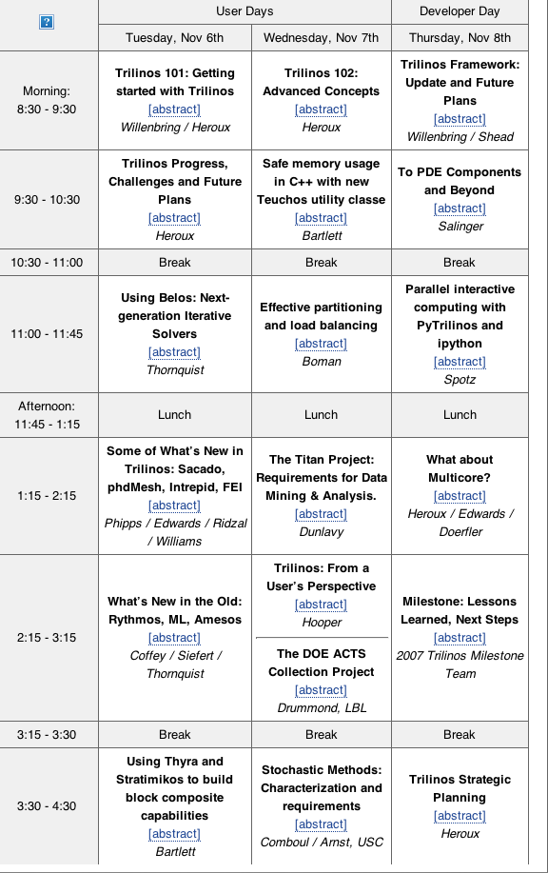
Overview of Talks, AM

Slide 53
PM

Slide 54
Trilinos Availability/Information
Trilinos and related packages are available via LGPL.
Current release (8.0) is “click release”.
Unlimited availability.
Trilinos Awards:
  2004 R&D 100 Award.
  SC2004 HPC Software Challenge Award.
  Sandia Team Employee Recognition Award.
  Lockheed-Martin Nova Award Nominee.
More information:
  http://trilinos.sandia.gov
  http://software.sandia.gov
  Additional documentation at my website:
  http://www.cs.sandia.gov/~mheroux.

