Slide 1
Trilinos CI Testing/Contribution Overview
Samuel E. Browne
Sandia National Laboratories
HPSF Conference 05/07/2025

Slide 2
Trilinos DevSecOps Team
The Trilinos DevSecOps (Framework) team is responsible for the CI processes that enable the assurance of software quality for the Trilinos code suite. It also functions to assist with work related to the build system of this large and complex C++ suite.
With the transition of Trilinos to the HPSF, open-source partner contribution and collaboration is more greatly emphasized. This increased emphasis highlights the need to improve the contribution experience, particularly with respect to accessible CI processes, and simpler build experience.
Special thanks to Anderson Chauphan, Joe Frye, and Justin LaPre for their contributions to the team and to this presentation.

Slide 3
How Trilinos CI Testing Works

Slide 4
CI Testing
Trilinos uses a modified version of the “Gitflow” workflow with a develop and master (main) branch, where developers merge changes to develop, and the summation of those changes is merged to master on an approximately-weekly cadence.
As part of this workflow, Trilinos has CI-style checks running through several different automation frameworks to ensure code quality
Required
A fairly comprehensive set of package builds and tests succeed on multiple toolchains
No commits contain Git LFS objects (causes mirroring complexity for internal repositories)
All commits have a DCO signoff
Commits which touch packages that have opted-in to clang-tidy conform to the standard
MPI_COMM_WORLD is not used in any modified lines of code
Non-required
CodeQL static analysis
Upcoming/experimental builds

Slide 5
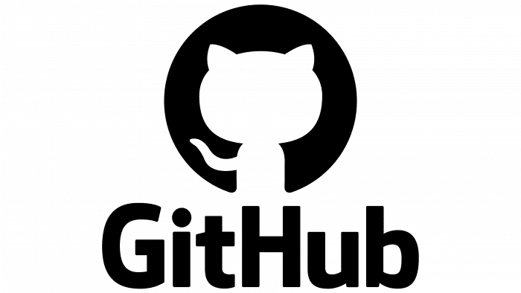


How does Trilinos CI V1 work?
AutoTester
AutoTester1 job
Pull Request
for pr in open_prs:
report_start_status_comment()
launch_all_test_jobs()
wait_on_all_test_jobs()
report_end_status_comment()
Set up merged state
Execute build-and-test script(s)
Report status back to pipeline
Pipeline controllable (limited) via AT: labels on Pull Requests
gcc-openmpi
intel-classic
framework-tests
…
AT1 job
AT1 job
CDash
CDash
User-facing
Internal (opaque)

Slide 6

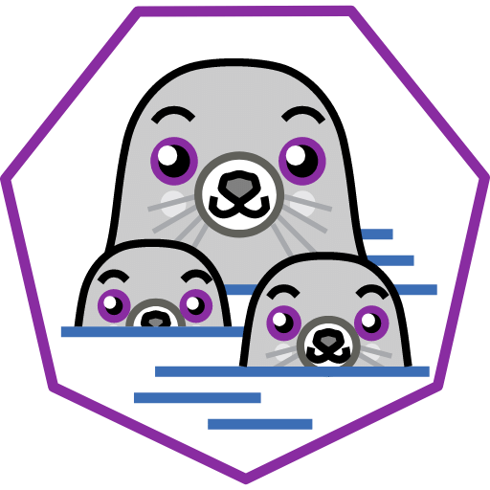
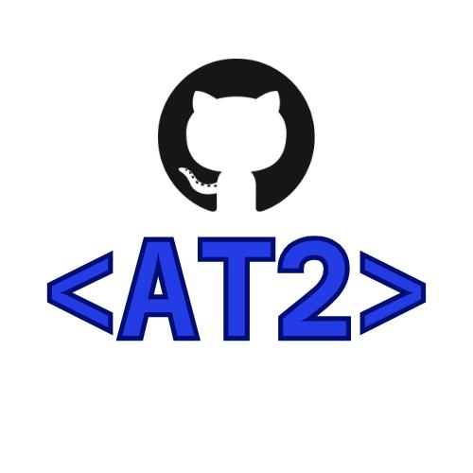

How does Trilinos CI V2 work?
Sandia-Hosted Runner
Pull Request
gcc10-openmpi4
framework-tests
oneapi2024
cuda11
…
Runner
Check if job can be run
Check out merged state
Execute build-and-test script(s)
Post comment with filtered CDash result URLs
Runner
Non-build checks
DCO signoff
No git LFS objects added
No PRs to `master` branch
…
persistent ccache object storage
CDash
User-facing
Internal (opaque)

Slide 7
Trilinos AT2 Runner Decision Tree
Is author member of Pretest-Inspectors?
Is .github directory modified?
Is AT2: SpecialApprove label applied by member of Framework team?
Is PR approved (via label or explicitly) by member of Pretest-Inspectors?
Is action triggered by member of Pretest-Inspectors?
Is action triggered by member of Pretest-Inspectors?
Arrow legend
= yes = no
Refuse to run job
Run job

Slide 8
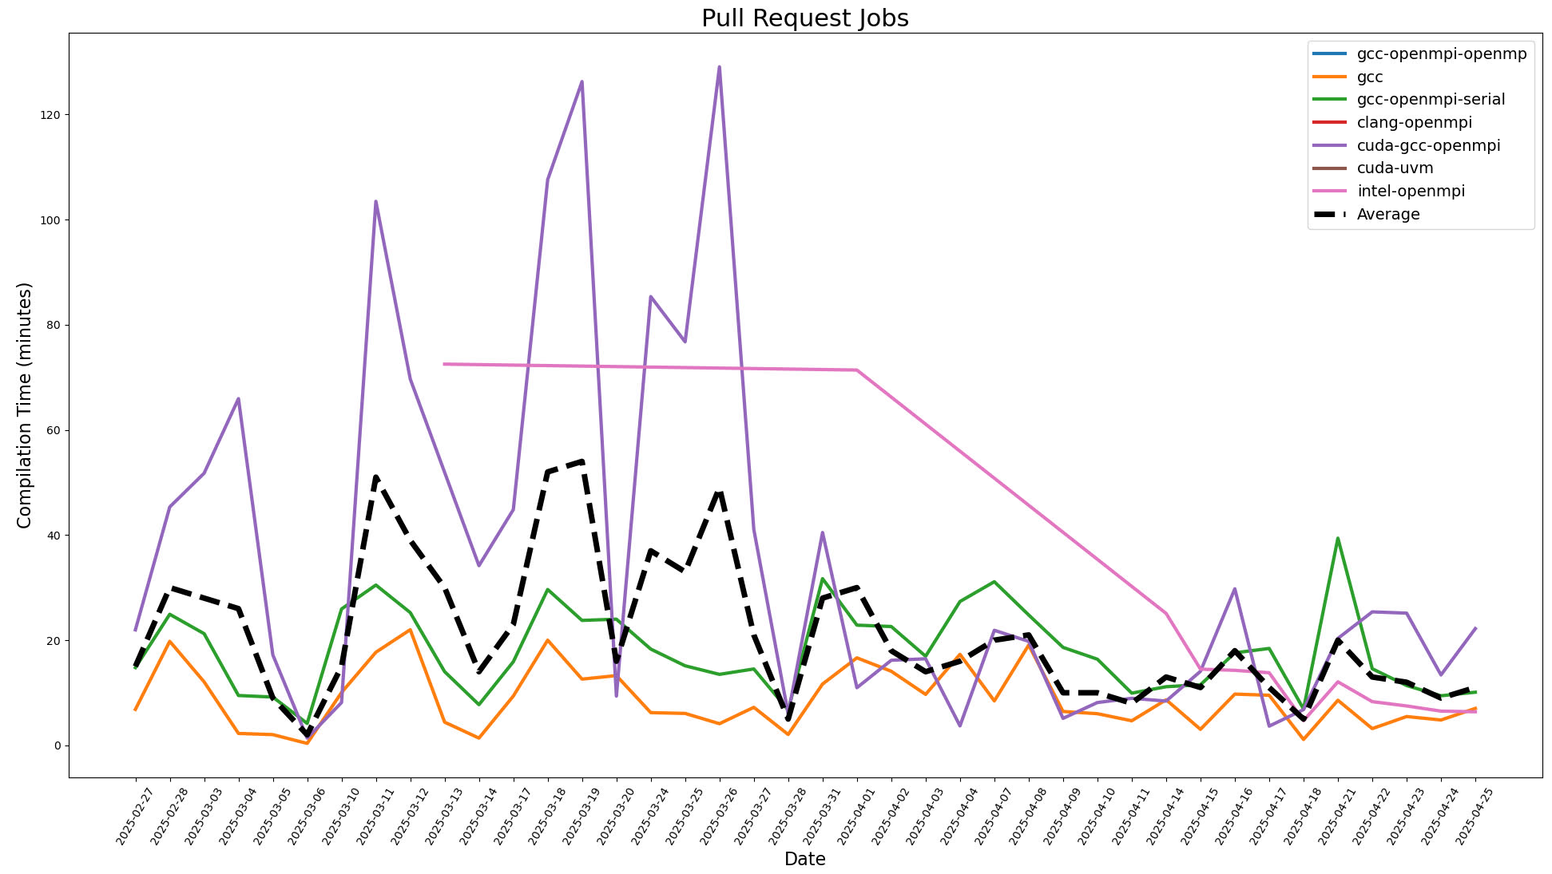
A Note on Build Speed (Why ccache Matters for Trilinos)
Building Trilinos packages from scratch is fairly compute-intensive, and when running in a CI context, many duplicate compilations are performed run-to-run
Using a per-node filesystem compiler cache (ccache) is giving a current direct hit rate of 88-91% depending on toolchain

Slide 9

How DOES Trilinos CI V2 work WithouT Sandia Resources?
Runner
Pull Request
gcc10-openmpi4
framework-tests
oneapi2024
cuda11
…
Runner
Post comment with filtered CDash result URLs
Runner
Check out merged state
Execute build-and-test script(s)
Non-build checks
DCO signoff
No git LFS objects added
No PRs to `master` branch
…
persistent sccache object storage
CDash
CDash

Slide 10


How COULD Trilinos CI V2 work WITH UO/CASS Resources?
UO GitLab
rocm sycl …
Kitware mirror script(s)
HubCast
Pull Request
all_gitlab_checks
framework-tests
gcc10-openmpi4
…
Runner
Post comment with filtered CDash result URLs
Check out merged state
Execute build-and-test script(s)
Non-build checks
DCO signoff
No git LFS objects added
No PRs to `master` branch
…
Runner
persistent sccache object storage
CDash
User-facing
Internal (opaque)

Slide 11
The Future of Trilinos CI
Encapsulating build/run environments as containers is incredible beneficial as compared to large toolchain and TPL stack deployments on internal machines
Allows customers to reproduce exact CI testing environment
Trilinos can have a CI testing environment separate from Sandia hardware if necessary, but can also utilize Sandia hardware in a relatively seamless manner
Accelerated build and tests
Exploring per-package binary caching with Spack approach (later in this presentation)
Continue to use ccache on hardware supporting mounted filesystems, but explore sccache for external resources
Make Trilinos configurations as easy to understand and interact with as possible

Slide 12
Making Trilinos Easier to Build

Slide 13
Minimizing Configuration Options
“Trilinos is too difficult to build” – every surveyed user
Most surveyed users tend to get a set of configuration options that work for them, then avoid changing any unless necessary
Trilinos should strive to minimize the number of configuration options that must be passed, and ensure that sensible defaults are chosen to adjust the default configuration for the majority of users
This proliferation of configure options can be seen in the CI configurations

Slide 14
Minimizing Configuration Options
Old CI example
~250 total config options passed
145 related to TPL related
15 package disables*
40 test disables
50 global/package-level configuration
New CI example
~200 total config options passed
115 related to TPL related
15 package disables*
20 test disables
50 global/package-level configuration
Are they all necessary?

Slide 15
Minimizing Configuration Options
Old CI example
~250 total config options passed
145 related to TPL related
15 package disables*
40 test disables
50 global/package-level configuration
New CI example
~200 total config options passed
115 related to TPL related
15 package disables*
20 test disables
50 global/package-level configuration
Are they all necessary?

Slide 16
Minimizing Configuration Options – Third-party Libraries
TPL options are system-dependent
If a user has only one installation of LAPACK, -DTPL_ENABLE_LAPACK is generally sufficient
If a user has six installations of LAPACK, additional specificity may be needed for robustness (example of necessary configure options)
New CI testing containers contain environments set up to Just Work with the single enable option
At a minimum, must have the correct enables and disables
Exploring setting more sensible defaults
Moving towards ”standard” find_package() as CMake package ecosystem matures will help decrease this complexity

Slide 17
Minimizing Configuration Options – Package Disables
Package disables are entirely due to deprecated packages, and will be eliminated at the end of this year

Slide 18
Minimizing Configuration Options – Test Disables
Disabling Trilinos tests is generally due to a test that exhibits unstable behavior when running in CI testing
General position is that while unstable tests are problematic for CI testing, they may still provide developers (or users) helpful information, so disable as part of CI instead of deleting

Slide 19
Minimizing Configuration Options – Global Configuration
Largest spot for individual improvement within Trilinos packages
Set defaults intelligently within multiple packages
Eliminate the case where one must pass options per-package:
set(TPL_ENABLE_CUDA ON CACHE BOOL "from .ini configuration”)
set(Kokkos_ENABLE_CUDA ON CACHE BOOL "from .ini configuration")
set(Phalanx_KOKKOS_DEVICE_TYPE CUDA CACHE STRING "from .ini configuration")
Eliminate explicit setting of default options
Test the defaults!

Slide 20
Spack
Trilinos currently has ~80 Spack variants
~30 of them related to enabling non-deprecated packages
Casual or first-time users may not understand this, and see Trilinos as a monolith
How to represent Trilinos packages more understandably to users, while preserving the level of granularity of other configuration options?
Proposed solution: Model Trilinos packages as individual Spack packages
trilinos+sacado+muelu+cuda --> sacado+cuda muelu+cuda
Already have a limited example of this with Kokkos and KokkosKernels (though only external “snapshotted” packages)
Leverage knowledge and approach used for SNL Sierra code, see Phil Sakievich’s presentation at 4:40PM on Thursday

Slide 21
Conclusion
New CI infrastructure leverages tooling familiar to much of the open-source community (GitHub Actions, containerized development environments, podman) and will help make the Trilinos development/contribution process more accessible
Emphasis on reducing the number of configuration options required to produce a build of Trilinos that is desirable for most customers (to the degree possible)
The Spack/Trilinos interaction is being worked to improve Trilinos user experience when using the de-facto standard build orchestration tool for HPCs and scientific software

