Slide 1


Optika
A GUI Package for Trilinos
Kurtis Nusbaum
klnusbaum@gmail.com
St. John's University
November 3, 2009

Slide 2
Presenation Structure
What is Optika?
Why might I use Optika?
Optika features
  Basic usage
  Advanced features

Slide 3
What is Optika?
Dynamic GUI generator
Takes a simple set of inputs and generates a GUI
Separation of concerns
Examples can be found in package

Slide 4
Qt
Utilized by Optika
GUI Library from Nokia
Cross-Platform
Cmake integration
http://qt.nokia.com/

Slide 5
Why might I use Optika?
You want to make a canned program
You need a user interface that isn't a complicated text file
You don't want to spend a lot of time designing your GUI

Slide 6
Text File Input
Very Hard for the user to understand. Not very intuitive.
************* DIMENSION PARAMETERS *************************************************
@ -1. -1. -1. -1. 10. Length_ref Density_ref Temp Dielec_ref VEXT_MAX
************* MESH PARAMETERS *************************************************
@ 1 Ndim
@ 10.0 Size_x(idim): idim=0,Ndim-1
@ 0.025 Esize_x(idim): idim=0,Ndim-1
@ -1 0 Type_bc(x0,: left, right) (-1=IN_WALL, 0=IN_BULK, 1=PERIODIC, 2=REFLECT, 3=LAST_NODE)
@ 0 0 Type_bc(x1,: down, up)
@ 0 0 Type_bc(x2,: back, front)
************ FUNCTIONAL SWITCHES *********************************************
@ 0 0 Type_func (-1=No HS functional, 0=FMT1, 1=FMT2, 2=FMT3) Type_hsdiam(0=SIGMA_DIAM 1=BH_DIAM)
@ 0 0 Type_attr Type_pairPot
(Type_attr options: -1=No attractions, 0=strict MF 2=MF_VARIABLE)
(Type_pairPot options: 0=PAIR_LJ12_6_CS, 1=PAIR_COULOMB_CS, 2=PAIR_COULOMB, 3=PAIR_YUKAWA_CS)
@ -1 Type_coul (-1=No coulomb, 0=strict MF, 1=include 2nd order corrections)
@ -1 Type_poly (-1=No polymer, 0=CMS, 1=CMS_SCFT, 2=WTC, 3=WJDC, 4=WJDC2, 5=WJDC3)

Slide 7
XML File
A little better, but still not quite what we want.
<?xml version="1.0" encoding="UTF-8"?>
<ParameterList>
<Parameter name="Enable Delayed Solver Construction" value="false" type="bool"/>
<Parameter name="Linear Solver Type" value="Amesos" type="string"/>
<ParameterList name="Linear Solver Types">
<ParameterList name="Amesos">
<ParameterList name="Amesos Settings">
<Parameter name="AddToDiag" value="0" type="double"/>
<Parameter name="AddZeroToDiag" value="false" type="bool"/>
<Parameter name="ComputeTrueResidual" value="false" type="bool"/>
<Parameter name="ComputeVectorNorms" value="false" type="bool"/>
<Parameter name="DebugLevel" value="0" type="int"/>
<ParameterList name="Lapack">
<Parameter name="Equilibrate" value="true" type="bool"/>
</ParameterList>
<Parameter name="MatrixProperty" value="general" type="string"/>
<Parameter name="MaxProcs" value="-1" type="int"/>

Slide 8
Simple Example
#include "Optika_GUI.hpp"
#include "Teuchos_ParameterXMLFileReader.hpp"
#include "Teuchos_XMLParameterListWriter.hpp"
int main(int argc, char* argv[]){
using namespace Teuchos;
using namespace Optika;
//Set up Parameter List
RCP<ParameterList> myInputs = RCP<ParameterList>(new ParameterList("Example"));
myInputs->set("Max Iters", 1550, "Determines the maximum number of iterations in the solver");
myInputs->set("Tolerance", 1e-10, "The tolerance used for the convergence check");
myInputs->set("Solver" ,"GMRES" ,"The type of solver to use.");
Teuchos::Array<double> testArray(10,0.0);
myInputs->set("Initial Guess", testArray, "The initial guess as a RCP to an array object.");
Teuchos::ParameterList& Prec_List = myInputs->sublist("Preconditioner",false,"Sublist that defines the preconditioner.");
Prec_List.set("Type", "ILU", "The type of preconditioner to use");
Prec_List.set("Drop Tolerance", 1e-3 ,"The tolerance below which entries from the\n""factorization are left out of the factors.");
//Call Optika
getInput(myInputs);
return 0;
}

Slide 9

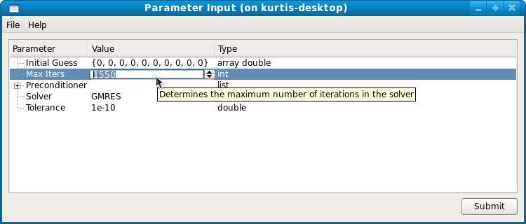
Resulting GUI

Slide 10
Advanced Features
Validators
  Number validators
  Filename validators
  String validators
  Array versions of most validators
Dependencies
  Visual Dependencies
    Bool Visual
    String Visual

Slide 11
Advanced Features Cont.
Dependencies
  Validator dependencies
  Array Length dependencies
Alternate ”exec” work-flow
Custom Functions
  Also available with standard work flow

Slide 12
Dependencies and Validators
Teuchos::RCP<Teuchos::StringToIntegralParameterEntryValidator<int> >
stringFoodTypeValidator = Teuchos::rcp(
new Teuchos::StringToIntegralParameterEntryValidator<int>(
Teuchos::tuple<std::string>( "Cheese", "Soda", "Chips" )
,"Food Type"
));
Teuchos::RCP<Teuchos::StringToIntegralParameterEntryValidator<int> >
cheeseValidator = Teuchos::rcp(
new Teuchos::StringToIntegralParameterEntryValidator<int>(
Teuchos::tuple<std::string>( "Swiss", "American", "Super Awesome Cheese" )
,"Food Selector"
));
Teuchos::RCP<Teuchos::StringToIntegralParameterEntryValidator<int> >
sodaValidator = Teuchos::rcp(
new Teuchos::StringToIntegralParameterEntryValidator<int>(
Teuchos::tuple<std::string>( "Pepsi", "Coke", "Kurtis Cola", "Bad Cola" )
,"Food Selector"
));
Teuchos::RCP<Teuchos::StringToIntegralParameterEntryValidator<int> >
chipsValidator = Teuchos::rcp(
new Teuchos::StringToIntegralParameterEntryValidator<int>(
Teuchos::tuple<std::string>( "Lays", "Doritos", "Kurtis Super Awesome Brand" )
,"Food Selector"
));

Slide 13
Dependencies and Validators
Optika::StringValidatorDependency::ValueToValidatorMap testValidatorMap1;
testValidatorMap1["Cheese"] = cheeseValidator;
testValidatorMap1["Soda"] = sodaValidator;
testValidatorMap1["Chips"] = chipsValidator;
Teuchos::ParameterList& stringValiDepList = My_deplist->sublist(
"String Validator Dependency", false);
stringValiDepList.set("Food Selector", "Swiss", "select the food you want", cheeseValidator);
stringValiDepList.set("Food Type", "Cheese", "String Validator Dependency Tester",
stringFoodTypeValidator);
depSheet1->addDependency(Teuchos::RCP<Optika::StringValidatorDependency>(
new Optika::StringValidatorDependency("Food Type",
Teuchos::sublist(My_deplist,"String Validator Dependency"),
"Food Selector",
Teuchos::sublist(My_deplist,"String Validator Dependency"),
testValidatorMap1,
cheeseValidator)));
getInput(My_deplist, depSheet1);
return 0;
}

Slide 14
Using Optika with Existing Code
Optika only requires you specify the inputs you need
Should be listed in a Teuchos Parameter List
Any existing program with a Parameter List can use Optika
Usually requires only minimal modification to existing source code.

Slide 15
Using Optika on Stratimikos
Extract the Stratimikos functionality into a Custom Function
Obtain inputs
Run custom function everytime the user hits submit

Slide 16
Stratimikos GUI
Int main(int argc, char* argv[]){
...
RCP<ParameterList> inputList = RCP<ParameterList>(new
ParameterList(*linearSolverBuilder.getValidParameters()));
RCP<FileNameValidator> fileVali = ValidatorFactory::getFileNameValidator();
fileVali->setFileMustExist(true);
inputList->set("Matrix File", matrixFile, "The file containing the matrix you wish to solve", fileVali);
Optika::OptikaGUI myGUI(inputList);
myGUI.setCustomFunction(&runSolver);
myGUI.setWindowIcon("straticon.svg");
myGUI.setWindowTitle("StratRunner");
myGUI.setStyleSheet("myStyle");
myGUI.exec();
…
}

Slide 17
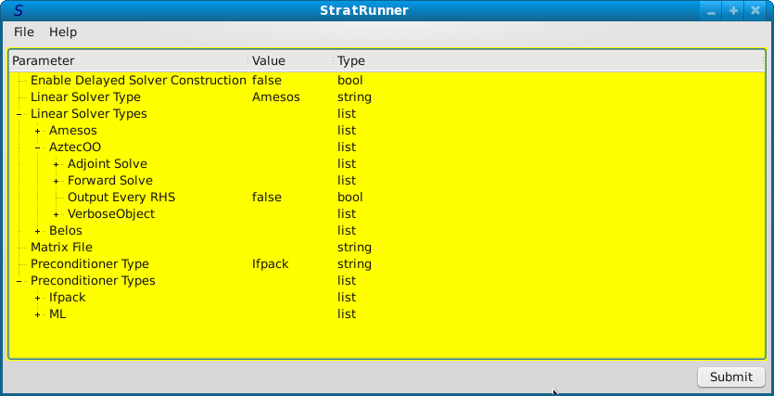
StratRunner

Slide 18
Current State Of Affairs
Looking for user feedback
  Optika is young
  What do you want?
Changes in Teuchos
  Make Parameter List serialization better
  Parameter List parental references
  Move validators from Optika to Teuchos
Add Qt as TPL
Currently in limited release
  Available in Trilinos repository

Slide 19
Summary
Optika helps you build a better user interface
Utilizes Teuchos Parameter Lists
Has multiple workflows
Has validators & dependencies
Can be used with existing code
Looking for user feedback
http://trilinos.sandia.gov/packages/optika/

Slide 20
Questions?

