Slide 1




A Current Overview of the Trilinos Project
Jonathan Hu
Tenth Copper Mountain Conference on Iterative Methods
Monday, April 7th, 2008
SAND#2008-2511 C
Sandia is a multiprogram laboratory operated by Sandia Corporation, a Lockheed Martin Company,
for the United States Department of Energy’s National Nuclear Security Administration
under contract DE-AC04-94AL85000.

Slide 2
This Evening’s Talks
Kevin Long (7:55pm)
  "Building parallel multi-physics simulations with Sundance"
Ross Bartlett (cancelled)
  "Stratimikos: Unified Access to Trilinos Linear Solver and Preconditioner Capabilities"
Heidi Thornquist (8:20pm)
  "Belos: A Framework for Next-generation Iterative Linear Solvers"
Vicki Howle (8:45pm)
  "Physics-based preconditioners in Meros"
Chris Siefert (9:10pm)
  "Recent Algorithmic (and Practical) Developments in ML"

Slide 3

Outline of Talk
Background / Motivation / Evolution.
(Some) capabilities in Trilinos
  Core
  Discretization/Optimization
  Solvers
Concluding remarks.

Slide 4
Trilinos Development Team
Chris Baker
Developer of Anasazi, RBGen
Ross Bartlett
Lead Developer of Thyra and Stratimikos
Developer of Rythmos
Pavel Bochev
Project Lead and Developer of Intrepid
Paul Boggs
Developer of Thyra
Eric Boman
Lead Developer of Isorropia
Developer of Zoltan
Todd Coffey
Lead Developer of Rythmos
David Day
Developer of Komplex and Intrepid
Karen Devine
Lead Developer of Zoltan
Clark Dohrmann
Developer of CLAPS
Michael Gee
Developer of ML, NOX
Bob Heaphy
Lead Developer of Trilinos SQA
Mike Heroux
Trilinos Project Leader
Lead Developer of Epetra, AztecOO,
Kokkos, Komplex, IFPACK, Thyra, Tpetra
Developer of Amesos, Belos, EpetraExt, Jpetra
Ulrich Hetmaniuk
Developer of Anasazi
Robert Hoekstra
Lead Developer of EpetraExt
Developer of Epetra, Thyra, Tpetra
Russell Hooper
Developer of NOX
Vicki Howle
Lead Developer of Meros
Developer of Belos and Thyra
Jonathan Hu
Developer of ML
Sarah Knepper
Developer of Komplex
Tammy Kolda
Lead Developer of NOX
Joe Kotulski
Lead Developer of Pliris
Rich Lehoucq
Developer of Anasazi and Belos
Kevin Long
Lead Developer of Thyra,
Developer of Teuchos
Roger Pawlowski
Lead Developer of NOX
Eric Phipps
Developer of LOCA, NOX, and Sacado
Denis Ridzal
Lead Developer of Aristos and Intrepid
Marzio Sala
Lead Developer of Didasko and IFPACK
Developer of ML, Amesos
Andrew Salinger
Lead Developer of LOCA
Paul Sexton
Developer of Epetra and Tpetra
Bill Spotz
Lead Developer of PyTrilinos
Developer of Epetra, New_Package
Ken Stanley
Lead Developer of Amesos and New_Package
Heidi Thornquist
Lead Developer of Anasazi, Belos, RBGen, and Teuchos
Ray Tuminaro
Lead Developer of ML and Meros
Jim Willenbring
Developer of Epetra and New_Package.
Trilinos library manager
Alan Williams
Lead Developer of Isorropia
Developer of Epetra, EpetraExt, AztecOO, Tpetra

Slide 5
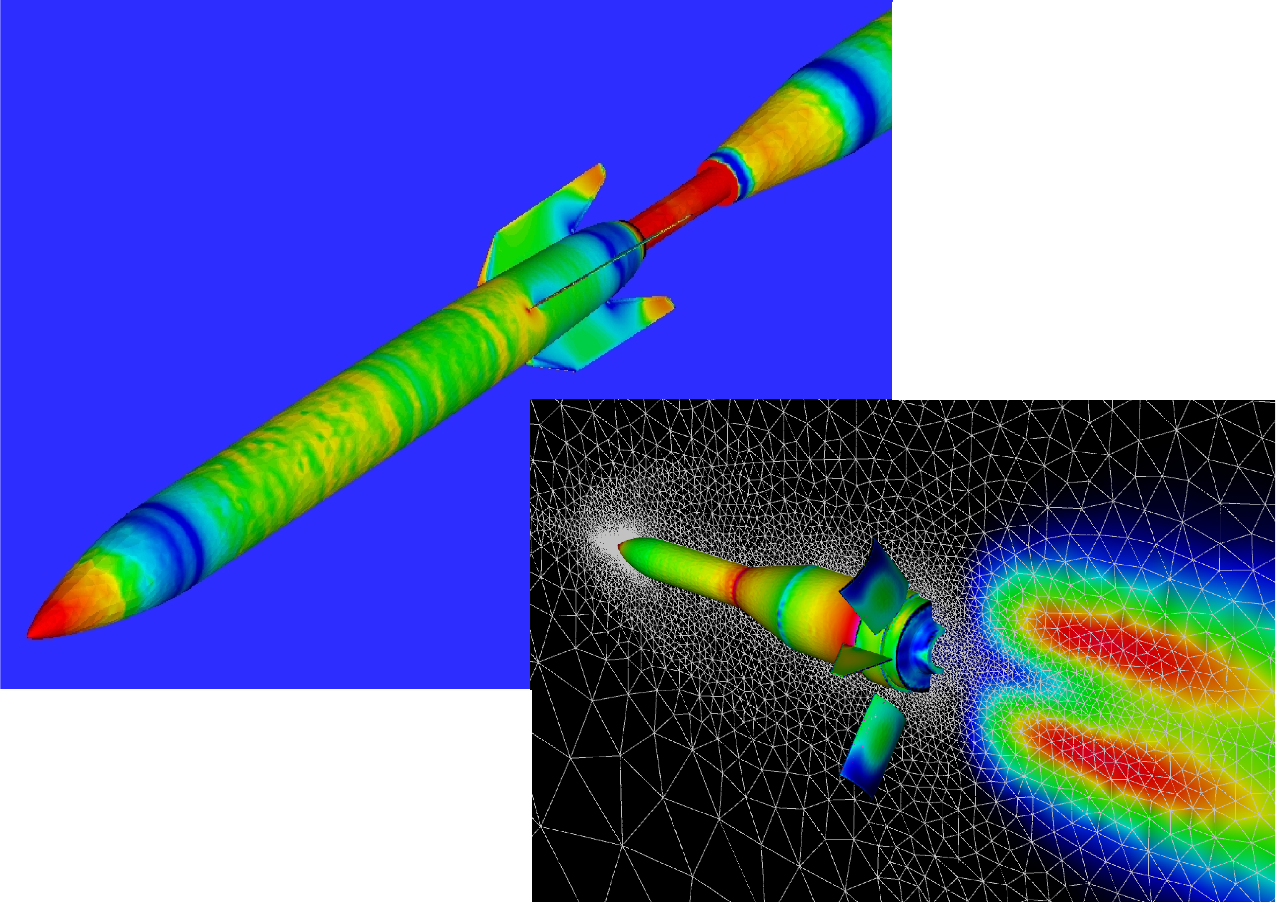
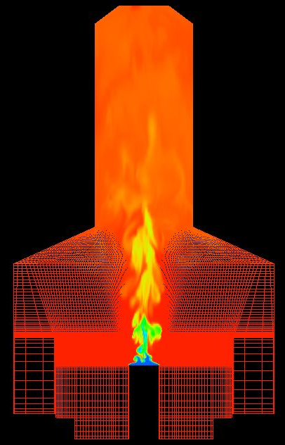
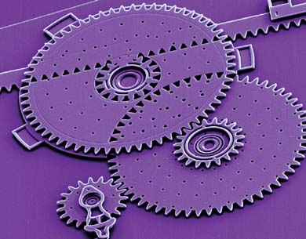
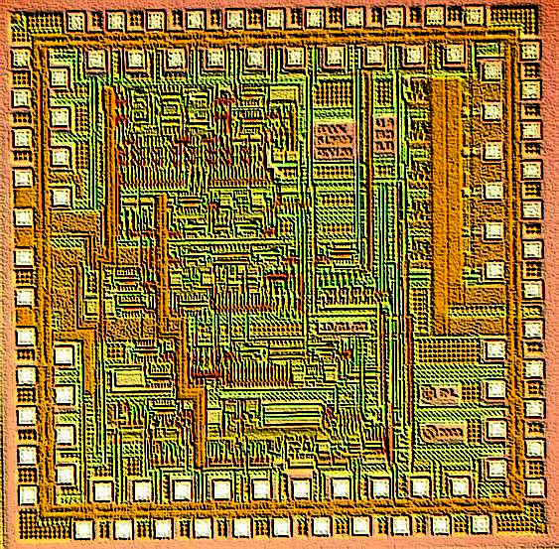
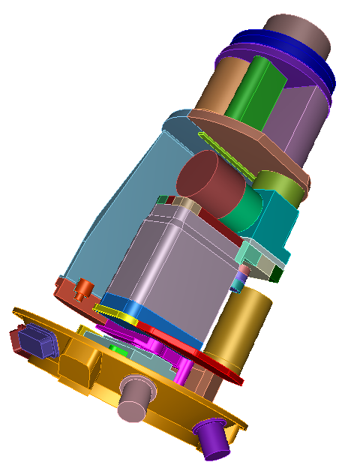
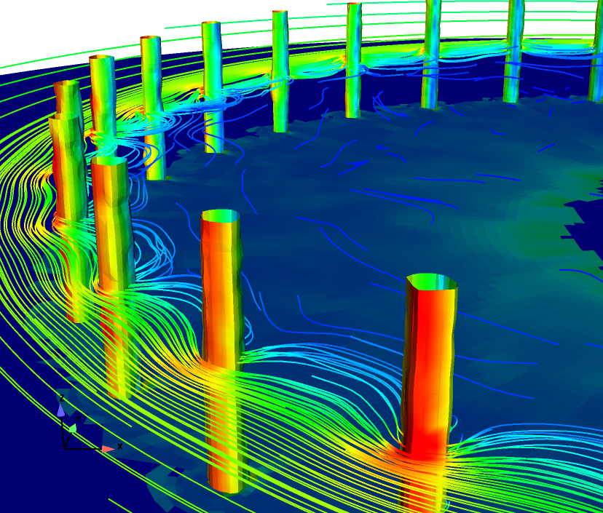
Sandia Physics Simulation Codes
Element-based
  Finite element, finite volume, finite difference, network, etc…
Large-scale
  Billions of unknowns
Parallel
  MPI-based SPMD
  Distributed memory
C++
  Object oriented
  Some coupling to legacy Fortran libraries
Fluids
Combustion
MEMS
Circuits
Structures
Plasmas
Notes:
Sandia simulates lots of different kinds of physics
Sandia’s physics simulation codes are mostly FE or FV discretized PDEs, some MD, circuit, etc…, but all element-based
We can differentiate these codes with AD by exploiting this element-based structure

Slide 6

Evolving Trilinos Solution
physics
Beyond a “solvers” framework
Natural expansion of capabilities to satisfy application and research needs
L(u)=f
Math. model
discretizations
methods
Numerical math
Convert to models that can be solved on digital computers
Time domain
Space domain
Automatic diff.
Domain dec.
Mortar methods
L_{h}(u_{h})=f_{h}
Numerical model
solvers
core
Algorithms
Find faster and more efficient ways to solve numerical models
Linear
Nonlinear
Eigenvalues
Optimization
Petra
Utilities
Interfaces
Load Balancing
u_{h}=L_{h}⁻¹•f_{h}
Algorithms
Discretization methods, AD, Mortar methods, …
computation

Slide 7

Trilinos Capabilities
 | Objective | Package(s)
Discretizations | Meshing & Spatial Discretizations | phdMesh, Intrepid, Sundance
 | Time Integration | Rythmos
Optimization | Optimization (SAND) | MOOCHO, Aristos
Methods | Automatic Differentiation | Sacado
 | Mortar Methods | Moertel
Core | Linear algebra objects | Epetra, Jpetra, Tpetra
 | Abstract interfaces | Thyra, Stratimikos, RTOp
 | Load Balancing | Zoltan, Isorropia
 | “Skins” | PyTrilinos, WebTrilinos, Star-P, ForTrilinos
 | C++ utilities, (some) I/O | Teuchos, EpetraExt, Kokkos, Triutils
Preconditioners | Multigrid methods | ML
 | Domain decomposition methods | CLAPS, IFPACK
 | ILU-type methods | AztecOO, IFPACK
 | Block preconditioners | Meros
Solvers | Iterative (Krylov) linear solvers | AztecOO, Belos, Komplex
 | Direct sparse linear solvers | Amesos
 | Direct dense linear solvers | Epetra, Pliris
 | Nonlinear system solvers | NOX, LOCA
 | Iterative eigenvalue solvers | Anasazi
Notes:
*slide from Mike Heroux’s Trilinos101 presentation from the 2007 TUG

Slide 8
Trilinos Framework
Trilinos¹ provides a coordination of efforts:
  Leverages Sandia’s research in solvers, discretizations, optimization, graph algorithms
  Fundamental atomic unit is a package (e.g., AztecOO, Zoltan)
  Includes core set of vector, graph and matrix classes.
  Provides common abstract solver API.
  Provides ready-made package infrastructure to incorporate new packages:
    Source code management (cvs, bonsai).
    Build tools (autotools).
    Automated regression testing (queue directories within repository).
    Communication tools (mailman mail lists).
  Specifies requirements and suggested practices for package SQA.
In general allows us to categorize efforts:
  Efforts best done at the Trilinos level (useful to most or all packages).
  Efforts best done at a package level (peculiar or important to a package).
  Allows package developers to focus only on things that are unique to
  their package.
1. Trilinos loose translation: “A string of pearls”

Slide 9
Trilinos Package Concept
Library of common math algorithms developed by small team of experts
Package interoperability
  Minimal explicit dependencies
  Enabled via configure
  Accepts user data in Epetra or Thyra format
  Accepts runtime options via Teuchos parameter lists
  Uses Epetra for privata data
  Can use/can be used by Thyra abstract solver interfaces
  Python interfaces (PyTrilinos)
Package autonomy
  Can be built independently of Trilinos.
  Has own self-contained CVS structure.
  Has own Bugzilla product and mail lists.
  Free to decide own algorithms, coding style, release contents, testing process, etc.
Trilinos is not “monolithic”:
  You don’t need all of Trilinos to get things done.
  Any collection of packages can be combined and distributed.
    Current public release contains only 26 of the 30+ Trilinos packages.
Optional, but as package matures, more of these tend to be satisfied
Notes:
Trilinos top layer source line count is less than 2% of total Trilinos line count
JJH: TODO animate to reduce text clutter
Do we need an explicit definition of package?
package – autonomous library of common algorithms

Slide 10
Whirlwind Tour of Packages
Core Discretizations & Methods Solvers

Slide 11
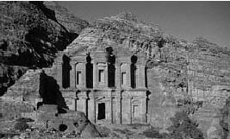
Petra: Common Linear Algebra Foundation
Provides distributed linear algebra objects (operator, matrix, vector)
Three implementations
  Epetra – current production version.
    Real, double precision
    Stable core subset of C++ (circa 2000).
    C and Fortran interfaces
  Tpetra – templated scalar & ordinal fields, STL
  Jpetra – Java, portable to any JVM, interfaces to Java versions of MPI, BLAS, LAPACK
Developers: Mike Heroux, Rob Hoekstra, Alan Williams, Paul Sexton

Slide 12
Teuchos
Portable utility package of commonly useful tools:
  ParameterList class: key/value pair database, recursive capabilities.
  LAPACK, BLAS wrappers (templated on ordinal and scalar type).
  Dense matrix and vector classes (compatible with BLAS/LAPACK).
  FLOP counters, timers.
  Ordinal, Scalar Traits support: Definition of ‘zero’, ‘one’, etc.
  Reference counted pointers / arrays, and more…
Takes advantage of advanced features of C++:
  Templates
  Standard Template Library (STL)
Teuchos::ParameterList:
  Allows easy control of solver parameters.
  XML format input/output.
Developers: Roscoe Barlett, Kevin Long, Heidi Thornquist, Mike Heroux,
Paul Sexton, Kris Kampshoff, Chris Baker
Notes:
Teuchos is being designed as an optional utility package that takes advantage of some of the more advanced features of C++, including templates and the STL.
Planned features for Teuchos include: a parameter list of arbitrary types, a memory management package, and templated interfaces to the BLAS, LAPACK and a dense matrix class.
My talk will focus on the templated interface to the BLAS. First, I’ll give you a brief background on the BLAS and C++ templates.

Slide 13
Thyra
High-performance, abstract interfaces for linear algebra
Offers flexibility through abstractions to algorithm developers
Linear solvers (Direct, Iterative, Preconditioners)
  Abstraction of basic vector/matrix operations (dot, axpy, mv).
  Can use any concrete linear algebra library (Epetra, PETSc, BLAS).
Nonlinear solvers (Newton, etc.)
  Abstraction of linear solve (solve Ax=b).
  Can use any concrete linear solver library:
    AztecOO, Belos, ML, PETSc, LAPACK
Transient/DAE solvers (implicit)
  Abstraction of nonlinear solve.
  … and so on.
Developers: Roscoe Bartlett, Kevin Long
Notes:
Many different kinds of numerical problems and algorithms for solving those problems are used in scientific computing
Just some of the categories of problems and algorithms are:

Slide 14
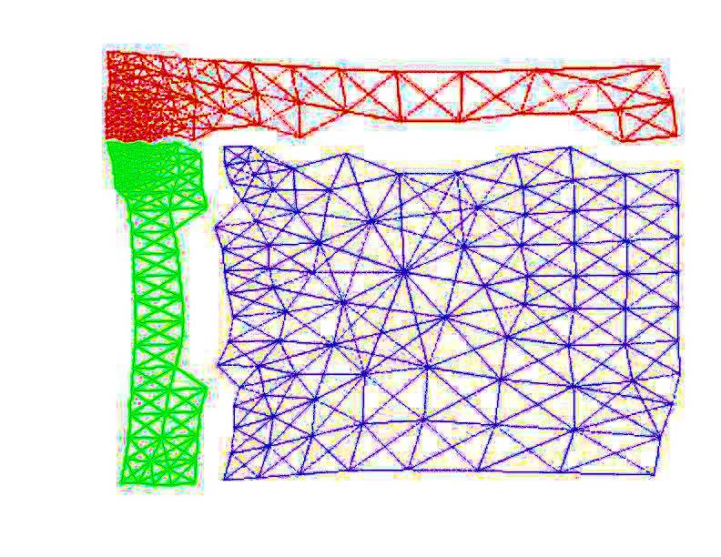
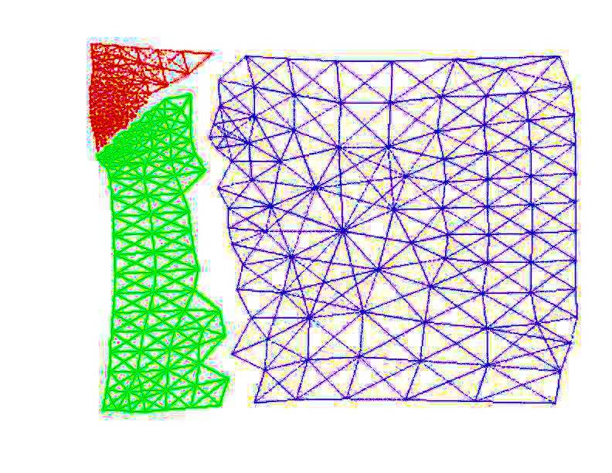
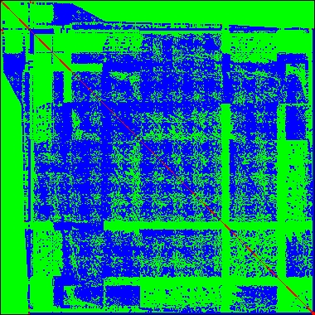
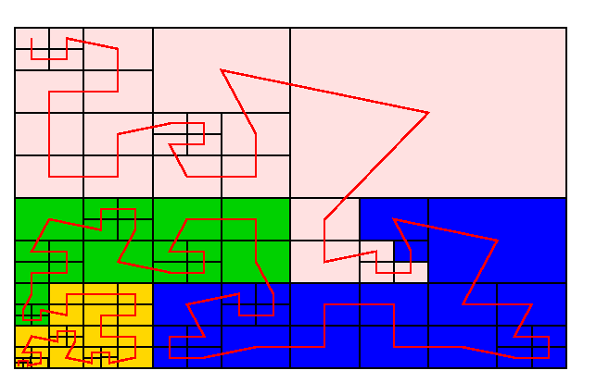
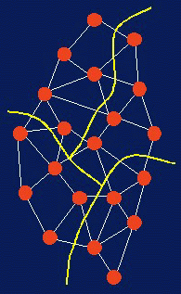
Zoltan
Data Services for Dynamic Applications
  Dynamic load balancing
  Graph coloring
  Data migration
  Matrix ordering
Partitioners:
  Geometric (coordinate-based) methods:
    Recursive Coordinate Bisection (Berger, Bokhari)
    Recursive Inertial Bisection (Taylor, Nour-Omid)
    Space Filling Curves (Peano, Hilbert)
    Refinement-tree Partitioning (Mitchell)
  Hypergraph and graph (connectivity-based) methods:
    Hypergraph Repartitioning PaToH (Catalyurek)
    Zoltan Hypergraph Partitioning
    ParMETIS (U. Minnesota)
    Jostle (U. Greenwich)
Developers: Karen Devine, Eric Boman, Robert Heaphy

Slide 15
Whirlwind Tour of Packages
Core Discretizations & Methods Solvers

Slide 16
Intrepid
Interoperable Tools for Rapid Development of Compatible Discretizations
Intrepid offers an innovative software design for compatible discretizations:
  allows access to FEM, FV and FD methods using a common API
  supports hybrid discretizations (FEM, FV and FD) on unstructured grids
  supports a variety of cell shapes:
    standard shapes (e.g. tets, hexes): high-order finite element methods
    arbitrary (polyhedral) shapes: low-order mimetic finite difference methods
  enables optimization, error estimation, V&V, and UQ using fast invasive techniques (direct support for cell-based derivative computations or via automatic differentiation)
Λ^{k}
Forms
Reduction
{C⁰,C¹,C²,C³}
Discrete forms
d,d*,⬆,∧,(,)
Operations
Cell Data
D,D*,W,M
Discrete ops.
Reconstruction
Higher order
General cells
Pullback: FEM
Direct: FV/D
Developers: Pavel Bochev and Denis Ridzal
Notes:
Reduce text at the top
Remove the red line from slide

Slide 17
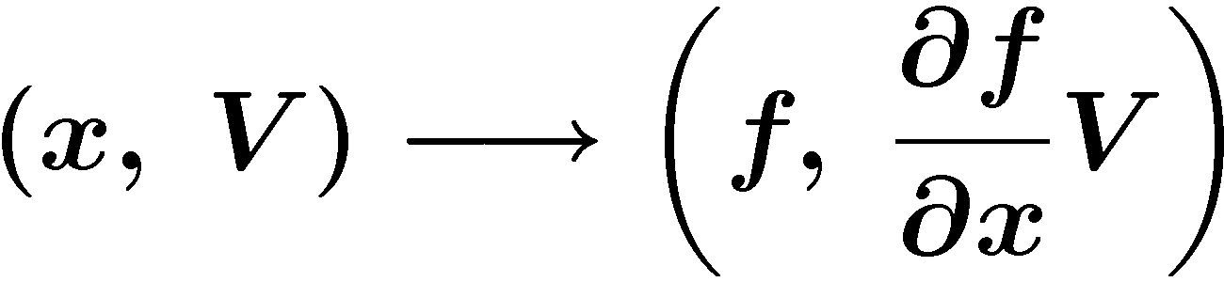
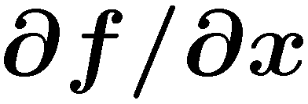
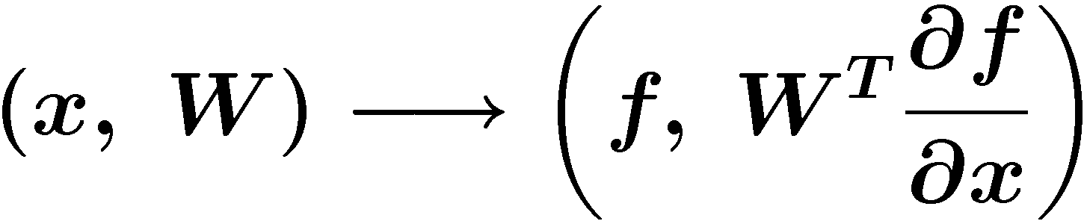
Sacado: Automatic Differentiation
Efficient OO based AD tools optimized for element-level computations
Applies AD at “element”-level computation
  “Element” means finite element, finite volume, network device,…
Template application’s element-computation code
  Developers only need to maintain one templated code base
Provides three forms of AD
  Forward Mode:
    Propagate derivatives of intermediate variables w.r.t. independent variables forward
    Directional derivatives, tangent vectors, square Jacobians, when m ≥ n.
  Reverse Mode:
    Propagate derivatives of dependent variables w.r.t. intermediate variables backwards
    Gradients, Jacobian-transpose products (adjoints), when n > m.
  Taylor polynomial mode:
  Basic modes combined for higher derivatives.
Developers: Eric Phipps, David Gay
Notes:
That takes me to the Sandia AD project called Sacado, which means roughly “I have derived” in Spanish.
This structure is the many Sandia application codes are element-based where the global computation is a linear combination of small element-level compuations
Element can mean an element in a finite element code, a cell in a finite volume code, a device in a network simulation, etc…
We can use AD to compute element-level derivatives that are manually summed into global derivative.
These element computations are well suited for AD since they involve many fewer independent and dependent variables, I.e., up to a few hundred as opposed to millions for the global computation, and also don’t involve any parallel communication, typically.
Because of simplicity of element-level computation, we can use simple but fast OO AD tools
We’ve been using this package Tfad for forward mode, but are rewriting it since it is no longer a supported library
We’re using a package called Rad developed by David Gay for reverse mode, which is a less general but much more efficient implementation of reverse-mode AD than other packages like ADOL-C
To apply these tools, you have to change the types in the code from floats/doubles to the AD types for Tfad and Rad
We can make that process more efficient by templating the application code using C++ templates
By instantiating the templates classes on floats/doubles, you get the original computation and by instantiating them on the AD types you get the AD computation
Means developers only need to develop and maintain one templated code base
Makes it easy to add new AD types since you only need to add new instantiations
We’ve been developing these ideas in Charon, a large-scale finite element semiconductor device and reacting fluid flow simulation code that you’ve heard about before
We’ve templated both the finite-element residual computation in Charon and the electric current calculation
Having AD just in Charon is allowing us to directly impact important projects such as QASPR
I just presented this work at an AD workshop at ICCS a week ago, which made me realize just how different this approach is than what people are typically doing in the AD community
This is a much more lower-level, intrusive approach designed to be used by code developers who are experts on the structure of their codes instead of a black-box, all or nothing approach for people who may not know anything about the internals of the code
Difference is the approach:
By applying AD at element-level , eliminate all of the difficulties of applying AD to a large-scale code (cross-country accumulation, MPI, etc…)
By templating app, we can use simple, highly specialized tools that are fast (ADOL-C tries to do everything with one type)

Slide 18
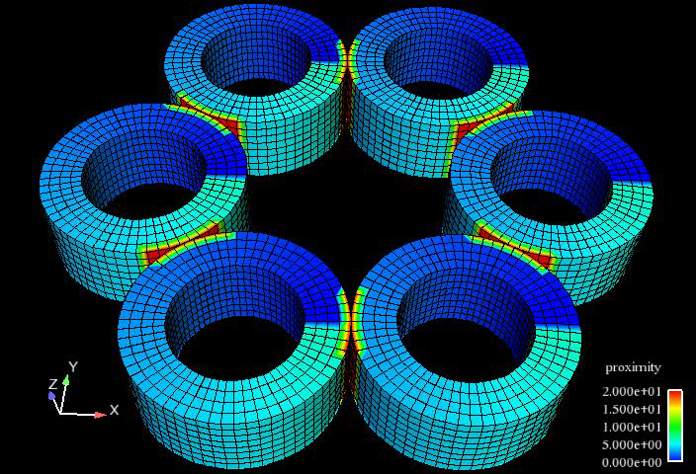
phdMesh
Highly portable & compact
  parallel heterogeneous dynamic unstructured mesh library
  parallel geometric proximity search
  dynamic load balancing
Geometric proximity search is a performance constraining kernel for contact detection and multiphysics loose-coupling.
Dynamic mesh modification is a performance constraining capability for adaptive applications.
Exploits hybrid parallelization – single algorithm for distributed (MPI) + local (threads) + serial proximity search.
Provides a superset of a much larger Sandia mesh subsystem’s capabilities with an API and implementation 1/10 of the size.
Research effort for advanced applications concepts:
  scaling studies
  performance interaction between load balancing and geometric search
  explore hybrid distributed/local parallelization of other application kernels in anticipation of manycore architectures.
Notes:
phdMesh not only provides a first-of-a-kind explicit dynamics micro-application, but will also provide Trilinos with a fully-functional state-of-the-art mesh library in Trilinos 9.0.
Furthermore, the algorithms developed in phdMesh are being incorporated into existing Sandia applications directly.

Slide 19
Whirlwind Tour of Packages
Core Discretizations & Methods Solvers

Slide 20
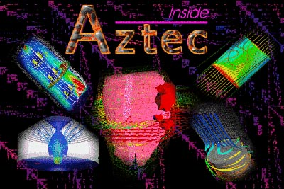
AztecOO
Krylov subspace solvers: CG, GMRES, Bi-CGSTAB,…
Preconditioners: Incomplete factorizations, SOR, polynomial
Based on Aztec library (written in C):
  Extracted from MPSalsa reacting flow code.
  Installed in dozens of Sandia apps.
  1900+ external licenses.
AztecOO improves on Aztec by:
  Using Epetra objects for defining matrix and RHS.
  Providing more preconditioners/scalings.
  Using C++ class design to enable more sophisticated use.
AztecOO interfaces allow:
  Continued use of Aztec for functionality.
  Introduction of new solver capabilities outside of Aztec.
Developers: Mike Heroux, Alan Williams, Ray Tuminaro

Slide 21
IFPACK: Algebraic Preconditioners
Overlapping Schwarz preconditioners with incomplete factorizations, block relaxations, block direct solves.
  Accepts user matrix via abstract Epetra matrix interfaces
  Simple perturbation stabilizations, condition estimation
  Separates graph construction from factorization
Interface to sparse direct solvers (KLU, UMFPACK, SuperLU, MUMPS, ScaLAPACK)
  Single, clear, consistent interface. Common look-and-feel for all classes
  Separation from specific solver details
  Serial and distributed solvers; Amesos handles data redistribution
  Native solvers: KLU and Paraklete
Developers: Marzio Sala, Mike Heroux, Heidi Thornquist
Amesos
Developers: Heidi Thornquist Ken Stanley, Marzio Sala, Tim Davis
Notes:
JJH: TODO animate to make less cluttered

Slide 22
Anasazi
Next-generation eigensolver library, written in templated C++.
Provide a generic framework for developing iterative algorithms for solving large-scale eigenproblems.
Algorithm implementation is accomplished through the use of traits classes and abstract base classes:
  Operator-vector products: Anasazi::MultiVecTraits, Anasazi::OperatorTraits
  Orthogonalization: Anasazi::OrthoManager, Anasazi::MatOrthoManager
  Status tests: Anasazi::StatusTest, Anasazi::StatusTestResNorm
  Iteration kernels: Anasazi::Eigensolver
  Eigensolver managers: Anasazi::SolverManager
  Eigenproblem: Anasazi::Eigenproblem
  Sort managers: Anasazi::SortManager
Currently has solver managers for three eigensolvers:
  Block Krylov-Schur
  Block Davidson
  LOBPCG
Can solve:
  standard and generalized eigenproblems
  Hermitian and non-Hermitian eigenproblems
  real or complex-valued eigenproblems
Developers: Heidi Thornquist, Mike Heroux, Chris Baker,
Rich Lehoucq, Ulrich Hetmaniuk

Slide 23
NOX: Nonlinear Solvers
Suite of nonlinear solution methods
Newton-type methods.
Uses abstract vector and “group” interfaces:
  Flexible selection and tuning of various direction & line search strategies
  Epetra/AztecOO/ML, LAPACK, PETSc implementations of abstract vector/group interfaces.
Designed to be easily integrated into existing applications.
Developers: Roger Pawlowski, Russ Hooper, Eric Phipps
LOCA
Library of continuation algorithms
  Zero order, first order, & arc length continuation
  multi-parameter (via Henderson's MF Library)
  Turning point, pitchfork bifurcation, Hopf bifurcation
  Phase transition continuation
  Eigenvalue approximation (via ARPACK or Anasazi)
Developers: Andy Salinger, Eric Phipps

Slide 24
MOOCHO & Aristos
MOOCHO: Multifunctional Object-Oriented arCHitecture for Optimization
  Large-scale invasive simultaneous analysis and design (SAND) using reduced space SQP methods.
Aristos: Optimization of large-scale design spaces
  Invasive optimization approach based on full-space SQP methods.
  Efficiently manages inexactness in the inner linear system solves.
Developer: Roscoe Bartlett
Developer: Denis Ridzal

Slide 25
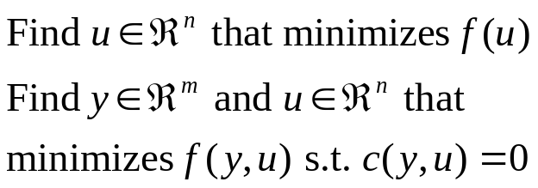
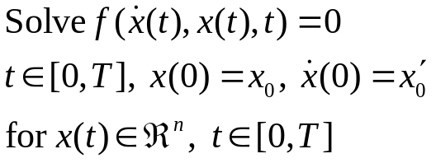
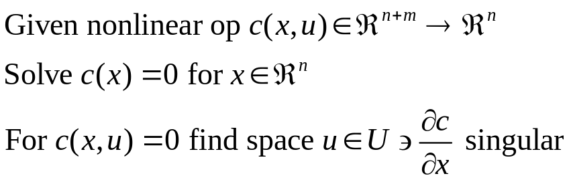
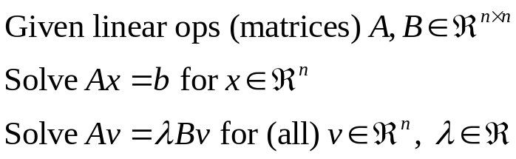
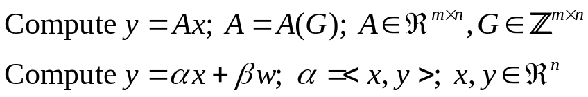
Full “Vertical” Solver Coverage
Trilinos Packages
Optimization Problems:
  Unconstrained:
  Constrained:
MOOCHO,
Aristos
Transient Problems:
  DAEs/ODEs:
Rythmos
Nonlinear Problems:
  Nonlinear equations:
  Stability analysis:
NOX
LOCA
Implicit Linear Problems:
  Linear equations:
  Eigen problems:
AztecOO, Belos,
Ifpack,ML,etc.
Anasazi
Explicit Linear Problems:
  Matrix/graph equations:
  Vector problems:
Epetra, Tpetra
Notes:
Many different kinds of numerical problems and algorithms for solving those problems are used in scientific computing
Just some of the categories of problems and algorithms are:

Slide 26
Trilinos Availability / Information
Trilinos and related packages are available via LGPL.
Current release (8.0) is “click release”. Unlimited availability.
  1800+ Downloads since 3/05 (not including internal Sandia users).
  750 registered users:
    57% university, 11% industry, 20% gov’t.
    35% European, 35% US, 10% Asian.
Trilinos Release 8: September 2007.
Trilinos Release 9: Fall, 2008
Trilinos Awards:
  2004 R&D 100 Award.
  SC2004 HPC Software Challenge Award.
  Sandia Team Employee Recognition Award.
  Lockheed-Martin Nova Award Nominee.
Annual Trilinos User Group Meeting @ SNL
  talks available for download
For more info, visit http://trilinos.sandia.gov

