Slide 1
Bag of Tricks for Training-Free Vision-Language-Action Models
Motivation Efficient VLA inference without retraining
The control loop of a frozen VLA policy (Fig. 2 of the paper). Green, orange, purple, and blue boxes mark where the five tricks enter; Redundancy Control is action repeat.
[1] VLA inference is slow. Tens to hundreds of milliseconds per step (60 to 450 ms in our runs), which limits how often the policy can observe, decide, and correct.
[2] Gains are reported in isolation. Training-free tricks are typically evaluated for a specific trick, backbone, benchmark, and implementation, so transfer across models is unknown.
Do the gains transfer across VLA models and environments, or are they configuration-dependent?
Notes:
SLIDE 1 | 13 s | 36 words (2.8 w/s)
NARRATION:
Vision-language-action models are capable but slow. Every policy call runs a vision encoder and a language backbone. Training-free tricks promise cheaper inference, but gains are typically reported for one backbone and one benchmark. Do they transfer?
VISUAL / PRODUCTION NOTE:
Static. Optional: play a short original-policy rollout behind the loop diagram. Pipeline row cropped from Fig. 2(a).

Slide 2
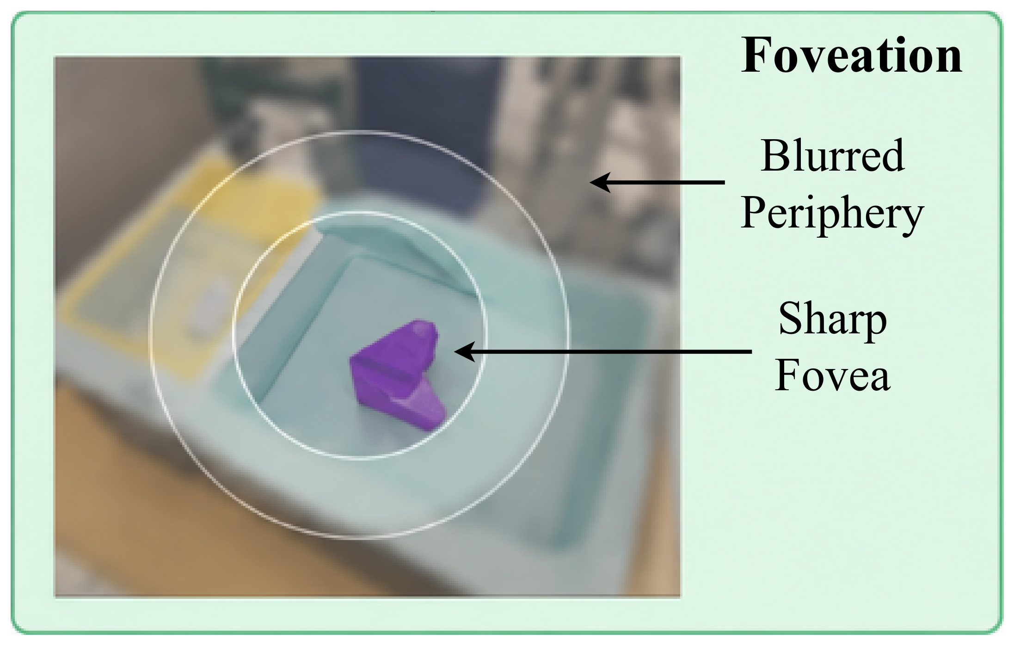
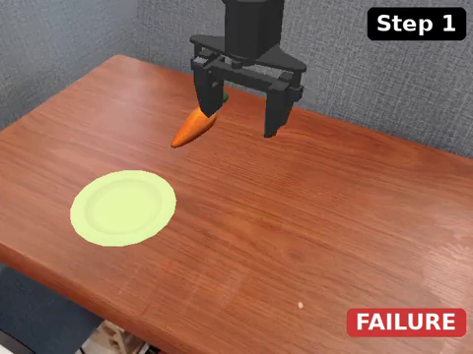
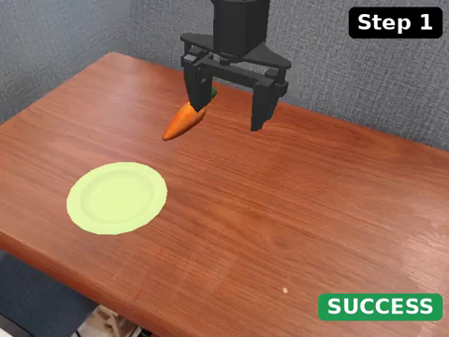
Trick 1 Visual foveation
What to see
Original
Foveation 50%
CogACT, WidowX, "Carrot on the plate", same episode, 2× speed. Green = success, red = failure.
Sharp central disc, progressively blurred periphery
Keep ratio 20% or 50%; token count unchanged
Tests whether high-frequency detail is needed only near the objects and the gripper
Notes:
SLIDE 2 | 11 s | 27 words (2.5 w/s)
NARRATION:
Trick one, visual foveation. The observation keeps a sharp central disc and blurs the periphery. Token count and compute are unchanged. Only what the policy sees changes.
VISUAL / PRODUCTION NOTE:
Left: Fig. 2(a) foveation panel. Right: side-by-side rollout clip.

Slide 3
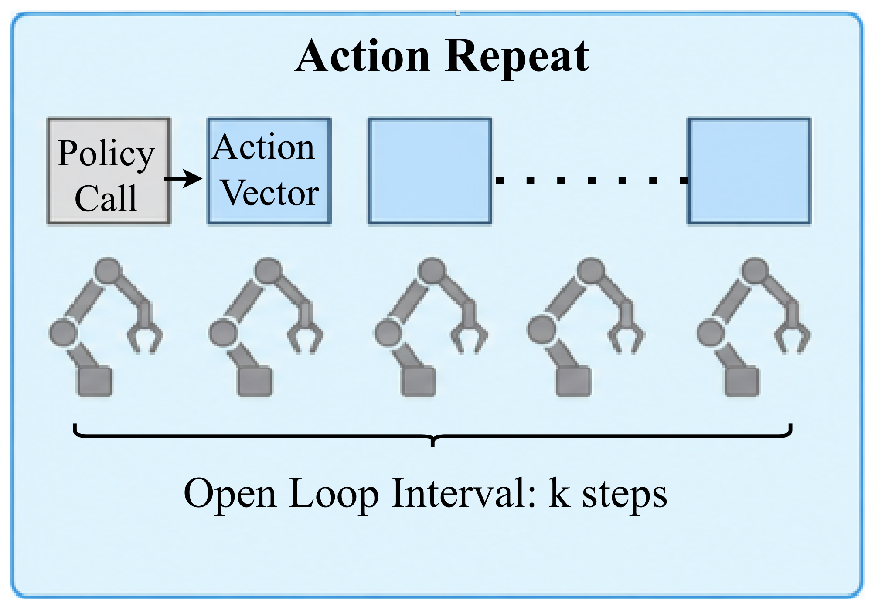
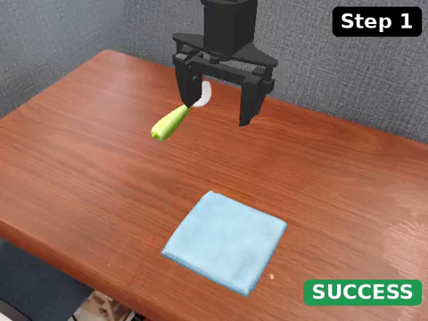
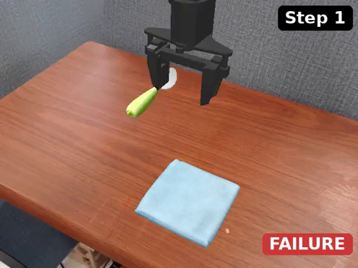
Trick 2 Action repeat
When to act
Original
Action repeat 2
CogACT, WidowX, "Spoon on the towel", same episode, 2× speed. Green = success, red = failure.
Hold each predicted action for k = 2 or 4 steps, about one call per k steps
Cuts policy calls by about k, but lengthens the open-loop interval
Fixed reduction, no state check: a speed-oriented baseline
Notes:
SLIDE 3 | 11 s | 29 words (2.6 w/s)
NARRATION:
Trick two, action repeat. Each predicted action is held for two or four control steps, so the policy is called less often. No state check, a pure speed baseline.
VISUAL / PRODUCTION NOTE:
Left: Fig. 2(a) action repeat panel. Right: side-by-side rollout clip.

Slide 4
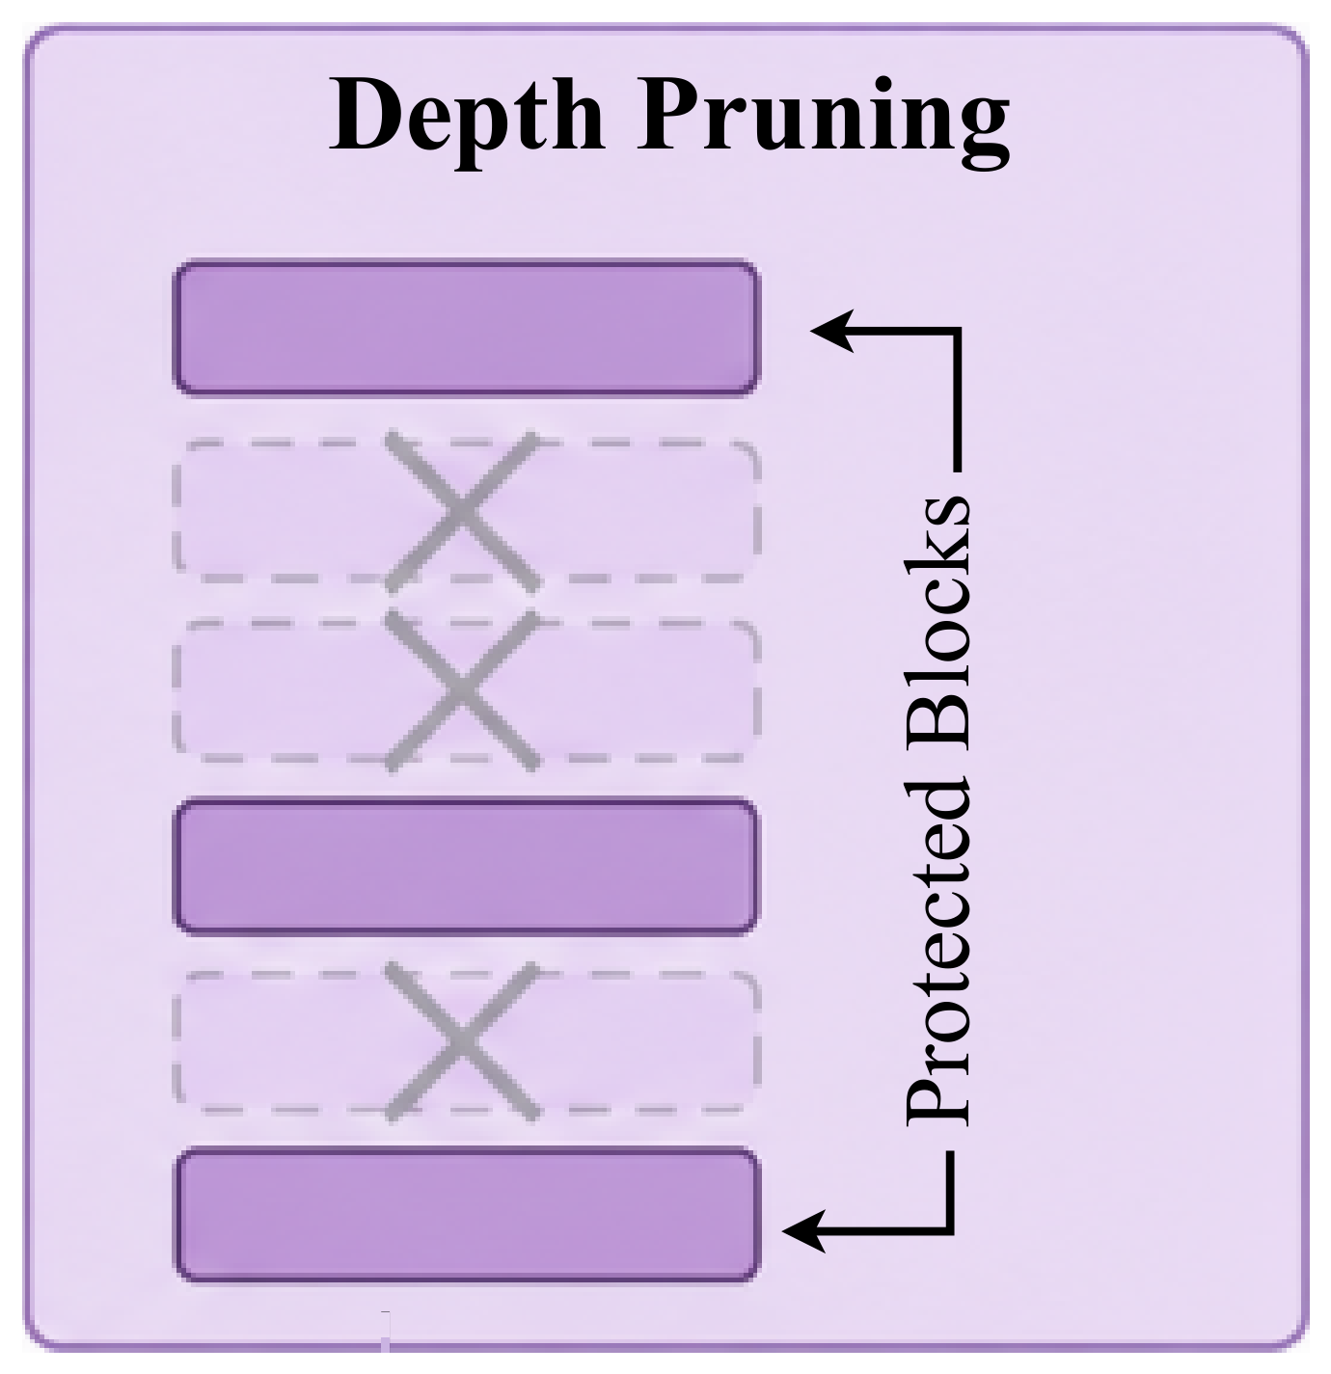
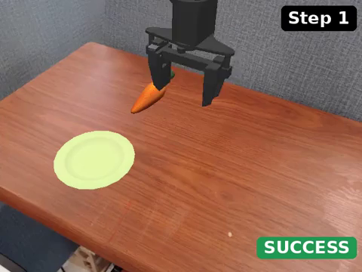
Trick 3 Depth pruning
How much to compute
Original
Depth pruning 1
Score each decoder block by Block Influence
Remove 1, 2, or 4 low-influence blocks; none adjacent, early blocks and the final block kept
Fixed once from calibration data, not adapted at test time
CogACT, WidowX, "Carrot on the plate", same episode, 2× speed. Green = success, red = failure.
Notes:
SLIDE 4 | 12 s | 32 words (2.7 w/s)
NARRATION:
Trick three, depth pruning. Decoder blocks that barely change their hidden states are removed, one, two, or four of them, keeping the early and final blocks. The selection is fixed before evaluation.
VISUAL / PRODUCTION NOTE:
Left: Fig. 2(a) panel. Right: side-by-side rollout clip.

Slide 5
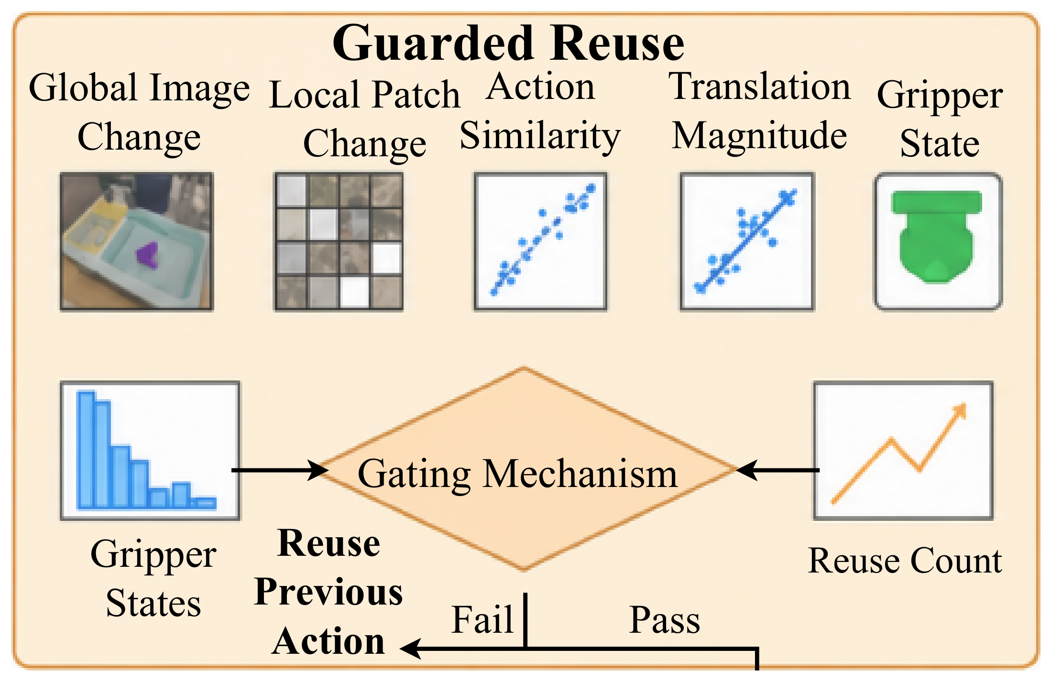
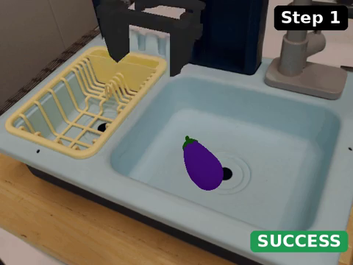

Trick 4 Guarded action reuse
When to act
Original
Reuse strict
CogACT, WidowX, "Eggplant in the basket", same episode, 2× speed. Green = success, red = failure.
Reuse the previous action only when all gates pass: small global and local image change, recent actions agree, translation not near zero, gripper unchanged, reuse count below a cap
Presets: strict, moderate, aggressive
Notes:
SLIDE 5 | 11 s | 28 words (2.5 w/s)
NARRATION:
Trick four, guarded reuse. The previous action is reused only while every gate passes: image change, action agreement, translation, and gripper. Any failed gate restores a full call.
VISUAL / PRODUCTION NOTE:
Left: Fig. 2(a) guarded reuse panel. Right: side-by-side rollout clip with gate overlay.

Slide 6
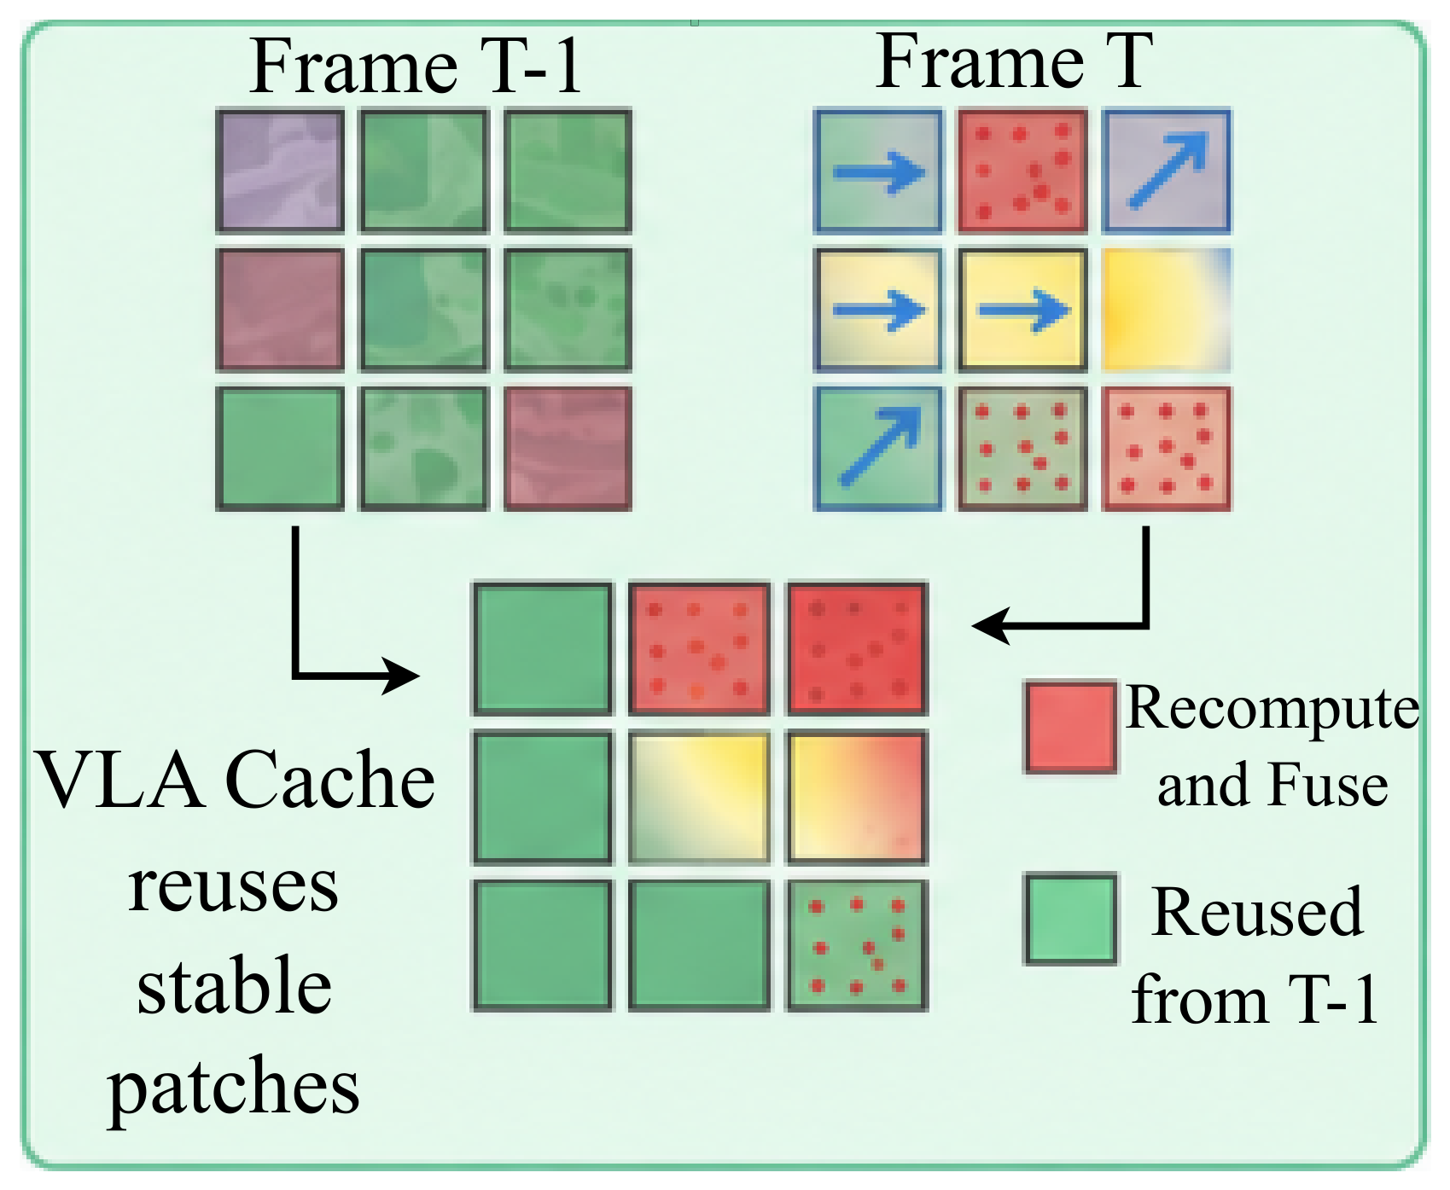
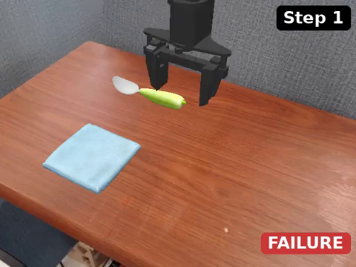
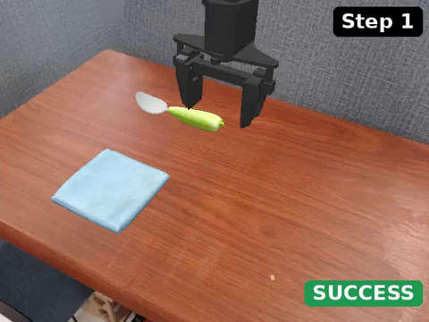
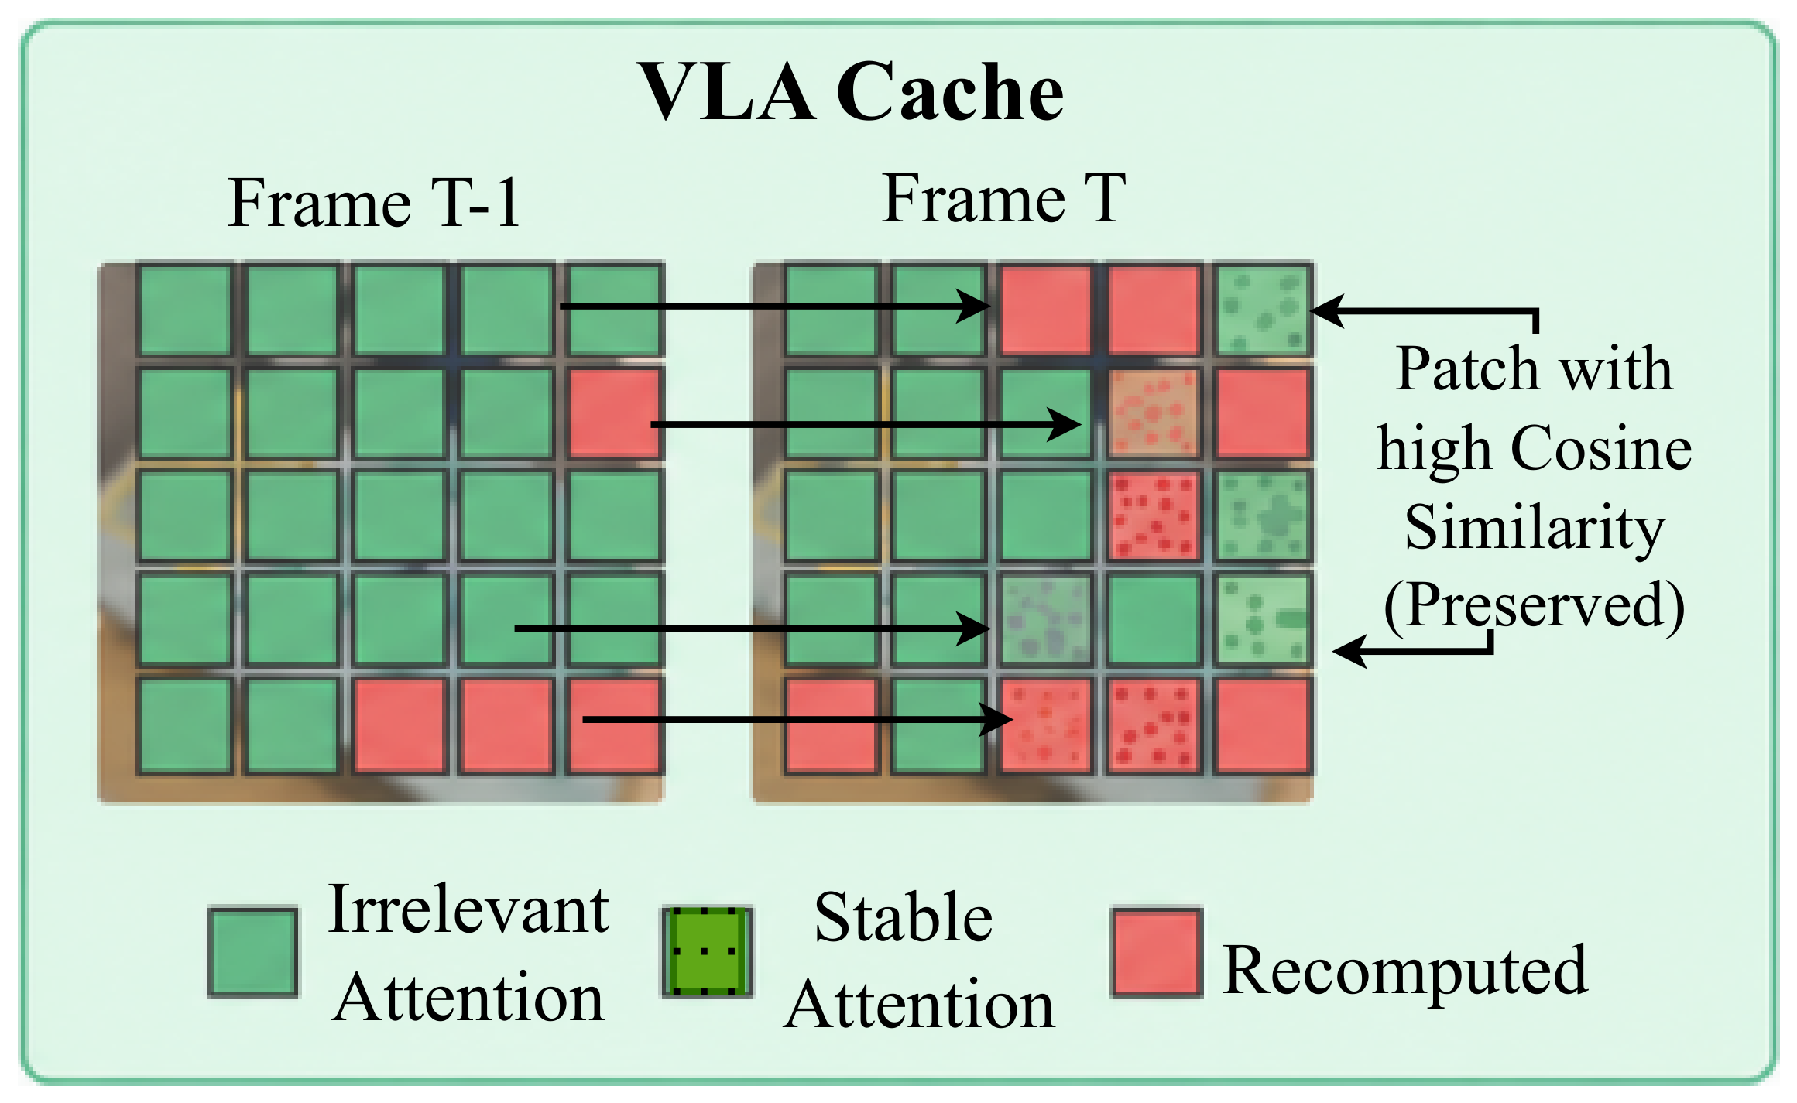
Trick 5 Temporal fusion
How much to compute
Original
Fusion task-aware
Reuse visual tokens of stable patches from the previous call
Recompute patches with motion, local structure, language attention, or in the interaction region
Presets: motion-entropy, task-aware, conservative-adaptive
CogACT, WidowX, "Spoon on the towel", same episode, 2× speed. Green = success, red = failure.
Top: fusion mask. Bottom: VLA-Cache criterion.
Notes:
SLIDE 6 | 12 s | 31 words (2.6 w/s)
NARRATION:
Trick five, temporal fusion. Visual tokens of stable patches are reused from the previous call, while patches with motion, entropy, or language attention are recomputed. The policy still runs every step.
VISUAL / PRODUCTION NOTE:
Left: Fig. 2(a) panel. Right: side-by-side rollout clip.

Slide 7
Results: matched evaluation protocol
Backbone | WidowX | Fractal | LIBERO
CogACT (7.6B) | ● | ●
OpenVLA (7B) | ● | ● | ●
SpatialVLA (4B) | ● | ●
CronusVLA (0.5B) | ● | ●
UniVLA (8.5B) | ● |  | ●
MiniVLA (1B) | ●
SmolVLA (0.45B) |  |  | ●
22
13 + 1
286
backbone × environment pairs
trick settings + original, per pair
trick settings (13 × 22), all paired with the original
Official checkpoints, no retraining
Same task instances and initial states as the original
Latency = wall-clock per environment step
Exact two-sided McNemar test on paired episodes
4 × RTX 5090; tables report the best setting per trick
SimplerEnv WidowX: 4 tasks × 50 episodes. Google Robot/Fractal: 5 tasks × 50. LIBERO: Long, Goal, Object, Spatial, each suite a separate pair (3 × 4 = 12), giving 22 pairs in total.
Notes:
SLIDE 7 | 12 s | 29 words (2.4 w/s)
NARRATION:
Seven backbones, official checkpoints, on WidowX, Fractal, and LIBERO. Thirteen trick settings per pair plus the original, 286 trick settings, each compared with the original on the same episodes.
VISUAL / PRODUCTION NOTE:
286 = 13 trick settings × 22 pairs.

Slide 8
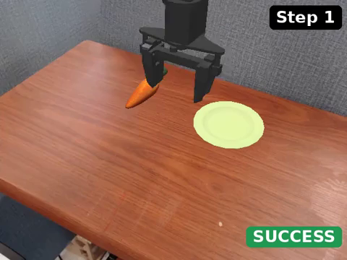
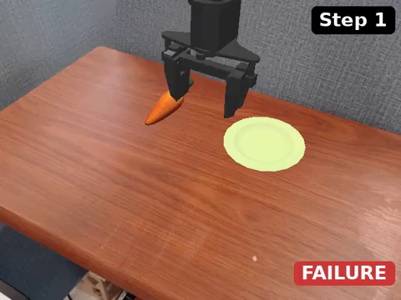

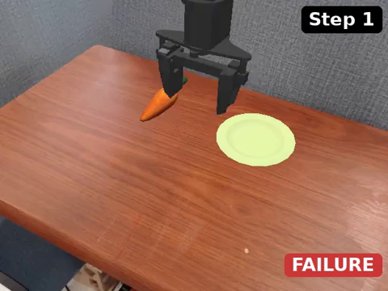

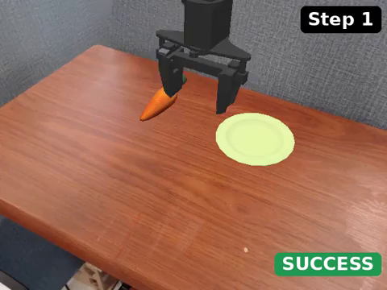

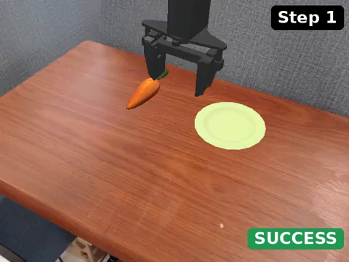




CogACT on SimplerEnv WidowX: "Carrot on the plate"
All 14 configurations on the same episode (same initial state), played at 2× speed. Green = success, red = failure (badge in each clip).
Original
Foveation 20%
Foveation 50%
Action repeat 2
Action repeat 4
Depth pruning 1
Depth pruning 2
Depth pruning 4
Reuse strict
Reuse moderate
Reuse aggressive
Fusion motion/entropy
Fusion task-aware
Fusion conservative
Notes:
SLIDE 8 | 6 s | 13 words (2.2 w/s)
NARRATION:
Now every configuration on one episode. CogACT on WidowX, 6 of 14 succeed.
VISUAL / PRODUCTION NOTE:
Video wall, 14 clips at 2x, longest 6 s; the slide auto-advances after 6 s. Clips auto-play on slide entry.

Slide 9



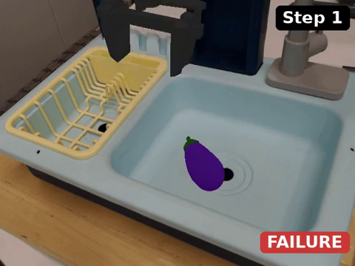









CogACT on SimplerEnv WidowX: "Eggplant in the basket"
All 14 configurations on the same episode (same initial state), played at 3× speed. Green = success, red = failure (badge in each clip).
Original
Foveation 20%
Foveation 50%
Action repeat 2
Action repeat 4
Depth pruning 1
Depth pruning 2
Depth pruning 4
Reuse strict
Reuse moderate
Reuse aggressive
Fusion motion/entropy
Fusion task-aware
Fusion conservative
Notes:
SLIDE 9 | 8 s | 8 words (1.0 w/s)
NARRATION:
Eggplant in the basket: 11 of 14 succeed.
VISUAL / PRODUCTION NOTE:
Video wall, 14 clips at 3x, longest 8 s; the slide auto-advances after 8 s. Clips auto-play on slide entry.

Slide 10










CogACT on SimplerEnv WidowX: "Spoon on the towel"
All 14 configurations on the same episode (same initial state), played at 2× speed. Green = success, red = failure (badge in each clip).
Original
Foveation 20%
Foveation 50%
Action repeat 2
Action repeat 4
Depth pruning 1
Depth pruning 2
Depth pruning 4
Reuse strict
Reuse moderate
Reuse aggressive
Fusion motion/entropy
Fusion task-aware
Fusion conservative
Notes:
SLIDE 10 | 6 s | 8 words (1.3 w/s)
NARRATION:
Spoon on the towel: 11 of 14 succeed.
VISUAL / PRODUCTION NOTE:
Video wall, 14 clips at 2x, longest 6 s; the slide auto-advances after 6 s. Clips auto-play on slide entry.

Slide 11
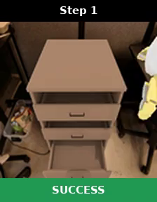
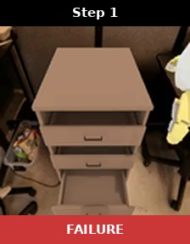
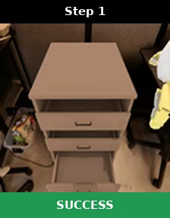
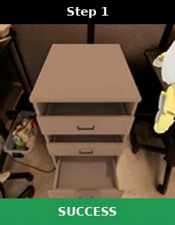
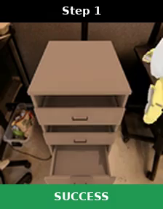




OpenVLA on Google Robot / Fractal: "Close the drawer"
All 12 configurations on the same episode (same initial state), played at 2× speed. Green = success, red = failure (badge in each clip).
Original
Foveation 20%
Foveation 50%
Action repeat 2
Action repeat 4
Depth pruning 1
Depth pruning 2
Depth pruning 4
Reuse strict
Reuse moderate
Reuse aggressive
Fusion motion/entropy
Notes:
SLIDE 11 | 8 s | 12 words (1.5 w/s)
NARRATION:
OpenVLA on Fractal, same episode for every configuration. 9 of 12 succeed.
VISUAL / PRODUCTION NOTE:
Video wall, 12 clips at 2x, longest 8 s; the slide auto-advances after 8 s. Clips auto-play on slide entry.

Slide 12
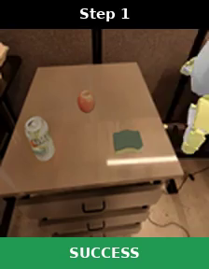
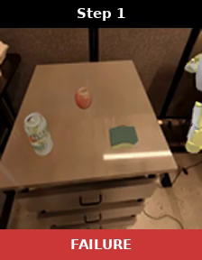
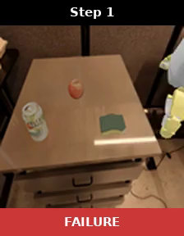

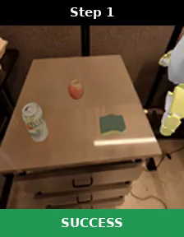


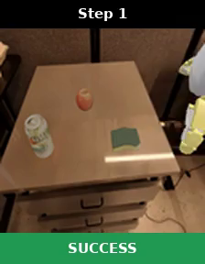

OpenVLA on Google Robot / Fractal: "Move the object near another"
All 12 configurations on the same episode (same initial state), played at 2× speed. Green = success, red = failure (badge in each clip).
Original
Foveation 20%
Foveation 50%
Action repeat 2
Action repeat 4
Depth pruning 1
Depth pruning 2
Depth pruning 4
Reuse strict
Reuse moderate
Reuse aggressive
Fusion motion/entropy
Notes:
SLIDE 12 | 8 s | 9 words (1.1 w/s)
NARRATION:
Move the object near another: 9 of 12 succeed.
VISUAL / PRODUCTION NOTE:
Video wall, 12 clips at 2x, longest 8 s; the slide auto-advances after 8 s. Clips auto-play on slide entry.

Slide 13
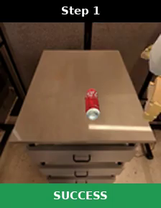
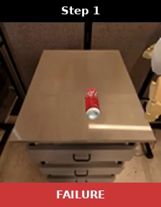

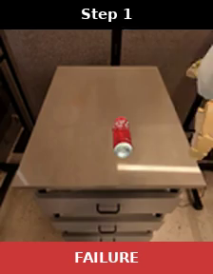


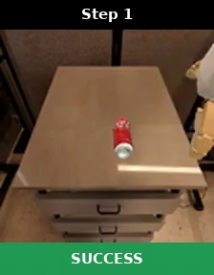
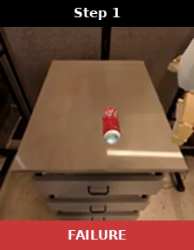

OpenVLA on Google Robot / Fractal: "Pick the coke can"
All 12 configurations on the same episode (same initial state), played at 2× speed. Green = success, red = failure (badge in each clip).
Original
Foveation 20%
Foveation 50%
Action repeat 2
Action repeat 4
Depth pruning 1
Depth pruning 2
Depth pruning 4
Reuse strict
Reuse moderate
Reuse aggressive
Fusion motion/entropy
Notes:
SLIDE 13 | 8 s | 8 words (1.0 w/s)
NARRATION:
Pick the coke can: 9 of 12 succeed.
VISUAL / PRODUCTION NOTE:
Video wall, 12 clips at 2x, longest 8 s; the slide auto-advances after 8 s. Clips auto-play on slide entry.

Slide 14
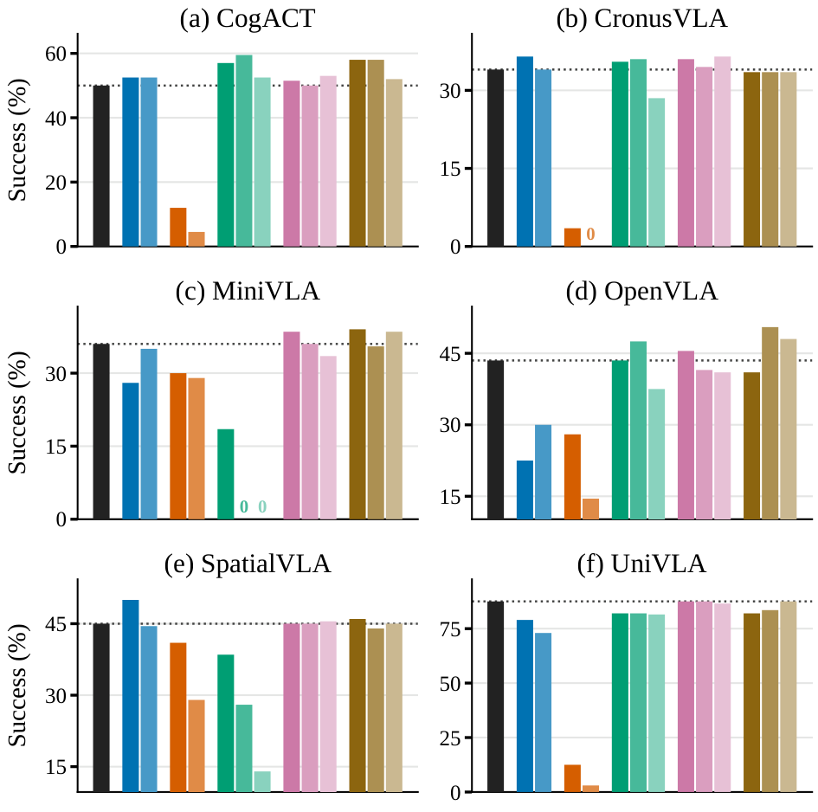
Which tricks preserve success?
Q1 Success
Guarded reuse and temporal fusion are the safest for preserving success.
Selected backbones also gain:
Foveation, WidowX: CogACT +2.5 · SpatialVLA +5.0 · CronusVLA +2.5
Depth pruning, WidowX: CogACT +9.5
Backbone-dependent:
Foveation, LIBERO Goal: UniVLA +7.0 vs SmolVLA −13.0
Action repeat: mainly a speed baseline
Fig. 1: success per configuration, six WidowX backbones (14 bars each, darker to lighter within a trick). Dotted line = original policy, 0 = no successful episodes. Deltas from Tables I and II, best setting per trick.
Original
Foveation
Action repeat
Depth pruning
Guarded reuse
Temporal fusion
Notes:
SLIDE 14 | 12 s | 27 words (2.3 w/s)
NARRATION:
First, success. Guarded reuse and temporal fusion are the safest for preserving success. Foveation and depth pruning help selected backbones. Action repeat is mainly a speed baseline.
VISUAL / PRODUCTION NOTE:
Fig. 1 with a native legend. Optionally enlarge one row of panels at a time.

Slide 15
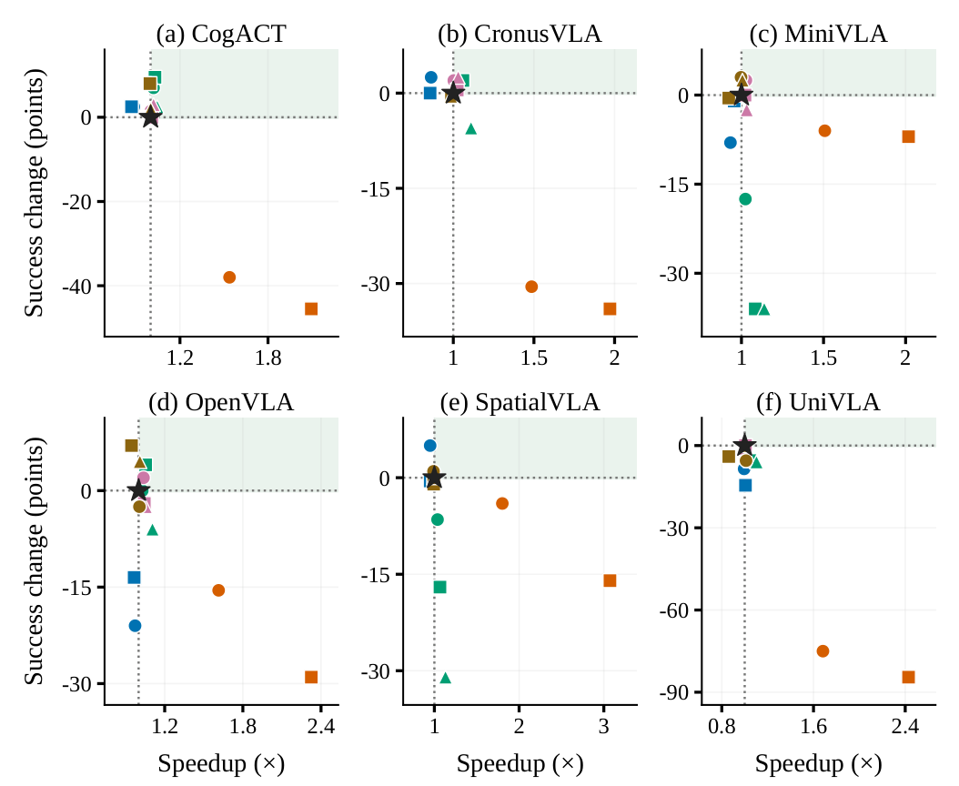
Which tricks are actually faster?
Fig. 4, SimplerEnv WidowX. Star = original, shaded = faster and no worse. Colour = trick; circle, square, triangle = first, second, third setting of that trick.
Q2 Speed
Action repeat gives the largest speedup, depth pruning gives decoder-level savings, guarded reuse gives the safest trade-off.
Latency, ms per step | Original → trick
Repeat · SpatialVLA WidowX | 423.5 → 235.1
Repeat · OpenVLA LIBERO Long | 171.6 → 93.2
Pruning · OpenVLA WidowX | 210.2 → 199.4
Reuse · SmolVLA LIBERO Long | 289.5 → 268.9
Original
Foveation
Action repeat
Depth pruning
Guarded reuse
Temporal fusion
Notes:
SLIDE 15 | 13 s | 32 words (2.5 w/s)
NARRATION:
Second, speed. Action repeat gives the largest speedup. SpatialVLA on WidowX drops from about 424 to 235 milliseconds per step. Depth pruning gives smaller decoder-level savings, and guarded reuse the safest trade-off.
VISUAL / PRODUCTION NOTE:
Paper Fig. 4 with a native colour legend. If the Speechma clip runs longer than 13 s, extend the slide rather than speeding the voice.

Slide 16
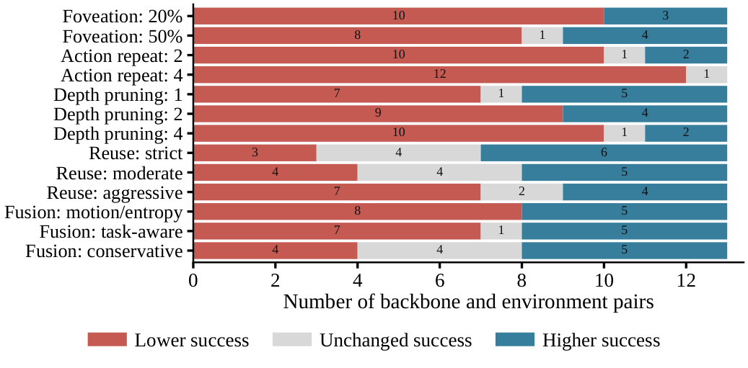
Does the effect transfer across models?
Q3 Transfer
Effects are a joint property of the trick, the backbone, and the task distribution.
Depth pruning, WidowX: CogACT +9.5 · MiniVLA −17.5
Foveation, LIBERO Goal: UniVLA +7.0 · SmolVLA −13.0
Action repeat: often harmful on WidowX, milder on Fractal for some backbones
For each setting: how many of 13 backbone and environment pairs got lower, unchanged, or higher success. LIBERO episodes are pooled over the four suites, so 13 pairs stand for the 22.
No trick is plug-and-play: each one needs matched evaluation under the target backbone and environment.
Notes:
SLIDE 16 | 12 s | 24 words (2.0 w/s)
NARRATION:
Third, consistency. Across backbone and environment pairs the same trick improves one model, leaves another unchanged, and hurts a third. No trick is plug-and-play.
VISUAL / PRODUCTION NOTE:
Consistency chart (supplementary figure, counts from the per-setting records with LIBERO episodes pooled). Do not read the counts aloud.

Slide 17
Takeaways
Guarded reuse
Action repeat
Most reliable. Preserves success, modest speedup when the gates open.
Largest speedup, but the risk of long open-loop execution.
Depth pruning
Foveation · Temporal fusion
Decoder-level savings, benefit depends on the backbone.
Test how much the visual representation can change while the policy stays stable.
VLA efficiency is policy- and environment-dependent. Evaluate every trick under the target backbone and environment before applying it.
Notes:
SLIDE 17 | 12 s | 29 words (2.4 w/s)
NARRATION:
Guarded reuse is most reliable. Action repeat is fastest but risky. Depth pruning is backbone-dependent. Evaluate every trick under the target backbone and environment before applying it. Thank you.
VISUAL / PRODUCTION NOTE:
Final slide. No names, logos, or URLs. Hold 2 s after the narration ends, then fade to black.

