Slide 1
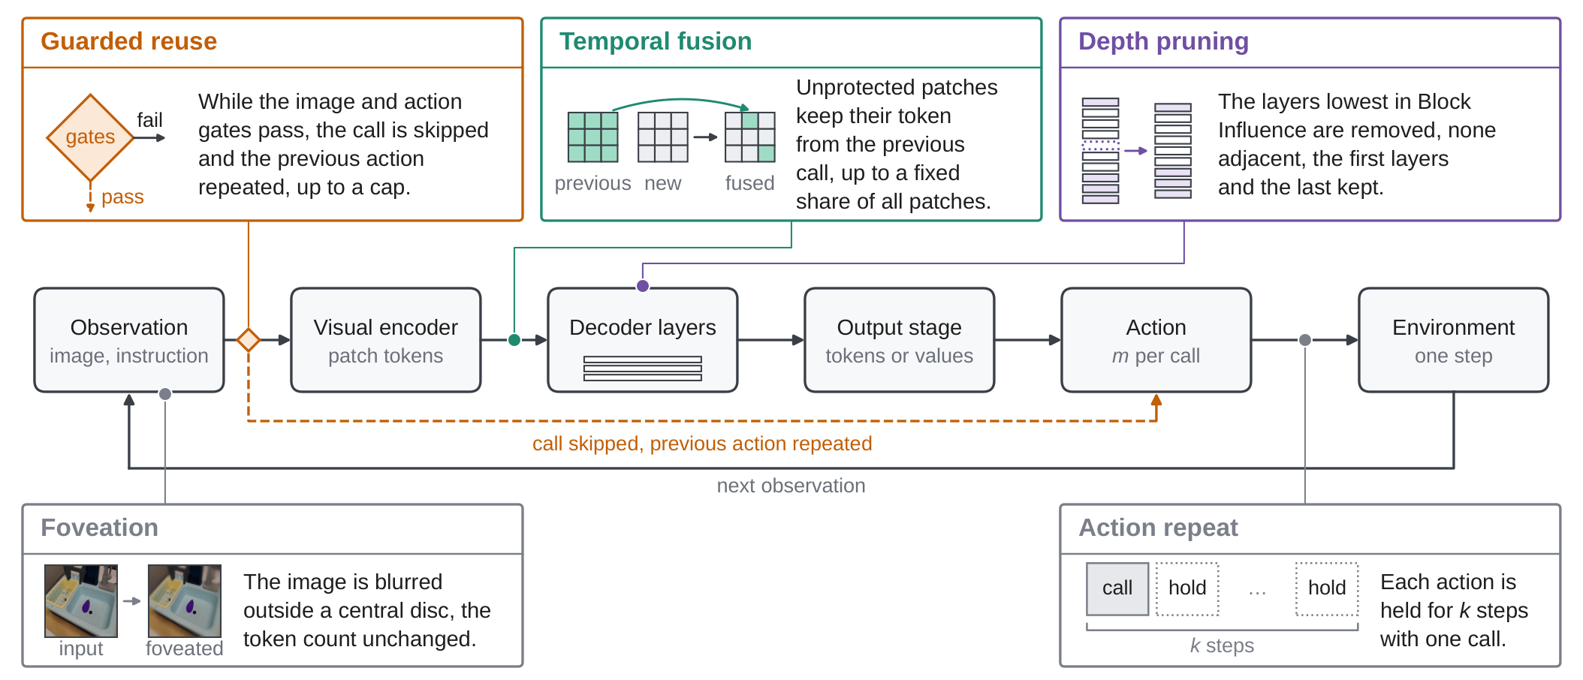
1 · 7s
Bag of Tricks for Training-Free
Vision-Language-Action Models
What to See, When to Act, and How Much to Compute?
Anonymous submission · ICRA 2027 accompanying video
Notes:
SLIDE 1 | 7 s | 13 words (1.9 w/s)
NARRATION:
This video accompanies an anonymous submission on training-free efficiency tricks for vision-language-action models.
VISUAL / PRODUCTION NOTE:
Static title card. No names, affiliations, logos, or URLs anywhere in the video.

Slide 2
2 · 10s
No trick is plug-and-play
Depth pruning on SimplerEnv WidowX, success change in points, three backbones.
CogACT
MiniVLA
SpatialVLA
+9.5
−17.5
−6.5
50.0 → 59.5 %
36.0 → 18.5 %
45.0 → 38.5 %
success
success
success
The same trick helps one model, leaves another unchanged, and hurts a third.
Best setting per trick, Table I of the paper.
Notes:
SLIDE 2 | 10 s | 22 words (2.2 w/s)
NARRATION:
Our headline finding. The same training-free trick, on the same benchmark, helps one model and hurts two others. No trick is plug-and-play.
VISUAL / PRODUCTION NOTE:
Numbers animate in one by one (CogACT, then MiniVLA, then SpatialVLA). All three from Table I, WidowX, depth pruning row.

Slide 3
3 · 10s
VLA models are strong but slow
Image + instruction
▼
Vision encoder
▼
Language backbone
▼
Action
CLIP: one original WidowX rollout
Overlay a live counter "ms per step" (e.g. CogACT 141 ms, SpatialVLA 424 ms).
Record from the evaluation run, 720p, 8-10 s.
Every control step runs a large vision encoder and language backbone
Existing tricks are each reported for one trick, one backbone, one benchmark
Do the gains transfer?
Notes:
SLIDE 3 | 10 s | 24 words (2.4 w/s)
NARRATION:
VLA models are capable but slow. Each control step runs a vision encoder and language backbone. Existing tricks are each reported in one setting.
VISUAL / PRODUCTION NOTE:
Left: recorded original-policy episode with a latency counter burned in. Right: static pipeline stack.

Slide 4
4 · 12s
Five tricks, three axes of the control loop
What to see Foveation
When to act Action repeat · Guarded reuse
How much to compute Depth pruning · Temporal fusion
Notes:
SLIDE 4 | 12 s | 30 words (2.5 w/s)
NARRATION:
We study five training-free tricks along three axes of the control loop. What to see, when to act, and how much to compute. Each trick changes both cost and behavior.
VISUAL / PRODUCTION NOTE:
Fig. 2(a) of the paper. Highlight each trick box in sequence as it is named. The original policy is the unmodified loop and counts as one of six variants.

Slide 5
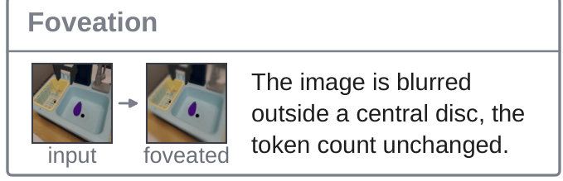
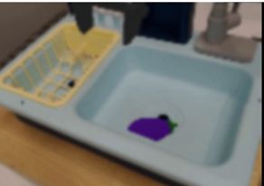
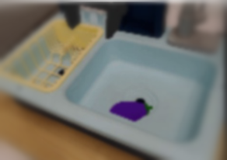

5 · 8s
What to see: visual foveation
Original frame
Keep 20%
Keep 50%
Sharp central disc, progressively blurred periphery
Keep ratio 20% or 50% of the image
Token count unchanged, so this changes information, not FLOPs
Tests whether a policy needs high-frequency detail only near the objects and the gripper.
Notes:
SLIDE 5 | 8 s | 19 words (2.4 w/s)
NARRATION:
What to see. Visual foveation keeps a sharp central disc and blurs the periphery. The token count is unchanged.
VISUAL / PRODUCTION NOTE:
The three frames are a WidowX observation rendered with the foveation mixture at keep ratio 20% and 50% (replace with frames from the actual foveation code if preferred).

Slide 6
6 · 10s
When to act: action repeat vs guarded reuse
Original
policy call every step
Action repeat k = 4
one call, then three held actions
Guarded reuse
skip only while every gate passes
filled = policy call hollow = previous action held green dot = all gates passed
Gates: global and local image change small · recent actions agree · translation not near zero · gripper unchanged · reuse count below cap. Presets: strict, moderate, aggressive.
Notes:
SLIDE 6 | 10 s | 24 words (2.4 w/s)
NARRATION:
When to act. Action repeat holds each action for two or four steps. Guarded reuse skips the policy call only when every gate passes.
VISUAL / PRODUCTION NOTE:
Timeline of policy calls. Optionally animate the dots left to right in step with the narration.

Slide 7
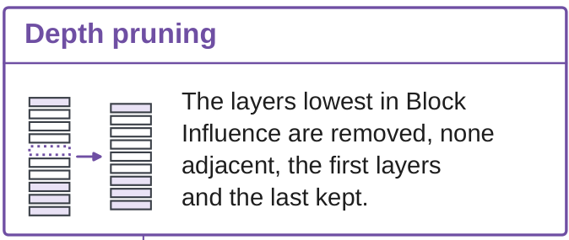
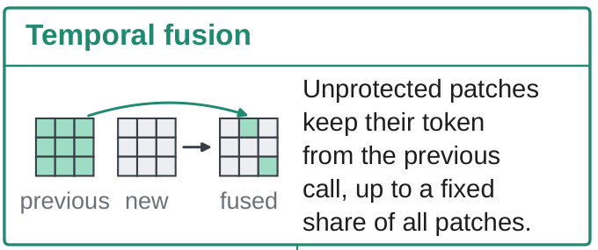
7 · 10s
How much to compute: pruning and fusion
Remove 1, 2, or 4 decoder layers with the lowest Block Influence
None adjacent, first and last layers kept
Selected once from calibration data, fixed before evaluation
Reuse projected visual tokens of stable patches from the previous call
Protect patches with motion, entropy, language attention, or interaction regions
Presets: motion-entropy, task-aware, conservative-adaptive
Notes:
SLIDE 7 | 10 s | 25 words (2.5 w/s)
NARRATION:
How much to compute. Depth pruning removes one, two, or four decoder layers with lowest Block Influence. Temporal fusion reuses visual tokens of stable patches.
VISUAL / PRODUCTION NOTE:
Two crops from Fig. 2(a). Optional: fade out the pruned layers in the left diagram.

Slide 8
8 · 12s
Matched evaluation protocol
Backbone | WidowX | Fractal | LIBERO
CogACT (7.6B) | ● | ●
OpenVLA (7B) | ● | ● | ●
SpatialVLA (4B) | ● | ●
CronusVLA (0.5B) | ● | ●
UniVLA (8.5B) | ● |  | ●
MiniVLA (1B) | ●
SmolVLA (0.45B) |  |  | ●
22
13 + 1
286
backbone × environment pairs
trick settings + original, per pair
trick settings, all paired with the original
Official checkpoints, no retraining
Same task instances and initial states as the original
Latency = wall-clock per environment step
Exact two-sided McNemar test on paired episodes
4 × RTX 5090; tables report the best setting per trick
SimplerEnv WidowX: 4 tasks × 50 episodes. Google Robot/Fractal: 5 tasks × 50. LIBERO: Long, Goal, Object, Spatial.
Notes:
SLIDE 8 | 12 s | 28 words (2.3 w/s)
NARRATION:
Seven open-source backbones, official checkpoints, no retraining, on SimplerEnv WidowX, Fractal, and LIBERO. Thirteen trick settings per pair, 286 settings in total, same initial states, paired McNemar tests.
VISUAL / PRODUCTION NOTE:
286 = 13 trick settings × 22 pairs (the original policy is the 14th configuration of each pair).

Slide 9
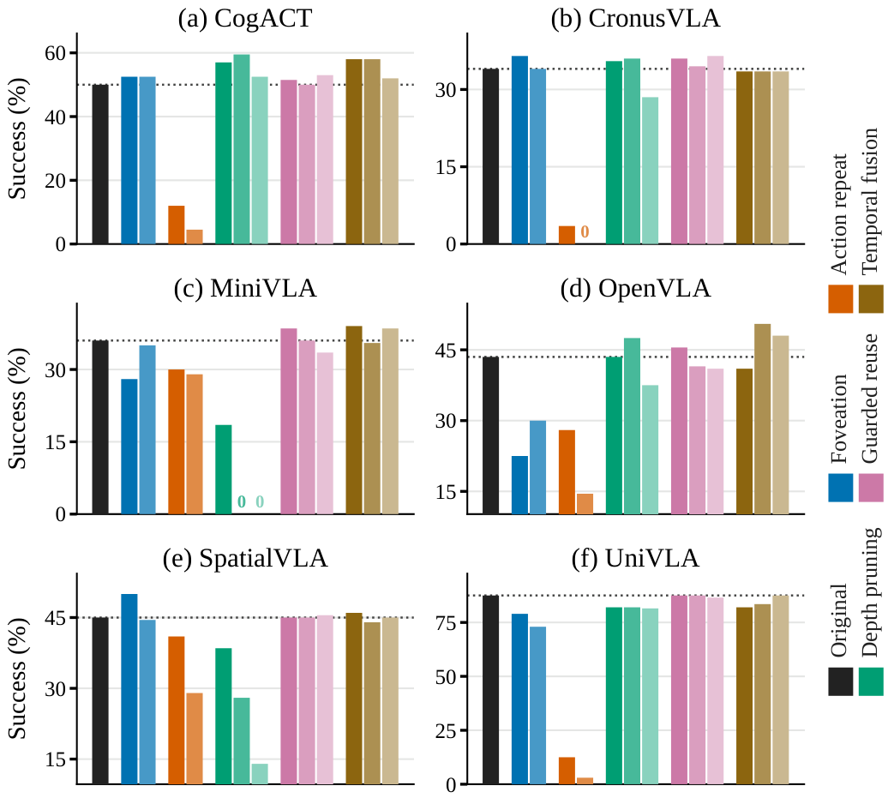
9 · 12s
RQ-1 Which tricks preserve success?
A-1
Guarded reuse and temporal fusion match or improve success for most backbones.
Selected backbones also gain:
Foveation, WidowX: CogACT +2.5 · SpatialVLA +5.0 · CronusVLA +2.5
Depth pruning, WidowX: CogACT +9.5
Foveation, LIBERO Goal: UniVLA +7.0 vs SmolVLA −13.0
Action repeat: mainly a speed baseline
Fig. 1: success per configuration, six WidowX backbones. Dotted line = original policy. Deltas from Tables I and II, best setting per trick.
Notes:
SLIDE 9 | 12 s | 28 words (2.3 w/s)
NARRATION:
First, success. Guarded reuse and temporal fusion match or improve success for most backbones. Foveation and depth pruning help selected backbones. Action repeat is mainly a speed baseline.
VISUAL / PRODUCTION NOTE:
Optionally enlarge one row of the 2×3 panel at a time. Outline guarded-reuse and temporal-fusion bars in green.

Slide 10
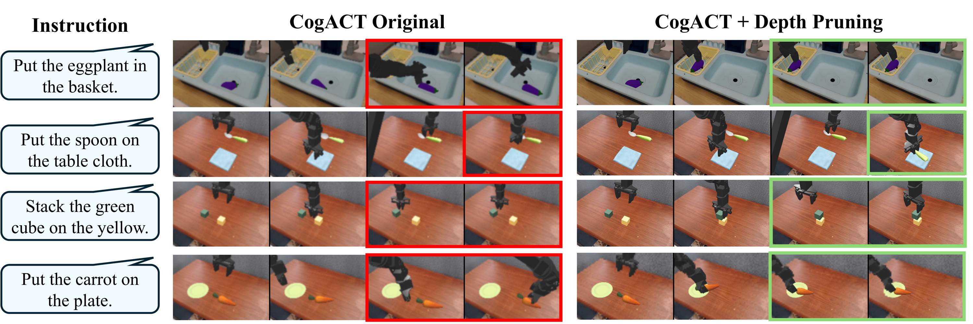
10 · 12s
Depth pruning helps CogACT on WidowX
▶ CLIP: original vs depth pruning (paired episode)
Success 50.0 → 59.5 %
Latency 141.4 → 137.5 ms/step
Red = failure, green = success. Selected episodes, same task instances and initial states. Aggregate values from Table I.
Notes:
SLIDE 10 | 12 s | 25 words (2.1 w/s)
NARRATION:
CogACT on WidowX. In these paired episodes the original fails and depth pruning succeeds. Overall success rises from 50.0 to 59.5, and latency drops slightly.
VISUAL / PRODUCTION NOTE:
Fig. 3(a) strips (Project Page mention cropped off). Bottom-left: side-by-side recorded episode, original left, depth pruning right, success/fail badge at the end.

Slide 11
11 · 10s
Same trick, same benchmark, different backbone
Depth pruning, WidowX
CogACT +9.5
MiniVLA −17.5
CLIP: MiniVLA original
CLIP: MiniVLA + pruning
succeeds (green border)
fails (red border)
SpatialVLA −6.5
Selected episode, same initial state, WidowX
Structural redundancy is not a property of the trick alone. It depends on how each backbone uses its decoder layers during control.
Notes:
SLIDE 11 | 10 s | 24 words (2.4 w/s)
NARRATION:
Same trick, same benchmark, different backbone. On MiniVLA, depth pruning drops success by 17.5 points, on SpatialVLA by 6.5. Here the pruned policy fails.
VISUAL / PRODUCTION NOTE:
Record a MiniVLA WidowX episode from the same task family as slide 10 (e.g. carrot on plate) for original and depth pruning.

Slide 12
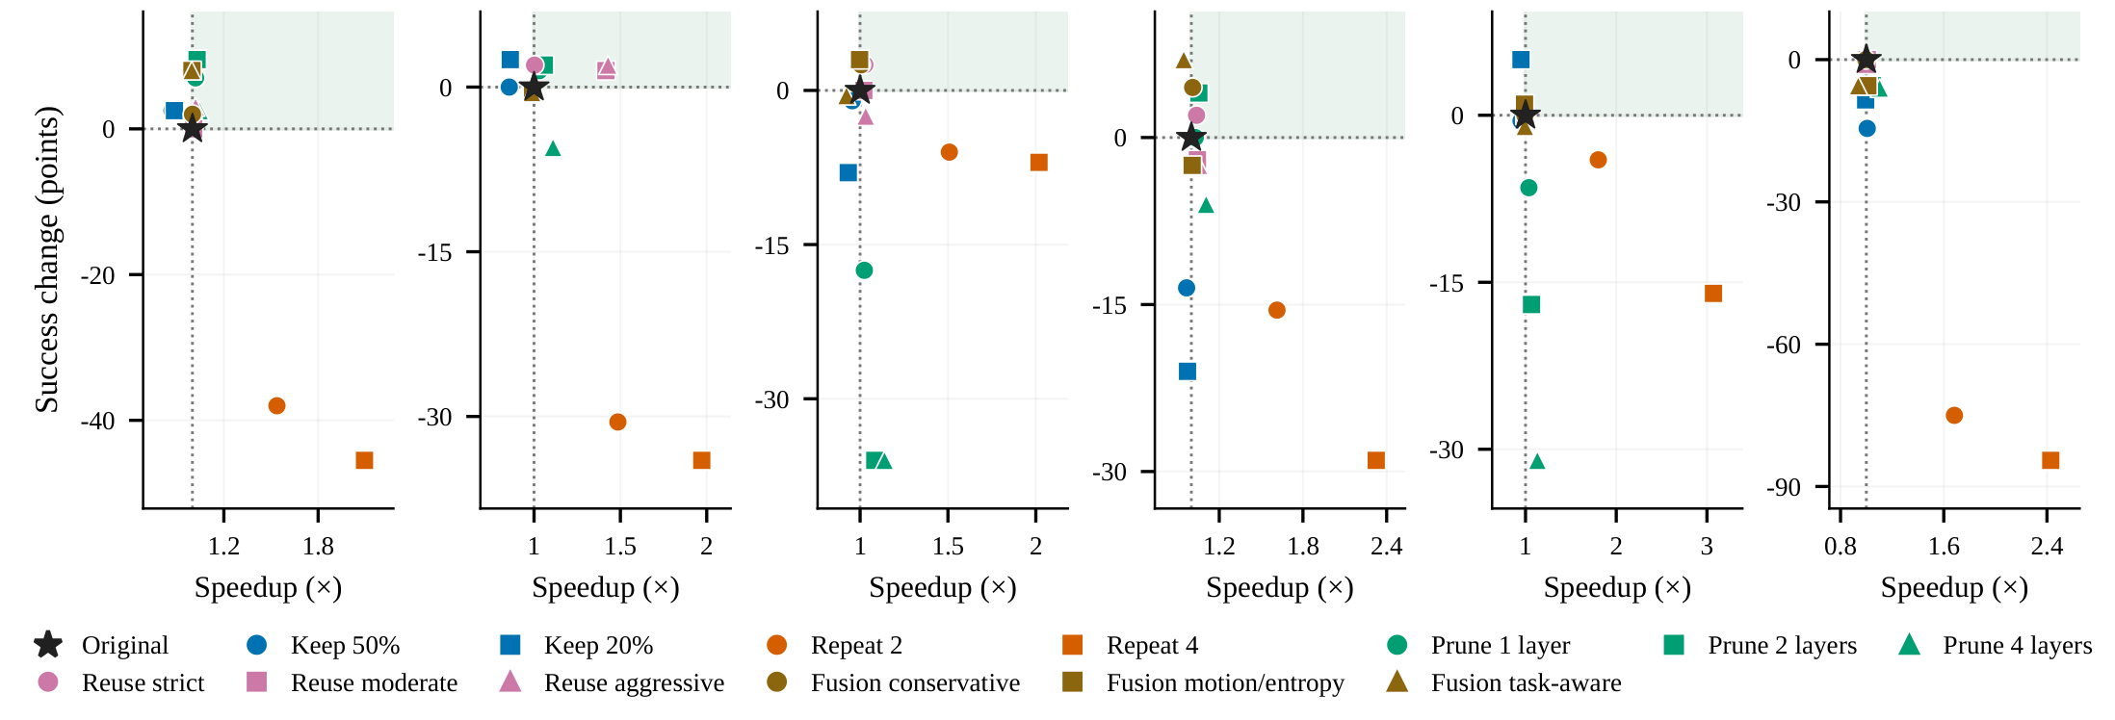
12 · 12s
RQ-2 Which tricks are actually faster?
A-2
Action repeat gives the largest speedup, depth pruning gives practical decoder-level savings, guarded reuse gives the safest trade-off.
Latency, ms per step | Original → trick
Repeat · SpatialVLA WidowX | 423.5 → 235.1
Repeat · OpenVLA LIBERO Long | 171.6 → 93.2
Pruning · OpenVLA WidowX | 210.2 → 199.4
Reuse · SmolVLA LIBERO Long | 289.5 → 268.9
Notes:
SLIDE 12 | 12 s | 25 words (2.1 w/s)
NARRATION:
Second, speed. Action repeat gives the largest speedup. SpatialVLA on WidowX drops from 423.5 to 235.1 milliseconds per step. Depth pruning gives smaller decoder-level savings.
VISUAL / PRODUCTION NOTE:
Fig. 4: speedup vs success change, star = original, shaded = faster and no worse. Highlight the action-repeat points at the far right and the depth-pruning points near the star.

Slide 13
13 · 14s
Open loop has a cost, gating keeps it safe
CLIP: Original
CLIP: Action repeat k = 4
CLIP: Guarded reuse
policy call every step
held actions, episode fails
gates shown, calls skipped only when they pass
policy calls used: ___
policy calls used: ___
policy calls used: ___
Action repeat, WidowX: CogACT −38.0 · UniVLA −75.0
Guarded reuse, SmolVLA LIBERO Long: 289.5 → 268.9 ms
Fractal, some backbones: CogACT −1.2 · SpatialVLA 0.0
success unchanged at 42.0 %
Same CogACT WidowX episode and initial state in all three panels. Deltas from Tables I and II, best setting per trick.
Notes:
SLIDE 13 | 14 s | 35 words (2.5 w/s)
NARRATION:
Action repeat runs open loop. On WidowX, CogACT loses 38 points and UniVLA 75. Guarded reuse skips calls only when the gates agree. SmolVLA on LIBERO Long saves 20 milliseconds per step with success unchanged.
VISUAL / PRODUCTION NOTE:
Three-panel recording of one CogACT WidowX episode: original, action repeat k=4, guarded reuse. Under each panel a "policy calls used" counter; in the third panel a five-gate strip that turns green on skipped steps.

Slide 14
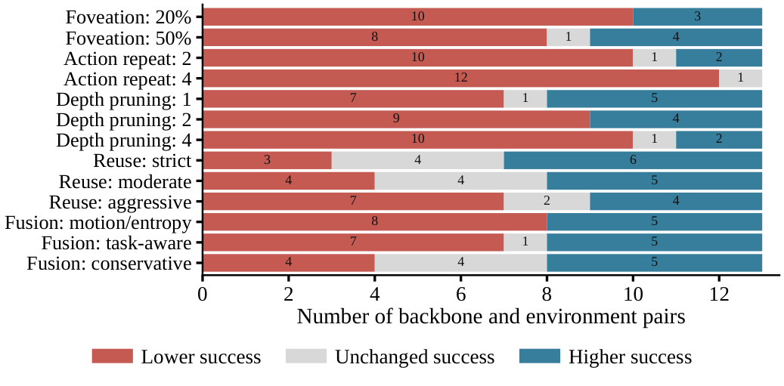
14 · 12s
RQ-3 Does the effect transfer across models?
A-3
Effects are a joint property of the trick, the backbone, and the task distribution.
Depth pruning, WidowX: CogACT +9.5 · MiniVLA −17.5
Foveation, LIBERO Goal: UniVLA +7.0 · SmolVLA −13.0
Action repeat: harmful on WidowX, milder on Fractal for some backbones
For each setting: how many of 13 backbone and environment pairs got lower, unchanged, or higher success (LIBERO suites pooled, so 13 stand for the 22 pairs).
Not plug-and-play: each trick needs matched evaluation under the target backbone and environment.
Notes:
SLIDE 14 | 12 s | 28 words (2.3 w/s)
NARRATION:
Third, consistency. Across backbone and environment pairs the same trick improves one model, leaves another unchanged, and hurts a third. Gains depend on the backbone and the environment.
VISUAL / PRODUCTION NOTE:
Consistency chart (Project Page figure). Do not read the counts aloud. Optionally highlight the depth-pruning and foveation rows.

Slide 15
15 · 10s
Takeaways
Guarded reuse
Action repeat
Most reliable. Preserves success, modest speedup when the gates open.
Largest speedup, but the risk of long open-loop execution.
Depth pruning
Foveation · Temporal fusion
Decoder-level savings, benefit depends on the backbone.
Test how much the visual representation can change while the policy stays stable.
VLA efficiency is policy- and environment-dependent. Evaluate every trick under the target backbone and environment before applying it.
Notes:
SLIDE 15 | 10 s | 27 words (2.7 w/s)
NARRATION:
Guarded reuse is most reliable. Action repeat is fastest but risky. Depth pruning is backbone-dependent. Evaluate every trick under the target backbone and environment before applying it.
VISUAL / PRODUCTION NOTE:
Four verdict cards in the paper's conclusion wording.

Slide 16
16 · 4s
Bag of Tricks for Training-Free Vision-Language-Action Models
Details, per-cell p-values, and all 286 settings are in the paper and its supplementary material.
Anonymous submission · ICRA 2027
Notes:
SLIDE 16 | 4 s | 7 words (1.8 w/s)
NARRATION:
Details are in the paper. Thank you.
VISUAL / PRODUCTION NOTE:
No URLs, names, or logos. Hold 4 s and fade to black.

