Slide 1
Bag of Tricks for Training-Free Vision-Language-Action Models
Motivation Efficient VLA inference without retraining
The control loop of a frozen VLA policy (Fig. 2 of the paper). Green, orange, purple, and blue boxes mark where the five tricks enter; Redundancy Control is action repeat.
[1] VLA inference is slow. Tens to hundreds of milliseconds per step (60 to 450 ms in our runs), which limits how often the policy can observe, decide, and correct.
[2] Gains are reported in isolation. Training-free tricks are typically evaluated for a specific trick, backbone, benchmark, and implementation, so transfer across models is unknown.
Do the gains transfer across VLA models and environments, or are they configuration-dependent?
Vision-language-action models are capable but slow. Every policy call runs a vision encoder and a language backbone. Training-free tricks promise cheaper inference, but gains are typically reported for one backbone and one benchmark. Do they transfer?
Notes:
SLIDE 1 | 15 s | 36 words (2.4 w/s)
NARRATION:
Vision-language-action models are capable but slow. Every policy call runs a vision encoder and a language backbone. Training-free tricks promise cheaper inference, but gains are typically reported for one backbone and one benchmark. Do they transfer?
VISUAL / PRODUCTION NOTE:
Static. Optional: play a short original-policy rollout behind the loop diagram. Pipeline row cropped from Fig. 2(a).

Slide 2
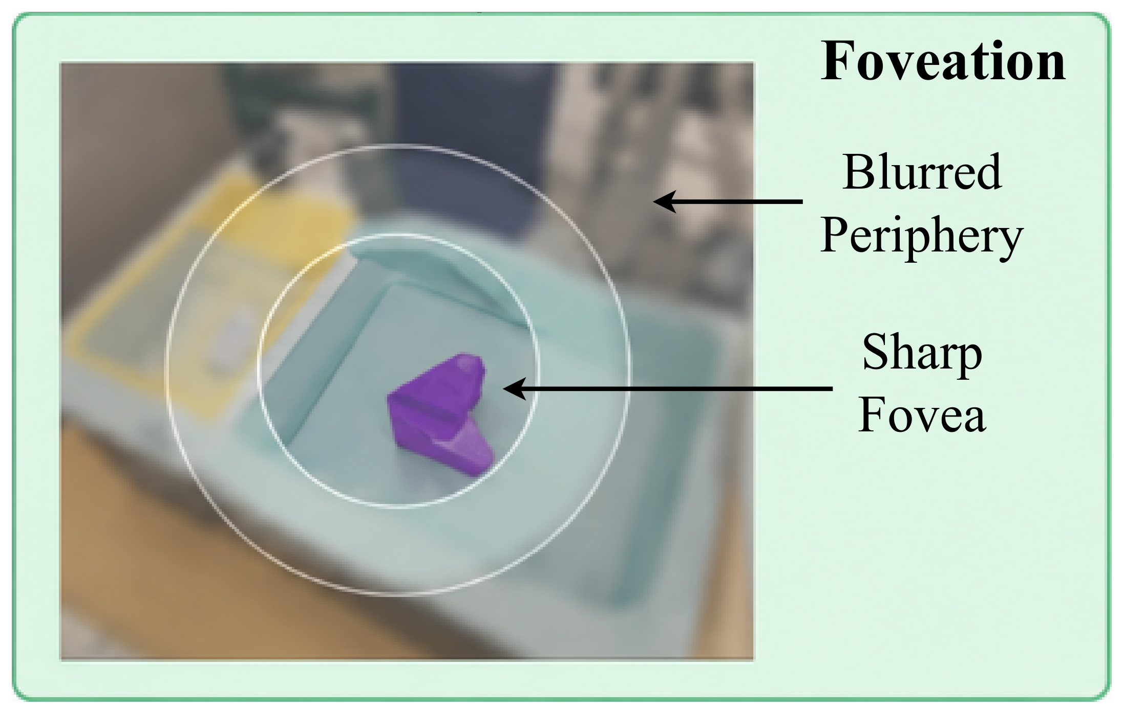
Trick 1 Visual foveation
What to see
CLIP: original vs foveation
same episode, same initial state
Sharp central disc, progressively blurred periphery
Keep ratio 20% or 50%; token count unchanged
Tests whether high-frequency detail is needed only near the objects and the gripper
Rollout: original (left) and foveated observation (right), success or failure badge at the end.
Trick one, visual foveation. The observation keeps a sharp central disc and blurs the periphery. Token count and compute are unchanged. Only what the policy sees changes.
Notes:
SLIDE 2 | 11 s | 27 words (2.5 w/s)
NARRATION:
Trick one, visual foveation. The observation keeps a sharp central disc and blurs the periphery. Token count and compute are unchanged. Only what the policy sees changes.
VISUAL / PRODUCTION NOTE:
Left: Fig. 2(a) foveation panel. Right: side-by-side rollout clip.

Slide 3
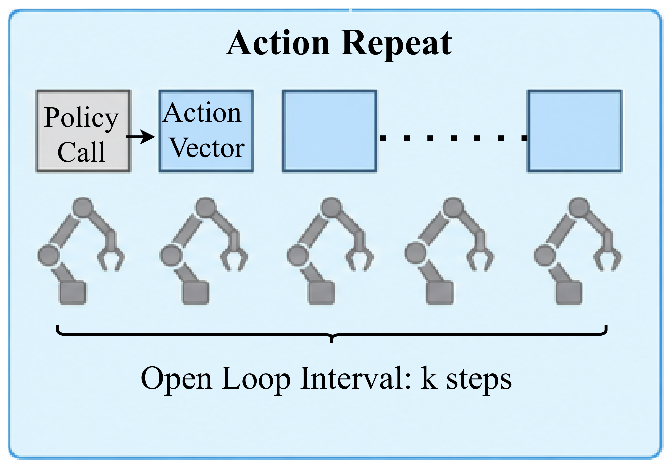
Trick 2 Action repeat
When to act
CLIP: original vs action repeat
same episode, same initial state
Hold each predicted action for k = 2 or 4 steps, about one call per k steps
Cuts policy calls by about k, but lengthens the open-loop interval
Fixed reduction, no state check: a speed-oriented baseline
Rollout: watch contact and placement, where a held action can miss a needed correction.
Trick two, action repeat. Each predicted action is held for two or four control steps, so the policy is called less often. No state check, a pure speed baseline.
Notes:
SLIDE 3 | 11 s | 29 words (2.6 w/s)
NARRATION:
Trick two, action repeat. Each predicted action is held for two or four control steps, so the policy is called less often. No state check, a pure speed baseline.
VISUAL / PRODUCTION NOTE:
Left: Fig. 2(a) action repeat panel. Right: side-by-side rollout clip.

Slide 4
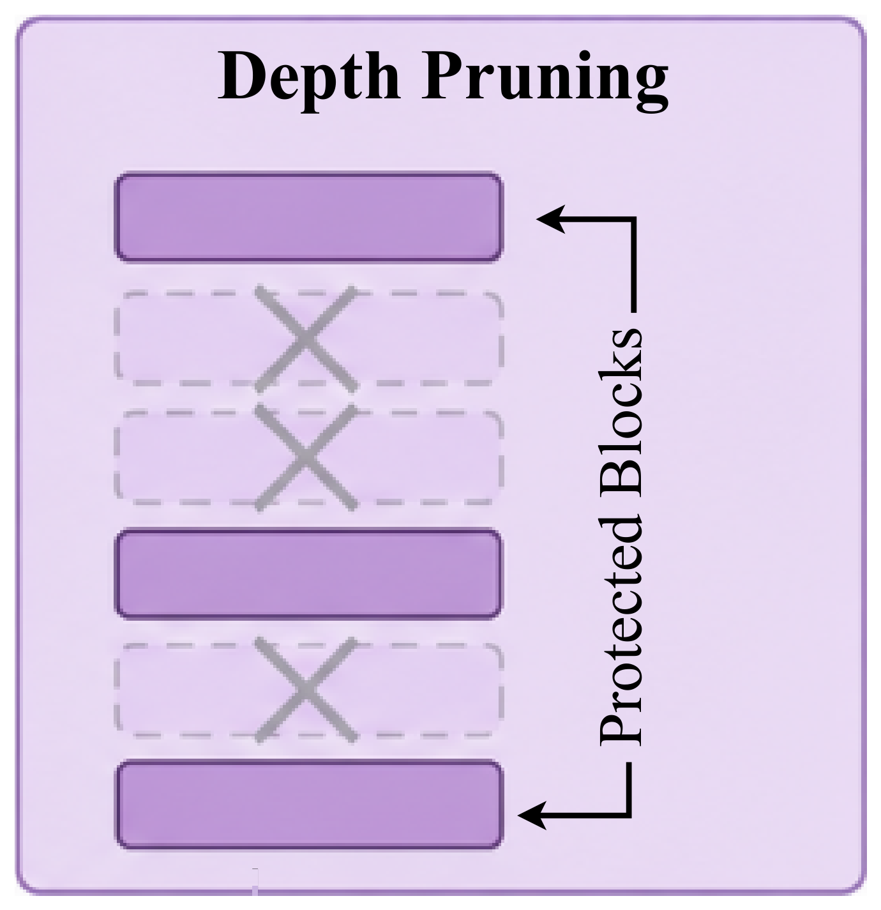
Trick 3 Depth pruning
How much to compute
Score each decoder block by Block Influence
Remove 1, 2, or 4 low-influence blocks; none adjacent, early blocks and the final block kept
Fixed once from calibration data, not adapted at test time
CLIP: original vs depth pruning
same episode, same initial state
Rollout: CogACT on WidowX, where pruning removes decoder layers without breaking the closed loop.
Trick three, depth pruning. Decoder blocks that barely change their hidden states are removed, one, two, or four of them, keeping the early and final blocks. The selection is fixed before evaluation.
Notes:
SLIDE 4 | 12 s | 32 words (2.7 w/s)
NARRATION:
Trick three, depth pruning. Decoder blocks that barely change their hidden states are removed, one, two, or four of them, keeping the early and final blocks. The selection is fixed before evaluation.
VISUAL / PRODUCTION NOTE:
Left: Fig. 2(a) panel. Right: side-by-side rollout clip.

Slide 5
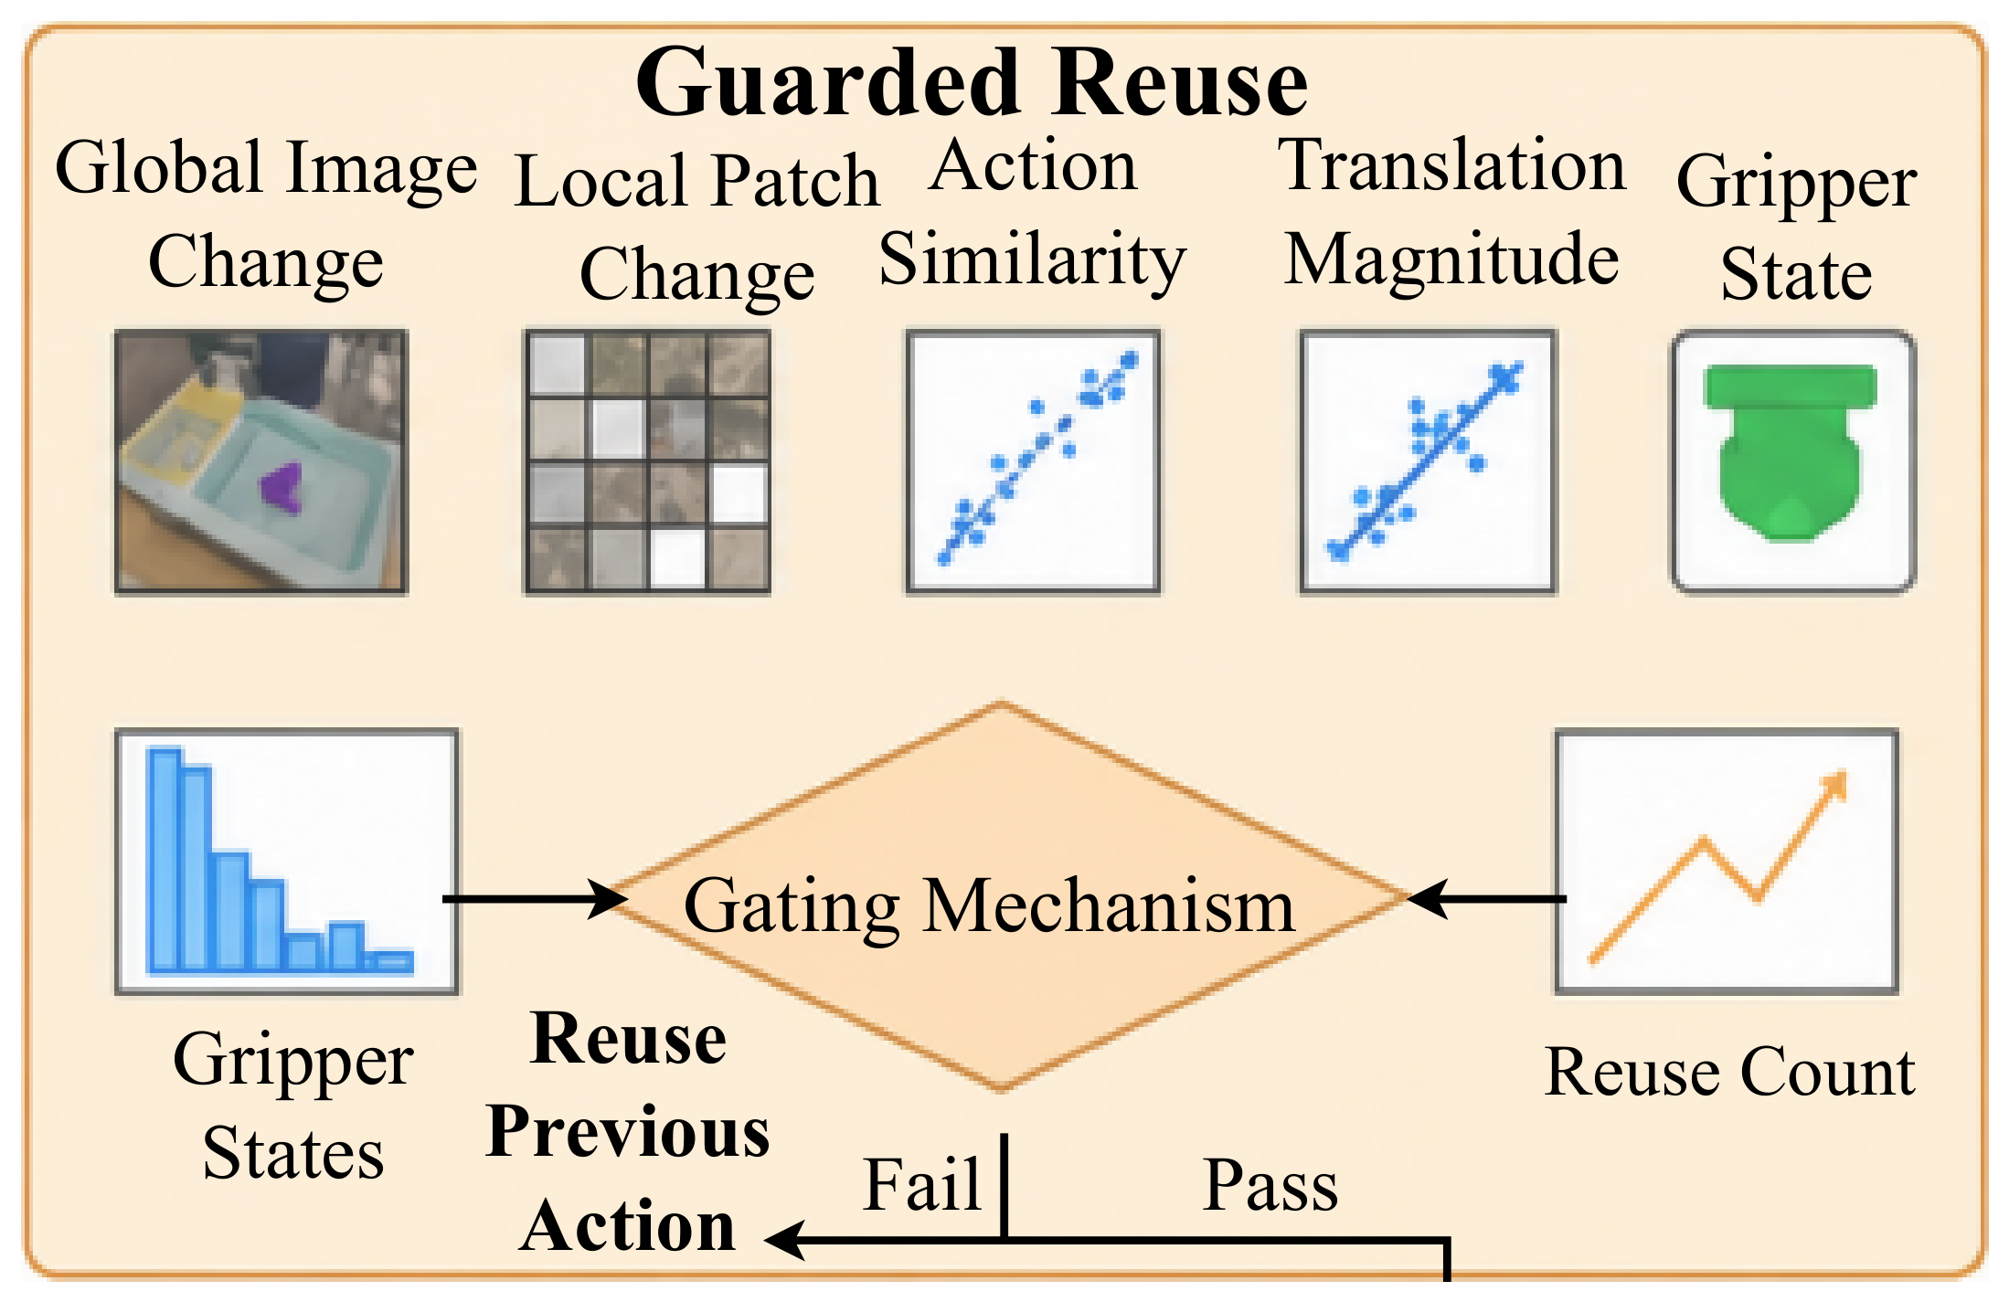
Trick 4 Guarded action reuse
When to act
CLIP: original vs guarded reuse
same episode, same initial state
Reuse the previous action only when all gates pass: small global and local image change, recent actions agree, translation not near zero, gripper unchanged, reuse count below a cap
Presets: strict, moderate, aggressive
Rollout: overlay the gate indicators and a "calls skipped" counter on the right pane.
Trick four, guarded reuse. The previous action is reused only while every gate passes: image change, action agreement, translation, and gripper. Any failed gate restores a full call.
Notes:
SLIDE 5 | 11 s | 28 words (2.5 w/s)
NARRATION:
Trick four, guarded reuse. The previous action is reused only while every gate passes: image change, action agreement, translation, and gripper. Any failed gate restores a full call.
VISUAL / PRODUCTION NOTE:
Left: Fig. 2(a) guarded reuse panel. Right: side-by-side rollout clip with gate overlay.

Slide 6
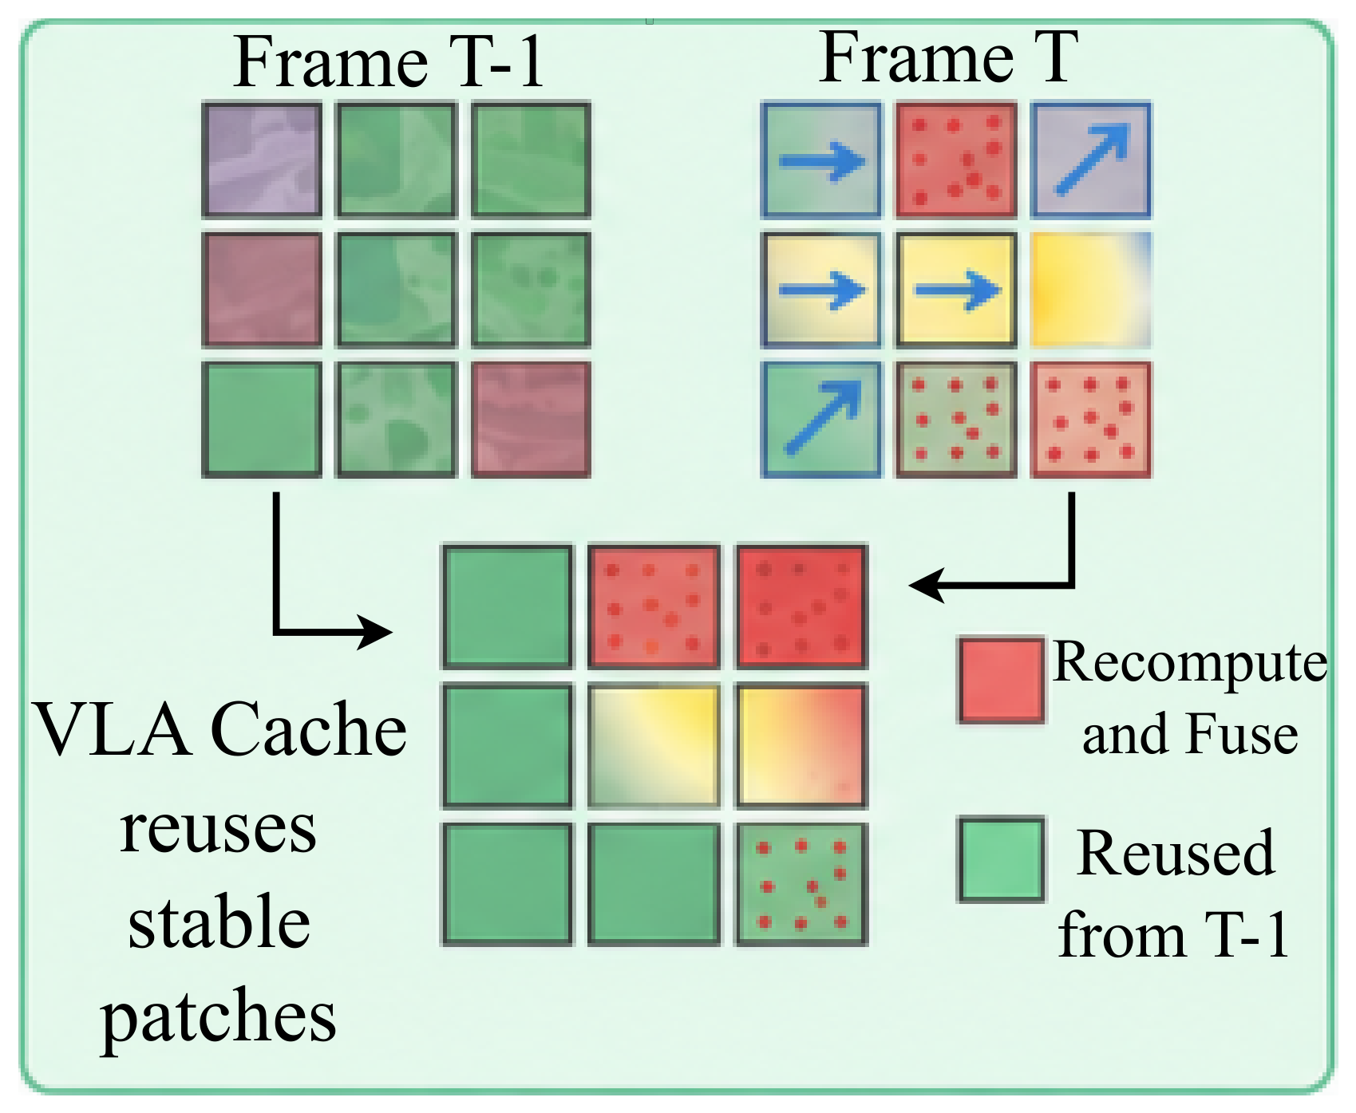
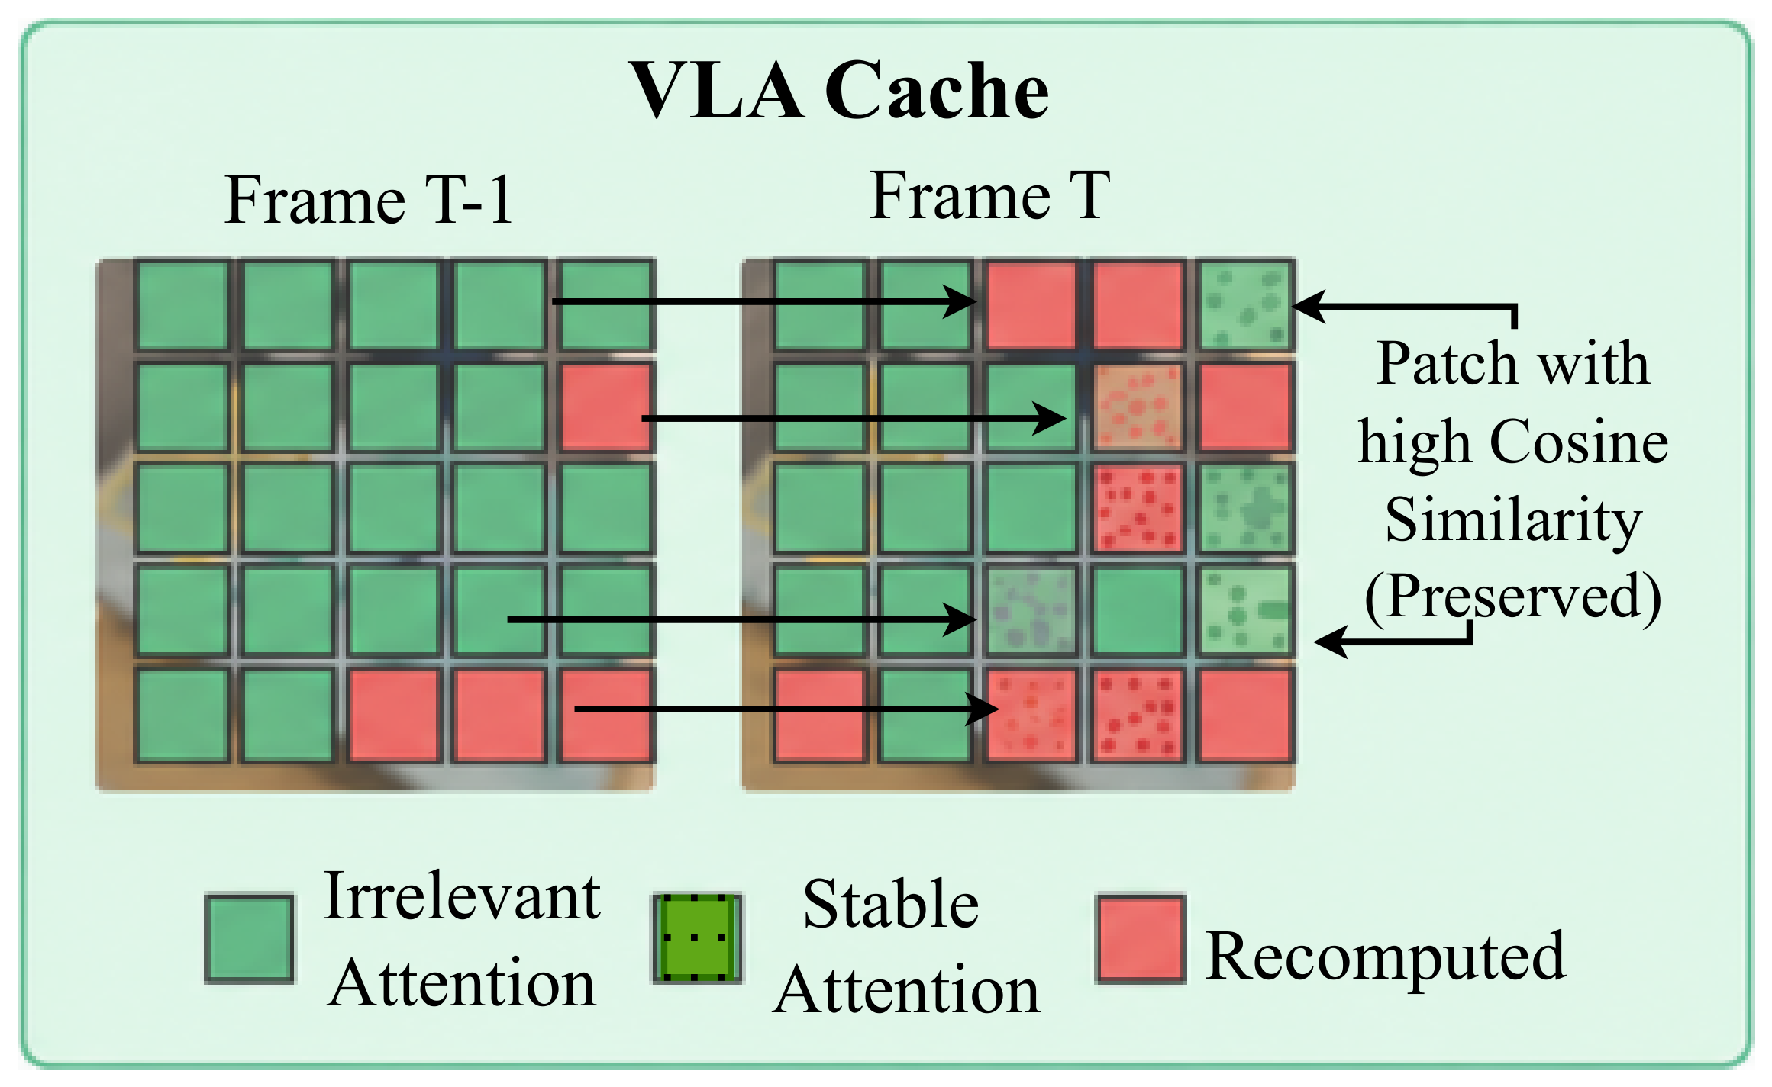
Trick 5 Temporal fusion
How much to compute
Reuse visual tokens of stable patches from the previous call
Recompute patches with motion, local structure, language attention, or in the interaction region
Presets: motion-entropy, task-aware, conservative-adaptive
CLIP: original vs temporal fusion
same episode, same initial state
Rollout: optionally tint reused patches on the right pane to show what is carried over between frames.
Top: fusion mask. Bottom: VLA-Cache criterion.
Trick five, temporal fusion. Visual tokens of stable patches are reused from the previous call, while patches with motion, entropy, or language attention are recomputed. The policy still runs every step.
Notes:
SLIDE 6 | 12 s | 31 words (2.6 w/s)
NARRATION:
Trick five, temporal fusion. Visual tokens of stable patches are reused from the previous call, while patches with motion, entropy, or language attention are recomputed. The policy still runs every step.
VISUAL / PRODUCTION NOTE:
Left: Fig. 2(a) panel. Right: side-by-side rollout clip.

Slide 7
Results: matched evaluation protocol
Backbone | WidowX | Fractal | LIBERO
CogACT (7.6B) | ● | ●
OpenVLA (7B) | ● | ● | ●
SpatialVLA (4B) | ● | ●
CronusVLA (0.5B) | ● | ●
UniVLA (8.5B) | ● |  | ●
MiniVLA (1B) | ●
SmolVLA (0.45B) |  |  | ●
22
13 + 1
286
backbone × environment pairs
trick settings + original, per pair
trick settings (13 × 22), all paired with the original
Official checkpoints, no retraining
Same task instances and initial states as the original
Latency = wall-clock per environment step
Exact two-sided McNemar test on paired episodes
4 × RTX 5090; tables report the best setting per trick
SimplerEnv WidowX: 4 tasks × 50 episodes. Google Robot/Fractal: 5 tasks × 50. LIBERO: Long, Goal, Object, Spatial, each suite a separate pair (3 × 4 = 12), giving 22 pairs in total.
Seven backbones, official checkpoints, on WidowX, Fractal, and LIBERO. Thirteen trick settings per pair plus the original, 286 trick settings, each compared with the original on the same episodes.
Notes:
SLIDE 7 | 12 s | 29 words (2.4 w/s)
NARRATION:
Seven backbones, official checkpoints, on WidowX, Fractal, and LIBERO. Thirteen trick settings per pair plus the original, 286 trick settings, each compared with the original on the same episodes.
VISUAL / PRODUCTION NOTE:
286 = 13 trick settings × 22 pairs.

Slide 8
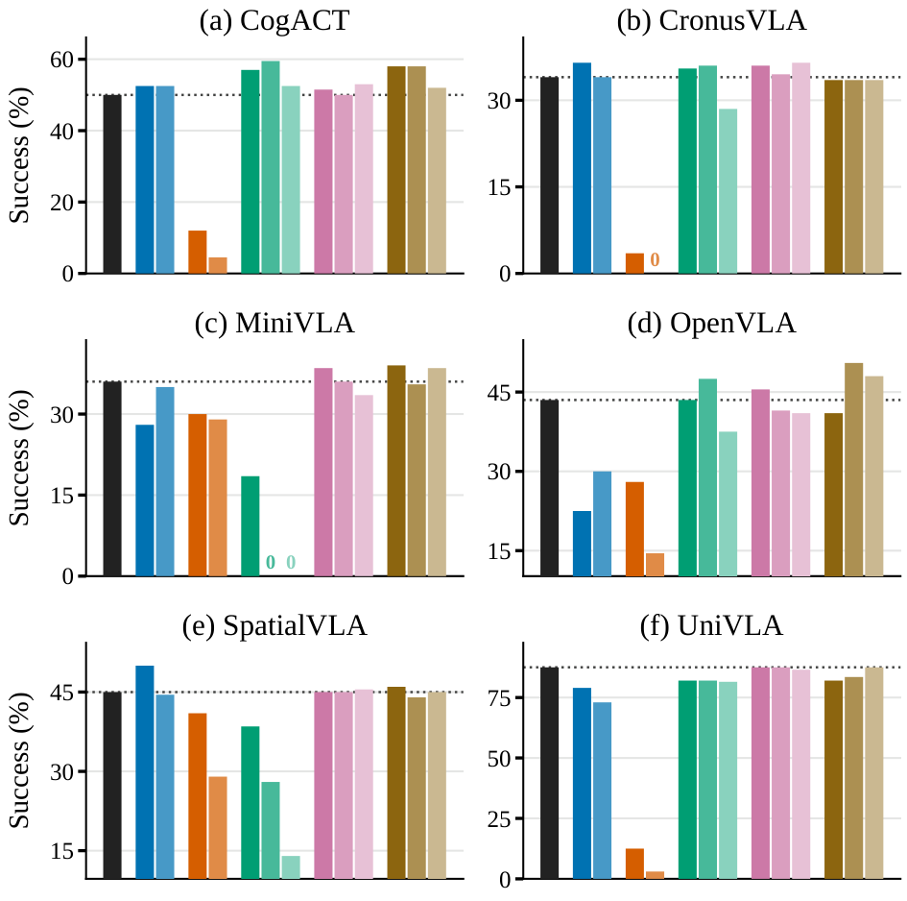
Which tricks preserve success?
Q1 Success
Guarded reuse and temporal fusion are the safest for preserving success.
Selected backbones also gain:
Foveation, WidowX: CogACT +2.5 · SpatialVLA +5.0 · CronusVLA +2.5
Depth pruning, WidowX: CogACT +9.5
Backbone-dependent:
Foveation, LIBERO Goal: UniVLA +7.0 vs SmolVLA −13.0
Action repeat: mainly a speed baseline
Fig. 1: success per configuration, six WidowX backbones (14 bars each, darker to lighter within a trick). Dotted line = original policy, 0 = no successful episodes. Deltas from Tables I and II, best setting per trick.
Original
Foveation
Action repeat
Depth pruning
Guarded reuse
Temporal fusion
First, success. Guarded reuse and temporal fusion are the safest for preserving success. Foveation and depth pruning help selected backbones. Action repeat is mainly a speed baseline.
Notes:
SLIDE 8 | 12 s | 27 words (2.3 w/s)
NARRATION:
First, success. Guarded reuse and temporal fusion are the safest for preserving success. Foveation and depth pruning help selected backbones. Action repeat is mainly a speed baseline.
VISUAL / PRODUCTION NOTE:
Fig. 1 with a native legend. Optionally enlarge one row of panels at a time.

Slide 9
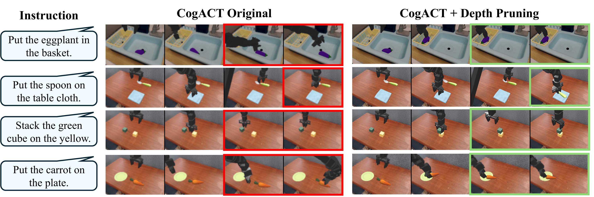
Depth pruning helps CogACT on WidowX
▶ CLIP: original vs depth pruning (paired episode)
Success 50.0 → 59.5 %
Latency 141.4 → 137.5 ms/step
Red = failure, green = success. Selected episodes, same task instances and initial states. Aggregate values from Table I.
CogACT on WidowX. In these paired episodes the original fails and depth pruning succeeds. Overall success rises from 50.0 to 59.5, and latency drops slightly.
Notes:
SLIDE 9 | 12 s | 25 words (2.1 w/s)
NARRATION:
CogACT on WidowX. In these paired episodes the original fails and depth pruning succeeds. Overall success rises from 50.0 to 59.5, and latency drops slightly.
VISUAL / PRODUCTION NOTE:
Fig. 3(a) strips. Bottom-left: side-by-side recorded episode.

Slide 10
Same trick, same benchmark, different backbone
Depth pruning, WidowX
CogACT +9.5
MiniVLA −17.5
CLIP: MiniVLA original
CLIP: MiniVLA + pruning
succeeds (green border)
fails (red border)
SpatialVLA −6.5
Selected episode, same initial state, WidowX
Structural redundancy is not a property of the trick alone. It depends on how each backbone uses its decoder layers during control.
Same trick, same benchmark, different backbone. On MiniVLA, depth pruning drops success by 17.5 points, on SpatialVLA by 6.5. Here the pruned policy fails.
Notes:
SLIDE 10 | 10 s | 24 words (2.4 w/s)
NARRATION:
Same trick, same benchmark, different backbone. On MiniVLA, depth pruning drops success by 17.5 points, on SpatialVLA by 6.5. Here the pruned policy fails.
VISUAL / PRODUCTION NOTE:
Record a MiniVLA WidowX episode from the same task family as the CogACT clip.

Slide 11
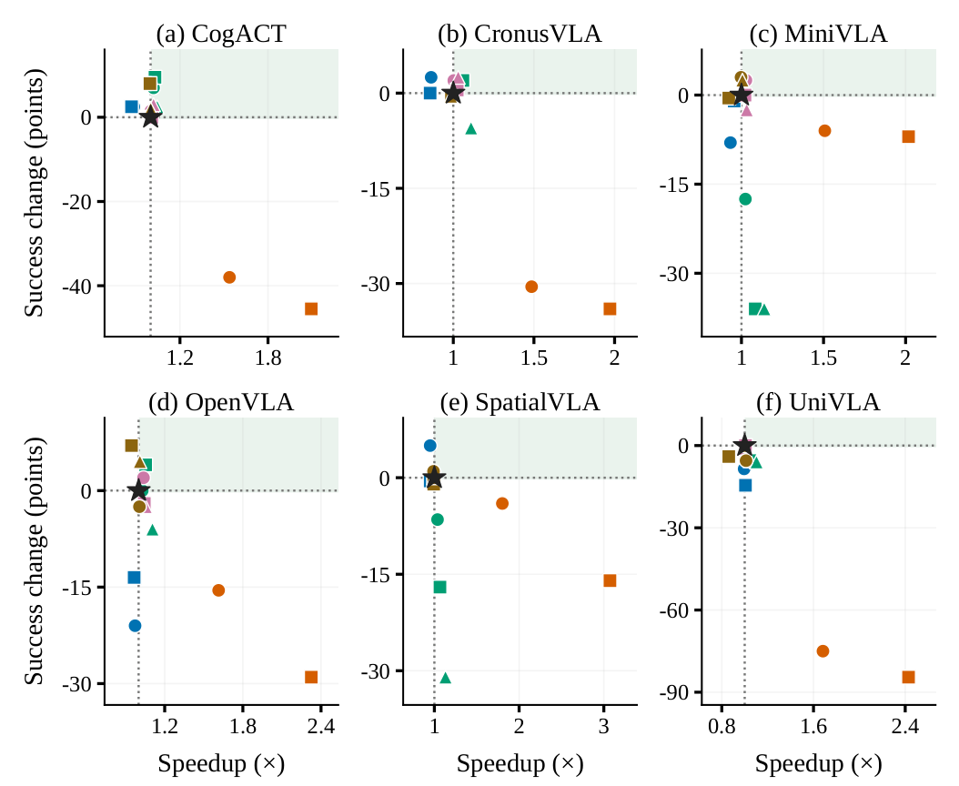
Which tricks are actually faster?
Fig. 4, SimplerEnv WidowX. Star = original, shaded = faster and no worse. Colour = trick; circle, square, triangle = first, second, third setting of that trick.
Q2 Speed
Action repeat gives the largest speedup, depth pruning gives decoder-level savings, guarded reuse gives the safest trade-off.
Latency, ms per step | Original → trick
Repeat · SpatialVLA WidowX | 423.5 → 235.1
Repeat · OpenVLA LIBERO Long | 171.6 → 93.2
Pruning · OpenVLA WidowX | 210.2 → 199.4
Reuse · SmolVLA LIBERO Long | 289.5 → 268.9
Original
Foveation
Action repeat
Depth pruning
Guarded reuse
Temporal fusion
Second, speed. Action repeat gives the largest speedup. SpatialVLA on WidowX drops from about 424 to 235 milliseconds per step. Depth pruning gives smaller decoder-level savings, and guarded reuse the safest trade-off.
Notes:
SLIDE 11 | 13 s | 32 words (2.5 w/s)
NARRATION:
Second, speed. Action repeat gives the largest speedup. SpatialVLA on WidowX drops from about 424 to 235 milliseconds per step. Depth pruning gives smaller decoder-level savings, and guarded reuse the safest trade-off.
VISUAL / PRODUCTION NOTE:
Paper Fig. 4 with a native colour legend. If the Speechma clip runs longer than 13 s, extend the slide rather than speeding the voice.

Slide 12
Open loop has a cost, gating keeps it safer
CLIP: Original
CLIP: Action repeat
CLIP: Guarded reuse
policy call every step
held actions, episode fails
calls skipped only when the gates pass
policy calls used: ___
policy calls used: ___
policy calls used: ___
Action repeat (k = 2, best setting), WidowX: CogACT −38.0 · UniVLA −75.0
Guarded reuse, SmolVLA LIBERO Long: 289.5 → 268.9 ms
Fractal (milder): CogACT −1.2 · SpatialVLA 0.0
success unchanged at 42.0 %
Same CogACT WidowX episode and initial state in all three panels. Deltas from Tables I and II, best setting per trick.
Action repeat runs open loop: on WidowX, CogACT loses 38 points and UniVLA 75. Guarded reuse skips calls only when the gates agree. On SmolVLA in LIBERO Long, success stays at 42.0 with lower latency.
Notes:
SLIDE 12 | 13 s | 35 words (2.7 w/s)
NARRATION:
Action repeat runs open loop: on WidowX, CogACT loses 38 points and UniVLA 75. Guarded reuse skips calls only when the gates agree. On SmolVLA in LIBERO Long, success stays at 42.0 with lower latency.
VISUAL / PRODUCTION NOTE:
Three-panel recording of one CogACT WidowX episode; use k = 2 for the action-repeat panel so the clip matches the quoted deltas (k = 4 is worse, about -46 and -85 points, Fig. 5). Before rendering, fill the three "policy calls used" counters from that episode: original = number of steps, repeat = about steps / k, guarded = steps minus skipped calls, or delete the counter lines.

Slide 13
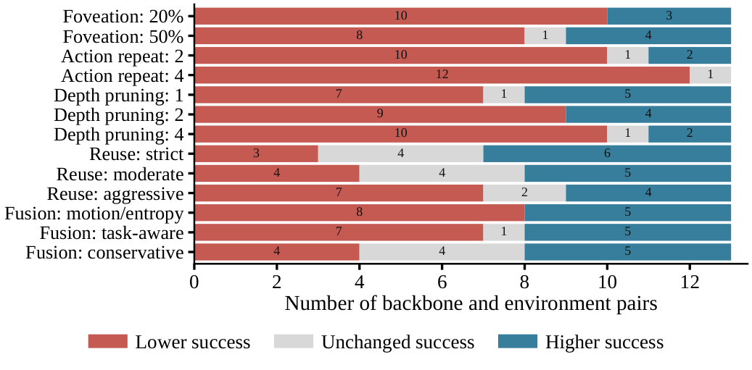
Does the effect transfer across models?
Q3 Transfer
Effects are a joint property of the trick, the backbone, and the task distribution.
Depth pruning, WidowX: CogACT +9.5 · MiniVLA −17.5
Foveation, LIBERO Goal: UniVLA +7.0 · SmolVLA −13.0
Action repeat: often harmful on WidowX, milder on Fractal for some backbones
For each setting: how many of 13 backbone and environment pairs got lower, unchanged, or higher success. LIBERO episodes are pooled over the four suites, so 13 pairs stand for the 22.
No trick is plug-and-play: each one needs matched evaluation under the target backbone and environment.
Third, consistency. Across backbone and environment pairs the same trick improves one model, leaves another unchanged, and hurts a third. No trick is plug-and-play.
Notes:
SLIDE 13 | 12 s | 24 words (2.0 w/s)
NARRATION:
Third, consistency. Across backbone and environment pairs the same trick improves one model, leaves another unchanged, and hurts a third. No trick is plug-and-play.
VISUAL / PRODUCTION NOTE:
Consistency chart (supplementary figure, counts from the per-setting records with LIBERO episodes pooled). Do not read the counts aloud.

Slide 14
Takeaways
Guarded reuse
Action repeat
Most reliable. Preserves success, modest speedup when the gates open.
Largest speedup, but the risk of long open-loop execution.
Depth pruning
Foveation · Temporal fusion
Decoder-level savings, benefit depends on the backbone.
Test how much the visual representation can change while the policy stays stable.
VLA efficiency is policy- and environment-dependent. Evaluate every trick under the target backbone and environment before applying it.
Guarded reuse is most reliable. Action repeat is fastest but risky. Depth pruning is backbone-dependent. Evaluate every trick under the target backbone and environment before applying it. Thank you.
Notes:
SLIDE 14 | 12 s | 29 words (2.4 w/s)
NARRATION:
Guarded reuse is most reliable. Action repeat is fastest but risky. Depth pruning is backbone-dependent. Evaluate every trick under the target backbone and environment before applying it. Thank you.
VISUAL / PRODUCTION NOTE:
Final slide. No names, logos, or URLs. Hold 2 s after the narration ends, then fade to black.

