Slide 1

stroke prediction
Saroj Kumar Pati
Trilochan Sahoo
Guided By:-
Miss Anindita Jena

Slide 2
INTRODUCTION
Stroke Prediction our top priority in this health problem is to identify patients with a stroke. According to the World Health Organization (WHO) stroke is the 2nd leading cause of death globally, responsible for approximately 11% of total deaths. This dataset is used to predict whether a patient is likely to get stroke based on the input parameters like gender, age, various diseases, and smoking status. Fach row in the data provides relavant information about the patient
Library
PANDAS
NUMPY
MATPLOTLIB
SEABORN
PLOTLY
SKLEARN
XGBOOST

Slide 3
ATTRIBUTE INFORMATION
Id: unique identifier
Gender: "Male", "female" or "other"3
Age : age of the patient
Hypertension:0 if the patient doesn't have hypertension, 1 if the patient has hypertension
Heart disease: 0 if the patient doesn't have any heart diseases, 1 if the patient has a heart disease
Ever married: "no" or "yes“
Work type: "children", "govt_jov", "never_worked", "private" or "self-employed“
Residence_type:"rural" or "urban“
Avg_glucose level: average glucose level in blood
Bmi:body mass index
Smoking status: "formerly smoked", "never smoked", "smokes" or "unknown"*
Stroke:1 if the patient had a stroke or 0 if not
note: "unknown" in smoking status means that the information is unavailable for this patientimport libraries

Slide 4
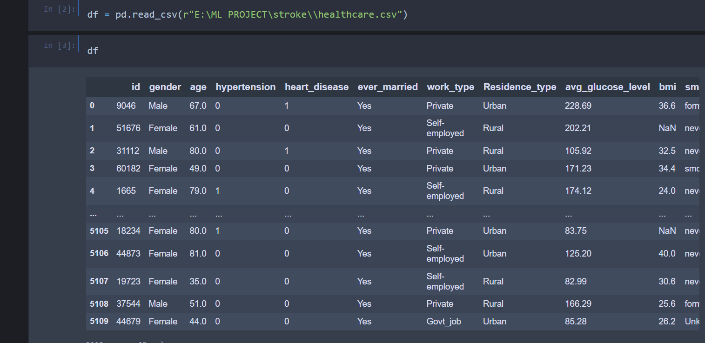
READ THE DATA SET

Slide 5
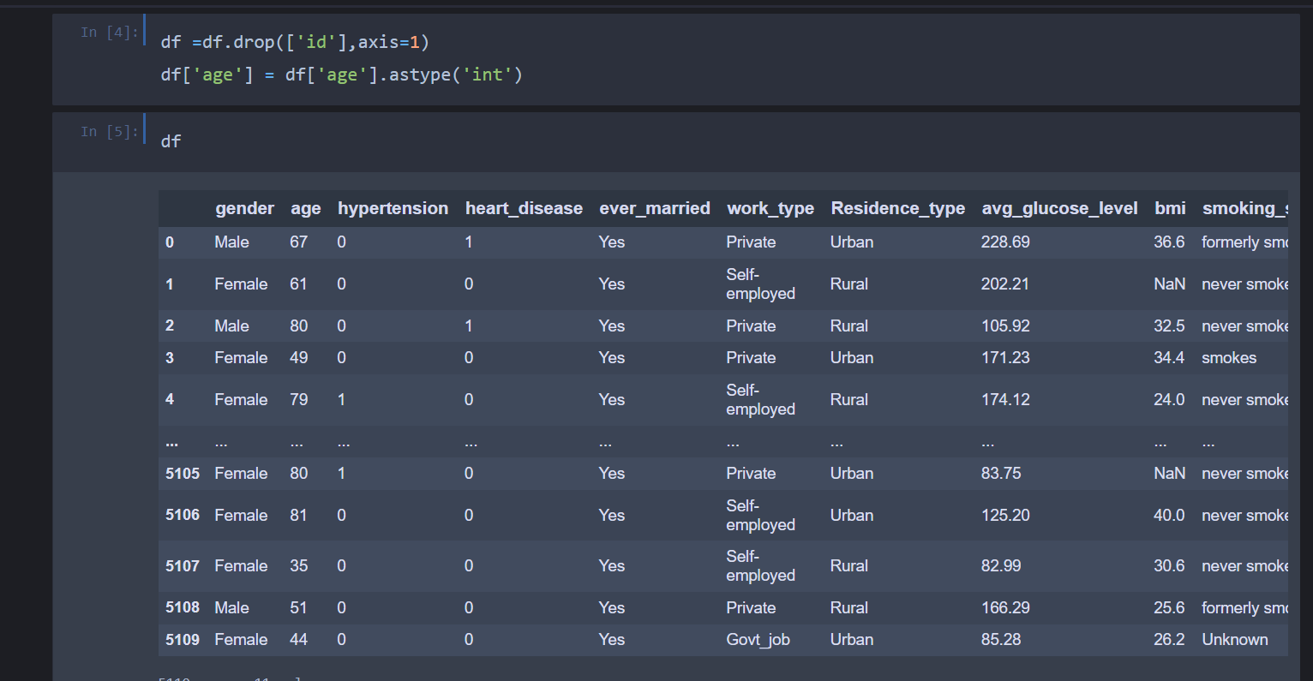

Slide 6
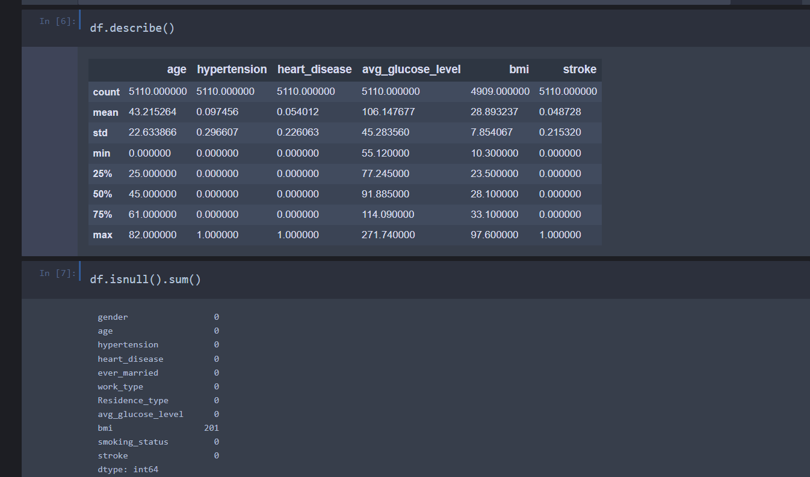

Slide 7
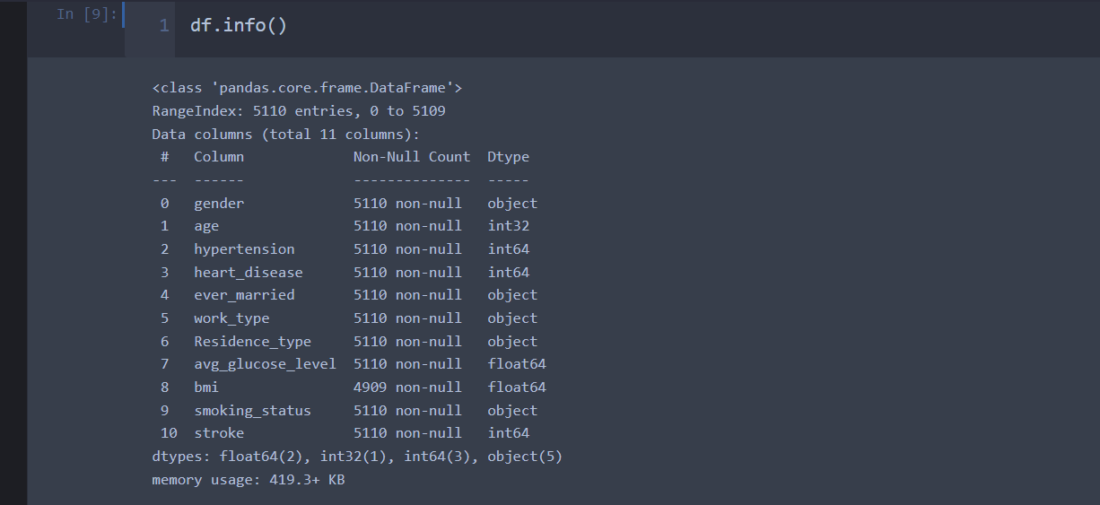

Slide 8
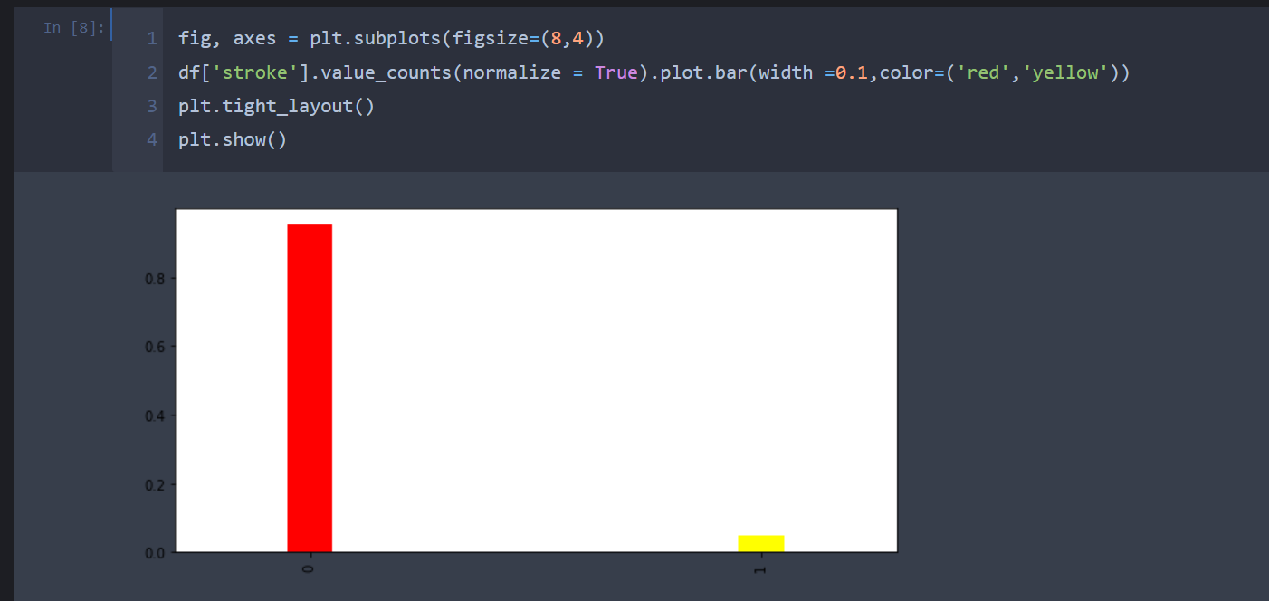

Slide 9
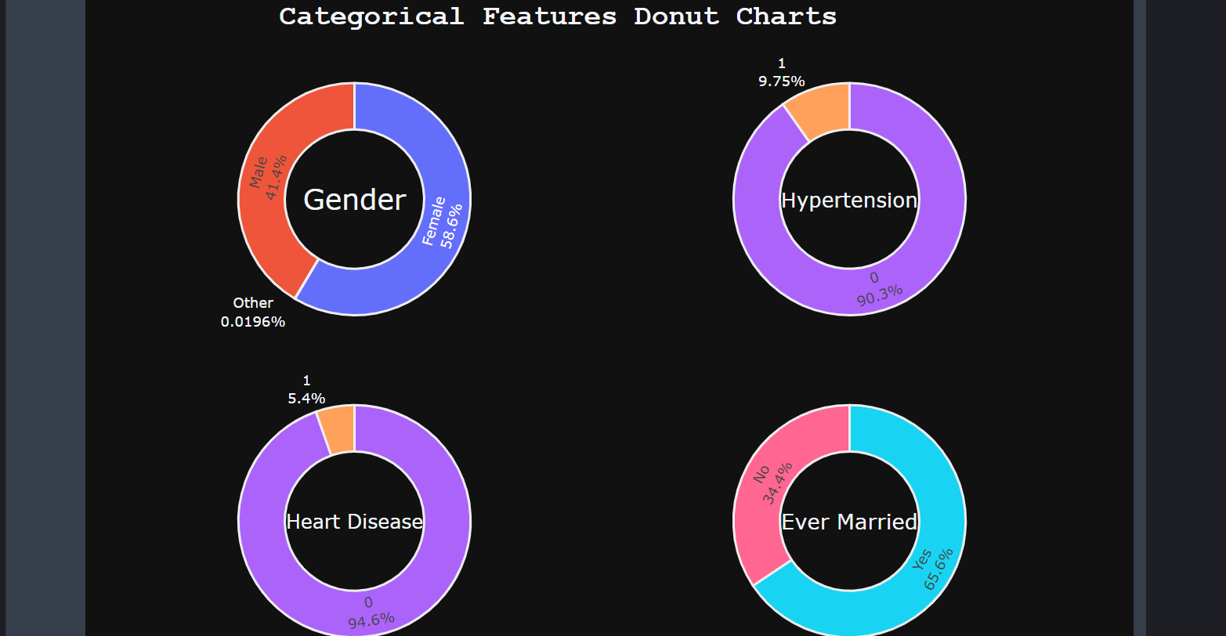

Slide 10
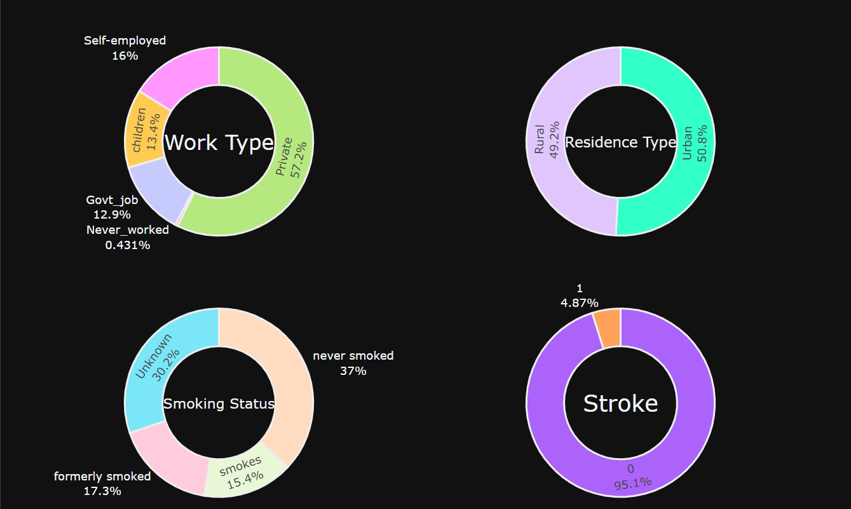

Slide 11
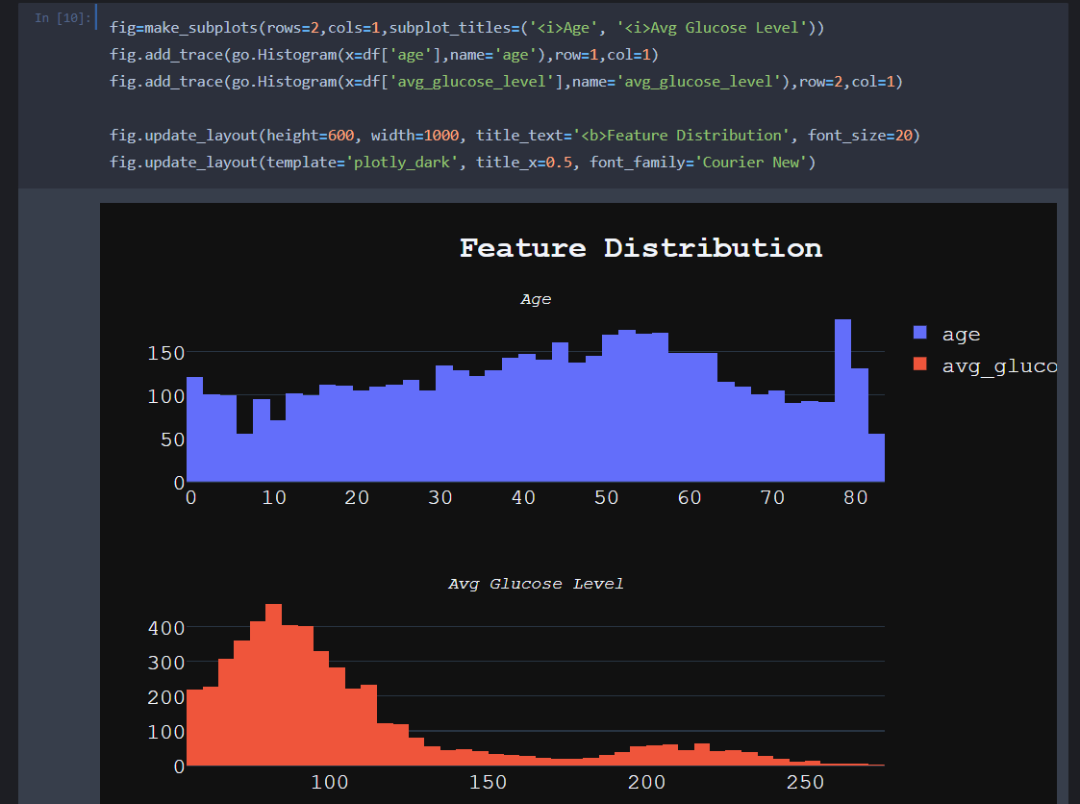

Slide 12
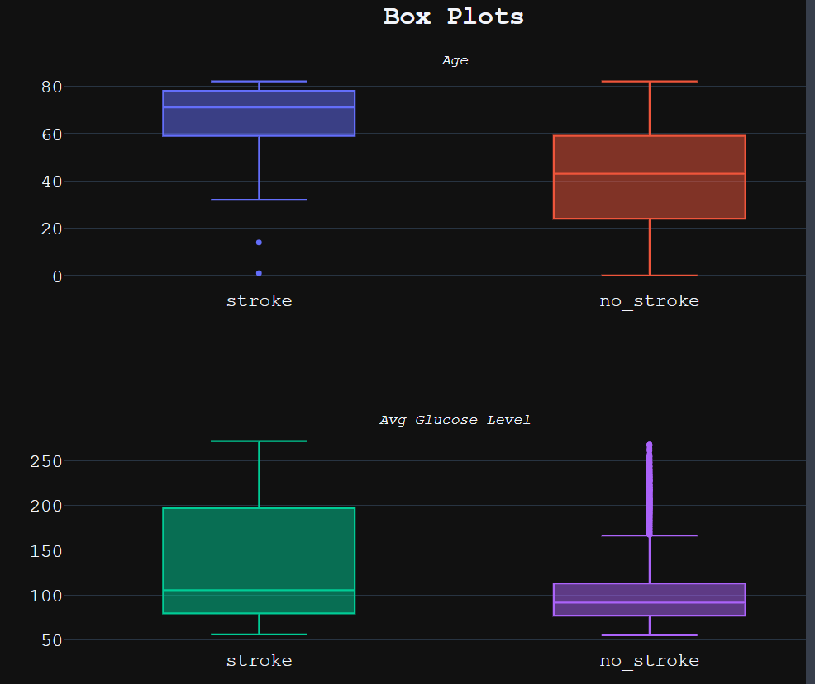

Slide 13
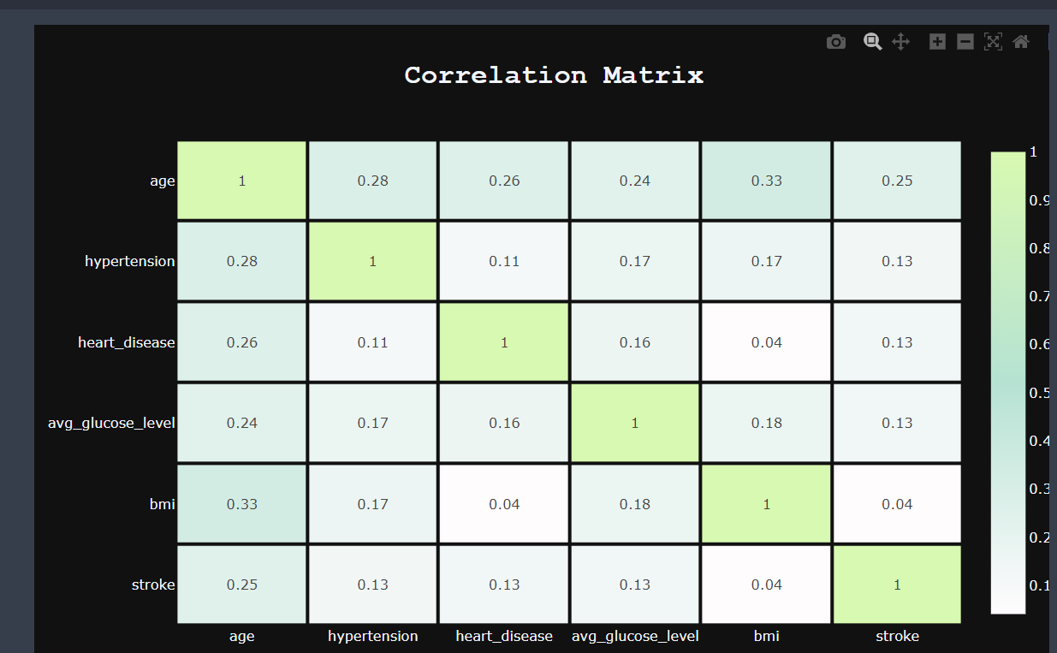

Slide 14
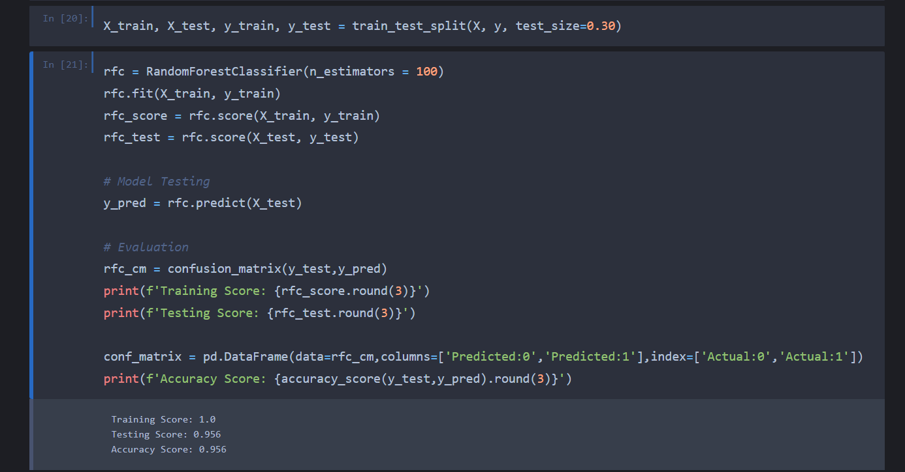

Slide 15
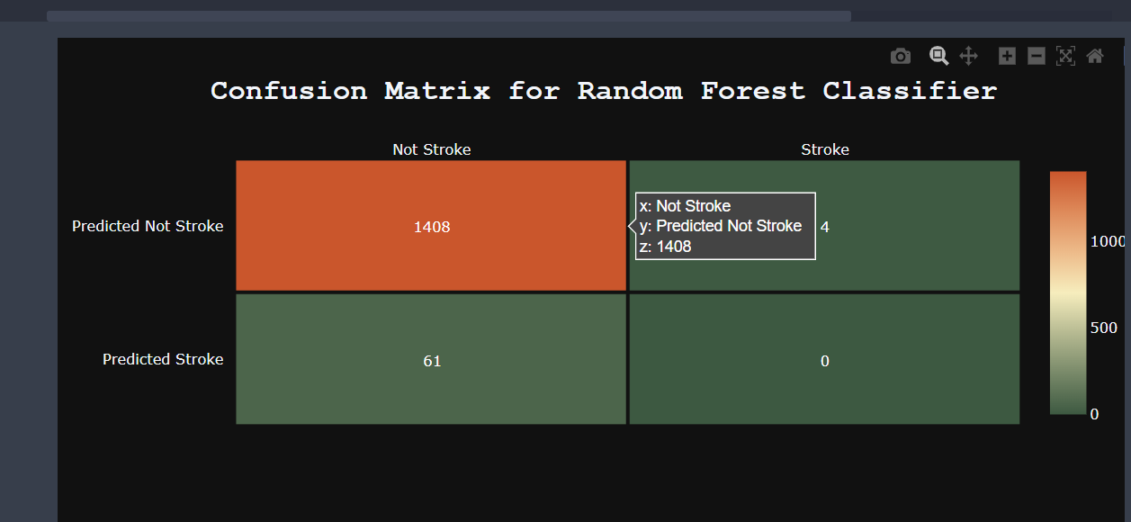

Slide 16
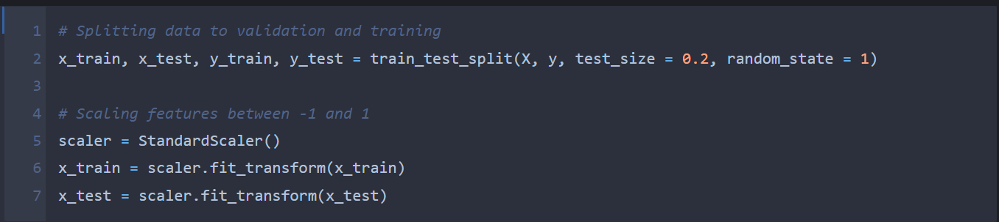
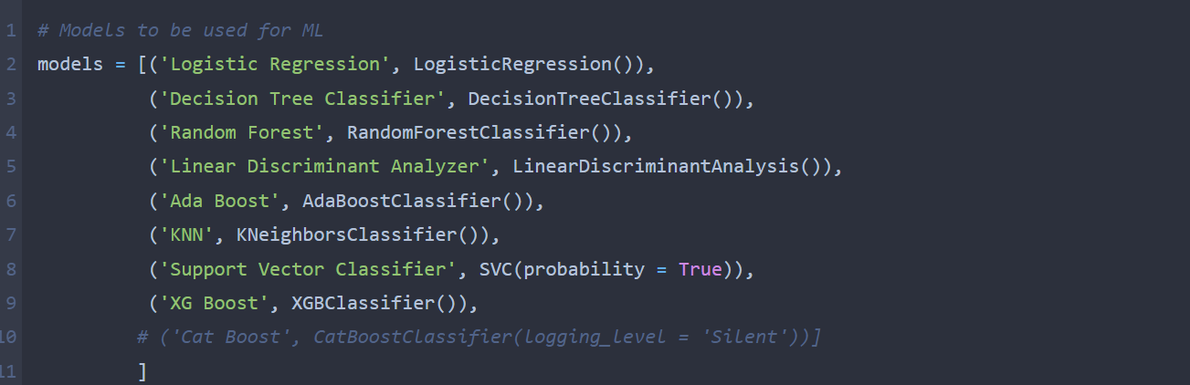

Slide 17
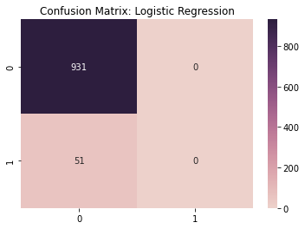
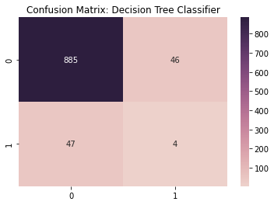

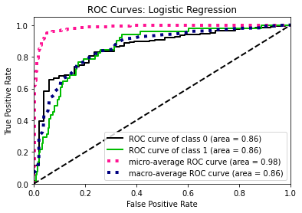
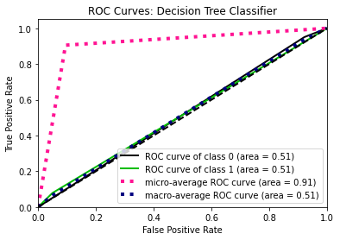
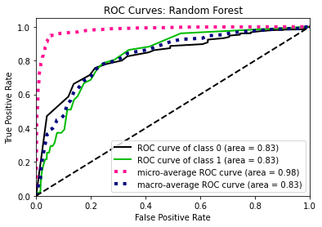
Model: Logistic Regression Validation Accuracy: 0.9480651731160896 Training Accuracy: 0.9600203717850777
Model: Decision Tree Classifier Validation Accuracy: 0.905295315682281 Training Accuracy: 1.0
Model: Random Forest Validation Accuracy: 0.9470468431771895 Training Accuracy: 1.0

Slide 18
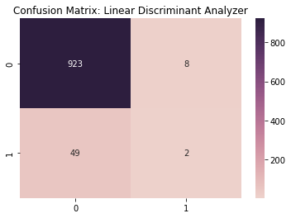
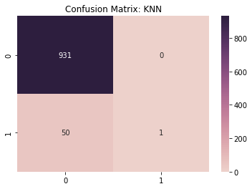
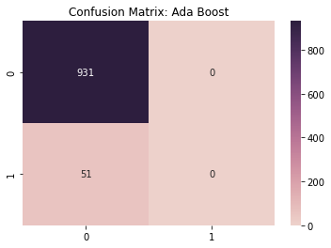
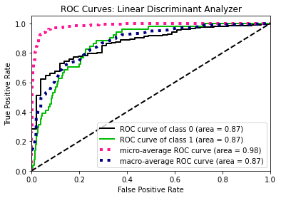
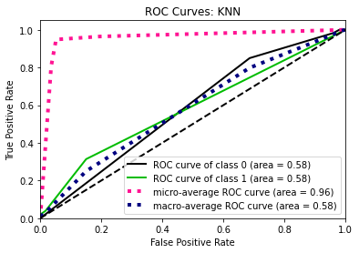
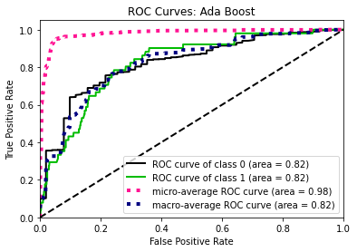
Model: Linear Discriminant Analyzer Validation Accuracy: 0.9419551934826884 Training Accuracy: 0.9567099567099567
Model: Ada Boost Validation Accuracy: 0.9480651731160896 Training Accuracy: 0.9607843137254902
Model: KNN Validation Accuracy: 0.9490835030549898 Training Accuracy: 0.9615482556659027

Slide 19
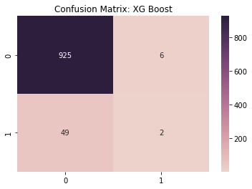
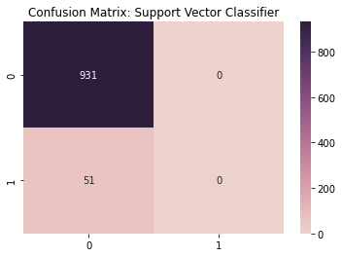
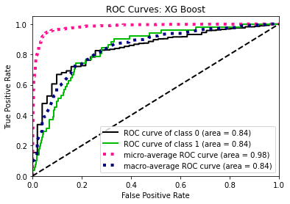
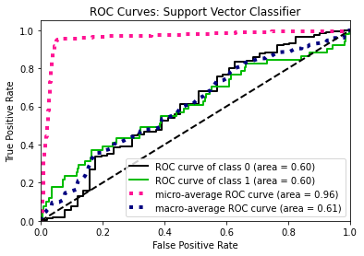
Model: Support Vector Classifier Validation Accuracy: 0.9480651731160896 Training Accuracy: 0.9602750190985485
Model: XG Boost Validation Accuracy: 0.9439918533604889 Training Accuracy: 0.9982174688057041

Slide 20
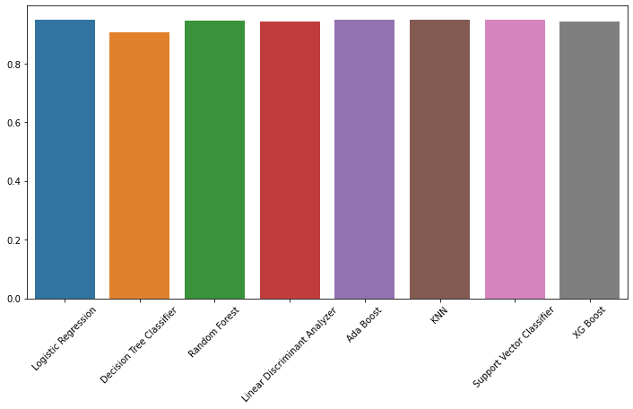
plt.figure(figsize = (12, 6))
sns.barplot(x = np.array(models_score)[:, 0], y=np.array(models_score)[:, 1].astype('float64'))
plt.xticks(rotation = 45);

Slide 21


