Slide 1
Three additional Concepts to Infer Using FOL
Substitution
Unification
Skolemization

Slide 2

What is substitution ?
f - Term
Likes(Alice,x)
x/Maths
Likes(Alice,Maths)
g - A Proposition

Slide 3

What is substitution ?
Term - f
Likes(x,y)
{x/Alice}
Likes(Alice,y)
Term g

Slide 4

What is substitution ?
Term
Likes(x,y)
{x/Alice,y/Maths}
Likes(Alice,Maths)
A Proposition

Slide 5

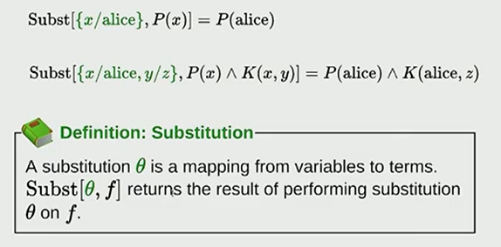
Substitution

Slide 6
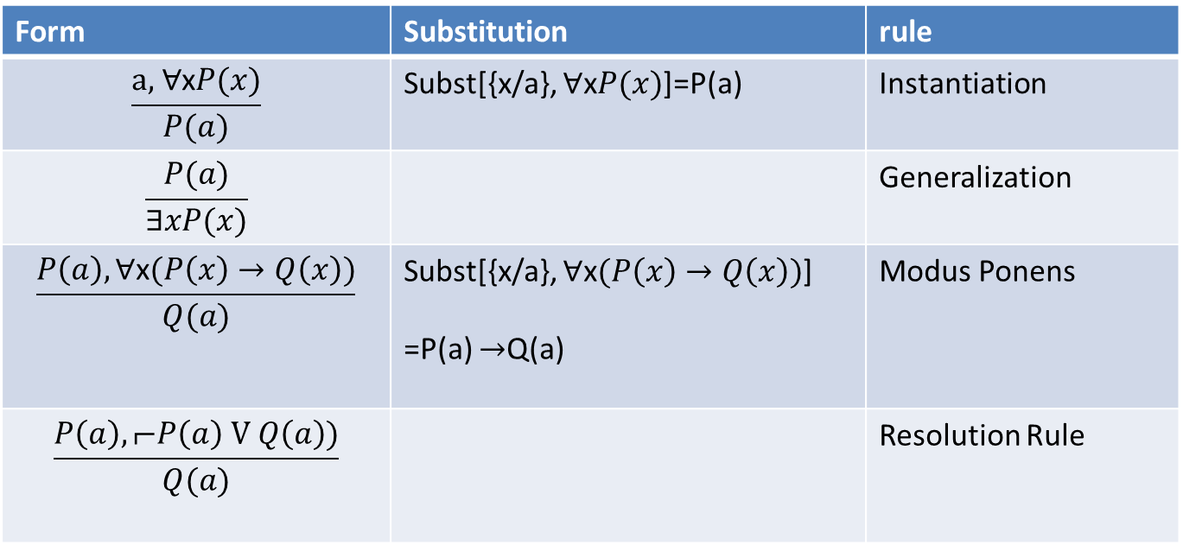
Rules of Inference

Slide 7

What is unification ?
Term 1 - f
Term2 - g
Likes(x,y)
Likes(x,Maths)
{y/Maths}

Slide 8


Result of unification ?
Term 1 - f
Term2 - g
Likes(x,y)
Likes(x,Maths)
{y/Maths}
Likes(x,Maths)
Term 2 - g

Slide 9
What is unification ?
Term 1 - f
Term2 - g
Likes(Alice,y)
Likes(x,Maths)
{x/Alice, y/Maths}

Slide 10
What is unification ?
Term 1 - f
Term2 - g
Likes(Alice,y)
Likes(x,Maths)
{x/Alice, y/Maths}
Likes(Alice,Maths)
A proposition

Slide 11

Can unification fail ?
Term 1 - f
Term2 - g
Likes(Alice,y)
Likes(Bob,Maths)
Which one do I choose ?
Alice or Bob ??
{null}

Slide 12
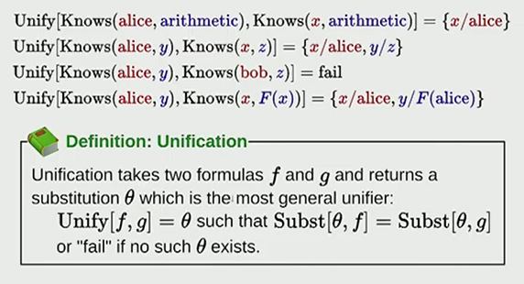
Unification

Slide 13
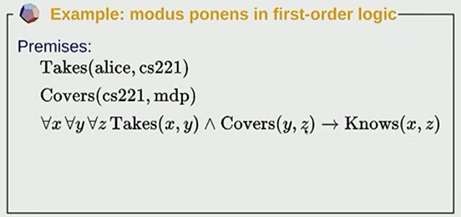

Modus Ponens Example

Slide 14
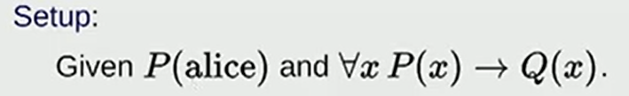
Trying to Apply Modus Ponens to FOL

Slide 15
Applying Resolution to FOL

Slide 16
FOL Problem
FOL also includes statements which are not horn clauses
Given
  All students register in some course
  Every one who registers in a course writes exam
Prove
  All students write exam
∀x(Student(x) →∃y(Course(y) ΛRegisters(x,y)))
∀x(∃yRegisters(x,y)→WritesExam(x))
∀x(Student(X)→WritesExam(x))

Slide 17
Step 1 Convert to CNF Form
∀x(Student(x) →∃y(Course(y) ΛRegisters(x,y)))
Remove Implication
Skolemize Existential Quantifiers
∀x(⌐Student(x) V ∃y(Course(y) ΛRegisters(x,y)))

Slide 18
What is Skolemization ?
It used to replace the variables bound by existential Quantifiers with a function called skolem function.
Skolem function can be given any name.
It takes a argument, which is the universal quantifier which binds this term

Slide 19
Step 1 Convert to CNF Form
∀x(Student(x) →∃y(Course(y) ΛRegisters(x,y)))
Remove Implication
Skolemize Existential Quantifiers
∀x(⌐Student(x) V ∃y(Course(y) ΛRegisters(x,y)))
Variables bound by existential Quantifier

Slide 20
Step 1 Convert to CNF Form
∀x(Student(x) →∃y(Course(y) ΛRegisters(x,y)))
Remove Implication
Skolemize Existential Quantifiers
∀x(⌐Student(x) V ∃y(Course(y) ΛRegisters(x,y)))
Variables bound by universal Quantifier

Slide 21
Step 1 Convert to CNF Form
∀x(Student(x) →∃y(Course(y) ΛRegisters(x,y)))
Step A: Remove Implication
Step B: Skolemize Existential Quantifiers
∀x(⌐Student(x) V ∃y(Course(y) ΛRegisters(x,y)))
Variables bound by existential Quantifier
∀x(⌐Student(x) V Course(Sk1(x)) ΛRegisters(x,Sk1(x)))

Slide 22
Step 1 Convert to CNF Form
∀x(⌐Student(x) V Course(Sk1(x)) ΛRegisters(x,Sk1(x)))
Step C: Remove Universal Quantifiers
by using ?variable name
Be cautious to rename variables which are bound by different universal quantifiers in the same statement.
⌐Student(?x) V (Course(Sk1(?x)) ΛRegisters(?x,Sk1(?x)))

Slide 23
Step 1 Convert to CNF Form
⌐Student(?x) V (Course(Sk1(?x)) ΛRegisters(?x,Sk1(?x)))
Step D: Distribute V over Λ
(⌐Student(?x) V (Course(Sk1(?x)))
Λ (⌐Student(?x) V Registers(?x,Sk1(?x)))

Slide 24
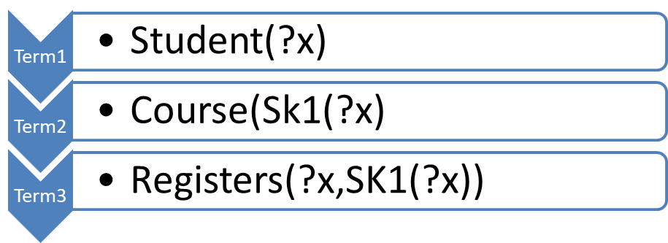

Step 1. Convert to CNF successful
∀x(Student(x) →∃y(Course(y) ΛRegisters(x,y)))
(⌐Student(?x) V (Course(Sk1(?x)))
Λ (⌐Student(?x) V Registers(?x,Sk1(?x)))

Slide 25
Step 1 Convert to CNF
Assertion b
∀x(∃yRegisters(x,y)→WritesExam(x))
Remove implication
∀x(⌐∃yRegisters(x,y) V WritesExam(x))
Skolemize y
∀x(⌐Registers(x,sk1(x)) V WritesExam(x))
Remove Universal quantifier
⌐Registers(?x,sk1(?x)) V WritesExam(?x))

Slide 26
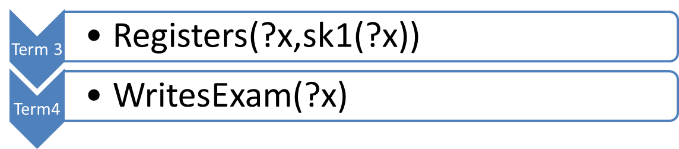

Assertion 2 Converted to CNF
⌐Registers(?x,sk1(?x)) V WritesExam(?x))

Slide 27


Step 2: Apply Resolution
(⌐Student(?x) V (Course(Sk1(?x)))
Λ (⌐Student(?x) V Registers(?x,Sk1(?x)))
⌐Registers(?x,sk1(?x)) V WritesExam(?x))

Slide 28



Apply Resolution

Slide 29


Proof
⌐Student(?x) V WritesExam(?x))
Which is the CNF form of the goal below
∀x(Student(X)→WritesExam(x))

Slide 30
Example 2
Given
  A. All students write exam
  B. Sham is a student
Infer
  C. Sham writes exam
∀x(Student(X)→WritesExam(x))
Student(Sham)
WritesExam(Sham)

Slide 31
Step 1 Convert to CNF
∀x(Student(X)→WritesExam(x))
⌐Student(?x) V WritesExam(?x))

Slide 32

Step 2 Apply Resolution
⌐Student(?x) V WritesExam(?x))
Can you apply resolution ?
Student(Sham)

Slide 33
Step 2 Apply Resolution
⌐Student(?x) V WritesExam(?x))
Student(Sham)
Step A: Unify the two terms
{?x/Sham}

Slide 34
Step 2 Apply Resolution
⌐Student(?x) V WritesExam(?x))
Step B: Substitute the variable set to first term
{?x/Sham}
⌐Student(Sham) V WritesExam(Sham))

Slide 35

Step 2 Apply Resolution
⌐Student(Sham) V WritesExam(Sham))
Student(Sham)
WritesExam(Sham))

Slide 36
Summary
To Apply Resolution Proof to FOL
Convert all assertions to CNF
  Remove Implication
  Remove Existential Quantifier using skolem functions
  Remove Universal Quantifier
  Apply Distributive Law
Apply Resolution
To Apply Resolution
  You may need to do Unification and Substitution

Slide 37
reference
https://www.youtube.com/watch?v=_Iz83hfkFds
http://intrologic.stanford.edu/dictionary/operator_precedence.html

