Slide 1



PHASE 2 · MYSQL IMPLEMENTATION
DBMS Phase 2 Review
School Transport Route & Student Pickup Management System
Sardar Trilochan Singh
B.Tech AIML | Woxsen University | Batch 2025–2029 | 25WU0102246
Implemented Schema — Conceptual Node Map
MySQL 8.0 · Database: school_transport_db · 8 Tables

Slide 2







PHASE 2 OVERVIEW
From Design to Implementation
Phase 2 converts the proposed system into a structured relational database and validates it through SQL execution.
ER Model
Relational Schema
MySQL Database
Populated Tables
SQL Query
Query Output
Review 1 covered the project idea and motivation — this review demonstrates the working database.
DBMS Phase 2 Review — School Transport Route & Student Pickup Management System
2

Slide 3
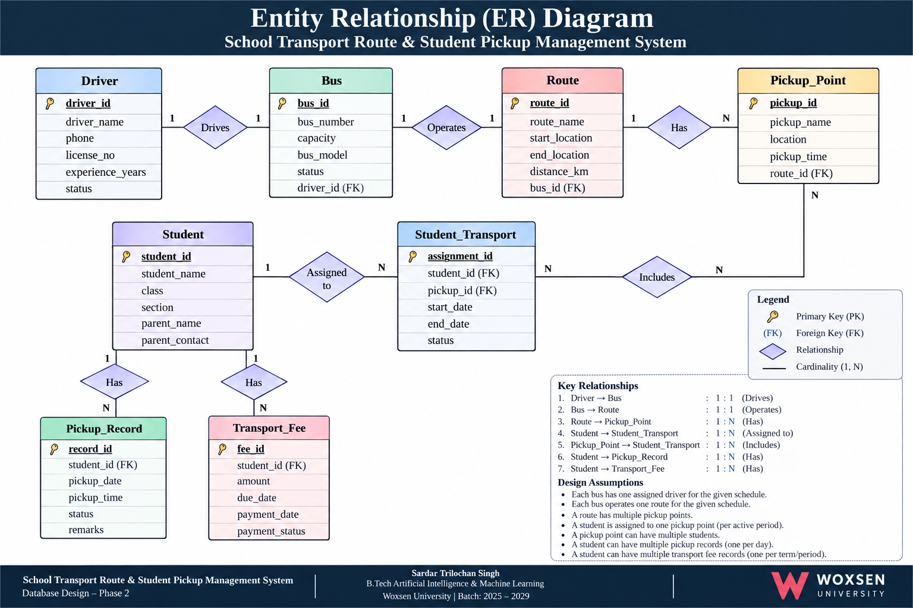



DATABASE DESIGN
Entity Relationship Diagram
DRIVER
BUS
ROUTE
PICKUP_POINT
1 : 1
1 : 1
1 : N
driver_id (PK)
bus_id (PK)
route_id (PK)
pickup_id (PK)
driver_name
driver_id (FK)
bus_id (FK)
route_id (FK)
1 : N
STUDENT
1 : N (assigns)
STUDENT_TRANSPORT
student_id (PK)
assignment_id (PK)
student_name
student_id (FK)
pickup_id (FK)
1 : N
PICKUP_RECORD
TRANSPORT_FEE
Primary Key
Foreign Key
record_id (PK)
fee_id (PK)
student_id (FK)
student_id (FK)
DBMS Phase 2 Review — School Transport Route & Student Pickup Management System
3

Slide 4






DATABASE DESIGN
8 TABLES IMPLEMENTED
Relational Database Design
STUDENT
DRIVER
BUS
ROUTE
PK student_id
PK driver_id
PK bus_id
PK route_id
student_name • class • section
driver_name • license_no (UQ) • status
FK driver_id
FK bus_id
bus_number (UQ) • capacity
route_name • distance_km
PICKUP_POINT
STUDENT_TRANSPORT
PICKUP_RECORD
TRANSPORT_FEE
PK pickup_id
PK assignment_id
PK record_id
PK fee_id
FK route_id
FK student_id
FK student_id
FK student_id
pickup_name • pickup_time
FK pickup_id
pickup_date • status
amount • payment_status
start_date • status
DBMS Phase 2 Review — School Transport Route & Student Pickup Management System
4

Slide 5

IMPLEMENTATION
MySQL Database Implementation
mysql>
Database created in MySQL
CREATE DATABASE school_transport_db;
USE school_transport_db;
8 relational tables implemented
CREATE TABLE Student (
student_id VARCHAR(10) PRIMARY KEY,
student_name VARCHAR(100) NOT NULL,
class VARCHAR(20),
section VARCHAR(10),
parent_name VARCHAR(100),
parent_contact VARCHAR(15)
);
Primary keys defined on every table
Foreign keys established between tables
Sample records inserted for all tables
DBMS Phase 2 Review — School Transport Route & Student Pickup Management System
5

Slide 6
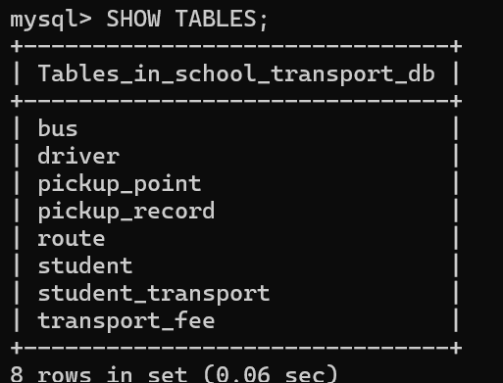
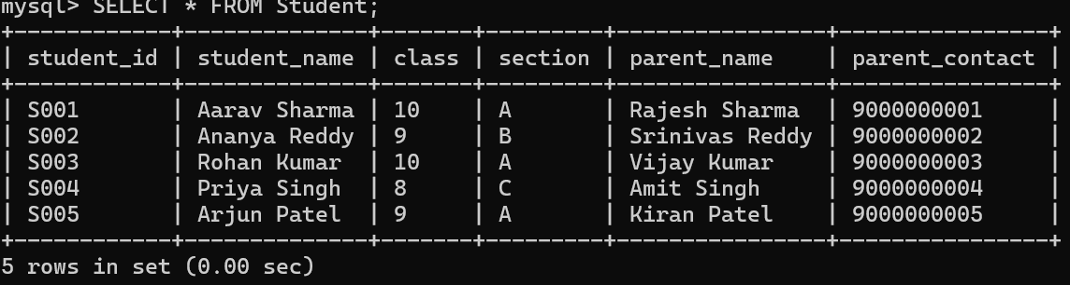
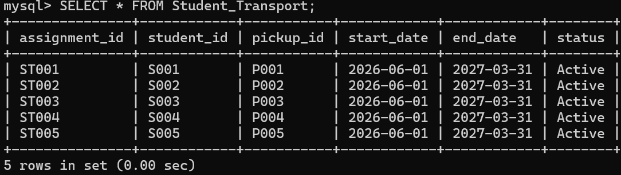
LIVE MYSQL EVIDENCE
REAL MYSQL OUTPUT
Populated RDBMS Tables
SHOW TABLES; → 8 Tables Registered
Student Table
Student_Transport Table
Database successfully populated with sample transport records.
DBMS Phase 2 Review — School Transport Route & Student Pickup Management System
6

Slide 7
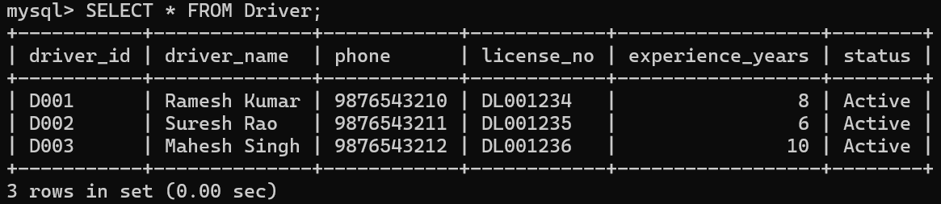
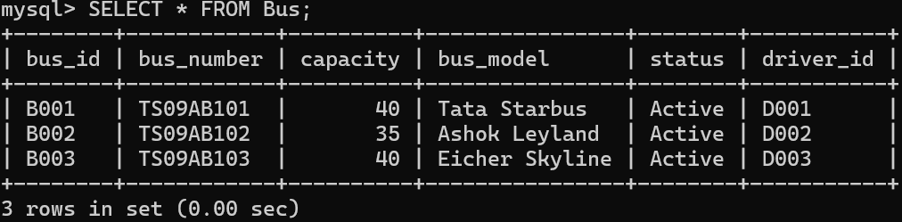
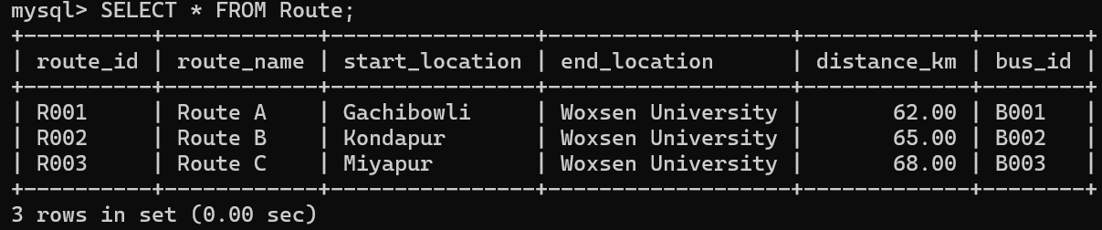
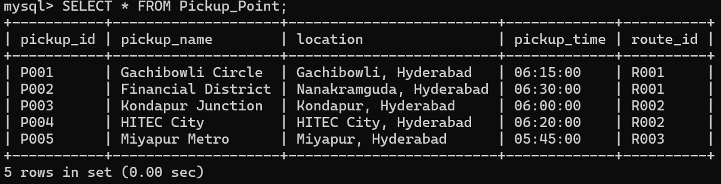
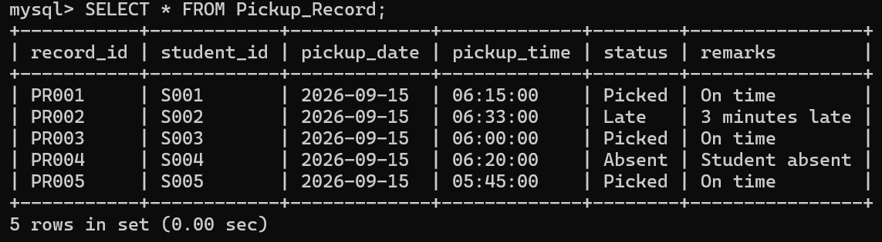
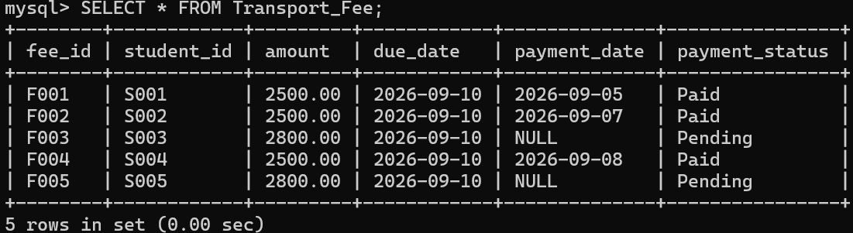
LIVE MYSQL EVIDENCE
Additional Populated Tables
Driver Table
Bus Table
Route Table
Pickup_Point Table
Pickup_Record Table
Transport_Fee Table
DBMS Phase 2 Review — School Transport Route & Student Pickup Management System
7

Slide 8
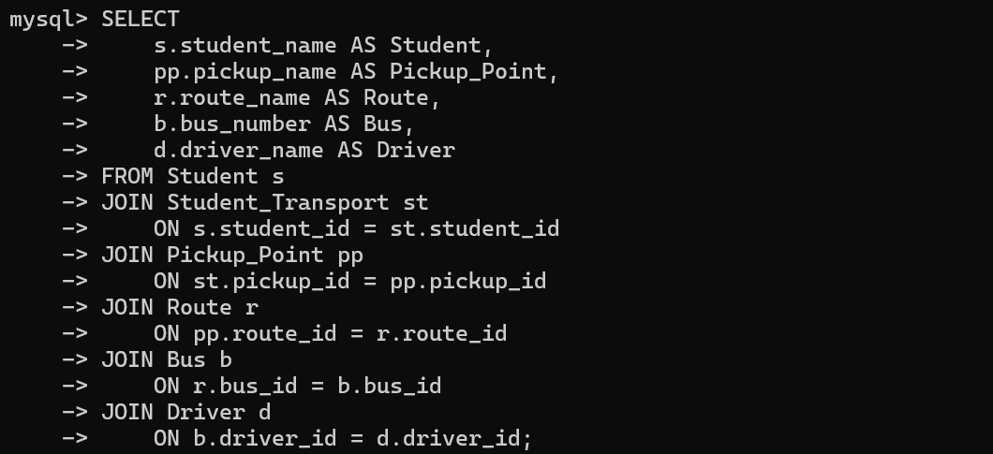
QUERY EXECUTION
SQL Query Execution
JOIN Query — Student Transport Assignment
What this query does
Joins student and transport information across 5 tables
Retrieves pickup point, route, bus and driver details
Demonstrates the primary/foreign key relationships in action
DBMS Phase 2 Review — School Transport Route & Student Pickup Management System
8

Slide 9
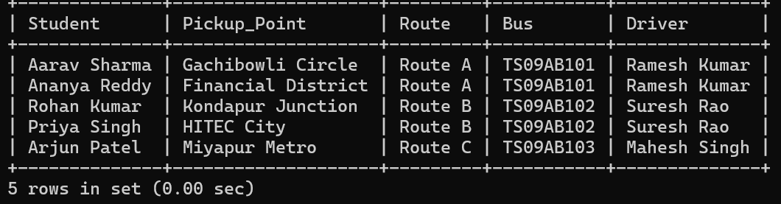
QUERY EXECUTION
Query Result
Query Output — 5 Rows Returned
Successful output confirms that the relational links and JOIN operations are functioning correctly.
DBMS Phase 2 Review — School Transport Route & Student Pickup Management System
9

Slide 10
SUMMARY
Phase 2 Outcome
ER Model Designed
Relational Schema Implemented
MySQL Tables Populated
SQL Query Successfully Executed
NEXT PHASE
Advanced queries, reports and additional database functionality.
DBMS Phase 2 Review — School Transport Route & Student Pickup Management System
10

