Slide 1







DBMS COURSE PROJECT · PRESENTATION III
School Transport Route &
Student Pickup Management System
Database Management System — Presentation III
Sardar Trilochan Singh
25WU0102246 | B.Tech AIML | Woxsen University
Transport Network ⇄ Relational Database
React + Vite · Node.js + Express · MySQL
Notes:
Good [morning/afternoon]. I'm Sardar Trilochan Singh, Roll Number 25 W U 0102246, B.Tech AIML, Woxsen University. This is Presentation 3 for my DBMS course project — the School Transport Route and Student Pickup Management System. It's a fully working, MySQL-backed application with a React frontend and a Node.js/Express backend, and in the next ten minutes I'll walk through the design, the live database, and demonstrate real insert and delete operations against MySQL.

Slide 2



PROBLEM & OBJECTIVE
From Transport Chaos to One Connected System
Manual transport management makes it difficult to track assignments, bus capacity, routes, pickup/drop points, drivers, attendance and fees together.
BEFORE
AFTER
Scattered records
Centralized database
Manual tracking
Connected entities
Difficult updates
Live UI
Poor visibility
Instant updates
Objective: Build a centralized relational database and web interface that allows transport information to be viewed and managed efficiently.
School Transport Route & Student Pickup Management System — Presentation III
2 / 9
Notes:
Before this system, transport data for a school this size lived in scattered spreadsheets — assignments, bus capacity, routes, pickups and fees all tracked manually, with no single source of truth and no easy way to verify anything quickly. The objective of this project was to design a normalized relational database and a live web interface on top of it, so every piece of transport information — students, buses, drivers, routes, pickup and drop points, attendance and fees — is connected and instantly queryable instead of scattered.

Slide 3




SYSTEM ARCHITECTURE
LIVE MYSQL CONNECTION
How the System Works
USER
REACT + VITE
FRONTEND
NODE.JS + EXPRESS
API
MYSQL
9 RELATIONAL
TABLES
FRONTEND PAGES
BACKEND CAPABILITIES
DATABASE
Dashboard
Students
REST API
school_transport_db
Transport
Routes
Validation
9 tables · live connection pool
Buses
Pickup/Drop
MySQL Pool
Pickup Records
Fees
CRUD Ops
Every request flows React → Express → MySQL and back — no mock data, no static JSON, no simulated responses.
School Transport Route & Student Pickup Management System — Presentation III
3 / 9
Notes:
The architecture is a standard three-tier design. The user interacts with a React and Vite frontend — eight pages covering dashboard, students, transport, routes, buses, pickup and drop points, pickup records and fees. Every page calls a Node.js and Express REST API, which validates input and runs parameterized queries through a MySQL connection pool using the mysql2 driver. MySQL itself holds nine relational tables. There's no mock data anywhere — every number on screen is a live round trip from React to Express to MySQL and back.

Slide 4





DATABASE DESIGN
The Database Behind the Transport Network
9
Tables
1,773
Records
STUDENT_
TRANSPORT
PICKUP_
POINT
DROP_
POINT
285
Students
ROUTE
STUDENT
7
Routes
PICKUP_
RECORD
BUS
7
Buses
TRANSPORT_
FEE
DRIVER
— Primary flow: Student → Transport Assignment → Pickup/Drop → Route → Bus → Driver
School Transport Route & Student Pickup Management System — Presentation III
4 / 9
Notes:
At the center of the schema is the Student table. From there, a solid primary flow connects Student to Student Transport — the associative table — then to Pickup Point, Route, Bus and Driver in sequence. Two more tables, Transport Fee and Pickup Record, connect directly to Student with a one-to-many relationship, since every student independently accumulates fee and attendance records. Drop Point mirrors Pickup Point on the same Route. In total this is nine tables, one thousand seven hundred and seventy-three records, covering 285 students across 7 routes and 7 buses.

Slide 5
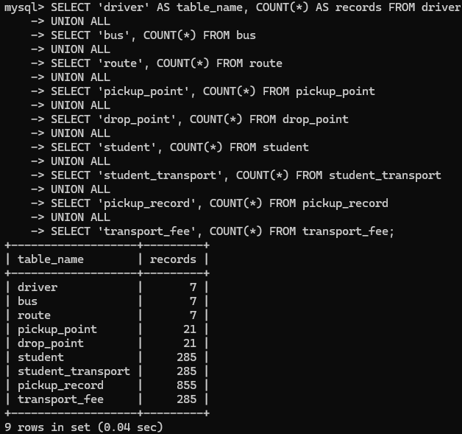
DATABASE IMPLEMENTATION
REAL DATA · NOT MOCK
A Fully Populated Relational Database
7
7
7
TOTAL RECORDS
driver
bus
route
1,773
21
21
285
pickup_point
drop_point
student
285
285
855
285
Students
Transport
Assignments
Pickup
Records
Fee
Records
285
855
285
student_transport
pickup_record
transport_fee
Live aggregate COUNT across all 9 tables
School Transport Route & Student Pickup Management System — Presentation III
5 / 9
Notes:
This isn't a mock dataset — it's a fully populated MySQL database. Nine tables holding one thousand seven hundred seventy-three real rows: 285 students, 285 transport assignments, 855 pickup records — that's three attendance entries per student on average — and 285 fee records. On the right you can see the actual MySQL terminal output of an aggregate COUNT query across all nine tables, which matches these numbers exactly.

Slide 6
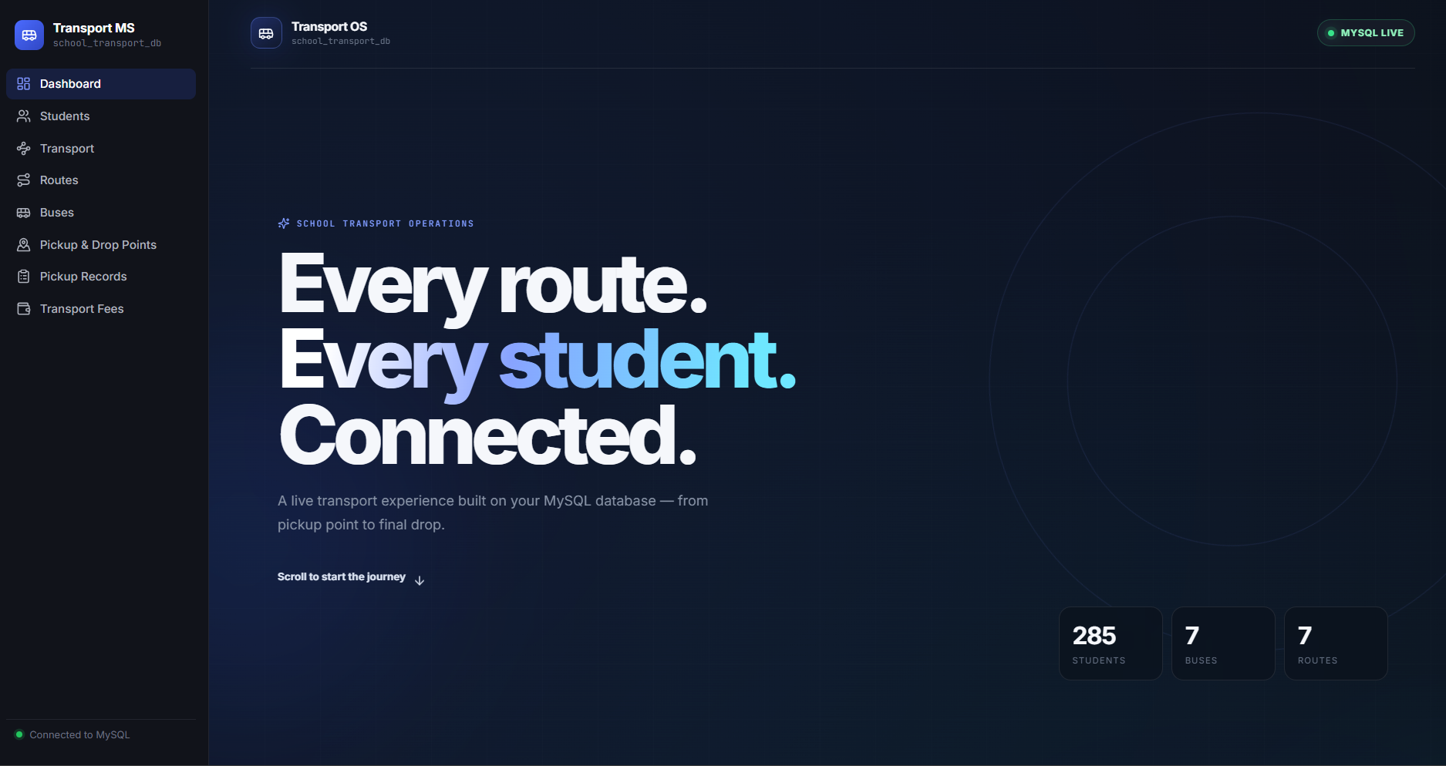
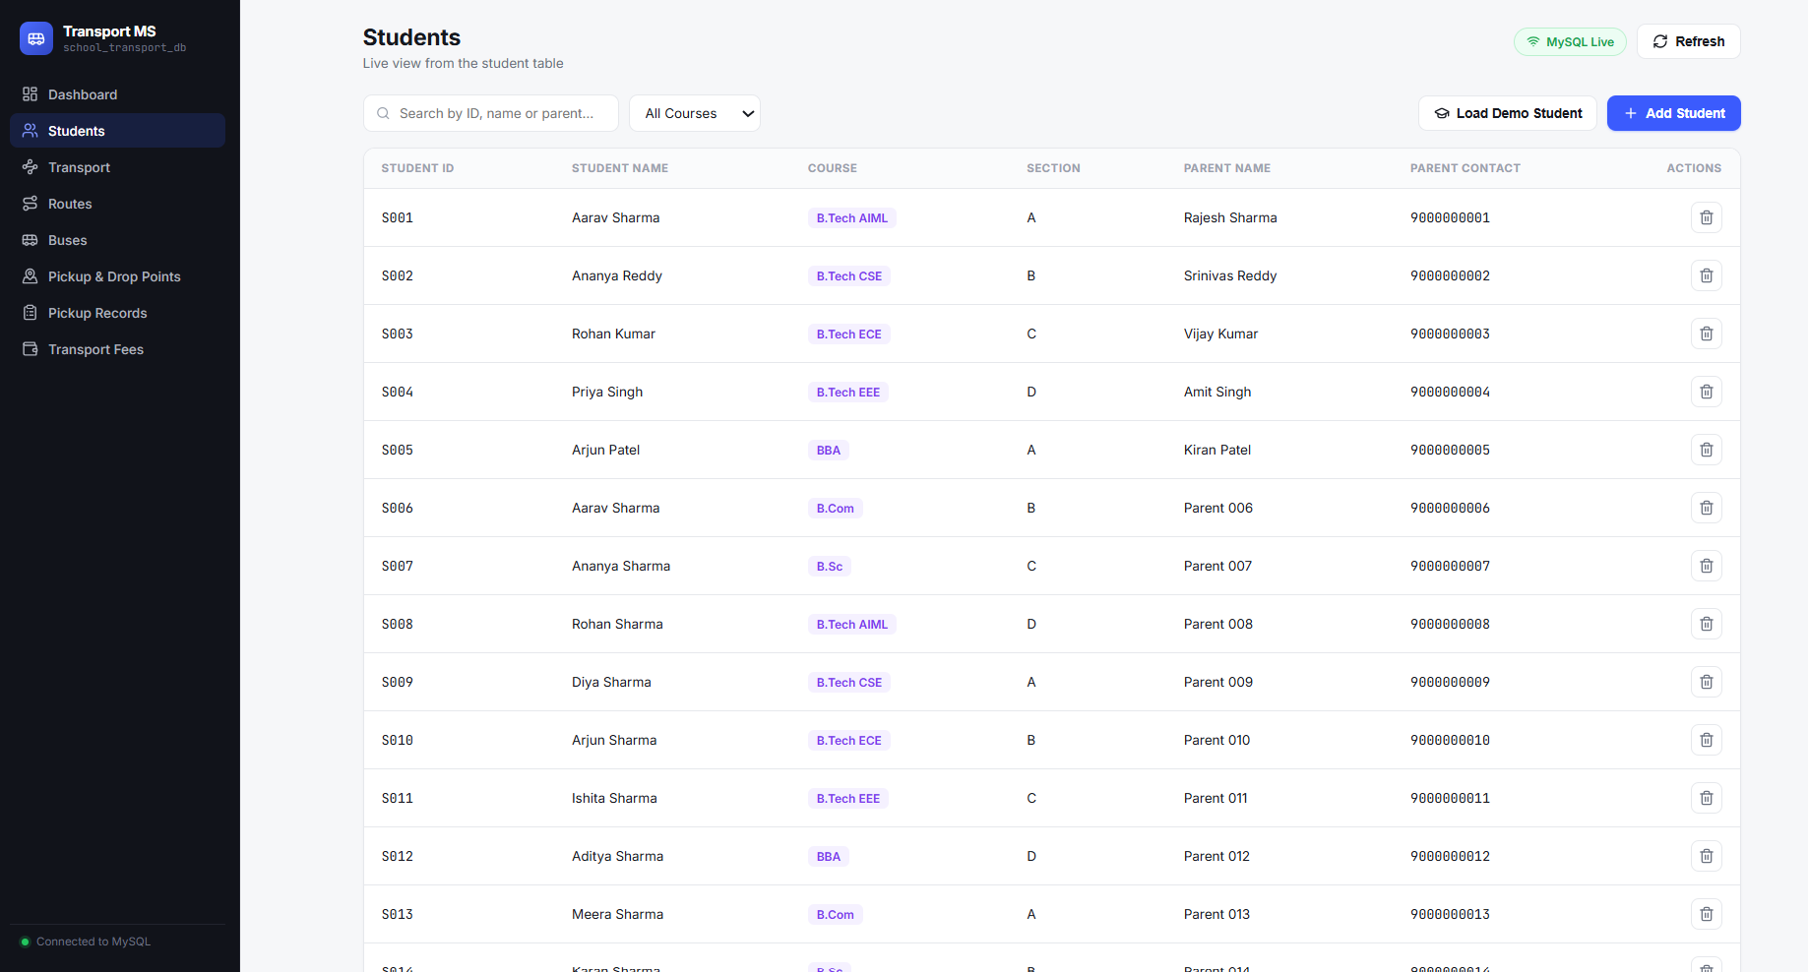
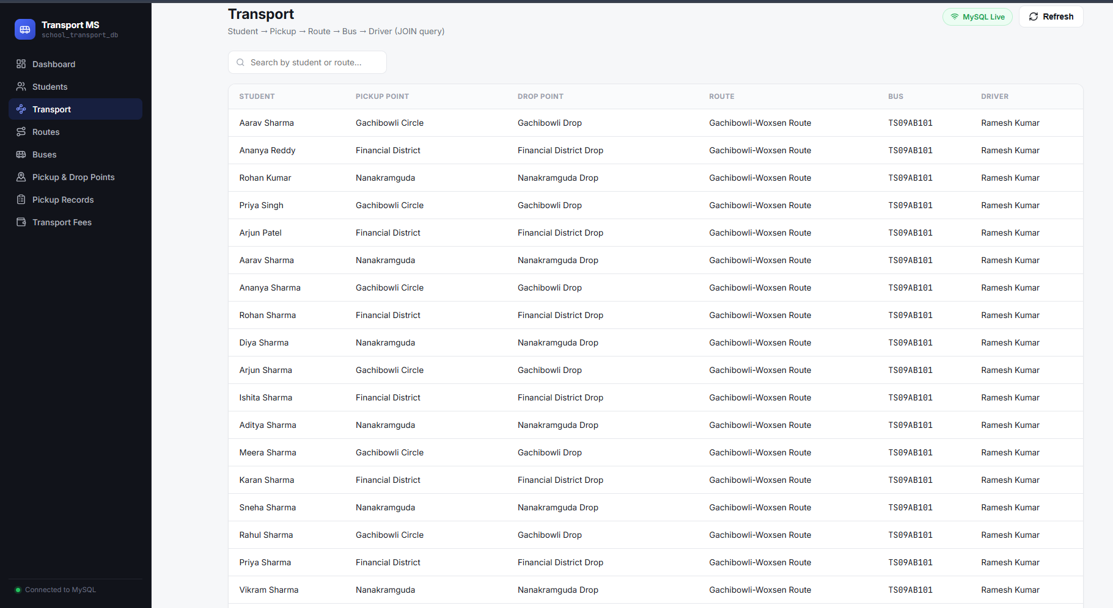
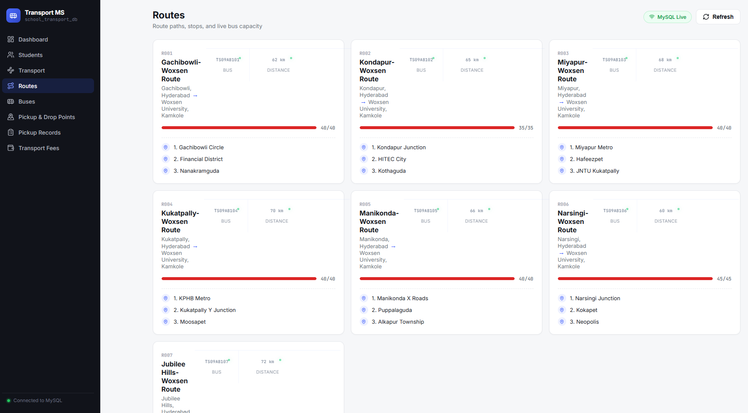
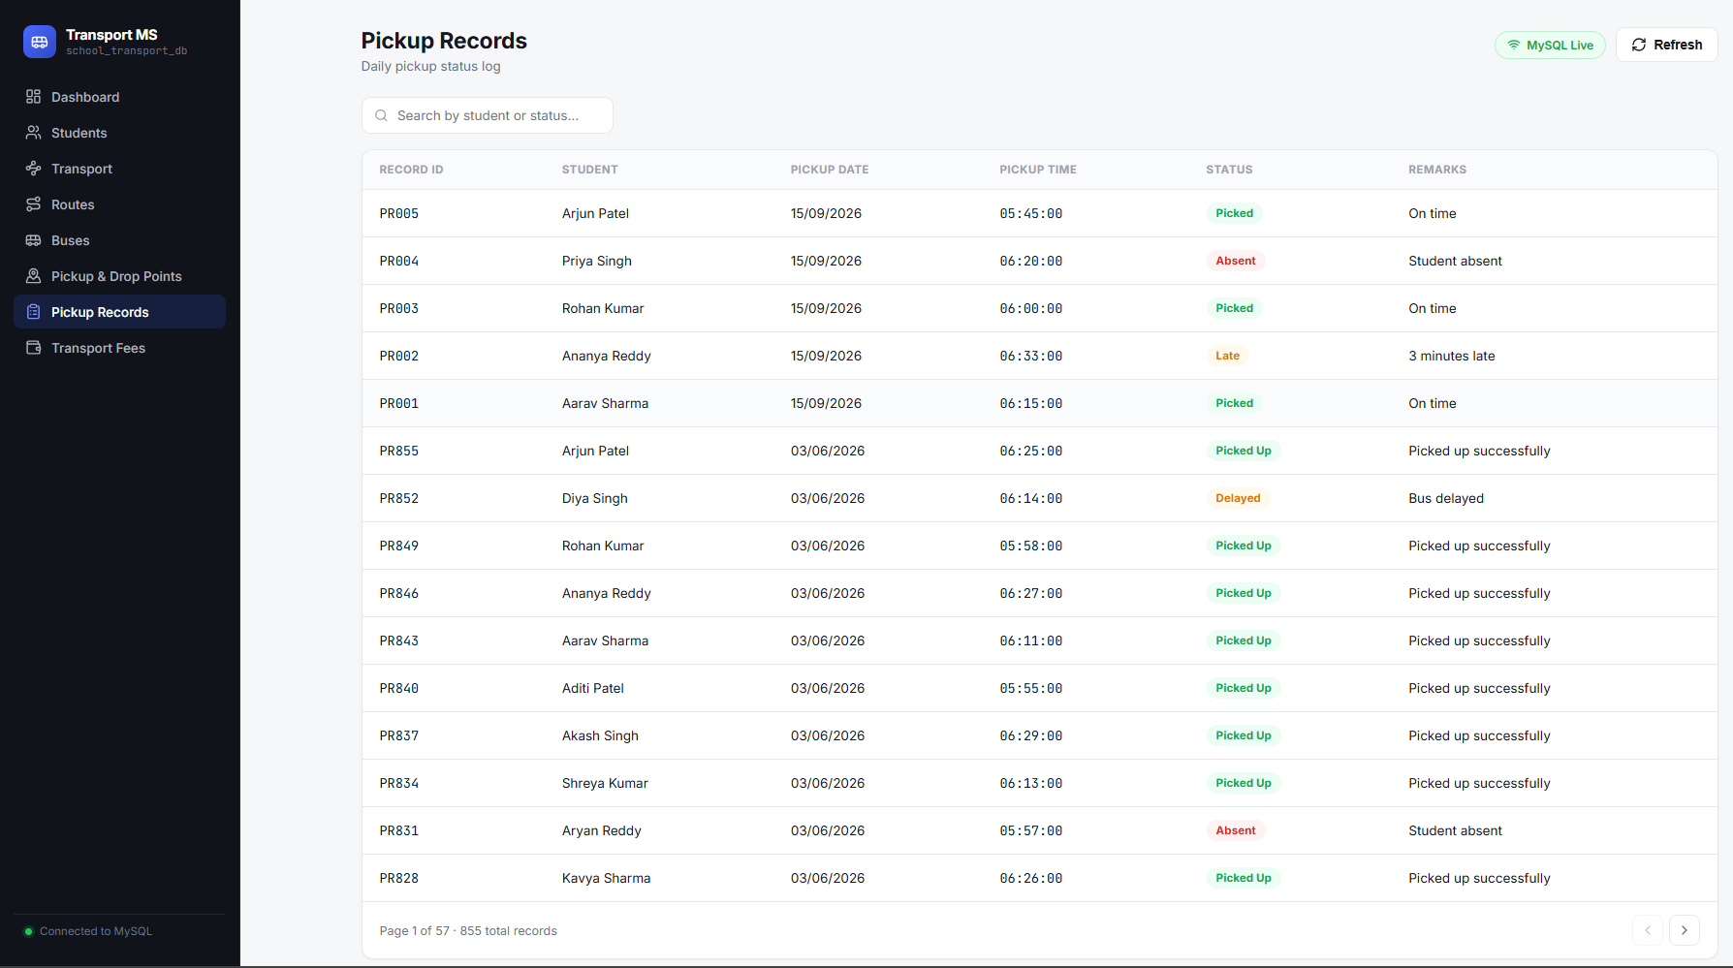
LIVE APPLICATION
MYSQL LIVE
A Live Transport Management Dashboard
Students — search & filter
Transport — JOIN view
Dashboard — live counts from MySQL
Routes — live capacity
Pickup Records — status log
View
Search
Filter
Insert
Delete
Route Analysis
Capacity Analysis
School Transport Route & Student Pickup Management System — Presentation III
6 / 9
Notes:
This is the actual application, not a mockup — every screen you're seeing here is a live screenshot of the running React app talking to MySQL. The dashboard on the left shows real-time counts. On the right, the Students page supports search and course filtering, the Transport page is a five-table JOIN showing student, pickup, route, bus and driver together, and the Routes page shows live bus-capacity bars computed with a GROUP BY aggregation. Every one of these — view, search, filter, insert, delete, route and capacity analysis — is backed by a real SQL query.

Slide 7
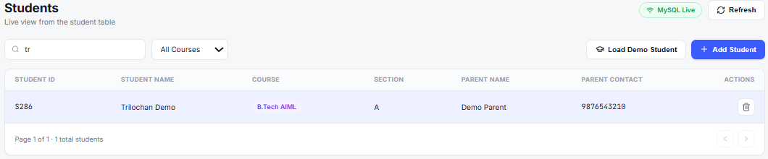
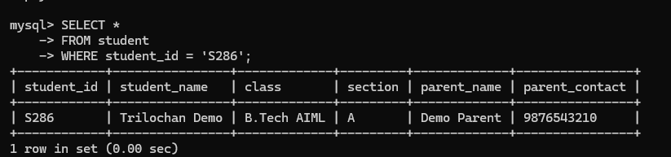
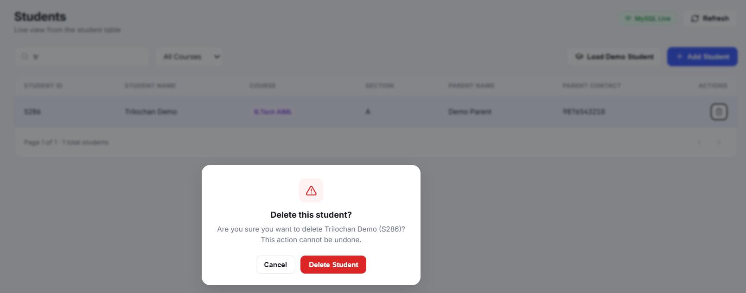
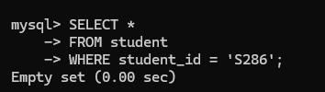
THE MOST IMPORTANT SLIDE
Live Demo — UI ↔ MySQL
01
VIEW
02
INSERT
03
VERIFY
04
DELETE
05
VERIFY
285 students visible
S286 — Trilochan Demo
MySQL: 1 row found
Confirm & remove S286
MySQL: Empty set
UI ACTION → API → MYSQL → DATABASE UPDATED
Temporary demo record S286 — inserted and deleted live, final count returns to 285.
School Transport Route & Student Pickup Management System — Presentation III
7 / 9
Notes:
This is the core of today's evaluation. Step one: View — I open the Students page and you can see all 285 real students loaded from MySQL. Step two: Insert — I add a temporary demo student, S286, Trilochan Demo, B.Tech AIML, through the Add Student form; it's validated, sent to the backend, and inserted with a parameterized SQL statement. Step three: Verify — switching to the MySQL terminal, a SELECT for student_id S286 returns exactly one row, proving the insert really happened in the database, not just in the UI. Step four: Delete — I remove S286 from the UI with a confirmation dialog. Step five: Verify — the same SELECT now returns an empty set, and the student count is back to 285. This proves the React interface is genuinely reading and writing live MySQL data, end to end.

Slide 8
QUERIES & ANALYSIS
From Raw Data to Useful Decisions
Students Under a Driver
Route-wise Student Distribution
SELECT s.student_name, d.driver_name
FROM student_transport st
JOIN pickup_point pp ON pp.pickup_id=st.pickup_id
JOIN route r ON r.route_id=pp.route_id
JOIN bus b ON b.bus_id=r.bus_id
JOIN driver d ON d.driver_id=b.driver_id;
SELECT r.route_name, COUNT(st.student_id)
FROM route r
JOIN pickup_point pp ON r.route_id=pp.route_id
JOIN student_transport st
ON pp.pickup_id=st.pickup_id
GROUP BY r.route_id, r.route_name;
Traces every student back to their assigned driver
7 routes · 285 students distributed
Bus Capacity Utilization
Pending Transport Fees
SELECT b.bus_number, b.capacity,
COUNT(st.student_id) AS assigned
FROM bus b
JOIN route r ON r.bus_id=b.bus_id
JOIN pickup_point pp ON pp.route_id=r.route_id
JOIN student_transport st ON st.pickup_id=pp.pickup_id
GROUP BY b.bus_id;
SELECT s.student_name, tf.amount, tf.due_date
FROM transport_fee tf
JOIN student s ON s.student_id=tf.student_id
WHERE tf.payment_status='Pending';
285 / 285 seats · 100% utilization
Flags unpaid fees across 285 records
School Transport Route & Student Pickup Management System — Presentation III
8 / 9
Notes:
The database isn't just storage — it supports real analysis through SQL joins and aggregations. These four queries are actually running behind the Transport, Routes and Fees pages: tracing students back to their driver through a five-table join, counting route-wise student distribution with GROUP BY, computing bus capacity utilization — which currently comes out to 285 out of 285 seats, full capacity across all seven buses — and flagging pending transport fees with a simple WHERE filter. Together these show the schema was designed for genuine relational querying, not just flat storage.

Slide 9
TESTING & CONCLUSION
Tested. Connected. Ready.
MySQL connection
Dashboard data loading
Student insertion
Student deletion
Student viewing
Search and filtering
Transport joins
Route information
Bus capacity
Pickup records
Transport fees
285
7
7
21
21
1,773
100%
Students
Buses
Routes
Pickup Pts
Drop Pts
Records
Utilization
CONCLUSION
FUTURE SCOPE
The system successfully integrates a relational MySQL database with a modern web interface to manage student transport data, routes, buses, pickup/drop points and transport records.
• Authentication & role-based access
• Live GPS tracking
• Automated notifications
• Mobile application
• Predictive route optimization
• Automated fee reminders
ONE SYSTEM. EVERY STUDENT. EVERY ROUTE.
Thank You.
School Transport Route & Student Pickup Management System — Presentation III
9 / 9
Notes:
To summarize what's been tested end to end: the MySQL connection, dashboard loading, student insertion and deletion, viewing, search and filtering, the transport joins, route information, bus capacity, pickup records and transport fees — all verified live today. The final numbers: 285 students, 7 buses, 7 routes, 21 pickup points, 21 drop points, 1,773 total records, and 100% seat utilization. This system successfully brings together a normalized MySQL database and a modern React interface to manage the full transport lifecycle. Future scope includes authentication, live GPS tracking, automated notifications, a mobile app, predictive route optimization and automated fee reminders — none of which are implemented yet, but the schema is designed to extend cleanly into them. Thank you.

