Slide 1

GURU GHASIDAS VISHWAVIDYALAYA BILASPUR (C.G) (A CENTRAL UNIVERSITY) Dept. of Computer Science And Information Technology (CSIT)
Guided By Submitted By Mr. Nripedra sir Hari Ram
Assistant Professor BSc 5th
CSIT,GGV 17207225
A MINOR PROJECT ON ONLINE VOTING SYSTEM
GUIDED BY
MR. VIVEK SARATHE SIR
SUBMITTED BY
DURGA DEWANGAN
MCA 2nd SEM
20606069

Slide 2
CONTENTS
INTRODUCTION
OBJECTIVE & OVERVIEW
PROGRAMMING LANGUAGE USED
SOFTWARE AND HARDWARE
DATA FLOW DAIGRAM
SCREENSHOTS
FUTURE ENHANCMENT
CONCLUSION

Slide 3
INTRODUCTION
ONLINE VOTING SYSTEM is a website developed using PHP, HTML, CSS and JAVA SCRIPT . this project is based on the concept of giving their votes online, during any elections. The user can register himself by entering details like name, phone number, password etc. on this site, and they can login into this site and can give votes. And same as the party also can register and party can upload their brand logo. For using this website user don’t need to install any application, they can go on any browser like chrome and opera, and type url of this site and they can be able to use this site.

Slide 4
OBJECTIVE AND OVERVIEWS
In offline election, there is a lots of crowd in offline election , it takes lots of social workers , managers and police team to conduct offline election it can be very expensive, and most important people have to stand in a line for very long time to give their vote so people get irritated, so regarding this problem and the reduce this problem we have developed this website. Its very easy to use by user. And it takes very least cost to conduct any election, and most important things that every people can give vote from anywhere. So this can be game changer in our voting system in the country

Slide 5
PROGRAMMINNG LANGUAGE USED
ONLINE VOTING SYSTEM is developed by PHP, JAVASCRIPT, HTML, CSS programming language, which is basically a web based markup and scripting language
FEATURES OF PHP
Simple and faster.
Open source, case sensitive, platform independent.
Flexibility, security, very efficient.
Flexible data access, real time access monitoring
Quick development.
Quick error detection and correction.
Loosely typed language.

Slide 6
SOFTWARE AND HARDWARE
SOFTWARE:
HTML5, CSS3 (FRONT END)
PHP, JAVASCRIPT(BACK END)
MySQL database, XAMPP server , chrome browser to run
Window 10 operating system
HARDWARE:
Ram minimum(0.5)gb
Rom minimum(120)gb
laptop

Slide 7
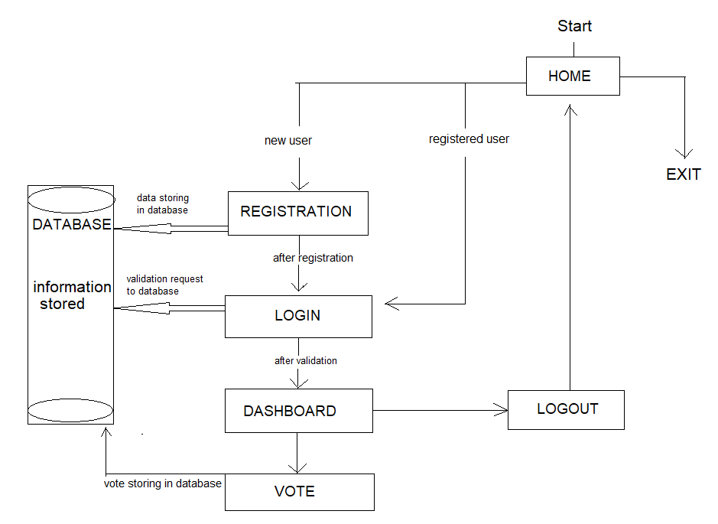
DATA FLOW DIAGRAM

Slide 8
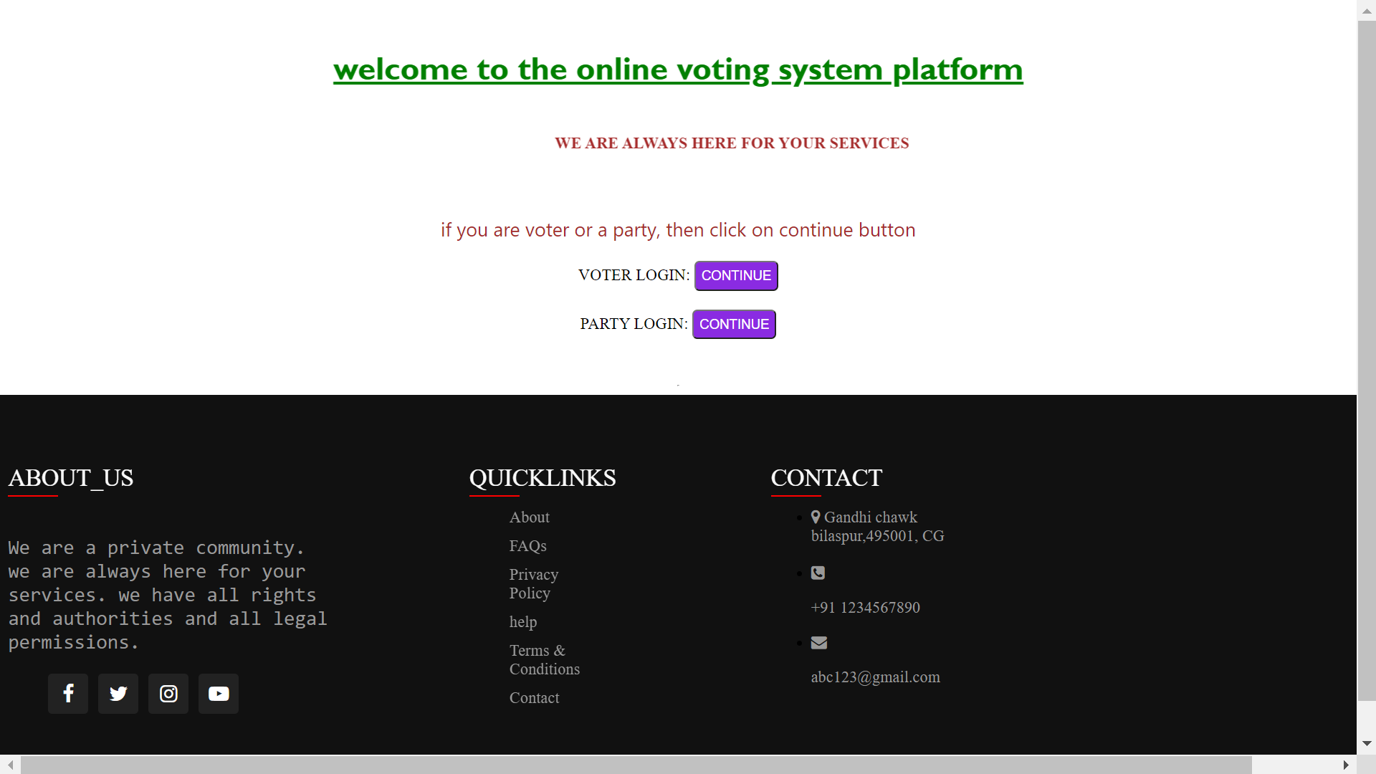
SCREENSHOTS HOME PAGE OF WEBSITE

Slide 9
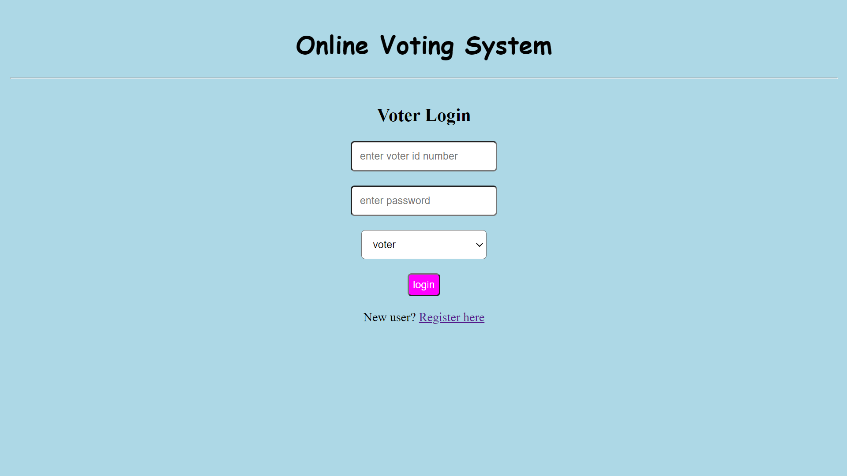
VOTER LOGIN PAGE

Slide 10
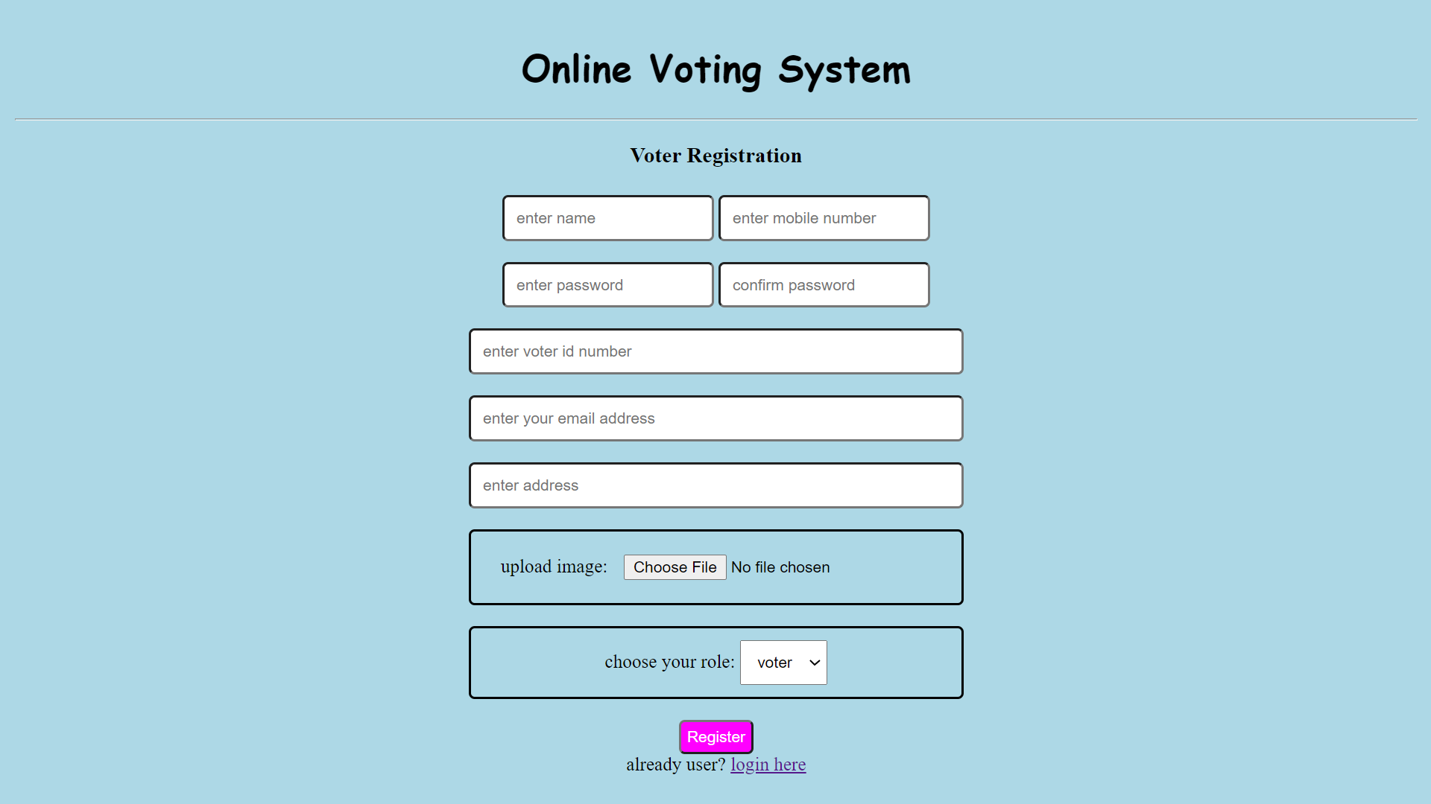
VOTER REGISTRATION PAGE

Slide 11
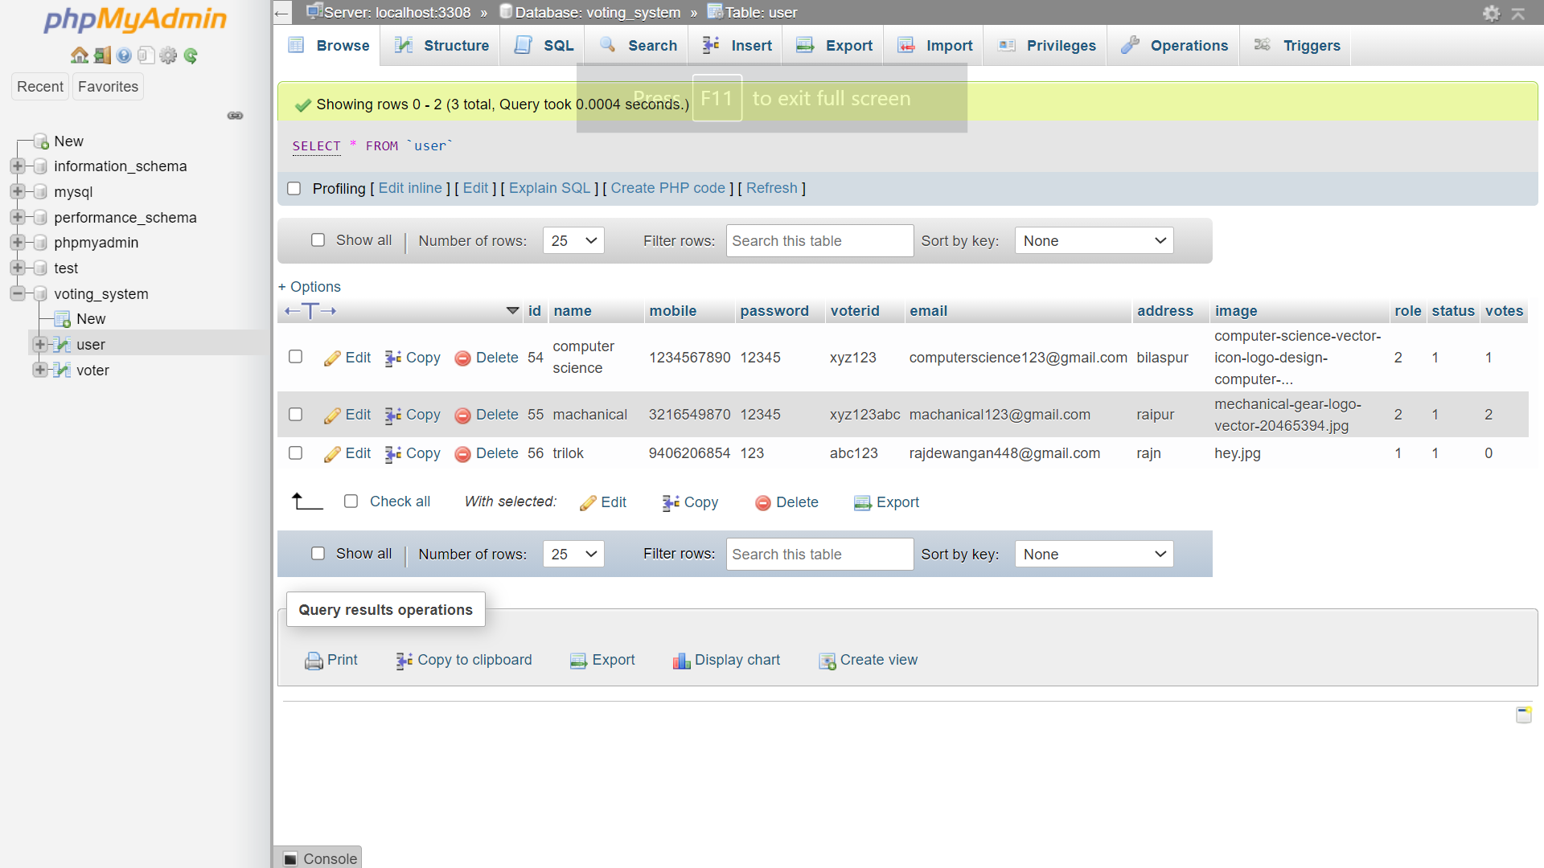
DATABASE INTERFACE AFTER REGISTRATION

Slide 12
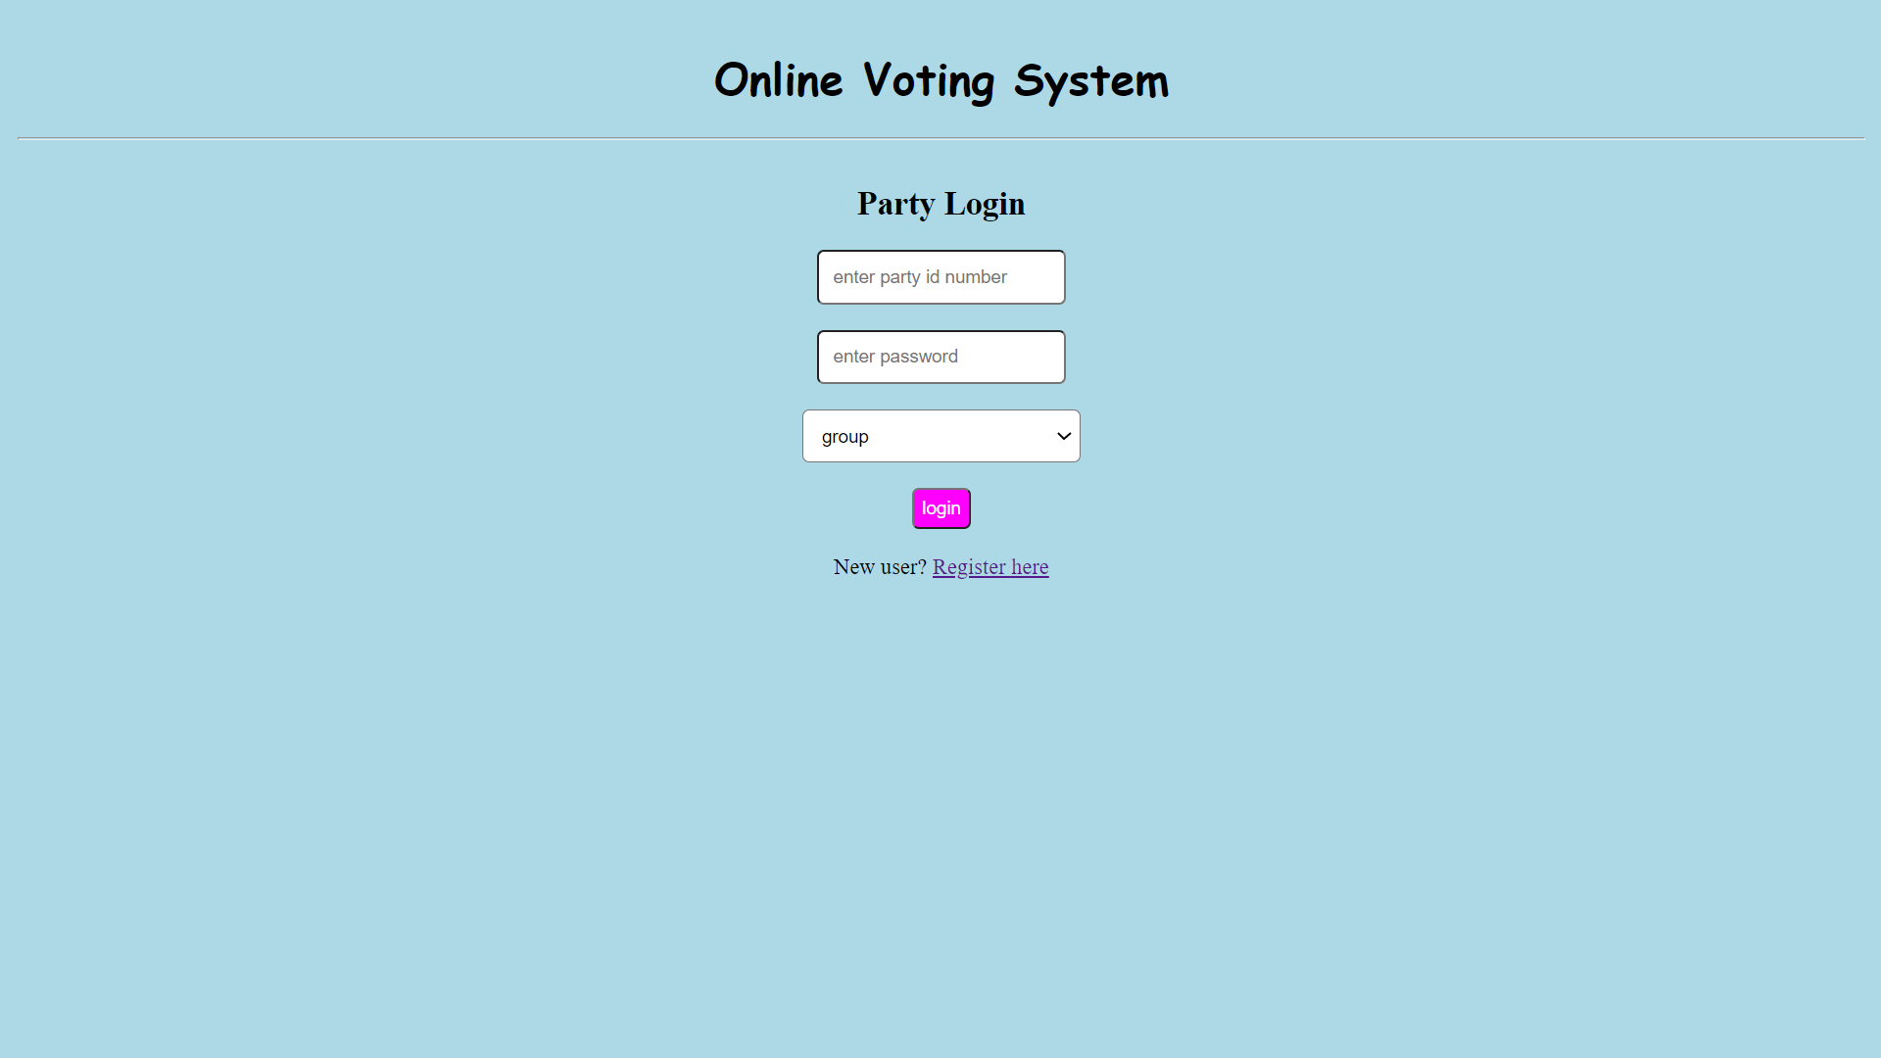
PARTY LOGIN PAGE

Slide 13

PARTY REGISTRATION PAGE

Slide 14
DATABASE INTERFACE

Slide 15
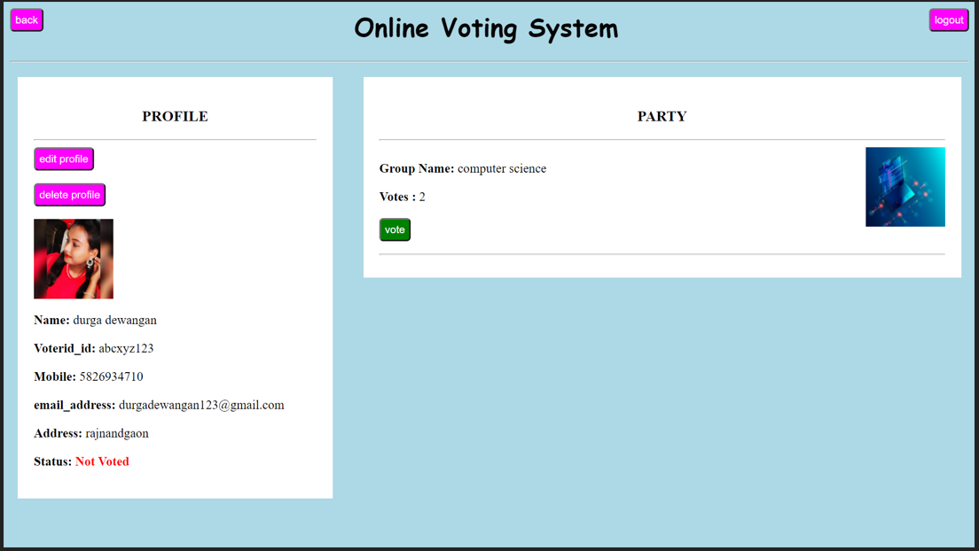
VOTER DASHBOARD

Slide 16
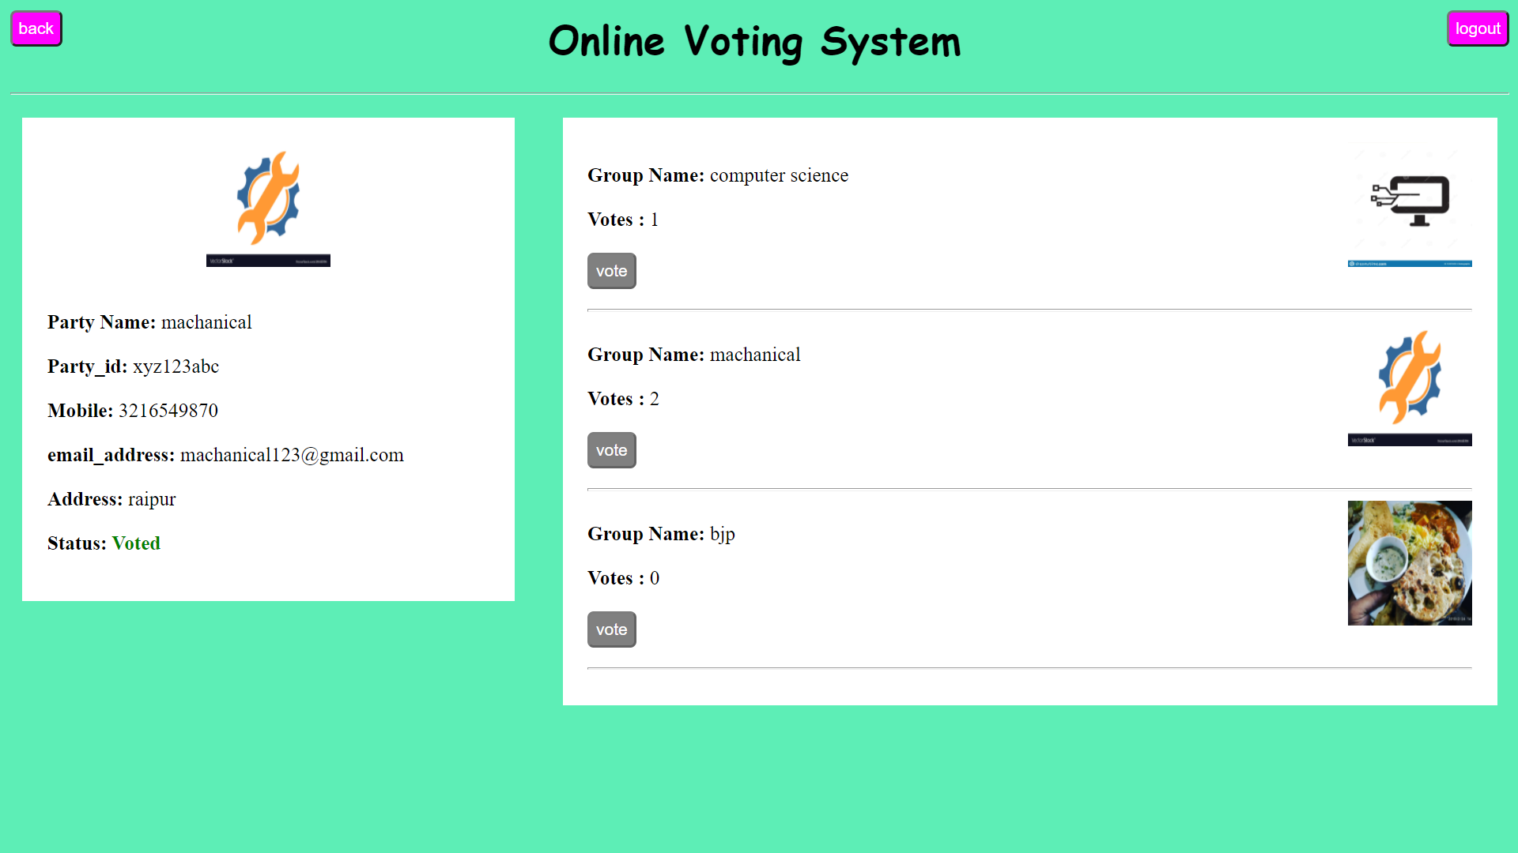
PARTY DASHBOARD

Slide 17
HOME PAGE AFTER LOGOUT

Slide 18
FUTURE ENHANCEMENT
There is no any feature of forgot password in situation of forgot password by any user, so this feature can be add in future by developer.
In this project there is no any option of modify the profile and delete the profile by candidate and voters, both this option can be add in future.
There is no any admin option who can handle and manage all information of candidate and voter, this feature can be also add in future.
There are lots of data field that not available on registration page, that also can be add in future accordingly.

Slide 19
CONCLUSION
Main purpose of this project is committed to provide online home based services in online voting system, we hope all users love it.
This online voting system will manage the voter’s information as we as candidate(party) information by which voter can login and they can use their voting rights, the system will incorporate many feature of voting system. It provide tools for maintaining voter’s vote to every party and it count total number of votes every party. There is a database tha will be maintain by ELECTION COMMISION OF INDIA in which all the name of voter with complete information is stored.
In this user who is above 18 register him/her information on the database. And they can login by their id and password and can vote any party

Slide 20
THANK YOU

