Slide 1

GURU GHASIDAS VISHWAVIDYALAYA BILASPUR (C.G) (A CENTRAL UNIVERSITY) Dept. of Computer Science And Information Technology (CSIT)
Guided By Submitted By Mr. Nripedra sir Hari Ram
Assistant Professor BSc 5th
CSIT,GGV 17207225
A MINOR PROJECT ON VOICE ASSISTANT
GUIDED BY
MR. VIKAS PANDEY SIR
(ASSISTANT PROFESSOR)
SUBMITTED BY
Thanendra Kashyap
MCA 2nd SEM
21072164

Slide 2
CONTENTS
INTRODUCTION
OBJECTIVE & OVERVIEW
PROGRAMMING LANGUAGE USED
SOFTWARE AND HARDWARE
DATA FLOW DAIGRAM
SCREENSHOTS
FUTURE ENHANCMENT
CONCLUSION

Slide 3
INTRODUCTION
SPEECH RECOGNITION is a MOBILE APPLICATION developed using PYTHON PROGRAMMING LANGUAGE. For using this application used just need to install apk file to this project. This project is based on mobile application functionality. Main aim of this project is to convert Hindi speech to Hindi text and addition features is that is depend on resultant data. User can be search resultant data to web and save resultant data as text file format . For using this application user need to just install SPEECH RECOGNITION application. And they can use the application.

Slide 4
OBJECTIVE AND OVERVIEWS
The main objective of this application is to reduce the efforts and time to work on the system. By using this application we can convert our speech to text only just saying loudly.
By just giving our statement, Our Project reduce the effort to manually typing our statement in hindi text. We can convert our speech in hindi text, search our statement on web and save our statement to text file.

Slide 5
PROGRAMMINNG LANGUAGE USED
the voice assistant application has made in python and flutter
FEATURES OF PYTHON
Simple and faster.
Open source, case sensitive, platform independent.
Flexibility, security, very efficient.
Flexible data access, real time access monitoring
Quick development.
Quick error detection and correction.
Loosely typed language.
Various module that is important for machine learning
Flutter provide awesome gui for android application

Slide 6
SOFTWARE AND HARDWARE
HARDWARE REQUIREMENT
Processor - Octa-core Max 1.40GHz
Hard Disk - 2 GB
Main Memory - 500 MB RAM
Android Version – 6.0.1 Mashmellow
SOFTWARE REQUIREMENT
• apk file of the application for installation
• Installed Android operating system to use this application
• Internet Accessibility.

Slide 7
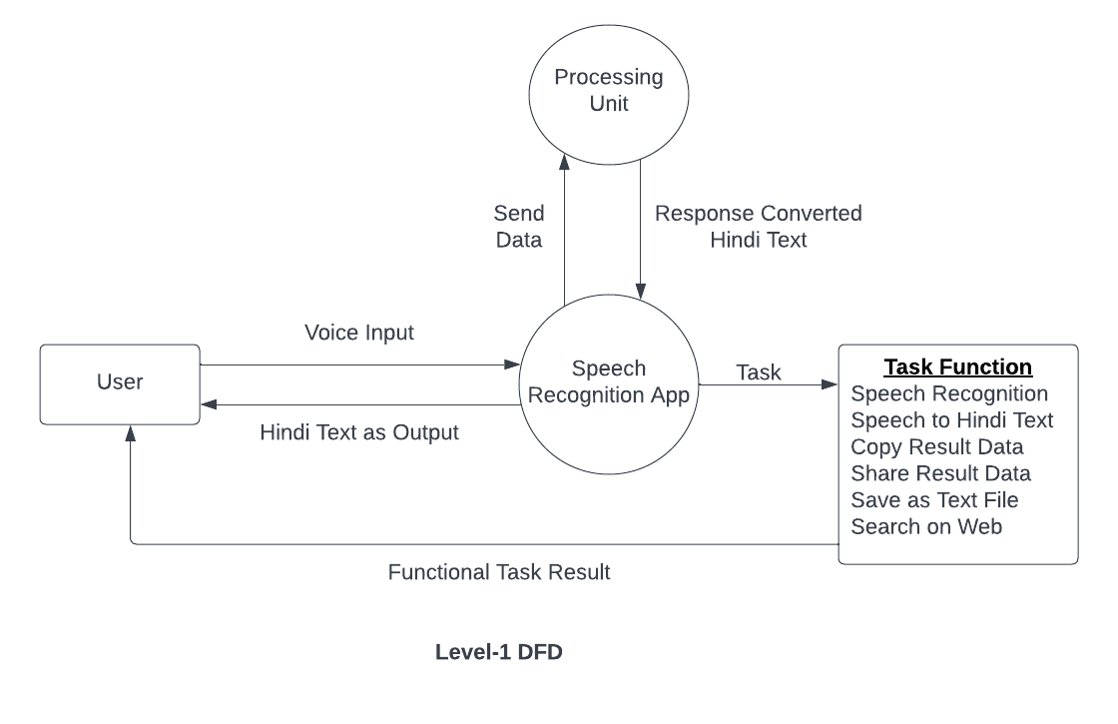
DATA FLOW DIAGRAM

Slide 8
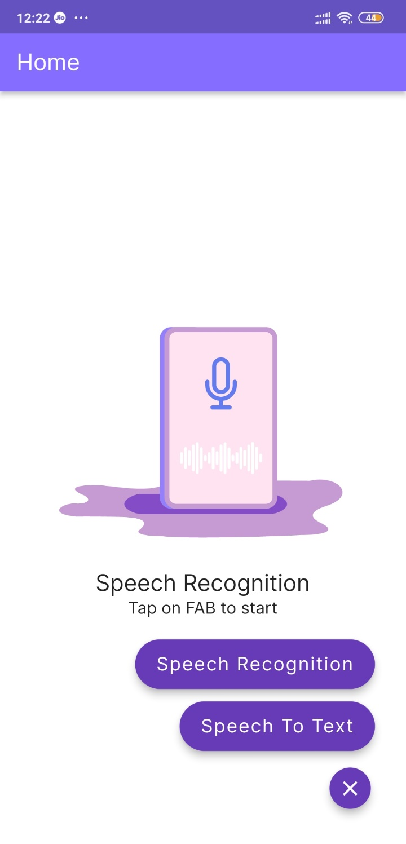
SCREENSHOTS HOME PAGE

Slide 9
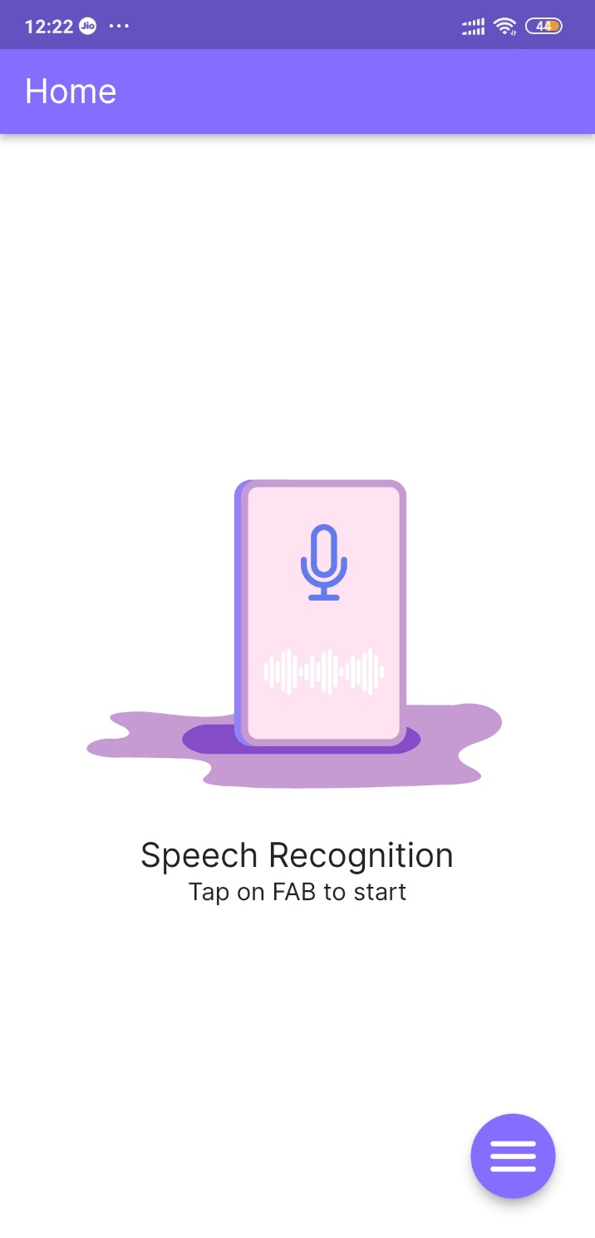

Slide 10
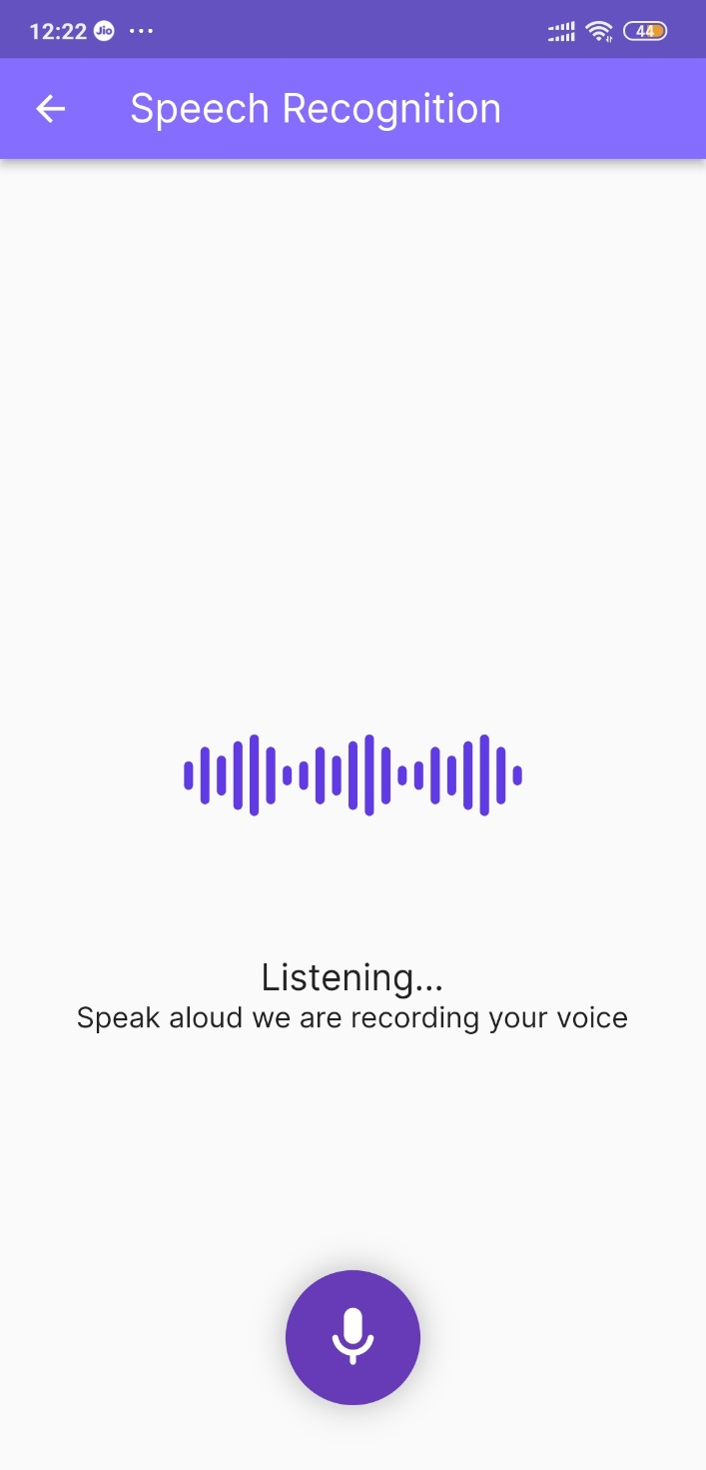

Slide 11
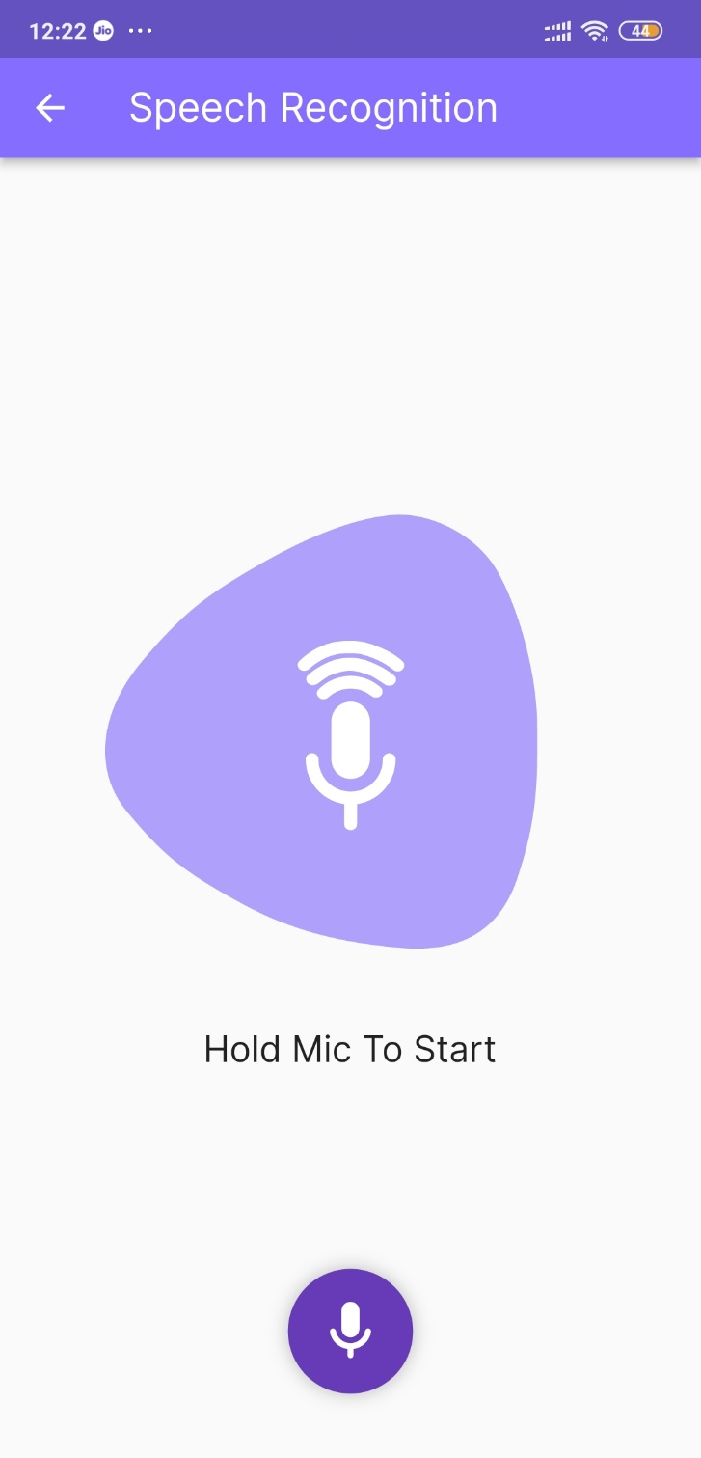

Slide 12
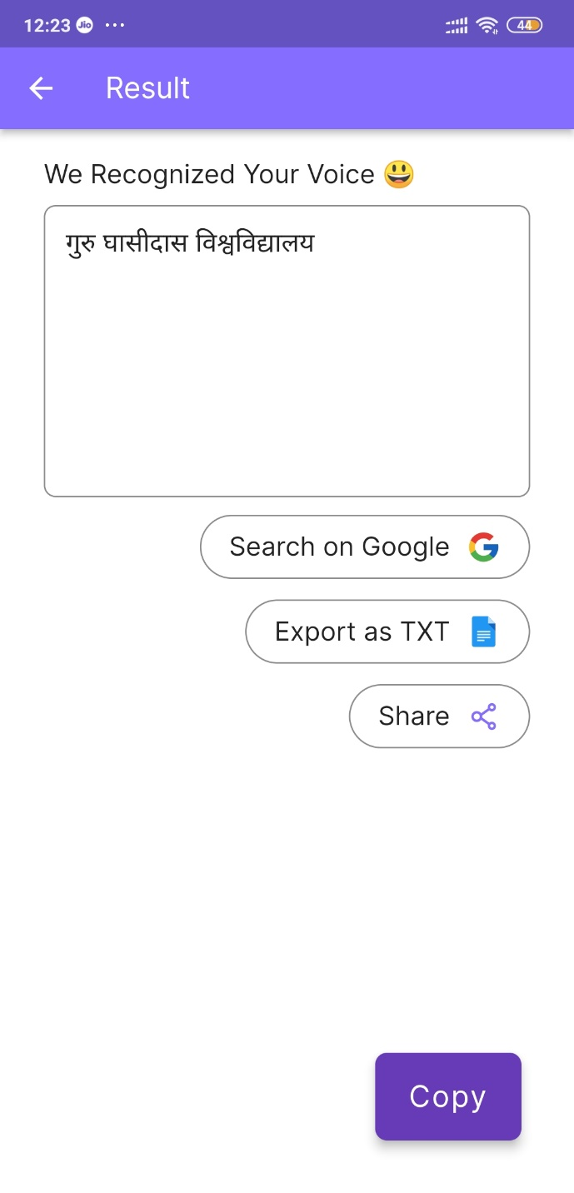

Slide 13
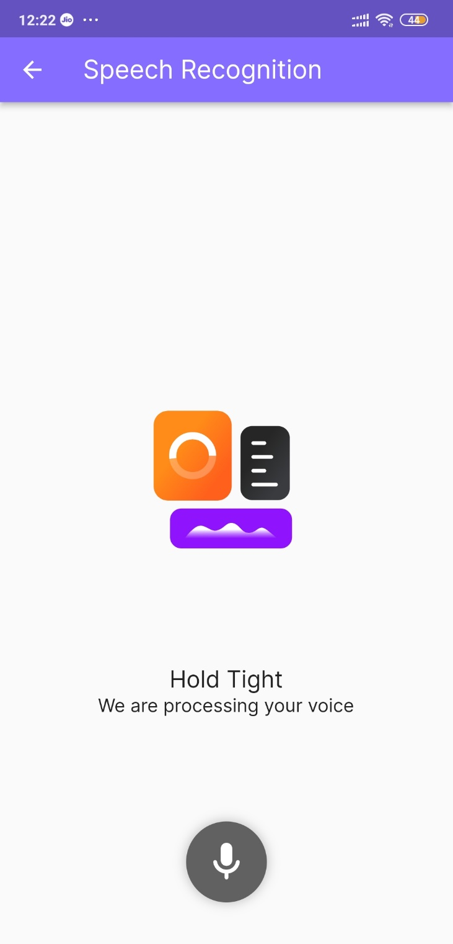

Slide 14
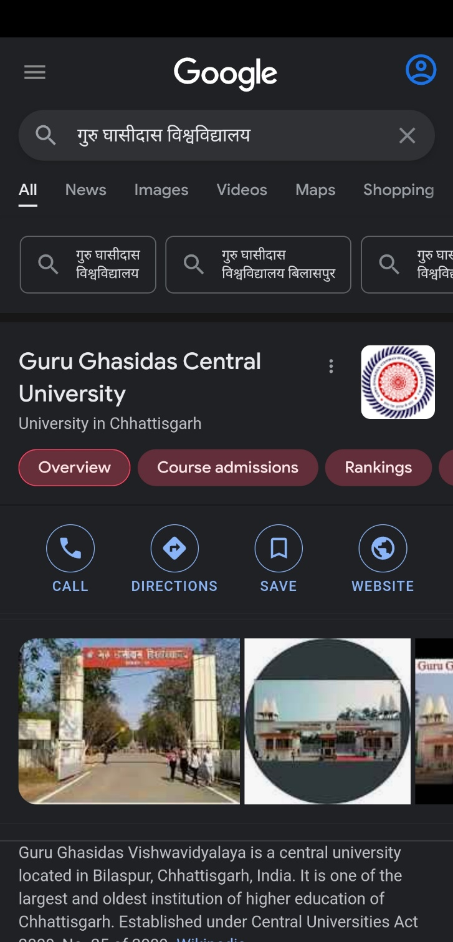

Slide 15
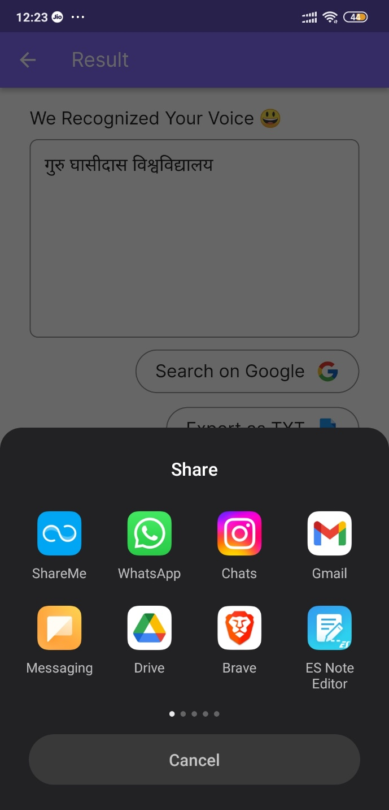

Slide 16
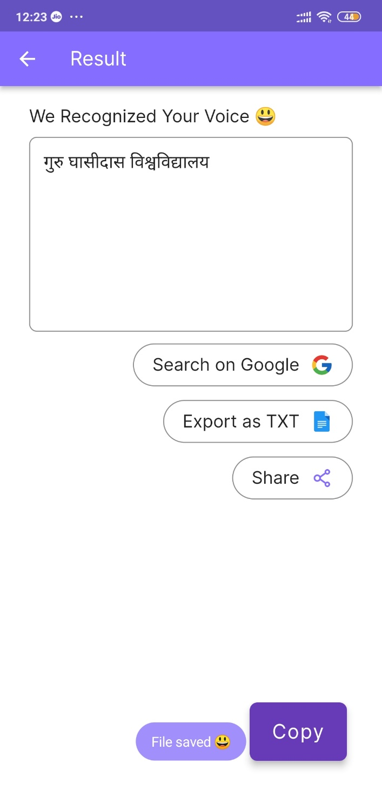

Slide 17
FUTURE ENHANCEMENT
Data encryption feature will be added in future
Try to reduce response Response
Can be build web and desktop version of project
Improve UI Design
Universal compatible version will be build for any operating system, this can run only on android os.
Can be added more language in future , currently its detects Hindi language.

Slide 18
CONCLUSION
The main of this project is to convert speech to hindi text our, reduce the time and efforts of manually typing hindi word and do task by giving Voice speech.
Its try to give effective specific response to the user’s Voice Speech, hence it make communication interesting and interactive.
We can search our result data on web .
There are some limitation encountered and also realized some scope of enhancement in the future which are mentioned below

Slide 19
THANK YOU

