Slide 1
EDA Pipeline with Agentic Workflow
Intelligent Exploratory Data Analysis pipeline powered by LangGraph and open-source tools

Slide 2
Agenda
Project Overview
Key Features
Architecture & Tech Stack
6 Specialized Agents
Human-in-the-Loop Approval Gates
Transformation & Export Capabilities
Demo & Use Cases
Future Roadmap

Slide 3
Project Overview
What is EDA Pipeline?
An intelligent, production-ready EDA pipeline powered by AI agents
Automated exploratory data analysis with explainable AI
Complete suite of 6 specialized agents for comprehensive analysis
Interactive Streamlit UI with real-time progress tracking
Supports CSV and Excel files (.xlsx, .xls)
Hybrid scaling: handles small to large datasets intelligently
Human-in-the-loop workflow with approval gates
Export capabilities: HTML reports, JSON data, transformed CSV

Slide 4
Key Features
Excel and CSV File Support
Support for .xlsx and .xls files
Automatic detection and loading of first sheet
Seamless integration with all agents
Human-in-the-Loop Approval Gates
Review and approve each agent before proceeding
4 decision options: Approve, Retry, Skip, Stop
Complete decision history tracking
Multi-Transformation Selection
Select and apply multiple transformations at once
Preview combined effects before applying
Export transformed CSV for downstream use

Slide 5
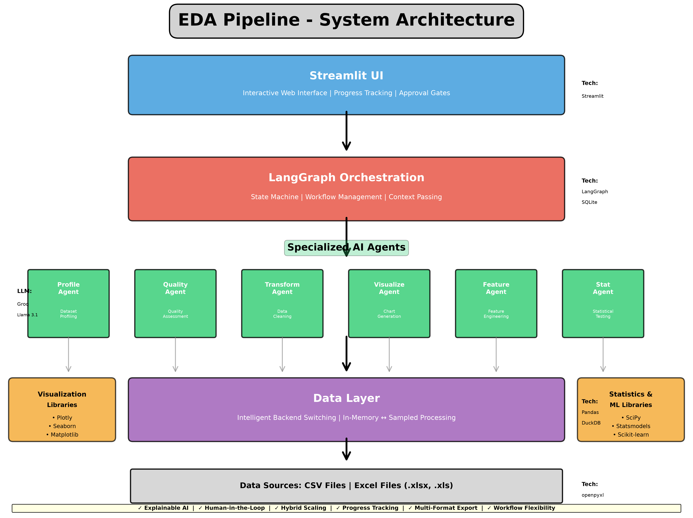
System Architecture

Slide 6
6 Specialized Agents
ProfileAgent
Dataset profiling, structure, column types, basic statistics
QualityAgent
Data quality assessment, missing values, duplicates, outliers
TransformAgent
Data cleaning, imputation, encoding, scaling, transformations
VisualizationAgent
Automatic chart generation, distributions, correlations
FeatureAgent
Feature importance, correlation analysis, engineering suggestions
StatAgent
Statistical testing, normality tests, hypothesis testing

Slide 7
ProfileAgent - Dataset Profiling
Capabilities:
Dataset shape and structure analysis
Column type detection (numeric, categorical, datetime)
Memory usage analysis
Basic statistics per column (mean, median, std, min, max)
Cardinality analysis
Missing value detection
Issue identification (high missing, high/low cardinality)

Slide 8
QualityAgent - Data Quality Assessment
Features:
Missing value detection and pattern analysis
Duplicate row identification
Outlier detection using IQR method
Data quality scoring
Interactive visualizations:
• Missing value heatmaps
• Outlier detection box plots
• Duplicate analysis gauge charts
Data type inconsistency detection

Slide 9
TransformAgent - Data Transformation
Transformation Types:
Missing value handling (drop, impute median/mode/constant)
Outlier handling (capping, removal)
Categorical encoding (one-hot, label encoding)
Numeric scaling (standard, min-max)
Data type conversions
Deduplication
Cardinality reduction
NEW Features:
✓ Multi-transformation selection
✓ Before/after comparison preview
✓ Apply to full dataset with progress tracking
✓ Export transformed CSV

Slide 10
Human-in-the-Loop Approval Gates
What are Approval Gates?
Pause workflow after each agent for human review
Review confidence scores, issues found, and recommendations
Make informed decisions before proceeding
4 Decision Options:
✅ Approve - Continue to next agent
🔄 Retry - Re-run current agent
⏩ Skip - Move to next agent without applying changes
⏹️ Stop - End workflow immediately
Benefits:
• Critical analysis control
• Compliance and auditability
• Learning and understanding workflow
• Complete decision history tracking

Slide 11
Available Workflows
Quick Analysis
All 6 agents, comprehensive overview, ~5-10 minutes
Deep Dive
5 agents (no transform), thorough quality assessment
ML Preparation
4 agents focused on ML readiness (Profile, Quality, Feature, Transform)
Individual Agent
Run any single agent on-demand for specific questions
All workflows available WITH or WITHOUT approval gates

Slide 12
Technology Stack
Orchestration: LangGraph - State machine workflow management
LLM: Groq (Llama 3.1) - Fast LLM inference
UI: Streamlit - Interactive web interface
Data Processing: Pandas, DuckDB - In-memory and large dataset handling
Visualization: Plotly, Seaborn, Matplotlib - Interactive charts
Statistics: SciPy, Statsmodels, Scikit-learn - ML prep
Persistence: SQLite - State checkpointing
File Support: openpyxl - Excel file reading

Slide 13
Export Capabilities
Multiple Export Formats:
📄 HTML Reports - Beautiful, interactive reports with embedded visualizations
📊 JSON Data - Complete analysis results in structured format
📋 Transformed CSV - Cleaned and transformed dataset for downstream use
Features:
• Custom export naming
• Timestamp-based organization
• Confidence scores and reasoning included
• Shareable with stakeholders
• API-ready JSON format
• Full dataset processing (not just samples)

Slide 14
Example Use Case: Titanic Dataset
1. Upload titanic_train.csv (891 rows, 12 columns)
2. Run 'Quick Analysis' workflow
3. Review results in tabbed interface
4. Navigate to 'Transform' tab
5. Click 'Select All High Priority' → 3 transformations selected
6. Preview combined transformations:
• Sex becomes Sex_male & Sex_female (one-hot encoding)
• Missing Age values filled with median (28)
• Cabin column removed (77% missing)
7. Apply 3 transformations to Full Dataset
8. Export transformed CSV
9. Result: 891 rows, 13 columns - ML ready! 🚀

Slide 15
Best Practices
For Small Datasets (< 10k rows)
Use 'Quick Analysis' for complete overview
All processing happens in-memory
Fast execution (~2-5 minutes)
For Large Datasets (> 100k rows)
System automatically switches to DuckDB backend
Intelligent sampling for visualization
Enable progress tracking
For Production Use
Run Deep Dive Workflow
Export HTML reports for documentation
Review confidence scores before acting
Use transformed CSV for downstream processing
For ML Projects
Use ML Preparation workflow
Review FeatureAgent recommendations
Check StatAgent for distribution assumptions
Apply and export transformations

Slide 16
Future Roadmap
Planned Enhancements:
Additional agent types (time series, text analysis)
More export formats (PDF, Excel workbooks)
Advanced visualizations (3D plots, interactive dashboards)
Performance optimizations for very large datasets
Custom workflow builder UI
Cloud deployment options
API endpoints for programmatic access
Integration with popular ML platforms
Collaborative features (team workspaces)
Scheduled/automated analysis runs

Slide 17
Conclusion
Key Takeaways:
✓ Production-ready EDA pipeline with AI-powered agents
✓ Comprehensive analysis with 6 specialized agents
✓ Human-in-the-loop control with approval gates
✓ Flexible workflows for different use cases
✓ Excel and CSV support with intelligent scaling
✓ Complete export capabilities for sharing and downstream use
✓ Explainable AI with confidence scores and reasoning
🚀 Ready to accelerate your data analysis workflow!

Slide 18
Thank You!
Questions? EDA Pipeline - Version 3.3 July 2026

