Slide 1
Natural language is a design brief
1 / 10
BUILD 1/2
VAGUE REQUEST
→
Make me a dashboard.

Slide 2
Natural language is a design brief
1 / 10
BUILD 2/2
VAGUE REQUEST
USER
GOAL
→
Make me a dashboard.
Field supervisor
Find delayed jobs before the morning stand-up
CONTEXT
BEHAVIOR
Laptop, weak connection, 40+ jobs
Filter by risk; open job details
ACCEPTANCE
A prompt is not decoration. It is the product decision written down.
A supervisor finds one delayed job in under 20 seconds
Useful prompts describe a situation—not a screen.

Slide 3
The first prompt is the start, not the finish
2 / 10
BUILD 1/3
1
→
2
→
3
→
4
→
5
Describe
Build
Preview
Observe
Revise

Slide 4
The first prompt is the start, not the finish
2 / 10
BUILD 2/3
1
→
2
→
3
→
4
→
5
Describe
Build
Preview
Observe
Revise
FIRST PROMPT
“It made a page!”
↓
FIFTH PROMPT
“It solves the task.”

Slide 5
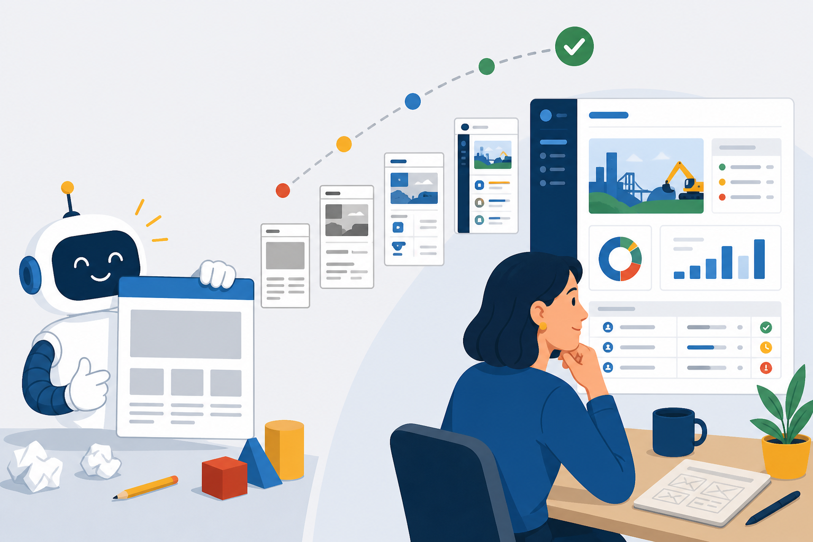
The first prompt is the start, not the finish
2 / 10
BUILD 3/3
1
→
2
→
3
→
4
→
5
Describe
Build
Preview
Observe
Revise
FIRST PROMPT
“It made a page!”
↓
FIFTH PROMPT
“It solves the task.”
Design judgment lives in the loop.

Slide 6
HTML gives meaning. CSS gives direction.
3 / 10
BUILD 1/2
Heading
Filters
Results
Primary action
HTML: what each region is

Slide 7
HTML gives meaning. CSS gives direction.
3 / 10
BUILD 2/2
HIERARCHY
SPACING
Heading
What matters first
What belongs together
Filters
COLOR
ALIGNMENT
Results
What needs attention
How the eye moves
CSS: how the structure communicates
Primary action
HTML: what each region is
Ask Agent for both: what each part is and how it should read.

Slide 8
A screenshot is one moment
4 / 10
BUILD 1/3
CLOSED
Nothing selected

Slide 9
A screenshot is one moment
4 / 10
BUILD 2/3
CLOSED
LOADING
EMPTY
Nothing selected
Getting job details
No delayed jobs

Slide 10
A screenshot is one moment
4 / 10
BUILD 3/3
CLOSED
LOADING
EMPTY
ERROR
SUCCESS
Nothing selected
Getting job details
No delayed jobs
Could not load
Job ready to review
CLICK
→ REQUEST → RESPONSE → RECOVERY →
A product is the movement between these moments.

Slide 11
Why does a framework appear?
5 / 10
BUILD 1/2
COMPONENT
STATE
EVENT
RESPONSE
A reusable filter panel
→
risk = “high”
→
The user changes the filter
→
The same list updates

Slide 12
Why does a framework appear?
5 / 10
BUILD 2/2
COMPONENT
STATE
EVENT
RESPONSE
A reusable filter panel
→
risk = “high”
→
The user changes the filter
→
The same list updates
The design system above can ride in different vehicles:
REACT
ANGULAR
VUE
Workshop choice
Also valid
Also valid
Same product idea. Different implementation vehicle.
The framework is the vehicle. The interaction is the design.

Slide 13
A Figma link carries structured context
6 / 10
BUILD 1/2
1
2
3
4
Selection link
→
Components + variables + layout
→
Agent builds
→
Browser comparison

Slide 14
A Figma link carries structured context
6 / 10
BUILD 2/2
1
2
3
4
Selection link
→
Components + variables + layout
→
Agent builds
→
Browser comparison
SCREENSHOT
FIGMA MCP
pixels
vs
design structure
layout · components · variables · assets
Give Agent the selection and the user goal.

Slide 15
Rules, skills, and MCP do different jobs
7 / 10
BUILD 1/3
RULES
Standards wall
Always follow these
“Use Modus.”

Slide 16
Rules, skills, and MCP do different jobs
7 / 10
BUILD 2/3
RULES
SKILLS
Standards wall
Task playbook
Always follow these
Use this workflow
“Use Modus.”
“Build a form this way.”

Slide 17
Rules, skills, and MCP do different jobs
7 / 10
BUILD 3/3
RULES
SKILLS
MCP
Standards wall
Task playbook
Connected library
Always follow these
Use this workflow
Look up current facts
“Use Modus.”
“Build a form this way.”
“Which event is current?”
Together they reduce guessing. They do not replace your brief.

Slide 18
Do not invent a second design system
8 / 10
BUILD 1/3
PARALLEL SYSTEM
Agent invents substitutes
× Custom button
× Almost-right spacing
× New colors
× One-off modal

Slide 19
Do not invent a second design system
8 / 10
BUILD 2/3
PARALLEL SYSTEM
MODUS
Agent invents substitutes
Shared product language
× Custom button
✓ Foundations
× Almost-right spacing
✓ Components
× New colors
✓ Patterns
× One-off modal
✓ Templates

Slide 20
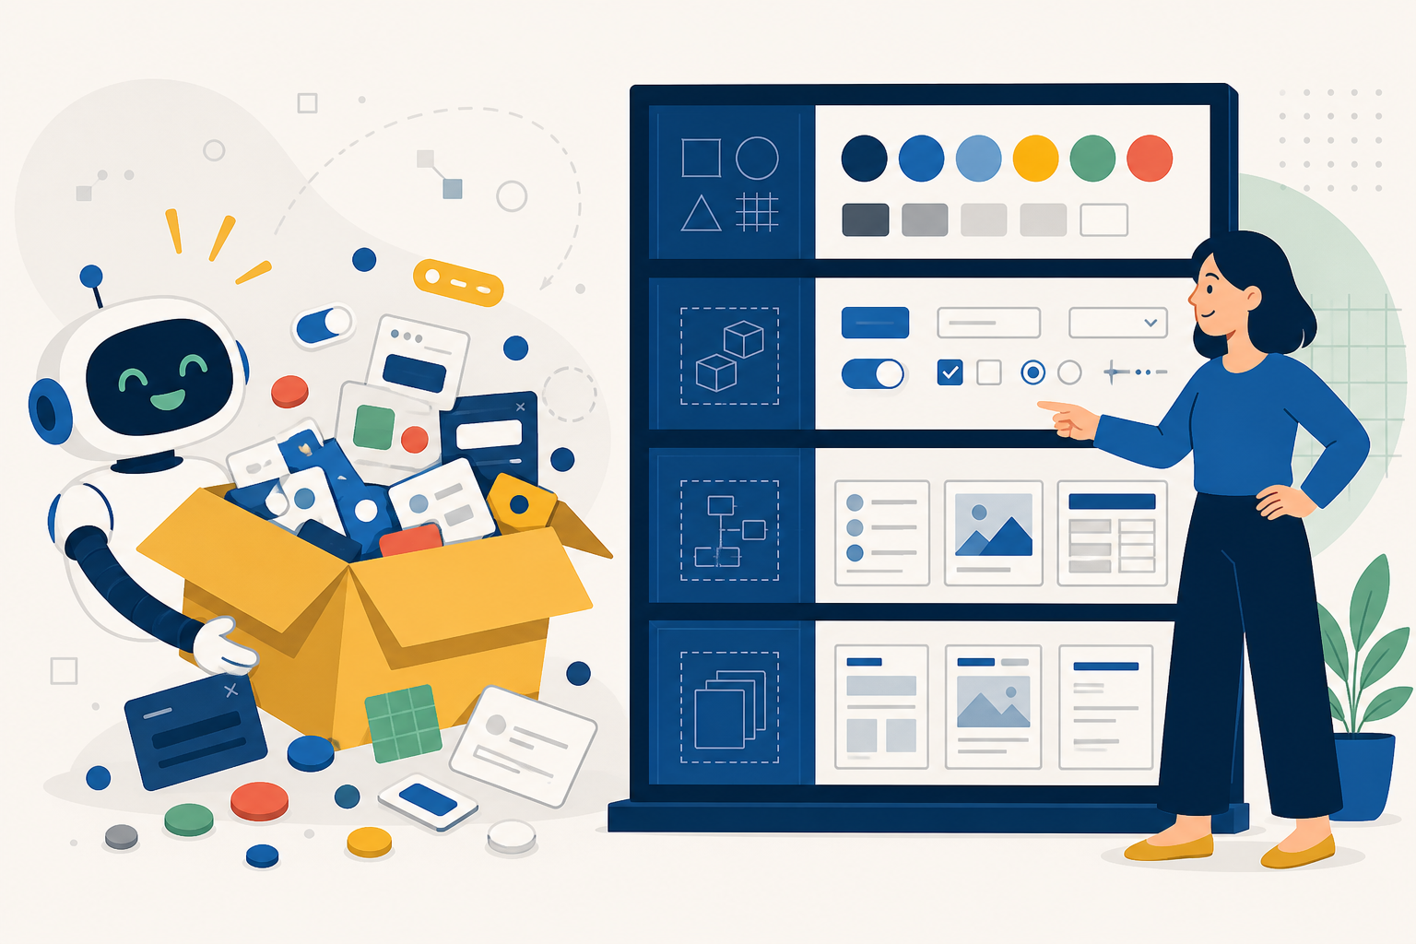
Do not invent a second design system
8 / 10
BUILD 3/3
PARALLEL SYSTEM
MODUS
Agent invents substitutes
Shared product language
× Custom button
✓ Foundations
× Almost-right spacing
✓ Components
× New colors
✓ Patterns
× One-off modal
✓ Templates
Agent: “I made a design system!” Designer: “We already have one.”
Start with Modus. Change only what the product truly needs.

Slide 21
“It works” is a claim. The browser is evidence.
9 / 10
BUILD 1/3
□ TASK
□ STATES
Can someone finish it?
Empty, loading, error, success?

Slide 22
“It works” is a claim. The browser is evidence.
9 / 10
BUILD 2/3
□ TASK
□ STATES
□ LAYOUT
Can someone finish it?
Empty, loading, error, success?
Narrow and wide?
□ KEYBOARD
Focus visible and usable?

Slide 23
“It works” is a claim. The browser is evidence.
9 / 10
BUILD 3/3
□ TASK
□ STATES
□ LAYOUT
Can someone finish it?
Empty, loading, error, success?
Narrow and wide?
□ KEYBOARD
□ CONTENT
□ REGRESSION
Focus visible and usable?
Long names and real volume?
Did the earlier flow still work?
Agent says: “Done.”
Browser shows: evidence.
Watch the behavior. Do not accept the status message.

Slide 24
From Figma to a prototype people can try
10 / 10
BUILD 1/3
1
2
3
→
→
Figma
Agent
Modus

Slide 25
From Figma to a prototype people can try
10 / 10
BUILD 2/3
1
2
3
4
5
6
→
→
→
→
→
Figma
Agent
Modus
Browser
GitHub
Live URL

Slide 26
From Figma to a prototype people can try
10 / 10
BUILD 3/3
1
2
3
4
5
6
→
→
→
→
→
Figma
Agent
Modus
Browser
GitHub
Live URL
REPEAT AT EVERY STEP
1
2
3
4
5
6
7
Describe
Build
Look
Try
Adjust
Check
Share
A shareable prototype turns opinion into something people can try.
The output is not code. It is evidence for a product decision.

