Slide 1
Success your DevOps tasks
With Ansible
HAMIDA TRIMECHE

Slide 2
Agenda
Configuration management tools
Ansible:
Inventory
Playbook
Variables
Template module (Jinja2)
Roles

Slide 3
1
Configuration management tools
DevOps is evolving and gaining traction as organizations discover how it enables them to produce better applications and reduce their software products' time to market. DevOps' core values are Culture, Automation, Measurement, and Sharing (CAMS), and an organization's adherence to them influences how successful it is.
Culture
Automation
Measurement
Sharing
brings people and processes together
creates a fabric for Dev
permits improvements
enables the feedback loop in the CAMS cycle
Another DevOps concept is the idea that almost everything can be managed in code: servers, databases, networks, log files, application configurations, documentation, automated tests, deployment processes, and more.

Slide 4




advantage of ansible:
Free
Ansible is an open-source tool. Very simple to set up and use: No special coding skills are necessary to use Ansible’s playbooks (more on playbooks later).
Powerful
Ansible lets you model even highly complex IT workflows.
Flexible
You can orchestrate the entire application environment no matter where it’s deployed. You can also customize it based on your needs.
Agentless
You don’t need to install any other software or firewall ports on the client systems you want to automate. You also don’t have to set up a separate management structure.

Slide 5
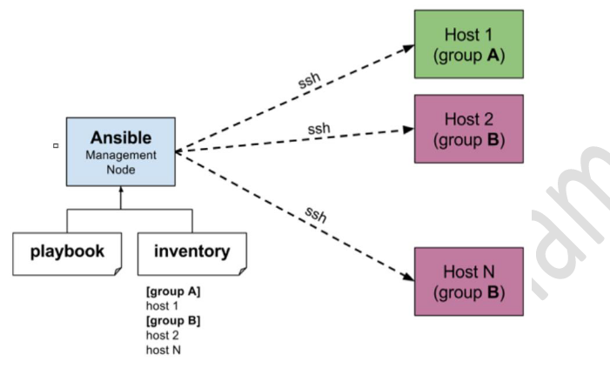
How Ansible work
Ansible works by connecting to your nodes and pushing out small programs, called "Ansible Modules" to them. Ansible then executes these modules (over SSH by default) and removes them when finished. Your library of modules can reside on any machine, and there are no servers, daemons, or databases required.

Slide 6

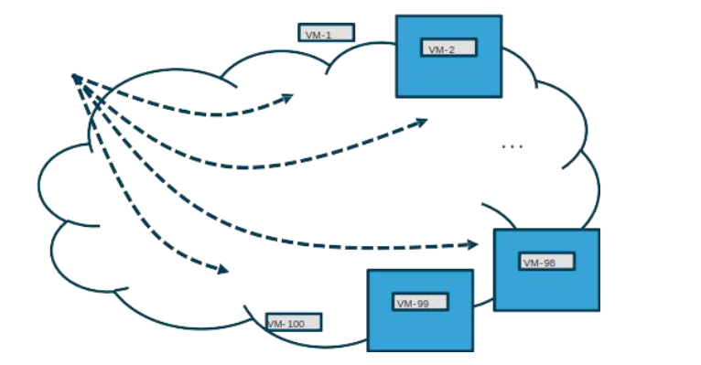
2
Ansible
Why Ansible: Real-Time Remote Execution of commands
1.Audit routes on all virtual machines: $ ansible -m shell -a “netstat -rn” datacenter-east
2.Updates routes required for consistency: $ ansible -m shell -a “route add X.X.X.X” datacenter-east

Slide 7
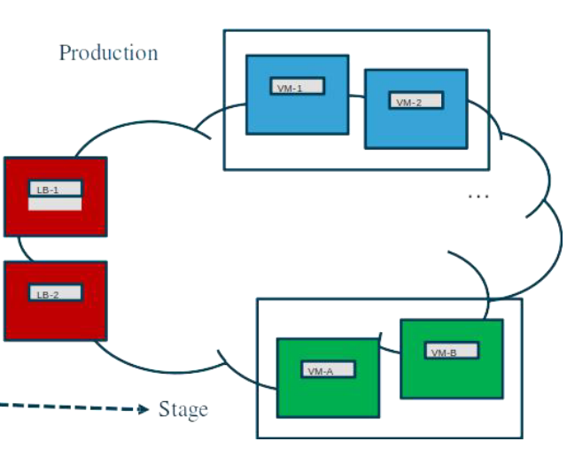
Why Ansible: Change Control Workflow Orchestration
1. Update load balancer pools to point to stage
2. Deploy application change to stage and verify

Slide 8
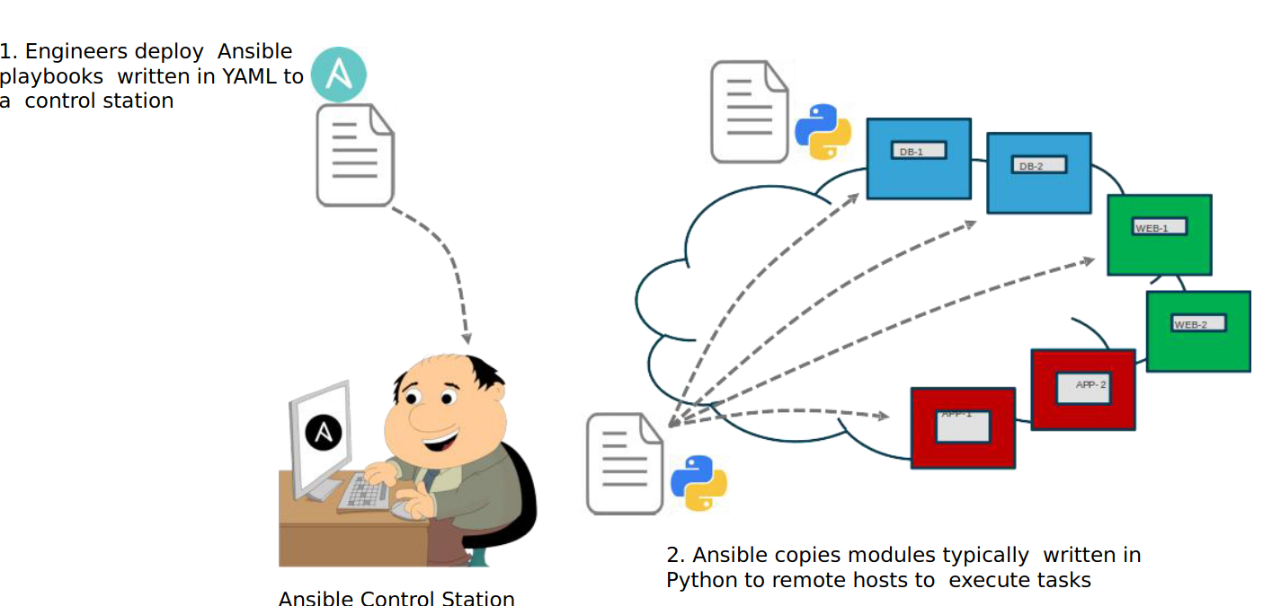
How does Ansible work

Slide 9
Ansible Configuration File
• Linux host with a Python and the Ansible installed
• Support transport to remote hosts
• Typically SSH but could use an API
• Ansible Components
• Ansible configuration file
• Inventory files
• Ansible modules
• Playbooks

Slide 10
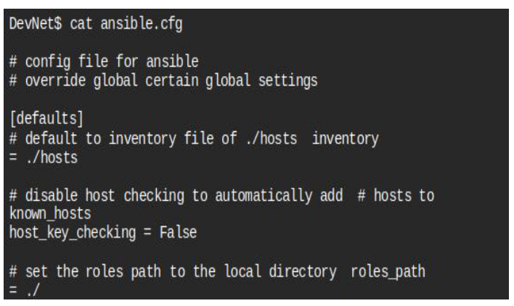
Control operation of Ansible
• Control operation of Ansible
• Default configuration
• /etc/ansible/ansible.cfg
• Override default settings
• ANSIBLE_CONFIG ENV
• ansible.cfg in current directory
• .ansible.cfg in home directory

Slide 11
Ansible Authentication Basics
Typically, Ansible uses SSH for authentication and assumes keys are in place
• Setting up and transferring SSH keys allows playbooks to be run automatically
• Using passwords is possible
• Network Devices often use passwords

Slide 12
Ansible Inventory File
Inventory file identifies hosts, and groups of hosts under management
• Hosts can be IP or FQDN
• Groups enclosed in
• Can include host specific parameters as well
• Example: Instructing Ansible to use the active Python Interpreter when using Python Virtual Environments : $ansible_python_interpreter="/usr/bin/env python

Slide 13
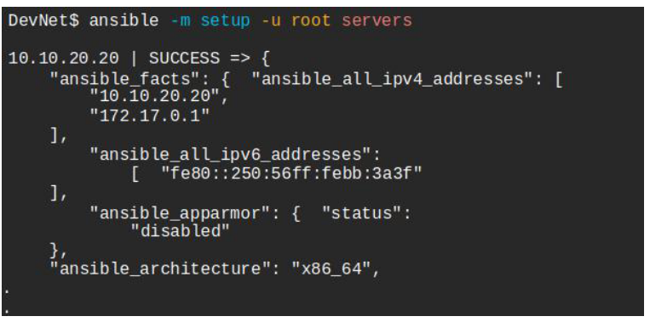
Using Ansible CLI for ad-hoc Commands
• Quickly run a command against a set of hosts
• Specify the module with –m module
• Specfiy the username to use with –u user, default is to use local username
• Specify the server or group to target
• Provide module arguments with –a argument

Slide 14
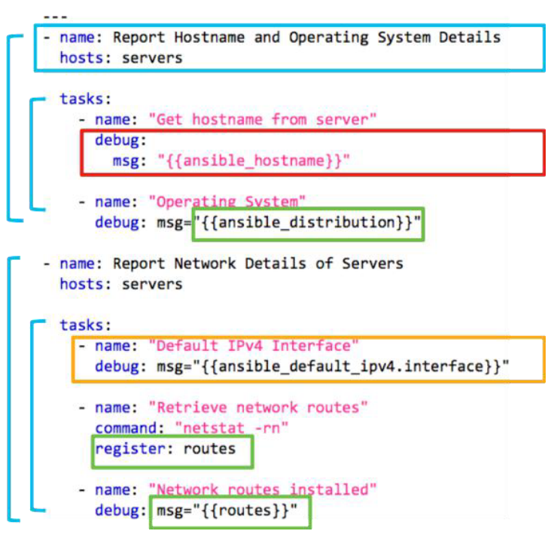
Ansible playbook
• Written in YAML
• One or more plays that contain hosts and tasks
• Tasks have a name & module keys.
• Modules have parameters
• Variables referenced with {{name}}
• Ansible gathers “facts”
• Create your own by register-ing output from another task

Slide 15
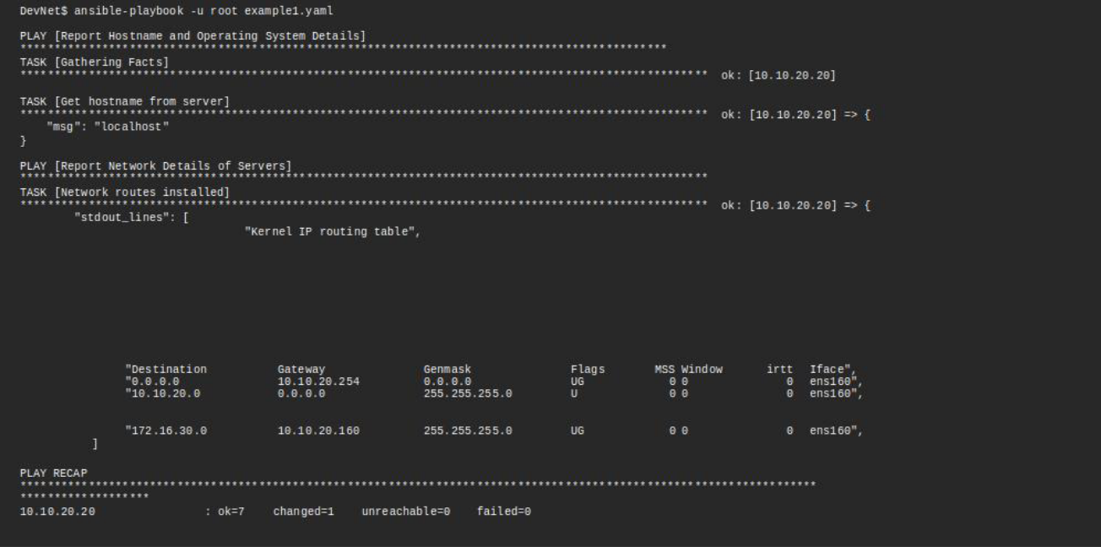
Ansible playbook

Slide 16
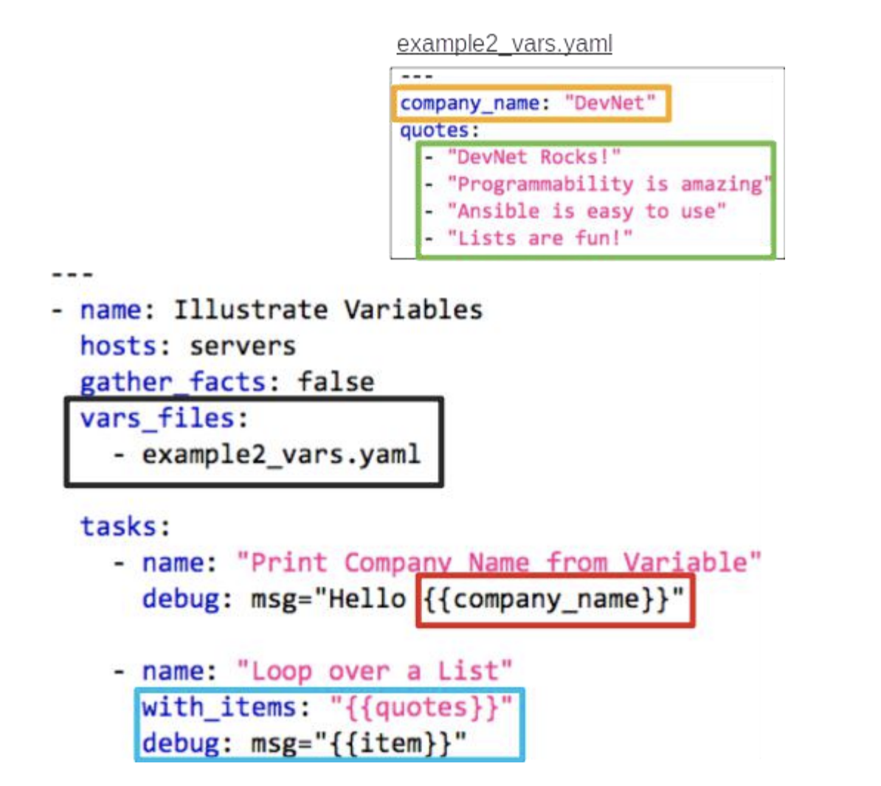
Using Variable Files and loops with Ansible
• Include external variable files using
• vars_files: filename.yaml
• Reference variables with {{name}}
• YAML supports lists and hashes (ie key/value)
• Loop to repeat actions with with_items: variable

Slide 17
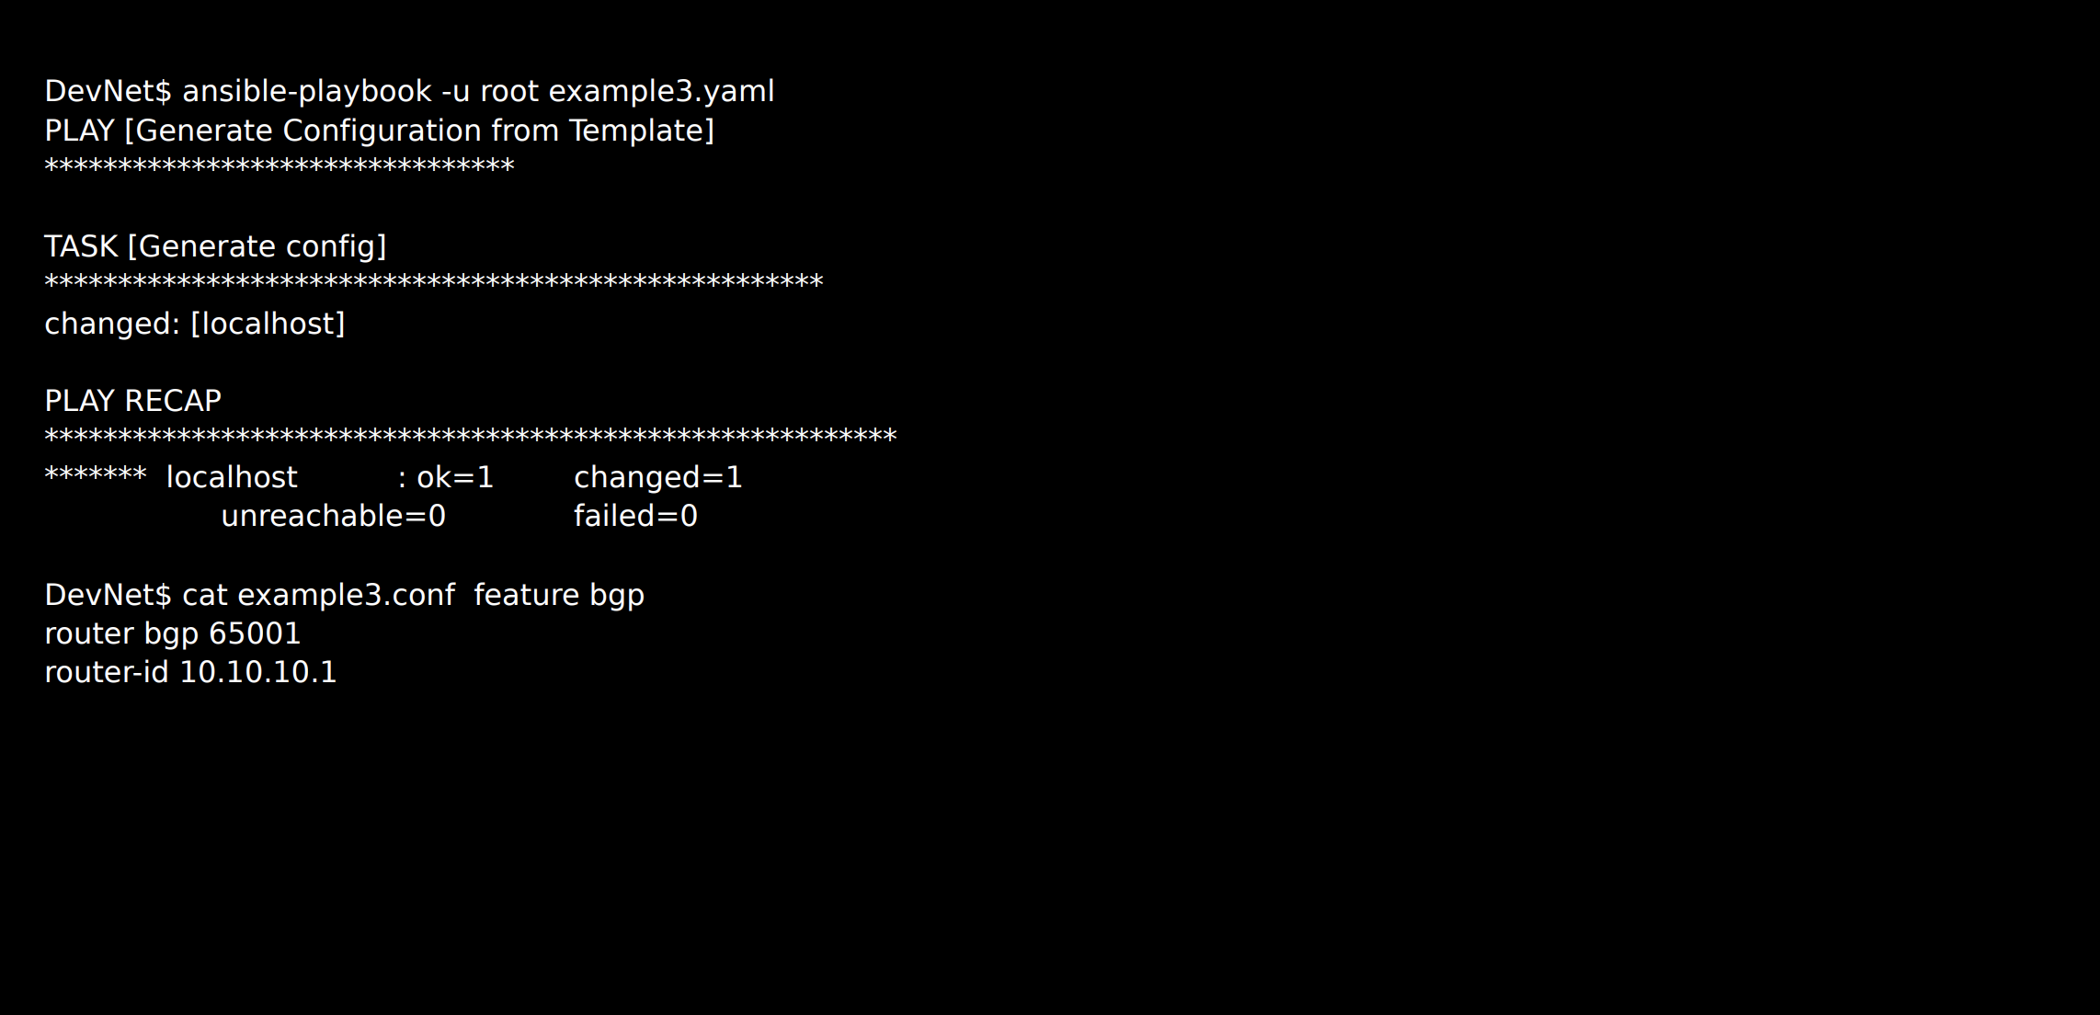
3
Template module (Jinja2)

Slide 18
Jinja2 Templating – Variables to the Max!

Slide 19
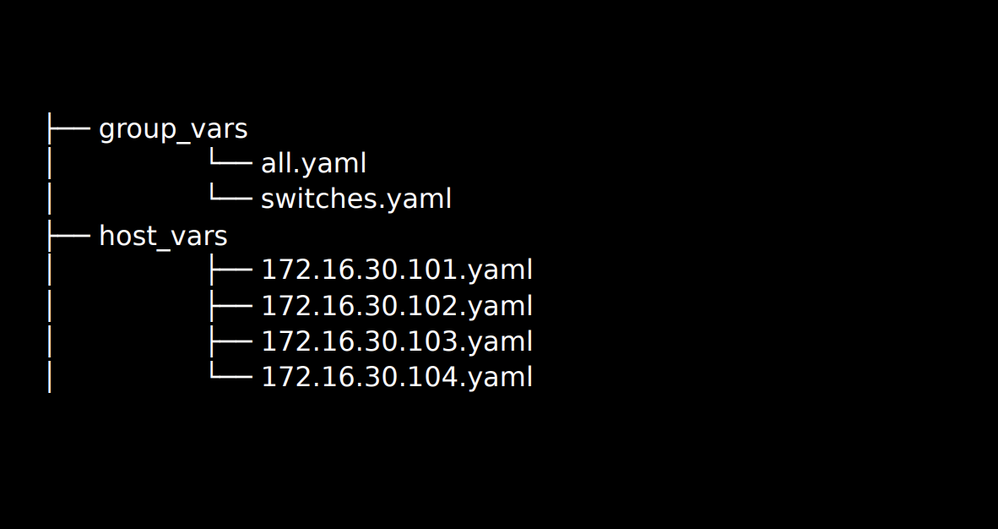
Jinja2 Templating – Variables to the Max!
• Ansible allows for Group and Host specific variables
• group_vars/groupname.yaml
• host_vars/host.yaml
• Variables automatically available

Slide 20
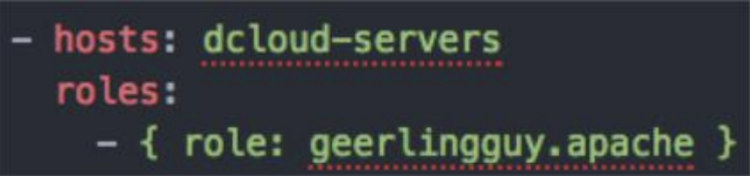
4
Roles
Using Ansible Roles
Roles declares any playbooks defined within a role must be executed.
against hosts
Roles promote playbook reuse
Roles contain playbooks, templates, and variables
to complete a workflow (e.g. installing Apache

Slide 21
Thank You
HAMIDA TRIMECHE

