Slide 1

Fetch
Lesson 14 – DONG, BUI HUU

Slide 2
Objectives
Install Fetch in your React application
Use Fetch to communicate from your React application with a REST API server

Slide 3

Fetch

Slide 4
Promise
Promise is a mechanism that supports asynchronous computation
Proxy for a value not necessarily known when the promise is created:
It represents a value that may be available now, or in the future, or never

Slide 5
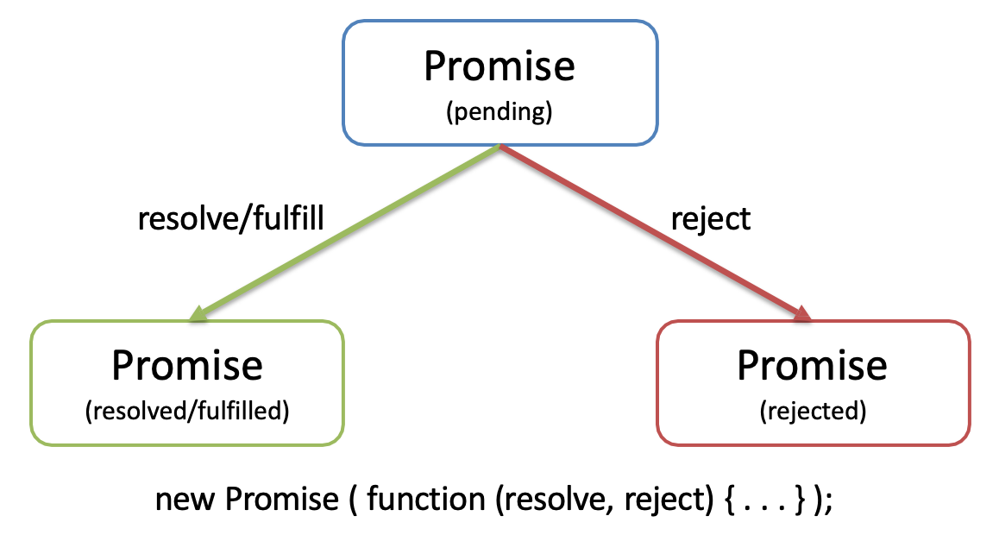
Promise

Slide 6
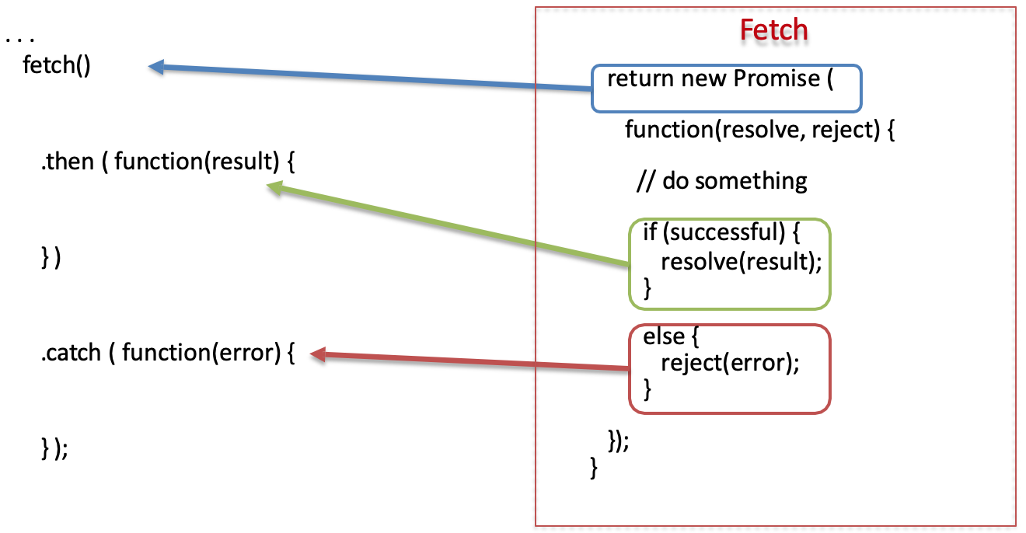
Promise Example

Slide 7
Why Promises?
Solves the callback hell (heavily nested callback code) problem
Promises can be chained
Can immediately return:
Promise.resolve(result)
Promise.reject(error)

Slide 8
Fetch
XMLHttpRequest() is quite cumbersome and outdated
Has been made palatable by wrapping it appropriately in most JavaScript libraries like jQuery as Ajax
The Fetch API is a modern replacement for XMLHttpRequest
Provides an interface for fetching resources (including across the network)
More powerful and flexible feature set
Promise based

Slide 9
Fetch Abstractions
Request: Represents a resource request
Response: Represents the response to a request
Headers: Represents response/request headers, allowing you to query them and take different actions depending on the results
Body: Provides methods relating to the body of the response/request, allowing you to declare what its content type is and how it should be handled

Slide 10
Fetch Usage
fetch(baseUrl + ‘dishes’)
.then(response => response.json())
.then(data => console.log(data))
.catch(error => console.log(error.message));

Slide 11
Fetch Posting Data
fetch(baseUrl + 'comments', { method: 'POST’,
body: JSON.stringify(newComment), headers: {
'Content-Type': 'application/json’
},
credentials: 'same-origin’
})

Slide 12
Fetch Dealing with Errors
fetch(baseUrl + 'dishes’)
.then(response => {
if (response.ok) {return response;}
else {var error = new Error('Error ' + response.status + ': ' + response.statusText); error.response = response;
throw error;}
},
error => {var errmess = new Error(error.message); throw errmess;
})
.then(response => response.json())
.then(data => console.log(data))
.catch(error => console.log(error.message));

Slide 13
Cross-Fetch
Cross-Fetch library provides support for Fetch both in Node applications and Browsers
Uses whatwg-fetch polyfill in browsers that do not have fetch support
Uses node-fetch for Node applications on the server
To use in the application:
import fetch from ‘cross-fetch’;

Slide 14
Fetch Alternatives
Axios
Superagent

Slide 15
Exercise 20: Fetch from Server
Incorporate Fetch into your React app
Use Fetch to communicate with the REST API server

Slide 16
Exercise 21: Fetch Post
Configure Fetch to post data to the server
Receive and process the response to the POST operation on the server

Slide 17
Summary
Install Fetch in your React application
Use Fetch to communicate from your React application with a REST API server

