Slide 1

Introduction
Lesson 1 – Lecture: Dong, BUI HUU

Slide 2

Course Introduction

Slide 3
Front-End Web Development with React
ReactJs basic
Frontent UI (Material UI)
Redux
Communicate API
Optional: different way to build reactjs web instead of javascript

Slide 4
Evaluation Strategy
Must attend more than 80% of contact hours (if not, not allow to take exam).
Evaluating
02 Progress Tests (PT: 15%)
08 Labs (L: 20%)
01 Assignment (AS: 15%)
01 Practical Exam (PE: 20%)
(Practical exam retake only when the score of PE < 4))
Final Exam (FE: 30%)
Final result = 15%(PT) + 20%(L) + 15%(AS) + 20%(PE) + 30% (FE)
Pass:
Every on-going assessment component > 0
Final Exam score >= 4 and
Final result >= 5

Slide 5
Module 1: ReactJs basic
Install React app
React Components
Lab1
React Hook
Lab 2
React Router, Single Page Applications
Lab 3

Slide 6
Module 2: frontend ui
Install/ configure Material UI
Material Components
Lab 4
CSS Preprocessor
Lab 5

Slide 7
Module 3: Redux
Redux
React form
Lab 6

Slide 8
Module 4: Communicate api
Client-Server Communication
Brief Representational State Transfer (REST)
FETCH & React Animation
Lab 7

Slide 9
Module 5: Typescript
Configure
Function
Lab 8

Slide 10
Full Stack Web Development and Setup Development Evironment

Slide 11
Full Stack Web Development and Setup Development Evironment
Understand what is meant by full stack in the context of web development
Distinguish between front-end, back-end and full stack web development
Set up a Git repository and perform basic Git operations
Set up and use online Git repositories
Use Node-based modules to perform basic operations.

Slide 12
What is Full Stack Web Development?
Front end / Client-side
HTML, CSS and Javascript
Back end / Server-side
Various technologies and approaches – PHP, Java, ASP.NET, Ruby, Python

Slide 13
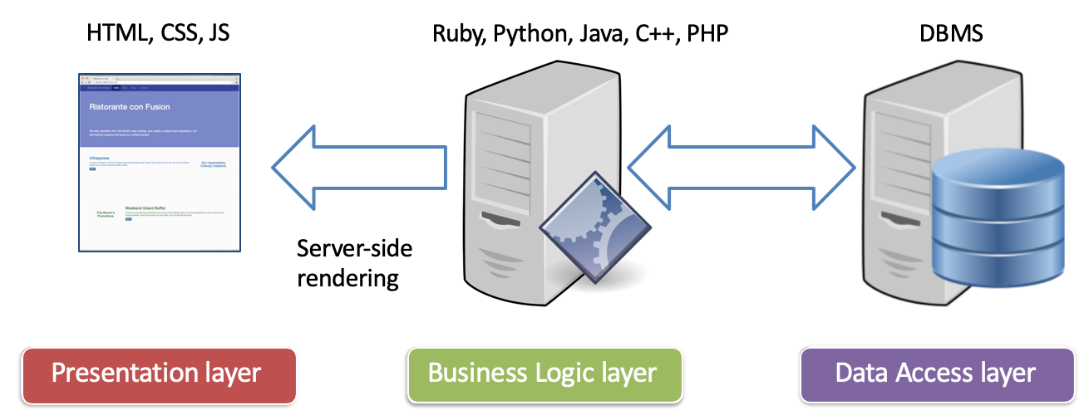
Traditional Web Development

Slide 14
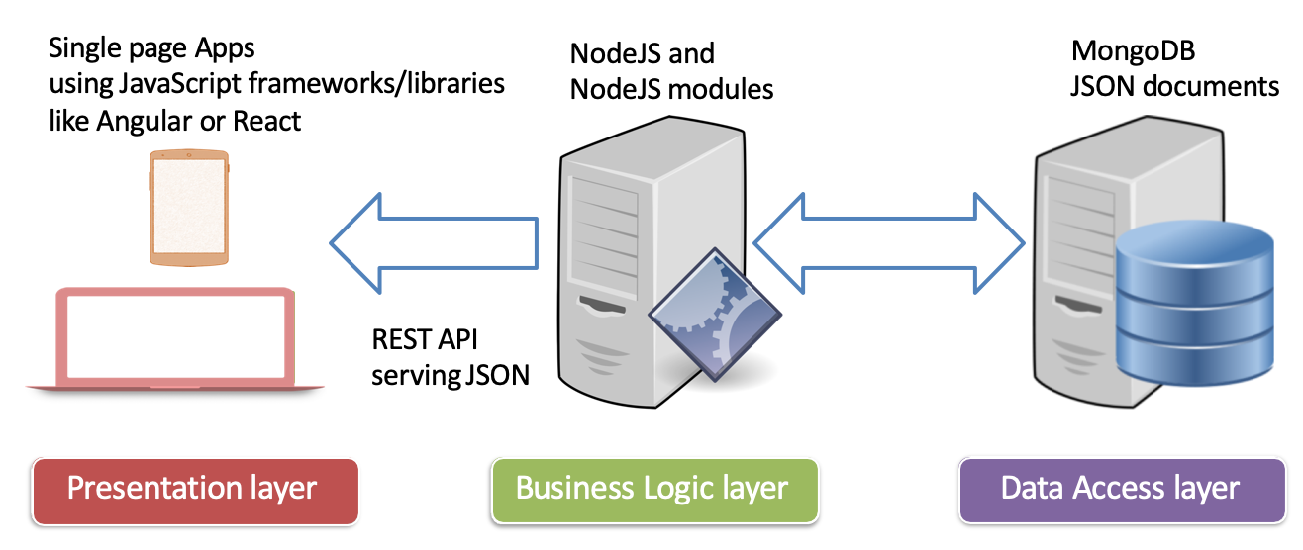
Full Stack JavaScript Development

Slide 15
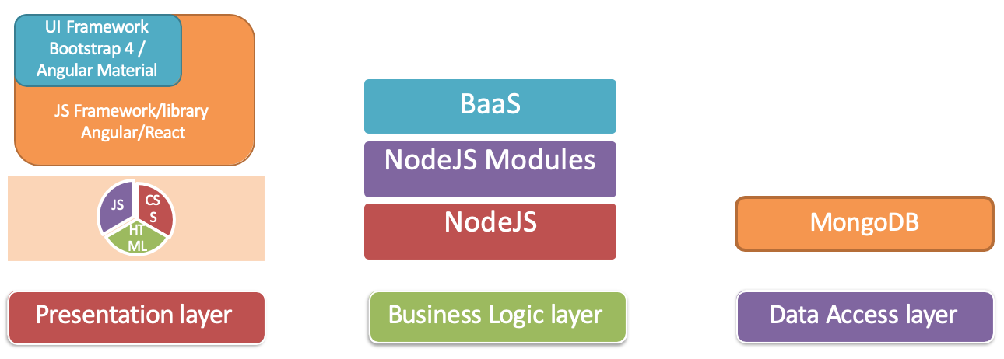
Full Stack Web Development

Slide 16
Summary
Understand what is meant by full stack in the context of web development
Distinguish between front-end, back-end and full stack web development

