Slide 1
FOSS
Seminar - Shreevardhan T V

Slide 2
Contents
What is FOSS?
History of FOSS
Examples of FOSS
The Impact of FOSS

Slide 3
What is FOSS?
Foss stands for
Free and
Open
Source
Software

Slide 4
Free-dom
The Free in FOSS does not talk about cost of the software
But rather the Freedom of doing as you please with the program
You have the freedom to use, modify and distribute the software as you see fit

Slide 5
The four essential freedoms
The freedom to run the program as you wish, for any purpose (freedom 0).
The freedom to study how the program works, and change it so it does your computing as you wish (freedom 1). Access to the source code is a precondition for this.
The freedom to redistribute copies so you can help others (freedom 2).
The freedom to distribute copies of your modified versions to others (freedom 3). By doing this you can give the whole community a chance to benefit from your changes. Access to the source code is a precondition for this.
Source: https://www.gnu.org/philosophy/free-sw.en.html#four-freedoms

Slide 6


Open-Source Software
The case of
Red Hat is the primary sponsor of the
project.
They Provide Open source Software
Which is developed with the FOSS Community.
Their Business model is to provide the software for free, and sells subscriptions for the support,training and integration services for their software
Open source software can be Freely used.
They are usually free of charge but it doesn’t have to be.
The program may be paid, but the software will be provided along with its source code which can be modified by the customer.

Slide 7
Philosophy of Open Source
Free redistribution
Source code
Derived works
Integrity of the Author’s source code
No discrimination against persons or groups
Against fields of Endeavor
Distribution of License
License must not be specific to a product
The license must not restrict other software
License must be technology neutral

Slide 8
History of FOSS
The first computers 1960s
The GNU Project 1983
Free Software Foundation 1985
Open Source Initiative 1998
The Linux Foundation 2000
.

Slide 9
1950s to 1960s
During this time, almost all software was produced under collaboration for research and academics
The source code was distributed the software as users had to modify the software to make it compatible with their hardware

Slide 10
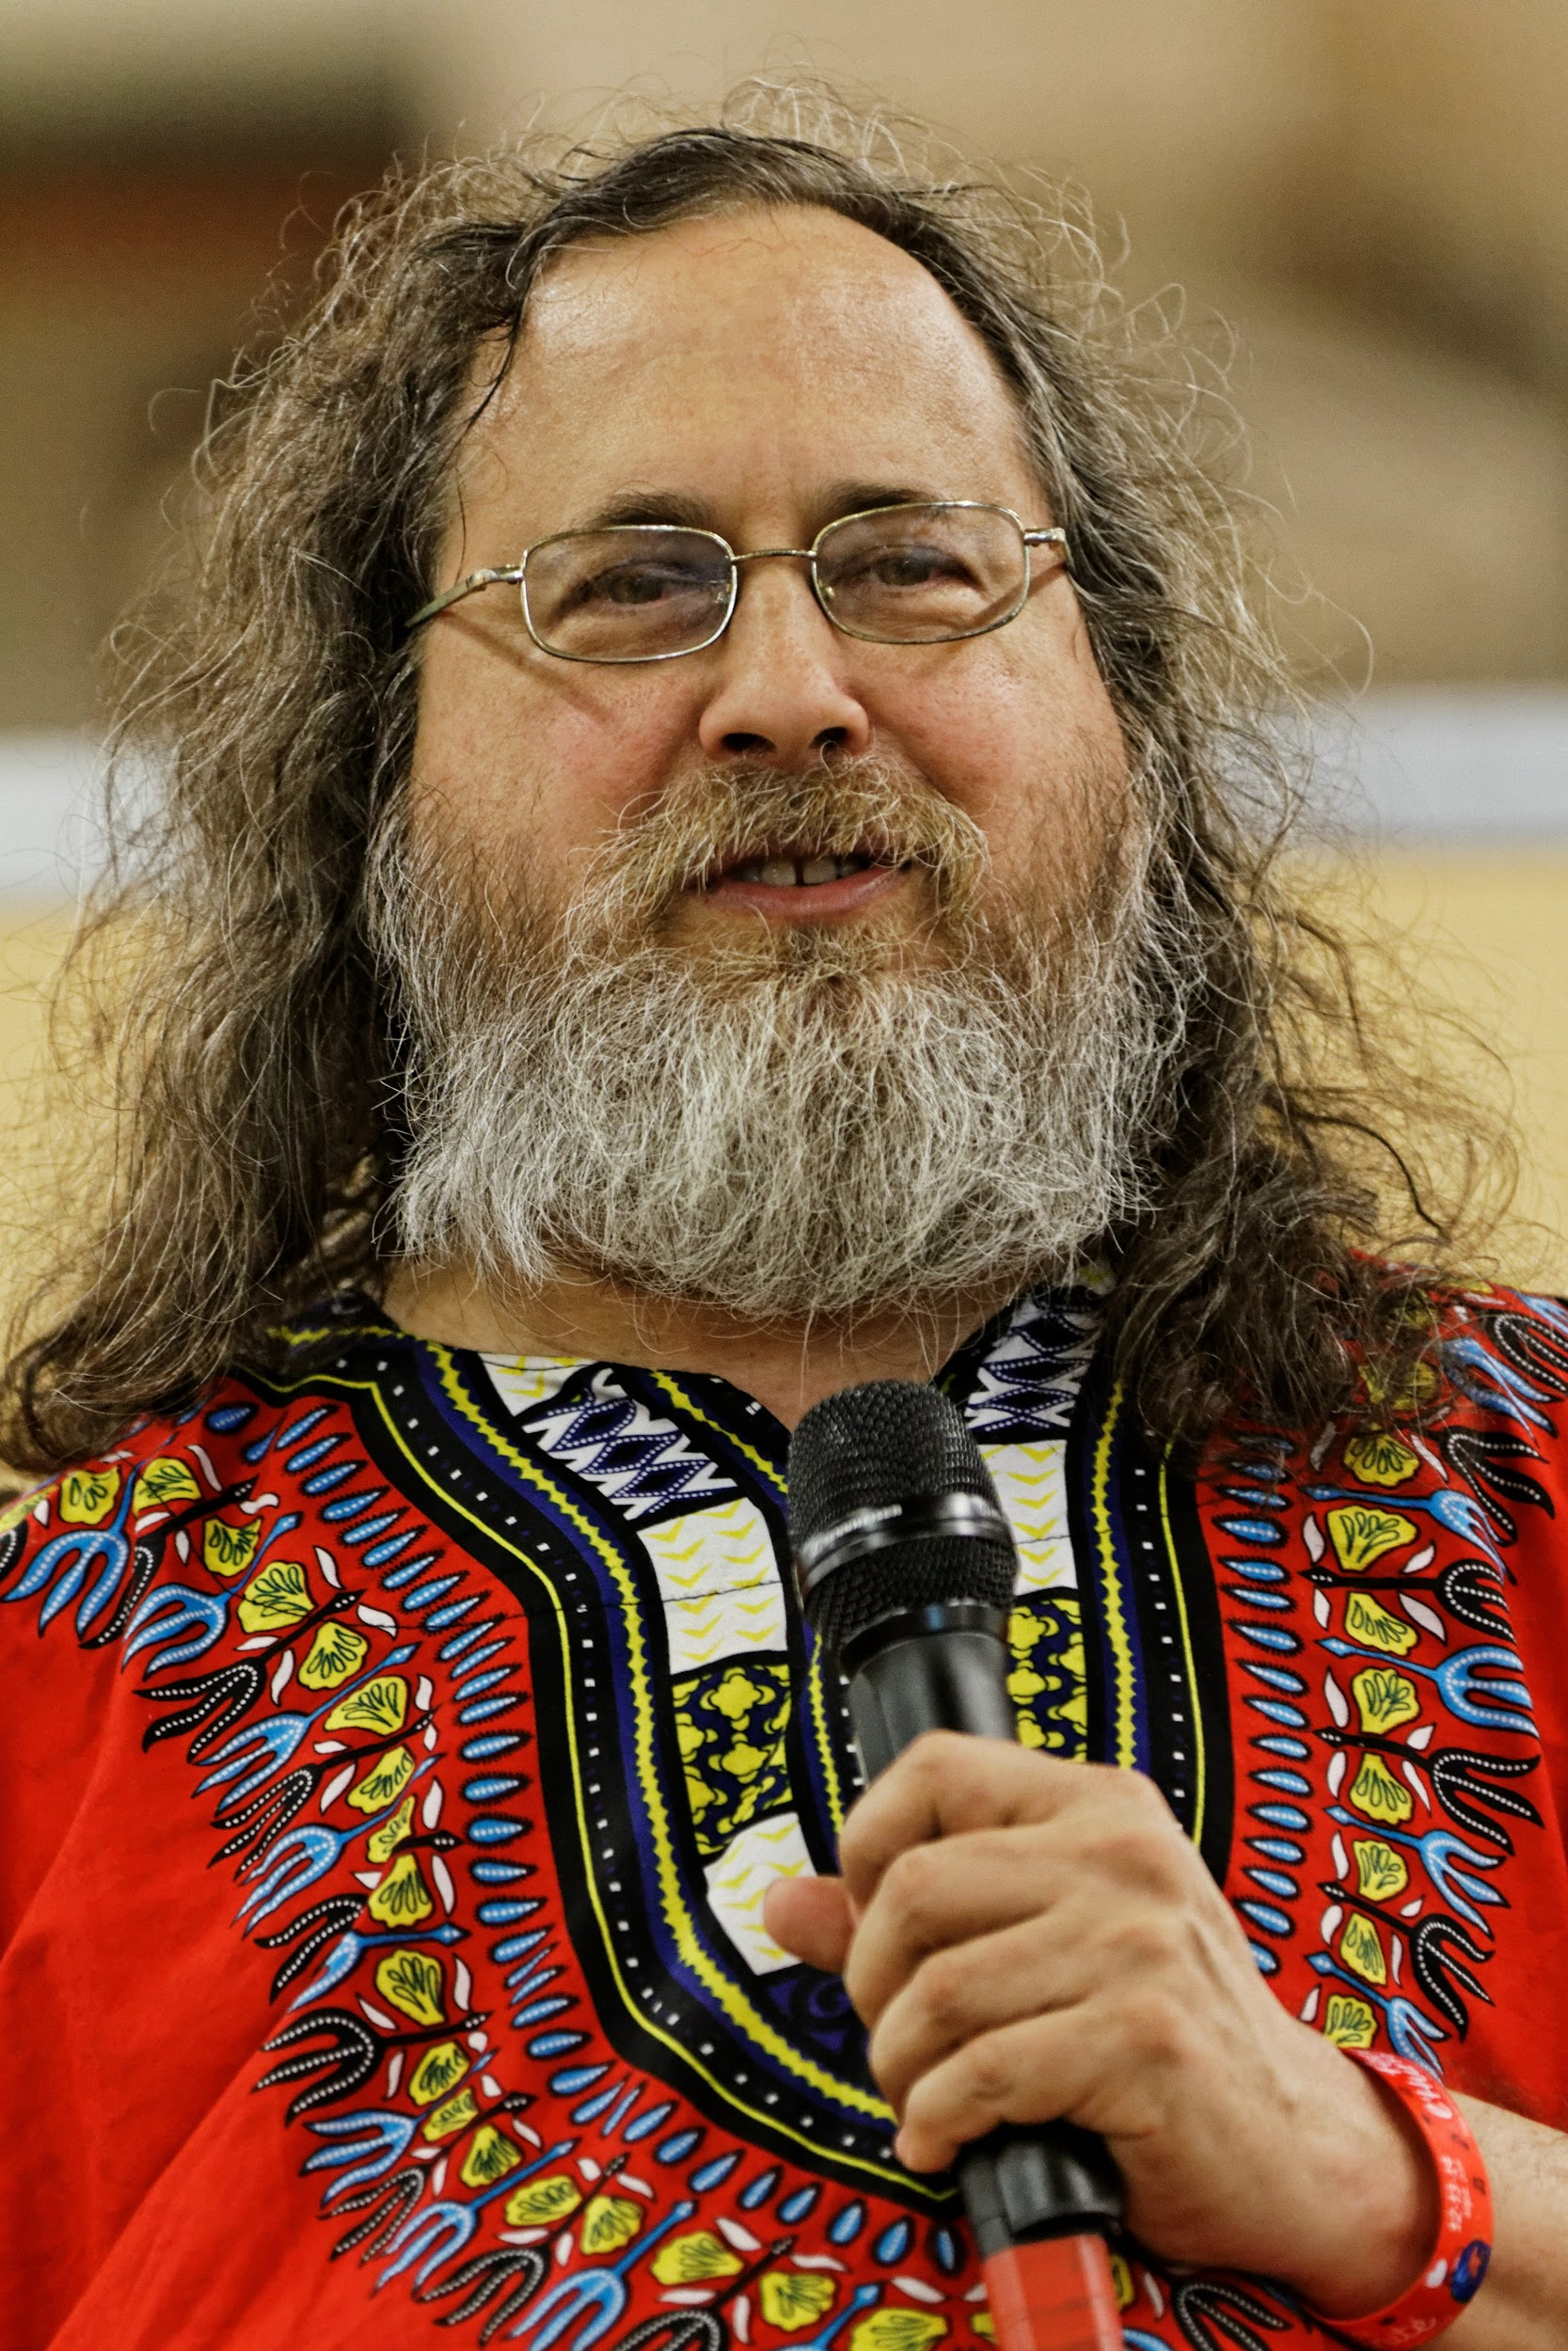
The GNU Project
GNU Stands for GNU’s Not Unix
Launched in 1983 by Richard Stallman
The goal was to create a complete Unix like operating system that was entirely free software.
Stallman published The GNU Manifesto in March 1985. It explains what The GNU project is, and it’s goals and philosophy.

Slide 11
Free Software Foundation
It was founded in 1985 by Stallman
It is a non profit dedicated to promoting FOSS.
It maintains the GNU General Public License(GPL), supports the GNU Project

Slide 12
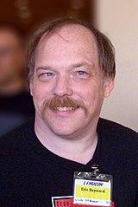

Open Source Initiative
It is an organization dedicated to promoting OSS.
It was founded by Bruce Perens and Erics Raymond in February 1998
OSI specifies the criteria for Open Source Software and properly defines the terms and specifications of OSS
Erics Raymond Bruce Perens

Slide 13
Linux Foundation
It was founded in 2000 to develop the Linux Operating system.
It manages over 500 open source projects including Node.js and Linux

Slide 14

Meet Saraswathi.
Saraswathi works in data analysis.
Her company relied on a proprietary software for data analysis, but it was very slow and unreliable.
Saraswathi along with the FOSS community made a new Open source Alternative which was not only faster and more reliable, surpassed every other software.

Slide 15
Did you know?
•Most servers used to run the internet runs on linux
•Android runs on Linux
•Telegram is Open source
•Python, and most other languages are open source

Slide 16
Some more FOSS
VLC Media Player
Mozilla Firefox
LibreOffice
Linux(Ubuntu,Arch linux etc)
Audacity
Brave Browser
Blender
VirtualBox
MySQL

Slide 17
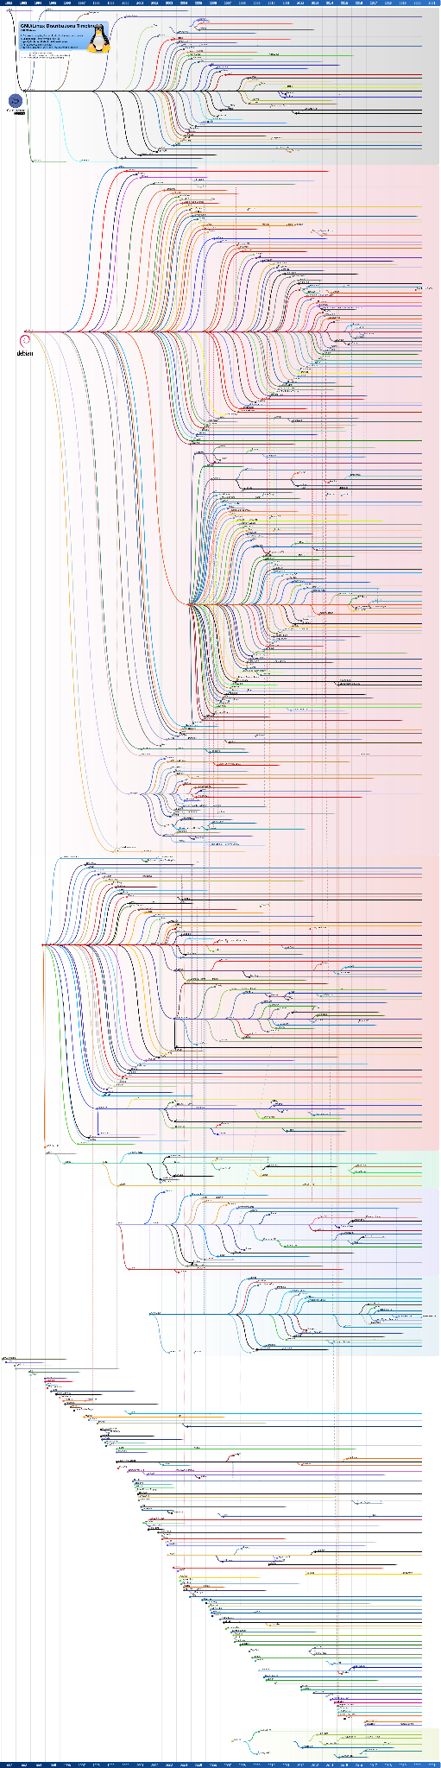
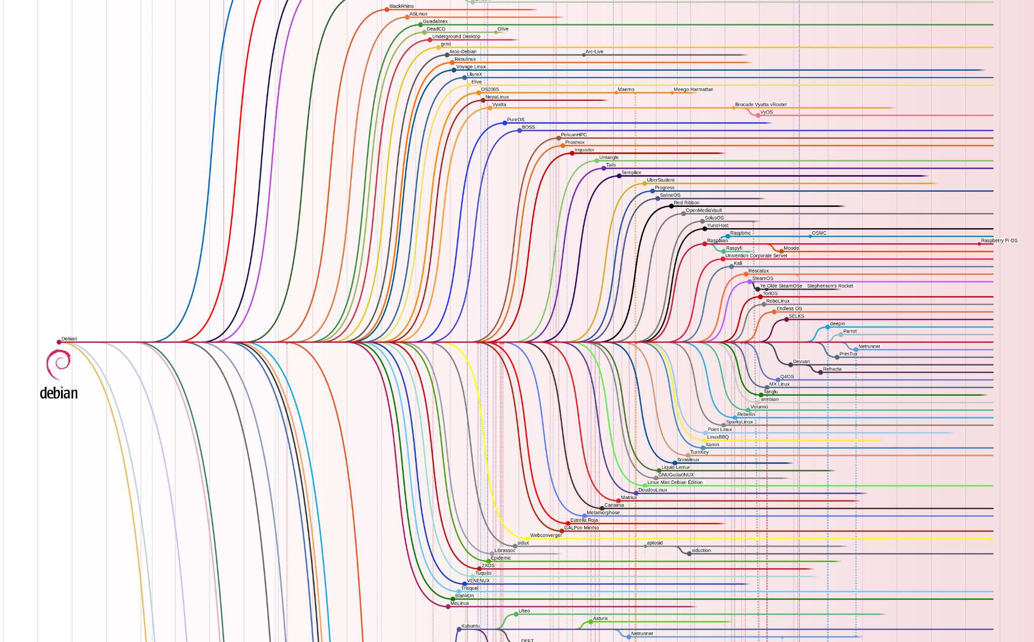
Linux Distro
Chart

Slide 18
Licenses and Domains of
OSS

Slide 19
“Open source licenses are licenses that comply with the Open Source Definition - In Brief, they allow software to be freely used, modified, and shared.” - OSI
An Open source license makes it easy for others to contribute to a project without having to seek special permission. It also makes sure that the original creator gets credit for their contributions.
Some of the widely used open source licences are…

Slide 20

Creative Commons Licenses
CC Licences, issued by Creative Commons Organisation, allows the creator of the work to select how they want others to use the work.
CC Provides Six Core licenses, each of which allows members of the public to use the material in different ways

Slide 21
GNU General Public License(GPL)
It is probably one of the most commonly used licenses for open source projects.
It grants and guarantees a wide range of rights to developers who work on open source projects.
It allows users to legally copy,distribute and modify software

Slide 22
Apache License
Under the Apache License,
The rights are perpetual
The rights are Worldwide
The rights are granted for no fee or royalty
The rights are non-exclusive
The rights are irrevocable

Slide 23
Proprietary Software
Proprietary software is owned and controlled by a single entity, usually a company
It is sold commercially and the source code is not disclosed to the public
The user is usually limited in their ability to modify, distribute, or inspect the software
Proprietary software is in contrast to open-source software, which allows users to view, modify, and share the code.

Slide 24

Thank you!

