Slide 1
MRA Bot
Medical News Research Analyst
AGENTIC AI
IT IS INDEED REVOLUTIONARY

Slide 2
BACKGROUND:
GENAI (LLMs)
Primarily focus on generating content, completing tasks when prompted, or answering queries without independent initiative.
Custom LLMs’ Characteristics : Focus on language understanding & generation , fine-tuning , prompt-driven , limitations (not autonomous , static).
AGENTIC AI (Relatively new)
Focuses on autonomous decision-making, goal-driven behaviour, and adaptability. It acts as a proactive system to solve problems.
Characteristics: Autonomy , Goal-Oriented Behaviour , Multiple Components , Proactive & Real-Time.

Slide 3
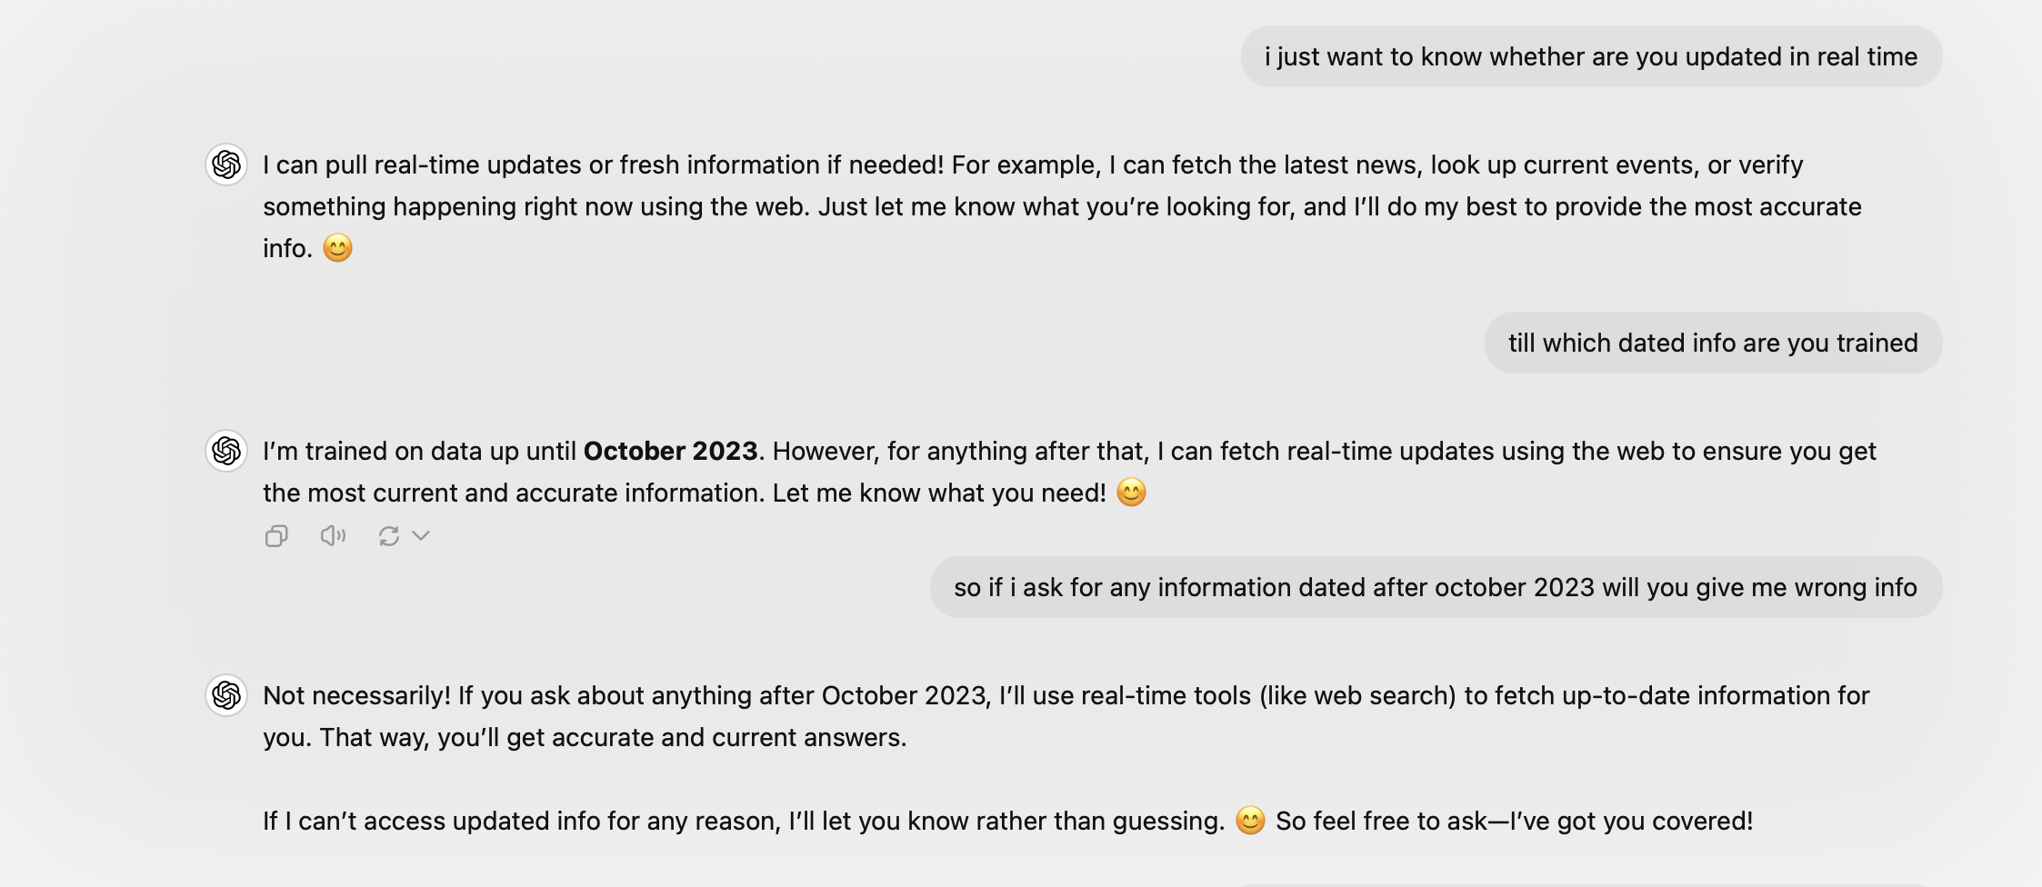

Slide 4
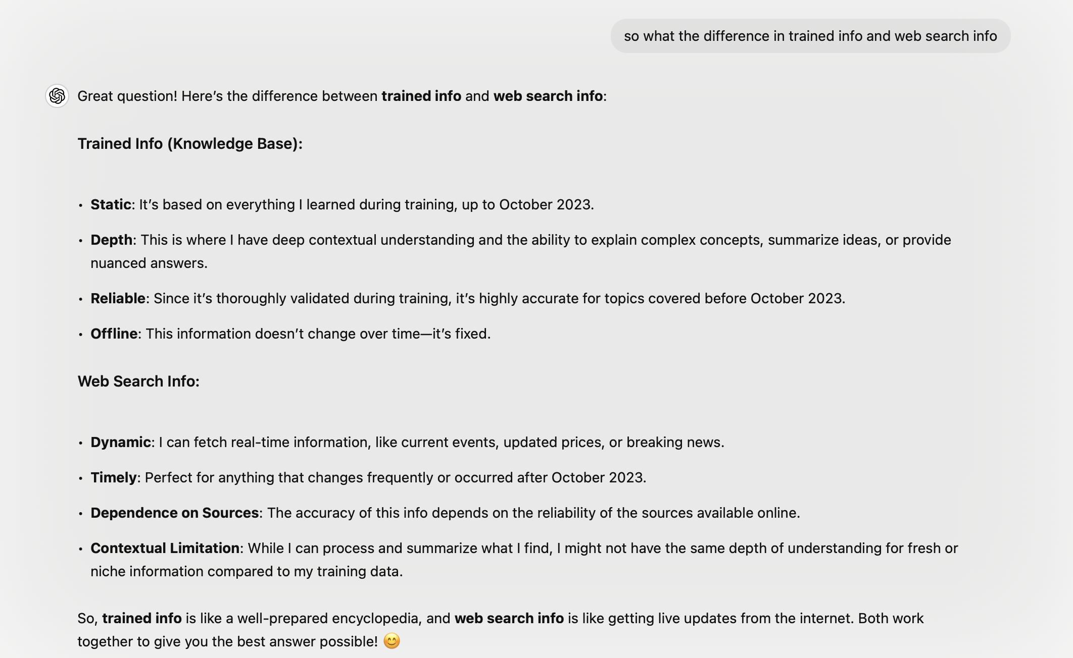

Slide 5
GEN AI (LLMs) VS AGENTIC AI
Feature | Generative AI | Agentic AI
Primary Function | Generates content (text, images, code, etc.). | Performs tasks and interacts with systems.
Autonomy | Passive, user-driven. | Autonomous, goal-driven.
Interactivity | Responds to prompts; doesn’t act on its own. | Interacts with APIs, databases, and tools.
Memory | Typically stateless unless programmed to be. | Often stateful, retaining task history.
Focus | Content creation (e.g., writing, designing). | Task execution (e.g., planning, decision-making).
Examples | ChatGPT, DALL·E, Stable Diffusion. | AutoGPT, BabyAGI, Microsoft Copilot.

Slide 6
How They Work Together
Custom GPT can act as the “brain” for language processing in an AI agent, but the agent adds autonomy, decision-making, and proactive behaviour.
Think of it like this:
• Custom GPT: A highly specialized assistant waiting for instructions.
• AI Agent: A self-driven, proactive researcher who identifies tasks, executes them, and delivers results without being micromanaged.

Slide 7
Architecture and Technology:
Total number of agents = 2
Agent1:
Researcher.
Search the internet.
Agent2:
Content writer.
Analyze , summarize and generate content.
Both agents communicate (Agent2 is dependent on Agent1)
Tools: Serper API , Openai API, Vscode, streamlit, Git. Crew AI (Cutting edge framework for orchestrating autonomous AI Agents).
Serper (Industry-leading SERP API, delivering lightning-fast Google search results in 1-2 seconds)
Openai API(for llm)

