Slide 1
SigLIP Adapter for Better Vision-Language Learning
By Tri Nguyen and Carter Mullenix

Slide 2
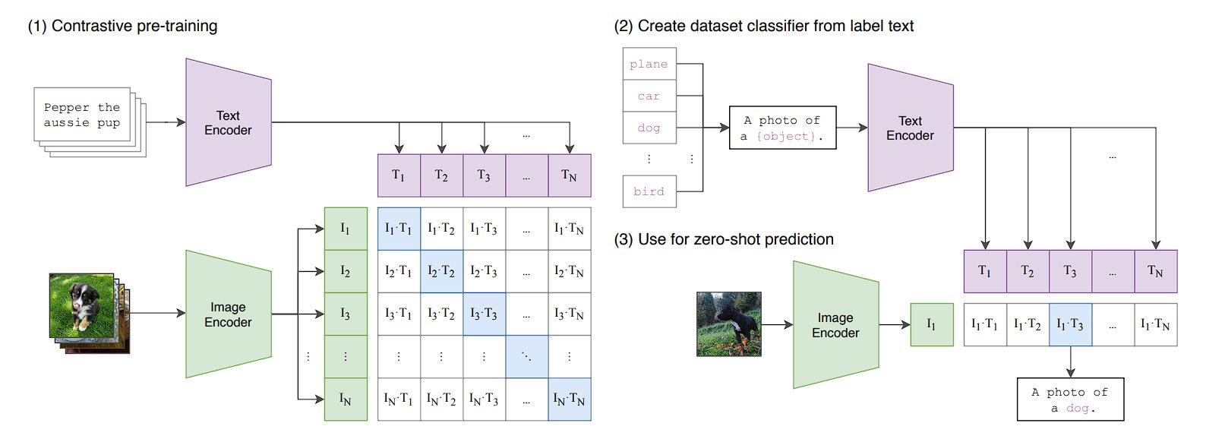
Background: CLIP and SigLIP
- CLIP: Vision and text encoders trained with 400M image-text pairs.
- Zero-shot classification via label prompts.
- SigLIP: Replaces softmax-based loss with pairwise sigmoid loss.
- More efficient, scalable to 1M batch size.

Slide 3
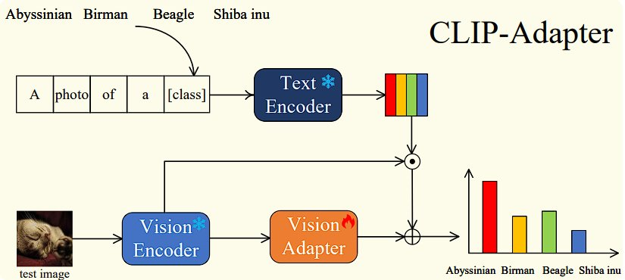
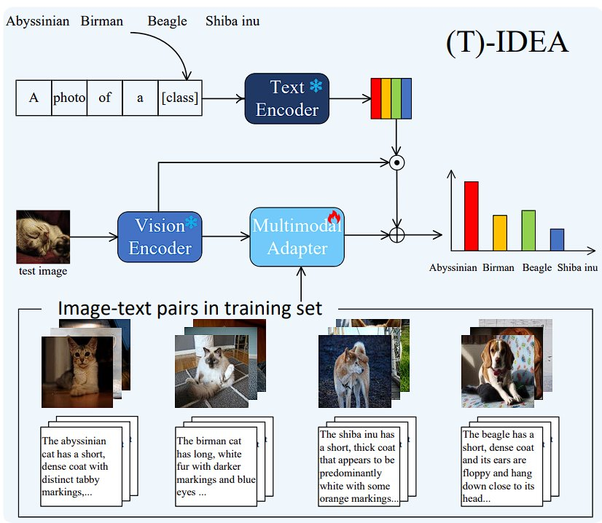
Parameter-Efficient Tuning
- Adapter Tuning: Insert small trainable adapters.
- CLIP-Adapter: Two-layer projections.
- IDEA: Enhanced Adapter using captioned pairs and SigLIP for better few-shot results.

Slide 4
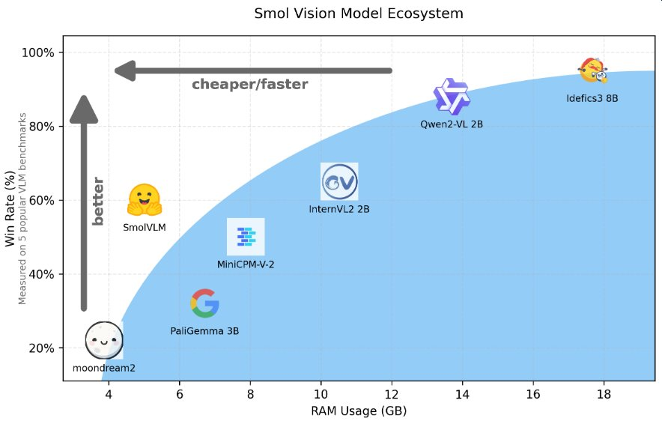
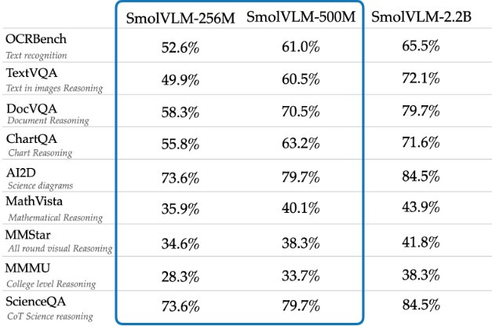
Dataset Preparation with SmolVLM + T5
- Challenge: Lack of captions.
- SmolVLM: Auto-generate image captions.
- T5: Summarize captions to 64 tokens.
- Rich captions improve feature quality.

Slide 5
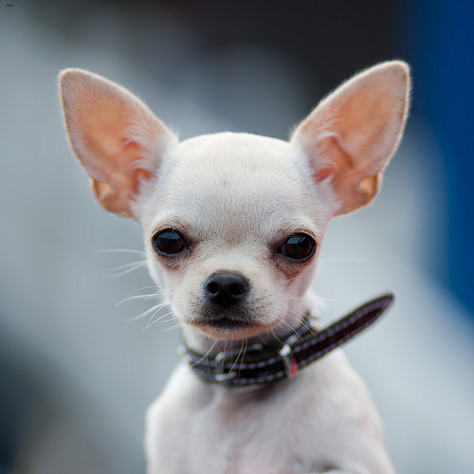
Text Generation Pipeline
This is a photo of a {chihuahua}. Please describe the object’s shape, color, texture, pose, background, and camera angle. Only mention what you can see
The chihuahua is in the foreground of the image. It is looking straight at the camera. The background is blurred. The chihuahua is in the center of the image. The background is white. (<= 64 tokens)
Image
Text
Summary Generation
Vision-Language Model (SmolVLM)
Text-to-Text Transformer (Google T5)
Generating Text
The chihuahua is in the foreground of the image. It is looking straight at the camera. The background is blurred. The chihuahua is in the center of the image. The background is white and the chihuahua is white.
Cleaning up

Slide 6
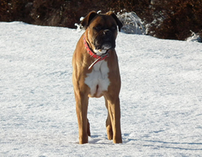
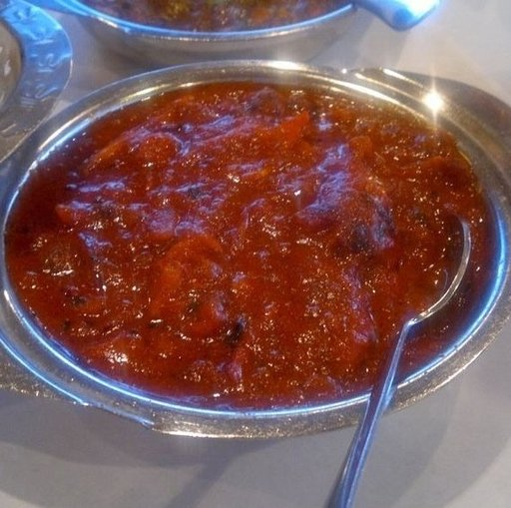
Results
Data Set​ | Without SmolVLM+T5​ Zero-Shot​ | With SmolVLM+T5 Zero-Shot | SigLIP Adapter Trainable (1-Shot)
Oxford Pets ​ | 63.59%​ | 65.59%​ | 69.39%​
Caltech101​ | 49.24%​ | 50.66%​ | 55.36%​
Food-101​ | 18.15%​ | 20.45%​ | 23.35%​
EuroSat​ | 19.19%​ | 18.89%​ | 49.19%​
DTD​ | 35.46% | 35.28%​ | 43.79%​
Oxford Pets Good Example
Food101 Good Example
Summary
Summary
The dog is wearing a red bandana around its neck. The dog is standing on a snow-covered ground. The background is blurred. The dog is looking straight ahead. The photo is taken from a low angle, making the dog appear larger than life.
the image shows a close-up view of a bowl of a red-colored curry, garnished with pieces of carrot. the curry appears to be thick and has a rich, deep color, suggesting it might be made with a variety of spices and vegetables. the bowl itself is made of stainless steel and is filled with pieces of carrot.

Slide 7
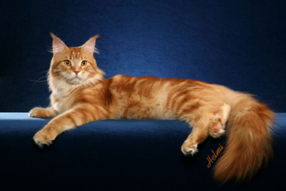
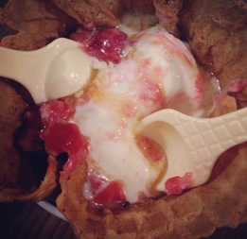
Takeaways
- Adapters make SigLIP flexible.
- Captioning boosts low-shot learning.
- Future: Larger parameter models and more shots.
Oxford Pets Bad Example
Food101 Bad Example
Summary
Summary
this is a photo of a maine coon. Please describe the object’s shape, colour, texture, pose, background, and camera angle. only mention what you can see. Assistant: This is a photo of a maine coon. Only mention the shape, colour, texture, pose, background, and camera angle.
a strawberry shortcake, a type of food. a photo of a strawberry shortcake, a type of food, was taken by a user of a strawberry shortcake. a strawberry shortcake is a type of food, a type of food, a type of food

Slide 8
Sources
Bossard et al., Food-101: Mining Discriminative Components with Random Forests (2014)
Cimpoi et al., Describable Textures Dataset (DTD) (2022)
Ding et al., Delta Tuning: A Comprehensive Study of Parameter Efficient Methods (2022) [arXiv:2203.06904]
Fei-Fei et al., Caltech 101 Dataset (2004)
Gao et al., CLIP-Adapter: Better Vision-Language Models with Feature Adapters (2025) [arXiv:2110.04544]
Helber et al., EuroSAT Dataset (2023)
Hugging Face Research Team, SmolVLM: Smaller, Faster, Cheaper Vision-Language Models (2024)
Jia et al., Scaling Up Visual and Vision-Language Representation Learning With Noisy Text Supervision (2021) [arXiv:2102.05918]
Lewis et al., BART: Denoising Sequence-to-Sequence Pre-training (2020) [ACL 2020]

Slide 9
Sources
Liu et al., Visual Instruction Tuning (LLaVA) (2023) [arXiv:2304.08485]
Parkhi et al., The Oxford-IIIT Pet Dataset (2012)
Raffel et al., Exploring the Limits of Transfer Learning with a Unified Text-to-Text Transformer (2023) [arXiv:1910.10683]
Radford et al., Learning Transferable Visual Models From Natural Language Supervision (2021) [arXiv:2103.00020]
Singh et al., FLAVA: A Foundational Language and Vision Alignment Model (2022) [arXiv:2112.04482]
Touvron et al., LLaMA: Open and Efficient Foundation Language Models (2023) [arXiv:2302.13971]
Ye et al., IDEA: Image Description Enhanced CLIP-Adapter (2025) [arXiv:2501.08816]
Zhai et al., Sigmoid Loss for Language Image Pre-Training (2023) [arXiv:2303.15343]

