Slide 1
MELBOURNE CATCHMENT MODEL
Optilogic Modelling Review
Baseline v2 staged-SKU model — inputs prepared, business logic encoded, baseline outputs & observations
First / Middle / Last mile · Cosmic Frog NEO · single-day basis (all fixed costs per day)
Classification: UNOFFICIAL · draft for review

Slide 2
OBJECTIVE & ALIGNMENT
Everything in the kick-off structure is implemented
Kick-off stage | Implemented in Optilogic | Status
First mile — Route Collection | 411 postcode catchment suppliers originate Pickup; Red Vans to van-op PUDs, Trucks to transport facilities | DONE
First mile — Collection Facilities | 5 van-op PUDs + 2 new Transport Facilities receive Pickup | DONE
Middle mile — Line-haul | PUD-HUB lanes with Rigid / 12-Tonner / B-Double choice (volume-driven, Treat-As-Full) | DONE
Middle mile — Originating processing | Full unload-sort-load recipes at machine-level work centres; per-hub sorter capability | DONE
Middle mile — Terminating processing | Last-mile enters as prev-day supply at HUB and is re-handled (unload-sort-load) | DONE (HUB-HUB leg abstracted)
Last mile — Delivery facilities | Driver sort (3rd/final) + load-to-vehicle at each PUD; real ops caps | DONE
Last mile — Route delivery | Contract White Vans, PUD to 1,046 clusters | DONE
Volume conservation | All BOMs 1:1; supply capacities sized to demand | VERIFIED in run
Weekly-plan position: Week 6–7 milestone — baseline solved, one infeasibility diagnosed & fixed, output review notebooks built.

Slide 3
KICK-OFF CROSS-CHECK — OPTILOGIC_KICK_OFF.PPTX
Cross-checked against the full kick-off deck
Activity taxonomy (kick-off slides 13-14) maps 1:1
Demand calibration — kick-off slide 12
Kick-off activity | Ours | Match
[A2.1] Forklift in/outbound | ULD unload & load | YES
[A2.2] Loose Hand | Loose unload & load | YES
[A2.3] Loose Longreach | Longreach unload & load | YES
[A3.1/2] SPS Manual | Manual sort + 10% floor | YES
[A3.3] SPS Automated | Small auto sort (90k/day) | YES
[A3.4] LPS Automated | Large auto sort (250k/day) | YES
Vehicle: cap + fixed + $/hr + $/km | cap + $/km (hr, fixed pending) | PARTIAL
Time windows (pickup/sort/despatch) | not yet — cut-off gap | GAP
AP terminating volumes across our 11 sites: 271,949/day vs our modelled 167,431 (~62%). On AP volumes 5 sites BREACH capacity (Sunshine W -4,434 · Mt Waverley -2,187 · Abbotsford -2,078 · Bayswater -894 · Pakenham -500); on our lighter baseline none do. Calibrate demand before quoting capacity conclusions.
• Capacities match exactly — same source as our Facilities inputs.
• Scope: kick-off covers 17 sites (adds Mornington Peninsula + Geelong); we model the 11 metro PDCs.
Engine enablers the kick-off names for our open gaps
• SLA (KPI 4): Customer Transit Constraints (Transit Band, Band %) + TransportationPolicies.TransportTime.
• Facility footprint: InitialState=Potential / FacilityStatus=Consider + FacilityCountConstraints (future scenarios).
• Automation strategy: sortation variants + FacilityCountConstraints — our work-centre variant design already follows this pattern.
• Intra-day peaks (AM last-mile vs PM first-mile sharing capacity): flagged NEO limitation in the kick-off — THROG for time-sequenced review.

Slide 4
NETWORK & NODES
17 facilities — 4 HUBs, 11 PUDs (ops caps), 2 transport facilities
HUB sortation capability
PUD daily capacities — operations team input (EA/day)
HUB | Auto sorter | Manual
Melbourne Gateway | Small only | Yes
Dandenong Letter | Small only | Yes
Tullamarine | Large only | Yes
Melbourne Parcel | Large + Small | Yes
PUD | Cap | PUD | Cap
Sunshine West * | 55,767 | Dandenong South * | 29,754
Darebin | 38,018 | Tullamarine | 29,160
Bayswater * | 35,520 | Pakenham | 18,444
Oakleigh South * | 32,375 | Mulgrave | 11,100
Melbourne North * | 30,770 | Abbotsford | 5,828
 |  | Mount Waverley | 3,885
First-mile-only Transport Facilities (new)
Facility | Catchment | Coordinates
Dandenong Transport | 49 postcodes | = Dandenong Letter Ctr
Melbourne Transport | 40 postcodes | = Melbourne Parcel Fac.
* = the 5 van-operation first-mile collection depots.
Watch-out: Mount Waverley is at 99.7% of capacity on last-mile demand alone (3,874 / 3,885).
Collect & line-haul only — deliberately excluded from every last-mile table (no CZ node, no HUB→PUD lanes, no load processes). Verified in the generated files.
Demand nodes: 1,046 last-mile clusters (pinned to their PUD) + 15 first-mile CZ nodes. Suppliers: 411 pickup + 4 SUP_HUB + 11 SUP_PUD.

Slide 5
OPERATING MODEL
End-to-end flow — activities, vehicles & rules per step
FIRST MILE
MIDDLE MILE — HUB
LAST MILE
FIRST-MILE STREAM Pickup → Sorted_Pickup
Red Van · cap 200
5 van-op PUDs
collection depots
411 pickup catchments
Pickup_EP / PP
supply cap 2× demand
HUB — first-mile handling
UNLOAD → SORT → LOAD
(BOM_SORT)
Pickup → Sorted_Pickup
Truck / Rigid / B-Dbl · TAF
15 first-mile CZ nodes
83,699 parcels / day
2 transport facilities
first-mile only
Truck · cap 1,500
line-haul: Rigid / 12-T / B-Double · Treat-As-Full · ≥500 EA per lane
LAST-MILE STREAM Sorted_Lastmile → Prestage → Final → Delivered
SUP_HUB ×4 · 80%
prev-day arrivals
Sorted_Lastmile
HUB — last-mile re-handle
separate WC_LM_* machines
UNLOAD → SORT → LOAD
(BOM_LMSORT) → Prestage
co-located
PUD — 11 sites (ops caps)
DRIVER SORT — 3rd / final sort
(BOM_RESORT) → Final
LOAD (BOM_LOAD) → Delivered
Contract White Van
1,046 clusters
167,431 parcels / day
SUP_PUD ×11 · 20%
staged locally · Prestage
line-haul · Treat-As-Full
skips line-haul & HUB re-handle
Rules: 10% manual-sort floor per hub (2,092 FM + 3,349 LM/day) · sorter capability by hub · line-haul Treat-As-Full = volume-driven truck · pickup ≥ min(40% of PUD demand, supply) · ≥500 EA/lane · PUD ops caps · all fixed costs charged PER DAY (annual ÷ 252)

Slide 6
PRODUCT TRANSFORMATION
12 staged SKUs · 4 BOM transforms — streams can never pool
BOM | Consumes → Produces | Where | Physical activity
BOM_SORT | Pickup → Sorted_Pickup | HUB | first-mile unload-sort-load
BOM_LMSORT | Sorted_Lastmile → Prestage_Lastmile | HUB | last-mile unload-sort-load on separate WC_LM_* machines
BOM_RESORT | Prestage_Lastmile → Final_Lastmile | PUD | driver sort — the 3rd and final sort, done by drivers
BOM_LOAD | Final_Lastmile → Delivered | PUD | load-to-vehicle
Why it is built this way
• Sequencing is enforced by product state — Delivered can only come from Final_Lastmile, which only comes from Prestage; no stage can be skipped.
• Sort count is explicit: HUB-fed last-mile parcels are sorted 3 times (pre-sorted arrival → HUB re-sort → PUD driver sort); locally-staged parcels once.
• First- vs last-mile HUB handling runs on separate machine sets (WC_* vs WC_LM_*) so per-stream throughput and cost are visible in the outputs.
• All transforms are 1:1 — the kick-off volume-conservation rule, confirmed in the baseline run.
• Each SKU exists as EP (eParcel) and PP (Parcel Post): 6 stages × 2 = 12.

Slide 7
ACTIVITIES & METHOD OPTIONS
Every step carries a rate, a unit cost and a per-day fixed cost
Activity | Method | Rate (EA/day) | Unit cost ($/EA) | WC fixed ($/day) | (annual quote)
Unload / Load | Loose | 15,000 | 0.050 | 198 | 50,000
Unload / Load | Longreach | 35,000 | 0.020 | 595 | 150,000
Unload / Load | ULD | 55,000 | 0.015 | 992 | 250,000
Sort | Manual | 25,000 | 0.060 | 397 | 100,000
Sort | Small auto | 90,000 | 0.020 | 3,175 | 800,000
Sort | Large auto | 250,000 | 0.010 | 9,921 | 2,500,000
PUD driver sort | single method | 40,000 | 0.050 | 198 | 50,000
• HUB handling is enumerated as UNLOAD × SORT × LOAD recipes; the optimiser picks the cheapest feasible combination per hub — Melbourne Parcel 27 recipes/stream, the other hubs 18 (sorter capability).
• Fixed costs are charged per day (annual ÷ 252 working days) because the model optimises one representative day — total work-centre fixed cost is $112,283/day.
• Cheapest handling stacks: first-mile HUB $0.040/parcel (large-auto hubs); HUB-fed last mile ~$0.105–0.115 incl. driver sort + load; locally-staged last mile ~$0.065.

Slide 8
SORTATION POLICY
Sorter capability by hub + a forced 10% manual floor
HUB | Large auto | Small auto | Manual
Melbourne Gateway | — | YES | YES
Dandenong Letter | — | YES | YES
Tullamarine | YES | — | YES
Melbourne Parcel | YES | YES | YES
Stream | Manual floor / hub / day
First mile (WC_MANUAL_SORT_*) | 2,092 EA
Last mile (WC_LM_MANUAL_SORT_*) | 3,349 EA
How the 10% is enforced
• Real operations always hand-sort ~10% (non-conveyable / exceptions). Anura has no native percentage constraint, so it is encoded as a MinimumThroughput floor on each hub's manual-sort work centres.
• Floors = 10% of each hub's expected sort volume (first-mile: total ÷ 4 hubs; last-mile: 80% × total ÷ 4). Auto sort is cheaper, so the solver fills exactly the floor with manual and the rest with auto.
• Caveat: it is an absolute floor, not a live ratio — if actual hub volumes shift materially, the realised percentage drifts. The exact alternative is a non-machinable product split (10% of parcels as a manual-only SKU).

Slide 9
TRANSPORT MODELLING
Six vehicles, consolidation economics, volume-driven line-haul
Vehicle | Capacity | $/km per trip | Cost rule | Used on
Red Van | 200 | 1.20 | Prorate | first-mile pickup → van-op PUD
Truck | 1,500 | 0.90 | Prorate / TAF | FM pickup → transport facility · FM delivery HUB→CZ (choice)
Rigid Truck | 1,500 | 0.70 | Treat As Full | line-haul + FM delivery HUB→CZ (choice)
12-Tonner | 2,500 | 0.95 | Treat As Full | line-haul (choice)
B-Double | 4,000 | 1.30 | Treat As Full | line-haul + FM delivery HUB→CZ (choice)
White Van | 180 | 1.10 | Prorate | last-mile delivery to REAL customers only (contract)
How the cost works
• Per-trip cost = $/km × distance; Prorate spreads it over vehicle capacity → per-parcel = rate × km ÷ capacity.
• Treat-As-Full makes a partial load pay a whole trip, so the line-haul truck choice becomes volume-driven.
• All rates/capacities are placeholders pending the kick-off cost build-ups (fixed $/day + fuel $/km + driver $/hr).
Verified crossover on a 31 km lane
Lane volume (EA) | Cheapest vehicle
≤ ~1,500 | Rigid Truck
~2,500 | 12-Tonner
≥ 4,000 | B-Double

Slide 10
SUPPLY & DEMAND
Three supply origins and the 80/20 last-mile split
Supply stream | Count | SKU supplied | Capacity logic
SUP_Pickup_* (catchments) | 411 | Pickup_EP / PP | EP 41 / PP 367 per postcode = 2× demand buffer
SUP_HUB_* (at hubs) | 4 | Sorted_Lastmile | 80% of last-mile ÷ 4 hubs (EP 5,037 / PP 28,450 each)
SUP_PUD_* (at PUDs) | 11 | Prestage_Lastmile | 20% of each PUD's own last-mile demand
Demand | EP | PP | Total / day
Last mile (Delivered, 1,046 clusters) | 25,182 | 142,249 | 167,431
First mile (Sorted_Pickup, 15 CZ nodes) | 8,364 | 75,335 | 83,699
• The 80/20 split is enforced by supplier capacities plus cost — local staging skips the HUB→PUD line-haul and the HUB re-handle, so it is naturally preferred up to its cap.
• First-mile volume assumed at 50% of last-mile (no first-mile demand data yet); distributed 40% to HUB zones / 60% to PUD zones, 90% PP.
• Local staging represents previous-day first-mile volume that terminates in the PUD's own catchment.

Slide 11
BUSINESS-LOGIC REGISTER
13 rules, each traceable to an exact Anura field
# | Business rule | Anura encoding | Value
1 | Transport facilities do first-mile only | Facilities + exclusion from last-mile tables | 2 facilities
2 | Prev-day terminating volume staged at PUD | SUP_PUD suppliers + capacity | 20% of PUD demand
3 | Last-mile sorted at HUB and again at PUD | BOM_LMSORT + BOM_RESORT chain | 3rd sort by drivers
4 | ~10% of sortation is always manual | WorkCenters.MinimumThroughput | 2,092 + 3,349 EA/hub
5 | Sorter capability differs by hub | per-hub recipe enumeration | small / large / both
6 | PUD daily capacity from operations | Facilities.throughputcapacity | 3,885 – 55,767 EA
7 | Red vans to PUDs; trucks to transport fac. | modename per pickup lane | Red_Van / Truck
8 | Line-haul right-sized to volume | 3 modes per lane, Treat As Full | Rigid / 12T / B-Dbl
9 | White vans serve real last-mile customers only | modename per delivery lane | White_Van (LM) / trucks (FM)
10 | Consolidation: fuller vehicle = cheaper | fixedcost ÷ averageshipmentsize | 6-vehicle fleet
11 | First-mile pickup floor per depot | FlowConstraints Min | min(40% demand, supply)
12 | Minimum line-haul service per lane | FlowConstraints Min | 500 EA / lane
13 | Fixed costs on single-day basis | all fixedoperatingcost fields | annual ÷ 252

Slide 12
INPUTS PREPARED
16 Anura tables generated from one reproducible notebook
Table | Rows | Encodes
Facilities | 17 | HUBs + PUD ops caps + transport facilities
Products | 12 | staged-SKU chain (6 stages × EP/PP)
BillOfMaterials | 8 | 4 transforms × 2 products, all 1:1
WorkCenters | 110 | machine capacity, per-day fixed, manual floors
Processes | 530 | every activity step: rate + unit cost
ProductionPolicies | 412 | recipe alternatives bound to BOMs
Suppliers / Capabilities | 426 / 852 | 3 streams; 80/20 + 2× buffer
Table | Rows | Encodes
ProcurementPolicies | 852 | supplier → facility sourcing edges
TransportationPolicies | 3,496 | all lanes: mode, distance, trip cost
TransportationModes | 6 | vehicle fleet (capacity + cost rule)
ReplenishmentPolicies | 144 | HUB ↔ PUD middle-mile edges
CustomerFulfillment | 2,208 | who serves which demand node
CustomerDemand | 2,118 | 167,431 LM + 83,699 FM parcels/day
FlowConstraints / Groups | 86 / 1,504 | floors + stream groups
Everything regenerates from create_input_melbourne_catchment_baseline_v2_model.ipynb — no hand-edited CSVs; every change is parameterised at the top of the notebook.

Slide 13
ASSUMPTIONS & SIMPLIFICATIONS
Eight explicit assumptions, all parameterised for revision
• 1. First-mile volume = 50% of last-mile (no first-mile demand data yet); split 40/60 HUB/PUD zones, 90/10 PP/EP.
• 2. Local staging fraction = 20% (PUD_LOCAL_STAGE_FRAC) — flat, not yet derived from catchment terminating data.
• 3. Vehicle rates & capacities are placeholders pending the kick-off cost build-ups (fixed $/day + fuel $/km + driver $/hr).
• 4. Handling unit costs and machine fixed costs are realistic-order placeholders, not finance-validated.
• 5. ALL costs are per-day: machine fixed = annual ÷ 252 working days ($112,283/day total). The Facilities Fixed_Cost_HUB/PUD StepCosts curves must be set to the same per-day basis.
• 6. Single representative day — no periods/seasonality, no induction/dispatch cut-offs yet (kick-off Week-5 item).
• 7. Parcel-count (EA) only — no weight/cube; motorbike posties not modelled.
• 8. Fixed network — all facilities and machines Open/Existing; no siting or investment decisions in the baseline.

Slide 14
BASELINE DEBUGGING
One violated constraint — diagnosed, root-caused, fixed
NEO reported a 'Site Production Capacity' violation at SUP_Pickup_Melbourne_North_3062 (Pickup_PP): capacity 184 vs required 2,113.8 (~11× over).
SYMPTOM
Pickup capacity had been sized to exactly equal demand — only 0.4% slack network-wide; 5 of 7 first-mile depots pinned at 100%. Adding the PUD ops caps and manual floors reshuffled hub allocation and consumed the last slack, so NEO relaxed the cheapest catchment (1.15 km from its PUD).
DIAGNOSIS
The per-postcode pickup cap is a modelling construct, not a real limit — the true constraints are demand and PUD capacity. The artificial cap should never bind.
JUDGEMENT
PICKUP_CAP_BUFFER = 2.0 → per-postcode caps EP 41 / PP 367 (~100% headroom). CONFIRMED CLEARED: 12-Jul ConstraintSummary reports 0 violations across all 86 constraints.
FIX & VERIFY

Slide 15
OUTPUTS — KPI COVERAGE
Four of six kick-off KPIs measurable today; two need new inputs
# | Kick-off objective | KPI | Baseline status
1 | Minimise total network cost | Total daily OPEX | All per-day and booking (12-Jul run): transport $14,853 + WC fixed $112,283 + handling $21,537 = ~$148,673/day
2 | Minimise contractor fleet | Peak vehicles required | Measured as trips/day by mode (single-period proxy)
3 | Minimise travel time | Average route duration | 27,298 lane-km and 496 lane-hours available per lane
4 | Maximise catchment | % volume within SLA | GAP — needs induction/dispatch cut-offs + service-time targets
5 | Balance facility utilisation | — | Work-centre & facility utilisation reported (next slide)
6 | Minimise empty kilometres | — | GAP — needs backhaul / return-leg modelling
Analysis notebooks: notebooks/output_analysis/ — 00 KPI dashboard + one notebook per Optimization*Summary CSV (executed, 22 charts).

Slide 16
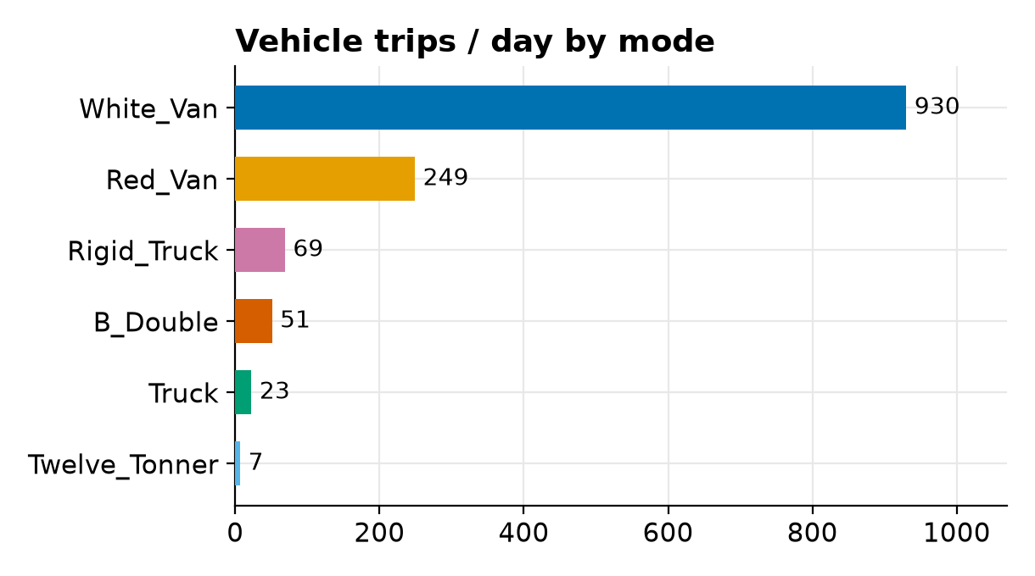
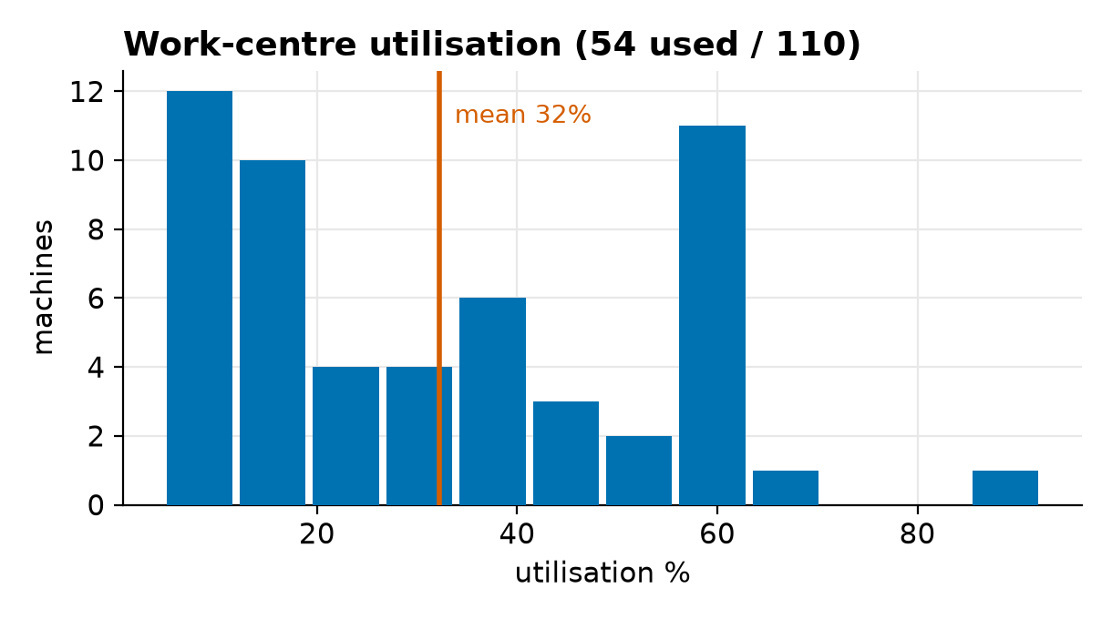
OUTPUTS — FLEET & UTILISATION (12-JUL RUN)
White vans serve customers only; fleet inside contract limits
• White vans 930 trips/day, origins PUD-only — they now serve real last-mile customers exclusively (was 1,209 incl. FM delivery). Total transport fell $19,529 → $14,853/day (−24%). Red vans 249 (of 500).
• FM HUB→CZ correction verified: that leg runs on Rigid (22 trips) + B-Double (13) — no white vans.
• B-Double 51 trips/day vs the kick-off fleet of 50 — borderline (was 92): monitor, or cap the fleet as a scenario. Line-haul mix Rigid 69 / B-Dbl 51 / 12T 7 shows Treat-As-Full right-sizing.
• Cost booking verified: WC fixed $112,283/day, handling $21,537/day; manual sort = 10.0% exactly; driver sort covers all 167,431. FLAG: unload/load runs 100% ULD — add method-compatibility floors if a loose/longreach share is realistic.

Slide 17
GAPS & NEXT STEPS
Close the data gaps, then run the Week 8–9 scenario set
Kick-off parameters not yet encoded
Recommended order
• Driver costs & shifts (van $34.06, HR/semi $35.89, B-double $40.50/hr; 10-hr days).
• Vehicle fixed + fuel build-ups per the kick-off tables.
• Loading/unloading times (25–75 min) as process fixed times.
• Induction & dispatch cut-offs; service levels (KPI 4).
• Motorbike posties; backhaul / empty km (KPI 6).
• Mandatory trunk routes, minimum frequencies, curfews (TBD in kick-off too).
• 1. Calibrate demand to kick-off slide-12 volumes (ours 167k vs AP 272k across the same 11 sites — 5 sites breach on AP volumes).
• 2. Replace placeholder vehicle economics with kick-off cost build-ups ($/trip = fixed/day + fuel×km + driver×hrs).
• 3. Purge legacy v1 rows in the Cosmic Frog model (old work centres, 12-month Periods, flow-count keys — all the moderate validation findings).
• 4. Add cut-offs via Customer Transit Constraints (the mechanism named in the kick-off) to unlock KPI 4 (SLA); backhaul for KPI 6.
• 5. Scenario set: B-Double fleet cap (50) · capacity stress on calibrated volumes · staging 20%→30% · automation investment.
Bottom line: the full kick-off operating structure is encoded and solving; costs are now on a consistent single-day basis; remaining gaps are data (real rates, cut-offs), not model structure.

