Slide 1
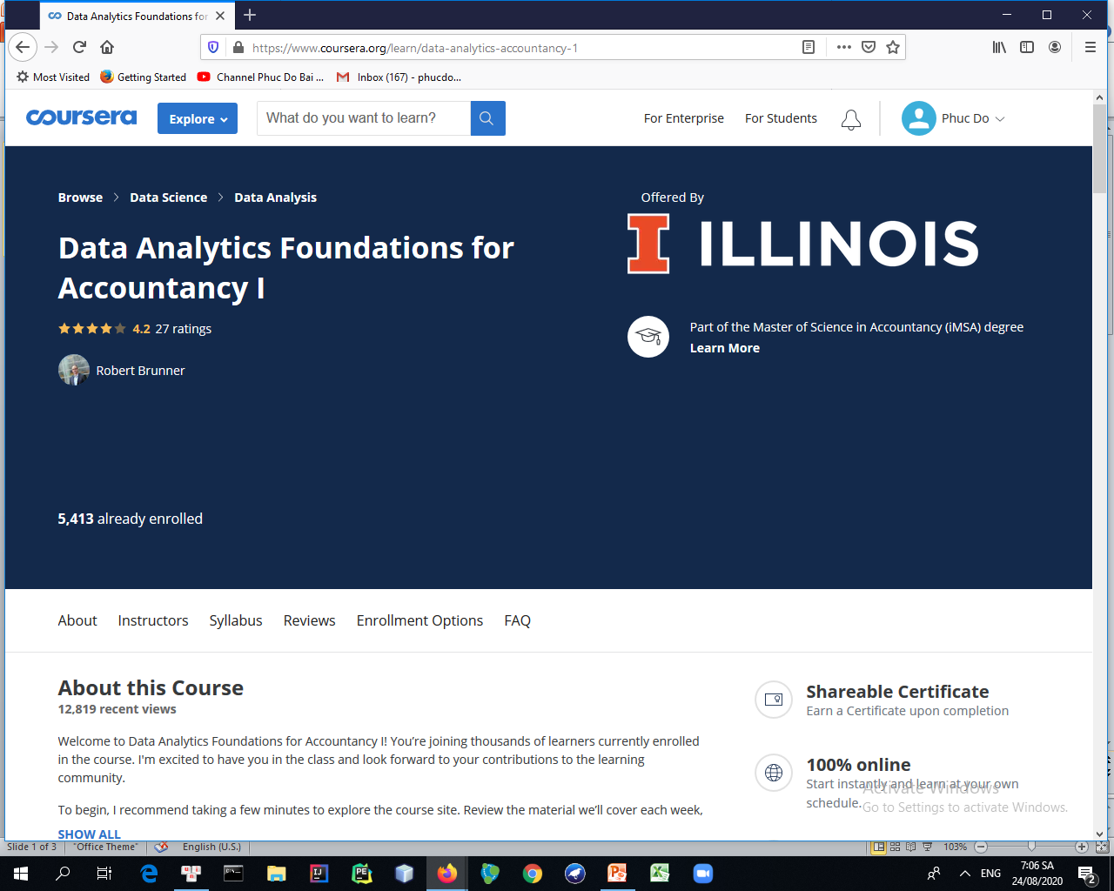
https://www.coursera.org/learn/data-analytics-accountancy-1

Slide 2
Syllabus
Course Orientation
You will become familiar with the course, your classmates, and our learning environment. The orientation will also help you obtain the technical skills required for the course.
Module 1: Foundations
This module serves as the introduction to the course content and the course Jupyter server, where you will run your analytics scripts. First, you will read about specific examples of how analytics is being employed by Accounting firms. Next, you will learn about the capabilities of the course Jupyter server, and how to create, edit, and run notebooks on the course server. After this, you will learn how to write Markdown formatted documents, which is an easy way to quickly write formatted text, including descriptive text inside a course notebook. Finally, you will begin learning about Python, the programming language used in this course for data analytics.
Module 2: Introduction to Python
This module focuses on the basic features in the Python programming language that underlie most data analytics scripts. First, you will read about why accounting students should learn to write computer programs. Second, you will learn about basic data structures commonly used in Python programs. Third, you will learn how to write functions, which can be repeatedly called, in Python, and how to use them effectively in your own programs. Finally, you will learn how to control the execution process of your Python program by using conditional statements and looping constructs. At the conclusion of this module, you will be able to write Python scripts to perform basic data analytic tasks.

Slide 3
Syllabus
Module 3: Introduction to Data Analysis
This module introduces fundamental concepts in data analysis. First, you will read a report from the Association of Accountants and Financial Professionals in Business that explores Big Data in Accountancy. Next, you will learn about the Unix file system, which is the operating system used for most big data processing (as well as Linux and Mac OSX desktops and many mobile phones). Second, you will learn how to read and write data to a file from within a Python program. Finally, you will learn about the Pandas Python module that can simplify many challenging data analysis tasks, and includes the DataFrame, which programmatically mimics many of the features of a traditional spreadsheet.
Module 4: Statistical Data Analysis
This module introduces fundamental concepts in data analysis. First, you will read about how to perform many basic tasks in Excel by using the Pandas module in Python. Second, you will learn about the Numpy module, which provides support for fast numerical operations within Python. This module will focus on using Numpy with one-dimensional data (i.e., vectors or 1-D arrays), but a later module will explore using Numpy for higher-dimensional data. Third, you will learn about descriptive statistics, which can be used to characterize a data set by using a few specific measurements. Finally, you will learn about advanced functionality within the Pandas module including masking, grouping, stacking, and pivot tables.
5 videos (Total 33 min), 2 readings, 2 quizzes

Slide 4
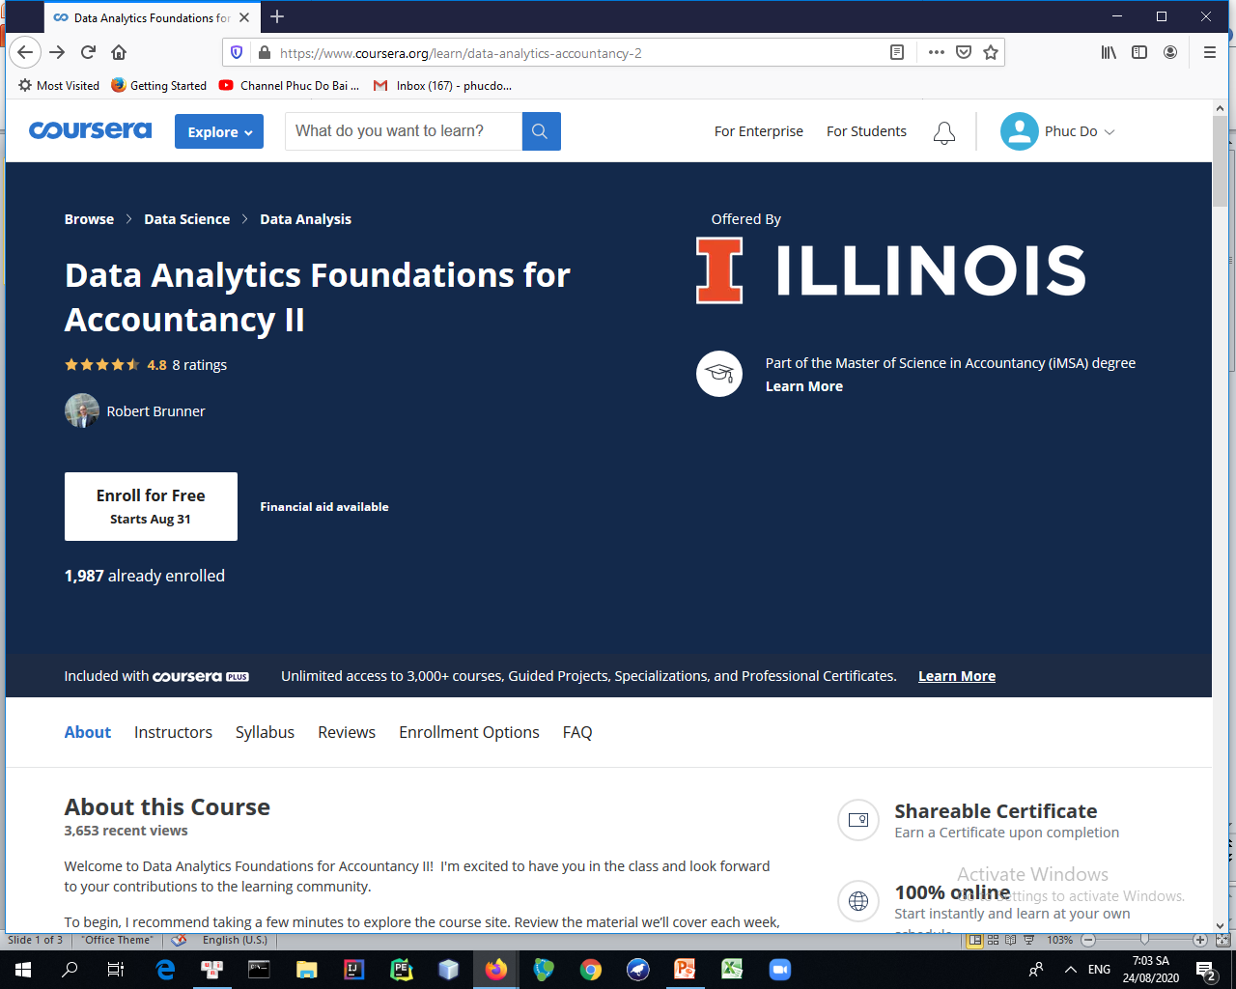
https://www.coursera.org/learn/data-analytics-accountancy-2

Slide 5
Syllabus
Module 1: Introduction to Machine Learning
This module provides the basis for the rest of the course by introducing the basic concepts behind machine learning, and, specifically, how to perform machine learning by using Python and the scikit learn machine learning module. First, you will learn how machine learning and artificial intelligence are disrupting businesses. Next, you will learn about the basic types of machine learning and how to leverage these algorithms in a Python script. Third, you will learn how linear regression can be considered a machine learning problem with parameters that must be determined computationally by minimizing a cost function. Finally, you will learn about neighbor-based algorithms, including the k-nearest neighbor algorithm, which can be used for both classification and regression tasks.
Module 2: Fundamental Algorithms
This module introduces several of the most important machine learning algorithms: logistic regression, decision trees, and support vector machine. Of these three algorithms, the first, logistic regression, is a classification algorithm (despite its name). The other two, however, can be used for either classification or regression tasks. Thus, this module will dive deeper into the concept of machine classification, where algorithms learn from existing, labeled data to classify new, unseen data into specific categories; and, the concept of machine regression, where algorithms learn a model from data to make predictions for new, unseen data. While these algorithms all differ in their mathematical underpinnings, they are often used for classifying numerical, text, and image data or performing regression in a variety of domains. This module will also review different techniques for quantifying the performance of a classification and regression algorithms and how to deal with imbalanced training data.

Slide 6
Syllabus
Module 3: Practical Concepts in Machine Learning
This module introduces several important and practical concepts in machine learning. First, you will learn about the challenges inherent in applying data analytics (and machine learning in particular) to real world data sets. This also introduces several methodologies that you may encounter in the future that dictate how to approach, tackle, and deploy data analytic solutions. Next, you will learn about a powerful technique to combine the predictions from many weak learners to make a better prediction via a process known as ensemble learning. Specifically, this module will introduce two of the most popular ensemble learning techniques: bagging and boosting and demonstrate how to employ them in a Python data analytics script. Finally, the concept of a machine learning pipeline is introduced, which encapsulates the process of creating, deploying, and reusing machine learning models.
Module 4: Overfitting & Regularization
This module introduces the concept of regularization, problems it can cause in machine learning analyses, and techniques to overcome it. First, the basic concept of overfitting is presented along with ways to identify its occurrence. Next, the technique of cross-validation is introduced, which can mitigate the likelihood that overfitting can occur. Next, the use of cross-validation to identify the optimal parameters for a machine learning algorithm trained on a given data set is presented. Finally, the concept of regularization, where an additional penalty term is applied when determining the best machine learning model parameters, is introduced and demonstrated for different regression and classification algorithms.

Slide 7
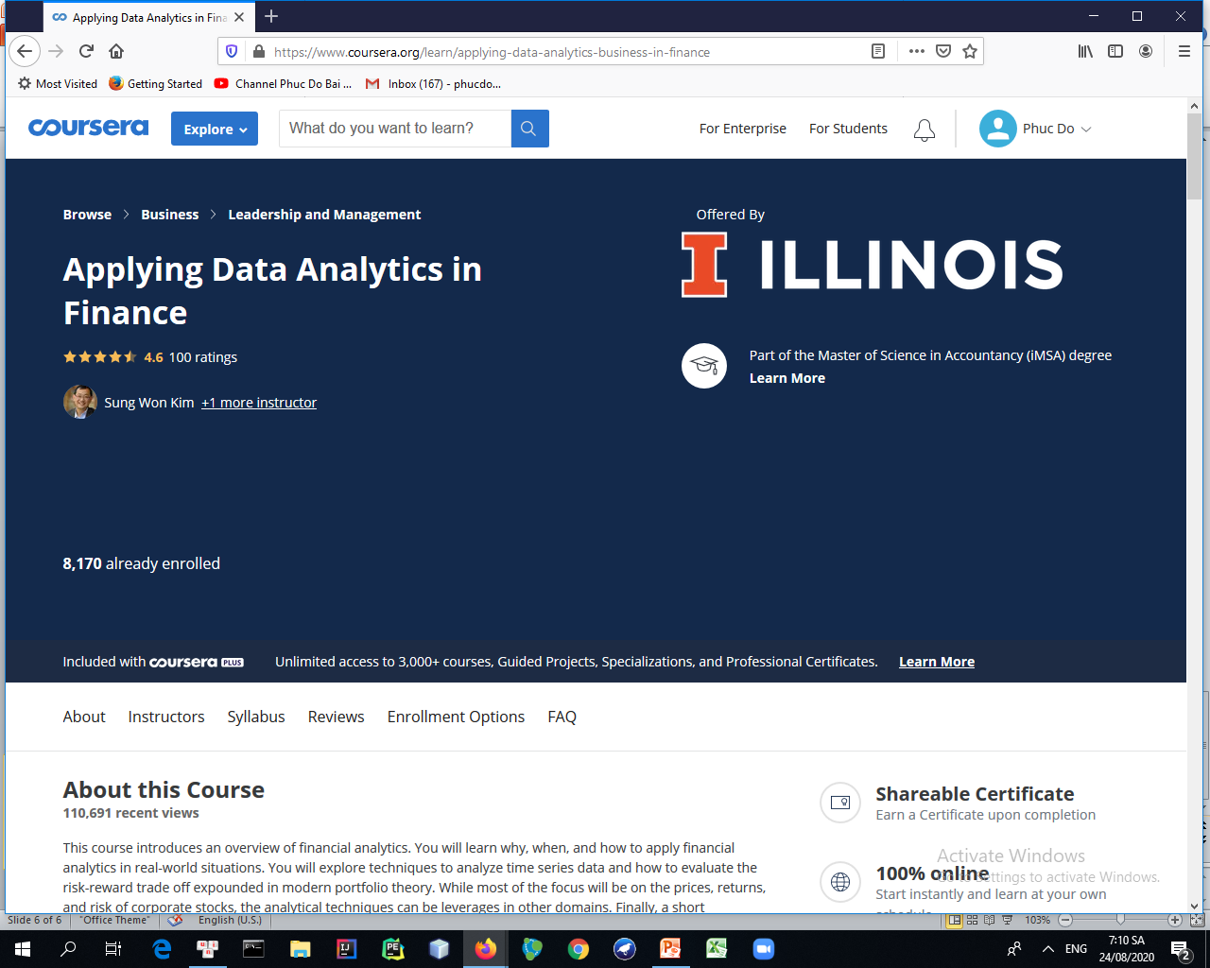
https://www.coursera.org/learn/applying-data-analytics-business-in-finance

Slide 8
Syllabus
Course Introduction
In this course, we will introduce a number of financial analytic techniques. You will learn why, when, and how to apply financial analytics in real-world situations. We will explore techniques to analyze time series data and how to evaluate the risk-reward trade off expounded in modern portfolio theory. While most of the focus will be on the prices, returns, and risks of corporate stocks, the analytical techniques can be leveraged in other domains. Finally, a short introduction to algorithmic trading concludes the course.
Module 1: Introduction to Financial Analytics and Time Series Data
In this module, we will introduce an overview of financial analytics. Students will learn why, when, and how to apply financial analytics in real-world situations. We will explore techniques to analyze time series data and how to evaluate the risk-reward trade off expounded in modern portfolio theory. While most of our focus will be on the prices, returns, and risks of corporate stocks, the analytical techniques can be leveraged in other domains. Finally, a short introduction to algorithmic trading concludes the course.

Slide 9
Syllabus
Module 2: Performance Measures and Holt-Winters Model
We will introduce analytical methods to analyze time series data to build forecasting models and support decision-making. Students will learn how to analyze financial data that is usually presented as time series data. Topics include forecasting performance measures, moving average, exponential smoothing methods, and the Holt-Winters method.
Module 3: Stationarity and ARIMA Model
In this module, we will begin with stationarity, the first and necessary step in analyzing time series data. Students will learn how to identify if a time series is stationary or not and know how to make nonstationary data become stationary. Next, we will study a basic forecasting model: ARIMA. Students will learn how to build an ARIMA forecasting model using R.
Module 4: Modern Portfolio Theory and Intro to Algorithmic Trading
We will introduce some basic measurements of modern portfolio theory. Students will understand about risk and returns, how to balance them, and how to evaluate an investment portfolio.

