Slide 1
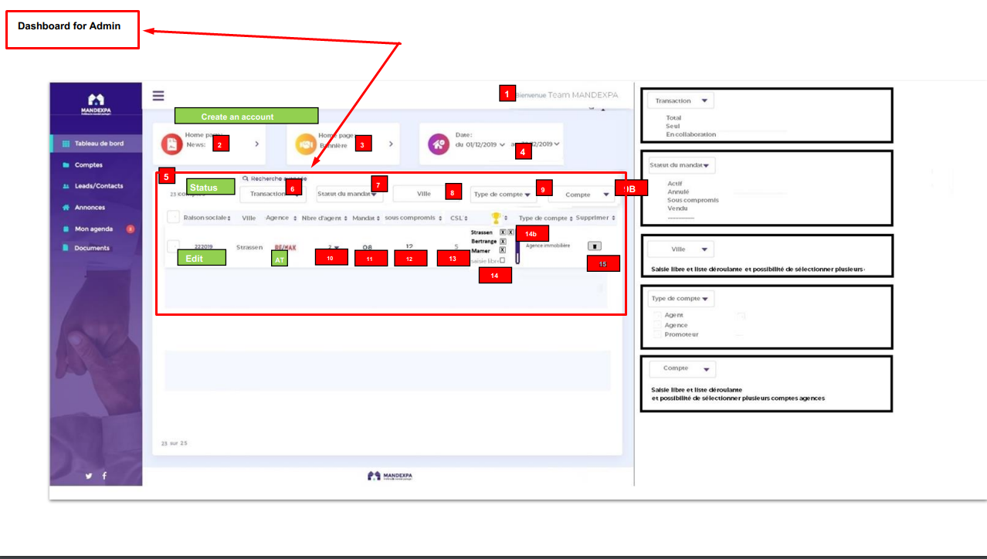

Slide 2
Dashboard Admin : display the list of main account Agency, Promoter
5 : counter for the number of accounts Agency and Promoter
6 : filter by « total collaborate », « collaborate solo » and « collaborate 2 » to display number of collaborate
7 : filter « status property » to display number of properties by status
8 : search field « main account » by City name. (select from a list existing cities (select 1 or more), or type city name)
9 : filter list by account type « Agency » , « Promoter » or « Staff »
9b : search field « existing accounts » Reason sociale. (select from a list existing Reason sociale (can select 1 or more), or type Reason sociale name)
10 : display the number of « staff account » in this main account. If more than 1 staff account, when hover this value, have a modal display the list staff account : firstname lastname
11 : display the total of properties
12 : display the total of properties with status « sous-compromis »
13 : display the total of properties where « Date lift condition » has been confirmed
14 : Depend function « Buyer Connect » on « portal »
14b – Depend function « Buyer Connect » on « portal »
15 – delete account : 1st clic open modal « are you sure » + 2nd clic « confirm delete »
6
Search bar
7
8
9
9b
In list

