Slide 1
Public transportation data software

Slide 2
hello!
We are group 9
Hyvää päivää

Slide 3
1.
This is what we’ve done

Slide 4
Project’s progress
PESTE
Stakeholders
Completed phase 1
Requirements gathering plan
Requirements

Slide 5
What is the software actually?
It’s a system that collects, analyses, and displays public transportation data of the city of Tambester
It’s used to enhance the services

Slide 6
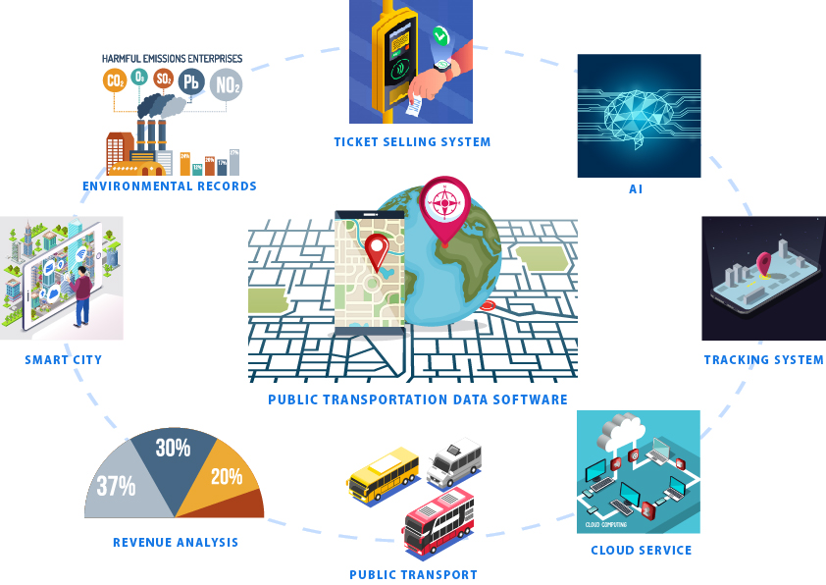

Slide 7
2.
Here is the result of PESTE analysis
PESTE consists of political, economic, social, technological, and environment

Slide 8
P
olitical
Vehicle quota
New tax policies
Changes in roads made by government
Government’s subsidies

Slide 9
E
conomic
Ticket price
Labour costs (for developers, managers, …)
Changes in fuel prices
Economic growth patterns

Slide 10
S
ocial
Lifestyles
Educational levels
Age distribution

Slide 11
T
echnological
Cybercrime
Introduction of new technologies
Database capacity
Technology level in the country

Slide 12
E
nvironmental
Power consumption of data centers
Climate change
Air pollution
Rapid development of environmentally-friendly vehicles

Slide 13
3.
Stakeholder analysis…

Slide 14
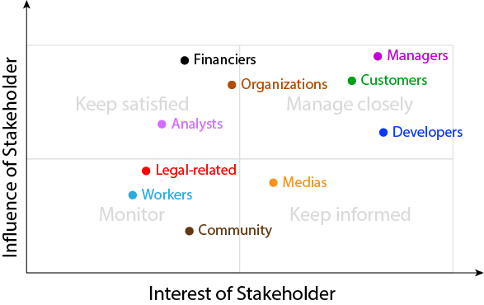

Slide 15
Stakeholder class | Stakeholder | Role | Required participation | Impact level (from product) | Areas of influence
Financiers | Banks | Sponsor | Steering group meetings, planning, requirement | Low | Goals
 | Personal investors | Financier |  | Medium | Risks, funding, goals
 | Government | Sponsor, controlling taxes |  | High | Taxes. business restrictions, goals, regulations

Slide 16
Stakeholder class | Stakeholder | Role | Required participation | Impact level (from product) | Areas of influence
Organizations | City councils | Enacting laws | Planning, requirement | High | Goals, administration
 | Con-salting Oy | UX/UI experts + consultants | Planning, requirement, design | Medium | Interface, consultancy
 | Public transportation companies | Vehicle providers | Testing, operation | Medium | Goals
 | Telecommunication companies | Connection infrastructure providers | All phases | Medium | Functionality

Slide 17
Stakeholder class | Stakeholder | Role | Required participation | Impact level (from product) | Areas of influence
Developers | Software developers | Software builders | All phases | High | Functionality
 | Network engineers | Network maintainers and administrators | Prototyping, development, operation, maintenance | Medium | Functionality
 | UX/UI designers | Graphic designer | Design, maintenance | Medium | Interface, functionality
 | Maintainers | Fixing bugs, regular maintainers | Maintenance | Medium | Usability, functionality
 | Testers | Testing functionalities | Testing | Medium | Functionality

Slide 18
Stakeholder class | Stakeholder | Role | Required participation | Impact level (from product) | Areas of influence
Analysts | Data scientists | Data analysts, trends detector, implement future predictor | Operation | Medium | Analytic, data
 | Financial analysts | Data analysts, trends detector, implement future predictor |  | Medium
Workers | Drivers | Transportation drivers, data contributors | Operation | Low | Goals
 | Human Resource Department | Recruiting and placing workers Bus maintainers, cleaners | Planning Operation | Low | Human resource
 | Bus maintenance crew | Recruiting and placing workers Bus maintainers, cleaners | Planning Operation | High | Services

Slide 19
Stakeholder class | Stakeholder | Role | Required participation | Impact level (from product) | Areas of influence
Customers | End-users | Users | Testing, operation | High | Revenue
 | Traffic bureau |  |  | High | Revenue, traffic solutions
 | Environmental bureaus |  |  | Medium | Revenue
 | Traffic planners |  |  | High | Revenue
Legal-related | Lawyers | Legal proceedings representatives, advisors | Planning | Medium | Legals, intellectual property
 | Lawmakers | Drawing up legal documents |  | Medium | Policies, legals

Slide 20
Stakeholder class | Stakeholder | Role | Required participation | Impact level (from product) | Areas of influence
Managers | Project managers | Monitoring, documenting, planning, budgeting,... the project | All phases | High | Administration, technical restrictions
 | CEO | Developing business strategies, overseeing all operations and business activities | Planning | High | Administration
 | Financial managers | Reviewing financial reports, monitoring accounts, analysing market | Planning, operation | Medium | Finance, business restrictions, administration
 | CTO | Outlining vision, implementing technical strategies, controlling technical resources | Planning, deployment | High | Administration, technical restrictions
Media | Newspapers | Public opinion controllers, spreading news | Marketing, in the end of project | Medium | Public opinion
 | Social networks

Slide 21
Stakeholder class | Stakeholder | Role | Required participation | Impact level (from product) | Areas of influence
Community | Similar products' owners | Competitors | Planning, requirement, at the beginning | High | Market, revenue, intellectual property
 | Ticket buyers (not end-user) | Data contributor | Testing, operation | Low | Data
 | Private car owners | Data contributor | Testing, operation | Low | Data

Slide 22
4.
Some preliminary requirements

Slide 23
Functional
System can collect data about routes, times, tickets, and environment
There is a simulator to approximate and show the results of new route combinations
System can update, add, and delete routes when users are using planning route function
User's interface should contain information about times and routes that are most full or delayed
System can generate reports about the usage of transportation and ticket revenue on the first day of new months

Slide 24
Non-functional
All data is public
Route information should be returned to user within 3 seconds
The simulator can run on low-setting computers, e.g. computers with Intel i3
The revenue data should be reported in total sum and in per route form

Slide 25
Restrictions
System has connection to ticket system and tracking system in the vehicles
AI can be integrated into system in the future without crashing it
System must have a separate interface for passengers

Slide 26
5.
Finally, requirements gathering plan

Slide 27
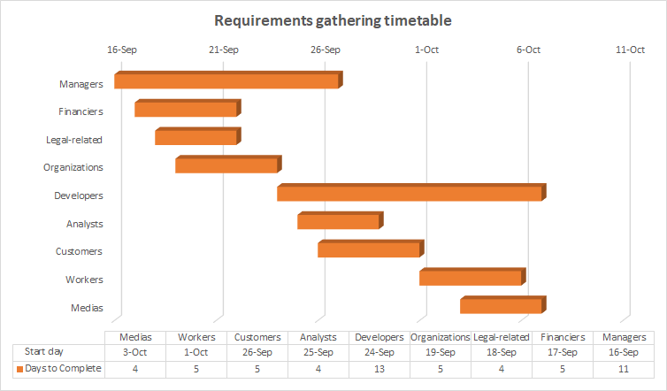

Slide 28
Stakeholder | Method | Person responsible
Managers | Brainstorming, Meetings | Manager of all company departments
Financiers | Brainstorming, Meetings | Manager and finance department
Legal-related | Meetings | Legal department
Organizations | Meetings | Administrative department
Developers | Brainstorming, Meetings, use cases, prototyping | Managers
Analysts | Facilitated sessions | Managers
Customers | Use Cases, Group interviews and Questionnaires, Prototyping | IT-department, Finance department, Business analysts
Workers | Group interviews, Questionnaires | Business analysts, IT-department
Medias | Meetings | Public relations
Managers | Brainstorming, Meetings | Manager of all company departments

Slide 30
thanks!
Any questions?

