Slide 1
Introduction to the project work
ItSE – TIE 02306

Slide 2
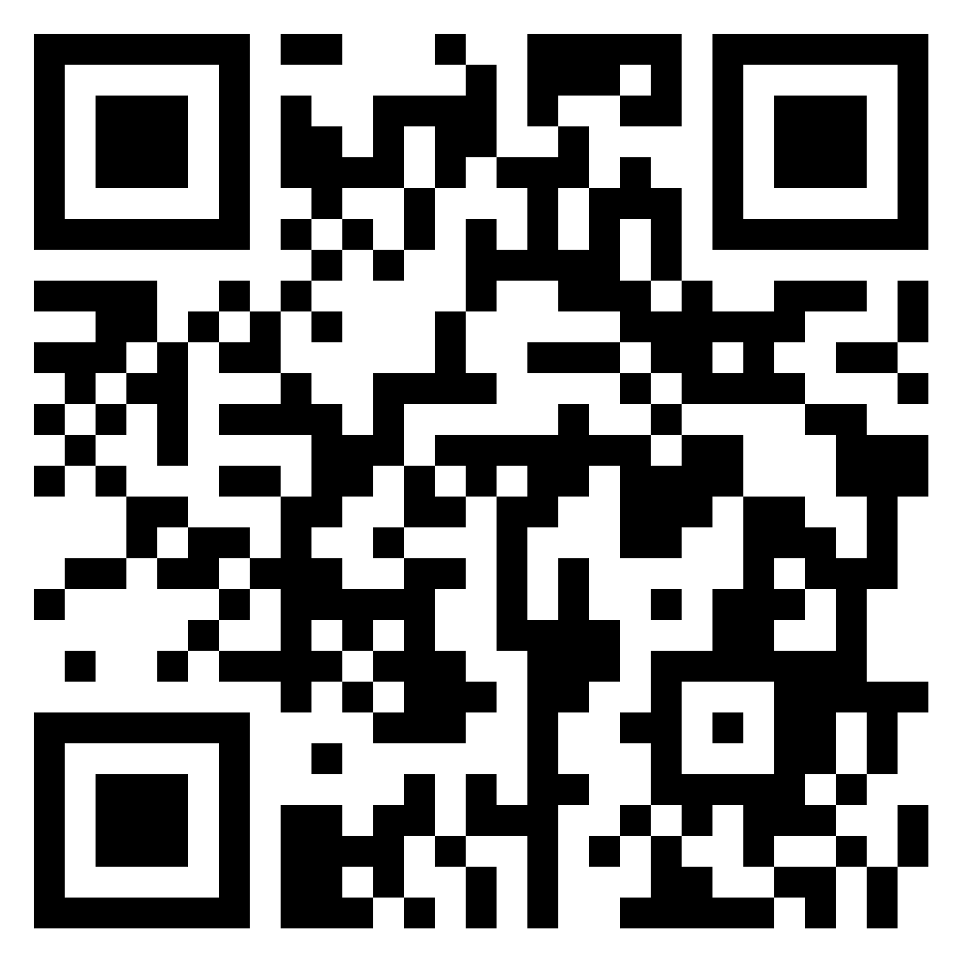
Questions?
padlet.com/tensu/zm6yflm6iizo

Slide 3
Goals
Get familiar with specifying and documenting a system and to showcase what have been learnt during the course
Practicing to work in Agile manner
Usage of UML-diagrams in specification
Working as a team, internal communication

Slide 4
Scrumban learning
Visualizing the different phases of work
Regular meetings, within group and also presenting to assistant
Iterative working
Transparent process (using Kanban to visualize work and presentations to showcase your results)
Peer feedback and self assessments

Slide 5
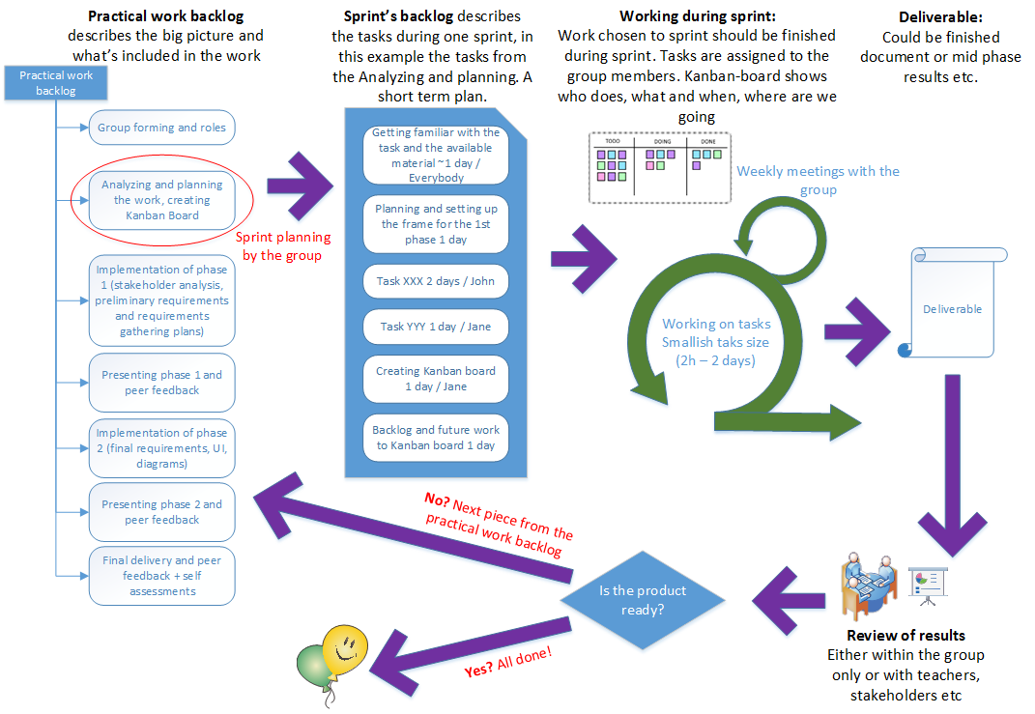

Slide 6
Process – Scrumban learning
Backlog of the practical work is given by the teachers, with deadlines
Student group is responsible for dividing the larger items in the backlog to manageable pieces to work with and assigning them withing the group to its members
Group works in sprints, and should have regular meetings to decide what to work with next
Kanban board in Trello should show the status of the tasks you are working with
Course requires specific deliverables, but group decides length of their sprints (usually 1-3 weeks/sprint).
In Scrum, the length of the sprint is constant, but the amount of tasks / work items may vary inside sprints.

Slide 7

Backlog items with deadline
9.9.2019 klo 23:59 Group forming (Moodle)
15.9.2019 klo 23:59 Trello creation (Trello)
13.10.2019 klo 23:59 Phase 1 documentation (Moodle)
13.10.2019 klo 23:59 Phase 1 presentation slides (PRP-tool)
Week 43 Phase 1 presentations (Physical realm)
3.11.2019 klo 23:59 Phase 1 peer feedback (PRP-tool)
17.11.2019 klo 23:59 Phase 2 documentation (Moodle)
17.11.2019 klo 23:59 Phase 2 presentation slides (PRP-tool)
Week 47 Phase 2 presentation (Physical realm)
1.12.2019 klo 23:59 Phase 2 peer feedback (PRP-tool)
8.12.2019 klo 23:59 Final delivery of project documentation
15.12.2019 klo 23:59 Final peer feedback and self assessments (PRP-tool)
Notes:
TODO: Add deadline dates

Slide 8
Project work
Topic: Public transportation data software for the great city of Tambester
Frame story available in Moodle
Main deliverable: Specification(ish) documentation with stakeholder analysis and requirements gathering plan
Other deliverables: Presentation slides and presentations, peer feedback and self assessments
More detailed document structure also available in Moodle. Includes the guidance for what is mandatory in each chapter or section in the document
Groups: Done in groups of 4 people
Each group is assigned an assistant

Slide 9
Support material in Moodle
Under Instructions for project work –folder:
ItSE_Frame_story.pdf
ItSE_Process_overview.pdf
ItSE_Document_structure.pdf
Under Example materials for project work –folder:
Here will be added examples of some of the table formats or diagrams that are used within the documentation
Will be updated during next week for first phase and bit later for second phase.
Notes:
Note: Lyhennä nimet ja lisää kaikkien alkuun ItSE-lyhenne
Template + erikseen doc pelkillä otsikoilla
Gantt-kaavio lisää
2 vaiheen kaaviot tulossa

Slide 10
Where to start?
Form the group, add it to Moodle. During intermission, you can chat around if there is somebody without group. In the Moodle, there is discussion board for group searching too.
When group forming deadline is over, we will add table to Moodle for groups to find out who their assistant will be.
Next, start planning and analyzing your work and create the Kanban board to Trello
Add the practical work backlog
Plan your first sprint (the analyzation and Trello part), divide tasks, assign them and finish that before the Trello deadline
INVITE YOUR ASSISTANT TO THE TRELLO BOARD!
Continue working with the project work. Plan your sprints within your group, divide the big jobs (work items) to smaller tasks, assign them within your group and of course, complete them.
Keep Trello board up to date

Slide 11
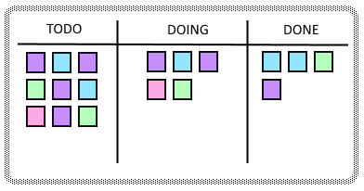
Trello & Kanban board
Weekly exercise 2 will go through some Trello usage if you are unfamiliar with it
Used to visualize your work in process, what has been done and what future work contains
Kanban board has roots as a Lean principled tool

Slide 12
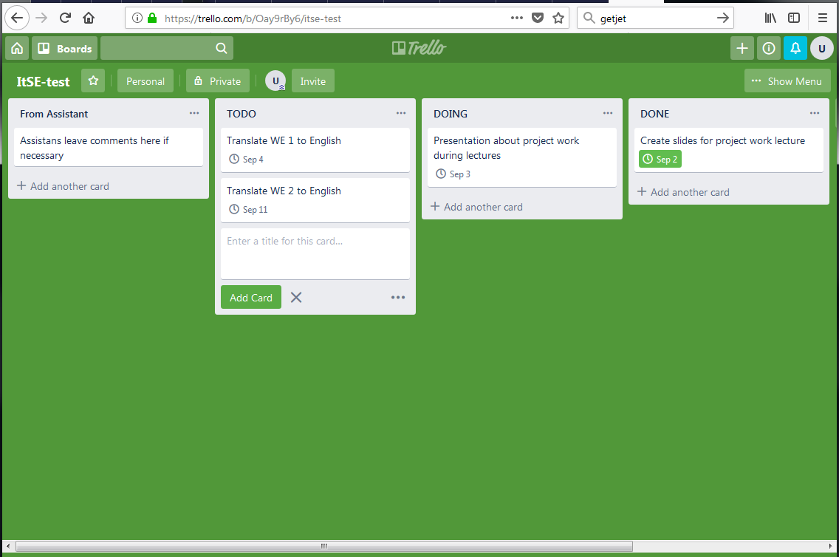

Slide 13
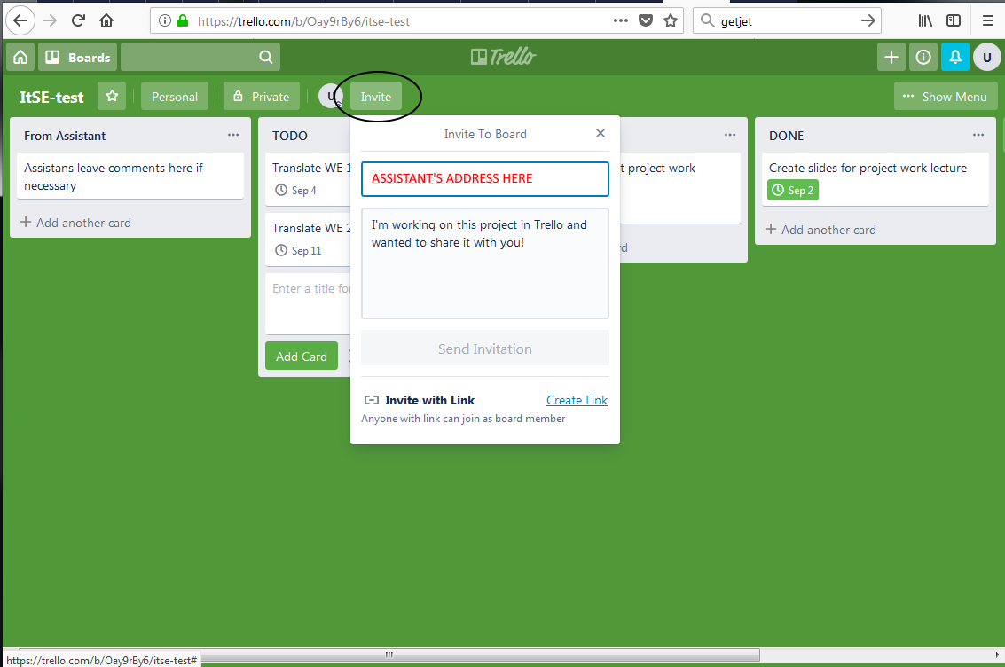
NOTE!
Invite assistant to the board. Just adding assistant to the team (other functionality) has resulted in lacking rights in the board.

Slide 14
