Slide 1
JobTrack
Job Application Tracking System — PRT681 Software Practice
Sydney campus
Group 3
Trinh Hieu Tran (S394100)
Prince Kumar Sah (S388535)
Pooja Tiwari (S396163)

Slide 2
Acknowledgements and Our Journey
CONTEXT · POOJA TIWARI
Thank you
Ahmedi Azra, unit coordinator, for guidance and feedback, and our classmates who tested JobTrack.
Background
Constraints
Challenges overcome
• Three part-time Master of IT students
• First time using parts of the stack: .NET 10, AWS S3, Playwright, Power BI
• Learned new tools while building
• About 8 weeks of development in a 12-week semester
• Around 6 hours per person per week
• Fixed technology stack and local-only deployment
• Requirements drifted from the build → BRD/SRS v2.0
• Secure file storage → S3 presigned URLs
• Test data clashes → unique data per test

Slide 3
What JobTrack Is and How It Works
ABOUT JOBTRACK · POOJA TIWARI
JobTrack is one private workspace where a job seeker records every application, tracks each status change and never misses an interview or follow-up.
1
2
3
Sign up and sign in
Add an application
Move through stages
Private account with email and a strong password
Company, role and platform; date and status set automatically
Applied → Interview → Offer, or Rejected / Withdrawn
4
5
6
Plan interviews and follow-ups
Attach documents
See what to do next
Rounds with times and contacts; reminders with due dates
The exact resume and cover letter that were sent
Dashboard: active count, interviews, overdue follow-ups
Behind the scenes
React web app → ASP.NET Core API → PostgreSQL · documents in AWS S3

Slide 4
Why Choose JobTrack?
PRODUCT OVERVIEW · POOJA TIWARI
Key strengths
Built on quality
Usability
• Private by design: each user sees only their own data
• One place for applications, interviews, follow-ups and documents
• Business rules enforced by the server
• 34 requirements traced to tests
• Manual and automated testing
• Clear, layered architecture that is easy to extend
• Only valid next steps are shown
• Confirmation before changes that cannot be undone
• Inline editing and clear error messages
• 26-page user manual with screenshots
Value for users: fewer missed follow-ups, no duplicate applications, and a clear view of progress.

Slide 5
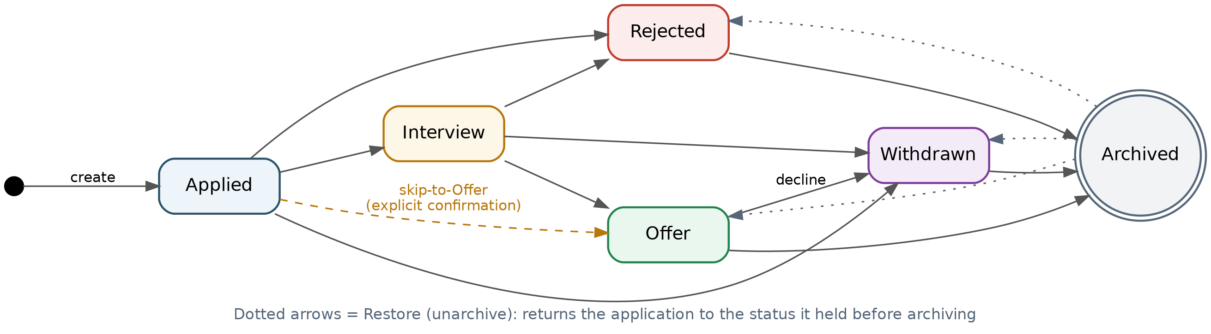
Requirements and Status Workflow
BUSINESS ANALYST · POOJA TIWARI
34
9
10
8
functional requirements
non-functional
user stories
use cases
Ten allowed moves
Skip to offer
Restore and audit
Enforced by the API; the UI shows only valid actions.
Applied → Offer only with explicit confirmation.
Unarchive returns the prior status; every change is logged.
Documented in BRD v2.0 and SRS v2.0 (as built), with every requirement traced to tests.

Slide 6
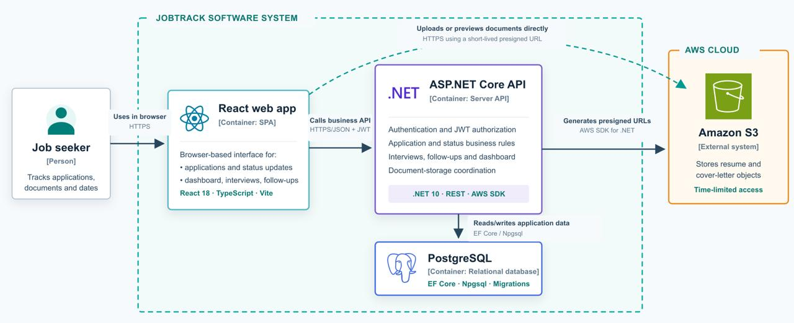
System Architecture
DEVELOPER · TRINH HIEU TRAN
Three tiers: the browser talks only to the API, except documents — the API issues short-lived presigned URLs so files go directly to and from S3.

Slide 7
Technology Stack and Security
DEVELOPER · TRINH HIEU TRAN
Technology stack
Security
Layer | Technology
Frontend | React 18, TypeScript, Vite, Tailwind CSS
Backend | ASP.NET Core on .NET 10, layered modules
Database | PostgreSQL 16, Entity Framework Core
Storage | AWS S3 with presigned URLs
API docs | Swagger / OpenAPI
Short-lived sessions
15-minute JWTs; refresh tokens rotated and revoked at logout
Hashed secrets
Passwords hashed (PBKDF2); refresh tokens stored as SHA-256
Per-user isolation
Every query scoped to the signed-in user
Server-side rules
Validation and status workflow enforced by the API; CORS restricted

Slide 8
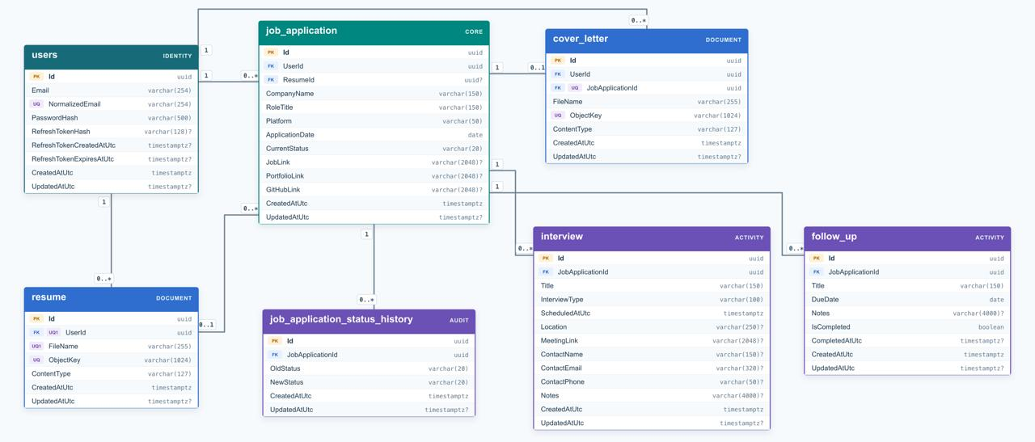
Database Design
DATABASE ADMINISTRATOR · TRINH HIEU TRAN
Seven tables: job_application is the core; users own applications and a resume library; each application has interviews, follow-ups, status history and at most one cover letter.

Slide 9
Maintainability, Improvements and Future
DEVELOPER · TRINH HIEU TRAN
Maintainability
Improvement areas
Future enhancements
• Layered backend: Api, Modules, Database, Core, Common
• Feature-based React modules in TypeScript
• 6 versioned EF Core migrations
• Swagger API docs; README setup
• 80 manual + 117 automated tests
• Add backend unit tests (xUnit)
• CI pipeline: tests on every push
• Fix DEF-01 and DEF-02
• Performance and accessibility testing
• Email follow-up reminders → never miss one
• Status history on screen → full timeline
• Outcome reports → best platforms
• Password reset → self-service
• Cloud deployment → use anywhere

Slide 10
Development Process
DEVELOPMENT PROCESSES · TRINH HIEU TRAN
207
3
12
8 wks
commits
contributors
merges
Aug 4 – Sep 29
Commit format
feat(dashboard): implement api for dashboard fix(auth): disable retry on use register hook
Agile / Scrum
Task management
Tracking
• Weekly sprints
• Sprint reviews in team meetings
• Adapted plans as the build evolved
• Backlog groomed weekly
• Prioritised with MoSCoW
• Tasks allocated by role
• Task names match commit scopes
• Meeting minutes every week
• Individual and group timesheets
• Evidence linked in GitHub

Slide 11
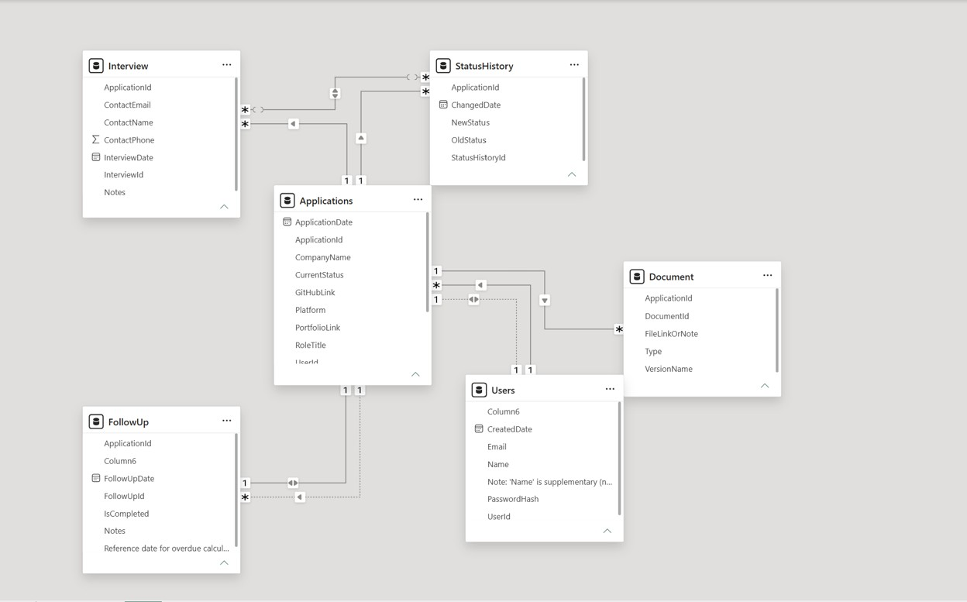
Sample Dataset and Power BI Model
DATA ANALYST · POOJA TIWARI
5
100
129
166
63
42
users
applications
status changes
documents
interviews
follow-ups
Power BI model: table relationships
Insight: referrals convert best — 62% reached interview and 19% an offer, vs 39% and 4% for company websites.

Slide 12
Status Transition and Traceability Matrices
QA · POOJA TIWARI
From ↓ To →
Applied
Interview
Offer
Rejected
Withdrawn
Archived
34 / 34
Applied
—
✓
Confirm
✓
✓
✗
requirements traced to test cases
Interview
✗
—
✓
✓
✓
✗
Offer
✗
✗
—
✗
✓
✓
✓ allowed (10)
Rejected
✗
✗
✗
—
✗
✓
✗ blocked (20)
Withdrawn
✗
✗
✗
✗
—
✓
Confirm: skip-to-offer
Archived
✗
✗
✗
✗
✗
—

Slide 13
Automated Testing and Defects Found
QA AUTOMATION · POOJA TIWARI
117
77
40
116 / 117
automated tests
API tests
browser UI tests
passed (verification run)
Playwright · Page Object Model · HTML and JUnit reports · techniques: equivalence partitioning, boundary values, state transitions, negative and access-control tests
ID | Severity | Defect | Found by
DEF-01 | Medium | Clearing a saved link fails: the API rejects the empty value the detail page sends. | API-JA-10
DEF-02 | Low | Date-range error message never shows: the browser’s own date check runs first. | UI-SF-07
Next: fix both defects, then re-run the full suite.

Slide 14
TESTER · PRINCE KUMAR SAH
Manual Testing Strategy
80
manual test cases
100%
passed
Positive + Negative
coverage
What I tested
Authentication and account validation
Application creation, editing, archiving and restoring
Search and filtering behaviour
Status tracking and transition rules
Document tracking and reusable versions
Interviews, follow-ups and dashboard behaviour
Testing approach
Used defined test scenarios with preconditions and test data
Compared actual behaviour against expected results
Covered positive, negative, security and workflow cases
Recorded status, actual result, evidence and defect notes
Goal: verify that implemented features satisfy expected user behavior before final demonstration.

Slide 15
TESTER · PRINCE KUMAR SAH
Testing Results and Evidence
Key Testing Findings
Duplicate application data could cause locator conflicts
Broad UI locators could match multiple elements
Status workflow rules were verified
Invalid status transitions were correctly blocked
Duplicate document filenames were rejected by the system
Automation was updated with unique test data and specific locators
Test Evidence
Manual test results and screenshots
Playwright screenshots on failures
Playwright video recordings
Trace files for debugging
HTML test reports
Retesting after fixes
TEST EVIDENCE • Screenshots • Test videos • Playwright traces • HTML reports

Slide 16
Team Collaboration and the Mythical Man-Month
DEVELOPMENT PROCESSES · PRINCE KUMAR SAH
Brooks’s law: adding people to a late software project makes it later.
Clear ownership
Collaboration
Adaptive practices
• Hieu: Developer and DBA
• Pooja: BA, Report and Data Analyst, QA
• Prince: Tester
• Small team, no late handovers
• Weekly meetings with action items
• BRD/SRS as single source of truth
• Shared GitHub repository
• Updated requirements to v2.0 as the build changed
• Unique test data and specific locators after test clashes

Slide 17
Summary
CONCLUSION · PRINCE KUMAR SAH
One private workspace
Secure and maintainable
Applications, interviews, follow-ups and documents together
Layered architecture, server-side rules, hashed passwords
Tested and traceable
Built as a team
34 requirements traced · 80 manual · 117 automated tests
Agile sprints, clear roles, 207 commits
JobTrack is ready for continued development — and so is our team.
Thank you — questions?

Slide 18
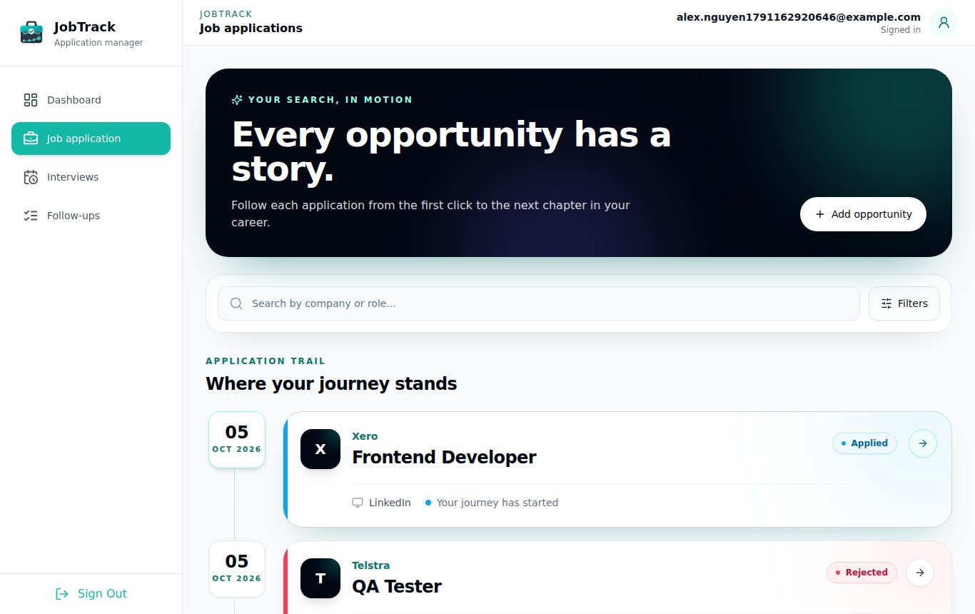
Live Demo
DEMO · TRINH HIEU TRAN
One application, start to finish
1
Register and sign in
2
Add an application
3
Move it to Interview; add an interview round
4
Add a follow-up
5
Check the dashboard updates
6
Record an offer, archive, restore

