Slide 1
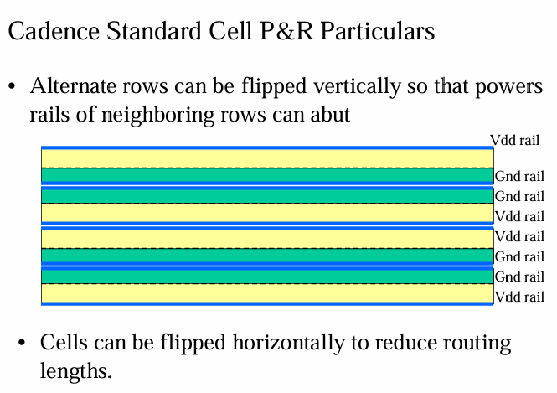
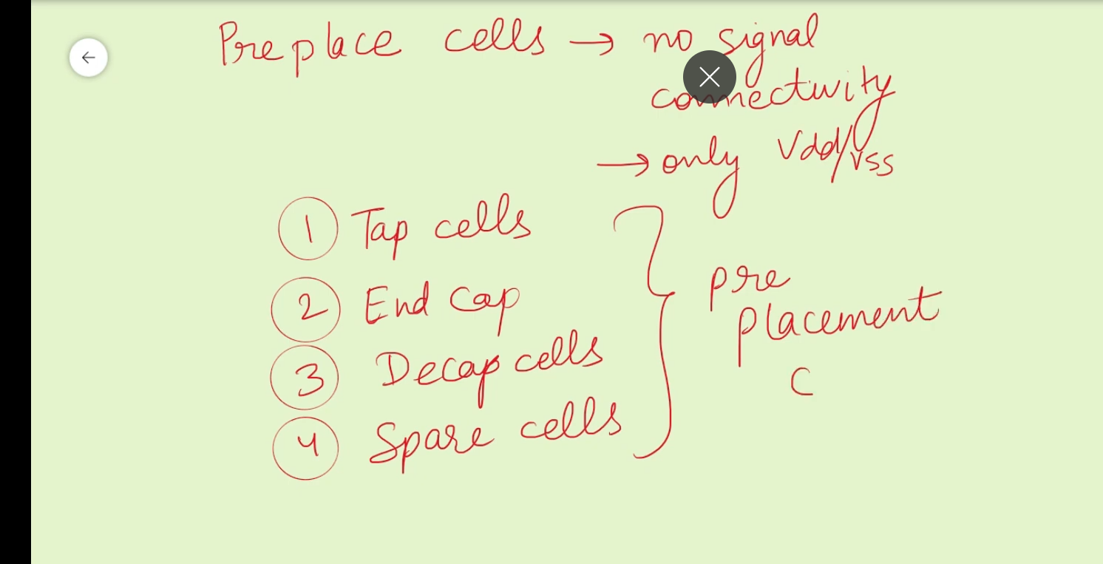

Slide 2
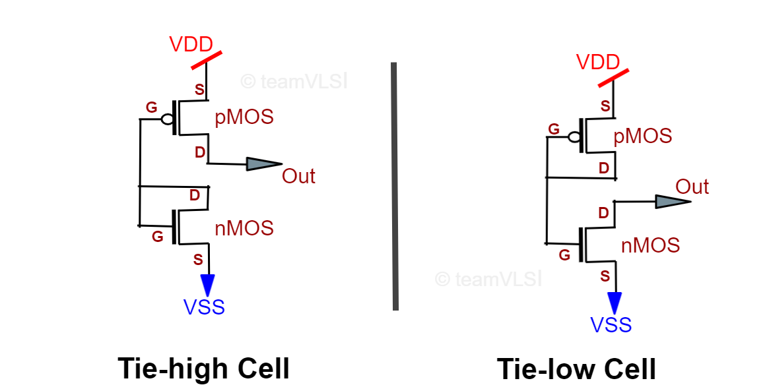
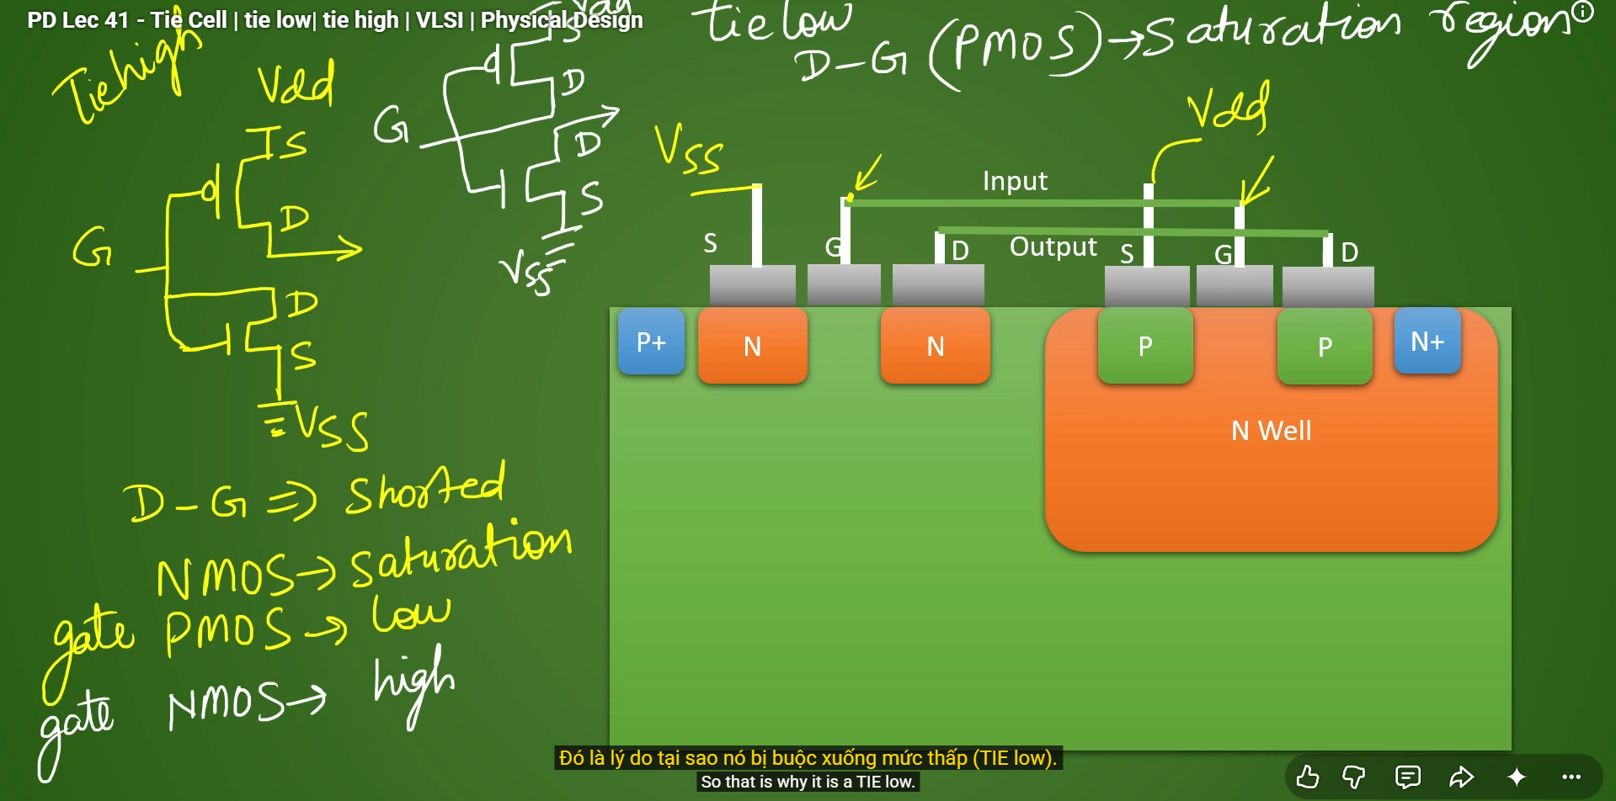
NMOS: Gate = 1 → thường bật khi \(V_{GS}>V_{TH}\).
PMOS: Gate = 0 → thường bật khi \(V_{SG}>|V_{TH}|\).

Slide 3
Terminates rows and protects row boundaries
Connects unused inputs to VDD or VSS safely
Connects substrate and n-well to VSS/VDD to prevent latch-up
Near cells requiring tie-high/tie-low
Beginning and end of each row
Regularly spaced across standard-cell rows
Floorplan: insert endcaps, taps, and power switches.
Placement: insert tap and decap cells according to foundry spacing rules.
Post-placement optimization: insert fillers, tie cells, and antenna diodes.
Routing/ECO: use spare or ECO cells for late functional fixes.

Slide 4
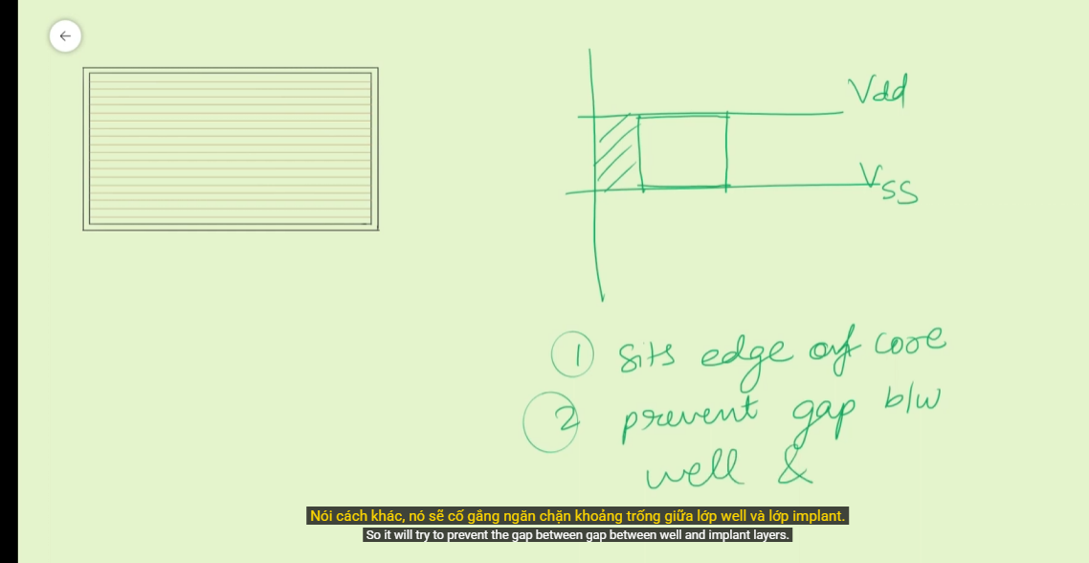
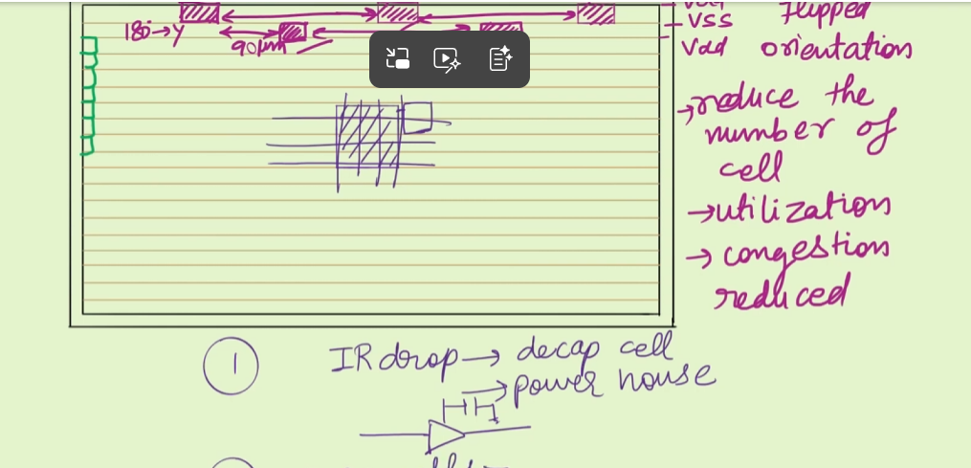
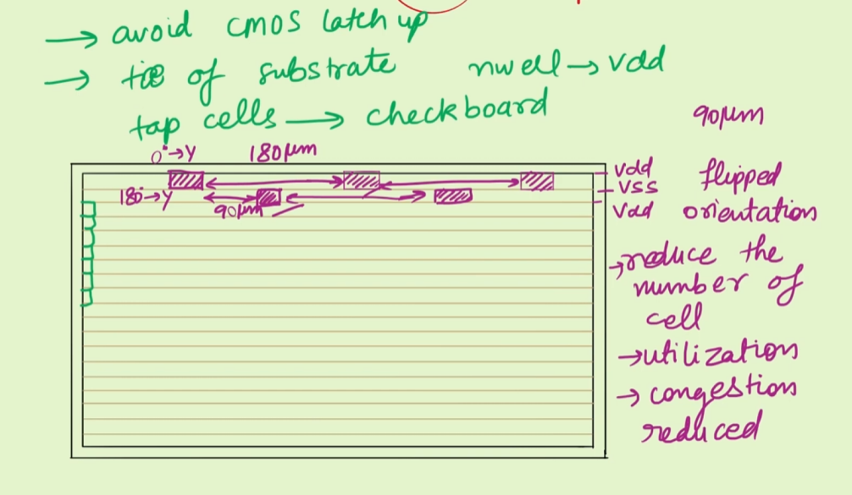
90 µm trong hình là độ lệch theo phương ngang giữa hai mẫu đặt tap;
Ô đảo ngược
Cách đặt tap cell -> kiểu bàn cờ, đặt theo chu kỳ from foudry

Slide 5

A decap cell, short for decoupling capacitor cell, provides local capacitance between VDD and VSS to help stabilize the power supply.

