Slide 1
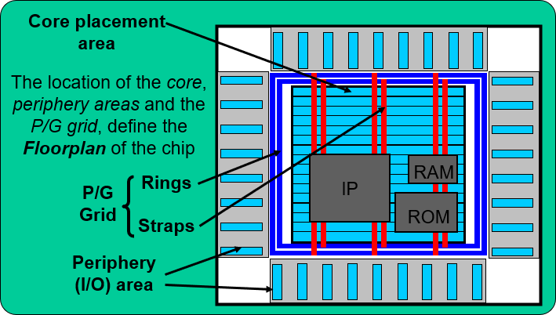
What Is Floorplanning?
Definition
Floorplanning is the process of deriving the die size, allocating space for soft blocks, planning power, and macro placement.
With a top-level netlist, you can start to floorplan the chip.
Define Die Size. Place the IOs.
Perform macro placement. Perform power planning. Power domain definition Flip-chip bump placement

Slide 2
Intro Floor
Floor Macro PAD
Floorplanning
Floorplanning consists of defining the Core Placement area, the Periphery area and the Power/Ground grid.
The Core Placement area consists of Placement Rows where standard cells and macro cells are placed.
A placement row consists of a row of “unit tile” cells (part of the standard cell library, width defined by the minimum metal pitch). Standard cells are placed in the core of a chip and occupy specific tile(s) within the placement rows. A standard cell may occupy a single or multiple tiles.
The pad cells (input, output, bi-dir, power and ground pads) are placed in the Periphery Area, which is defined by the area around the outside boundary of the core, usually separated by a “core-to-pad” spacing distance.
ASIC Physical Design

Slide 3
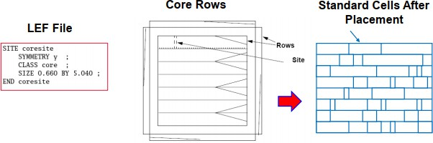
Intro Floor
Floor Macro PAD
What Are Sites and Rows?
A site is the minimum unit of placement. It represents a slot where a cell can be placed. Rows are multiples of sites and define locations where the placement tool places cells.
Placement tools place cells in locations defined by the cell’s description in the LEF file. If a cell is of type CORE, then it can only be placed in a CORE rows. If a cell is of type IO, it can only be placed in IO rows
ASIC Physical Design

Slide 4
Intro Floor
Floor Macro PAD
Core and IO Region
From:
A gate level netlist Relevant physical libraries
Default or user specified aspect ratio and utilization.
Calculate the area of all macro cells and leaf cells Generate bounding shapes and cell placement rows Place IO PADs
Signal pads
Filler and corner pads Bump or flip-chip IO pads
_{Utilization =} (Total Std Cell+Macro Cell Area) _{* 100%}
(1)
Core Area
ASIC Physical Design

Slide 5
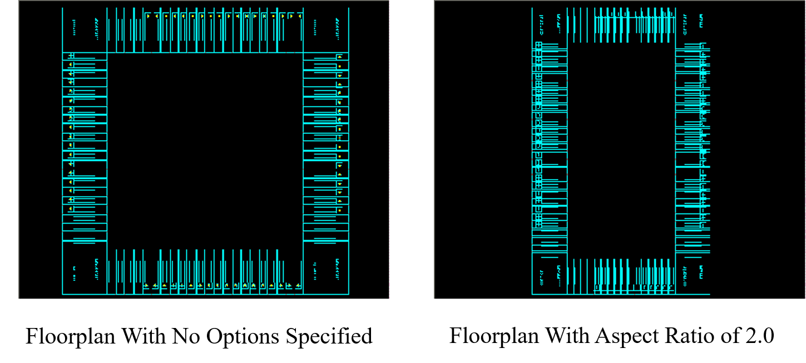
Aspect Ratio: A Factor in Determining Core Size
Intro Floor Floor Macro PAD
Aspect ratio is the ratio between vertical routing resources to horizontal routing resources.
If you specify a ratio of 1.00, the height and width are the same and therefore the core is a square.
If you specify a ratio of 2.00, the height is two times the width.
ASIC Physical Design

Slide 6
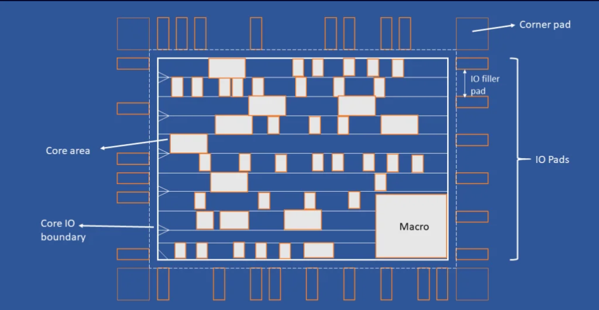

Slide 7
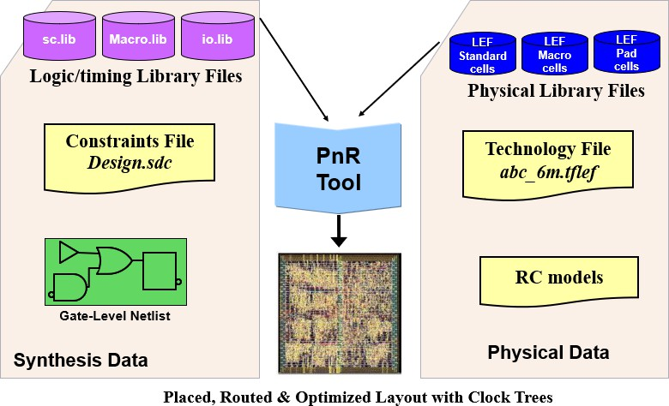
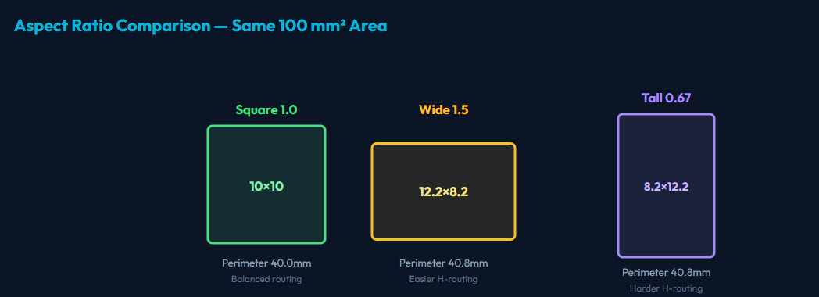

Slide 8
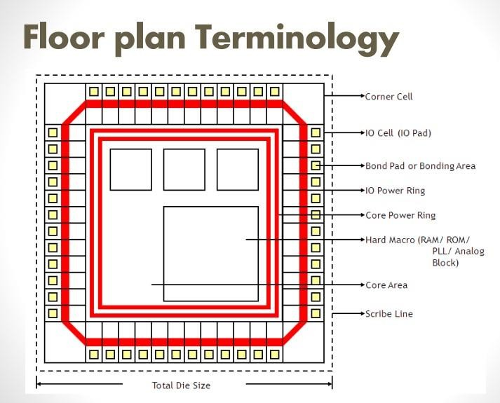

Slide 9
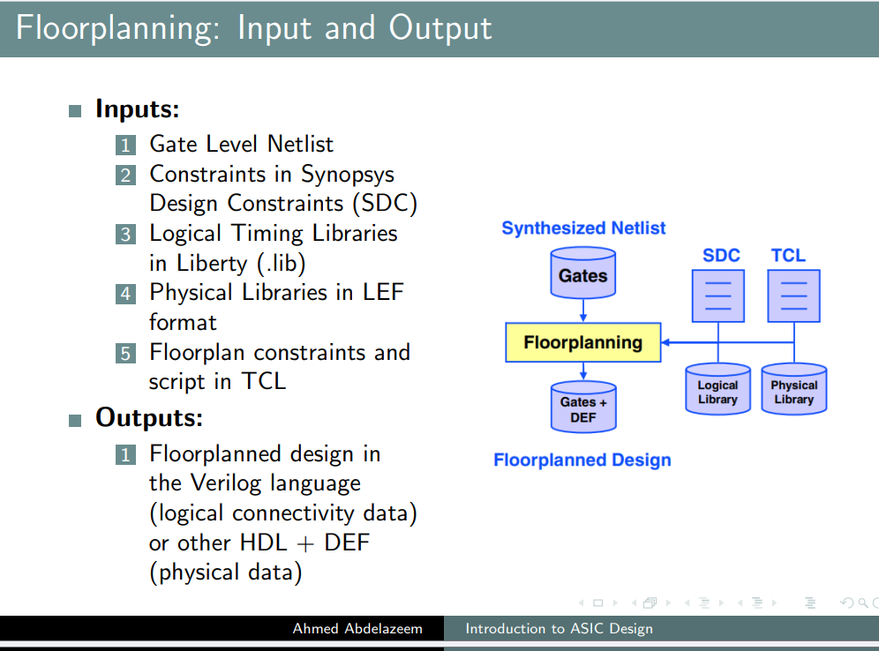
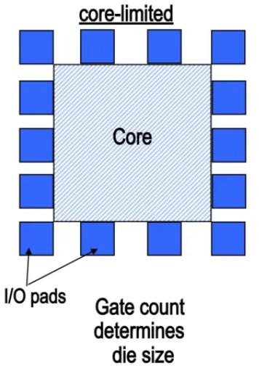
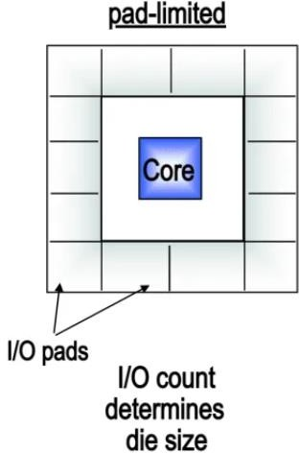

Slide 10
Die area
Terminals (ports implementation )
Core area
Core

Slide 11


Floorplanning: Area Utilization
Utilization refers to the percentage of core area that is taken up by standard cells
High Utilization can make it difficult to close routing!
It will make it also difficult to change the design in the future..
∑cellArea
Utilization =
CoreArea
Low standard-cell
utilization
High standard-cell utilization

Slide 12
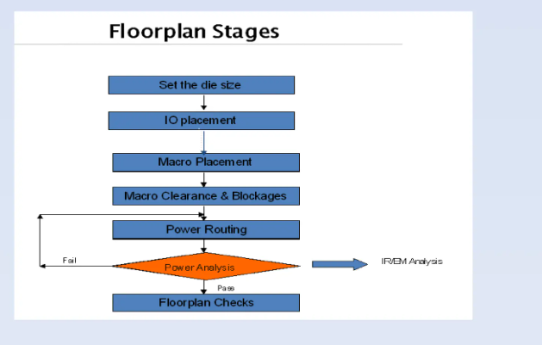

Slide 13
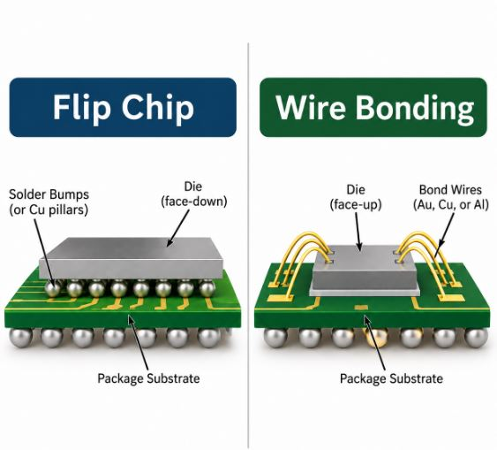
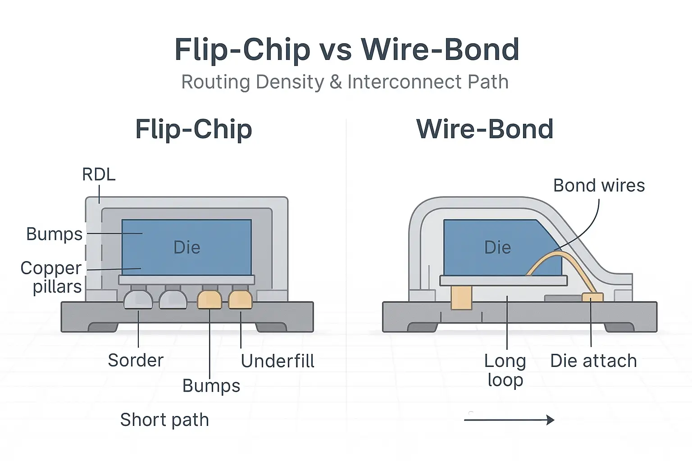
Notes:
Wire Bonding vs Flip Chip: Key Differences Explained [2026]

Slide 14
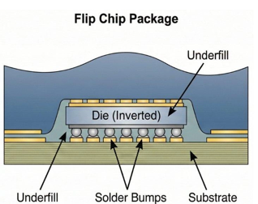
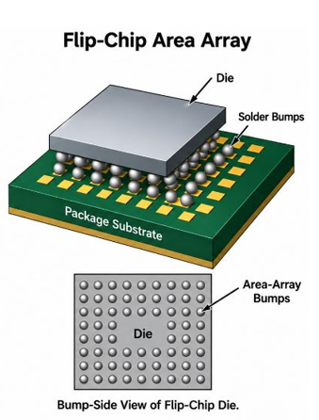

Slide 15
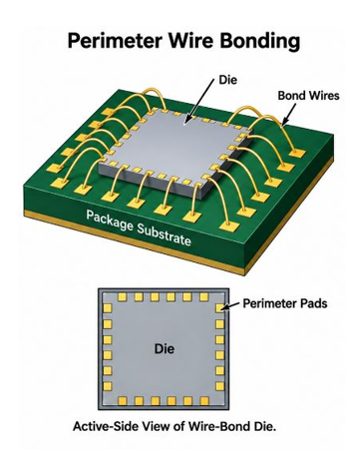
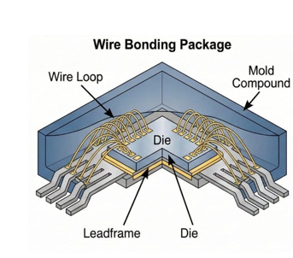

Slide 16
Factor | Flip Chip | Wire Bonding
Die Orientation | Active side normally faces the substrate | Active side normally faces upward
Pad Layout | Can use an area array through redistribution and bump structures | Commonly uses perimeter bond pads
Interconnect Structure | Solder bumps, copper pillars, or related structures | Fine gold, copper, aluminum, or other bond wires
Connection Length | Short vertical or near-vertical connections | Longer looped connections
Parasitics | Short bumps can reduce local resistance and inductance | Wire length and loop geometry contribute additional resistance and inductance
I/O Scaling | Area-array connections can support large I/O counts | Scaling is constrained by pad pitch, die perimeter, and wire routing
Assembly Method | Bumping or pillar formation, die alignment, bonding/reflow, optional underfill | Die attach followed by sequential wire bonding and encapsulation
Inspection Access | Joints become hidden beneath the die after assembly | Bonds can normally be viewed before encapsulation
Rework | Die-level rework becomes difficult, especially after underfill | Bond-wire repair may be possible during manufacturing before encapsulation
Main Cost Drivers | Wafer bumping, UBM/RDL, substrate complexity, alignment, bonding, underfill, inspection, yield | Bond count, bonding cycle time, wire material, equipment utilization, package design, yield

Slide 18
While Wire Bonding relies on peripheral connections using fine metal wires (Gold, Copper, or Aluminum), Flip Chip technology involves "flipping" the die face-down to connect directly to the substrate via conductive "bumps" distributed across the entire surface of the chip.

Slide 19
Feature | Wire Bonding | Flip Chip
Interconnect Method | Loops of fine wire (Au, Cu, Al) | Solder bumps or copper pillars
Connection Type | Peripheral (usually around the edges) | Area Array (entire die surface)
I/O Density | Limited (lower pin count) | High (maximum I/O per unit area)
Signal Integrity | Higher inductance (due to wire length) | Low inductance (short path)
Thermal Performance | Moderate (relies on substrate) | Excellent (direct thermal path)
Footprint Size | Larger (requires space for loops) | Minimal (package-scale or near-die size)
Process Maturity | Very High (Standard for decades) | High (Standard for HPC & Mobile)
Repairability | Possible (wires can be replaced) | Difficult to Impossible (underfilled)

Slide 20
Application Tier | Preferred Technology | Cost Logic
Low-End/Discrete | Wire Bonding | Low I/O count makes leadframe-based wire bonding unbeatable in price.
Mid-Range IoT/MCU | Wire Bonding | Mature infrastructure and high yield rates keep total cost of ownership (TCO) low.
High-Performance (SoC/GPU) | Flip Chip | Although the unit cost is higher, the performance gains (speed/thermal) justify the premium.

