Slide 2
Action item
1.1 RTL to GDSII flow
1.2 PPA
1.3 Input file PnR : .gdc & .upf
1.4 DEF : input and output each stages
1.5 liberty contain
1.6 Different between LEF and DEF

Slide 3
Architecture Specification
RTL Coding & Integration
RTL Design
RTL Verification
RTL Verification
DFT, Synthesis
Backend Integration (AC)
Design Services
Physical Implementation
Post-layout Verification
Physical Design (PI)
Physical Verification and Sign-off
Tape-out
Mask Tooling
Fabrication
Production Services
Package & Test

Slide 4
Init design
Floorplan
Place Opt
Clock Concurrent optimization Technology (CCOPT)
PnR flow
Post -CTS
Routing
Post Route

Slide 5
Target
Define die/core area, utilization, I/O and macro locations, blockages, and pin placement
Init design

Slide 6
Target
Define die/core area, utilization, I/O and macro locations, blockages, and pin placement
Floorplan
Key outputs
Input:
Netlist (from Synthesis)
Technology LEF files
Design Constraints (SDC)
Macro LEF / Lib files
PDK & Design Rules
Floorplan DEF with macros, IOs, rows, and blockages

Slide 7
Target
Timing, power & area optimization
Routable design
Low cell & pin density
Minimal congestion
Place Opt
Inputs
Netlist
Floorplan DEF
Logical & physical libraries
Design constraints
Technology file
Key output
Placed DEF, congestion and timing reports

Slide 8
Clock Concurrent optimization Technology (CCOPT)

Slide 9
Target
Post -CTS
Recover timing after clock-tree insertion changes delays
Key outputs
Optimized post-CTS netlist and timing reports

Slide 10
Target
Physically connect all signal nets using available metal layers without shorts or opens
Routing
Inputs:
CTS DEF, LEF, Technology/RC data, LIB
Key outputs
Global and detailed routed DEF

Slide 11
Target
Close timing using real parasitics; fix hold, setup, crosstalk, and DRC issues
Post Route
Key outputs
Optimized routed design and timing reports

Slide 12
Netlist (.v)
LEF
Liberty (.lib)
Init design
SDC
Other files

Slide 13
Performance
Power
Area
Performance → timing
Power → congestion: when the number of routing tracks available for routing in a given location is less than the number necessary . The area is considered congested
Area → density

Slide 14
Supply set definition
Power domain
Unified Power Format
(.upf)
Power switch
Retention cell
Level shifter cell
and other low power

Slide 15
It contains Logical connectivity Of all Cells
Netlist
It contains List of nets Connecting
Each cell has its own instance/cell name and library/ref name

Slide 16
It contains physical information of standard cells, macros, pad
Contain the name of the pin, pin location (Co-ordinates) , pin layers, direction of pin (in,out, inout), uses of pin (Signal, Power, Ground) , height and width of the pin and cell.
Tech LEF or Header LEF
Size of the cell (Height and width)
Symmetry of cell.
PHYSICAL LIBRARY

Slide 17
Contain manufacturing grid and site/unit tiles
Contain name, number convention of layer and via
Physical, electrical of layer and via
Physical design rule
Technology file

Slide 18
HEADER LEF
MACRO LEF

Slide 19
LOGIC LIBRARIES
Physical Libraries
Timing / power / functionality
Timing : setup /hold / input delay
Power : internal power and leadkage power
Cell functionality : and / or/ not / xor
PVT condition
Technology LEF and Marco LEF
Tech LEF : physical info of metal layer and vias
IO cell : physical info of all input and output cells
DEF
Exact location information / height / width / rows / tracks

Slide 20
Design Import
CTS + Post CTS setup Fixing
Create and load Floorplan
Flase
Post CTS Hold Fixing
Timing Mode
Timing met
Scan Definition
True
Cell placement + Pre CTS opt
Routing
Add Fillers
Flase
Physical Verification
Timing met
Flase
Post Route opt
True
Timing met
Timing met
True

Slide 21
RTL Design
Fsm optimization, Efficient coding
Synthesis
Gate level optimization
Physical design
Floorplanning , placement , CTS, Routing optimization
STA & Signoff
Timing closure , slack analysic
Post- silicon Validation
Voltage scaling

Slide 22
+ Timing data (propagation delay, setup/hold, transition times)
+ Power data (internal power, leakage)
Cell Characterization Data
Liberty(.lib)
Functional Descriptions
Operating Conditions
voltage, temperature, process corner

Slide 23
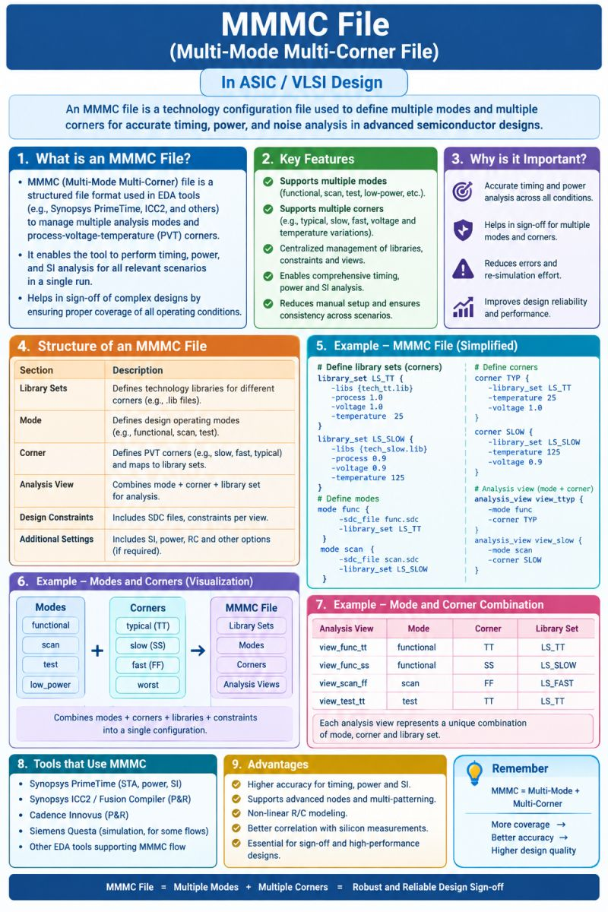
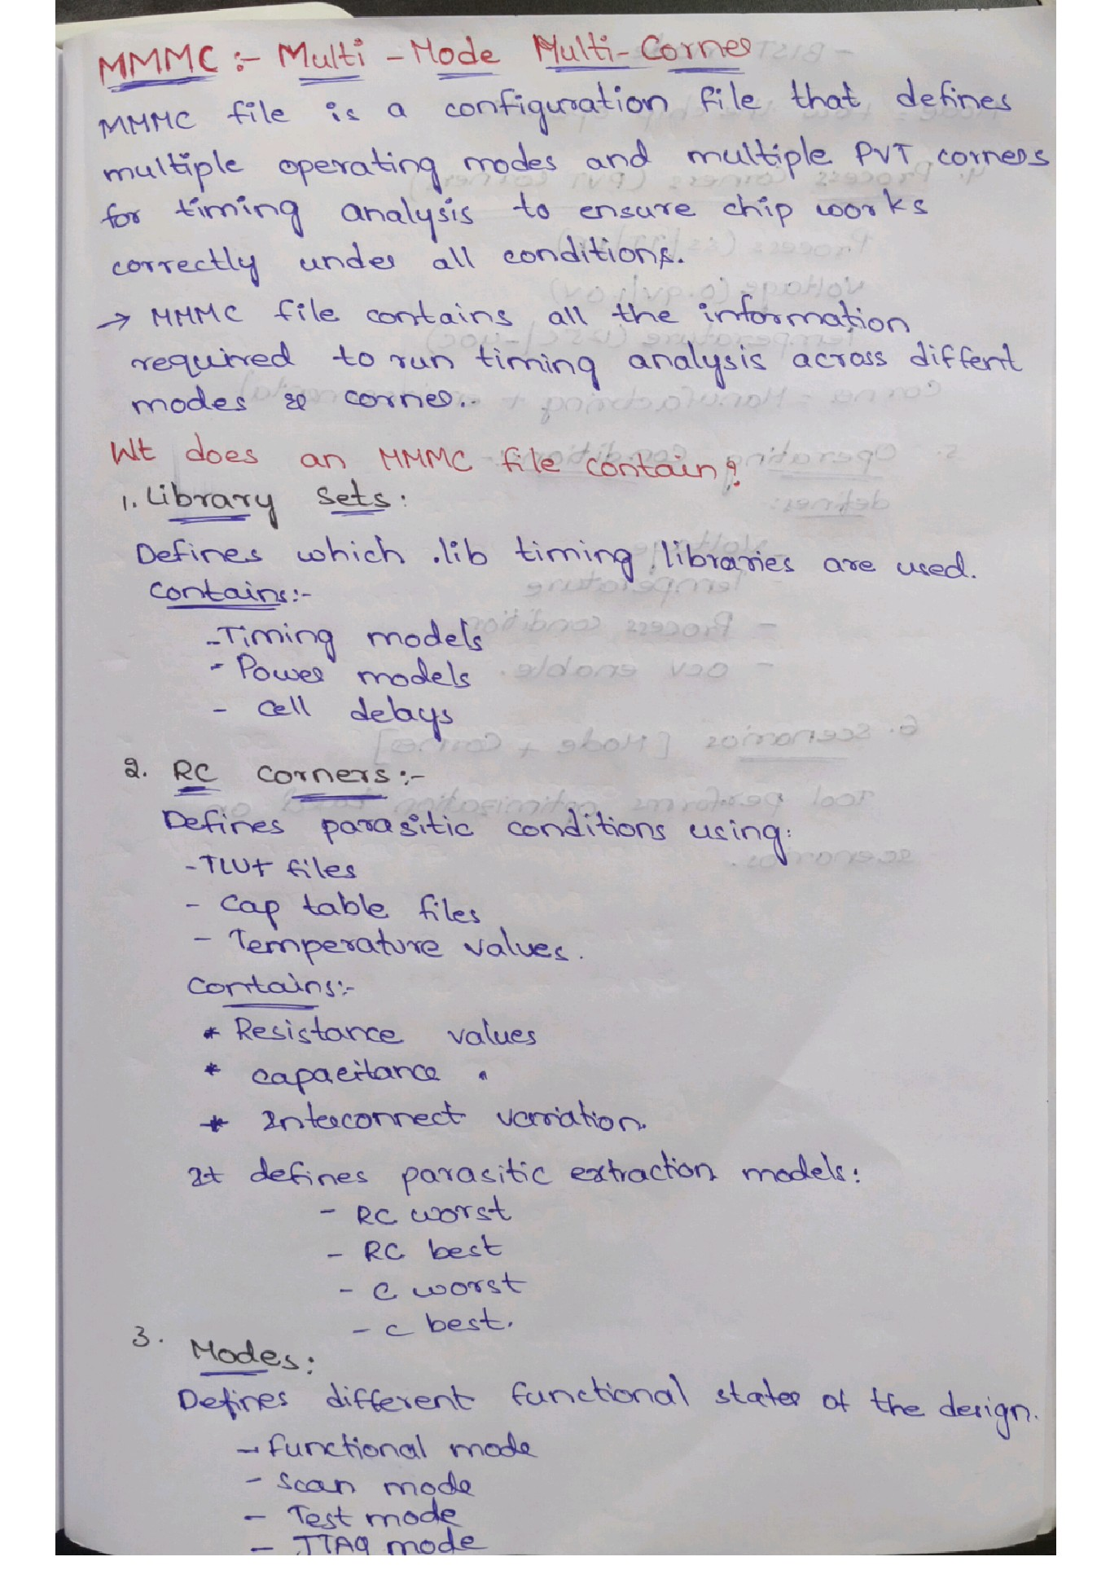

Slide 24
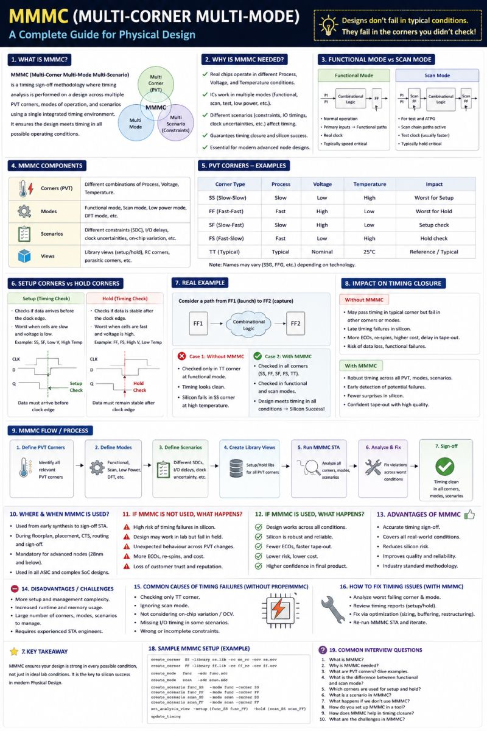
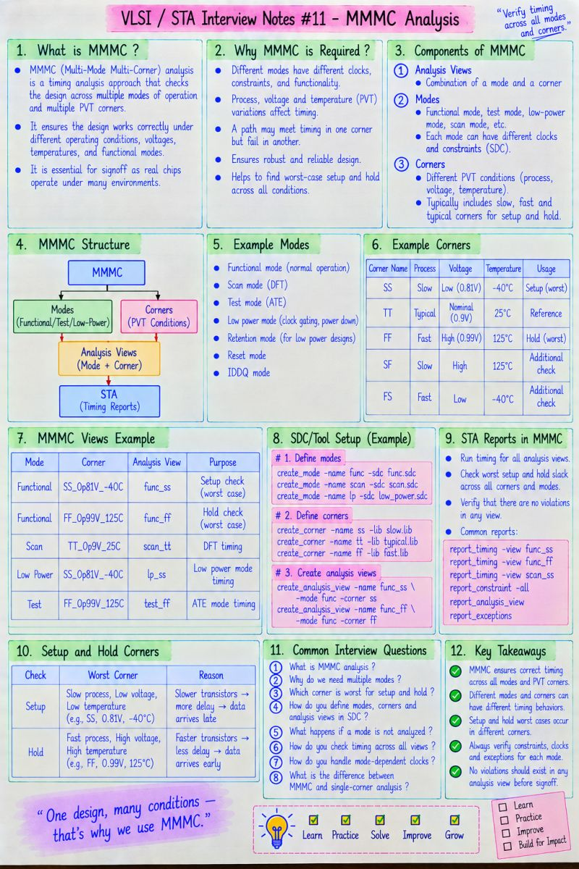

Slide 25
Cap table / QRC Tech file
RC Corner
Net delay
delay corner
affect
+
analysis_view
=
Library set
Cell delay
+
Timing (.lib)
Source :File .lib (Liberty)
Constraint mode
SDC
Functional, Scan, Sleep, Test…) ↔file SDC tương ứng.

Slide 26
the factors that determine Cell Delay :
Input transition time
Output load (capacitance)
PVT condition in which the library is characterized (SS, FF, TT, voltage, temperature…)
Cell delay
RC Corner → Net Delay
Net Delay (interconnect delay) is calculated from the parasitic R and C of the wire.
RC Corner specifies the parasitic parameter set:
  Cmax / Cmin
  RCmax / Rcmin
  Typical
  Temperature (affects the resistivity of the metal)
RC Corner

Slide 27
Netlist + LEF+ DEF+SDC
Init design
DEF
Floorplan
Placement
Post -CTS
Routing
Post Route
Updated DEF

Slide 28
Init design
Marcos,pin location, Core boundary and area
Floorplan
Place Opt
Std cells placed, plus new buffers/cells from pre-CTS optimization (resizing, buffering).
New clock buffers/inverters/ICGs, clock nets split into sub-nets, cells resized/moved.
Clock Concurrent optimization Technology (CCOPT)
Post -CTS
Hold buffers, sizing/moves from optDesign -postCTS.
Routing
Post Route

Slide 29
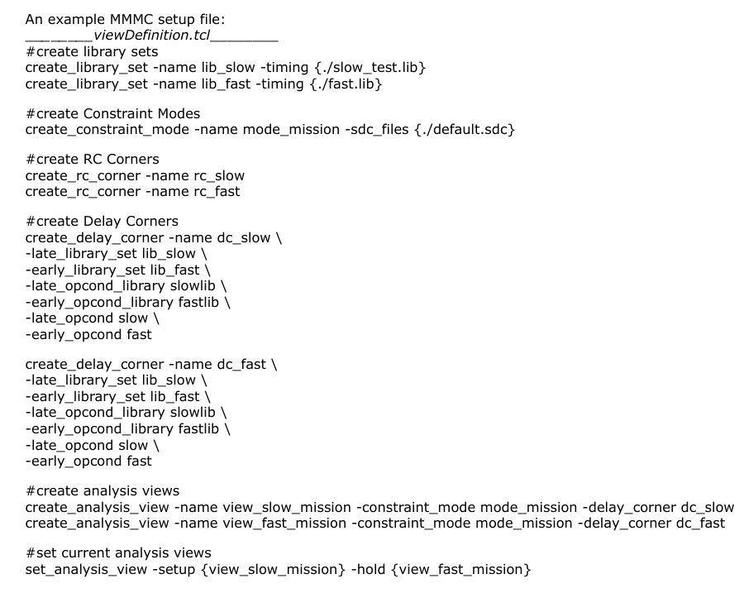

Slide 30
