Slide 2
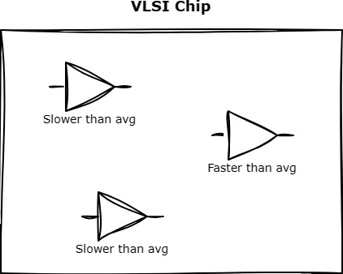
Introduction
On-Chip Variation refers to the variation in performance parameters (such as delay, power consumption, etc.) among different instances of the same integrated circuit design due to manufacturing process variations, environmental conditions, and other factors.
Gates with the same size and function can have different delays

Slide 3
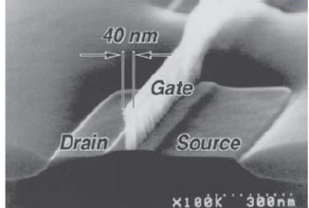
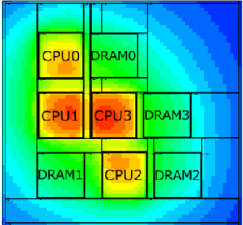
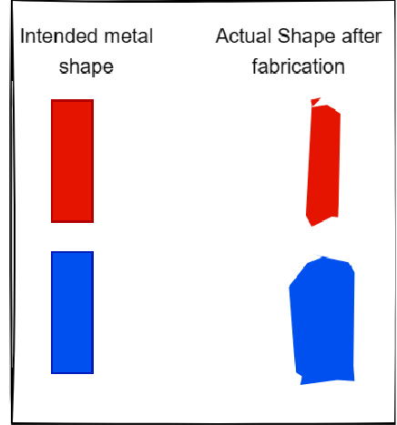
Sources of OCV
Process Variations: Variations in the manufacturing process can lead to differences in transistor characteristics (such as threshold voltage, oxide thickness, doping concentration, etc.)
Temperature Variations: Temperature fluctuations across the chip during operation can cause variations in transistor behaviour and interconnect delays.
MOSFET under microscope [1]
Temperature variations on chip [2]
Supply Voltage Variations: Fluctuations in the supply voltage, due to factors like power supply noise or voltage drop, can affect the performance of transistors and circuits.
Interconnect Variations: Variations in interconnect resistance, capacitance, and parasitic effects can lead to differences in signal propagation delay and power consumption
Variations in interconnect

Slide 4
On Chip Variation (OCV) vs Process Voltage Temperature (PVT)
PVT discusses global variation affecting the entire chip including all instances (Die to die variations)
OCV discusses the variations that happen within the same chip
This document will discuss OCV only
 | PVT | OCV
Process | Systematic and large variations such as doping, oxide thickness, etc can affect entire parts of a wafer resulting in all instance within the chip to be faster or slower than average | Non systematic and smaller variations that affect some instance within a chip while not affecting others
Voltage | Difference in the supply voltage provided to the entire chip For example, a chip can have two operating voltages 3V for high performance mode and 2V for low power mode | Variations between different cells due to different power grid resistances or hotspots with high cell density For example, for a supply 3V, a cell gets 2.9V while another one near it gets 2.85V
Temperature | Ambient temperature where the chip will be operated For example, the chip is being used in summer vs winter or in a cooled server room ( −40℃) vs hot car engine (120℃) | Temperature variations withing the same chip due to parts of the chip consuming more power than others or hotspots with high cell density. For example, the CPU within a chip has a temp of 125℃ while the rest of the chip has a temp of 100℃
Interconnect | Large variations affecting characteristics of all the wires on the chip For example, chemical variations resulting in all wires within a chip to have higher resistivity than average | Smaller variations between the wires within the same chip For example, due to random variations in etching, a wire was etched more than a wire near it resulting in a narrower wire with more resistance

Slide 5
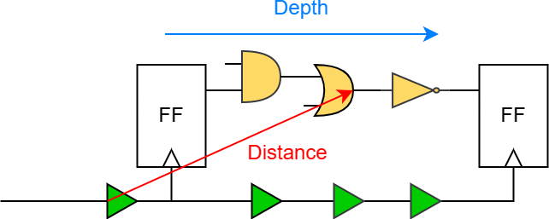
Advanced On-chip Variation (AOCV)
This approach relies on 3 observations
  Distance: When the distance between the cells increase, it becomes more likely that they vary in process temperature or voltage. Therefore, as the distance increases the derate will increase
  Depth: As the depth (number of cells in the path) increases, the random variations tend to cancel each other out. Therefore, as the depth increases derate will decrease
  Cell Type: The variation behavior will vary depending on cell type and size
The derate of each cell is taken from tables defined inside the timing library files (.lib/.db) and the derate value depend on the cell distance from the bounding box that encloses all path cells and the depth of the cell on the timing path. Look at the next slide!
Pros : Removes some of the pessimism of the flat derates approach
Cons :
Distance
the
AOCV derates
Depth (Decrease with depth)
 | 1 | 5 | 10 | 20
1000 | 1.10 | 1.08 | 1.04 | 1.02
2000 | 1.15 | 1.10 | 1.07 | 1.05
3000 | 1.2 | 1.14 | 1.12 | 1.10
Requires additional tables for the derates
Higher runtime
This approach is used for mid tech nodes (> 40nm). However, for small tech nodes there is still over pessimism that AOCV can’t cancel
(Increase with distance)
AOCV derates table

Slide 6
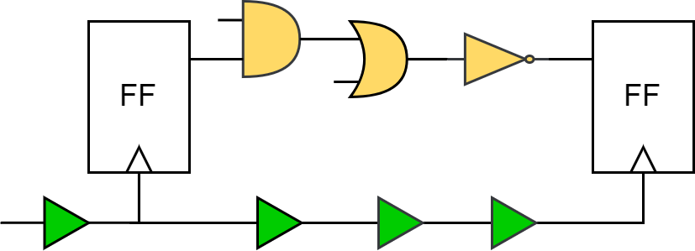
Advanced On-chip Variation (AOCV) - Calculations
Depth
 | 1 | 5 | 10 | 20
0 | 1.10 | 1.08 | 1.04 | 1.02
500 | 1.15 | 1.10 | 1.07 | 1.05
1500 | 1.2 | 1.14 | 1.12 | 1.10
Distance
1
The STA tool creates a bounding box that encloses all cells in the timing path
2
The STA tool gets the derate value of the 1st cell (clock buffer) from its AOCV tables
Buffer AOCV Table
Depth
200
 | 1 | 2 | 3 | 4
0 | 1.11 | 1.1 | 1.08 | 1.06
500 | 1.13 | 1.12 | 1.11 | 1.08
1500 | 1.15 | 1.14 | 1.13 | 1.09
𝑥 − 1.10 1.12 − 1.10
=
200 − 0 500 − 0
Distance
𝑥 = 1.108
3
The STA tool gets the derate value of the 2nd cell (FF) from its AOCV tables. Since the distance (200) is not in the table, the tool will do interpolation
FF AOCV Table

Slide 7
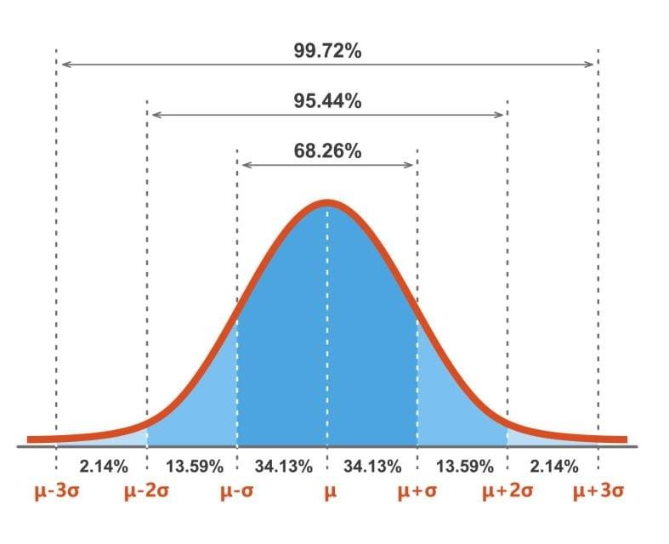
Parametric On-chip Variation (POCV)
This approach considers the cell a random variable with mean 𝝁 and standard deviation 𝝈
Using 𝜎 = ±1 means there is 68.26% probability that the cell delay will fall within this range
STA tools usually use a deviation 𝜎 = 3 to have a more accurate analysis but the designer can select whatever fits his requirements
The cell delay =
  Mean + 3𝜎 for late analysis
  Mean – 3𝜎 for early analysis
The mean and deviation are defined inside the timing library of each cell and sometimes the deviation is stored in a different file (.pocv file)
Pros : Removes the pessimism of the AOCV approach
Cons :
  Requires additional tables for the derates
  Higher runtime
This approach is used for low tech nodes (< 40nm).
POCV derates

Slide 8
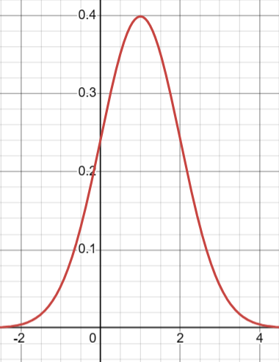
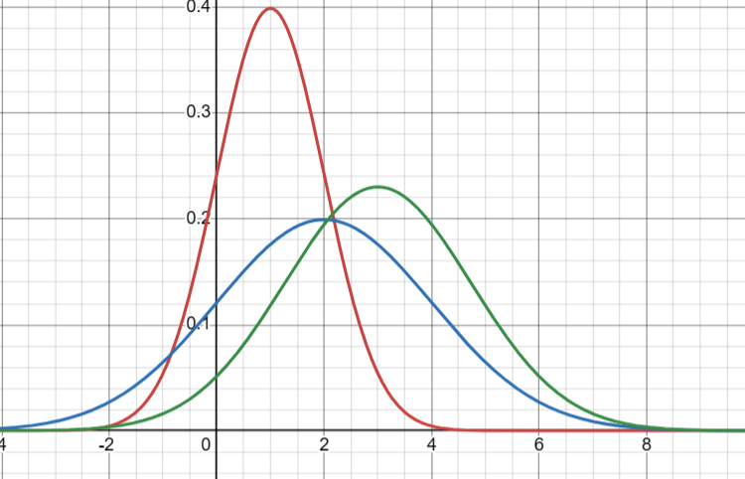
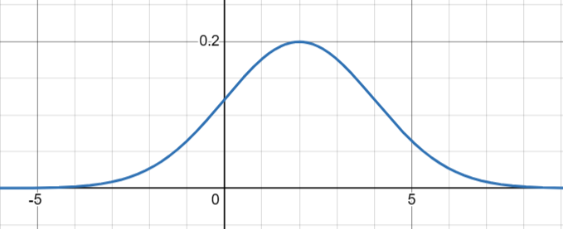
Parametric On-chip Variation (POCV) - Calculations
𝜇 = 1
𝜎² = 1
In probability theory, the sum of N normally distributed random variables is
also a normally distributed random variable
The mean of the sum = The sum of means of all random variables
The variance of the sum = The sum of variances of all random variable
Standard deviation = variance
𝜇 = 1 + 2 = 3
𝜎² = 1 + 2 = 3
𝜎 = √3
𝜇 = 2
𝜎² = 2

Slide 9
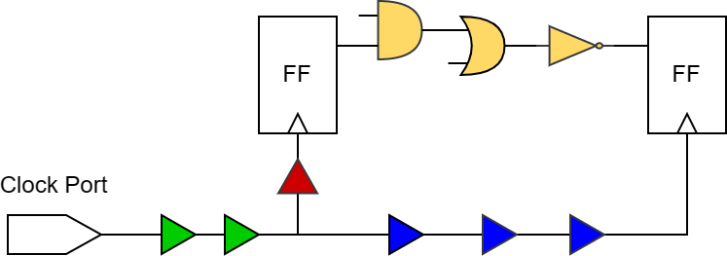
Clock Reconvergence Pessimism Removal (CRPR)
STA tools calculate the clock paths (Launch/Capture) from clock ports down to the clock pins of the FFs
Flow assuming setup analysis:
The tool will consider the launch path (from clock port to clock pin of 1st FF) and will apply positive derates on it to model the worst case OCV
The tool will then consider the capture path (from clock port to clock pin of 2nd FF) and will apply negative derates to model the worst case OCV
+10%
+10% +10%
Derates applied on launch clock path
We can see a clear over pessimism applied on the buffers common between the launch and capture paths (the green buffers) :
  During launch analysis we assumed they faced a variation that caused them to be slower
  During the capture analysis we assumed they faced a variation that
caused them to be faster
  In reality, these 2 events are mutually exclusive, either the buffers got slower or faster during fabrication but not both.
  This issue is called Clock Reconvergence Pessimism
-10% -10% -10% -10% -10%
Derates applied on capture clock path

Slide 10
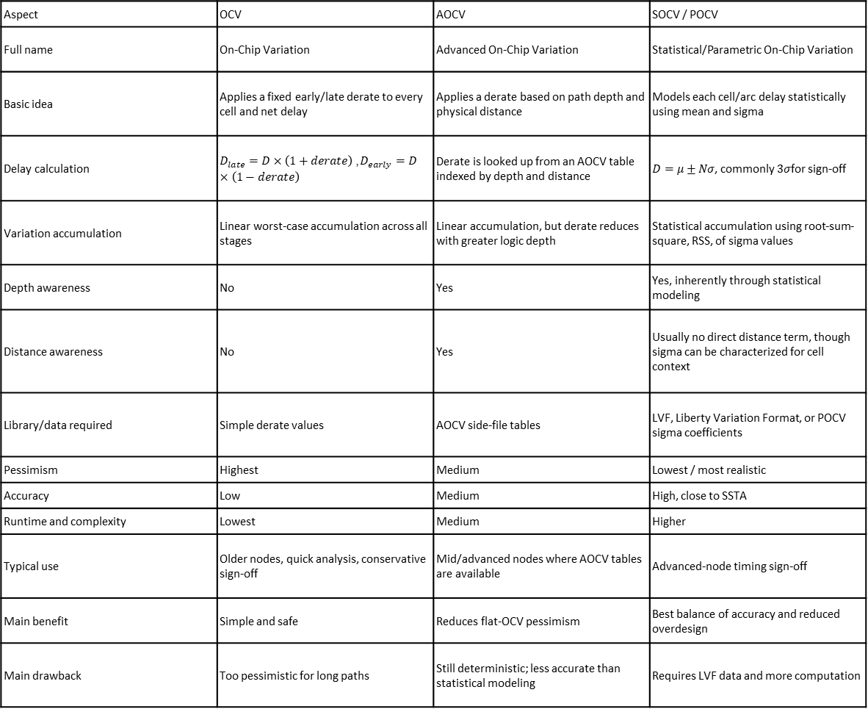
Aspect | OCV | AOCV | SOCV / POCV
Full name | On-Chip Variation | Advanced On-Chip Variation | Statistical/Parametric On-Chip Variation
Basic idea | Applies a fixed early/late derate to every cell and net delay | Applies a derate based on path depth and physical distance | Models each cell/arc delay statistically using mean and sigma
Delay calculation | $D_{late}=D×\left(1+derate\right)$, $D_{early}=D×\left(1−derate\right)$ | Derate is looked up from an AOCV table indexed by depth and distance | $D=μ±Nσ$, commonly $3σ$for sign-off
Variation accumulation | Linear worst-case accumulation across all stages | Linear accumulation, but derate reduces with greater logic depth | Statistical accumulation using root-sum-square, RSS, of sigma values
Depth awareness | No | Yes | Yes, inherently through statistical modeling
Distance awareness | No | Yes | Usually no direct distance term, though sigma can be characterized for cell context
Library/data required | Simple derate values | AOCV side-file tables | LVF, Liberty Variation Format, or POCV sigma coefficients
Pessimism | Highest | Medium | Lowest / most realistic
Accuracy | Low | Medium | High, close to SSTA
Runtime and complexity | Lowest | Medium | Higher
Typical use | Older nodes, quick analysis, conservative sign-off | Mid/advanced nodes where AOCV tables are available | Advanced-node timing sign-off
Main benefit | Simple and safe | Reduces flat-OCV pessimism | Best balance of accuracy and reduced overdesign
Main drawback | Too pessimistic for long paths | Still deterministic; less accurate than statistical modeling | Requires LVF data and more computation

Slide 11
What are the markers on IO cells, which command creates them, and what is their significance?
The markers on IO cells:
Visual indicators associated with IO pins or IO cells in the physical layout.
Help identify pin locations, placement status, or physical design violations.
Command create them:
editPin – Creates or modifies IO pin locations.
placeInstance – Places IO cell instances.
create_marker – Creates custom markers, if supported by the tool version.
verify_drc – Checks design-rule violations; marker generation depends on the verification flow.
Their Significance:
Placement: Check IO pin and cell locations.
Routing: Identify potential pin-access and connectivity issues.
DRC: Locate spacing and other physical design violations.
Debugging: Quickly identify problem areas for investigation and correction.
create_marker \
-bbox {x1 y1 x2 y2} \
-layer metal3 \
-type <marker_type> \
-sub_type <marker_subtype> \
-description "Spacing violation near IO pad"

Slide 12
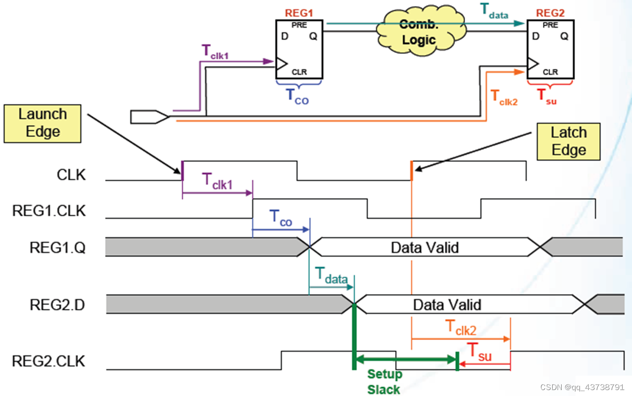


Slide 13
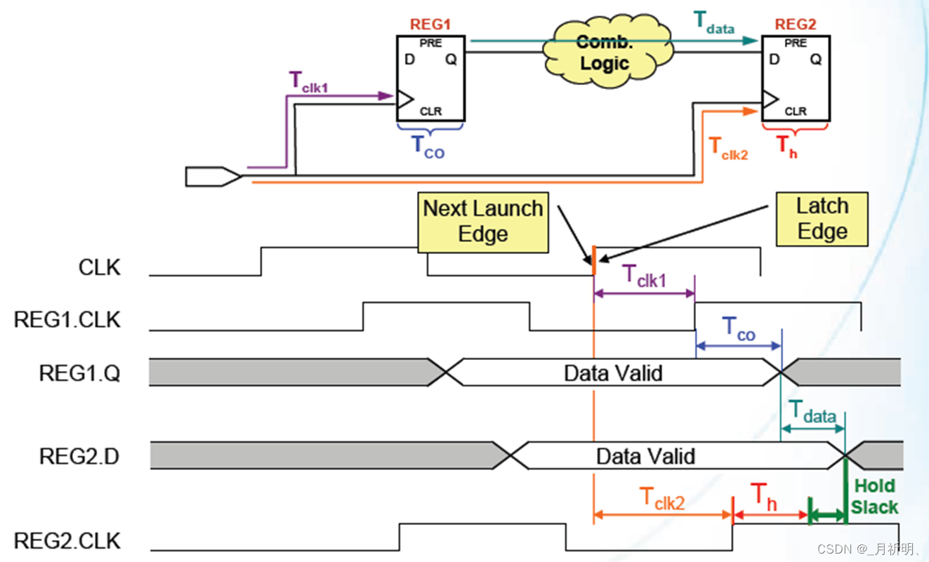


Slide 14
report_constraint -all_violators
report_constraint -all_violators -drv_violation_type max_transition
Tìm hai dòng vi phạm và ghi lại:
Tên net hoặc endpoint.
Loại constraint.
Giá trị actual.
Giá trị limit.
Slack hoặc violation value.
deselectAll
selectPin u_core/CKSRC0_ckbf_MMEM145/I ;# chọn pin
# hoặc
selectNet u_core/n592 ;# chọn net
zoomSelected ;# zoom tới đối tượng
report_net -net <ten_net> ;# fanout, điện dung, driver
report_timing -through <pin> ;# đường timing đi qua pin đó
all_fanin -to <pin> -only_cells ;# các cell phía trước
get_db [get_db pins <pin>] .slew_max_rise ;# kiểm tra slew
Ý nghĩa:
MaxFanLoad = 999: Giới hạn fanout được báo cáo cho net.
FanLoad = 17081 / 10844: Fanout thực tế được báo cáo vượt xa giới hạn.
FanLoadSlk = -16082 / -9845: Độ dư fanout âm, cho thấy hai net vượt giới hạn theo cách tính của report.
Net / InstPin | MaxFanLoad | FanLoad | FanLoadSlk
u_core/buf2m_B2 | 999 | 17081 | -16082
pad2buf_FCKA | 999 | 10844 | -9845

Slide 15
1. Đặt mục tiêu timing (margin)
tcl
setOptMode -setupTargetSlack 0.05 ;# đòi slack setup ≥ 0.05 ns
setOptMode -holdTargetSlack 0.03 ;# đòi slack hold ≥ 0.03 ns
set_clock_uncertainty 0.1 [get_clocks clk]
2. Điều khiển theo path group
tcl
group_path -name CRIT -from [get_pins u_core/MMEM*/CK]
setPathGroupOptions CRIT -effortLevel high
setPathGroupOptions reg2reg -targetSlack 0.05
setPathGroupOptions in2reg -weight 2 ;# tăng ưu tiên nhóm này
reportPathGroupOptions
3. Điều khiển hành vi tối ưu
tcl
setOptMode -effort high ;# mức nỗ lực toàn cục
setOptMode -usefulSkew true ;# dùng useful skew (post-CTS)
setOptMode -fixFanoutLoad true ;# sửa fanout/load lớn
setOptMode -restruct true ;# cho phép cấu trúc lại logic
setOptMode -allEndPoints true ;# tối ưu cả endpoint ngoài worst
setOptMode -reclaimArea true ;# lấy lại diện tích khi dư slack
setOptMode -leakageToDynamicRatio 0.5 ;# cân bằng leakage/dynamic
4. Giới hạn thay đổi trên cell/net cụ thể
tcl
setDontUse BUFX1 true ;# cấm dùng cell này
set_dont_touch [get_cells u_core/U1] true ;# không cho tool sửa cell
setOptMode -dontTouchNets {n592} ;# giữ nguyên net
setOptMode -maxLength 800 ;# giới hạn độ dài dây
5. Ràng buộc SDC (bản chất yêu cầu timing)
set_false_path, set_multicycle_path: loại hoặc nới lỏng đường không cần tối ưu.
set_case_analysis: cố định mode.
set_max_transition, set_max_fanout, set_max_capacitance: ràng buộc DRV.
set_input_delay, set_output_delay: khai báo đúng I/O để tránh tối ưu thừa.
6. Chạy tối ưu theo từng giai đoạn
tcl
place_opt_design ;# giai đoạn place
optDesign -preCTS
optDesign -postCTS -setup -hold ;# sau CTS
optDesign -postRoute -setup -hold ;# sau route
7. Kiểm tra và lặp lại
tcl
timeDesign -preCTS -pathReports -drvReports
report_timing -path_group CRIT -max_paths 10
report_constraint -all_violators
Quy trình gợi ý
Kiểm tra SDC đúng chưa (false path, multicycle, I/O delay).
Chạy tối ưu, xem path group nào tệ nhất.
Tăng effort hoặc weight cho nhóm đó, thêm margin vừa phải.
Dùng dont_touch bảo vệ phần đã tốt.
Lặp lại và theo dõi diện tích/công suất.

