Slide 1


PROJECT 07 • INTERNET OF THINGS
COLD-CHAIN MONITORING
AND INTELLIGENT STORAGE
MANAGEMENT
An IoT system for monitoring temperature, humidity, storage-door status, thermal exposure, and data integrity.
COURSE
ADVISOR
GROUP 07
Internet of Things
Huynh The Thien
TRẦN VẠN PHƯỚC •24161126
LƯƠNG THẾ QUỐC •24161127
NGUYỄN VĂN QUÝ •24161128
TRỊNH NGỌC TÍN •24161140
PROJECT 07 • COLD-CHAIN IoT
1
Notes:
1

Slide 2
01
OPENING & PROBLEM
Project structure and main chapters.
From physical sensing to intelligent decisions.
01
01
02
02
INTRODUCTION
Chapter 1: Overview & Problem Analysis
03
03
04
04
Chapter 2: Theoretical Basis & Hardware Selection
Chapter 3: System Architecture Design
05
05
06
06
Chapter 4: Hardware & Software Design – ESP32
Chapter 5: Backend, Database & API Communication
07
07
08
08
Chapter 6: Intelligent Monitoring Dashboard
Chapter 7–8: Experimental Results, Conclusion & Future Work
PROJECT 07 • COLD-CHAIN IoT
2
Notes:
2

Slide 3
01
CHAPTER 1
Cold-chain context and problem statement
Temperature and humidity must remain stable throughout storage, transportation, and distribution.
SOURCE
TRANSIT
STORAGE
DELIVERY
Fresh food /
pharmaceuticals /
vaccines
Refrigerated
transport
Cold warehouse
2–8°C
Distribution &
last mile
SAFE RANGE
KEY VARIABLES
RISK
2.0–8.0°C
T + RH
Thermal inertia
WHO range stated in the report for temperature-sensitive pharmaceutical products.
Temperature and relative humidity are continuously monitored.
Storage quality depends not only on an instantaneous condition, but also on how conditions vary over time.
PROJECT 07 • COLD-CHAIN IoT
3
Notes:
3

Slide 4
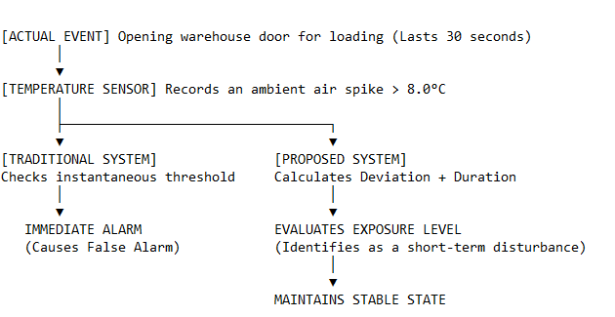
01
CHAPTER 1
Why instantaneous thresholds fail
A short temperature spike does not necessarily mean product-level damage.
EVENT
SENSOR
30 s
> 8°C
CORE PROBLEM
The alarm cannot distinguish a short disturbance from a prolonged violation.
INSTANTANEOUS THRESHOLD
CONSEQUENCE
False alarms can make operators complacent and cause critical incidents to be missed.
PROJECT 07 • COLD-CHAIN IoT
4
Notes:
4

Slide 5
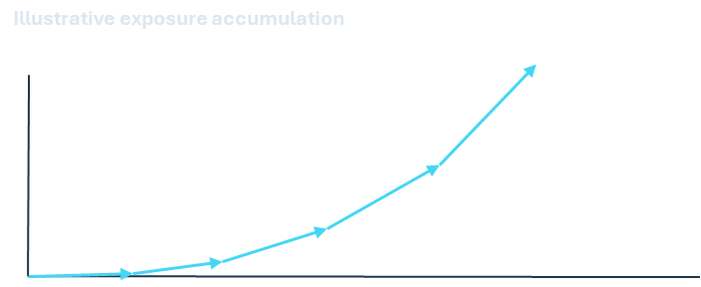
01
CHAPTER 1
The core idea: thermal exposure
Assess incident severity from temperature deviation and cumulative exposure duration.
OLD LOGIC
PROJECT LOGIC
THERMAL FSM
ACTION
T > limit
→ alarm
temperature deviation ×
exposure duration
STATE_NORMAL →
STATE_WARNING → STATE_VIOLATION
alert /
cooling
LOW DURATION
HIGH DURATION
DECISION PRINCIPLE
Severity depends on both how far temperature moves beyond the safe band and how long exposure persists.
PROJECT 07 • COLD-CHAIN IoT
5
Notes:
5

Slide 6
01
CHAPTER 1
Research objectives & scope
A small-scale prototype validating the monitoring algorithm and end-to-end data pipeline.
01
02
Continuous monitoring
Duration-aware assessment
Measure temperature, humidity, and storage-door status in real time.
Distinguish short-term disturbances from severe violations using temperature deviation and duration.
03
04
Fault-tolerant data
Monitoring dashboard
Preserve telemetry during network disconnection and synchronize after recovery.
Visualize historical data, compliance status, and multi-level alerts.
PROJECT 07 • COLD-CHAIN IoT
6
Notes:
6

Slide 7
02
CHAPTER 2
Thermal exposure: the math
The report converts the continuous Degree-Time model into a discrete accumulation on the ESP32.
CONTINUOUS MODEL
DISCRETE EMBEDDED MODEL
E = ∫ f(T(t)) dt
E = Σ f(Tᵢ) · Δtᵢ [°C·min]
f(T) acts as a filter: only harmful deviations contribute to exposure.
SAMPLE
FILTER
ACCUMULATE
Tᵢ at sampling time tᵢ
Inside safe band?
Violation amplitude
E += f(Tᵢ) · Δtᵢ
PROJECT 07 • COLD-CHAIN IoT
7
Notes:
7

Slide 8
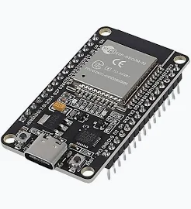
02
CHAPTER 2
Central microcontroller: ESP32
The ESP32 DevKit V1 is the Edge Computing Node for acquisition, processing, wireless communication, and local buffering.
CPU
RAM
WIRELESS
240 MHz
520 KB
Wi-Fi + BT
32-bit dual-core
Internal memory
802.11 b/g/n + Bluetooth v4.2
EDGE ROLE
Runs signal filtering, Thermal FSM, thermal exposure calculation, actuator control, MQTT communication, and a 100-record offline buffer.
Supports concurrent edge processing while reducing the amount of raw data sent upstream.
ESP32-WROOM-32
PROJECT 07 • COLD-CHAIN IoT
8
Notes:
8

Slide 9
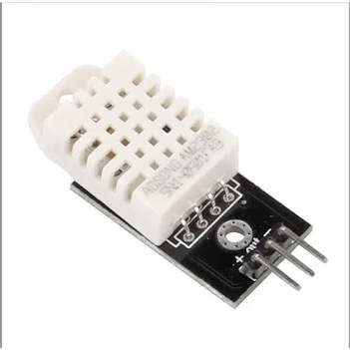
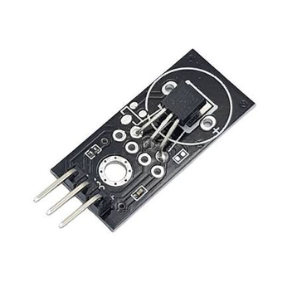
02
CHAPTER 2
Environmental sensing
Two sensors monitor the warehouse microenvironment and provide complementary temperature measurements.
DHT22
DS18B20
Temperature + RH
Waterproof probe
Air temperature: −40°C to 80°C; humidity: 0–100%RH; connected to GPIO 27.
Temperature: −55°C to 125°C; accuracy 0.5°C; 1-Wire via GPIO 14.
WHY TWO SENSORS?
DHT22
DS18B20
DHT22 measures ambient air temperature and humidity; DS18B20 measures deeper/local temperature.
REFERENCE CALIBRATION
Cross-calibration against a reference thermometer; the report states MAE below 0.25°C for 30 samples.
PROJECT 07 • COLD-CHAIN IoT
9
Notes:
9

Slide 10
02
CHAPTER 2
DS18B20 1-Wire hardware
A 4.7 kΩ pull-up stabilizes the DS18B20 DQ line.
4.7 kΩ
ESP32
DQ BUS
DS18B20
GPIO 14
1-Wire
temperature
PROBLEM
FIX
EFFECT
Floating
Pull-up
Stable pulses
GPIO 14 • 1-Wire • 3.3V • 4.7 kΩ pull-up
PROJECT 07 • COLD-CHAIN IoT
10
Notes:
10

Slide 11
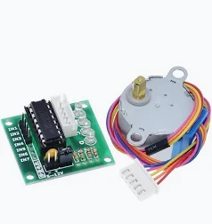
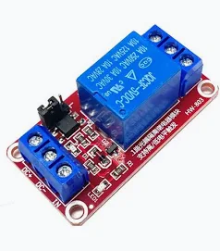
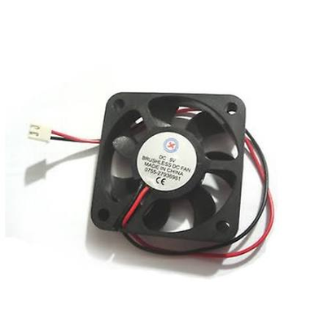
02
CHAPTER 2
Simulated warehouse actuators
The prototype simulates door events and emergency cooling.
DOOR SIMULATION
512 steps
POWER BUFFER
ULN2003
28BYJ-48 + ULN2003
1-CH RELAY
5V FAN
EMERGENCY COOLING
Relay → Fan
PROJECT 07 • COLD-CHAIN IoT
11
Notes:
11

Slide 12
02
CHAPTER 2
Dual power bus design
Separate sensor logic power from high-current actuator loads.
3.3V BUS
ACTUATOR LOAD
ESP32 + sensors
3.3V logic
Stepper / Relay
300–600 mA startup
RESULT
Brownout protection
5V BUS
MITIGATION
Reduces voltage drops and induced noise on the ESP32.
Relay + ULN2003
5V actuator power
Separate 3.3V / 5V rails
Report basis: 300–600 mA actuator startup demand.
PROJECT 07 • COLD-CHAIN IoT
12
Notes:
12

Slide 13
03
CHAPTER 3
Five-layer IoT architecture
A modular path from physical sensing to the web dashboard.
1
EDGE
ESP32 + sensors + actuators
CONTROL PLANE
DATA PLANE
Local edge logic
• EMA filtering
• Thermal FSM
• Actuator control
• Offline buffering
Telemetry path
• MQTT publish/subscribe
• Node.js ingestion
• SQLite storage
• REST / WebSockets
2
COMMUNICATION
EMQX / MQTT
3
BACKEND
Node.js / Express
SQLite
4
DATABASE
5
FRONTEND
Web dashboard / SPA
PROJECT 07 • COLD-CHAIN IoT
13
Notes:
13

Slide 14
03
CHAPTER 3
Telemetry data flow
Wi-Fi status determines the online or offline transmission path.
ONLINE
MQTT → Broker
SENSORS
EMA
THERMAL FSM
JSON
raw T / RH
smoothed T
thermal exposure
timestamped JSON
OFFLINE
Ring Buffer
ONLINE PATH
OFFLINE PATH
DATA GUARANTEE
Publish → EMQX → WebSockets + Node.js → SQLite
Buffer locally → keep sampling → backfill after reconnection
Original timestamps are preserved during backfill.
PROJECT 07 • COLD-CHAIN IoT
14
Notes:
14

Slide 15
03
CHAPTER 3
Warehouse door event flow
One switch event triggers actuator control and time monitoring.
TASK A
ACTUATOR
AccelStepper
512 steps = 90°
Motor moves
non-blocking
SWITCH
GPIO 4
MQTT
Door status +
alert state
TASK B
WARNING
doorOpenStartTime
60 s threshold
> 60 s →
STATE_WARNING
PROJECT 07 • COLD-CHAIN IoT
15
Notes:
15

Slide 16
04
CHAPTER 4
EMA noise filtering
Reduce transient DHT22 spikes while preserving the temperature trend.
Signal shape
RECURRENCE
Tfiltered = α·Tcal + (1−α)·Tfiltered_old
α
HISTORY
0.2
80%
PURPOSE
Purpose: filter transient noise before the Thermal FSM.
RAW
EMA
PROJECT 07 • COLD-CHAIN IoT
16
Notes:
16

Slide 17
04
CHAPTER 4
Thermal FSM
The FSM converts temperature exposure into three operating states.
STATE_NORMAL
STATE_WARNING
STATE_VIOLATION
2.0°C ≤ T ≤ 8.0°C
Door > 60 s
exposure > tolerance
→ relay action
CORE RULE
Thermal exposure accumulates over time; alert escalation is based on sustained severity rather than a single reading.
PROJECT 07 • COLD-CHAIN IoT
17
Notes:
17

Slide 18
04
CHAPTER 4
Non-blocking stepper control
Use AccelStepper so sensing and Wi-Fi remain active during door motion.
stepper.moveTo(512);
while (stepper.distanceToGo() != 0) {
stepper.run();
readSensors();
maintainMQTT();
}
stepper.disableOutputs();
TARGET
RUN LOOP
512 steps
stepper.run()
PARALLEL
FINISH
Sensors + Wi-Fi
disableOutputs()
BENEFIT
PROJECT 07 • COLD-CHAIN IoT
18
Notes:
18

Slide 19
04
CHAPTER 4 • EDGE ALGORITHMS
Offline Ring Buffer Management
Continuous sampling and time-series preservation during network outages.
dataBuffer[100] (Allocated in ESP32 SRAM)
Tᵢ
Tᵢ
Tᵢ
Tᵢ
Tᵢ
OFFLINE
RECOVERY (ONLINE)
EMQX BROKER
buffer_push() -> Push telemetry into RAM
buffer_pop() -> Sequentially flush data
Backfill synchronization (50ms delay)
Tᵢ
—
—
—
—
Preserves Original UNIX Epoch Timestamp
FAULT-TOLERANCE PRINCIPLE
Environmental acquisition never halts. Upon MQTT disconnection, the transmission path shifts from 'direct publish' to 'local buffer'. The system utilizes head, tail, and count index variables to automatically overwrite the oldest records when the 100-record array reaches maximum capacity
PROJECT 07 • COLD-CHAIN IoT
19
Notes:
19

Slide 20
05
CHAPTER 5
MQTT Protocol & EMQX Public Broker
Decoupling edge devices (Publishers) from backend applications (Subscribers)
NODE.JS
Subscriber
TOPIC
ESP32
EMQX BROKER
Publisher
broker.emqx.io
TCP 1883
WebSockets 8083
coldchain/nhom07/telemetry
WEB / MQTT.js
Subscriber
{
"timestamp": 1789489174, "device_id": "ESP32_COLD_01", "temperature": 8.3,
"humidity": 60.0,
"door_open": 0,
"cooling_state": 1
}
PROJECT 07 • COLD-CHAIN IoT
20
Notes:
20

Slide 21
05
CHAPTER 5 • BACKEND ARCHITECTURE
Central Processing Server: Node.js & Express
Asynchronous Non-blocking I/O for real-time telemetry ingestion and REST API provisioning
client.on('message', (topic, message) => {
const data = JSON.parse(message.toString());
// 1. Insert into telemetry_data
db.run(sqlInsert, [data.timestamp, data.device_id, ...]);
// 2. Threshold check (2.0°C - 8.0°C)
if (data.temperature > 8.0 || data.temperature < 2.0) {
// 3. Log incident to event_logs
db.run(sqlEvent, [data.timestamp, "CRITICAL_TEMP"]);
}
});
MQTT INGESTION
PROCESS & VALIDATE
Listen to topic via mqtt.js
JSON parsing & threshold check
SQLITE DATABASE
EXPRESS REST API
telemetry_data & event_logs
GET /api/history & /api/events
DESIGN BENEFIT
Decoupling the MQTT data collection flow from the HTTP data retrieval flow, enhancing system security and scalability
PROJECT 07 • COLD-CHAIN IoT
21
Notes:
21

Slide 22
05
CHAPTER 5 • DATABASE DESIGN
Embedded SQLite Data Model
Optimizing query performance by separating time-series data and incident logs
telemetry_data
event_logs
Column | Type | Purpose
Column | Type | Purpose
timestamp | INTEGER | Standard UNIX Epoch (Key)
timestamp | INTEGER | Incident time
device_id | TEXT | Edge device ID
device_id | TEXT | Device ID
temperature | REAL | Temperature (°C)
event_type | TEXT | e.g. CRITICAL_TEMP
humidity | REAL | Relative Humidity %RH
description | TEXT | Detailed description
door_open | BOOLEAN | Door state
cooling_state | BOOLEAN | Relay cooling status
Compliance Audit Trail
time-series
PROJECT 07 • COLD-CHAIN IoT
22
Notes:
22

Slide 23
05
CHAPTER 5 • DATA INTEGRITY
Composite Primary Key
Use timestamp + device_id to protect historical integrity.
BACKFILL
LATENCY
COMPOSITE KEY CHECK
SQLITE DATABASE
ESP32 flushes 100 buffered records
Packet duplication risk during retransmit
PRIMARY KEY (timestamp, device_id)
Duplicates rejected (SQLITE_CONSTRAINT)
DATA INTEGRITY MECHANISM
The RDBMS automatically rejects inserted records with duplicate timestamps from the same device, ensuring a linear and immutable historical timeline during buffer flushes
PROJECT 07 • COLD-CHAIN IoT
23
Notes:
23

Slide 24
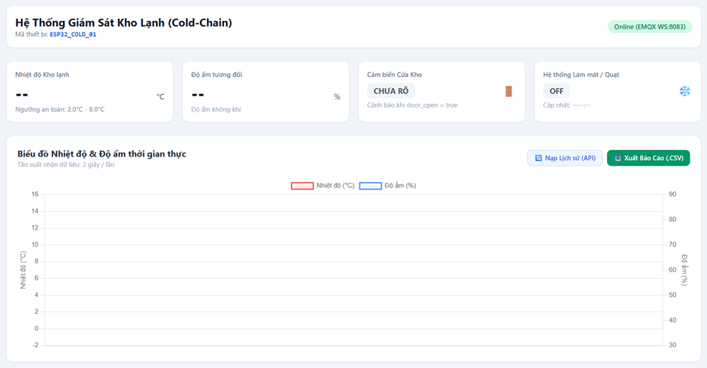
06
CHAPTER 6 • APPLICATION LAYER
Single-Page Web Dashboard
Real-time visualization, visual alerts, and historical data exploitation
HEADER
Device ID & MQTT Connection Badge
STATUS CARDS
Dynamic Cards: Temp, Hum, Door, Relay
CHART AREA
Dual Y-Axis Time-Series Line Chart
TECH STACK
Tailwind CSS • Chart.js • MQTT.js
Dashboard overview from the project prototype
PROJECT 07 • COLD-CHAIN IoT
24
Notes:
24

Slide 25
06
CHAPTER 6 • REAL-TIME ALERTING
MQTT over WebSockets & Visual Alerts
Push telemetry into the browser without page reloads.
LATENCY TARGET
EMQX
MQTT.js
DASHBOARD
WebSockets 8083
browser client
Live Cards & Dynamic UI
< 50 ms
Zero-polling mechanism ensures ultra-low latency push updates
ALERT LOGIC
OPERATOR SIGNAL
Incoming JSON → Detect Violation (T ∉ [2.0°C, 8.0°C]) → Switch temperature card to RED + animate-pulse effect
Dynamic color/state changes instantly attract the operator's visual attention to critical environmental anomalies
PROJECT 07 • COLD-CHAIN IoT
25
Notes:
25

Slide 26
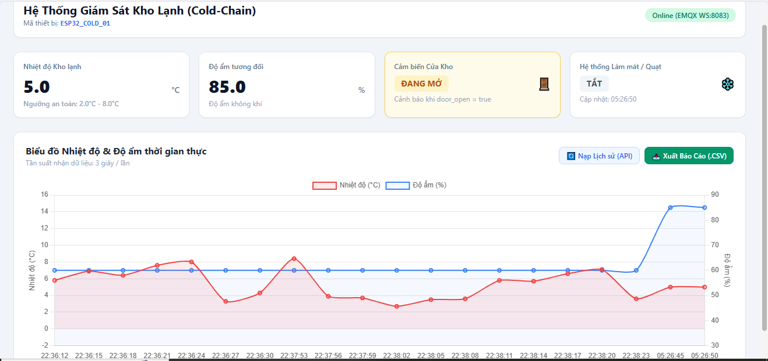
06
CHAPTER 6 • DATA VISUALIZATION
Dual-Axis Chart & Sliding Window
Visualizing temperature and humidity correlation while preventing browser memory leaks
LEFT Y-AXIS
Temperature (Unit: °C)
RIGHT Y-AXIS
Humidity (Unit: %RH)
SLIDING WINDOW
MAX_CHART_POINTS = 20
Real-time monitoring chart with dual independent Y-axes
PROJECT 07 • COLD-CHAIN IoT
26
Notes:
26

Slide 27
06
CHAPTER 6 • DATA EXPLOITATION
REST API Retrieval & CSV Export
Client-side report generation and historical data recovery
BUTTON
GET /api/history
CHART
WHY CLIENT-SIDE?
Load History API
Fetch 50 recent records from SQLite
Backfill & redraw canvas
Data URI Scheme packaging happens entirely in the browser's RAM. No extra backend storage or CPU step is needed, enabling instant file downloads.
DATA ARRAY
exportCSV()
LOCAL FILE
Extract current labels, temps, hums
∑ (label + temp + hum)
.csv format
PROJECT 07 • COLD-CHAIN IoT
27
Notes:
27

Slide 28
07
CHAPTER 7 • EXPERIMENTS
Scenario 1: Standard Operation & Actuator Control
Validating environmental sensing stability and non-blocking mechanical response
ENVIRONMENT
~5.0°C
MECHANISM
90°
WEB RESPONSE
OPEN
Dashboard reflects safe baseline and Warning UI for Door OPEN event
PROJECT 07 • COLD-CHAIN IoT
28
Notes:
28

Slide 29
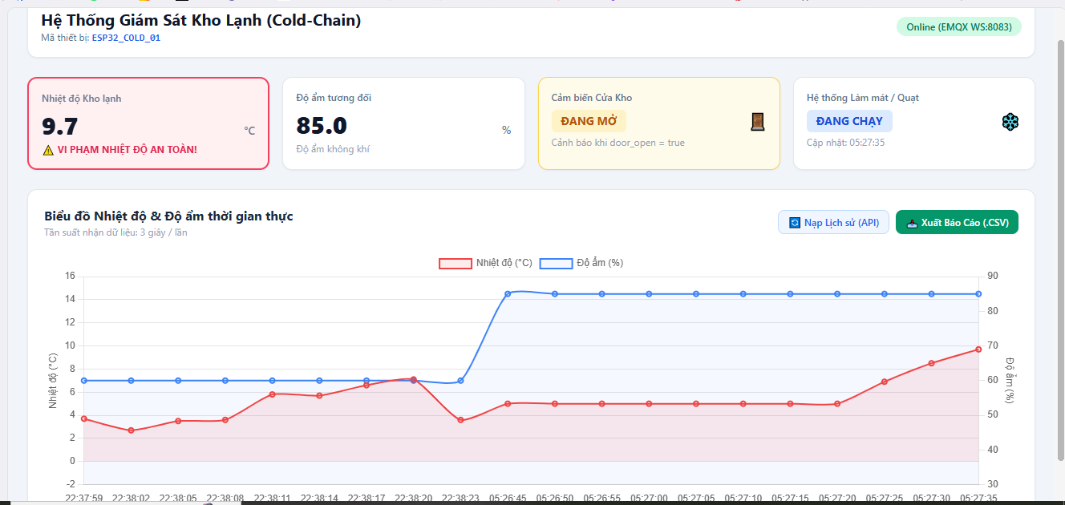
07
CHAPTER 7 • EXPERIMENTS
Scenario 2 — temperature violation
A deliberate over-temperature event tests the complete chain.
TRIGGER
> 8.0°C
EDGE ACTION
Relay ON
BACKEND
CRITICAL_TEMP
Violation state: temperature card turns red and cooling activates
PROJECT 07 • COLD-CHAIN IoT
29
Notes:
29

Slide 30
07
CHAPTER 7 • EXPERIMENTS
Scenario 3A — network loss
The system changes transmission mode, not sensing mode.
HOTSPOT DISCONNECTED FOR 30 s
ESP32
OFFLINE
RING BUFFER
RAM
sampling continues
MQTT connection lost
push records
100 records
WEB
EDGE
Connection badge → OFFLINE; live chart stops receiving new points.
No freeze. Sensors keep sampling and timestamps are attached before buffering.
PROJECT 07 • COLD-CHAIN IoT
30
Notes:
30

Slide 31
07
CHAPTER 7 • EXPERIMENTS
Scenario 3B — recovery & backfill
Reconnection restores the missing segment on the original time axis.
WI-FI RESTORED
buffer_pop()
BROKER
HISTORY API
MQTT reconnect
flush history
re-publish
chart backfill
Load History API
100% HISTORY BACKFILL
PROJECT 07 • COLD-CHAIN IoT
31
Notes:
31

Slide 32
08
CHAPTER 8 • CONCLUSION
Project conclusion
The prototype closes the loop from sensing to action and audit.
EDGE
DATA INTEGRITY
EMA + Thermal FSM
Ring Buffer + Composite Key
Smart local decision-making
No gaps during short outages
BACKEND
APPLICATION
MQTT + Node.js + SQLite
WebSockets + Chart.js
Non-blocking MQTT ingestion & structured incident logging
Real-time dynamic visualization & instant client-side CSV exports
The prototype successfully proves the feasibility of a low-cost, reliable, end-to-end Cold-Chain monitoring architecture with guaranteed zero data loss during network disruptions
PROJECT 07 • COLD-CHAIN IoT
32
Notes:
32

Slide 33
08
CHAPTER 8
Future work
Five paths from prototype to industrial-grade capability.
01
Edge AI / TinyML
Predict faults before the threshold is crossed.
02
ESP-MESH + 3D mapping
Cover spatial temperature differences.
03
MicroSD + SQLite WAL
Extend offline storage beyond RAM.
04
Blockchain audit
Immutable event / compliance trail.
05
LoRaWAN + low-power nodes
Long-range, energy-efficient deployment.
PROJECT 07 • COLD-CHAIN IoT
33
Notes:
33

Slide 34
THANK YOU
Cold-Chain Monitoring & Intelligent Storage Management
DEMO
HIGHLIGHT
Q&A
Live System
Ring Buffer
Discussion
Project Group 07
Q&A SESSION
PROJECT 07 • COLD-CHAIN IoT
34
Notes:
34

