Slide 1
Price/Cost
SMC = PMC
P*
SMB = PMB + EMB
Qm Q*
Quantity of vaccines

Slide 2
Price/Cost
SMC = PMC
P*
Pm
SMB = PMB + EMB
PMB
Qm Q*
Quantity of vaccines

Slide 3
Price/Cost
SMC = PMC
P*
Pm
SMB = PMB + EMB
PMB
Qm Q*
Quantity of vaccines
Underuse

Slide 4
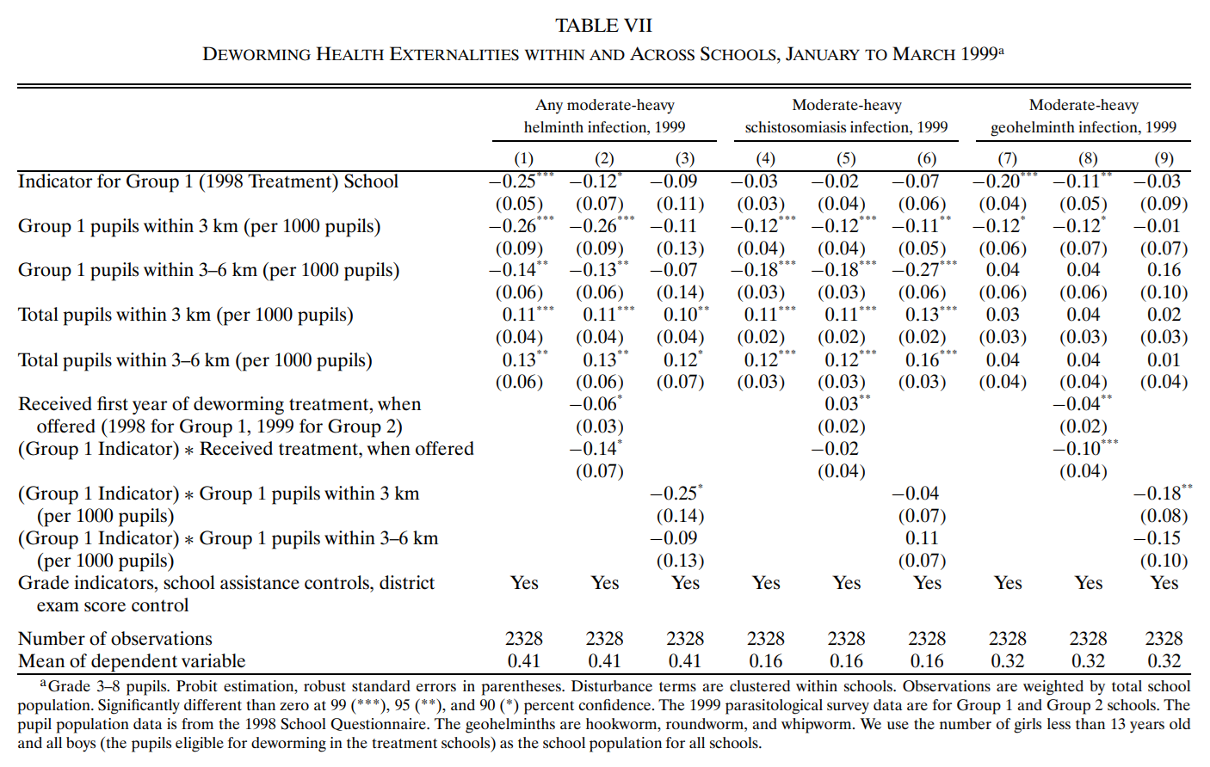
Direct effect (without externalities)

Slide 5
Direct effect (without externalities)
Cross-school externalities

Slide 6
Direct effect (without externalities)
Cross-school externalities
Within-school externalities

Slide 7
Direct effect (without externalities)
Cross-school externalities
Within-school externalities
direct effect on the treated

Slide 8
Direct effect (without externalities)
Cross-school externalities
Within-school externalities
direct effect on the treated
cross-school externalities in treated vs. control schools

