Slide 1
Outline
What is “data stewardship”?
What are we trying to achieve?
What is our current approach?
What is our plan moving forward?

Slide 2
Data stewardship attempts to improve the data publication process to better facilitate the use of our IEP datasets.
Greater efficiency in data flow
Greater transparency in data flow
Greater flexibility in data flow
Automation and consistency of the process
Ease of use of end products
Contains all relevant data
Increased accuracy of use

Slide 3

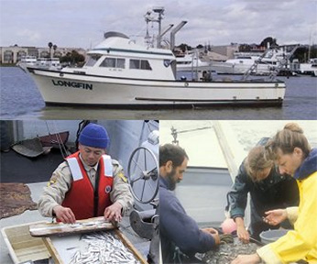
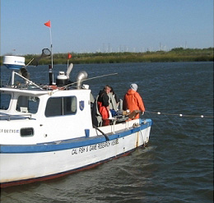

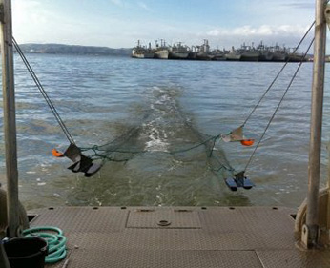
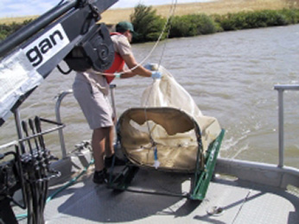
Data Users
Data Creators
This Photo by Unknown Author is licensed under CC BY-SA

Slide 4
Access process
Field Data
SLS Survey
Inputted into
R process
Access
Forms
Relational
Line-by-line protocol
Undergo
QAQC
All queries in one R script
Outliers in a streamlined output
Nearly 100% automated
Flexibility for additional QAQC
To set up for
Data export
Consistent exporting steps
Automated exports that includes field size conversion
Two forms
Relational tables
Maximum flexibility
E.g., LTMRData package
Joined table
Similar format as to DJFMP
Formatted for synthesis work
E.g., metadata document

Slide 5
Going forward
SLS, Bay Study, 20 mm, SKT, STN, FMWT, Zooplankton
EMP
Who’s next?

