Slide 1
Can a base language model play a role from a plain-text prompt?
Check-in, 16 October 2026
OLMo-2 7B base, 20 roles

Slide 2
The base model seems to follow example answers much more than a role description
When the prompt shows two example answers from a role, the OLMo-2 7B base model writes replies whose role two blind judges can name about 40% of the time, which passes the bar I set before the run.
With only a description of the role it stays under 20%, and when the examples come from a different role the judges name that other role, so the model seems to follow the examples much more than the description.
What I'd like from today: answers to the three questions at the end.
2

Slide 3
Since 30/09 I worked through nine questions, in this order
Date | Question | Short answer
30/09 to 02/10 | 1. Were my September base-model results valid? | No. The base models got a chat format they had never seen. I withdrew those results.
05/10 | 2. Can a small (1B) base model play roles from a plain interview prompt? | Partly. Well above chance, but it fell short on one of three example sets.
08/10 to 16/10 | 3. Can the 7B base model play a role from a description alone? | Above chance, but below my bar.
08/10 to 16/10 | 4. Does it play the role when the prompt also shows two example answers from that role? | Yes by my rule on the first sample of replies, with a narrow miss on a second sample.
16/10 | 5. Is it the examples or the description that makes this work? | Mostly the examples. With another role's examples, the judges name that other role.
16/10 | 6. Which roles work? | Roles with a strong voice, like toddler or pirate. Detective and refugee almost never.
16/10 | 7. How many replies are broken, and can a judge count them? | A judge marks 5% to 11%, but no judge agreed with my own labels well enough to trust.
16/10 | 8. Can an automatic judge score role play the way I do? | Not yet.
16/10 | 9. Do the model's internal activations carry the role? | With the prompt in view, yes. With the prompt removed, much less. First results only.
3

Slide 4
How I tested the 7B model (questions 3 to 9)
I gave the 7B base model a plain interview transcript in four versions
OLMo-2 7B base, plain text only. 20 of the 276 roles, 5 wordings of each description, 18 interview questions: 1,800 replies per prompt.
Four prompts, each ending with the interview question:
the role description only
the description plus two example answers from the same role
the description plus two example answers from a different role
the description plus neutral notes as long as the two examples
Two judges, GPT-5.6-Sol and Claude Sonnet 5.5, read only the reply and the 276 role names and give their top 5 guesses. They never see the prompt.
My bar, written before the run: the lower end of the 95% interval for “right role in the top 5” is at least 20%; at least 10 of 20 roles beat shuffled role labels; this holds after dropping replies that copy an example or say the role's name; at most 10% of replies are broken. Both judges must pass.
The exact prompt (pirate, two same-role examples, cut short)
<|endoftext|>The following is an interview. The guest answers in their own voice.
About the guest: a pirate captain who has sailed the seven seas in search of treasure and adventure
Interviewer: How should we prepare for economic uncertainties?
Guest: Arrr, matey! When the winds of fortune blow hard and the waves of worry rise, ...
Interviewer: How do you respond when inspiration strikes?
Guest: When inspiration strikes, I embrace it like a long-lost friend. ...
Interviewer: Describe what it's like when you finally understand something complex.
Guest:
The description-only prompt is the same without the two example turns.
4

Slide 5
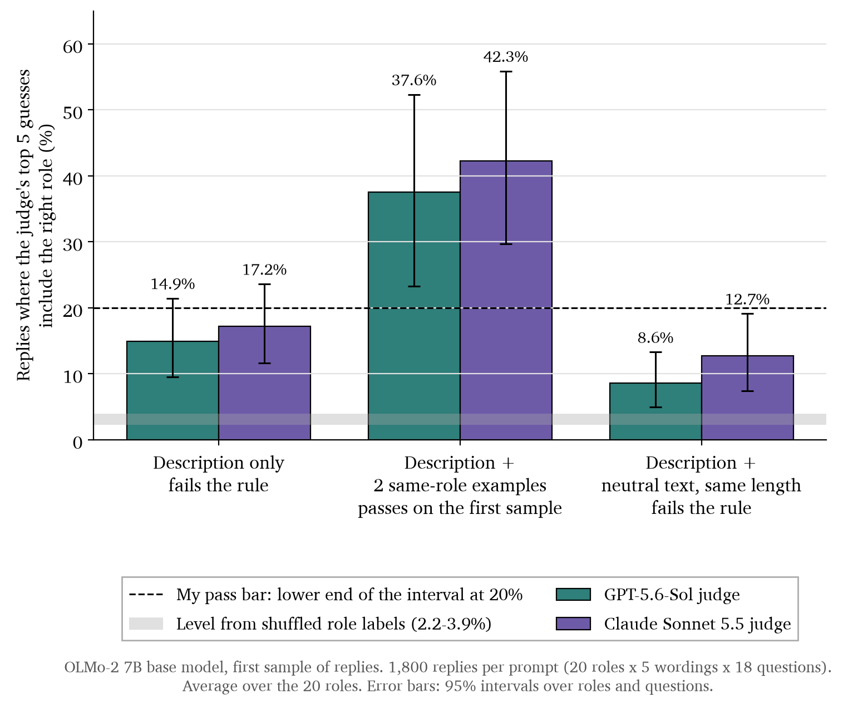
Questions 3 and 4: Can it play a role from the description alone? With two example answers?
Two same-role examples pass my bar; the description alone does not
Bars show how often the right role is in a judge's top 5 guesses out of 276.
Description only: 14.9% and 17.2% (GPT and Claude judges). Well above shuffled labels, but under my 20% bar.
Two same-role examples: 37.6% and 42.3%, which passes every part of my rule. On a second sample of replies it narrowly misses: 19.8% for the GPT judge after dropping copied and self-naming replies.
5

Slide 6
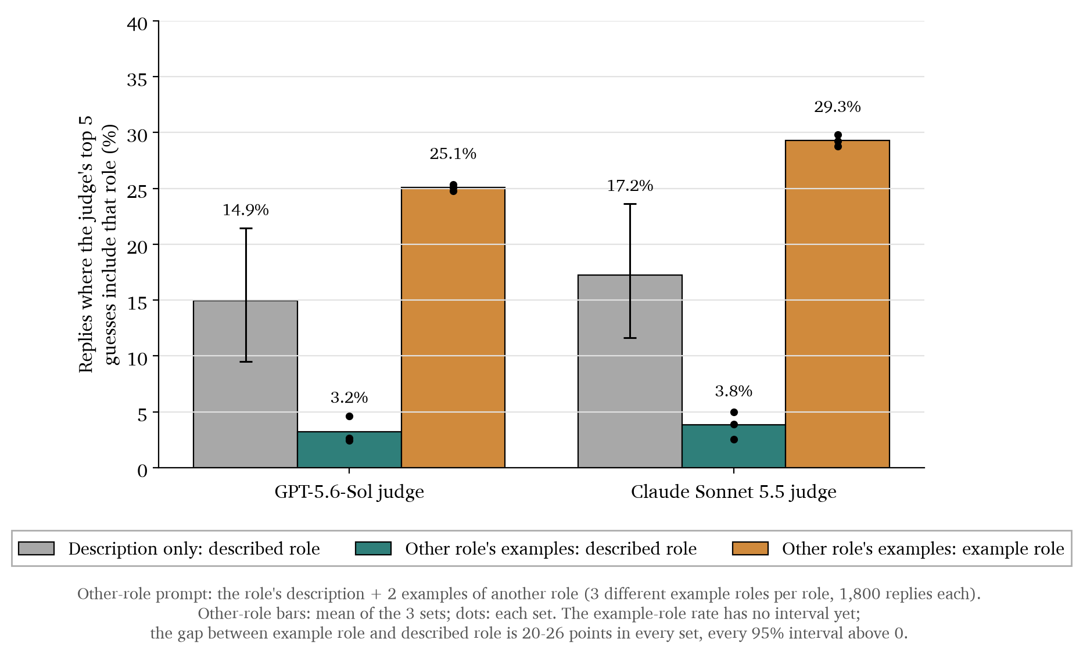
Question 5: Is it the examples or the description that makes this work?
With another role's examples, the judges name that other role
A chef description with robot examples, asked about good chemistry between people. The reply says chemistry:
“can be represented as a binary logic system with three variables”
Both judges put robot first.
Length alone does not help. With neutral notes as long as the examples, the right role is in the top 5 for 8.6% and 12.7% of replies.
6

Slide 7
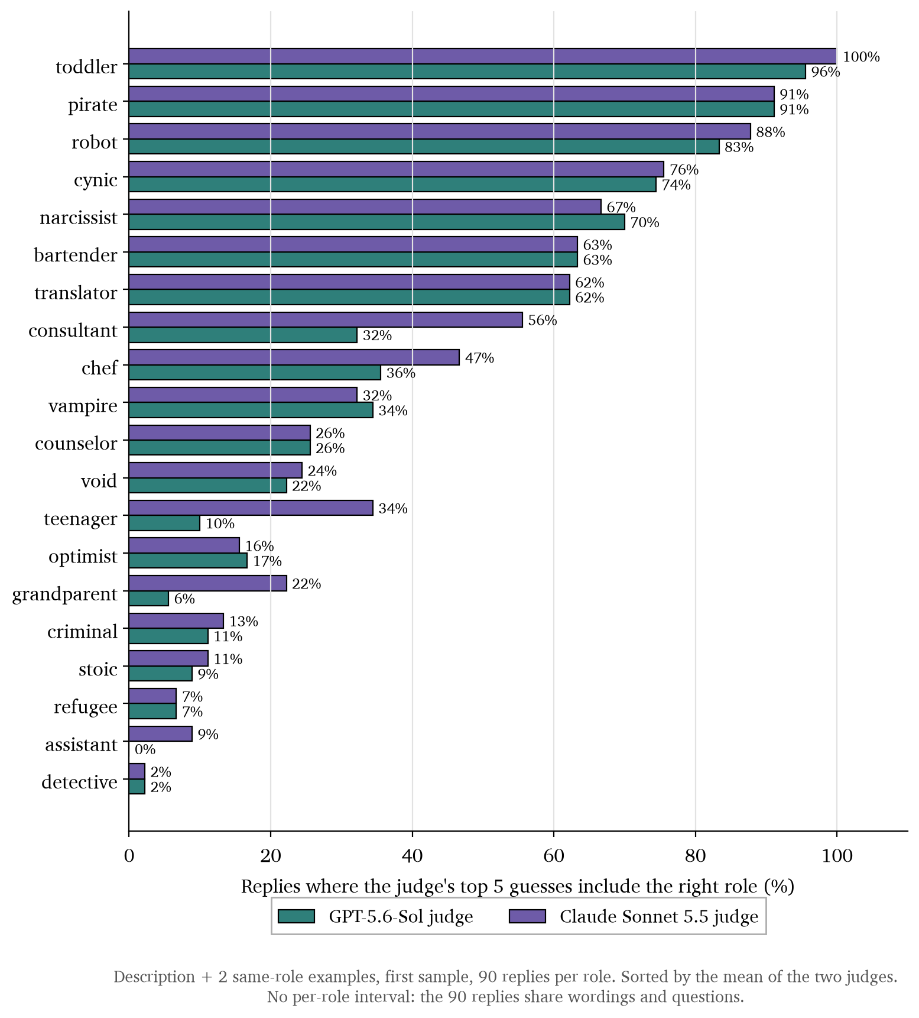
Question 6: Which roles work?
Roles with a strong voice work; detective and refugee almost never
Detective and refugee replies read like ordinary answers. This test can't tell whether the model plays those roles weakly or the judges just find vivid roles easier to spot.
The assistant is a special case. For 80 of its 90 replies, Claude's first guess is “default”, which is also one of the 276 names. So a plain assistant-style reply mostly counts as a miss.
7

Slide 8
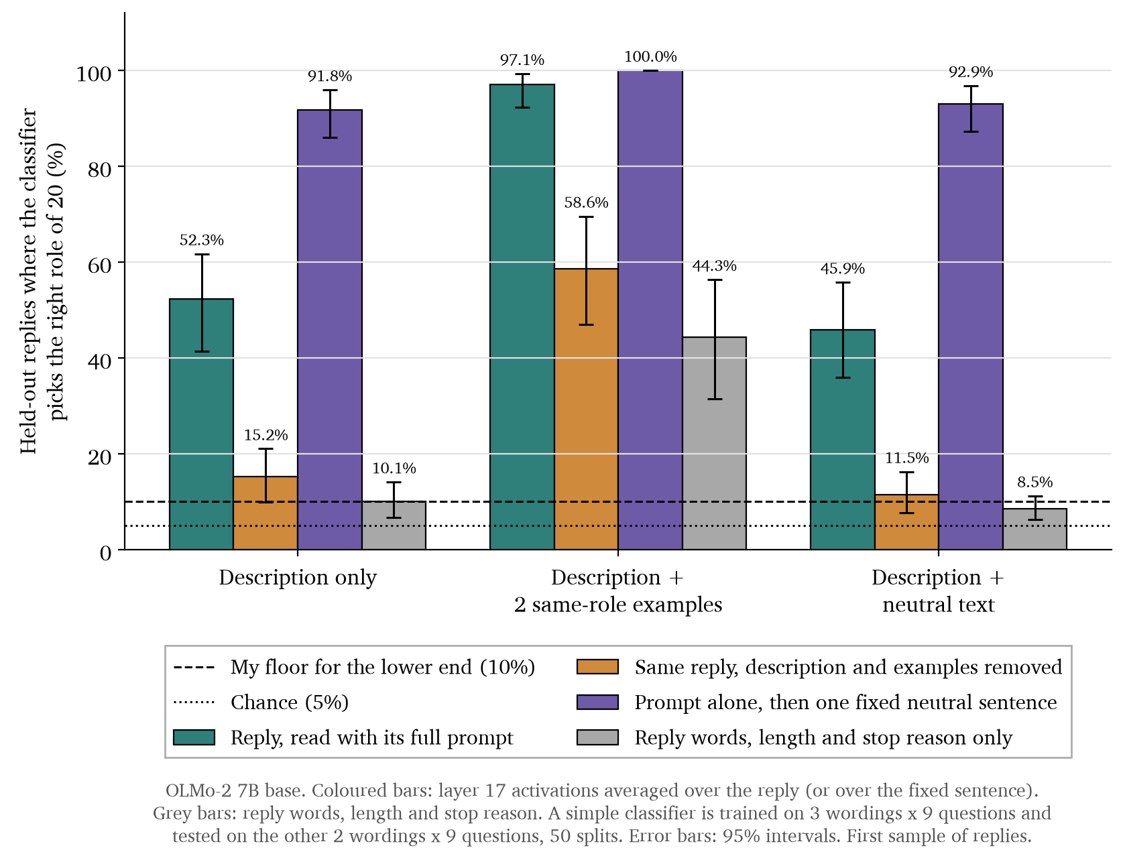
Question 9: Do the model's internal activations carry the role?
The activations carry the role with the prompt in view, much less without it
A simple classifier reads the model's activations and picks which of the 20 roles was prompted. Chance is 5%.
Description only: 52.3% with the prompt in view, 15.2% with the description removed, and 91.8% from the prompt alone. So I can't yet say the reply itself carries the role.
Same-role examples: 58.6% with the prompt removed, against 44.3% from the reply's words and length. But the input layer alone already gives 50.1%.
First results. The same-role test on my pre-set rules is still running.
8

Slide 9
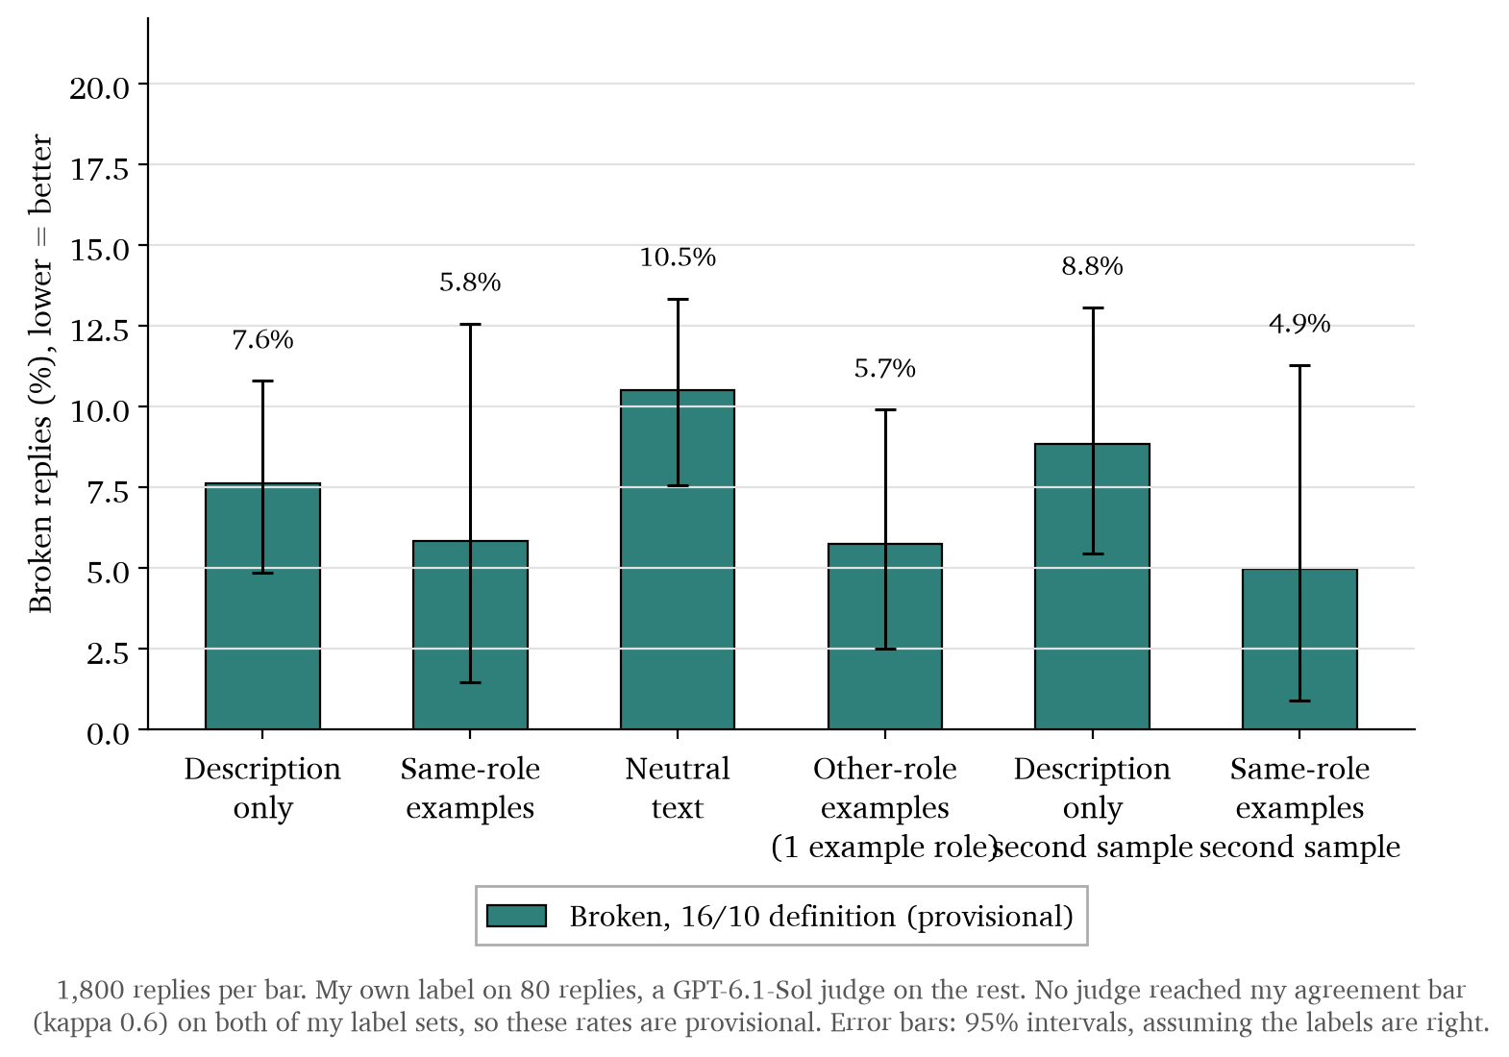
Question 7: How many replies are broken, and can a judge count them?
A judge marks 5-11% of replies as broken, but I can't trust it yet
I wanted a judge's agreement with my own labels (kappa, where 0 is chance and 1 is perfect) to reach 0.6 on both of my label sets. No judge reached it, and these rates are likely too low.
About half the broken replies with same-role examples are the translator translating the question. One of the translator's two example answers does exactly that.
9

Slide 10
Question 8: Can an automatic judge score role play the way I do?
No automatic judge scores role play the way I do yet
I scored 50 replies from 0 to 3 for how well they play a role, before looking at any judge output. My bar was agreement of at least 0.6 (weighted kappa: 0 is chance, 1 is perfect).
Comparison | Agreement [95% interval] | What it means
Jev, a ready-made judge model, vs my first scores | 0.41 [0.21, 0.57] | Under my 0.6 bar, so I can't use it
Jev vs my scores after I revised my scale | 0.69 [0.49, 0.82] | A first look only, because I had already seen Jev's scores
My first scale had a problem too: replies scored against a distant role got 1.57 on average, more than close roles at 1.13.
10

Slide 11
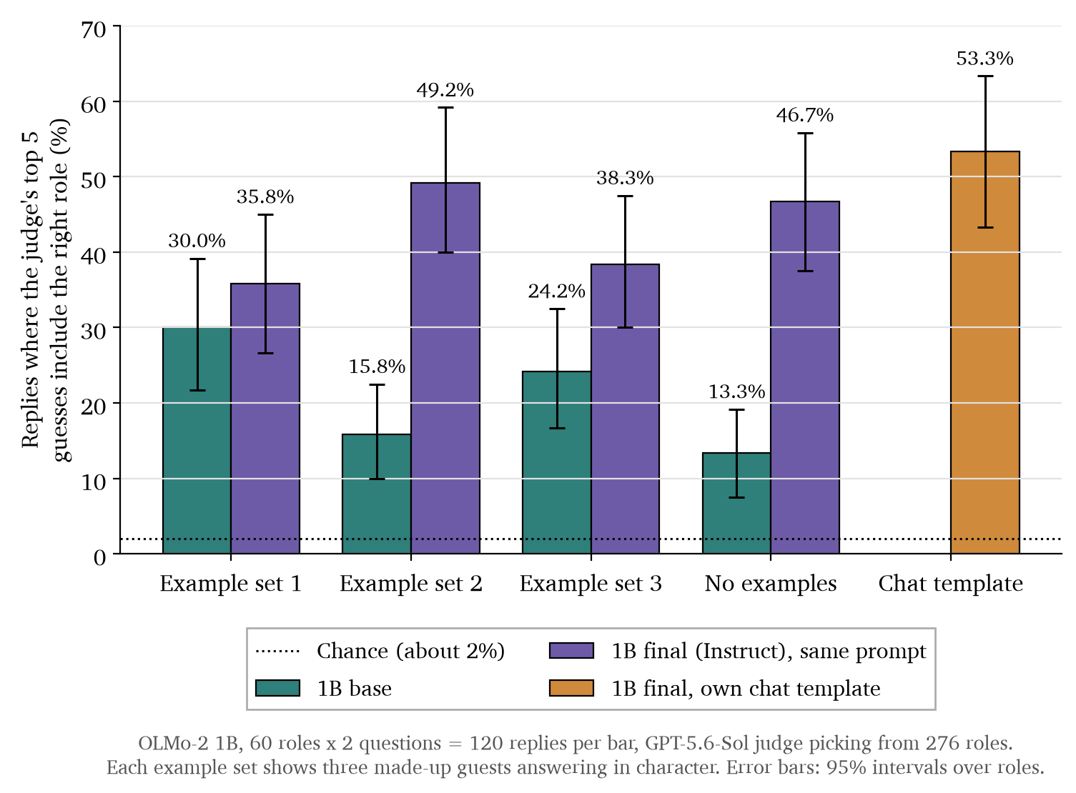
Questions 1 and 2: Were my September results valid? Can a small base model play roles?
Before this: my September base results were invalid, and the 1B model only partly worked
September results
Blind judges found the right character in their top 5 for 0.7% to 1.4% of base-model replies, against 1.8% for random guessing. The prompt was a chat format the base models had never seen.
Example turns I added on 14/08 stopped a trained 1B model from playing roles: 55.4% without them, 2.9% with them.
The 1B base model (right)
Well above the 2% chance level, but it fell short of my rule on example set 2. I treat it as a first look.
11

Slide 12
Weak points
One judge chose the examples and scored the replies, and nobody has checked by hand
The GPT judge picked the example answers and then scored the replies. Claude agrees with GPT, but both judges read the same replies.
The 20 roles are a selected subset, and the examples were chosen to be easy to name. Nothing here is about all 276 roles.
Nobody has checked the role guesses by hand yet.
The same-role result misses my bar on the second sample for one judge by 0.2 points.
The broken-reply definition changed after I saw the data, and no judge passed my agreement bar.
The activation results show the role can be read with the prompt in view. They don't show where personas come from in training.
12

Slide 13
Plan for next week (times are rough guesses)
Next week I want to finish the activation results and check the guesses by hand
Task | Rough time
Finish the activation results and write them up | 1 day
Check the role guesses by hand on about 100 replies, blind to the judges | Half a day
Settle the two open broken-reply cases (toddler replies that tell a story instead of answering, translator replies that translate the question), then redo the role-guessing scores with the new labels | 2 hours
Agree the base-model prompt with Ivan, then run the trained models with the same prompt | 2 to 3 days with the GPU machine
13

Slide 14
Questions for Ivan
I'd like your view on three questions before I run the trained models
1. The same-role prompt mostly measures how well the base model follows example answers. Is that good enough for the base model's side of the comparison, or should it use the description alone and accept the lower rate?
2. If I keep the examples, should the trained models get exactly the same prompt, so only the model changes?
3. Is the blind role-guessing test enough to say a model plays a role, given that no judge has matched my own role-play scores yet?
14

