Slide 1
A2C Architecture

Slide 2
Valid Login Sequence Diagram
User
Client
<<Browser\
Mobile app>>
Gateway
Server
TokenService
(IdP)
AutoService
Database
Enter email & password
POST Login (JSON)
Middleware UseAuthentication
POST Login (JSON)
Generate JWT
Singed JWT (OK)
Login (email, password, JWT with secret key)
Validate with public key
Validate (Email, Password)
Validate (OK)
Singed (user inf + JWT)
Token (user info + JWT)

Slide 3
┌──────────────┐
│ Client │
└─────┬────────┘
│
│ 1️⃣ Login (email + password)
▼
┌──────────────┐
│ AuthService │
└─────┬────────┘
│
│ 2️⃣ בדיקת פרטי המשתמש מול DB
│ (✔ אם תקין)
▼
┌──────────────┐
│ DB 🗄️ │
└──────────────┘
▲
│
│
┌─────┴────────┐
│ AuthService │
└─────┬────────┘
│
│ 3️⃣ מבקש מה-TokenService לחתום JWT
▼
┌──────────────┐
│ TokenService │
│ 🔑 PrivateKey │
└─────┬────────┘
│
│ 4️⃣ מחזיר JWT חתום ל-AuthService
▼
┌──────────────┐
│ AuthService │
└─────┬────────┘
│
│ 5️⃣ מחזיר JWT ל-Client
▼
┌──────────────┐
│ Client │
│ 🗝️ JWT │
└─────┬────────┘
│
│ 6️⃣ שומר JWT ב-local/session ושולח בכל בקשה
▼
┌─────────────────────┐
│ Microservice (API) │
└─────────┬───────────┘
│
│ 7️⃣ Middleware:
│ - קורא JWT מה-Header
│ - מוריד Public Key 🔓 מ-JWKS של TokenService
│ - בודק חתימה, Issuer, Audience, Expiration
▼
┌─────────────────────┐
│ HttpContext.User │
│ עם Claims מלאים │
└─────────┬───────────┘
│
│ 8️⃣ Controller מבצע פעולה
▼
┌──────────────┐
│ Client │
└──────────────┘
הדגשים:
🔑 Private Key נשאר ב-TokenService בלבד.
🔓 Public Key זמין לכל Microservice דרך JWKS.
AuthService לא מחזיק סוד, רק מבקש חתימה או JWT.
Microservices רק מאמתים JWT, לא יוצרים אותו.
Client שולח את ה-JWT בכל בקשה ל-Microservice.

Slide 4
Docker
Users
(Docker)
API Gateway
Message
Queues
(Kafka)
Login request
Authentication Micro-Service
Pub/Sub
Customers
(Docker)
Customer info
Customers Micro-Service
Pub/Sub
Products
(Docker)
Frontend - React
(Web\Mobile App client)
Customer info
HTTPS
Products Micro-Service
Pub/Sub
Orders
(Docker)
Create order
Orders Micro-Service
Pub/Sub
Log Files Storage
Log event
Logging Micro-Service
Pub/Sub
Notifications worker
Publisher Micro-Service

Slide 5
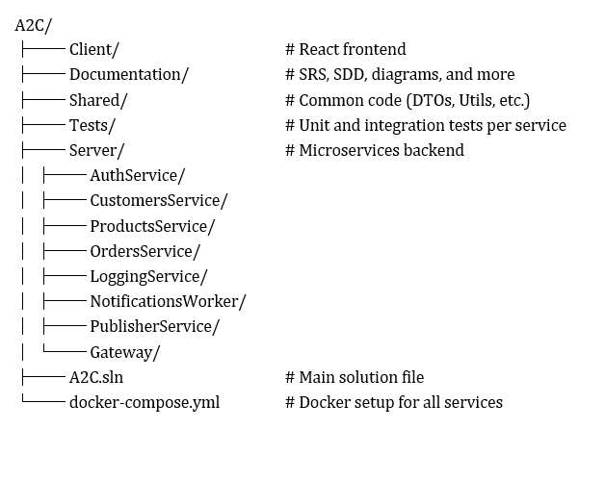

Slide 6
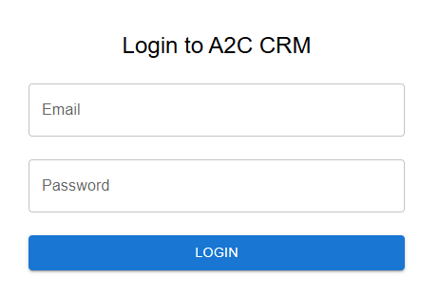

Slide 7
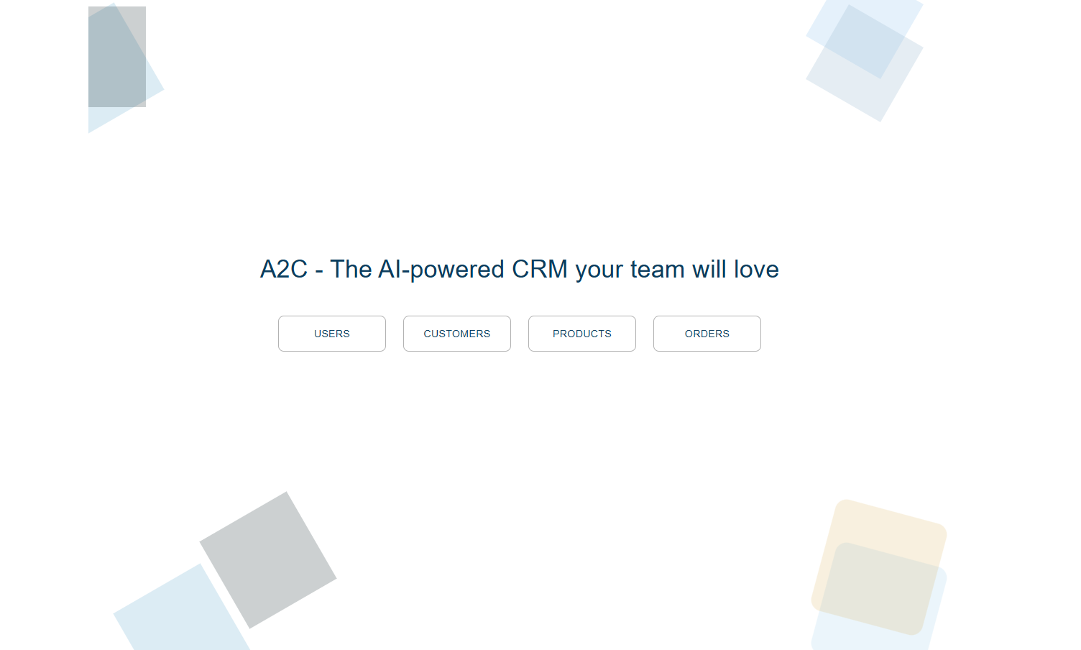

Slide 8
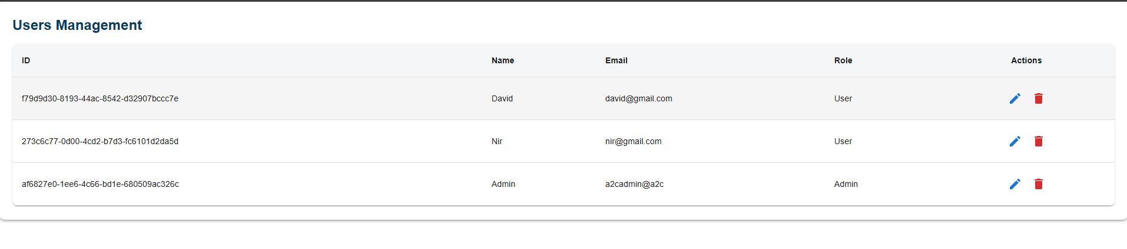

Slide 9
Customer Data Model
Customer
1:N
Address
Customer_Id : int
Name : string
Type : enum (Client, Lead, Prospect)
Email : string
Created_At : datetime
Owner_Name: string
Billing_Country : string
Industry : string
Address_Id
Customer_Id (FK) : int
Address_Type : enum (HQ, Shipping, Billing)
Street : string
Street_No : string
Building: string
Floor : string
City : string
State: string
Province : string
Country : string
Zip_Code : string
PO_Box : string
Is_primary : bool
1:N
Phone
Phone_Id : int
Customer_Id (FK) : int
Phone_Type : enum(Office, Mobile, Fax)
Phone_Number : string
Country_Code : string
Is_Primary : bool
Contact_Person
1:N
Contact_Id : int
Customer_Id (FK) : int
Name : string
Role : string
Email : string
Phone : string
Customer_Service_Plan
1:N
Plan_Id : int
Customer_Id (FK): int
Plan_Type : string
Start_Date : date
End_Date : date
Is_Active : bool
Customer_Contract
Customer_Tag
Contract_Id : int
Customer_Id (FK) : int
Start_Date : date
End_Date : date
Contract_Doc : blob
Tag_Id : int
Customer_Id (FK) : int
Tag : enum (VIP, Lead, Inactive)
End_Date : date
Contract_Doc : blob
1:N
1:N
1:N
Customer_History
History_Id : int
Customer_Id (FK) : int
Time_stamp : datetime
Interaction_Type : enum (Email, Call, Video)
Content : blob or text
Agent_Name : string

Slide 10
Users Data Model
users
users_history
user_id : uuid (PK)
user_name : string
user_email : string (Unique constraint)
user_password : Password_Hash
created_at : datetime
user_role int (user = 0, admin = 1, superuser = 2)
1:N
history_id : uuid (PK)
user_id : uuid (FK)
last_login_date : datetime
login_ip : string
login_status : int (success = 0, Failure = 1)

Slide 11
Folders Structure
A2C
Client
Server
A2C.CRM.Api
Controllers
Data
DTOs
Migrations
Models
Properties
Tests
A2C.CRM.Api.Tests
Documentation

Slide 12
