Slide 1

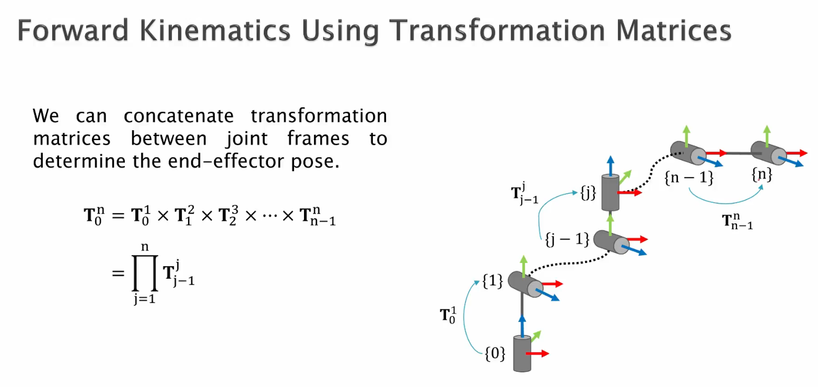
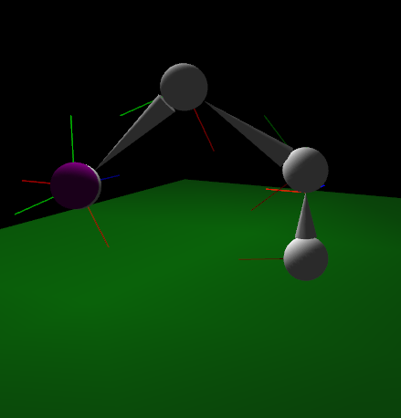
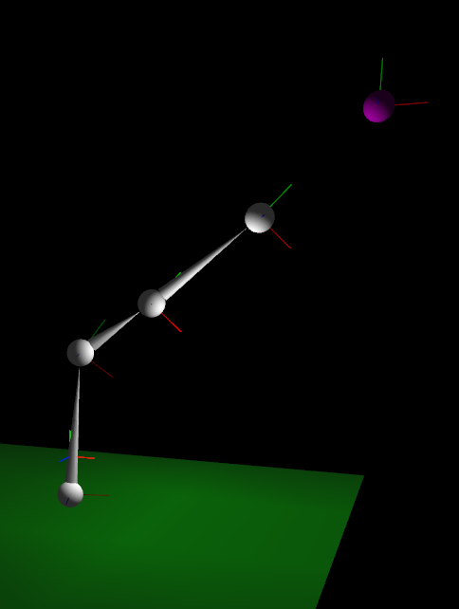
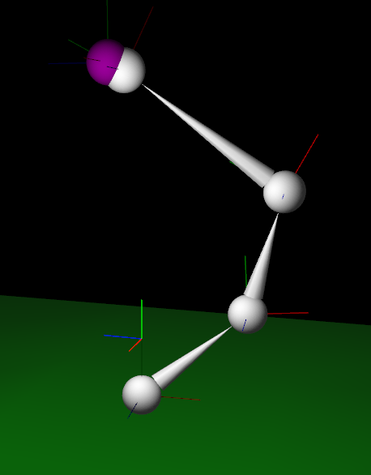
Computer Science Department
CS116A Final Project: Inverse Kinematics and Keyframing
Course Instructor: Kevin Smith
By Friend Trinity Dickinson
Introduction
Methodology
Keyframing
Keyframing is much less difficult conceptually. The goal is to animate an object moving between positions and not have to manually set each position along the way
This is accomplished by setting keyframes, or snapshots of the position and rotation of every scene object in the case of our project, and interpolating between the current positions and next keyframe.
This is achieved by keeping track of how long its been since the last keyframe (T), and how long we want each keyframe to be (D), then setting our interpolation factor to be (T / D).
The current and next frame index is kept track of, and the next frame index loops around to the first index when the current index is at the end of the keyframes vector – this allows the animation to naturally loop.
After implementing keyframing, we can define a simple walk cycle for a 9-joint skeleton, and it will follow it smoothly, with interpolated positions/rotations in between the keyframes. Here, the skeleton’s arms are rotating in between the keyframes, while its feet are translating back and forth along the ground.
One of the most interesting areas in computer graphics is animation. Making beautiful scenes is one thing, but it’s just incomplete without movement to tie it all together. There are many ways to implement animation in computer graphics. Some take a biological approach, emulating human or animal muscles as closely as possible. Other approaches take a physics-based approach, and others head in a purely mathematical direction.
Our project started with the aim of implementing two methods of animation, one in the form of a 2-bone inverse kinematics solver and another in the form of linearly interpolated keyframing. Along the way, we decided to go further with the inverse kinematics portion and ended up going in a much more interesting direction in the form of an N-bone inverse kinematics solver using gradient descent instead of a bunch of trigonometric functions. Both ended up fully implemented and working as intended.
There are several ways to implement forward kinematics, but thankfully we were able to choose a fairly easy one, given the work done previously in Project 3 to implement a series of transforms that combine to create the final position. Using this approach, we implemented forward kinematics on an N-bone/N-joint arm.
The forward kinematics process using multiplied transforms. Source: [1]
Analysis and Results
After implementing inverse kinematics with openFrameworks, we can drag or otherwise move the target joint around and the arm will follow. (Below, the target is being moved with keyframing.)
After implementing forward kinematics, it was time to move on to the real challenge: inverse kinematics. This was done using the technique of gradient descent, in which an error function is minimized gradually by following its gradient, a.k.a. derivative, a.k.a. tangent line, to a minimum, ideally 0 output. This general process is demonstrated in the following mathematical visualization [2].
Summary/Conclusions
We learned a lot about animation in the undertaking of this project and ended up with the beginnings of something that could possibly even be useful in the real world, whether its for controlling a robot arm on a factory floor or animating a digital character’s movement for a piece of media.
As it stands, the project is fun to play around with, but is a little rough around the edges. Future improvements, such as adding a mesh to the skeleton and ray tracing the animation would make it really stand out.
Inverse Kinematics arm. Joints and bones in grey, target in purple
Methodology
openFrameworks
openFrameworks is a C++ framework that handles a lot of the very basics when it comes to computer graphics and provides many useful functions and libraries. We used it for this final project because the project was based on work done previously in another openFrameworks project. It thankfully is a fairly powerful framework and is very useful for those learning about graphics from the ground up, although it lacks a lot of ease-of-use features compared to say, Unity and we would definitely not choose to use it if speed was the goal of a future project and we had our choice of development environments.
Kinematics
To implement the inverse kinematic arm in our project, we had to first implement forward kinematics. Forward kinematics, the much easier cousin of inverse kinematics, is the process of finding where the end of a series of bones will be, given a number of bone-connected joints with certain rotations.
The joints of the IK arm are fully manipulable, meaning that the bones can be stretched or rotated and it will continue to track the target on the fly. It will always find the way to minimize distance, whether its reaching the target or simply pointing at it.
Key References
[1] Woolfrey, Jon. 4.1 Forward Kinematics. YouTube, YouTube, 2 Aug. 2018, https://www.youtube.com/watch?v=EzNAs2w1cS0. Accessed 5 Dec. 2021.
[2] Kathuria, Ayoosh. “Intro to Optimization in Deep Learning: Gradient Descent.” Paperspace Blog, Paperspace Blog, 18 Dec. 2020, https://blog.paperspace.com/intro-to-optimization-in-deep-learning-gradient-descent/.
After moving the input value and following the direction of its gradient enough times, we eventually end up at a minimum error position. In the case of our IK arm, we use the distance from the end of the arm to the target as the error function and attempt to minimize it by changing the inputs – the angles at which each joint can rotate (limited to a single axis each).
Acknowledgements
The project could not be accomplished without the support and guidance of our project advisor, Professor Kevin Smith.

