Slide 1
Analyzing Key Drivers of Employee Attrition
- Rucha Belgali

Slide 2
Approach to Business Problem
Business Problem
Data
Data Analysis
Data exploration
Resampling Techniques
Model Development
Exploratory Data Analysis
Data preprocessing
Statistical Analysis
Problem: High attrition rate of 16.12%
Key Question: Why are our employees leaving, and what can we do to retain them?
Data: 1,470 observations with 237 attrition cases (Yes) and 1,233 non-attrition cases (No).
Oversampling: Balanced the dataset with 1,233 "Yes" and 1,233 "No" observations, resulting in 2,466 total records to address class imbalance.
Data Partitioning: 80% training set, 20% test set for model building and evaluation.

Slide 3
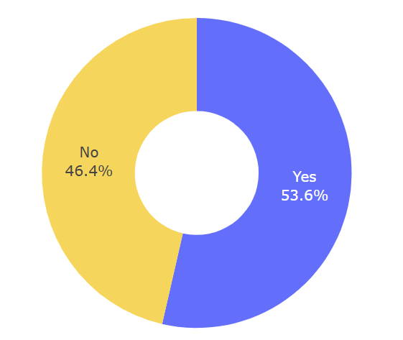
1. Overtime
Worked overtime?
More than half of employees who left worked overtime.
Overtime is a major contributing factor to employee turnover.
Implement a flexible work policy to reduce overtime and promote work-life balance, and monitor its impact on employee retention for the next 3 months.

Slide 4
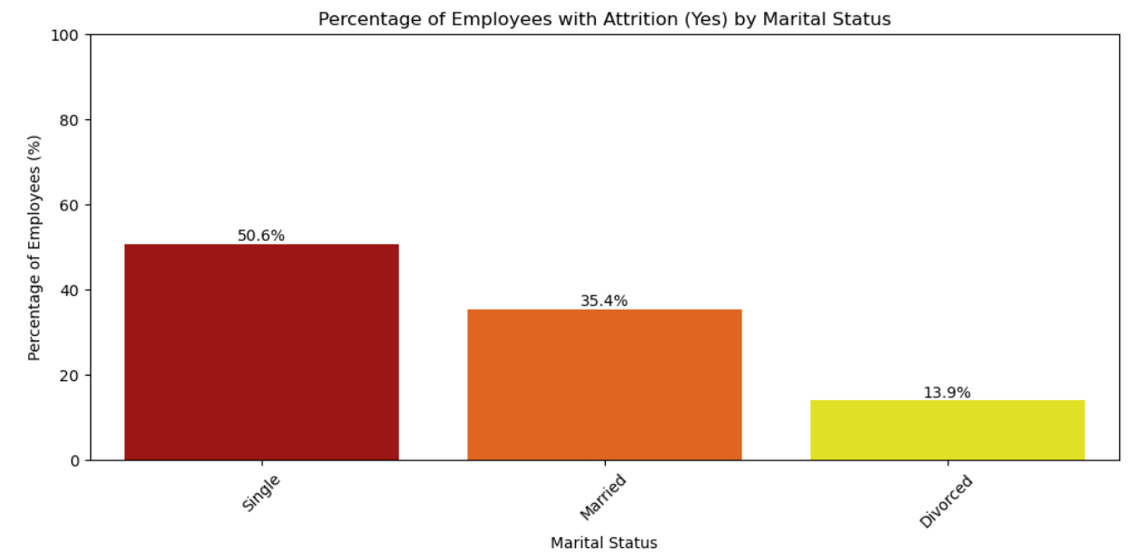
2. Marital Status
Over 50% of employees with single marital status have left the company
Single employees are more likely to leave the company.
Develop a targeted retention program for single employees, focusing on career development opportunities, and social events to foster a sense of community.

Slide 5
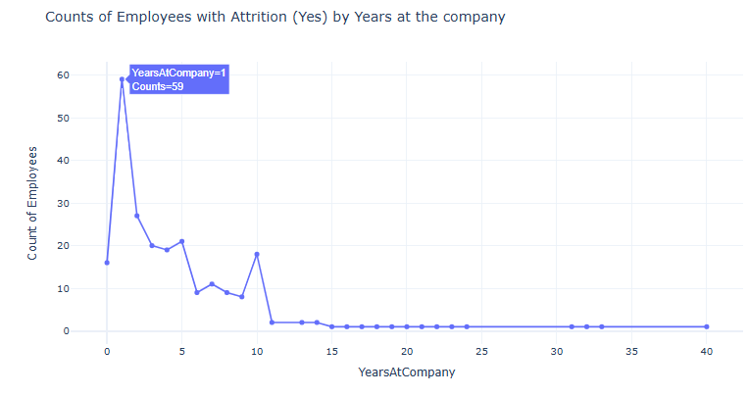
3. Tenure at the company
Most employees leave the company after 1 year.
The company is experiencing high turnover rates during the first year of employment.
Tailor the onboarding experience to each new hire's role and needs, assign mentors to new hires to offer guidance and support and provide regular feedback during the first year to reduce turnover.

Slide 6
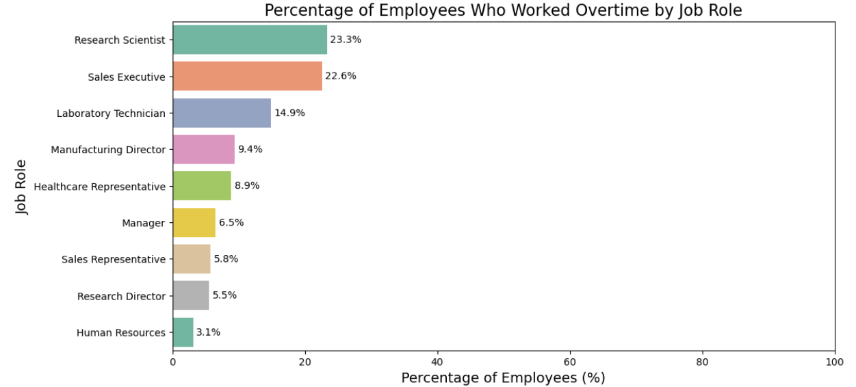
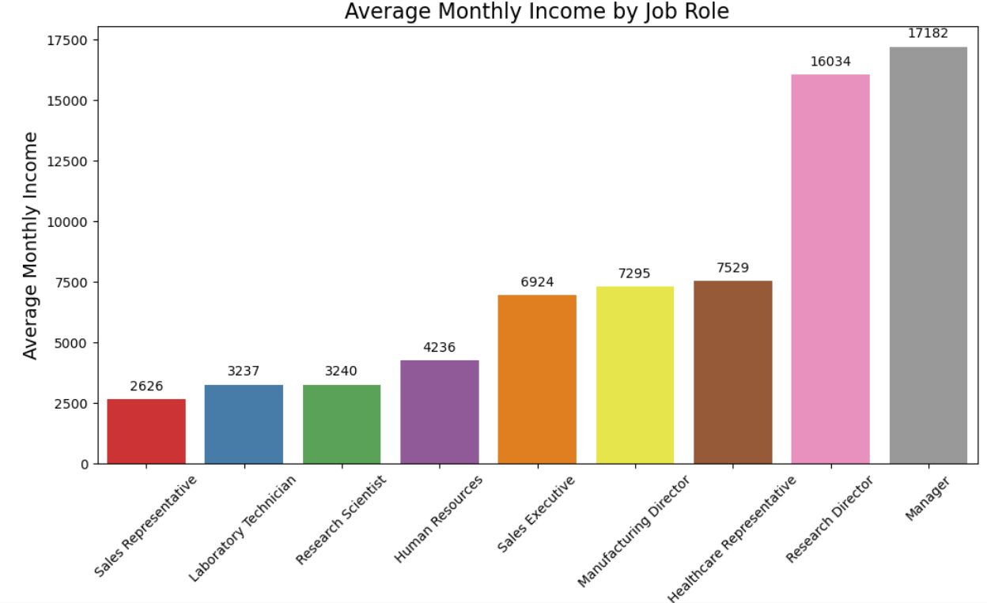
4.Job Roles
Lab Technician, Sales Executive, Research Scientist, Sales Representative are more likely to leave.
High overtime + low monthly income contribute to higher attrition in these roles.
For Lab Technicians and Research Scientists: increase salaries to bring them more in line with industry standards and offer an overtime premium to compensate for excessive overtime work.
For Sales Representatives: Develop a performance-based incentive program.

Slide 7
Thankyou

