Slide 1
Top 10 Recommended Locations for
Launching Iowa Spirits Online Delivery

Slide 2
The Opportunity
Online alcohol delivery market: $15 billion in 2025, projected to reach $50 billion by 2033 (CAGR 15%)
Dataset: The Iowa Liquor Sales dataset reflects wholesale transactions, not direct consumer sales. The transactions are from the Iowa Alcoholic Beverages Division (a government-controlled distributor) to retail stores, bars, or restaurants.
For the year 2012-2017:
Total sales: 1.17B
Total volume sold: 72.84M
No. of transactions: 12.26M
Number of stores: 1884
Business Question: “What are the top 10 recommended locations for online alcohol delivery — either from an existing store or a new delivery centre?”
https://www.datainsightsmarket.com/reports/online-alcohol-delivery-1435770

Slide 3
The Approach & Assumptions
Data-Driven Approach: Used sales, volume, and transaction data to cluster stores and identify high-potential areas for online delivery.
Top Location Recommendations: Pinpointed the top 10 locations for new delivery hubs or expanding online delivery, based on business performance and customer reach.
Product Insights: Highlighted best-selling and high-margin product categories for targeted inventory planning.
Assumptions:
Excluded extreme outliers using the 99th percentile for key metrics
Focused on standard bottle sizes (≤ 1,750 ml)
Removed bulk shipments (orders > 60 bottles or > 54 liters)
Limited analysis to realistic retail prices (≤ $46.50) and costs (≤ $31.00)
Set cluster size to 10 to identify top 10 locations
Ensured results reflect typical store sales, not rare or unusual transactions

Slide 4
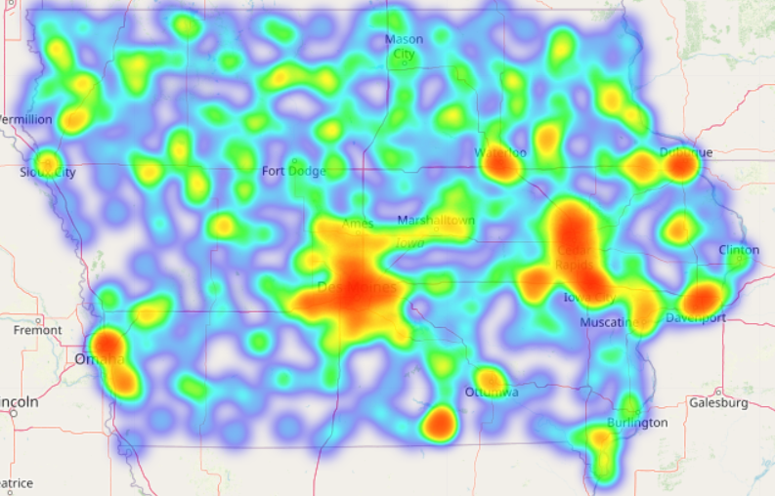
High-Performing Clusters
Most stores were clustered together around the cities of Cedar Rapids, Iowa City, and Des Moines.
High density of liquor stores and high volume and transaction count, consistently lead in spirits sales across the state.
This concentration reflects strong consumer demand, making them strategic locations for delivery hubs or expansion of online delivery services.

Slide 5
Top 10 recommended locations for Setting up out of an existing store for online delivery business
Hy-Vee in Des Moines leads with $20.6M in sales and over 101,000 transactions, followed closely by Central City 2 in Des Moines ($19.1M) and Hy-Vee Wine & Spirits in Iowa City ($13.3M).
Highest sales and transaction volumes cluster around Des Moines, Iowa City, Cedar Rapids, and Bettendorf, indicating strong consumer demand in these metro areas.
Stores with highest sales also show robust transaction counts, signaling consistent customer footfall and repeat business.
Most top stores rank #1 or #2 within their clusters, confirming their dominant market positions.

Slide 6

Top 5 Liquor Sales in Iowa
POPULAR selling Liquor in Iowa
Hy-Vee Wine and Spirits, Ankeny Vodka 80
Whiskies Hy-Vee Food and Drug, Clinton Canadian Whiskies
Hy-Vee Wine and Spirits, Fort Dodge Canadian Whiskies
Hy-Vee, Des Moines Imported Vodka
Benz Distributing, Cedar Rapids Imported Vodka
Lot-A-Spirits, Bettendorf Imported Vodka
Central City 2, Des Moines Imported Vodka
Hy-Vee Wine and Spirits #2 Tequila
Hy-Vee Food Store, Council Bluff Tequila
Proof Hy-Vee Wine and Spirits, Iowa City Straight Bourbon
Focus on Vodka, Canadian Whiskies, and Imported Vodka — they dominate both statewide and store-level sales.
Tequila is a regional outperformer — tailor online assortment by location.
Prioritize stores in Des Moines, Iowa City, and Clinton as delivery hubs is based on their strong sales volumes
seen in the underlying data.
Skip broad-but-weak categories like Spiced Rum in delivery. Prioritize fast movers with high margins.

Slide 7
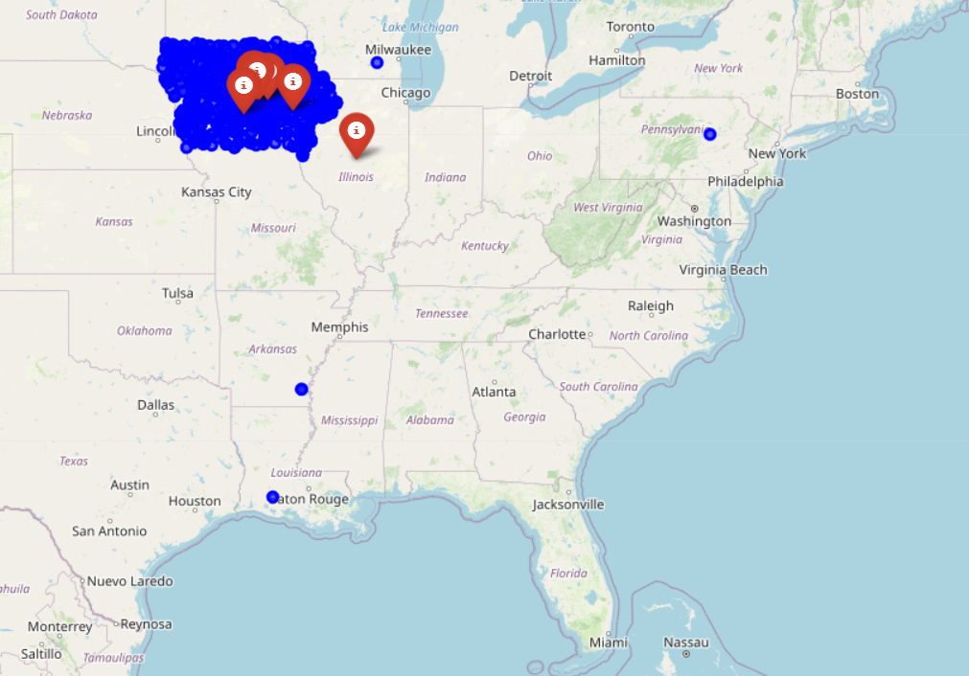
Geographic Gaps
Some high-demand areas remain underserved, signaling strong potential for new delivery centers.
Recommend establishing a new delivery center in the state of Illinois, subject to further analysis of customer locations and competitor presence.

