Slide 1
Pt. 2 - Intro to Expression Quantification Programming for Biologists CSHL 2019
Brian Haas
Broad Institute
Image borrowed from
(https://www.pharmaceutical-journal.com/pictures/600x424/9/6/5/1073965_man-measuring-mess-cr-ikonimages-17.png)

Slide 2
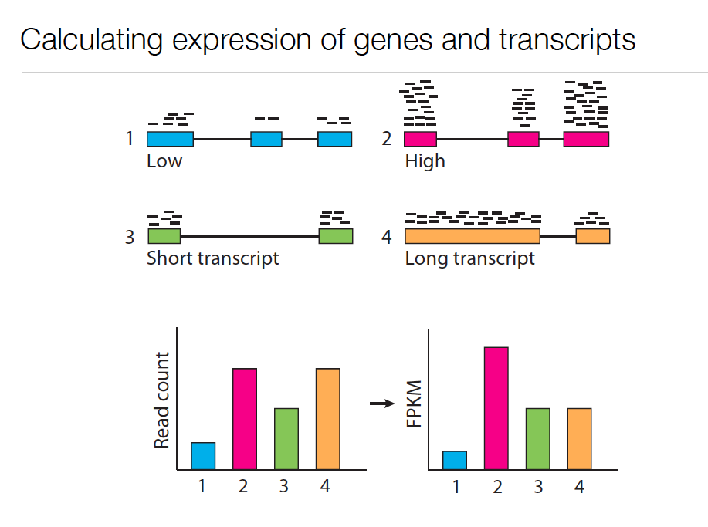
Expression Value
Slide courtesy of Cole Trapnell
Notes:
In RNA-Seq, the expression of a transcript is measured based on the number of RNA-Seq reads sampled that map to the corresponding transcript.
The number of reads sequenced for a transcript depends on a number of factors.
For one, the number of reads observed depends on the expression of the transcript. Transcripts that are expressed at higher levels should account for more reads in the sample than those expressed at lower levels if all else is equal.
Also, the sequencing depth must be taken into account. The deeper you sequence, the more reads you’ll observe mapping to transcripts at any expression level.

Slide 3
Expression Value
Slide courtesy of Cole Trapnell
Notes:
The number of reads corresponding to a transcript also depends on its length. Longer transcripts represent more real estate in the sequencing library than shorter transcripts expressed at the same level (number of transcripts per cell).

Slide 4
Normalized Expression Values
Transcript-mapped read counts are normalized for both length of the transcript and total depth of sequencing.
Reported as: Number of RNA-Seq Fragments Per Kilobase of transcript per total Million fragments mapped
FPKM
RPKM (reads per kb per M) used with Single-end RNA-Seq reads
FPKM used with Paired-end RNA-Seq reads.
Notes:
And so, when computing expression for transcripts, both the number of reads mapping to each transcript and the lengths of those transcripts must be taken into account.
The metric reported is often in units of FPKM.

Slide 5
Transcripts per Million (TPM)
Preferred metric for measuring expression
Better reflects transcript concentration in the sample.
Nicely sums to 1 million
Linear relationship between TPM and FPKM values.
TPM
Both are valid metrics, but best to be consistent.
FPKM

Slide 6
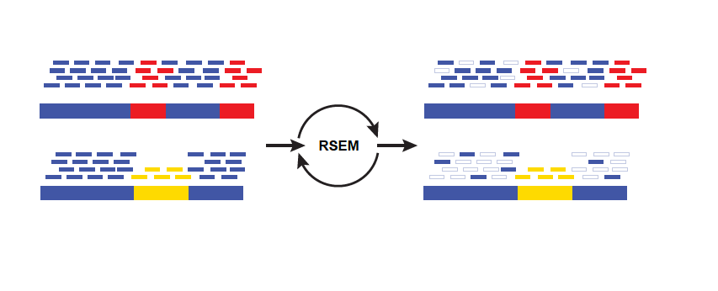
Multiply-mapped Reads Confound Abundance Estimation
Isoform A
EM
Isoform B
Blue = multiply-mapped reads
Red, Yellow = uniquely-mapped reads
Notes:
Accurately estimating transcript expression levels is actually much more complicated due to the fact that not all RNA-Seq reads are able to map uniquely to their corresponding transcript.
This is particularly the case for alternatively spliced transcripts. Such transcripts are not entirely identical, but can share a substantial amount of sequence in common, differing at sites of splicing variation, such as due to skipped exons or from differential splice site selection.
Here’s an example of the problem, where we have two isoforms A, B, with shared sequences in blue and isoform- unique sequences in yellow or red. Reads mapping to either the yellow or red sequences will map uniquely and unambiguously. However, the reads that map to the blue regions will map ambiguously. It isn’t obvious as to which transcript the reads were derived. Using sophisticated statistical inference methods, we can infer the likelihood of a blue read having been derived from one isoform or the other, by taking into account the number of uniquely mapping reads and the length of each isoform.

Slide 7
Multiply-mapped Reads Confound Abundance Estimation
Estimate expression,
Compute likelihood
Isoform A
EM
Adj Model Params,
Proportioning Reads
Isoform B
Blue = multiply-mapped reads
Use Expectation Maximization (EM) to find the most likely assignment of reads to transcripts.
Performed by:
Cufflinks, String Tie (Tuxedo)
RSEM, eXpress (genome-free)
Kallisto, Salmon (alignment-free)
Red, Yellow = uniquely-mapped reads
Notes:
There are tools available that implement these methods, which rely on the technique of expectation maximization.
Expectation maximization involves cycling between estimating parameters of a statistical model based on the data, and computing likelihood estimates of results from applying those model parameters.
In this case, you can think of the algorithm as fractionally assigning the blue reads to each isoform and estimating the likelihood of those assignments. With each iteration of the algorithm, the read assignments become more likely, and eventually the likelihood will converge to a maximum value. Finally, the counts of reads assigned to each isoform are reported.

Slide 8
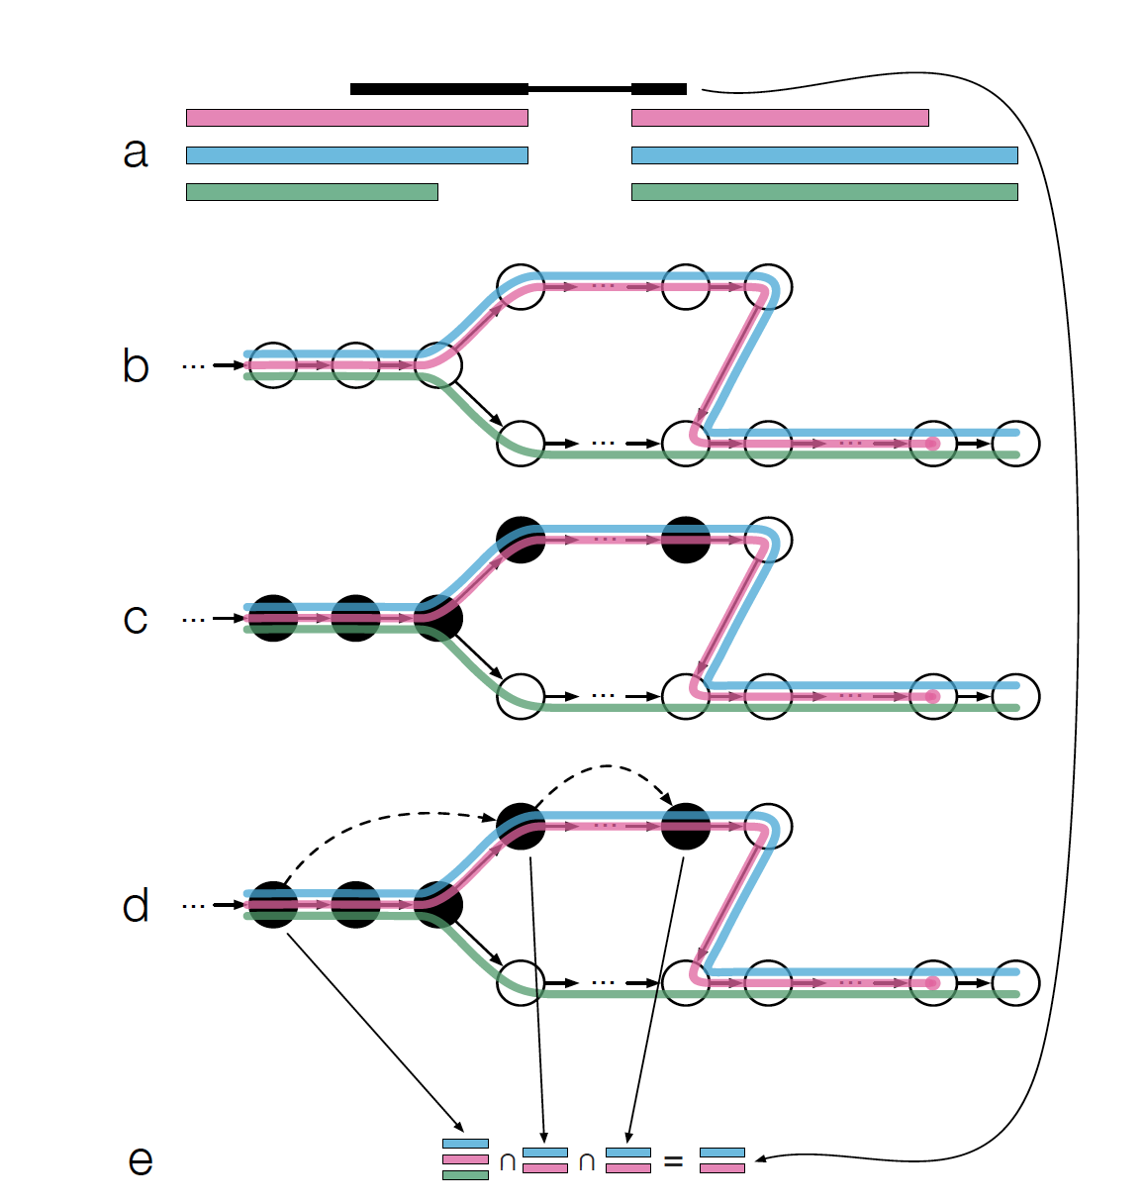
Fast Abundance Estimation Using Pseudo-alignments and Equivalence Classes (Kallisto software, Bray et al., NBT 2016)
Adapted from Fig 1 from Bray et al.

Slide 9
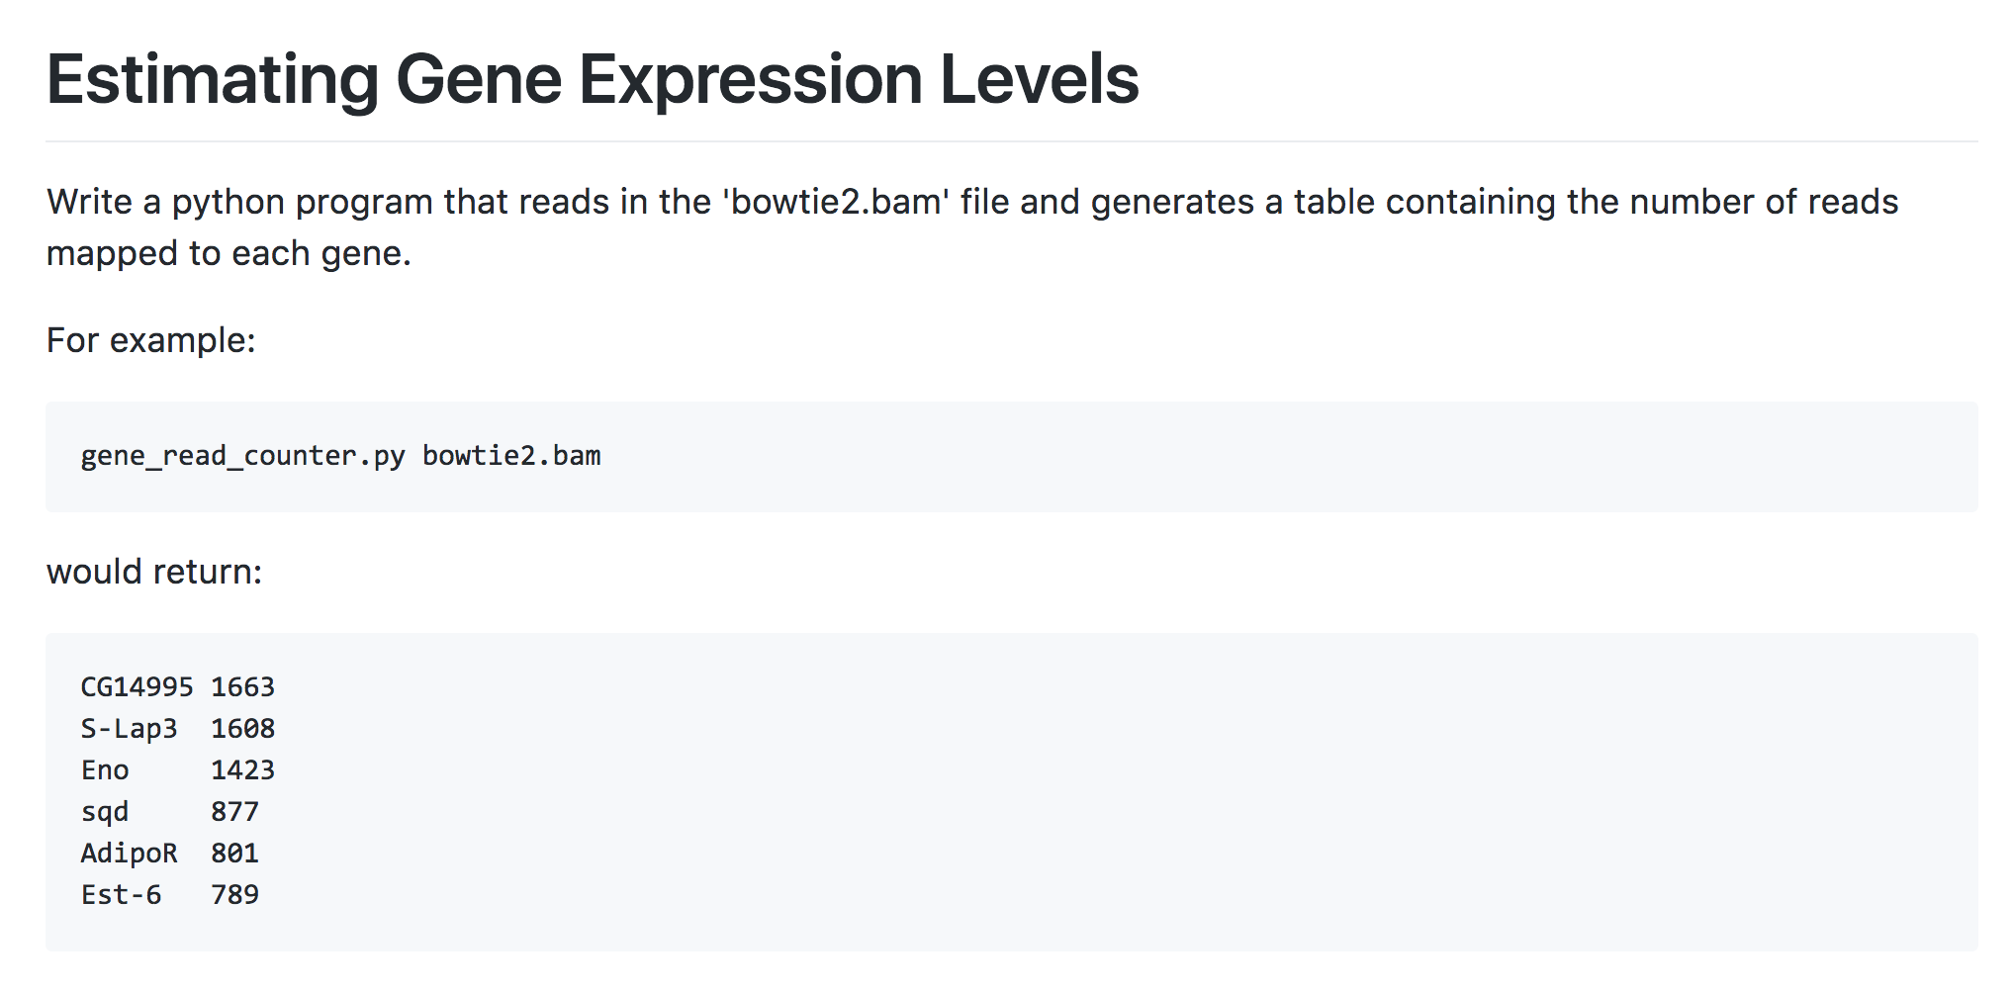
ProgForBio Exercise 2: Build a utility that measures expression by counting aligned reads
…
https://github.com/trinityrnaseq/CSHLProgForBiol2018/tree/master/Exercise_2-aligned_reads_to_expression

Slide 10
Summary of Key Points
RNA-Seq is a versatile method for transcriptome analysis enabling quantification and novel transcript discovery.
Expression quantification is based on sampling and counting reads derived from transcripts
Trinity assembly and supported downstream computational analysis tools facilitate transcriptome studies.

Slide 11
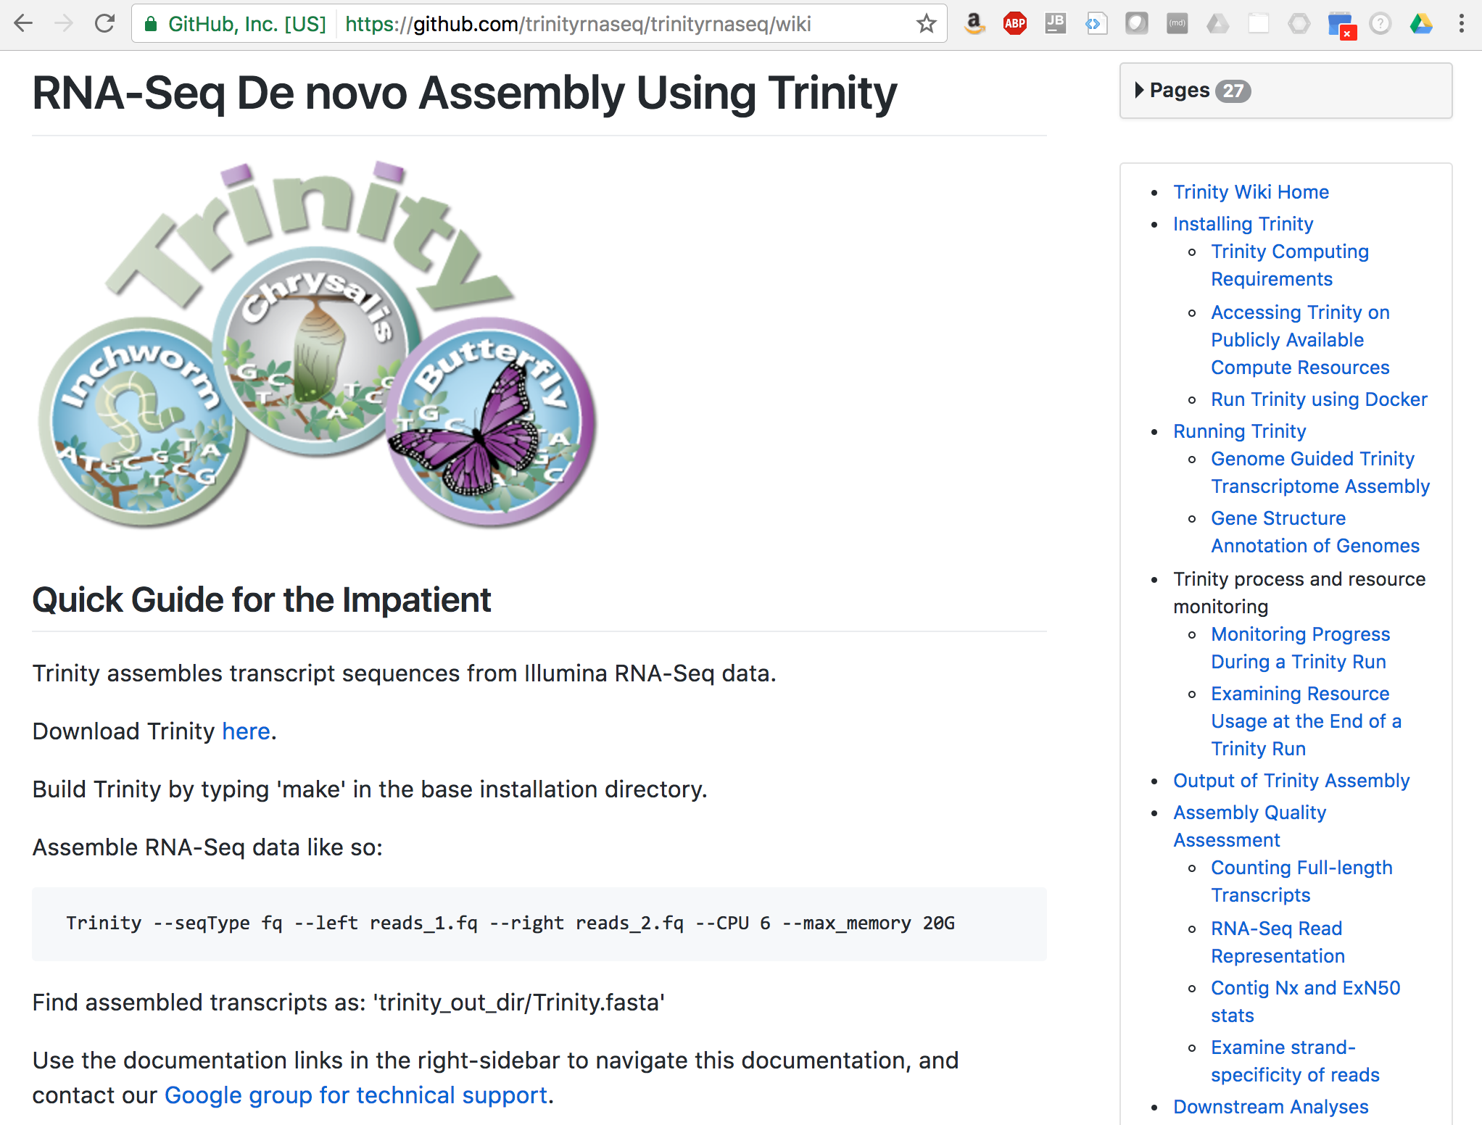
Visit website for more info:
http://trinityrnaseq.github.io

Slide 12
Let’s go write some code! ☺

